Slide 1
An Overview of Gamification as a Tool for Sustained Engagement
Dr Bobbie Fletcher
Head of the Games Technology Group
Director of the Centre for Media Arts Technology (C-MAT) Applied Research Centre

Slide 2
What is Gamification?
Gamification is the use of game thinking and game mechanics in non-game contexts to engage users in solving problems.

Slide 3
Experience Phases of Gamification
When you look at gamifying a service or a product you need to look at it as if you are engaging with 4 products.
This is because each user is interacting differently with the same product in totally different ways based on how much experience they have with the product. They are growing their knowledge baseline with each interaction
Discovery
Onboarding
Scaffolding
End Game

Slide 4
Discovery Phase
When people first discover your product or service
A common marketing mantra is -Awareness, Interest, Desire and then Action
How to make them aware they want what you have to offer?
Why should they sign up?
What do they have to do?
Common mistake is to stop at this phase

Slide 5
Onboarding
This is where you train the user to be familiar with the rules the mechanics, the reward mechanics and the win states.
This phase is where understanding a user motivation for your service/ product comes into play
Knowing your user Motivational Drivers can get your users to increase their excitement and motivation

Slide 6
Scaffolding
Where the user takes the rules and win states and tries to win as many time as possible to get rewards
They are providing scaffolding to support what they have learn and what they have learnt to do is to succeed (or not fail).
This is where you should start to see user motivation and sustained engagement
This is when you recommend the service/product to a friend

Slide 7
The End Game
The user has achieved Mastery and is still engaged in the service/product
Evergreen Mechanics
The user becomes the Guru
The user gives expert advice on the service/product to others at earlier engagement phases
The user then is rewarded by the Thank you Economy

Slide 8
Universal Motivators
Autonomy
Mastery
Social Interaction
Progress
Purpose

Slide 9
Octalysis Who? What?
Is a framework created by Yukai Chou, as a framework to audit gamification and its effectiveness, hence also a tool to design effective gamification.
based on work by
Prof Kevin Werbach and
Gary Vaynerchuk

Slide 10
Octalysis Framework- 8 Core Drives That Motivate
Epic Meaning and Calling
Development and Accomplishment
Empowerment of Creativity and Feedback
Ownership and Possession
Social Influence and Relatedness
Scarcity and Impatience
Unpredictability and curiosity
Loss Avoidance

Slide 11
Epic Meaning and Calling
Doing something that will bring some meaning to their life
Freerice.com Every time you answer a question correctly on this site they will donate 10 grains of rice to a 3rd world country (over 6000 tons of rice has been donated so far)
Representing a group (Tribal)
E.g. a hotel in the Us tried to get patrons to recycle their towels every evening. Very few did. They then put up a sign saying 87% of people who stayed in this room recycled their towels. The engagement shot up
This should start in the Discovery Phase, but come into its own in the Onboarding Phase- Give the user a narrative

Slide 12
Development and Accomplishment
Develops the sense of progress by actively accumulating points towards your goal
Break Challenges into stages PBL (Points, Badges, Leadership Boards)
These are not supposed to make you care about something, they should be used to let you keep track of how close you are getting to your goal
To become accomplished you have to overcome a challenge - Don’t reward for doing something very trivial- users aren’t stupid and they don’t want to do stupid things

Slide 13
Development and Accomplishment… Continued
Leadership Boards are only useful if you can see how to progress up them.
If the top three on the leader board have 10,000 points and you have 250 the leader board is meaning less to you
If you can see that the user above you has 251 points you can see that a little more effort can raise you up the board

Slide 14
Empowerment of Creativity and Feedback
People can utilise their creativity and come up with their own ideas
Draw something
Post up want you have drawn for feedback
Milestone unlock
Where after a certain amount of engagement maybe another colour palette or brush is unlock increasing the creativity possibilities
Use other tools to solve the problem (Goeguessr)

Slide 15
Empowerment of Creativity and Feedback…continued
Boosters- Things that make you play more efficiently or effectively- They make the user plan how they are going to use them to accomplish more- Empowerment through creative thinking
Use crowd sourcing as a way of problem solving using collective creativity
Foldit was a game produce by scientist who had tried to solve an AIDS virus issue about folding proteins. They couldn’t solve it in 15.
When they released the game to the public the problem was solved in 15 days

Slide 16
Ownership and Possession
Customise your character or space (Farmville, animal crossing new leaf)
Complete the set (Monopoly)
Rare part in a collection of parts (football Stickers)
Build from Scratch (Minecraft)
Virtual Goods (Virtual Currencies and dark patterns)
Monitoring (Facebook analytics, Google Analytics)
Protection(virtual pets)
Recruitment (trello gold)
Part of the End Game as it have an evergreen mechanic quality as the user has invested time and effort to get to this position of customisation

Slide 17
Social Influence and Relatedness
Mentorship- Emotional and Actionable guidance from someone at a higher level that you
Group Quest- An objective that can only be achieved through co-operation (Groupon the original concept-if enough people want it everyone gets a discount)
Social Prodding (Linkedin endorse)
Leader boards
Social treasure
A valuable that can only be got by someone else giving it to you (Farmville)
A vote (Go on my site and vote for me please)

Slide 18
Scarcity and Impatience
You want something just because you can’t have it or you can’t have it just now
Membership of an elite group
Throttle, slowing people down, you can’t play as your energy has not recharged (Zinga)

Slide 19
Unpredictability and Curiosity
Because you don’t know what's going to happen next you are obsessed with it
Glowing choice (you can click on me, but you don’t know if its going to be a good or bad experience)
Easter Eggs-unexpected reward
Flipping the viewpoint

Slide 20
Loss Avoidance
Motivation by stopping bad things to happen
Farmville, your crops die if you don’t return in time to harvest
You have 100 points register within 14 days or you will lose them
Coupons that expire (Tesco’s Fuel discount)
Scarlett letter-if you don’t act now you will look bad in front of your peers
Sunk Cost Tragedy- You can’t quit as you have invested too much time, emotion or money

Slide 21
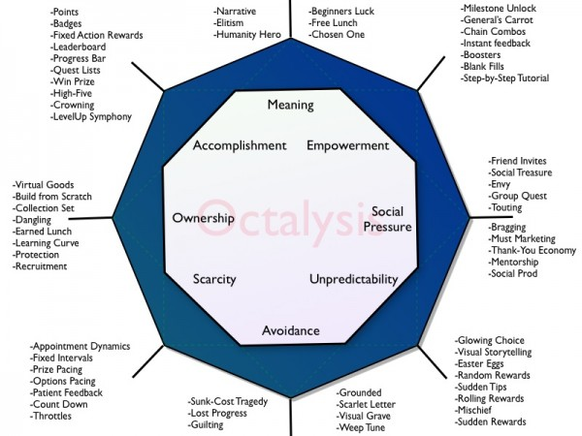
Octalysis Gamification Framework

Slide 22
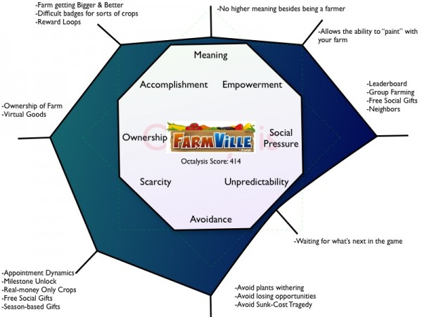
Examples of Octalysis Gamification Framework in Action

Slide 23
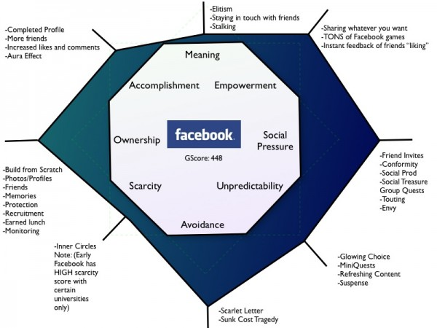
Examples of Octalysis Gamification Framework in Action

Slide 24
Thank you- Any Questions?

