Slide 1
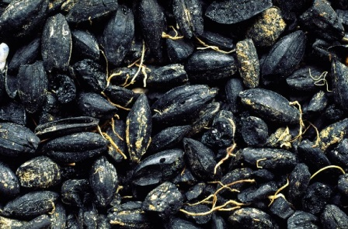
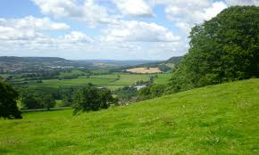
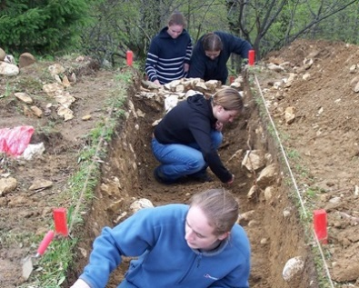
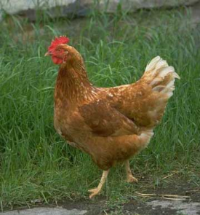
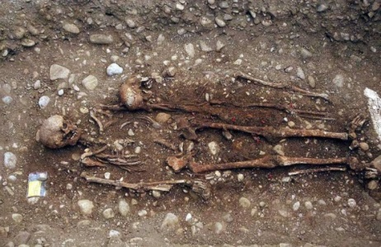
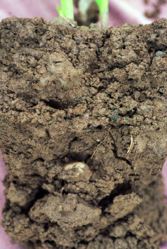
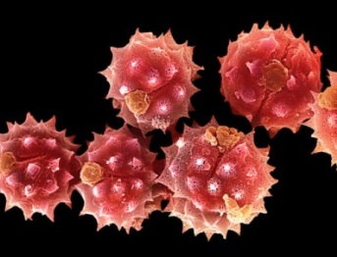
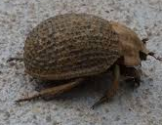
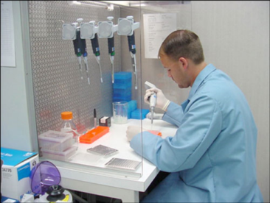

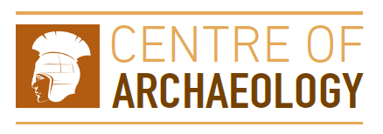
The bare bones: The application of scientific methods to environmental evidence – a case study
Dr Kirsty Squires
Staffordshire University and the Centre of Archaeology, UK
Kirsty.Squires@staffs.ac.uk
Notes:
WARNING: THIS PRESENTATION WILL CONTAIN IMAGES OF HUMAN BONE – BOTH ADULT AND CHILD.
Osteologist – focus on one small area of Environmental Archaeology.

Slide 2
Lecture outline
By the end of this lecture you should understand:
  The stages involved in designing and executing a research project;
  How environmental evidence can be used in conjunction with scientific methods to answer questions about past societies.
Case study
Notes:
Aim of this presentation is to show how environmental evidence can be used in conjunction with scientific methods to answer questions about past societies. The presentation will be based on how I tackled my doctoral research but the basic premise can be applied to all types of research project (scales).

Slide 3
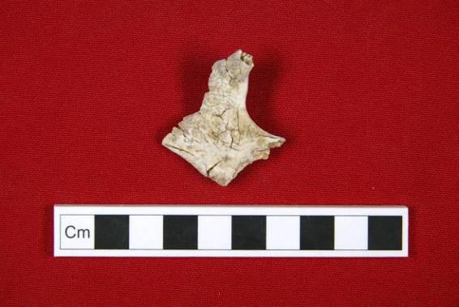
Designing a project: evidence type
Human skeletal remains
Cremated bone
Osteological analyses akin to unburned remains
Notes:
How I got to my research interest – undergraduate and master’s degree.
Ask students what information they can extract from cremated bone
Osteological analyses that can be carried out are similar to those that are used to assess unburned remains.
Ask students to identify the bones of the board – highlight distinctive characteristics do survive fires and can be analysed.
Talk about methods in more detail later in the lecture.

Slide 4
Picking an assemblage (or two)
Assemblages? Access issues?
  Elsham (n = 569)
  Cleatham (n = 977)
Research themes and aims
  Demography
  Social identity
  Pyre technology
Notes:
How I got to my research interest – undergraduate and master’s degree.
Consider access to assemblages – how to select assemblages. There can be access issues.
Looked at Elsham (early AS – 5th-mid 6th century) – studied part of this assemblage for my MSc.
Cleatham is the second site (early AS – 5th-mid 6th century) – in dire need of analysis (went unstudied for 25 years).
Research themes and aims – highlight dearth of studies that focused on cremation cemeteries, apart from Spong Hill and Sancton (point to map to show location), very few sites have been examined. This project aimed to redress the balance.
Also consider other questions relating to:
-Demography (comparable make up to other sites, i.e. children and females)
-Social identity (Possible to identify social identity and hierarchy, religion, etc.? – this has been done with other sites – comparison with biological attributes and grave goods and grave dimensions, position of body, etc.)
-Pyre technology (Efficiency of cremation process and investment in the funerary rite).
SO I HAD A LOT OF QUESTIONS! Given the fact that I wanted to answer so many questions and investigate different research themes, I would have to employ a variety of methods.
However, there are limitations…

Slide 5
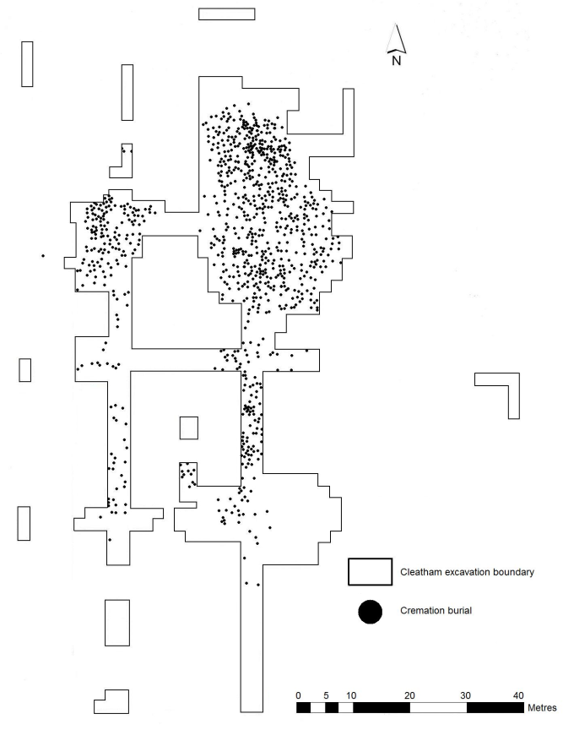
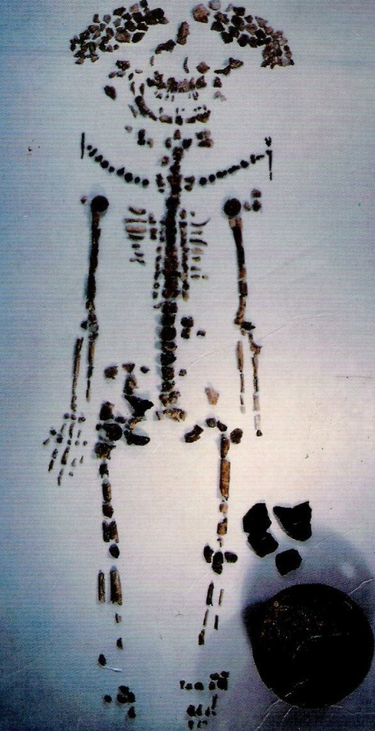
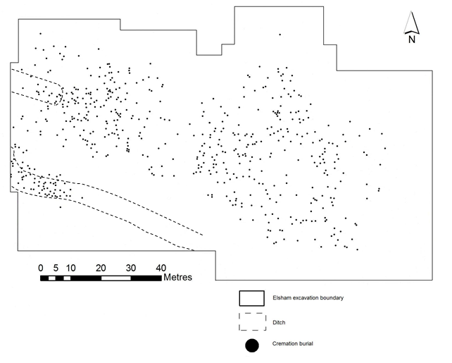
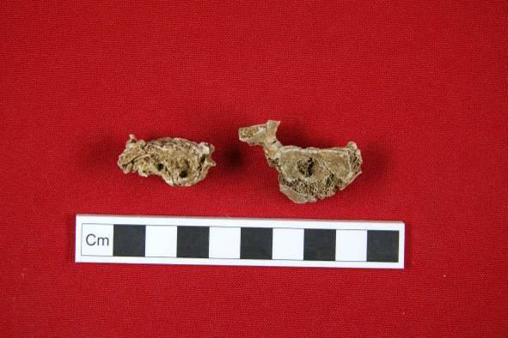
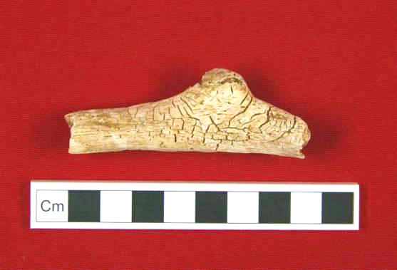
Methods
Osteological methods
  Loss of diagnostic elements
  Metrics – limitations
Combination of demographic, artefactual, and spatial data
  Statistical analyses
  ArcGIS
Notes:
Osteological analysis of the remains was the most important method employed – it created the foundation of the project and allowed me to explore other research themes. The osteological analysis of the remains meant I could determine the number of individuals from each site and for the most part, their age, sex, and any pathology and trauma. Given that I could establish the age and sex I could compare the demographic profiles of these sites with other cemeteries in the same area, the rest of Anglo-Saxon England and contemporary sites on the Continent.
However, there were limitations due to the nature of cremated bone. The biggest issue was the loss of skeletal elements that could be used to determine the age and sex of an individual. Consequently, what ever your record is the bare minimum, so to speak. A good example of this was the biological sex of individuals, at Elsham only 89 individuals (27%) could be assigned sex while at Cleatham only 147 (30%) individuals could be assigned to a sex category. Similarly pathology rates were low so we are unavoidably losing data about the health status of these populations as a result of the cremation process and post-cremation rites (i.e. not collecting all bones from the pyre site, for example) – and even the burial record.
The cremation process causes bone to fragment (i.e. image). In modern crematorium the bones are left in anatomical order but they have fragmented and shrunk. Bones shrink as the heat drives out the organic portion of bone, including water and collagen. As a result, the use of metrics is not as accurate as it is in studies focussing on unburned bone. So metrics of certain characteristics of bones are used to determine sex of different populations (e.g. head of humerus, femur or glenoid fossa of the scapula). Shrinkage is variable over the body and between individuals, thus this is not an accurate method to use when working with cremated remains. Similarly, stature estimation is rarely employed – normally need a complete long bone alongside regression calculations. Fragmentation (and shrinkage) means that stature estimation is rarely attempted and is often scrutinized due to the nature of cremated bone.
Social identity of individuals was assessed by using the demographic information obtained through osteological analyses along with artefacts buried with the deceased - this is commonly referred to as “biocultural analyses” – e.g. an individual with a horse, in a large urn may have been of a different social status to a person afforded a relatively short urn and no animal offerings. Early AS populations buried their dead with a variety of grave goods. In the inhumation rite we see dichotomous grave assemblages based on their sex. We don’t really see this in the cremation rite – very few weapons. We see toilet implements, dress accessories and individuals buried in pottery urns. The cremation and burial of animals was also common, so this could be a whole animal or joints of meat (I will return to the topic of animal remains shortly).
Artefactual and spatial data were obtained from published and unpublished sources, specialists and I also took some measurements of the pottery. An issue with the Elsham assemblage was the lack of artefactual information available to me. I was provided a list by the excavators but the Museum nor the excavators claimed to know nothing of the whereabouts of the actual finds. However, last year one of the excavators came forward with a number of boxes which contained the finds. A finds specialist is now going through these objects and will hopefully lead to a better understanding of the finds that were actually recovered from the site. Based on the available data, I carried out statistical analyses to establish whether any patterns in the data were significant. I used the SPSS statistical software package. Luckily I had been taught how to use this package during my MSc but I was unfamiliar with some of the tests I wished to use so I had to seek additional advise from lecturers and practice.
I also had access to the co-ordinates/location of each burial and this would allow me to determine whether different members of the burial population were segregated based on their biological attributes. This was a particularly tricky element of my project as my mapping skills were pretty limited. The first thing I had to do was ensure the outline of the cemeteries on my maps were to scale when I scanned them into the computer. I used ArcGIS throughout this section of my project, which is a mapping programme often used by archaeologists to draw up plans of sites and distribution of sites in the landscape – it requires quite a bit of training as it can be quite fiddly but once you know the procedures it isn’t too bad. Once the outline of the maps had been inputted I entered the co-ordinates of each burial. Now, I wanted to run statistical analyses to establish whether there were any statistically significant clusters of burials based on the age and sex of the deceased. One of the biggest issues I encountered here is that none of the lecturers knew how to run these types of analyses using ArcGIS so I had to teach myself using online tutorials and books. It took a while, but I did manage to learn how to use this function in ArcGIS.

Slide 6
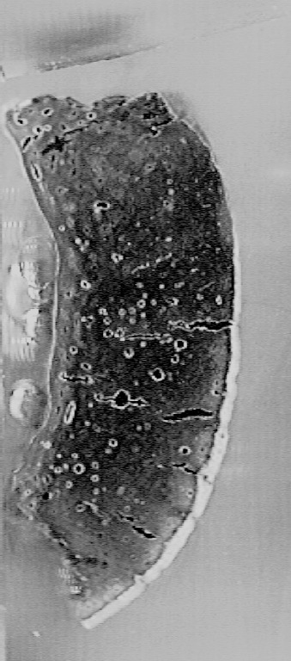
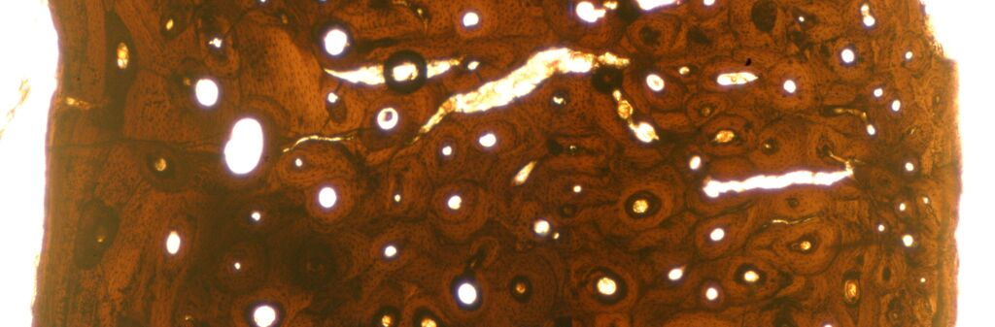
Methods
Macroscopic analyses
Microscopic analyses
  Histomorphometry (thin-section analysis)
Notes:
To tackle the questions surrounding pyre technology, I decided to employ three different methods. The main areas that I was interested in was the temperature, duration and oxidising conditions attained on the pyre, and the position of the body on the pyre. I was also interested to see if this reflected social attitudes to the dead, for example if individuals of lower social standing were afforded a shorter cremations or more affluent individuals were afforded a more elaborate cremation which demanded more fuel and manpower (stoking, etc.). This information could then be compared with artefactual evidence and demographic profiles of the deceased. Macroscopic analysis, histomorphological analysis and FTIR analysis. This would provide information about temperature, duration, oxidising conditions, fragmentation of remains and state of the remains at the time of burning, e.g. if they were fleshed or not.
Macroscopic – shrinkage and warping (wet bones show greater shrinkage due to higher water content that is driven out)
- fracturing (wet bones fracture more due to moisture. There are also different types of fractures depending on the location on the body and intensity of the heat)
- colour – can provide information about oxidising conditions and temperature – white suggests oxidising conditions and black implies reducing conditions. When a bone burns at different temperatures it goes through different colour changes: off white>brown> grey (more brownish hues)>black>blue>grey (more bluish hues)>white.
Given that changes occur to bones at a macroscopic level, I decided to look at the microstructure of bone to establish how burning affected the internal structure of bone. The two microscopic methods I chose to use were rarely used with archaeological remains, especially the second type.
- The first method I decided to use was histomorphological analysis (thin-section analysis). This involved cutting thin sections of cremated bone, setting it in resin and examining the bone microstructure. As a bone is heated and it loses moisture (collagen and water) we also see corresponding changes to the bone microstructure. So the osteons are destroyed due to the heat and loss of moisture. Instead we see a greater proportion of inorganic components, namely hydroxyapatatite. As bone is heated hydroxyapatite crystals change shape and expand. Examples on the board (low vs high temperature).

Slide 7
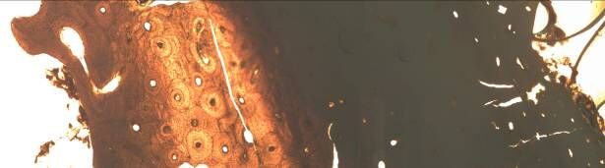
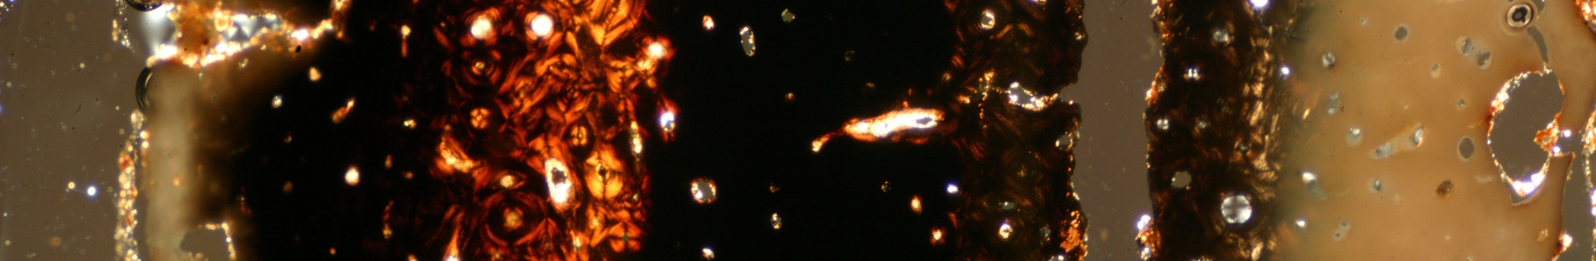
Methods
Notes:
Compare microstructure of different bone sections to show differences in microstructure
Consider – temperature, oxidising conditions, duration and fragmentation.

Slide 8
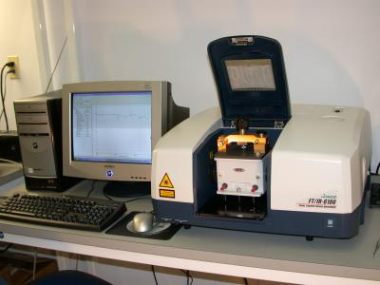
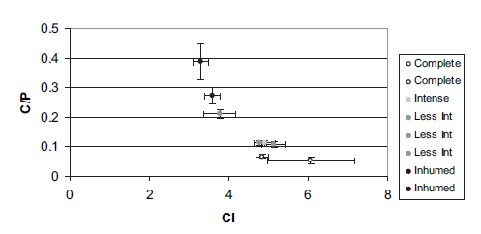
Methods
Macroscopic analyses
Microscopic analyses
  Histomorphometry (thin-section analysis)
  Fourier Transform Infrared (FTIR) Spectroscopy
Notes:
The second technique I employed was FTIR Spectroscopy. This technique is more commonly used in forensics so I worked with colleagues at Teesside University on this section of my project. So sometimes it is necessary to collaborate with lecturers or your peers to answer research questions as they may have equipment and expertise required to answer your questions. It also gives you the opportunity to learn a new skill. So, here I went up to Teesside University to receive training and use their equipment. The cremated bone I examined had been taken from different burials and showed different burning intensities indicative of different temperatures. FTIR was used as an additional means of understanding the burning process on bone. Samples were placed on a diamond stage and a laser was fired into the sample (point to equipment used on screen). In this analyses I examined the carbonate/phosphate ratio and crystallinity index. The Crystallinity Index is a measure of the structure order of the crystals within a bone. When these crystals are heated they become larger and/or more ordered. The C/P ratio decreases as a consequence of the carbonate fraction decomposing at higher temperatures. Each sample was processed three times and the data was then plotted on to a graph – on the screen (explain graph). So we can see that the macroscopic changes to bone reflected that seen on a “microscopic” method.
This project was great as it allowed me to use a variety of techniques to answer my research questions but there were limitations throughout that hindered extracting the maximum amount of information from the remains recovered from the burials under examination.

Slide 9
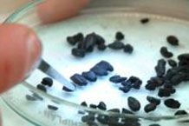
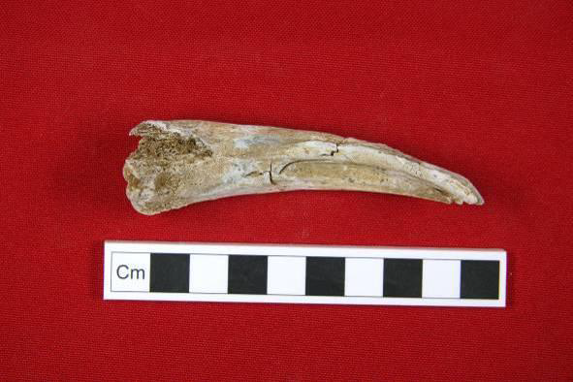
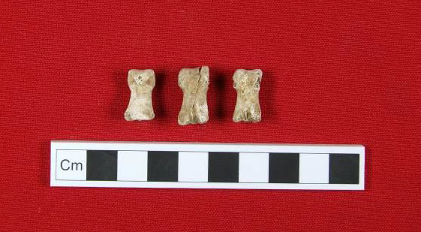
Know your limits
Limitations of the proposed project
  Animal remains (zooarchaeology)
  Charred wood (archaeoanthracology)
  Time – planning is key!
  Be realistic
Notes:
How was I going to extract this type of information from environmental evidence?
Need more money and specialists to assess all environmental evidence.
As previously mentioned, animal offerings were often provided in the Anglo-Saxon cremation rite – both wild and domestic animals. I only have basic identification skills when it comes to animal remains – I can determine whether it is human or not, can identify the specific skeletal element and occasionally the species. Therefore a zooarchaeologist is needed to provide more specific information, e.g. species, age of slaughter, etc. This information could then be fed into the biocultural analyses, e.g. certain sectors of the population buried with specific species or portions of an animal. Image of unfused goat/sheep ulna and bear phalanges (imported – bears extinct by end of Roman period).
Wood charcoal is sometimes recovered from early Anglo-Saxon cremation burials. The analysis of archaeological charcoal is known as archaeoanthracology. Samples obtained from soil, though groups that did practice cremation processed the cremated bone very well and pyre debris such as slag and charcoal is relatively rare BUT it can provide valuable information about the species and different uses of different types of wood, e.g. ritual use. Tacitus (Germany 27) recorded that ‘the bodies of famous men are cremated with particular kinds of wood’. The selection of certain types of wood may have been ascribed to these individuals based on their occupation and social standing, or alternatively, ideological beliefs. Also a suitable material for radiocarbon dating. However a problem with the analysis of this type of material is that the wood used for fuel, tools, building materials, etc. does not necessarily reflect the composition of local woodland or environments. Here, I would have used charcoal as part of the biocultural analysis – examine social identity and types of wood found with individuals – is it convenience or related to ritual and status?
The final two points are linked. Aside from the lack of specialist knowledge, time constraints was a massive issue. PhD students in the UK have three years to complete their project which means that planning is really important. The biocultural analysis of over 1500 cremation burials and then statistical tests was a little unrealistic and one professional even told me it could not be done. To finish on time I had to ensure I kept a detailed timetable – planning was important, this went from when paper work was due to the number of cremations I had to analyse each day. Had to sacrifice weekends and often spent over 12 hours in the lab. Furthermore, I didn’t have time to carry out some of the initial tests, e.g. compare degree of burning with artefactual evidence or demographic profiles – only a small set of samples could be used due to time constraints. So when you plan your projects ensure you produce a detailed plan and don’t give yourself unrealistic amounts of work to do.

Slide 10
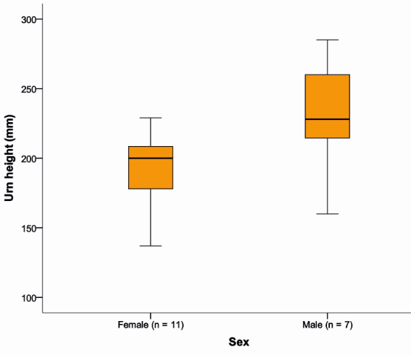
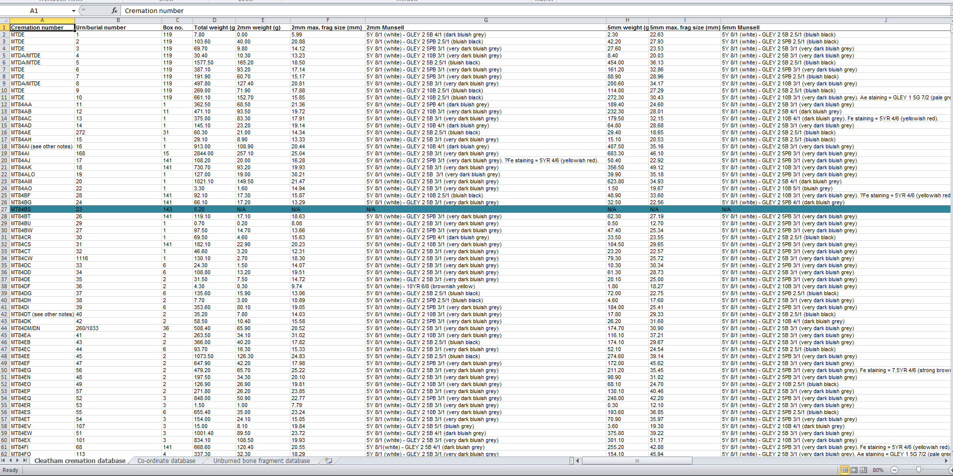
A mass of data: considerations
Break down large datasets into more manageable files
Type of data will influence statistical tests used
Incomplete datasets – unavoidable
Notes:
Once you have collected all your data and inputted it into a database it can be rather daunting when you are faced with hundreds if not thousands of entries to go through. This is the same regardless of area of environmental archaeology you may be working in. The first thing you should do is go back to your initial questions and breakdown your database based on questions or themes. So I had a database that just contained the demographic data and co-ordinates of each burial. You can end up with lots of databases but it is more manageable and you won’t feel as overwhelmed when processing your data.
Environmental Archaeologists frequently work with large assemblages and as a result, they need to employ statistical tests to establish whether there are any patterns in the data and if these patterns are significant. When you get round to processing your data in your project, you need to think about the type of data you are dealing with, as this will influence the statistical tests you will use.
-Categorical variables, e.g. sex of an individual
-Continuous variables, e.g. length of charcoal fragments
-Ordinal data, e.g. mixes numerical and categorical data. The data fall into categories, but the numbers placed on the categories have meaning. For example, rating a burning intensity of bone on a scale from 0 (lowest) to 4 (highest) gives ordinal data. Ordinal data are often treated as categorical, where the groups are ordered when graphs and charts are made.
One of the biggest issues with environmental evidence is preservation and completeness. I have already touched upon this point but when it comes to biocultural analyses, it can have serious implications on your results and interpretations of the data. A good example of this can be seen on the board when I examined pot height compared to biological sex of the Elsham population. There was only 11 females and 7 males that possessed corresponding urn height data. Deposits of cremated bone will always contain missing skeletal elements, and this limits the amount of data that can be obtained from the remains. If we wish to compare these data with artefactual data we should expect that not all individuals will have surviving or complete artefacts. So despite the fact that 89 individuals were assigned biological sex at Elsham, only 18 of these individuals were recovered from a cinerary urn where the full height of the vessel could be recorded. Size of dataset will also influence statistical significance of your results. Where possible, you should include at least 30 entries in statistical analyses.

Slide 11
The use of environmental evidence to answer research questions: results
Demography
  Higher frequency of females than males
  Under-representation of infants and children
Results can lead to more questions – time and resources needed to explore them further
Why?
Notes:
Osteological analyses showed that there were (as previously mentioned) more females than males at both sites and there was an under-representation of infants and children from both Elsham and Cleatham (17% from Elsham and 20% from Cleatham – these numbers include both infants and children). These points have important implications as they raise further questions about the demographic structure of these groups. So why do we see these patterns.
Split room in two (students can work in smaller groups). One half think about sex ratio and other half think about under-representation of children. Why do we see these patterns? Five minutes to think about this?
This is a classic example of how the results of environmental analyses can lead to the rapid expansion of a project. It is important that when this happens you think about the importance and relevance of exploring these questions further – do you have enough time and resources? Is there previous research on the subject?

Slide 12
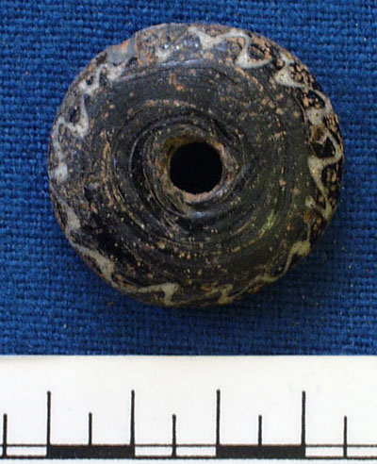
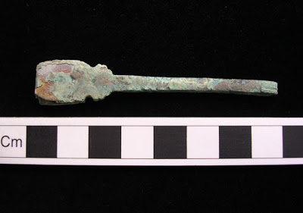
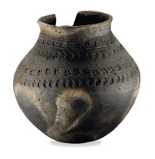
The use of environmental evidence to answer research questions: results
Social identity
  Demographic groupings buried with specific artefacts
Notes:
Upon carrying out statistical tests on the osteological and artefactual evidence a number of interesting patterns were identified, particularly with juveniles, that is, individuals under the age of 12 years old. This group of individuals were more likely to be buried in shorter cinerary urns and less likely to be afforded animal offerings. The grave and pyre goods offered to these individuals also closely reflected the objects buried with women, such as brooches and spindle whorls. In contrast, biological sex did not play a significant role in the selection of grave provisions with the exception that females were more likely to be buried with dress accessories and spindle whorls than males.

Slide 13
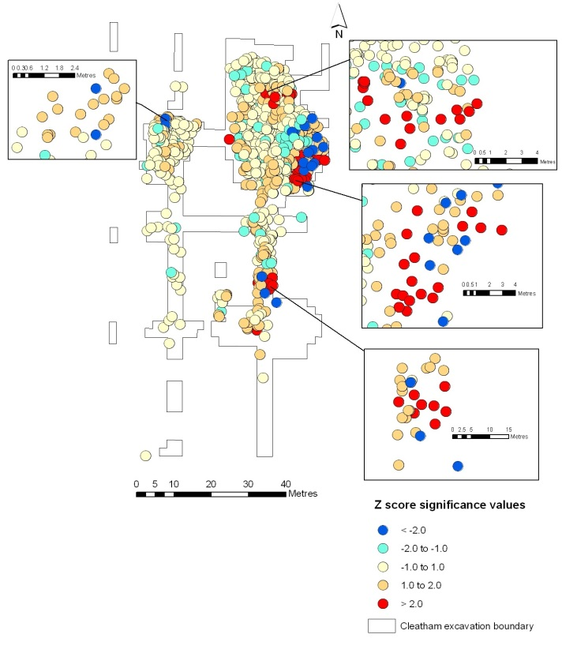
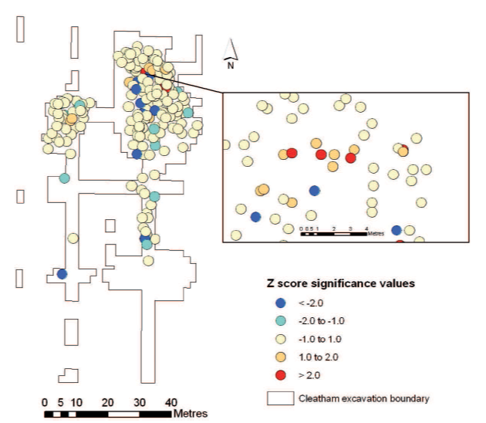
The use of environmental evidence to answer research questions: results
Social identity
  Demographic groupings interred in different areas of the cemeteries examined
Notes:
Unlike the late Anglo-Saxon period, we do not see any burial segregation based on the biological attributes of the dead. There are some very small statistically significant clusters but the rarity of these clusters do not indicate that children or females were segregated from the rest of the burial population. There is also a further issue with this analysis - based on the maps (left: biological sex at Cleatham – group of females; right: age at Cleatham – all right are juveniles and left is adult grouping) on the screen, can anyone identify a problem with the analyses run? (Hint: these cemeteries were in use for 150 years). The analyses do not take phasing of the sites into account, so the burials found in these clusters may have been deposited over a period of 150 years and the individuals buried in these groupings might not have known each other. Is it by chance that there are statistical clusters?
Based on these associations we can start to think about the social identity of individuals that were buried at these cemeteries. I will return to this point shortly.

Slide 14
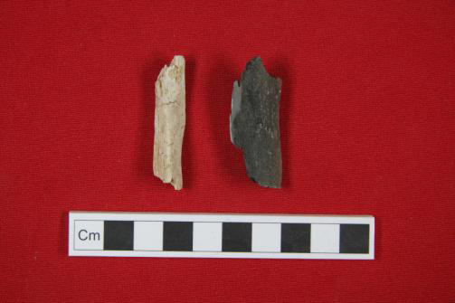
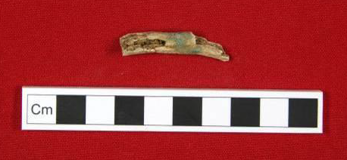
The use of environmental evidence to answer research questions: results
Pyre technology
  Efficiency of the cremation process
  Investment placed in the cremation rite
Notes:
Overall, the cremation process was efficient, though there was some variability between cremations and even in the same cremation which may be attributable to body position and oxidising conditions of the pyre. It also appears that bodies were left on the pyre until they were free of soft tissue. Evidence of horse and human burial – the human bone is fully oxidised and well cremated but the horse is poorly cremated. The latter would take longer to cremate than the human but it seems they were burned for the same length of time. Limited stoking of fire – presence of jewellery debris on bones (i.e. metacarpal).
None of the burials from Elsham or Cleatham were completely black in colour, suggestive of reducing conditions, low temperatures and short period of time. This raises questions about the fuel they used and where they were getting it from. It has been estimated that 146kg of pinewood or one to two whole tree trunks is needed to efficiently cremate a body. Communities must have good access to a wood supply and also storage facilities to practice this funerary rite. The trends identified when considering efficiency of the cremation process further highlights the need for collaboration and an examination of the charcoal recovered from some of the burials.
Max frag size from Elsham (89mm)

Slide 15
The bigger picture: interpreting the results
No written records – how do you interpret the results?
  Compare with contemporary local, national, and international sites
  Earlier and/or later written records
  Ethnographic studies
  Experimental archaeology
Notes:
Ask students to think of answers.

Slide 16
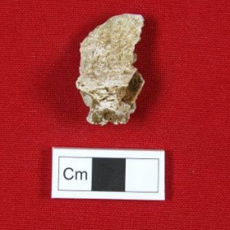
The bigger picture: interpreting the results
Demography
  Higher frequency of females than males
  Under-representation of infants and children
Similar disposal methods?
  Not burying all skeletal remains?
Similar methods of population control?
Taphonomic issues: relatively equal proportion of males and females if entire cemetery could be analysed?
Also seen at other sites in England and on the Continent
Supraorbital ridge
Notes:
Ask students to think of answers.
INTERPRETATION OF RESULTS
Demographic, social identity and pyre technology similarities and differences with other sites in the region and rest of England. Comparisons with the Continent can also be drawn upon here.

Slide 17
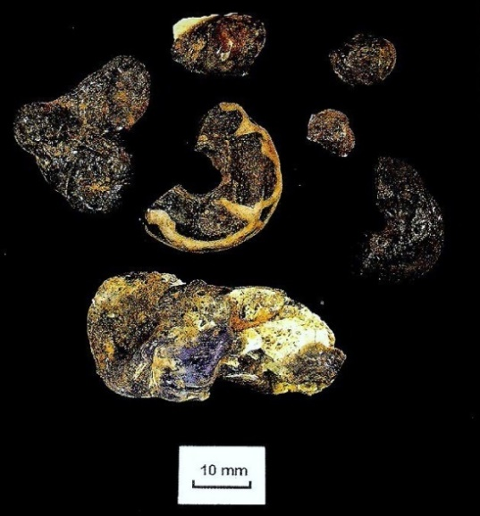
The bigger picture: interpreting the results
Social identity
  Demographic groupings buried with specific artefacts
  Demographic groupings interred in different areas of the cemeteries examined
Juveniles buried in shorter urns was universal and less likely to be buried with animal offerings – social standing?
Grave goods - lack of dichotomy; similarities between female and juvenile assemblages
Animal remains more common in the cremation rite in England – changes in burial fashion?
Burial in household plots
Some intra- and inter-site variation in England and on the Continent
Cremated beads
Notes:
Key findings from the research

Slide 18
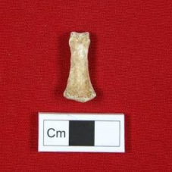
The bigger picture: interpreting the results
Pyre technology
  Efficiency of the cremation process
  Investment placed in the cremation rite
Overall, efficient cremation – similar technologies used?
Variable investment placed in the cremation rite – social standing?
Also seen at other sites in England and on the Continent
Complete intermediate hand phalanx

Slide 19
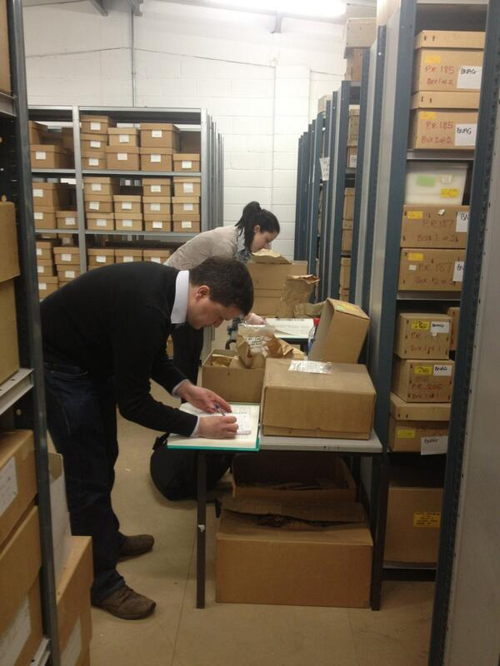
What did I learn?
Large datasets lead to a better understanding of the past…
…but be realistic – you may have to compromise
Multi-disciplinary approach is essential
Network – opportunity to meet new collaborators
The importance of forming a support network
Notes:
Large assemblages and, if well-preserved, large datasets can lead to a better understanding of the past. It can lead you to ask questions that you had not thought of when you first designed your project.
However, it is important to be realistic and to realise that it is not always possible to answer all the questions you may have about the assemblage, geographical area or period of time under investigation – you need to draw the line. This is what I had to do with the animal remains and charcoal. Hopefully in the future specialists will be able to look at these materials which can then be interpreted alongside the human skeletal remains.
- If you are unable to answer certain questions or even look at certain assemblages or sites, you may have to compromise. A recurring problem encountered by undergraduate project students is the difficulty in engaging with external lecturers and professionals. I faced this issue when I was doing my undergraduate dissertation and I needed to get hold of the stature estimations of skeletons from a site. They had been excluded from the site report. I emailed the osteologist and site director but neither responded to my emails. Therefore, I had to adjust my project and look at other sites where stature estimations were available. Many of these assemblages were smaller but I had to compromise.
One of the most important things I discovered during my project was that a multi-disciplinary approach is essential in research – you cannot just stick to what you know. So I had to venture into different subject areas such as gender and childhood studies, forensic anthropology, history and English literature, to name but a few. This in turn increased the range of subjects I was interested in researching and led to collaborations with other members of staff. On a similar line, during the course of my PhD I met specialists from another university that could bring in specialist skills, expertise and equipment. The problems I faced during my PhD and inability to answer specific research questions also highlighted the necessity to adopt a multi-disciplinary approach in future projects.
If you wish to adopt a multi-disciplinary approach to your research project, you will need to contact specialists. There are lots of networking opportunities that can help with this. So there are lots of student conferences, research groups and some of the big conferences that will allow you to meet students from other research fields that you may wish to work with. Conferences can be quite daunting but they provide an excellent opportunity to meet new people. Networking at conferences and workshops allowed me to meet new specialists – since finishing my PhD I have collaborated with biomolecular archaeologists, zooarchaeologists, and forensic anthropologists.
The final point on the board is extremely important. Carrying out an independent research project can be quite isolating so it is really important to form a support network with your peers or friends outside of your subject as it will give you the opportunity to talk about your work and gain an external perspective. You will also feel less alone, especially if your peers are researching a similar area to you.

Slide 20
Activity: Design your own project!
In small groups, design a project. Think about:
  Research question
  Type of environmental evidence
  Analytical methods that will be used
  Possible limitations of project
  Possible collaborators (e.g. specialists and equipment)
Notes:
10 minutes.
Research question you wish to answer
Env evidence you will use to answer this question
Analytical methods that will be used
Any limitations you may face – preservation (what would you do if a large assemblage was poorly preserved? What could it tell us and how would you go about rectifying this problem?)
Possible collaborators – specialists within your group or in other groups.

Slide 21
Summary
Distinct stages of planning and carrying out a project in environmental archaeology
Many types of scientific analysis that can be applied to environmental evidence
Adopt a multi-disciplinary approach to research (where possible!)
You will end up with more questions than you started with – remain focussed and don’t go off topic
Notes:
The application of sc

Slide 22
Any questions?

