Slide 1
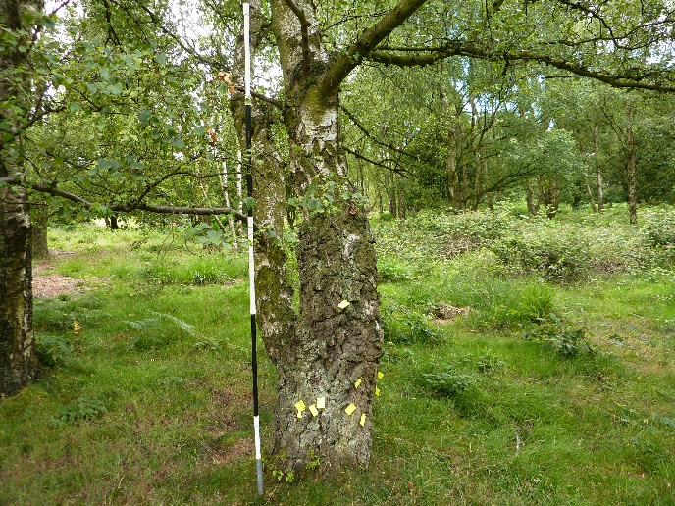
The relationship between silver birch (Betula pendula) bark structure and evidence of use by the Welsh Clearwing moth (Synanthedon scoliaformis)
Rachel Fryer and Dr Dave Skingsley (FRES).
Department of Biological and Biomedical Sciences, Staffordshire University, Leek Road Stoke-on-Trent, ST4 2DF
Abstract
The status of Synanthedon scoliaformis was investigated at Cannock Chase Country Park. A 1km² study area in Old Acre Valley, thought previously to be a key area for the moth, was selected for observation.
Tree surveys conducted prior to the adult moth’s flight period, identified 31 Betula trees with signs of emergence. Correlation analysis suggests there is a moderate to strong positive correlation between increasing bark fissure depth and number of emergence holes(r= 0.4413). It is thought that the significance of fissure depth has not been identified previously.
Results
Tree survey: Thirty-one Betula trees showing signs of S. scoliaformis emergence were found.
Bark fissuring: A range of fissure heights were observed, from 600mm to above 2700mm. The mean fissure depth ranged from 5mm to 37mm, with the majority falling between 10-19mm (13 trees) and 20-29mm (12 trees). Correlation analysis suggests that there is a moderate to strong positive correlation ( r = 0.4413) between increasing bark fissure depth and the number of S. scoliaformis emergence holes per tree (Figure 2).
Discussion
Tree charactertistics: The majority (28) of the 31 trees with signs of S. scoliaformis emergence were B. pendula, which is consistent with the findings of Graham (2005) and Green (2006; 2008). Emergence hole height was only recorded for descriptive reasons, as for this study, tree characteristics, not emergence characteristics, were prioritised. However, emergence holes appeared to occur below 2 metres, which is consistent with the findings of Graham (2005). Only one tree was observed with emergence holes exceeding 2 metres. Bark fissure depth ranged from 5mm to 37mm, with the majority falling between 10 and 29mm. There is a moderate to strong positive correlation between increasing bark fissure depth and number of S. scoliaformis emergence holes. The results are compelling and we suggest that the degree of fissuring, such as fissure depth, be considered in future studies or when managing Betula trees for conservation of S. scoliaformis
Fig 1. Betula pendula showing identified emergence holes. Ranging pole in 0.5m divisions
Fig 2. Mean bark fissure depth and number of emergence holes (r = 0.4413).
Introduction
S. scoliaformis larvae are thought to develop for 2-3 years in Betula spp. trees, before the adult moth emerges on sunny days in June and early July (Green, 2006). In Wales and Scotland, the larval food plant is thought to be primarily Downy Birch Betula pubescens, but in Europe, and on Cannock Chase, the moth larvae appear to feed primarily on Silver Birch Betula pendula (Green, 2006). S. scoliaformis was discovered at Cannock Chase Country Park in 1913 and was rediscovered in 2005 by Graham (2005). Graham (2005) observed the characteristic 5mm wide emergence holes in the Silver Birch (Betula pendula) trees within 2 metres from the base. Tree variables recorded include number of stems, trunk girth at breast height (GBH) and degree of openness (Green 2006; Green 2008) but not the bark characteristics. Results from Bevan (undated) suggested that larger Betula trees may be of importance in adult selection for oviposition but nothing more was characterized. These findings suggest there is potentially more to learn about S. scoliaformis oviposition behavior that potentially could inform S. scoliaformis conservation.
Materials and methods
The study area: Cannock Chase is a large heathland and woodland mosaic, and this study is focused within a 1km² of the Country Park (centered on SJ9718) that includes a known area for S. scoliaformis (Green, 2006).
Tree surveying: Betula trees within the study area were checked for emergence holes, in living wood. Similar holes in loose bark or dead wood were not recorded, due to the potential for these holes to be created by the Black-spotted Longhorn Beetle Rhagium mordax (Green, 2006). Trees within 10 metres of forest tracks were surveyed. Tree surveys were carried out in May, prior to the adult moth emergence timing, and again in late July, and August, after the adult moth emergence. The significance of the height and depth of fissures in the bark was investigated. For each tree with signs of emergence, the height at which bark fissures ended, and the depth of fissures, were recorded.
The height and aspect of emergence holes was also recorded. Post-it notes were temporarily attached to identify the location of emergence holes on each tree (figure 1), and each tree was photographed with a range-pole. This information facilitated a reliable return to recorded trees during the study, and may be of use to Country Park rangers when identifying trees used by S. scoliaformis.
References
Bevan, R. (undated). Assessing the larval host trees of the Welsh clearwing moth (Synanthedon Scoliaeformis) in Wales and England. Swansea University, Swansea.
Graham, A. (2005). The Welsh Clearwing Synanthedon scoliaeformis (Borkh.). Atropos 27: 3-8.
Green, D. G. (2006). The Welsh Clearwing moth Synanthedon scoliaeformis (Borkhausen, 1798) Cannock Chase Country Park Survey 2006. Butterfly Conservation Report No. S06-34. Butterfly Conservation, Dorset
Green, D. G. (2008). Argent & Sable Rheumaptera hastata and Welsh Clearwing Synanthedon scoliaeformis (Borkhausen, 1789) Cannock Chase Surveys 2007. Butterfly Conservation Report No. S08-13. Butterfly Conservation, Dorset.

