Slide 1
Student & graduate enterprise & entrepreneurship
The ICE and Honeypot experience https://twitter.com/HudHoneypotIce
Entrepreneurial University Leaders Programme
24th April 2014
Dr. Jess Power Dir T&L ADA
e.power@hud.ac.uk
Dr. Leigh Fleming Research Fellow C&E
l.t.fleming@hud.ac.uk

Slide 2


Initiatives:
Bridging the gap between design and engineering through the creation of a network of exchange to develop a legacy of learning
Providing a rich network for innovation, design and entrepreneurship in engineering and design – a “honeypot” of rich Ideas

Slide 3
Aims VP scheme
Creativity – Generation of ideas
Innovation – successful exploitation of ideas
Design – Links creativity and innovation
Outputs | students |  |  | Total number of opportunities
 | ADA | C&E | Total
Enhance the creativity, design and innovation content in undergraduate teaching | 291 | 49 | 340 | 8
Developing understanding of the innovation process | 4 | 15 | 19 | 3
Encourage inter-disciplinary design activity | 117 | 71 | 188 | 4
Greater awareness of and contact with industry and business | 18 | 1 | 19 | 3
Encourage UG endeavour in developing creative, innovative design proposals | 67 | 16 | 83 | 6

Slide 4
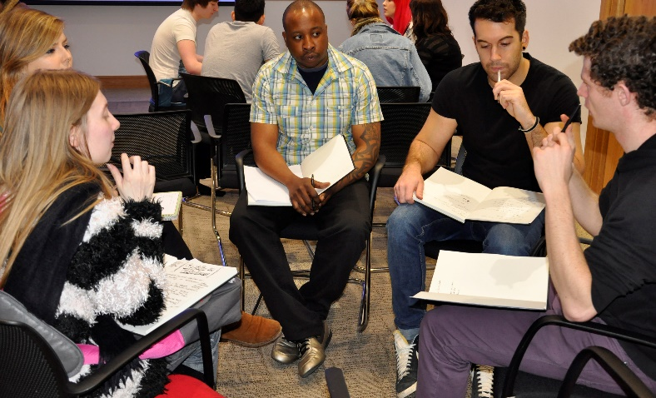
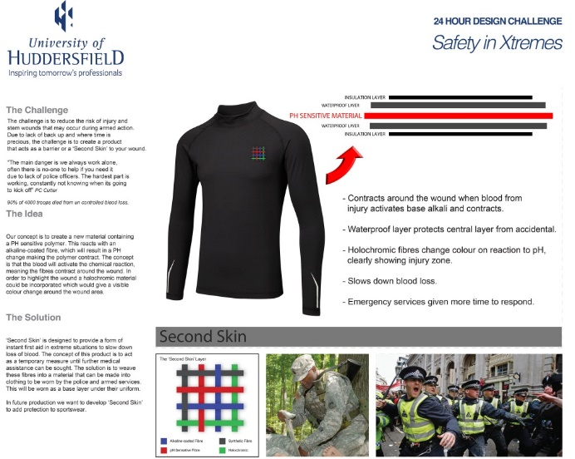
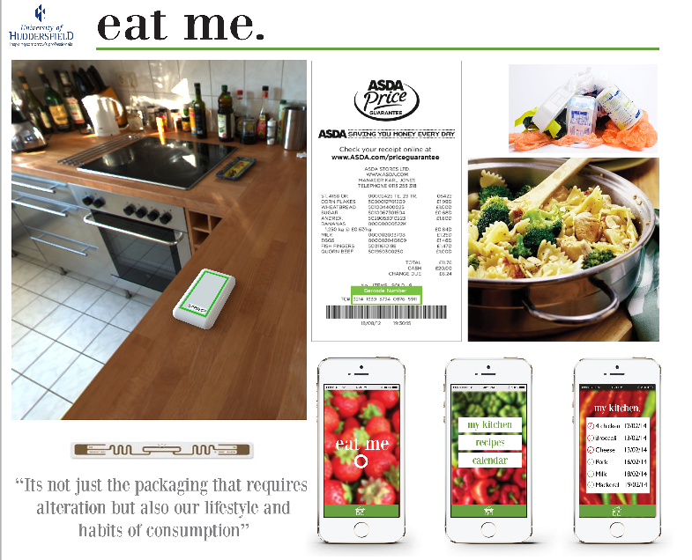
24 hour challenge
 | students
 | ADA | C&E | total
2013 challenge: Saftey in extremes | 28 | 12 | 40
2014 challenge: Sustainable solutions for global challenges | 19 | 16 | 35

Slide 5
Comments from the events:
“....in the 24 hours we were given I have been
given a massive insight into how completely separate skill sets can come together to generate an idea”.
“....I really enjoined the challenge and it was good to start viewing things from different discipline angles”.
“This design challenge was great. I love working with all of my team who were from different specialisms”.
“I believe I learned a lot from my peers… and this experience will benefit me in future group projects”
“It was really helpful to speak to the different tutors… and pick their brains about our ideas, as I would never normally come into contact with tutors from these courses”
(April 2013)
(Feb 2014)

Slide 6
“David Bailey” - April 2014
Judging the 24-hour design challenge
was a pleasure and revealed an impressive arsenal of talent the University of Huddersfield has amongst the students. Each multi-disciplined team presented well thought out and researched concepts which impressed the judging panel and stimulated much debate. Being spoilt for choice meant the pressure was put back on the panel when it came to us choosing a winner.
In my experience, great ideas occur when a creative person or team is constrained by time and/or budget. When placed under pressure, right brain instinct coupled with pragmatic decision making, causes inventive and exciting concepts and solutions. Events like the 24hr Design Challenge are a great example of where you'll see this in action.
David Bailey Creative Director UX&D, BBC Future Media
http://www.hud.ac.uk/news/visitors/interviews/davidbaileycreativedirectoruxdgelwiththebbc.php

Slide 7
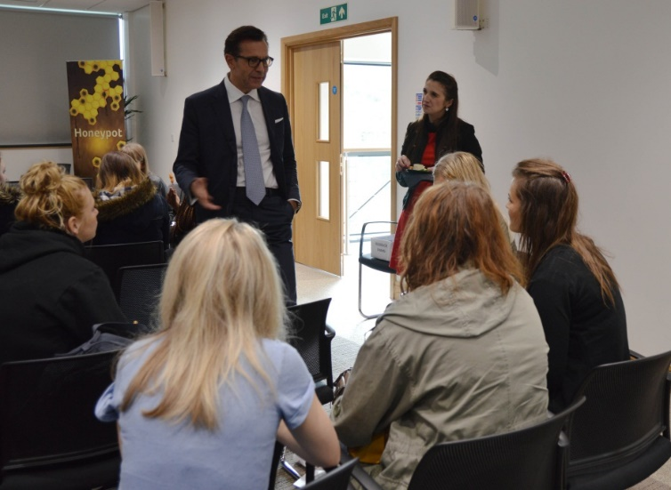
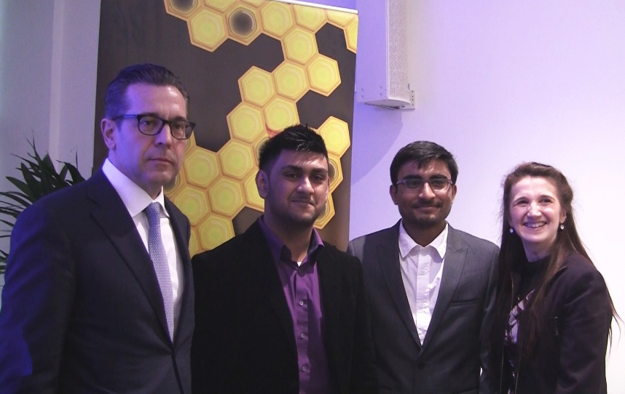
HoneyPot
Winners from HP1
Software Development studio
2 graphic Design students (ADA)
2 Computer systems (C&E)
 | students |  |  | projects
 | ADA | C&E | total | ADA | C&E | projects
Honeypot 1 Oct-Dec 2013 | 25 | 26 | 51 | 2 | 3 | 5
Honeypot 2 Feb-April 2014 | 45 | 17 | 62 | 5 | 2 | 7
(HP1
Oct-Dec 2013)
Winners from HP2
Solar Powered UAV
4 PD (1 first year) and 2 Mech Eng

Slide 8
Feedback from the students:
“Honeypot would be a great concept if it were inter-university”
“Very good networking tool for student enterprise – perhaps a summer project”
“Consider including final year students as many final years are perhaps more ready for enterprise activity”
(Oct 2013)

Slide 9
Challenges
Factors out of our control, outsourcing
Legal contracts first – IP, NDC
Outside curriculum (engaging the students)
Networking across courses – mix them up
Confidence to apply for funding – first experience
Mentor’s from specific disciplines – at the right time
Opportunities
Lots of opportunities – companies, guest lectures
Positive impact on student experience
Workshop in June with two schools aimed at staff

Slide 10
Final word:
“…defiantly glad I did [attend this guest lecture]”
(Innovation lecture Jan 2014)
POC “…should be arranged for individuals not only for teams”
(POC April 2014)
“I will be applying for placements again after almost giving up! (branding yourself for employment April 2014)
“…today was thoroughly interesting and very relevant to my studies…I feel informed and [it] will leave me with a lot to think about, and a fresh boost of creativity” (UX&D function March 2014)
“…really useful for my course… it should be an annual event” (Award winning design Nov 2013)
“This session has opened my mind into thinking differently about the consumer and how to appeal to them more” (Feb 2013)

