Slide 1
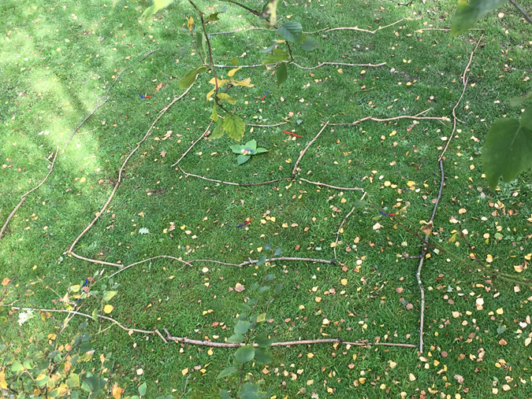
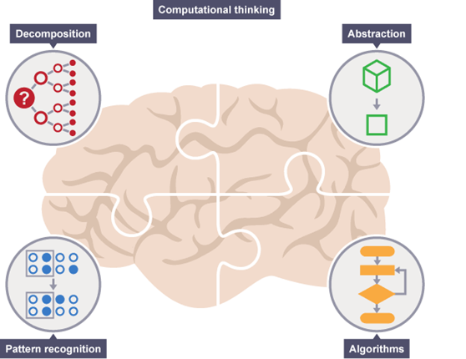

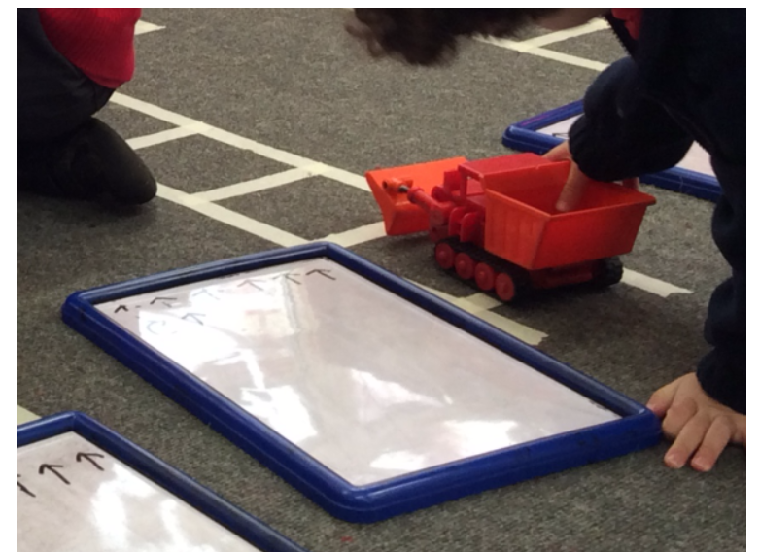
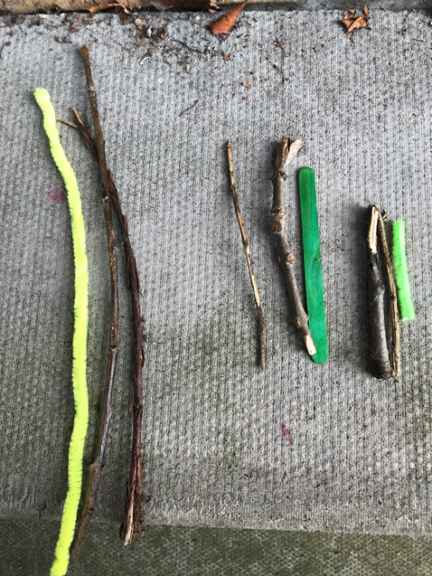
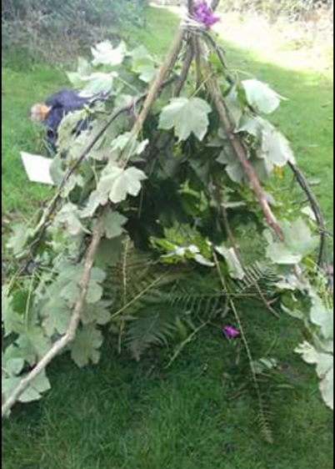



STEM without a Screen in Early Years
Where are we now? Guernsey (2016) and The National Association for the Education of Young Children (2008) to name a few, have highlighted the issues faced by early childhood educators in using technology in early years, and this is often arguably overly associated with sedentary behaviour. Thus, practice pertaining to anything technology related is frequently exercised with caution, and a fear of screen time is emerging (Kucirkova and Linvingstone 2017).
However, technology is far more than a screen, and when considering exploration in play and STEM activities, it is critical to consider that children can learn skills towards coding for example, and of course fulfil the Early Learning Goals of the EYFS, in a highly active and ‘unplugged’ way. Donohue (2015) succinctly explains the importance of this as we live in a digital age, whereby children and staff alike need to develop their STEM attitude, knowledge and competencies. In terms of school readiness, we must acknowledge that STEM features heavily in the curricula guidance following the EYFS.
Thus, research such as Katz (2010) has addressed facilitating STEM in early years and champions ‘classical science’, as this has the potential to elicit Higher Order Knowledge, skills, positive dispositions for learning, and feelings. Staff implementing and interpreting Knowledge and Understanding of the World activities or Mathematics lend themselves to STEM practices with ease, but it could be argued we are largely unaware of this.
Now what? Professionals need to immerse children in ‘classical science’, exploration and investigation of the world, and then supplement this with technology, rather than the tech being the exploratory focus. By familiarising ourselves with computational thinking and encouraging the children to engage with breaking down a problem into manageable sizes (decomposition) finding patterns (pattern recognition) focussing on key information (abstraction) developing instructions (algorithms) in our activities, we will facilitate STEM in the early years. We simply need to be largely aware of how we do this, and develop the ability to narrate the learning using computational thinking or STEM language in order to explicitly apply STEM in our Early Years provision.
What about the tech? When facilitating technological thinking in Early Years, for example, pre-coding, we need to (sometimes) step away from the iPad and reach for programmable toys, or even string, loose parts or nature.
Creating and navigating around labyrinths, a touch of orienteering, or hand made mazes and puzzles are all computational thinking skills. Involvement of technology may include children taking photographs, or pre-recording directional instructions for friends to listen to, or recreating the activity on software after the unplugged attempt. Withersy (2015) conveys such practices in a great blog ‘enabling environments’ whereby children write their own directions via arrows for cars to travel through (amongst other great ideas). Even for our youngest children, a pom pom drop is a STEM activity that facilitates computational thinking.
References
Donohue, C. (2015) What’s in your toolbox? New technology tools for early childhood professionals – Part 1. Exchange, pp. 74-80.
Guernsey, L. (2011) “A modest proposal for digital media in early childhood.” Early Ed Watch (blog), June 24
Katz, L. (2010) STEM in the Early Years, [Online] Available at http://www.ecrp.uiuc.edu/beyond/seed/Katz.html (Accessed May 2010)
Kucirkova, N. & Livingstone, S. (2017) Why the very idea of 'screen time' is muddled and misguided, [Online] Available at https://theconversation.com/why-the-very-idea-of-screen-time-is-muddled-and-misguided-82347 (Accessed August 2017)
NAEYC (2009) Position Statement: Developmentally Appropriate Practice in Early Childhood Programs Serving Children from Birth through Age 8. Washington, DC: NAEYC.
Withersy, M. (2015) Start Unplugged! Coding in Early Years, Enabling Environments: Technology Behind Early Years (blog), February 2
Francesca Cornwall @FrankieCornwall @EarlyYearsSU @EdStaffsUni francesca.cornwall@staffs.ac.uk

