Slide 1
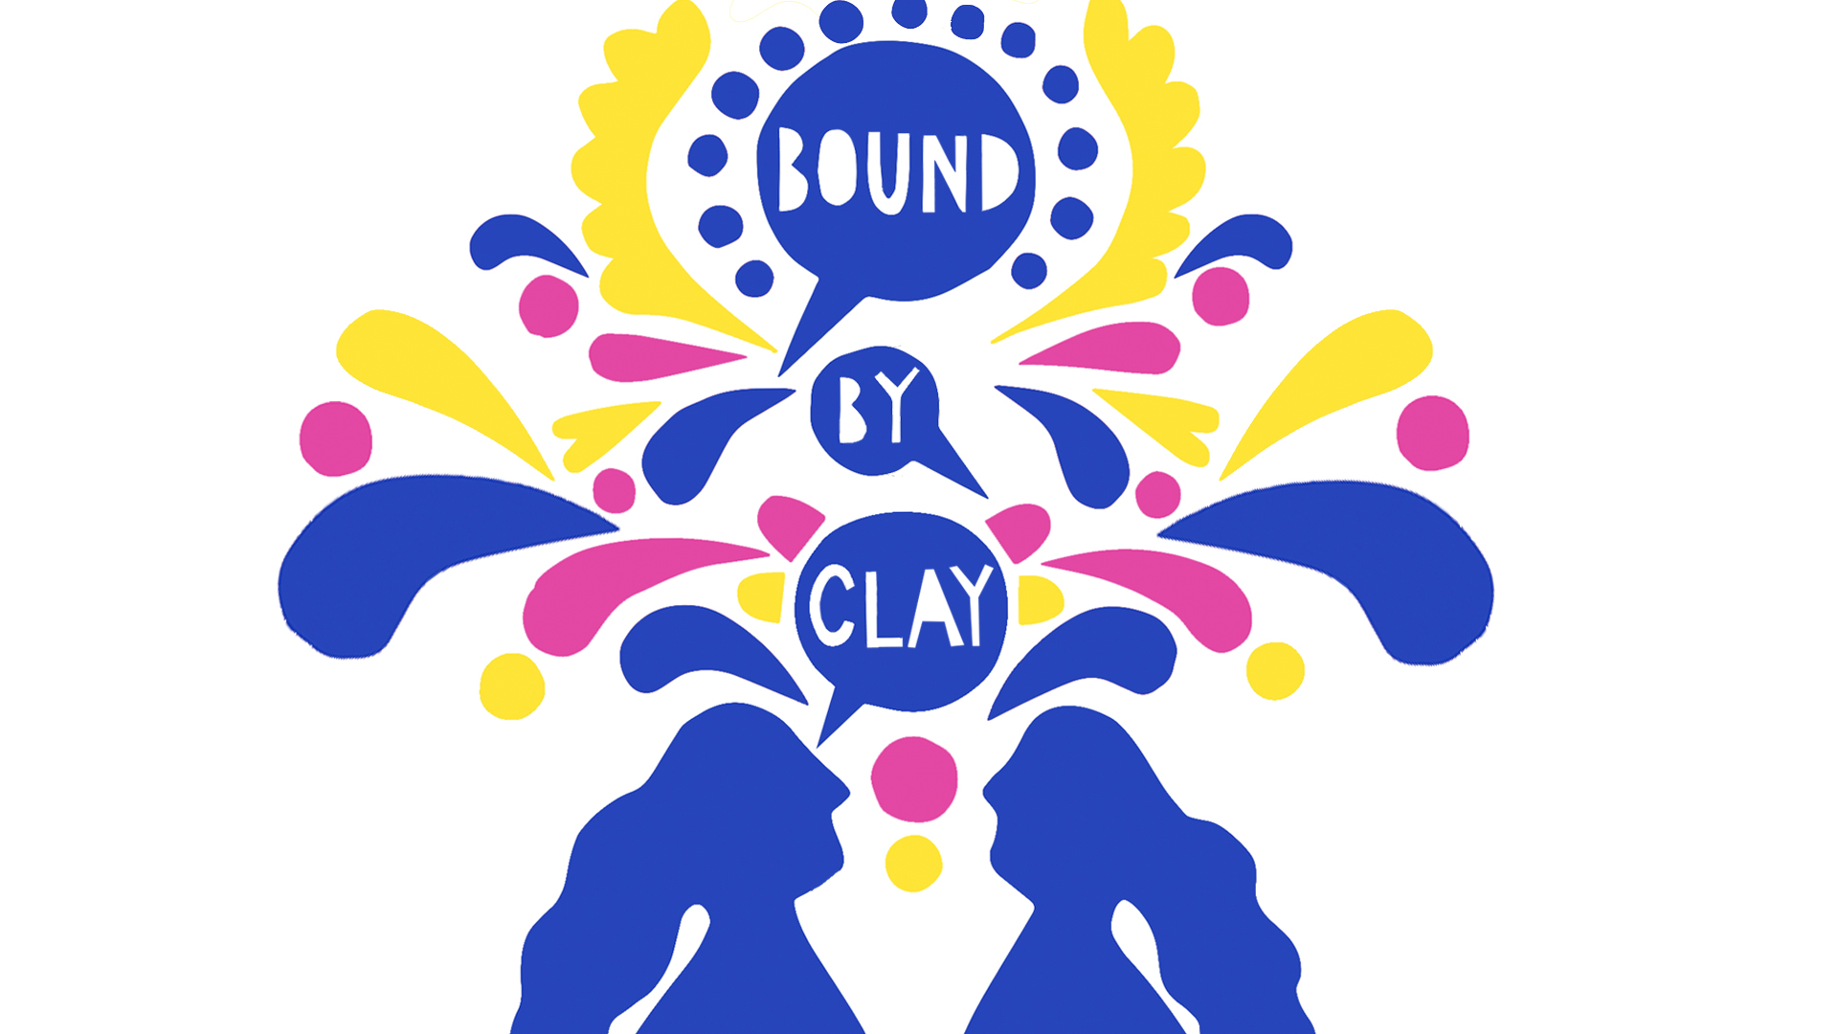
Bound by Clay remembering women’s contribution to the ceramics industry in Stoke-on-Trent
Vicki McGarvey
Chair Stoke & North Staffs Women’s NetworK
Librarian & Part Time Research Student Staffordshire University
Vicki.mcgarvey@staffs.ac.uk
@vickimcgarvey
Notes:
will give an overview of the challenges with respect to accurately documenting the contribution women have made within the industry and recording their memories. It will focus on the ethics and pressure of responsibility when depicting industrial heritage, specifically media and marketing representations and the risk of nostalgia distorting the local collective memory.

Slide 2
Heritage ... has enclosed the late twentieth century in a bell jar into which no ideas can enter, and, just as crucially, from which none can escape.
(Hewison, 1987, p.144)
Notes:
As this project could be classed by default as a heritage project because we were funded by the National Heritage Lottery Fund money which is raised by National Lottery players to resource UK’s heritage, we need to consider the complex arguments around the use of the word heritage and the heritage industry. For Hewison, heritage distorts the images of the past, creating a distraction from todays difficulties that have resulted from the break down on industrial society

Slide 3
Culture is fragile - languages dies off, people die off, stories, die off. That gives us a trenchant reason to build archives. There is almost an archival imperative to preserve, conserve and maintain historical memory so we can draw sustenance from the past to envision our future
(Ybarra-Frausto in, 2005 p.10 in Sommerville and Echohawk 2011 p.653)
Notes:
However, if we do not capture our heritage we are in danger of losing it. The challenge I suppose is how we do this in a representative honest way, without being distracted by mass consumption. Can we lift that bell jar and allow heritage to critically frame the past before stories and the intangible skills disappear, we have a responsibility to record the past make the unknown known. This is particularly urgent when acknowledging the contribution and integration of women into heritage, and we need to make sure that those women are known

Slide 4
Celebrating The Known
Anni Albers: Bauhaus student & master
Combined the ancient craft of hand-weaving with the language of modern art – Tate Modern
extile Designer
https://commons.wikimedia.org/wiki/File:June12_Anni_Albers.png
Notes:
An example of where women have been hidden from history is within the School of the Bauhaus which was a progressive art school, with an ethos of absolute equality amongst the sexes. Anni joined as an aspiring fine artist but when she joined the school she was told that women had a choice of 3 subjects, textiles, bookbinding and ceramics, not giving women the same choices as men was active discrimination. Anni chose weaving and ironically this turned out to be one of the most commercially successful areas of the Bauhaus, Anni Albers eventually moved weaving into the exclusive area of modern art

Slide 5
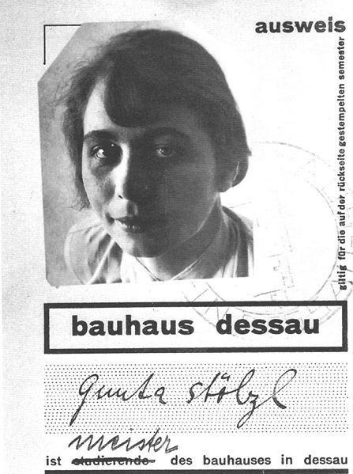
Celebrating The lesser known
Gunta Stolz
Weaver & textile artist
Bauhaus Student
First official department head
And all the other Bauhaus women
https://commons.wikimedia.org/wiki/File:Stolzl_bauhaus_ausweis.jpg
Notes:
There were many women that contributed to the success and were a major part of the Bauhaus history they were lesser known, like Gunter Stolz, the first official department lead, and there were many other women who studied at the Bauhaus who remain unknown

Slide 6
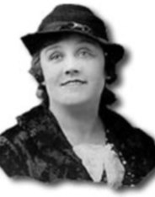
Celebrating The Known
Clarice Cliff
Ceramic Artist
Art Director Newport Pottery ,
Stoke-on-Trent
Best know for designing Bizarre Wear
https://commons.wikimedia.org/wiki/File:Clarice-cliff.jpg
Notes:
Likewise in ceramics there are known women like Clarice Cliff and Suzy Cooper that will be remembered for their progressive contribution, to ceramics. Clarice Cliff studied at the Royal College of Art and is well known for her art deco bizarre wear.

Slide 7
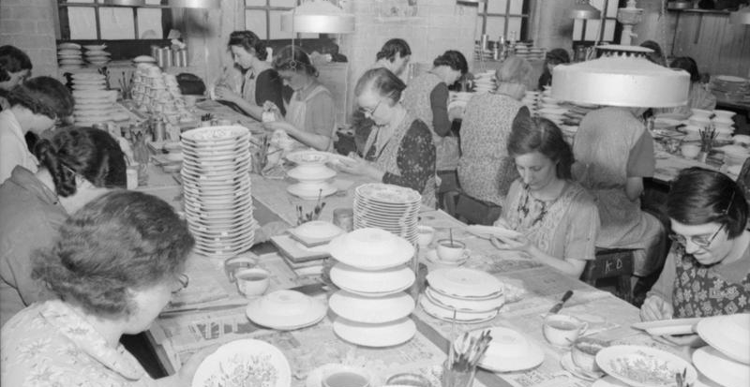
Celebrating
The Unknown
Women workers at Meakin Pottery in Stoke-on-Trent
…and all the women of the pottery industry
© IWM (D 11488) POTTERY IN THE MAKING: THE WORK OF J & G MEAKIN POTTERY, HANLEY, STOKE-ON-TRENT, STAFFORDSHIRE, ENGLAND, 1942
© IWM (D 11488) POTTERY IN THE MAKING: THE WORK OF J & G MEAKIN POTTERY, HANLEY, STOKE-ON-TRENT, STAFFORDSHIRE, ENGLAND, 1942
The Unknown
Notes:
There are many women like these women in the Meakin Pottery who also made a major contribution from painting to more heavy warehouse work that may be remembered collectively but not are unknown individually, just a mark on the underneath of the ware being the only identifiable link to their creative input to an internationally renowned ceramics industry

Slide 8
Now celebrating the known,
the women that have contributed to the ceramics industry
Notes:
As a result of the Bound by Clay project we can now not only celebrate the women but we now know some of them by name

Slide 9
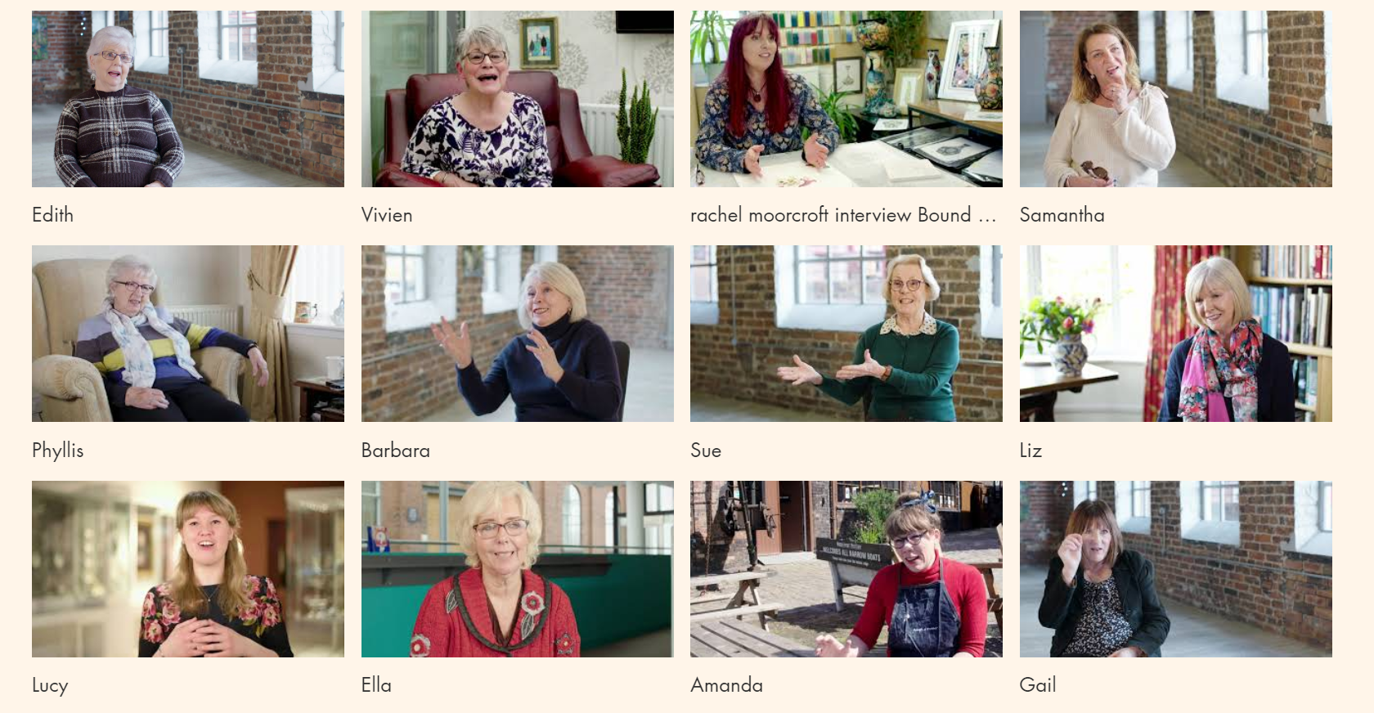
Notes:
These are the women of Bound by Clay

Slide 10
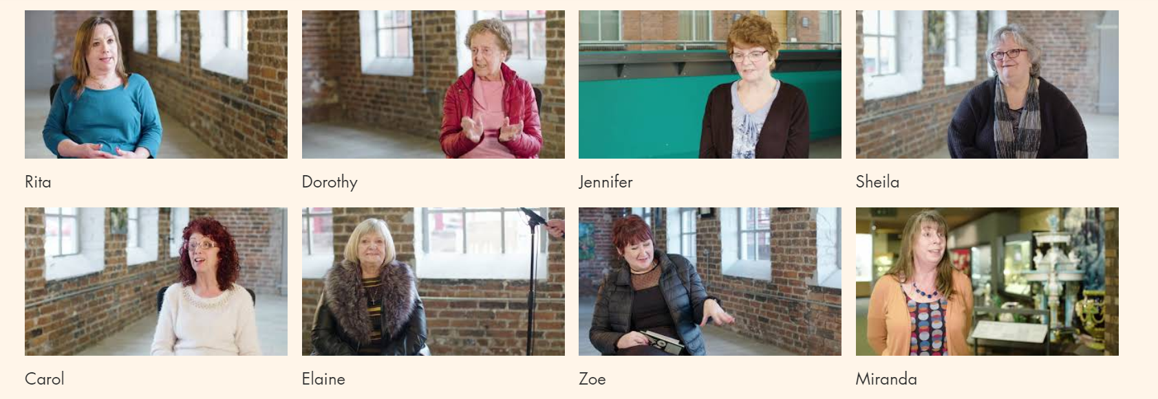
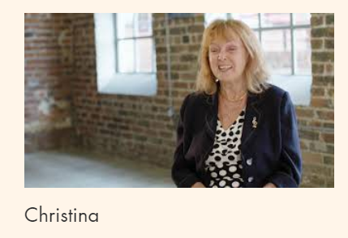
The Women of Bound by Clay
Notes:
The pottery industry is possibly one of the major industries where women have been most influential, from creative design to production, working in a very challenging situation, socially, economically and environmentally. In the early 20th Century women were considered lazy if they did not contribute to ceramics and there would not have been a pottery industry if there had not been women, as they were needed at the creating and the making end, because initially there was little mechanisation, and they were also a cheap form of labour.

Slide 11
Bound by Clay: Celebrating women’s contribution to ceramics
We wanted to tell their story
Successful bid Heritage Lottery Funding 7 month project to produce
A film
Educational Resource
Book
7 months to do this all with volunteers!
Notes:
Bound by Clay was a 7 month project to capture women’s recollections of working in the industry, so that we could preserve, document and evidence their contribution to ceramics, in Stoke-on-Trent. It had 3 main outputs, a film of women talking about their experiences, an educational resource that referred to the film and a book of anecdotes.

Slide 12
About Stoke-on-Trent…The Potteries
One of the few cities affectionately named after the product it produces
Historically: Became a city in 1910 comprised of 6 villages/towns that still hold onto their identity. It was the largest producer of ceramics from 17th century until late 70s
Economically: Heyday 1920s 1000,000 people were employed, in 2009 reduced to 9,000 – even less now. 40% of workforce were women. Most well known producers Wedgwood, Spode, Royal Doulton, Dudson, Minton, Churchill
Politically: Up until de-industrialisation, politically left, big Labour Party & Union support, however 70% of the population voted to leave the EU in the referendum in 2016
Culturally: Failed but unexpectedly close bid for UK City of Culture lost to Coventy in 2018, home to the British Ceramics Biennial, Great Pottery Throwdown, Clay College & re-emergence of studio ceramics education
Trying to rebrand itself whilst still acknowledging its past…
Notes:
Stoke-on-Trent is one of the few cities affectionately known after the product it produces.
Go through bullet points
I’m from Stoke-on-Trent, I was brought up in Burslem often referred to as the mother town, famous for the, initially Wedgwood tableware Burslem School of Art. My parents were not employed in the pottery industry but my grandparents were and my great grandmother went to Glasgow to pass on her skills. People tend to be proud of their place but not necessarily encouraged to be proud of their achievements, you spot a Stokie they often look at the underside of ceramics to see if the plate or cup has been made in Stoke

Slide 13
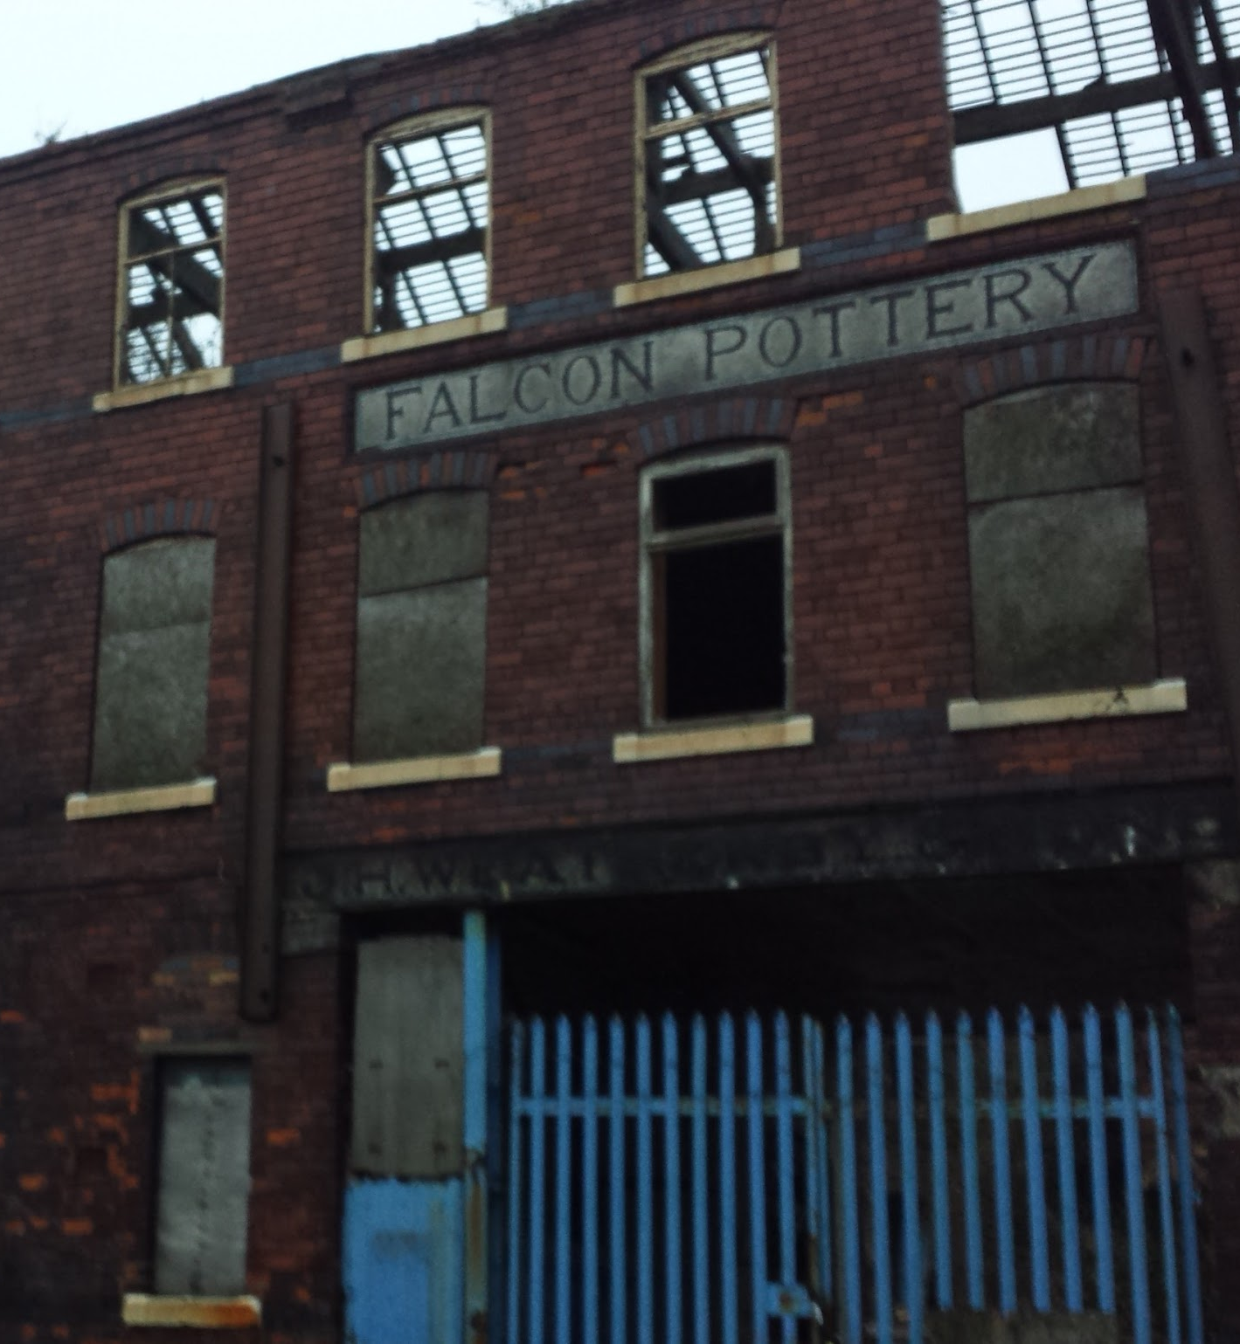
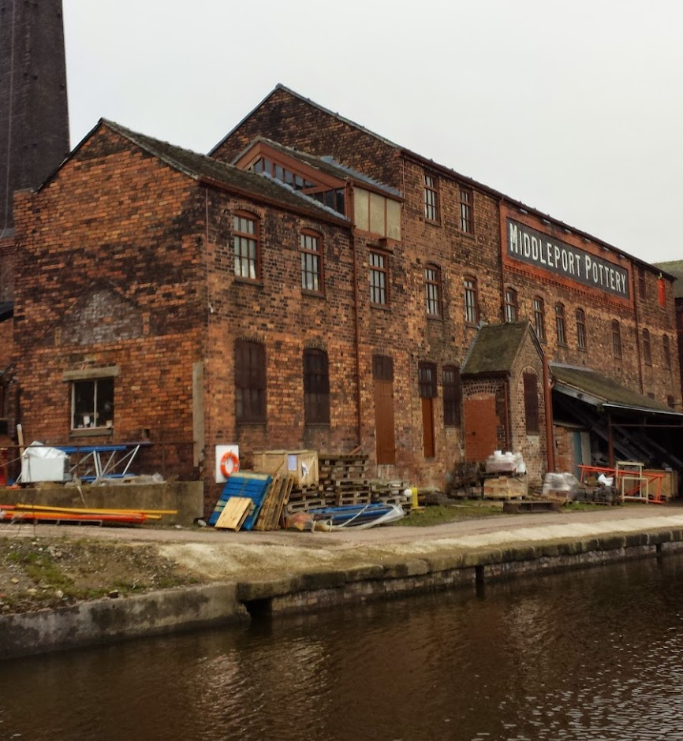
The Old
The new
V McGarvey cc by
Notes:
This picture very much tells the story of Stoke-on-Trent – the decaying industry, and the success story of Middleport pottery, home to Burleigh Pottery which still produces its own pots and Clay College – it also represents the tension between the old and new the tension of preserving the past whilst welcoming the future, through new initiatives and projects

Slide 14
Feminist studies and research need to work across heritage processes to understand the dynamics and trajectories that occur between, policy, production, text and consumption.
(Reading, 2014 p. 410)
Notes:
Critical heritage, and in particular feminist studies is a useful lens to review the Bound by Clay project and the many aspects of heritage that need to be taken into account to assess the representation and presence of gender

Slide 15
Gender & Heritage Considerations
Bringing together gender with heritage, there 4 areas of enquiry (Ann Reading, 2014)
Representation: collections, sites & performances
Production: curatorial practices & heritage management
Consumption: encounters with heritage, educators, visitors and tourists
Heritage policies: local & national
Notes:
Reading’s work on gender and heritage has suggested representation, production, consumptions and policy as areas of enquiry, which also help in assessing heritage projects and activities, with respect to the representation of gender

Slide 16
Focus of Bound by Clay
Focus of the project film also called Bound By Clay, has accounts by women of their experiences of working in the ceramics industry, past & present, with critical commentary
Considerations, with respect gender
Representation of women in the ceramics industry
Production of the film & associated outcomes, the educational resource & book
Consumption, how the project was branded, & the outcomes marketed
Policies, satisfying the funder, the Heritage Lottery Fund
Notes:
Catalyst for finding out more about the industry in particular the intangible skills that women had which are beginning to disappear. Using Reading’s enquiry model

Slide 17
Bound by Clay Representation, Production, Consumption
Representation
Project has testimonies of women working in the pottery industry past & present, in a range of roles
Critical context was provided women ceramics experts
Some of the women were identified by members of the Stoke & North Staffs Women’s Network
Production
Had a young female director Stephanie Rushton
Members of the women’s network were involved in writing questions and the editorial of the film
The educational resources were written by women with teaching experience from within the network
Consumption
Branding was by a young female designer Jess Slight
Project was launched at an event to celebrate International Women’s Day
Notes:
Applying this model of enquiry to Bound By Clay, we can see positively identify influence of gender in the representation, production and consumption of the project. However it must be acknowledged that the film production company was run by a man, who asked the questions within the film although these were edited out, the film company also identified some of the women. The web site for the educational resource has been designed by a man.

Slide 18
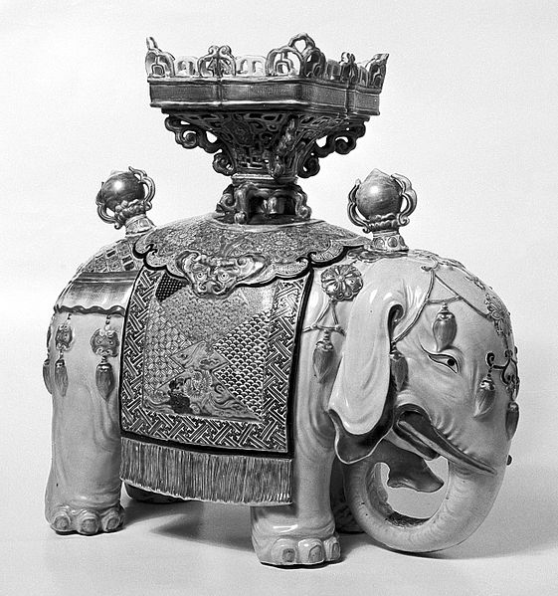
The elephant in the room…nostalgia
“Stoke is ceramics, ceramics is Stoke”
“You felt like you were all together as a family looking out for each other”
Elephant with Howdah Welcome Institute Copyrighted work available under Creative Commons Attribution only licence CC BY 4.0 http://creativecommons.org/licenses/by/4.0/
Notes:
With a project like this nostalgia impacting on the authenticity of what is being told is a considerable challenge, simplifying the story and distracting from the contributions individuals make, and if the outputs are not purely academic they can creep into all aspects of presentation and production.

Slide 19
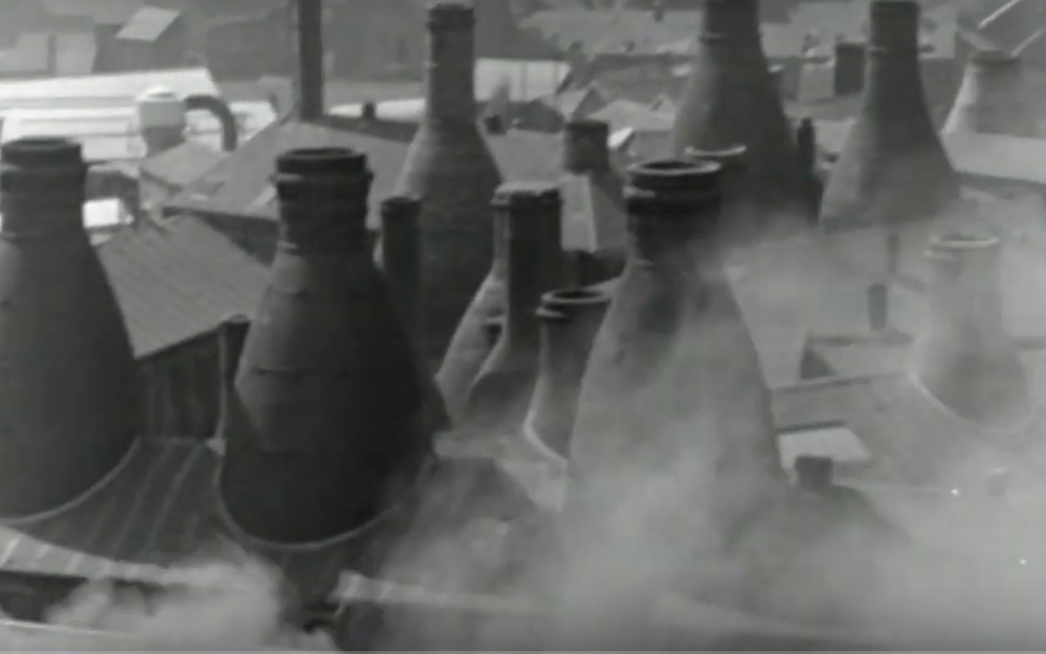
Still Bound by Clay Film Rights Reserved
Notes:
For Stoke people can very nostalgic, this type of image is very popular, and also appears in art and branding - this a still from the Bound by Clay film

Slide 20
Finding value in the active memory and former practices of those affected by industrial change often provokes simple assumption of nostalgia, or unchecked idealisation of the past. Thus the psychological and emotional dimensions of industrial history – the first hand recollections surrounding the complex networks, social bonds and pride forged by collective skill, can be too easily side-lined.
(Brownsword, 2017 p.6)
Notes:
For Neil Brownsword is the Professor of Ceramics at Staffordshire University whose fine are practice is focuses on the preservation of intangible industrial ceramics skills, as he says the temptation to move into nostalgic recollection distract form the complexity of the industrial production

Slide 21
Film & slipping into nostalgia
Challenges of historical film, you need to
Convey a lot of information in short time frame
Engage the viewer
Present complexity in a simplified form
Be more concise than the written word
Present light & shade
Provide an honest representation of the performers
Nostalgic techniques can help & hinder with this
Imagery, music, tone & editorial – group had major discussions on all of these
Our introduction is very nostalgic but it used effectively as an engaging technique
Nostalgia a useful mechanism in storytelling
Notes:
We found that creating a documentary film had its own challenges, it needed to present a lot of information in a concise way that engaged the viewer, but also the women needed to feel that they have been honestly represented, even though is not possible to include everything they said in the finished item. Nostalgia can help with this although we had many robust discussion about the imagery, the music, the light and shade within the Bound by Clay film.

Slide 22
Story telling…is widely regarded as feminine practice and therefore marginalized. If such intangible art became recognised internationally and received financial and other support, this would empower the women who practice the art.
(Moghadam and Bagheritari, 2007 in Reading p.406)
Notes:
However, nostalgia can be a useful mechanism in storytelling to help people dig deeper into their memories of the past.
Quote
Storytelling was a central part of the Bound by Clay project, this is an affecting observation by Moghadam and Bagheritari, for our project it was a mechanism that identified a whole range of sociological, cultural and economic aspects that impacted on the women whilst working in the ceramics industry

Slide 23
Bound by Clay Women in their own words
Working environment: Edith and Phyllis
“you went and whatever job was available at the time you took and they taught you your trade”
“eventually they cut the lunchtime down to half an hour it was not a long enough break when you are doing a heavy job, that’s lifting all day”
The Role of Women: Sheila, Barbara, Dorothy
“the women ruled the pot bank, the women looked after the makers”
“I went in at 16 and within 6 months I was earning a man’s wage, most women worked in the pottery, it was led by women totally”
“it was always men who were telling you want to do, we made them think we were listening but when they went we did it our way”
Notes:
It is not possible for me to present all the stories today so I recommend you see the film and look at the individual interviews which include even greater insights but I think the women of Bound by Clay should have a voice here today, without them I would not be here presenting and celebrating today – so here are their voices, the quotes relate to the major themes in the film

Slide 24
Bound by Clay Women in their own words
Economic stability: Zoe
“it was a serious business you knew if you worked hard you would see it in your wage packet…the skilled were women, the manual were men, the women ran the show, you wouldn’t see a man other than in management, it was empowering because you could see women earning money”
Community: Carol, Barbara
“ I was 15 when I started and with the older girls all I wanted to be was to be like them, everybody was friendly everybody looked after one another, if you couldn’t finish your work they would say I will do that for you and you go off to do something else”
“there was always singing, we always talked we would have debates from the Beatles to the Union”
Notes:
Economic stability – piece work wear each piece you produced had a value gave women of all ages financial stability
Community – this was a dominant theme in the film, the camaraderie, and support, Stoke has a history of community singing, singing was important until technology took over

Slide 25
Bound by Clay Women in their own words
Work and Loss, Dorothy, Elaine, Rita
“it was a case of fancy making them redundant what will happen next but the job was still there, so one of us had to pick that job up before we could do ours, it didn’t feel the same”
“they brought a counsellor in because it affected people that much, in fact when I said I would take somebody else’s redundancy I went back to the office and said I cant go, it was so much a part of my life I couldn’t handle it”
“you felt you were not needed any more you were so proud of what you did and all of a sudden it was ripped away from you”
Creativity: Zoe, Rita, Stephanie
“It’s a creative job right down to the shop floor even if you are putting a handle on a mug it is all skilful”
“we did not realise how talented and artistic we were”
“when I go travelling around the world and if you see a piece of what you have done and its got your mark on the bottom that’s a bit special”
Notes:
The closing of the factories had major impact on the women and continues to do so on the Stoke-on-Trent community
Despite it being industrial production the creative aspect was integral to their relationship with work, but in retrospect acknowledging how creative they were

Slide 26
“It’s people’s heritage it’s people’s livelihood and jobs, we are the best people to do it, Stoke-on-Trent, that’s where it came from, and we should be building on that heritage”
Gail designer
Made redundant after the filming when the Dudson factory was closed
Notes:
We started with heritage let’s end with heritage and I give Gail the final words

Slide 27
Final Reflections
Is nostalgia a bad thing if you own the nostalgia
Ideally would have more co-creation on production, time & resources limited this
We have an archive of women’s stories, that include rich information about, lives & culture of women working in the industry, as well as a greater insight into the production process & the roles associated with this
No longer defined as a group of unknown women but a group of known individuals that had specialist skills
It has generated more questions, around gender class and ethnicity such as class consciousness, preservations of skills and knowledge, the value of industrial production, harnessing of skills and knowledge for the future of the city, involvement of women in capturing and documenting their own history
Also biases that existed at all levels of the production process relating, to age, gender and class

Slide 28
Bound by Clay Website
https://www.boundbyclay.co.uk/
Stoke & North Staffs Women’s Website
https://www.northstaffswomen.org.uk/

Slide 29
References
BROWNSWORD, N., 2017. FACTORY. Neil Brownsword.
Chase, B., 1996. History and Poststructuralism. Hayden White and Frederic Jameson. The Expansion of England. Race, Ethnicity and Cultural History, pp.61-91.
De Groot, J., 2016. Consuming history: Historians and heritage in contemporary popular culture. Routledge.
Evans, R.J., 2002. Prologue: What is history?—now. In What is history now? (pp. 1-18). Palgrave Macmillan, London.
Hewison, R., 1987. The heritage industry Britain in a climate of decline.
Hunt, T., 2006. Reality, identity and empathy: the changing face of social history television. Journal of Social History, 39(3), pp.843-858. - television can enhance historical understanding
Moghadam, V. and Bagheritari, M., 2007. Cultures, conventions, and the human rights of women: Examining the convention for safeguarding intangible cultural heritage, and the declaration on cultural diversity. Museum international, 59(4), pp.9-18.
Reading, A., 2011. Identity, memory and cosmopolitanism: The otherness of the past and a right to memory?. European Journal of Cultural Studies, 14(4), pp.379-394.
Reading, A., 2015. Making feminist heritage work: Gender and heritage. In The Palgrave handbook of contemporary heritage research (pp. 397-413). Palgrave Macmillan, London.
Somerville, M.M. and EchoHawk, D., 2011. Recuerdos hablados/memories spoken: Toward the co-creation of digital knowledge with community significance. Library Trends, 59(4), pp.650-662.
Smith, Laurajane. "Heritage, gender and identity." The Ashgate research companion to heritage and identity (2008): 159-178.
Ybarra-Frausto, T., 2005. Imagining a more expansive narrative of American art. American Art, 19(3), pp.9-15.

Slide 30
Acknowledgements
The women in Bound by Clay
Stephanie Rushton Director
Jess Slight Designer
Val Bourne Bound By Clay Project Lead
Linda Holt Founder of Stoke and North Staffs Women’s Network
Members of the Stoke & North Staffs Women’s Network

