Slide 1
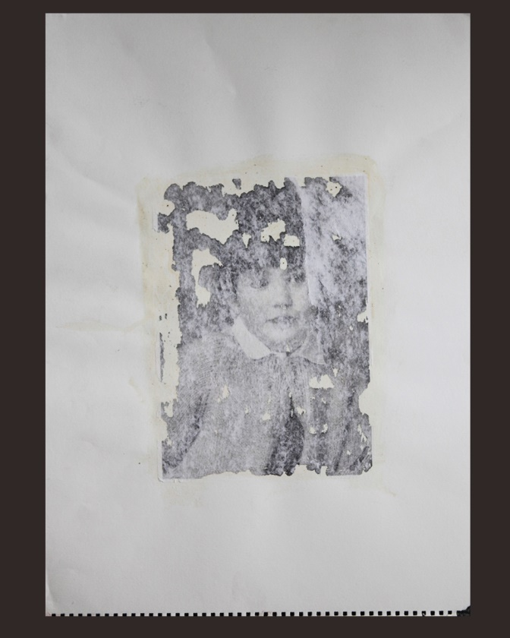
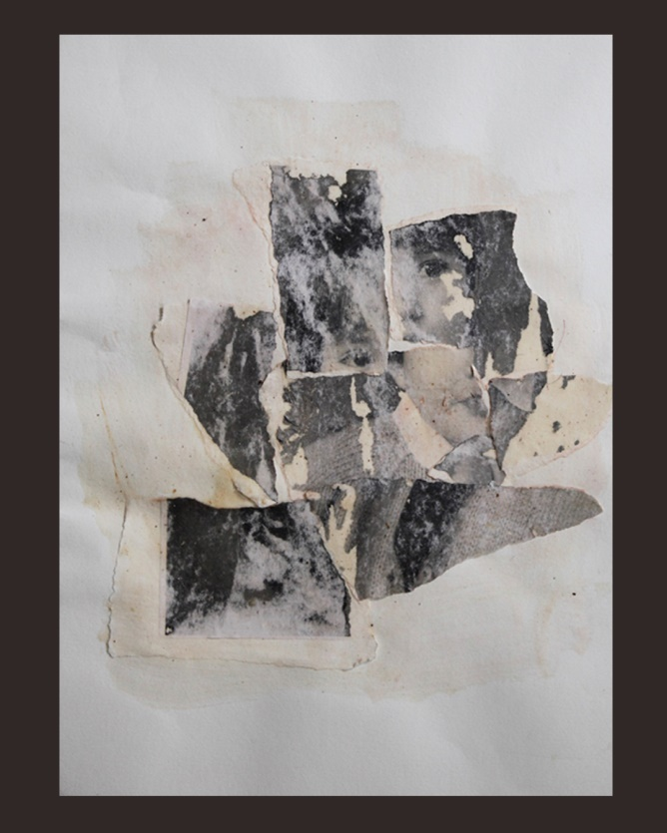
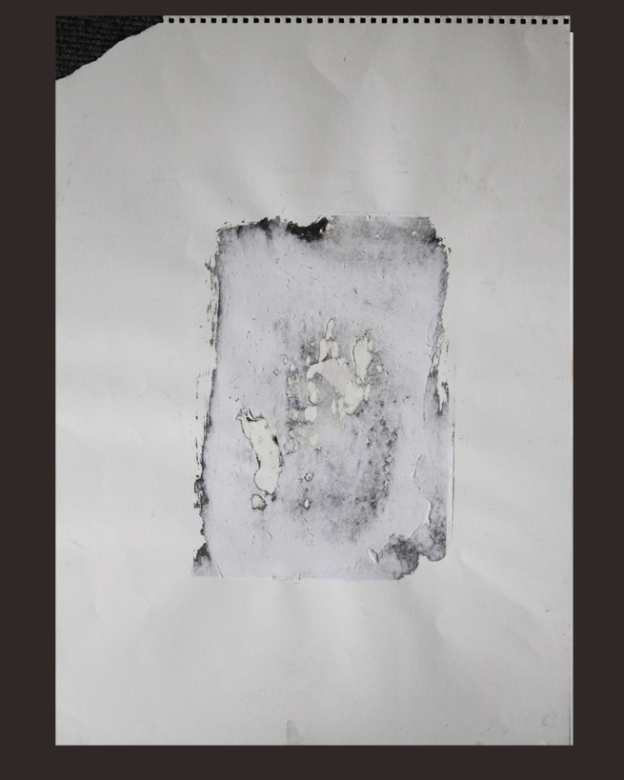
Using Aristotle’s Metaphor for persuading through images

Slide 2
Persuasion Theory
As a theory rose to prominence in the early 1930s
Study into how to effect behaviour and attitude change
Influenced by cultural paradigms, speech, sociological hierarchy, emotion
Today , it is prevalent in its application in everything we see and do
Politics
Media
Advertising
Drama
Comedy
Art

Slide 3
Aristotle/Persuasion Theory
Not a new theory
Its origins are cited back to Aristotle’s Rhetoric
Persuasion Theory uses in its attack,
Narrative
Emotional appeal
Credibility
Aristotle promotes
Logos
Pathos
Ethos

Slide 4
Logos Ethos Pathos
The main focus of this thesis is the use of Pathos within Persuasion Theory
There are many approaches as to how to utilise Pathos. O’Keefe (2002) concentrates on the generation of guilt to gain a persuasive response
Others have looked at the negative emotional response to test its effectiveness in the Persuasion process (Nabi, 2002).
However emotional persuasion needs a logical narrative behind it and Logos offers that argument. The ethos or credibility of the message could be judged by its logical argument and likewise affect the pathos of the message.
One is intrinsic to the other two

Slide 5
Pathos
Persusaion Theory Draws upon the experiences of the audience evokes an emotional response anger, sadness, joy, disgust and envy | Aristotle What one has experienced, good or bad, experience, my experiences, (Poetics 1447a) to drama Of the soul, emotion, passion to excite passion, Rhetoric 1418a sensation (Poetics)

Slide 6
Ethos
Persuasion Theory Credibility Ethos gives the argument credibility by nature of who or what is presenting it Credibility of the message Ethical impact of the message | Aristotle Credibility Connection to the audience Character of the narrator

Slide 7
Logos,
Each word has versatility within its definition.
Persuasion Theory Narrative Message/story Delivery through Speech, Metaphor, Simile, Imagery. | Aristotle Continuous Statement, narrative (whether fact or fiction), oration Fable ( Rhetoric 13938) Tale, story (Poetics 1336a) Thing spoken of, subject- case, plot of a narrative or dramatic poem,= "muthos", in Art, subject of a painting, expression, utterance, speech regarded formally, of rhythmical language set to music, (Poetics) logois" in orations, (Poetics) of various modes of expression, esp. artistic and literary, muthois kai logois“ (Plato, n.d.)Laws
Notes:
Each word has
versatility within
its definition.

Slide 8
Poetics
Basis of Poetics contains a universal structure/truth
Contains a sequence of linked events
Relies upon Primacy of the plot , with an aim to evoke a reaction
“Tragedy is not an imitation of persons, but of actions” (50a16f)
This also incorporates events, with an aim of raising fear and pity
True tragedy can be gauged from the actions of others
When someone close , family member, affects harm upon others
When harm is knowingly rendered upon a close friend or relative it instigates a feeling of disgust (Ch 13)

Slide 9
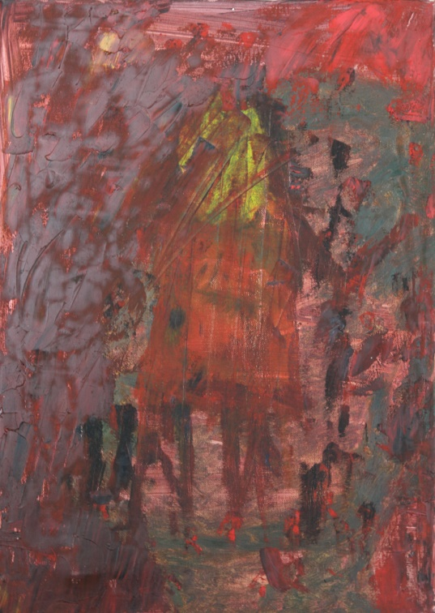
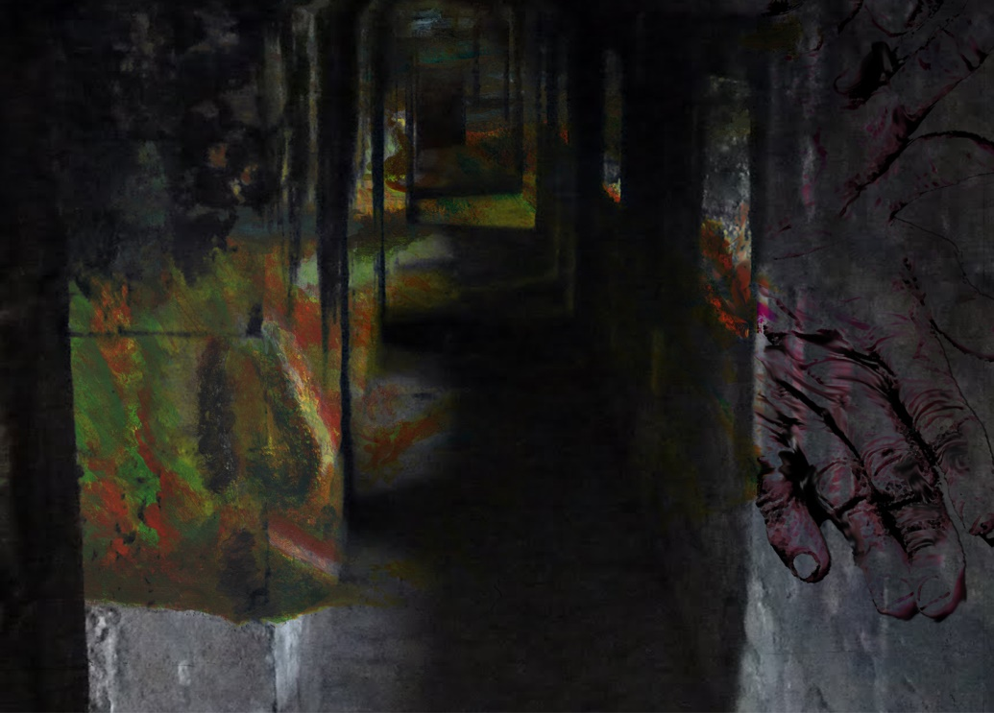
Poetics
Aristotle suggests that imitation is natural for humans
People get pleasure, whether good or bad, in viewing images of objects
It is the understanding that gives the pleasure
May be derived from understanding the use of colour, texture, execution, imagery

Slide 10
Metaphor
Aristotle recognises the presence of metaphor contained within the written word
Doesn’t distinguish between the use of metaphor and simile
Accredited for defining and adapting the use of metaphor to give new meaning within Rhetoric
Used as a vehicle to giving life and meaning to a narrative through the actualisation of its content (S.Newman)
Instigates the juxtaposition of form
Allows the audience to create their own imagery (J.Kirby)

Slide 11
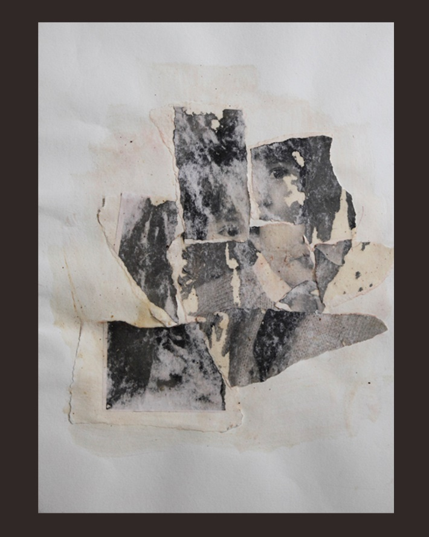
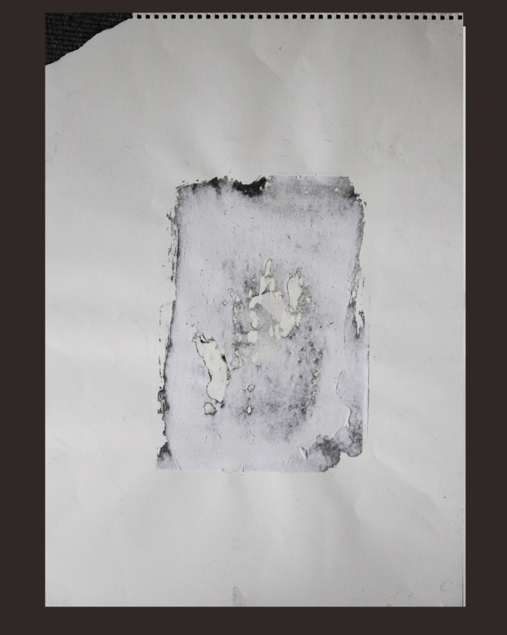
Logos
Primacy of plot, portrayed through metaphor of imagery.
Pathos
Evoke a reaction of
pity, disgust,
fear within the audience
Ethos
Credibility of the narrator, and virtuosity
of the child

Slide 12
Logos
The image itself is the metaphor for the story
Built up in layers
Explore juxtaposition of simple naive form
Through harsh, violent strokes
Pathos
Using simple primary colours (pigment based)
Red is used a metaphor for pain and blood
Greens/purples signifies dark destruction
Of soul
Explore juxtaposition of simple naive form
Through harsh, violent strokes
Ethos
is attained through the representation of the image

Slide 13
The Exhibition
Purpose of the exhibition was to test the theory
Ran for three days, one night
Evening showing was for invited guests
Those guests included representatives from art industry, health care, mental health care, and teaching professions
The day exhibitions were open to the general public

Slide 14
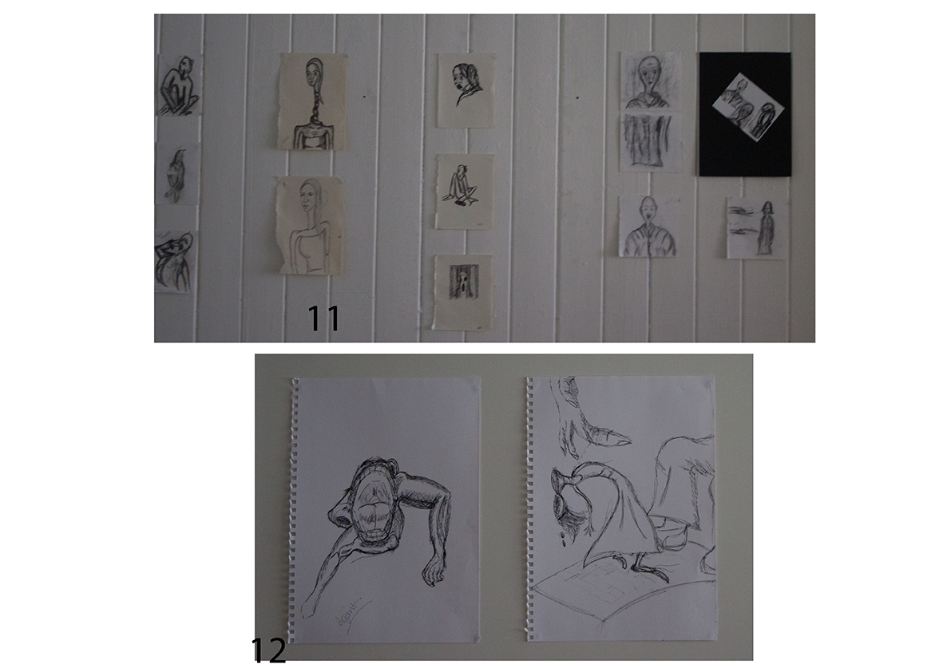
The Exhibition
The images were hung grouped in themes
Began with early drawings, culminating in final images

Slide 15
Each image contained its own number
There was no description given to the images and no title
Avoid influencing viewer
Tested under sterile conditions, in that there was no audio playing or discussion
The majority of people viewed the exhibition from left to right
Two people viewed it in reverse
81 people took part with an average of 20 people per day

Slide 16
Information and data was gathered through the use of semi structured interviews
An example of the questions used
Would you have any of these images upon your wall?
If yes, which and why?
If no, why?
Which images had the greatest impact?
How/why
Have the images affected you emotionally?
If yes how?
Do you think these images are acceptable in today’s society?
If no which images and why?
What do you think the exhibition is about?

Slide 17
Findings

Slide 18
Summary/Evaluation
Still analysing the data
Initial findings suggest that there is a gap within Persuasion Theory between,
Understanding
Knowing
Acceptance ( Not everybody thought the imagery itself was acceptable)
Aristotle
The imagery succeeded in Pathos
Generated shock, horror, sadness, memories
The main story (Logos) was recognised by 70% of the audience
Ethos of imagery was never questioned although 4 people questioned the Ethos/mental health of the artists

Slide 19
Influencing Factors
People who worked within the art industry appeared to have a greater understanding of the Logos, and Pathos
Found the imagery powerful
People who worked within Mental Health organisation also identified with the Logos and Pathos
Finally people who had experienced child abuse, and trauma also related to and were affected by the imagery,( this information was readily given by people and not requested)
80% of older people, who presented in the 65+ age group did not engage well with the exhibition. Many wanted to look at images that were pretty not dark and disturbing
Not liking the exhibition does not mean that they weren’t affected.

Slide 20
It isn’t about the imagination of the artist
It is unnecessary to now the age and background of the author
The credibility of the events or what is in the authors head is seen through the images
The portrayal is seen through metaphor and symbolism as displayed within poetics
It is about the message
The feelings that message evoke
The influence and effect that message has on others
This carries us full circle back to Aristotle’s teachings

