Slide 1
Hollywood Don't Surf... But Darrylin Zanuck Does
resistance and incorporation in Californian surf culture
s.k.thomas@liverpool.ac.uk

Slide 2
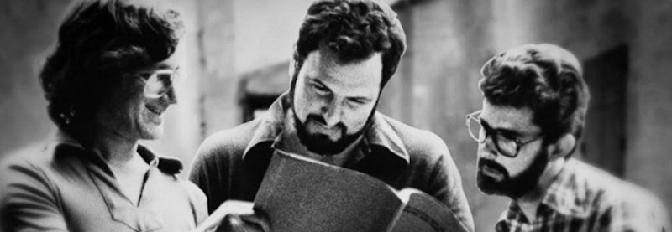
A rubber stamp wouldn’t do for John Milius. So he took a sledgehammer and pounded Important all over “Big Wednesday.” This film about three Malibu surfers in the 1960s has been branded major statement and it’s got Big Ideas about adolescence, friendship and the 1960s.
Variety Staff (1977) Big Wednesday Review, Variety.
s.k.thomas@liverpool.ac.uk

Slide 3
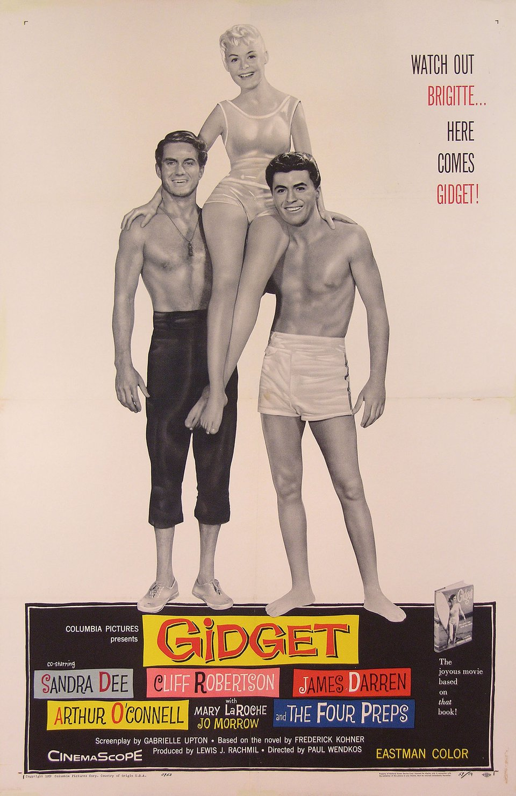
An 'idealised portrayal of teenage life in California' that 'highlighted the wholesomeness' of youth and that presented Gidget as 'a heroine marked by conformity' that offered a move away from the brooding male archetype established by James Dean Rebel Without a Cause.
(Granat May, Kirse, 2002: 67-8)
'show[s] teenagers as wistful, comic, conformist creatures, sexless and predictable, ultimately willing to carry on the traditions of consumer capitalism that they, as voracious consumers themselves, clearly benefit from’
(Morris, 1993: 4)
‘critics [who] read Gidget as non-rebellious’ are ‘reading the mainstreaming of surfing not as caused by Gidget but as proof of her conformity’
(Wojcik, 2021: 34-35).
s.k.thomas@liverpool.ac.uk

Slide 4
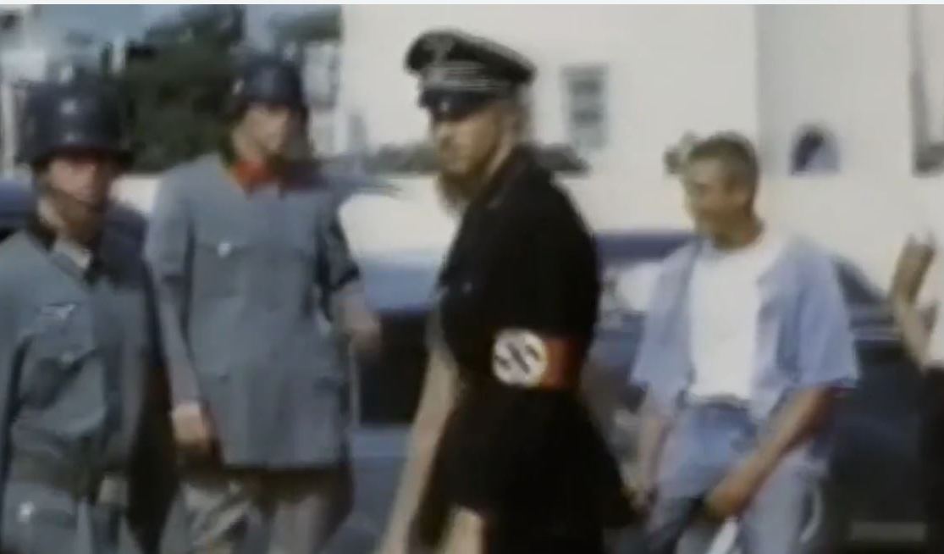
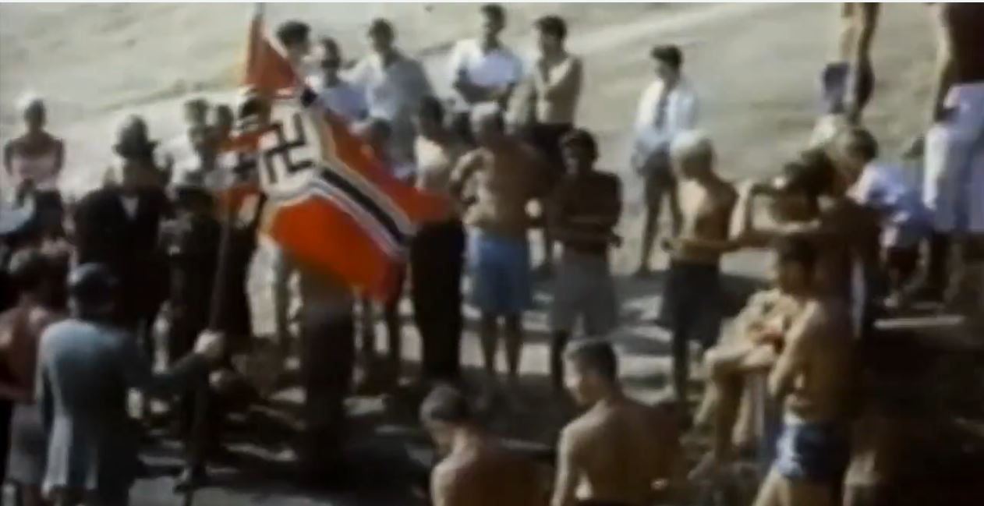
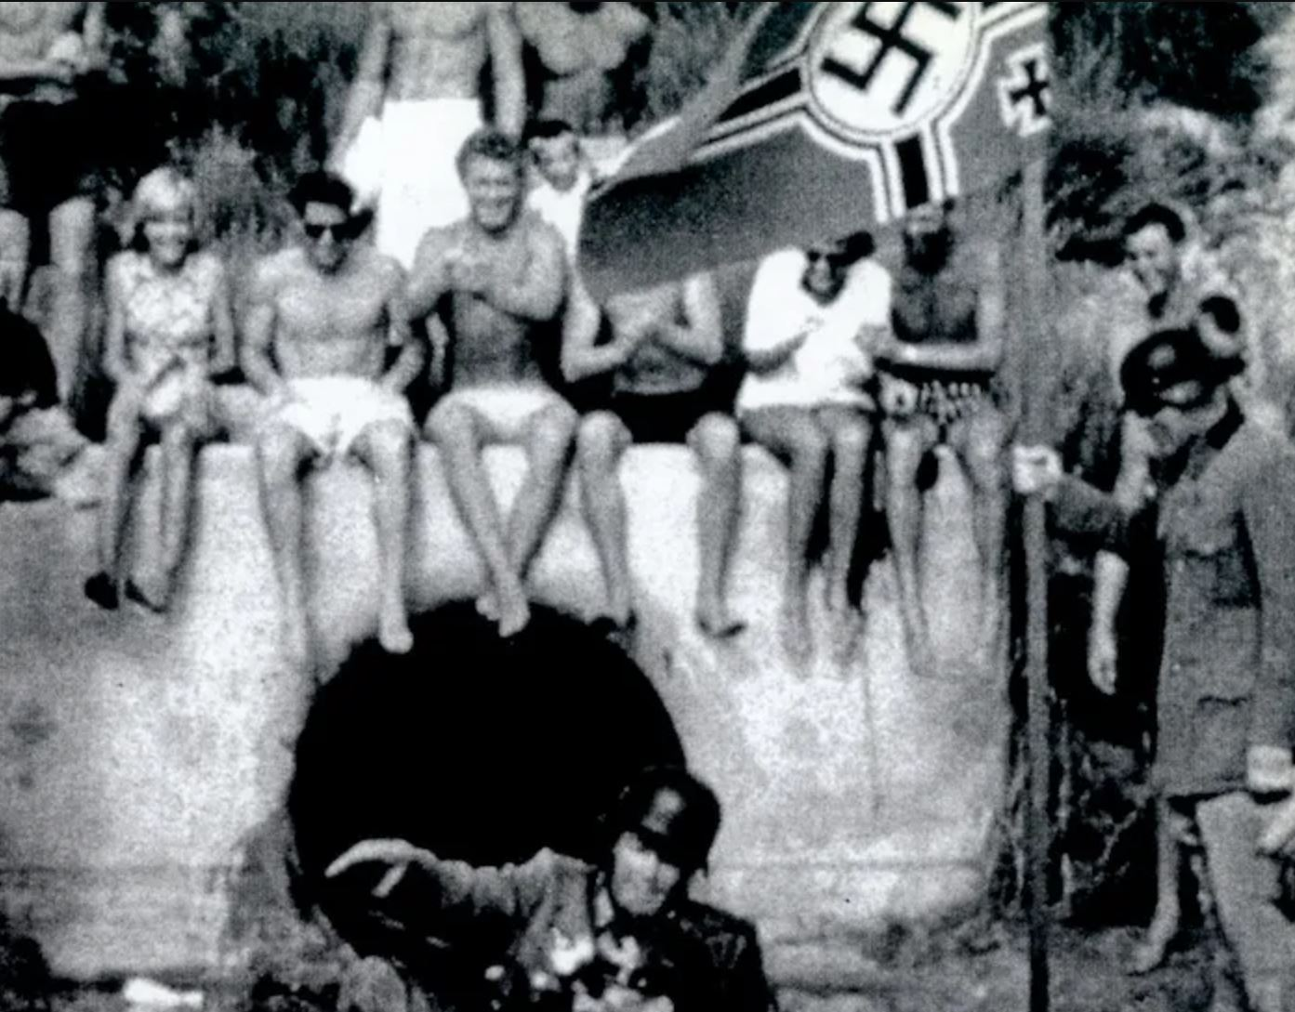
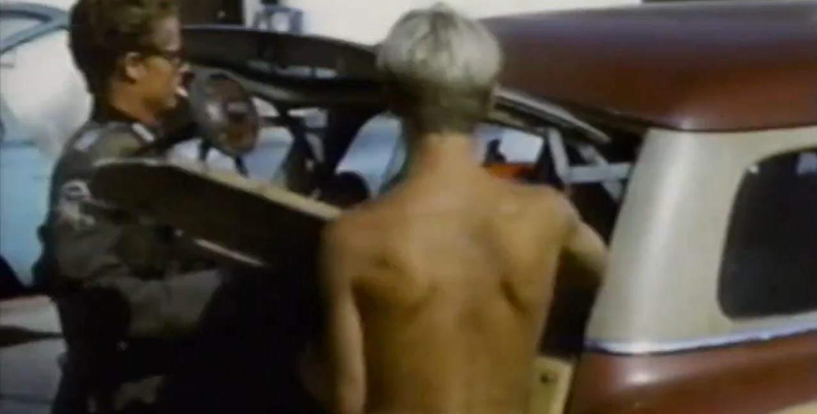
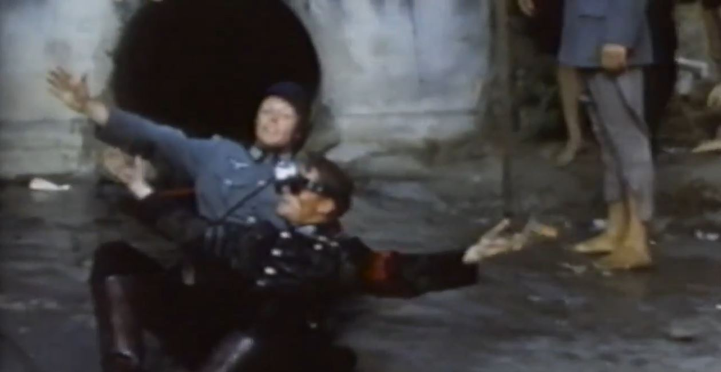
Surf Nazis, La Jolla, California (1959)
Like the punks of the 1970s who appropriated similar disgraced iconography for shock value … surf culture … for some people [was about] getting in your face.
(Gelfand cited in Tropics of Meta, 2015)
s.k.thomas@liverpool.ac.uk

Slide 5
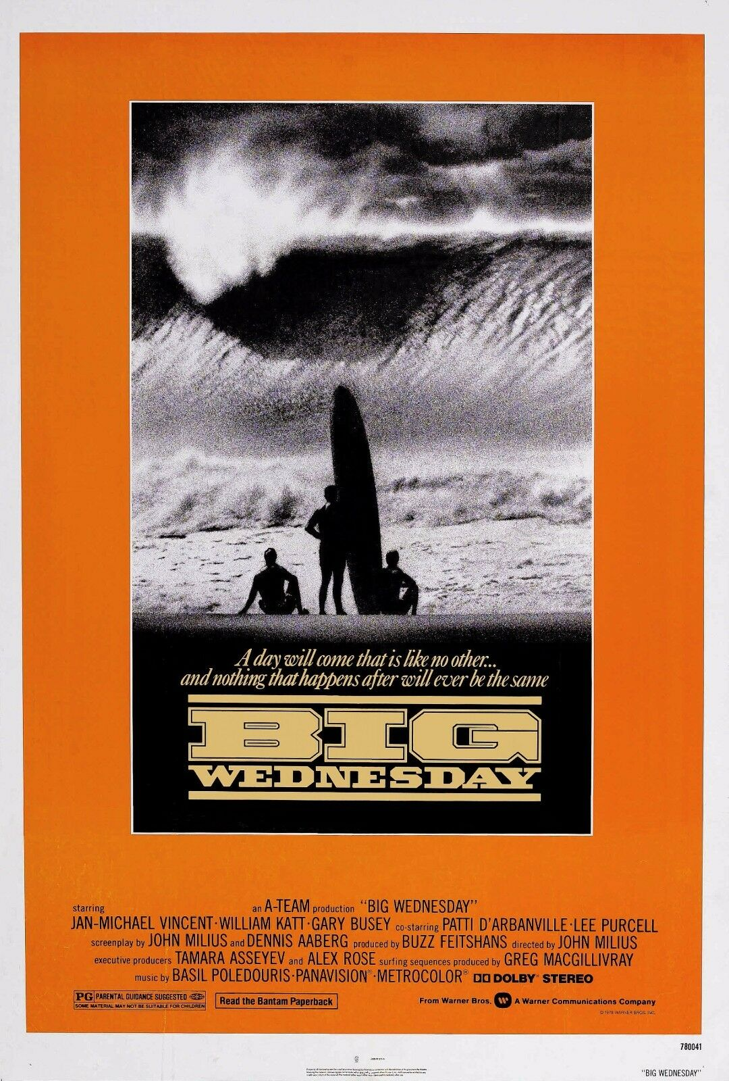
The score for the film includes a number of hit songs from the early 60's, which makes the absence of any "surf music" of that period worth noting. Surely the Beach Boys or Jan and Dean were just as deeply in love with the sport as Mr. Milius, and for them, too, it had connotations of masculine daring.
Maslin, Janet (1978: online).
s.k.thomas@liverpool.ac.uk

Slide 6
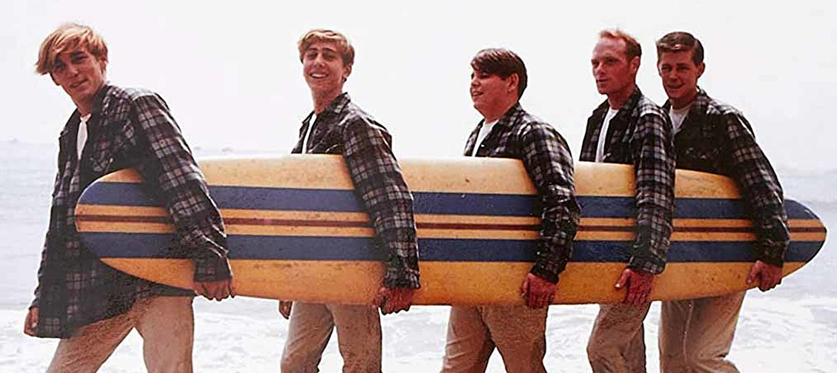
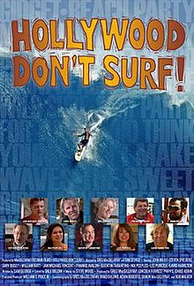
Tens of thousands of people slow dance to "Surfer Girl" and thronged to the local Bijou to see Ride the Wild Surf; they shopped ay May Company and bought nylon competition strip trunks from the McGregor surfing collection, Hang-Ten sneakers, and Cute ex "Wipe Out Pink" toenail polish. Coppertone and Jantzen rolled out surf themed ad campaigns- no surprise there. A ubiquitous Hamm's beer billboard showed Rusty Miller jamming down the face at Sunset Beach. Pepsi did surf ads. So did Triumph, Mobile, Chevy and Dewar's…. As The Saturday Evening Post put it in 1967, surfing was "the most successful California export since the orange."
(Warshaw, 2010: 187).

Slide 7
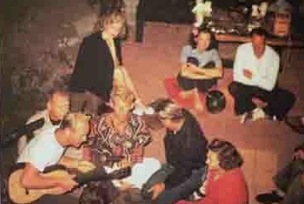
The father of the modern surfboard is considered by many to be Joe Quigg. ‘In ’47, Quigg crafted an experimental balsa-redwood hybrid for Darrylin Zanuck, daughter of Hollywood mogul Darryl Zanuck.
Thinner and lighter than any other boards of the era, the 25-pound “Darrylin” model became the precursor to the contemporary surf board.
Darrylin Zanuck shaping boards outside of a garage in Southern California, sometime in the 1940s.
Tommy Zahn (black jacket) and Norma Jean Baker with a jacket over her shoulders. Los Angeles beach party, 1947.

Slide 8
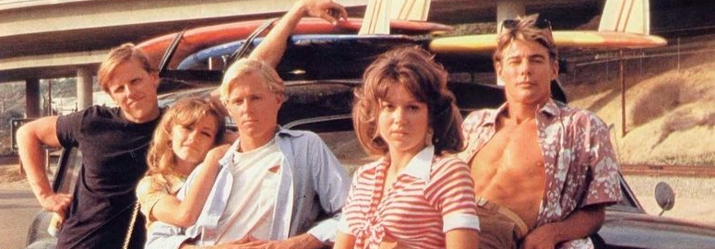
THANK YOU
s.k.thomas@liverpool.ac.uk

