Slide 1
Significance of Postgraduate Studies and Research in Human Rights Law
Dr Samantha Spence
LLB (Hons), LLM (Res), PhD (Law) SFHEA
Course Director Postgraduate Studies in Law
Staffordshire University, UK
Visiting Professor
REVA University, India

Slide 2
About me

Slide 3
Qualifications
LLB (Hons) - 1st Class
LLM (Research) – Distinction
Feminist Analysis of the Convention on the Elimination of All Forms of Discrimination Against Women on Violence Against Women in Southeast Asia
PhD (Law)
Witchcraft Accusations and Persecution as a Marginalisation Mechanism of Women
Senior Fellow of the Higher Education Academy

Slide 4
Legal Career Timeline
2007 - LLB (Hons) – 1st class award
2010 - Fee Earner Assistant Keoghs LLP
2011 - LLM (Research) - Distinction
2013 – Internship Witchcraft and Human Rights Information Network
2013 - PhD Scholarship
2013 – UN Consultancy Work
2013 – Associate Lecturer Lancaster University
2017 – Lecturer University of Bolton
2019 – Practice Manager Adlington Law Ltd
2020 – Lecturer in Law Staffordshire University
2021 – Senior Lecturer (promotion)
2022 – Postgraduate Course Director (promotion)
2023 – Senior Fellow of the Higher Education Academy

Slide 5
What do I do?
Teaching
UG and PG courses, Academic mentor, CPD Courses - REVA
Course Director PG Studies
Overall responsibility for all PG courses, development, students, staffing
PhD Supervisor
7 PhD students (national and international)
Employability lead
Work experience opportunities, Placements
International Mobility Lead
International student exchange, International collaborations
Research
Funding, publications, knowledge exchange

Slide 6
National Roles UK
Deputy Chair: National Working Group Forum for Abuse Linked to Accusations of Witchcraft and Spiritual Possession (ALWSPA)
UK Government commissioned (DfE)
Working with agencies and government to implement the National Action Plan 2023/24
Co-director: Staffordshire University Violence against Women and Girls Hub
Knowledge exchange, funded projects, research led, community driven

Slide 7
International Roles
UN Consultancy Work
Invited as panellist, guest speaker, give evidence and host events, written reports
Co-Director: The International Network Against Accusations of Witchcraft and Associated Harmful Practices https://www.theinternationalnetwork.org
International working group formed December 2022
International Alliance to End Witch Hunts
https://www.iaewh.com
GenDev Centre for Research and Innovation, India - Led by Professor Govind Kelkar (Executive Director)

Slide 8
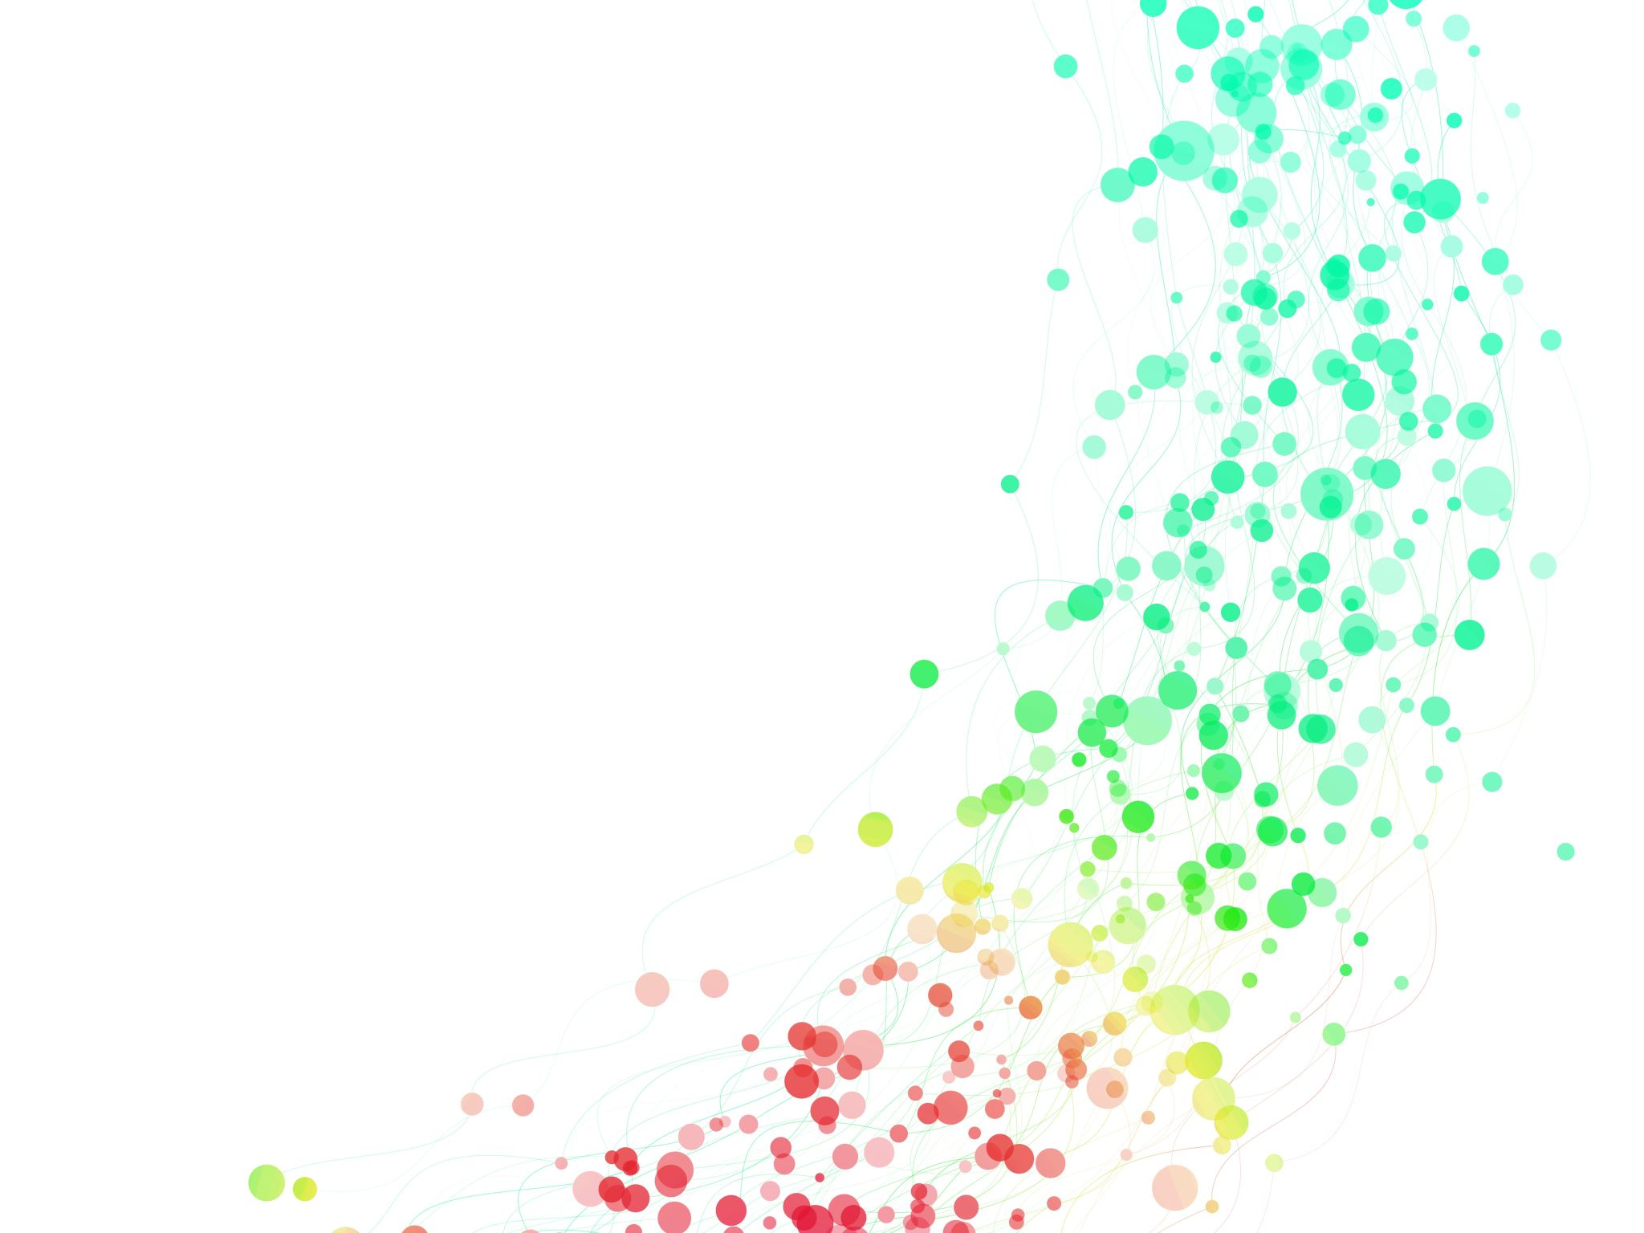
What is postgraduate study?

Slide 9
Postgraduate Study
Allows you to study the subject at a deeper level in diverse ways
Different types of routes to learning

Slide 10
Masters Level – Practical routes (UK)
BPTC – Bar Professional Training Course
the qualifying postgraduate course allowing graduates to prepare and practise as barristers in England and Wales.
SQE (replaces LPC)
The Solicitors Qualifying Examination (SQE) is being phased in to become the new centralised way to qualify as a solicitor in England and Wales. It will eventually replace the Legal Practice Course (LPC) route to practice (have to be enrolled on law degree by Sept 2021)
LLM Legal Practice
SQE (LPC) + dissertation

Slide 11
LLM by Research
1yr FT / 2yrs PT
Framework allows you time and intellectual space to work in your chosen field, and to refine and develop this initial phase of the project for future doctoral work.
The programme does not have formal coursework elements, other than initial training seminars alongside PhD students.
This makes the LLM by Research a particularly attractive option for those wishing to undertake postgraduate research on a part-time basis

Slide 12
LLM (Taught)
LLM (Taught)
Pathways – choose specific combination of modules in a specific pathway
General – choose any combination of modules that suits you
Dissertation module compulsory

Slide 13
MPhil / PhD
Traditional PhD
Admission to PhD research is initially be for MPhil.
After 9-12 months of FT study, students normally go through a formal procedure for upgrade to the PhD
Professional Doctorates
Designed to develop research and professional skills related to professional practice.
Combine taught modules with an in-depth research project.
Work must demonstrate an original contribution to knowledge within your profession.
PhD by Published Work
Based on research you've already undertaken and had published (excluding self-publishing).
Accompanied by commentary (5,000–10,000 words) which outlines your work's coherence, significance and contribution to knowledge.

Slide 14
So why is it important? Part 1 Institutional Importance

Slide 15
UK Research Excellence Framework (REF)
REF is the system used by the four UK higher education funding bodies to assess research quality in UK universities.
Scores are awarded across three key areas: publications, research impact, and research environment.
REF was the first exercise to assess the impact of research outside of academia.
Impact was defined as 'an effect on, change or benefit to the economy, society, culture, public policy or services, health, the environment or quality of life, beyond academia'

Slide 16
League Tables
The Times Higher Education World University Rankings - only global performance tables that judge research-intensive universities across all their core missions. The performance indicators are grouped into five areas:
Teaching (the learning environment)
Research (volume, income and reputation);
Citations (research influence);
International outlook (staff, students and research); and
Industry income(knowledge transfer).
The International Research Network (IRN) is a measure of global engagement, and specifically on how institutions create and sustain research partnerships resulting in internationally co-authored publications with other institutions across borders to collaborate on solving the world's challenges and disseminate vital research to wider audiences.
The QS World University Rankings by Subject showcases over 1,500 institutions across 55 different subjects grouped into 5 faculty areas.

Slide 17
So why is it important? PART 2 International Human Rights Law: My journey

Slide 18
Rationale
In 2013 a small group of academics and civil society groups embarked on a quest
All with the same aim in mind
To petition the UN for a Resolution against the harm caused by witchcraft accusations and persecution

Slide 19
Internship – WHRIN (2013)
2013
WHRIN ‘Exploring the Role of Nollywood in the Muti Murders of Persons with Albinism’ (WHRIN 2013) (Researcher)
2014
WHRIN, ‘Witchcraft Accusations & Persecution in Nepal: 2014 Country Report’ (WHRIN, 2014) (Co-author)

Slide 20
Book Publication
Spence, S.
Witchcraft Accusations and Persecution as a Marginalisation Mechanism of Women
(Cambridge Scholars, 2017)

Slide 21
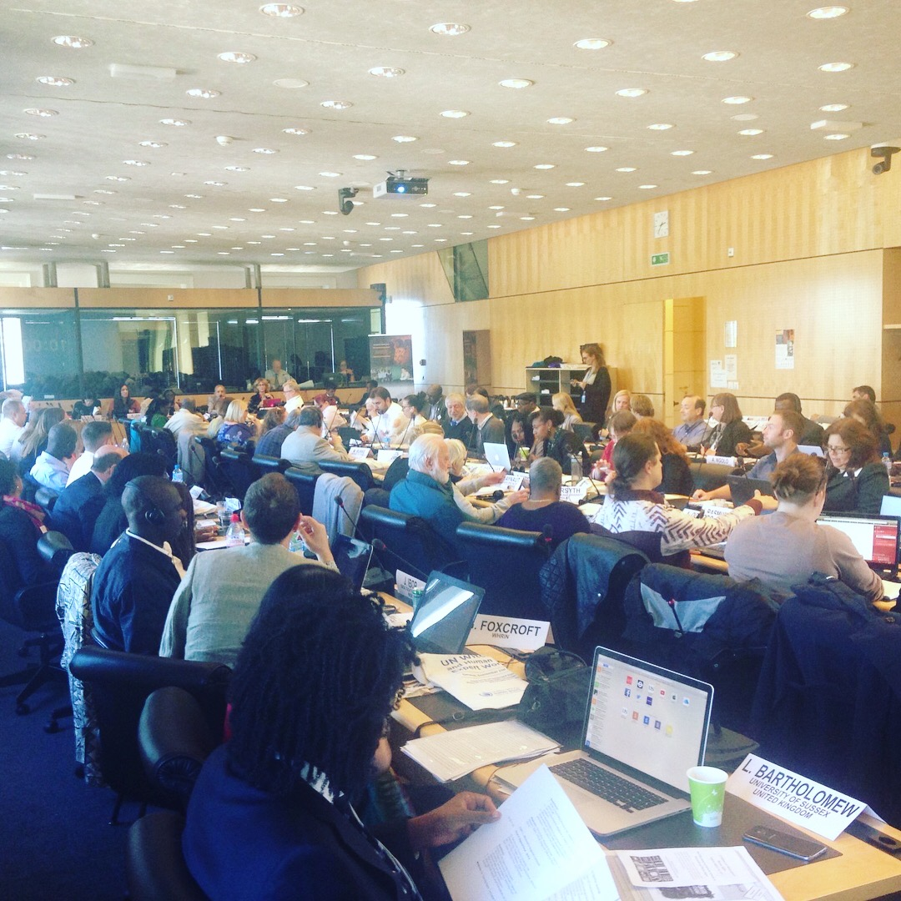
Witchcraft and Human Rights Workshop 21st and 22nd September 2017
1st international conference on the issue
Held at Office of the High Commissioner for Human Rights, Palais Wilson, Geneva
Over 100 experts from around the world
Aim: to better understand the complex web of meaning behind witchcraft and to identify potential solutions to prevent and address human rights violations relating to HPAWRA
PUBLICATION:
Report of the Independent Expert on the enjoyment of human rights by persons with albinism on the expert workshop on witchcraft and human rights A/HRC/37/57/Add.2 - Published 23rd January 2018

Slide 22
Witchcraft against children: Beliefs and Practices 7th March 2018
37th Session of the Human Rights Council
Presentation of:
21st Century Witchcraft Accusations & Persecution: Report to UNHRC (WHRIN)

Slide 23
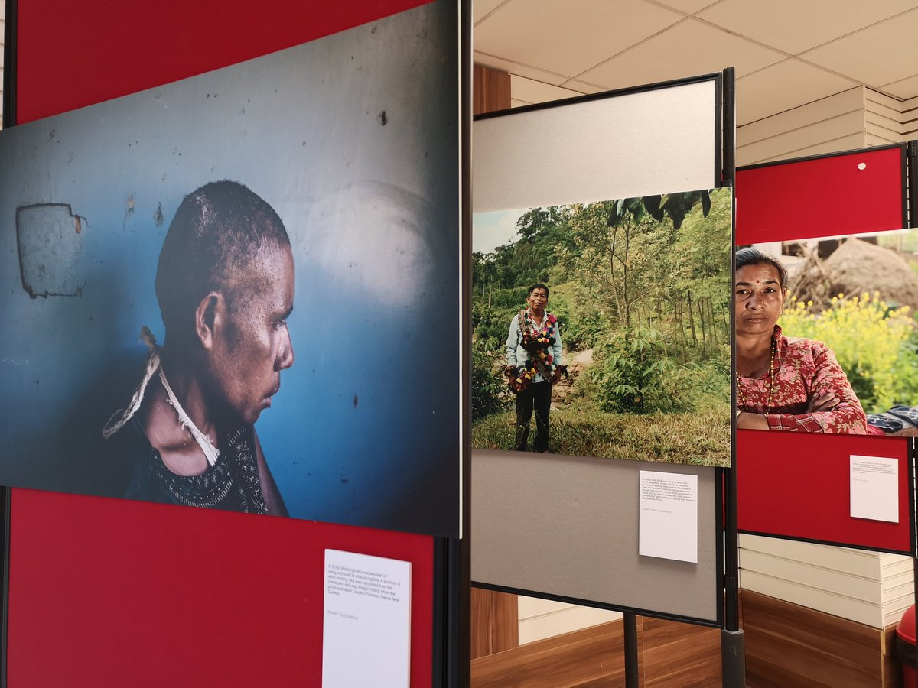
Research does not always have to be written ….. From Horror to Hope Launch - 19th September 2018
39th session of the UNHRC, Palais de Nations, Geneva
Exhibition captured the global scale of the human rights abuses that take place due to beliefs in witchcraft
20 images map stories of horror and hope, in India, Nepal, Papua New Guinea and Tanzania
Highlights individual cases of witchcraft-related human rights violations from across the world
17th Jan 2019 Exhibition came to UK

Slide 24
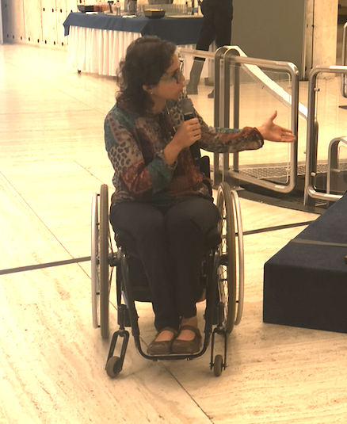
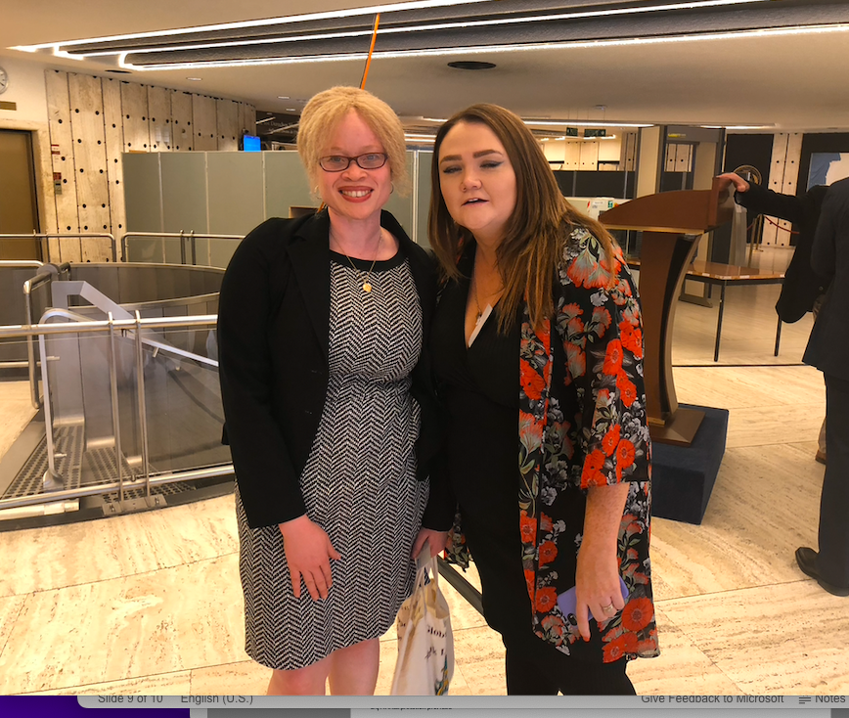
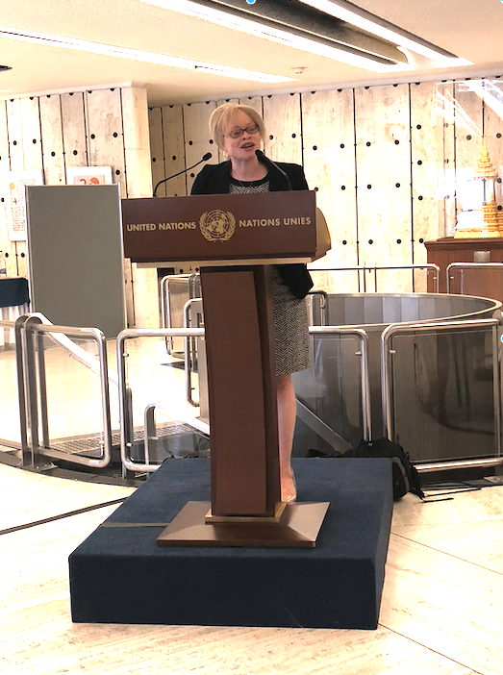
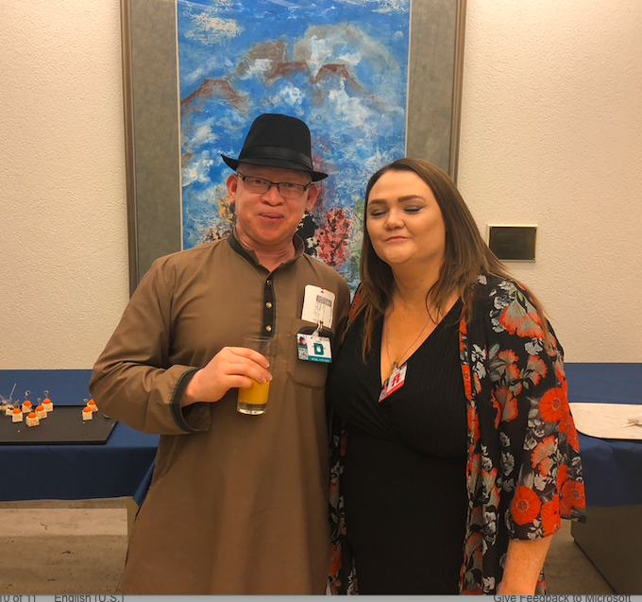
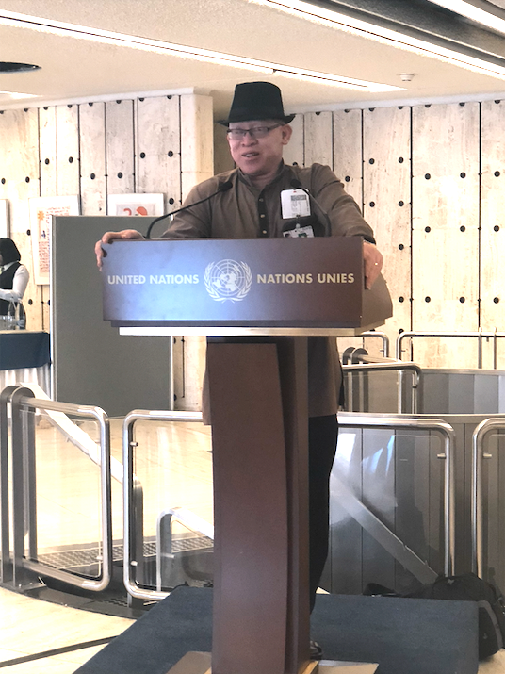
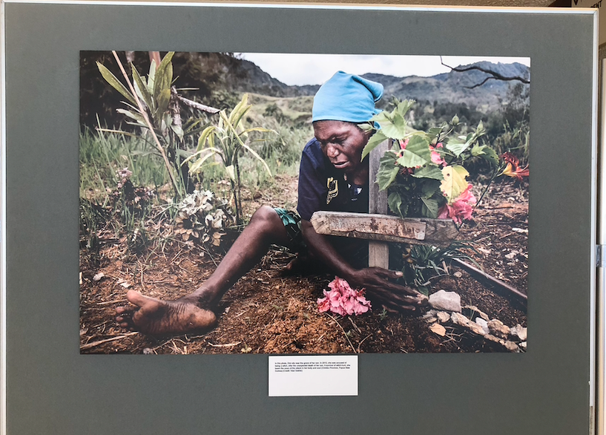
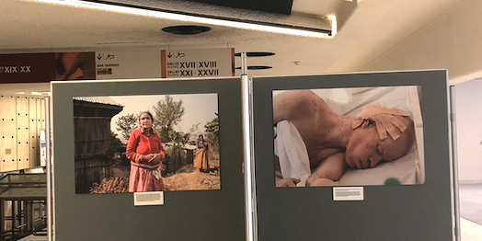
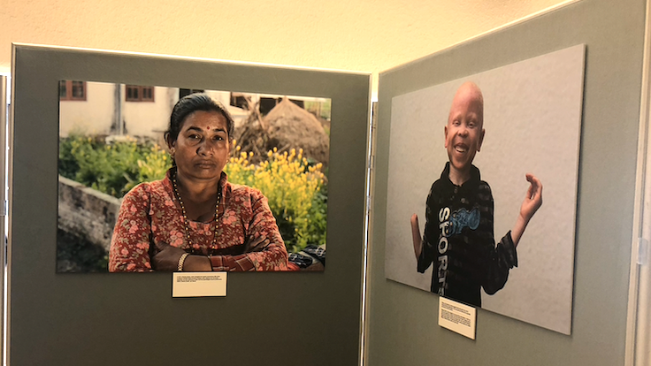
Horror to Hope: Palais de Nations, Geneva 19th September 2018
Photography by Vlad Sokhin, Joe Wood, Christo Geoghegan and Under the Same Sun

Slide 25
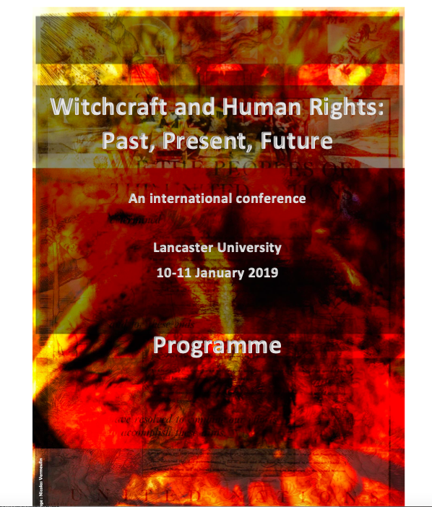
Witchcraft Beliefs and Human Rights: Past, Present and Future Perspectives Conference 10th and 11th Jan 2019
Aimed to:
Build upon momentum from UN
Further develop understanding of links between historic and contemporary witchcraft beliefs and persecution
Identify potential strategies to prevent further human rights abuses in the future
Outcomes to feed into the wider work of the UN, academic and civil society partners
Raising awareness of witchcraft-related human rights abuses and development of an international guidance document to States and civil society on the issue
PRESENTED:
Spence, S and Baker C., ‘The Challenge of Combining Agendas: Albinism and Witchcraft at the UN Human Rights Council’ (2019)
Notes:
Me and Amit both presented
International attendees went on the witch trail exhibition and journey in Lancaster

Slide 26
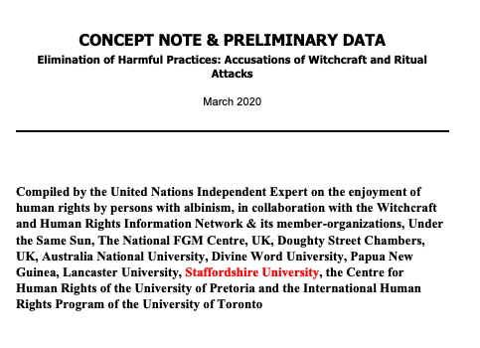
Highlights key information on current situation relating to HPAWRA
Recommendations on how to eliminate them
Precursor to Resolution
International collaborative approach
Published by UN 19th March 2020
Notes:
Behind all these events was a working group made up of academic, practitioners, UN experts, and others
Key aim had always been to get a UN resolution on the issue – together we drafted the concept note to establish a rationale for the Resolution

Slide 27
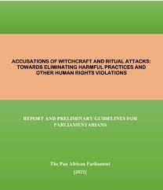
Pan-African Parliament Johannesburg - 19th and 20th April 2021
Validation of the Guidelines to end HPAWRA
Guidelines seek to:
enhance current and future discourse of legal and non-legal frameworks to end HPAWRA
to drive change at national levels across the African continent to contribute to safe communities where all persons, regardless of status, are free of all forms of harm stemming from accusations of witchcraft and ritual attacks
Guidelines adopted October 2022
Published 6 December 2022
Notes:
If we could get through to the Africa Group then we would have greater chance of lobbying for the Resolution – drafted the PAP guidelines
Backed strongly by Kenya

Slide 28
Resolution 47/8 Elimination of harmful practices related to accusations of witchcraft and ritual attacks 12th July 2021
Draft Resolution put forward by Cameroon
Adopted by Human Rights Council 12th July 2021
https://documents-ddsny.un.org/doc/UNDOC/GEN/G21/191/99/pdf/G2119199.pdf?OpenElement
'Taking note of the reports of the Independent Expert on the enjoyment of human rights by persons with albinism submitted to the Human Rights Council pursuant to its resolution 28/6 of 26 March 2015, and on the expert workshop on witchcraft and human rights held in Geneva on 21 and 22 September 2017, including its conclusions and recommendations'
Adopted by PAP – November 2022

Slide 29
Resolution 47/8. Elimination of harmful practices related to accusations of witchcraft and ritual attacks: Para 8
Requests the United Nations High Commissioner for Human Rights to organize an expert consultation with States and other relevant stakeholders, including the United Nations Secretariat and relevant bodies, representatives of subregional and regional organizations, international human rights mechanisms, national human rights institutions and non-governmental organizations, the results of which will help the Office of the High Commissioner to prepare a study on the situation of the violations and abuses of human rights rooted in harmful practices related to accusations of witchcraft and ritual attacks, as well as stigmatization, and to inform further action by existing mechanisms at the United Nations, and to submit a report thereon to the Human Rights Council at its fifty-second session

Slide 30
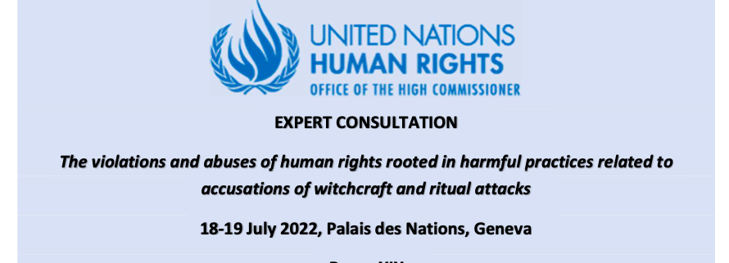
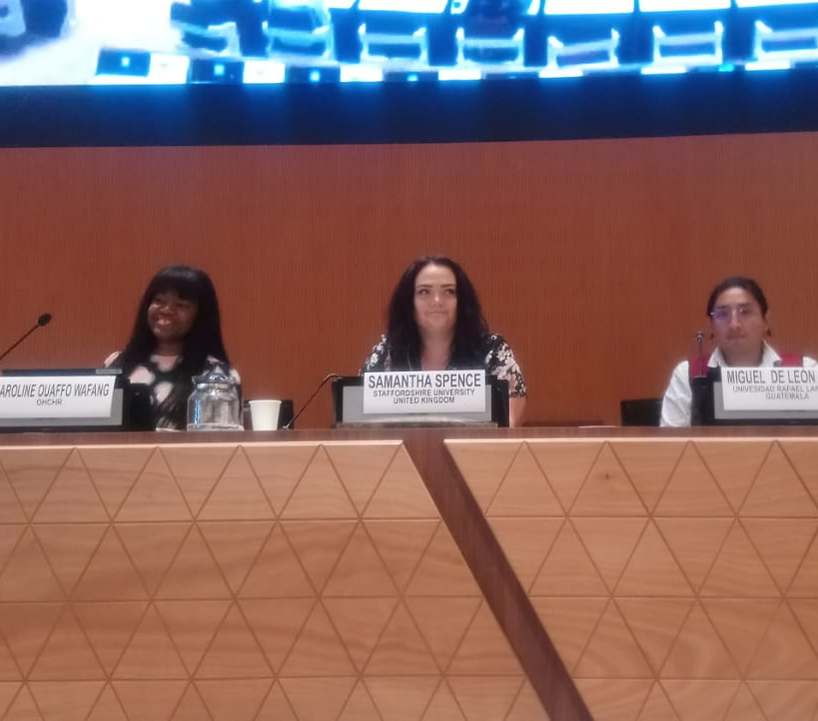
Expert Consultation Geneva 18th and 19th July 2022
Held in accordance with Human Rights Council resolution 47/8
Theme: Human rights violations and abuses rooted in HPAWRA
Objectives:
Analyse human rights and gender impact of HPAWRA
Identify measures to prevent them, protect those vulnerable to them
Implement accountability measures for these violations
Outcome: Inform study that will be presented to the 52nd session of the HRC

Slide 31
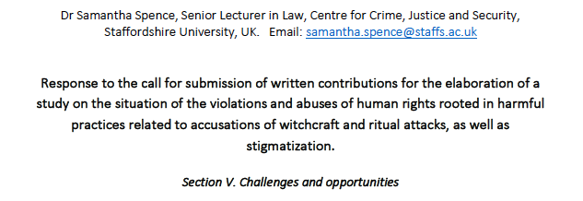
OHCHR Call for written submissions Aug /Sept 2022
'OHCHR invites Member States and other relevant stakeholders … to provide written inputs to help OHCHR to prepare a study on the situation of the violations and abuses of human rights rooted in harmful practices related to accusations of witchcraft and ritual attacks, as well as stigmatization.'
Notes:
Announced following expert consultations:

Slide 32
Study on the situation of the violations and abuses of human rights rooted in harmful practices related to accusations of witchcraft and ritual attacks, as well as stigmatization A/HRC/52/47 1st February 2023
Report of the OHCHR (published 1st Feb 2023)
Submitted at 52nd session HRC (27th February to 4th April)
Office concludes that additional efforts, including more comprehensive data gathering and further research, are needed to develop a greater understanding of the various aspects of this complex problem
Recommends a number of actions, such as developing comprehensive frameworks for prevention
Notes:
Submitted at 52nd session HRC (27th February to 4th April) pursuant to Human Rights Council resolution 47/8 on the elimination of harmful practices related to accusations of witchcraft and ritual attacks
Submitted at 52nd session HRC (27th February to 4th April) pursuant to Human Rights Council resolution 47/8 on the elimination of harmful practices related to accusations of witchcraft and ritual attacks

Slide 33
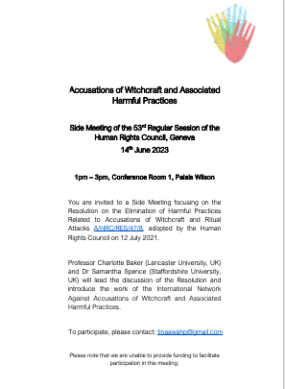
So what is next?!
Propose to hold a series of symposiums
Launch of network and culmination of symposiums
F2F workshops / conference
Geneva March 2024
Lancaster September 2024

Slide 34
Thank you! Any Questions?

