Slide 1
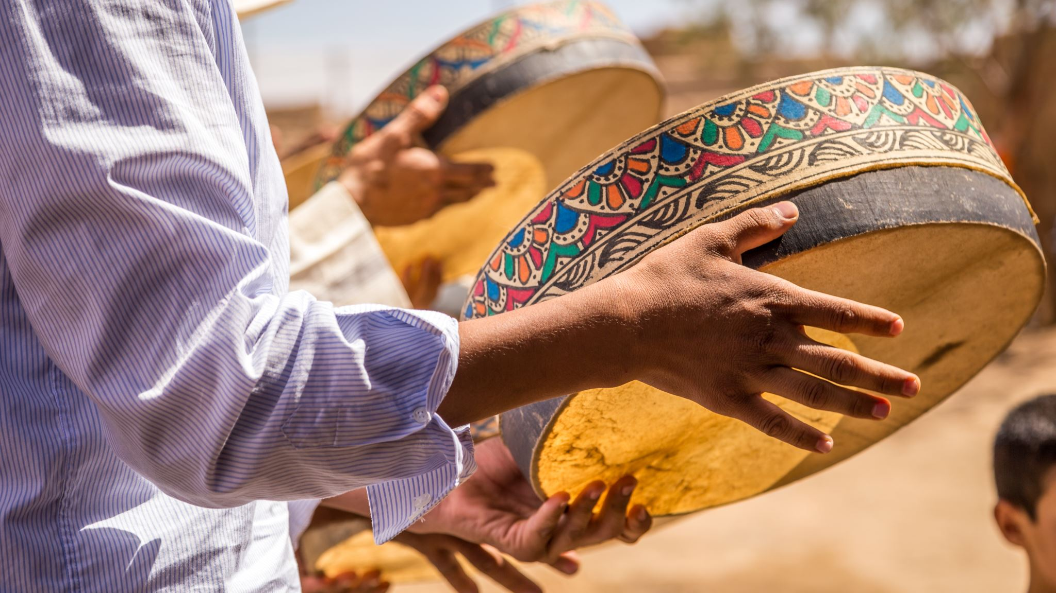
Divergent interpretations of the intersection of health, harmful practices and women in India
Dr Samantha Spence
Naveen Suresh

Slide 2
Outline of presentation
What do we mean by harmful practices?
1
Drivers and Intersectionality
2
Public health implications
3
Essential measures to be taken
4

Slide 3
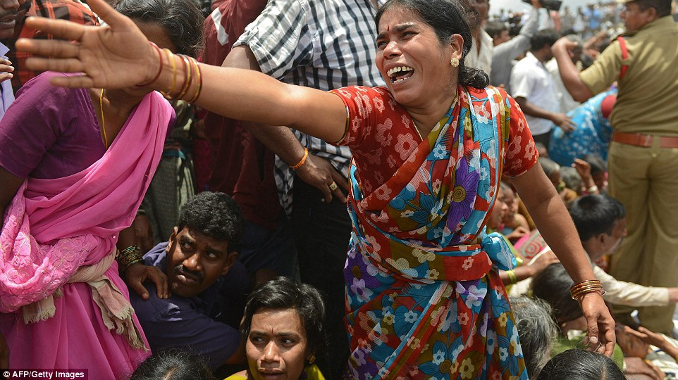
What are harmful practices?
Discriminatory practices committed regularly over such long periods of time that societies begin to consider them acceptable
Traditional cultural practices reflect values and beliefs held by members of a community for periods often spanning generations
Every social grouping in the world has specific traditional cultural practices and beliefs, some of which are beneficial to all members, while others are harmful to a specific group, such as women.
Examples include
Dowry-related violence, Forced marriage, Female infanticide, Sex-selective abortions, Child marriage, Virginity testing, Honour killings, Witchcraft Accusations and Persecution, Human sacrifice, Devadasi, Nata marriage

Slide 4
Complex drivers and intersectionality

Slide 5
Policy and Institutions
Poverty, economic decline; increasing cost of living
Poor implementation of laws and policies
Harm compounded by the fact it is not properly addressed by the legal system
Cases often go unreported as witnesses or victims may fear community retaliation or believe the police will not take complaint seriously
Lack of accountability and justice contributes to a culture of impunity - individuals feel empowered to continue perpetrating acts of violence.
This perpetuates a cycle of fear and mistrust, potentially further contributing to spreading health risks
Poor representation of women in key decision-making forums

Slide 6
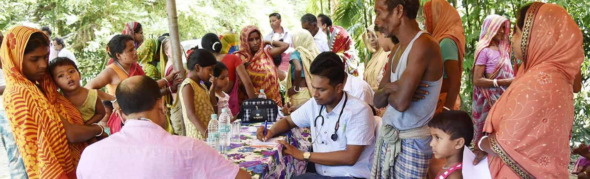
Systems and Services
Poor access to secondary and higher education- poor infrastructure
(lack of safe spaces, poor sanitation facilities)
Poor quality of Health and Sexual Reproductive Health services
supply chain issues, weak capacities, lack of regard for privacy and dignity
Lack of comprehensive sexuality education

Slide 7
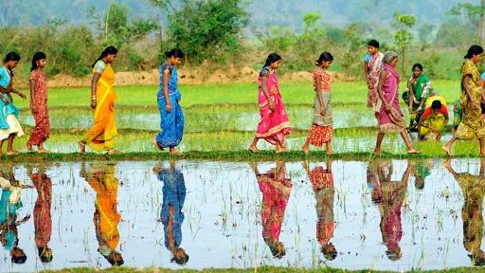
Community
Strict and outdated social norms about sexuality, marriage, fertility
Negative attitudes about adolescent sexuality and sexual behavior of women and girls.
Social acceptance for violence against women and girls
Negative attitudes towards women’s choice and autonomy
This Photo by Unknown author is licensed under CC BY.

Slide 8
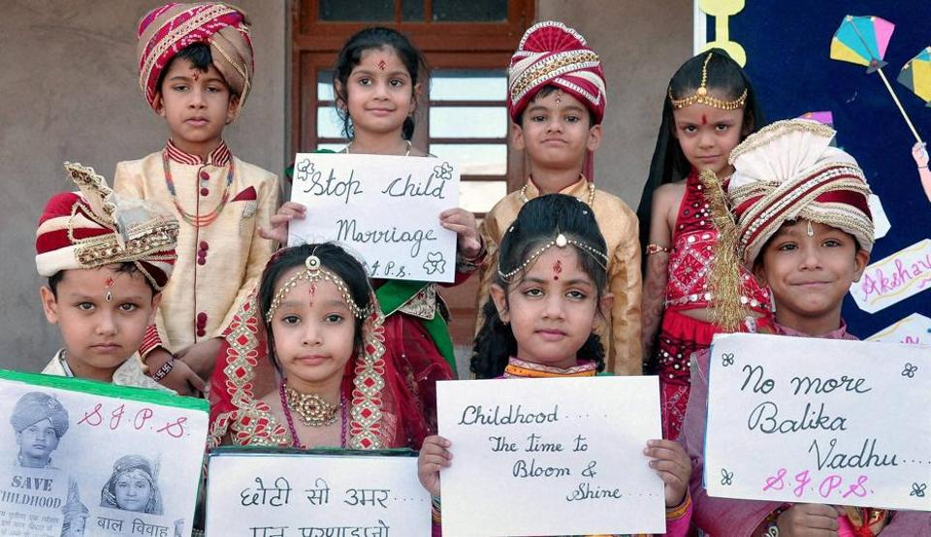
Family
Son preference and daughters 'unwanted'
Burden perception of girls (patrilocal marriage, concerns over girls’ safety, dowry)
Control over girls’ sexuality and mobility
Little value to girls’ education and professional skill building
Value placed on marriage, especially early marriage and motherhood portrayed as the most important event in the life of a female
Discrimination in inheritance
Girls not perceived as source of support in old age

Slide 9
Individual level
Discrimination against girls before and after birth
Transition to adolescence-age of puberty and sexual debut
Centrality of marriage and motherhood as only option in life
Normalization of violence in women’s lives
Internalised gender-inequitable values for both men and women

Slide 10
Public Health
Physical and Mental Health Impact
Cultural violence contributes to physical and mental health problems among women
Victims of domestic violence suffer physical injuries and psychological trauma
Long-term health consequences
Often go untreated due to social stigma and lack of access to healthcare
Mental Health
Societal pressure to conform to traditional gender roles and norms leads to stress, anxiety, depression, and other mental health issues among women
Stigma surrounding mental health in India can discourage women from seeking help
Reproductive Health
Cultural norms in India can also affect women's reproductive health
Early and forced marriages can lead to early pregnancies and increased risks for maternal / infant mortality
Lack of education about reproductive health / contraception contributes to higher birth rates and related health risks

Slide 11
Public health
Sexual and Reproductive Rights
Cultural violence restricts women's access to sexual and reproductive rights, including family planning and safe abortion services - leads to unintended pregnancies and unsafe abortions
Malnutrition and Healthcare Access
Discrimination against women impacts their access to healthcare and nutrition.
In many cases, women and girls receive less attention and fewer resources for their health and well-being
Leads to higher rates of malnutrition and related health problems
Economic Consequences
Gender-based violence and discrimination can limit women's economic opportunities, making them financially dependent on their families or spouses
Economic discrimination hinder their ability to access healthcare and escape abusive situations
Psychosocial Impact on Children
Children growing up in households marked by cultural violence may also suffer psychosocial consequences, which can affect their health and development

Slide 12
Recommendations

Slide 13
Policy, participation and effective implementation
Initiate policies that support women’s asset ownership, equitable labour participation, credit access
Increase women’s political participation, and leadership in governance and across sectors
Effective implementation of critical gender laws and policies that advance women’s human rights including reproductive rights
Much greater recognition of economic and social value of unpaid care work
Special protection during crises and disaster

Slide 14
Gender mainstreaming across ALL sectors
Improved quality of health and sexual and reproductive health; health insurance cover for girls at birth
Improved quality and accessibility of secondary and higher education for girls
Mechanisms to prevent and respond to harmful practices and gender-based violence

Slide 15
Challenging discriminatory structures and norms
Positive community images of women, their roles and their contributions
Community mobilisation for increased rights awareness and effective enforcement of rights (especially through local self-governance institutions)
Freedom from threat of violence within community
Recognition of economic and social value of unpaid care work
Positive attitudes towards women’s mobility, sexuality, choice

Slide 16
Voice, Choice, Agency
Collectivization –supportive social and professional networks
Women’s economic independence
The ultimate solution is to frame a policy Incorporating Comprehensive sexuality education in the school curriculum

Slide 17
Conclusion
Need to focus on transforming unequal power relations, structural inequalities, and discriminatory norms, attitudes and behaviours that reinforce and perpetuate harmful practices, to aim for gender transformative change
Engagement needed at multiple levels
From the individual, interpersonal, community level, and systemic to larger public policy- enabled through strategic partnerships
Realisation of UN Sustainable Development Goal 5 on gender equality - especially target 5.3 on eliminating harmful practices
We as human beings should feel ashamed that even in the year 2023, we have to still talk against normalizing gender discrimination and gender based violence. Fighting for the marginalized communities is not the responsibility of the marginalized alone. It is the duty of each and everyone of us. Remember, Education is not just about scoring marks , research is not just about assimilation of knowledge but about raising our voices for the voiceless.

