Slide 1
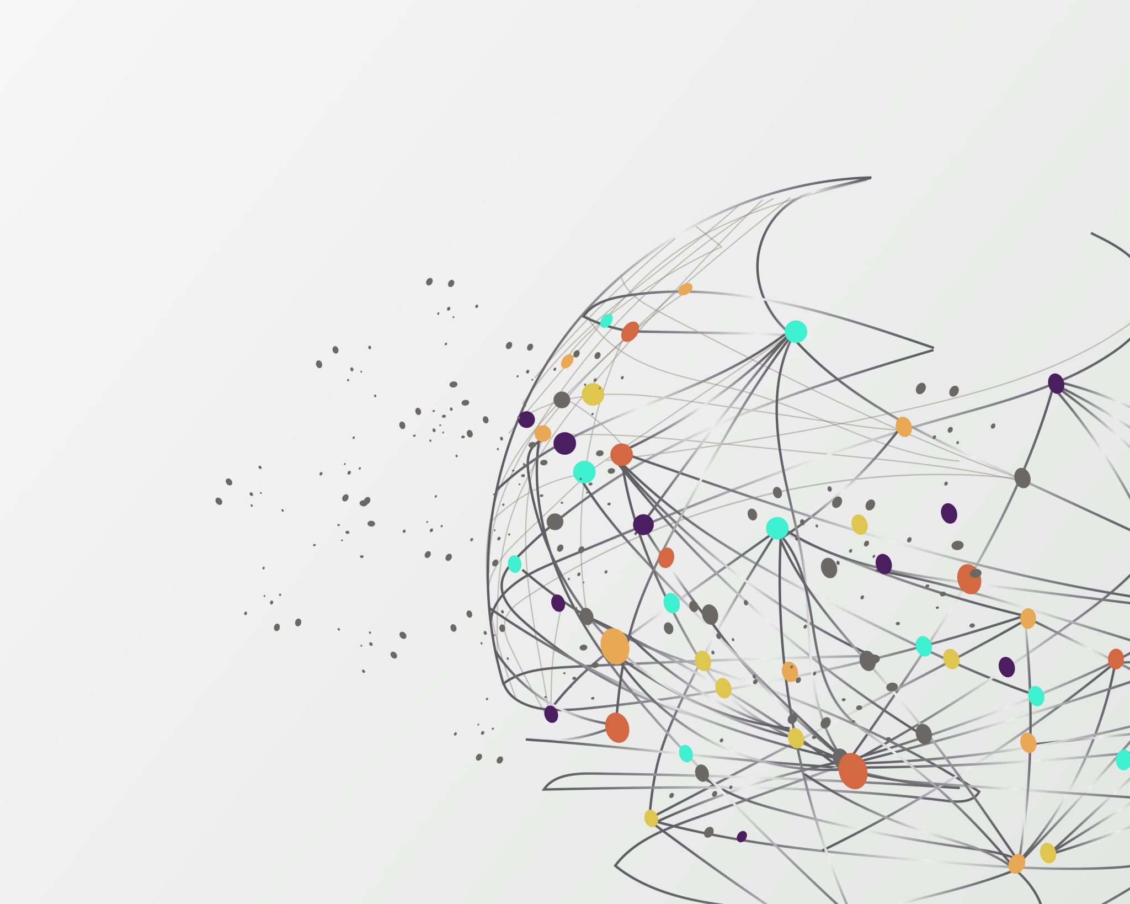
Intersection of caste, gender, and harmful practices
Dr Samantha Spence

Slide 2
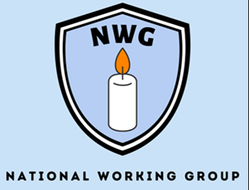
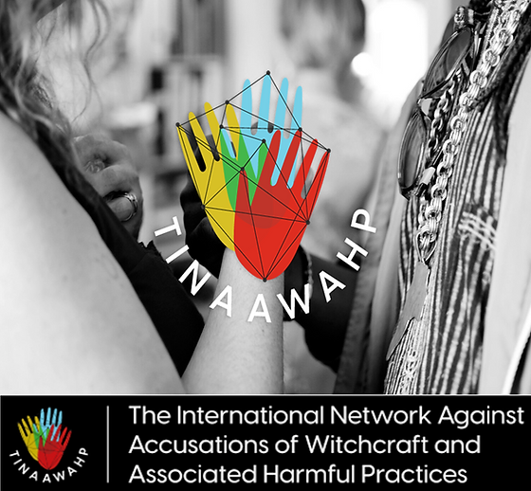
Course Director: Postgraduate Studies in Law, Staffordshire University, UK
Co-Director: VAWG Hub, Staffordshire University, UK
Visiting Professor: REVA University, Bangalore, India
Co-Director: The International Network Against Accusations of Witchcraft and Associated Harmful Practices
Deputy Chair: National (UK) Working Group Forum for Abuse Linked to Accusations of Witchcraft and Spiritual Possession
Alliance Member: International Alliance to End Witch Hunts
z

Slide 3
Introduction
Understanding caste, gender and harmful practices
Intersectionality and the complexities of caste and gender-based discrimination
Harmful traditional and cultural practices as violence against women
Legal frameworks and policies addressing caste and gender-based discrimination
Grassroots movements and organizations working towards social change
The role of education and awareness in challenging these norms
Positionality
Conclusion: Moving towards an inclusive and equitable society

Slide 4
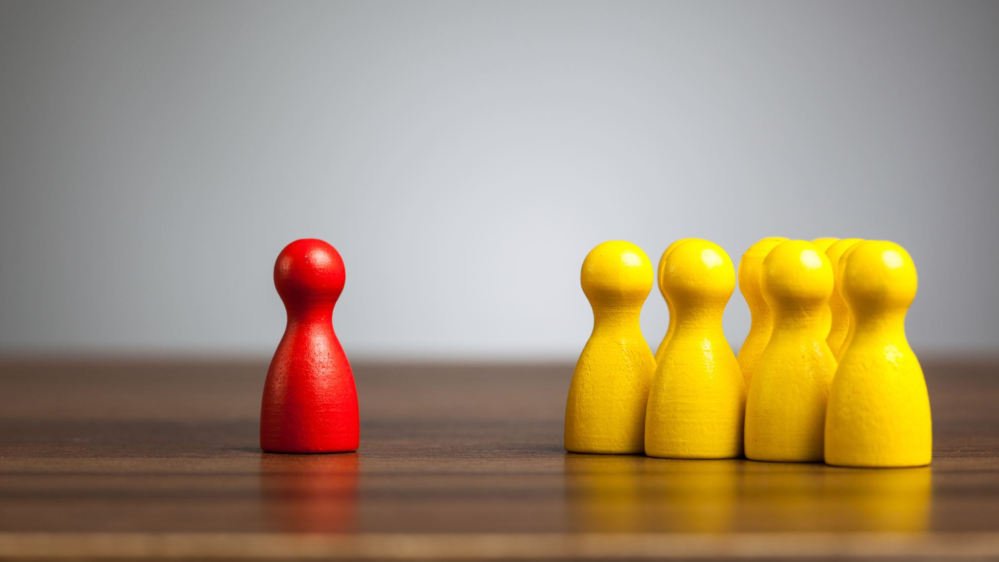
Understanding caste, gender, and harmful practices

Slide 5
Understanding caste, gender, and harmful practices
Caste is a deeply ingrained social construct
Categorises individuals into hierarchical groups based on their birth, determining their social status, occupation, and access to resources
Harmful practices, are deeply intertwined with caste and gender norms
Dowry-related violence, forced marriage, female infanticide, sex-selective abortions, child marriage, virginity testing, honour killings, witchcraft accusations, human sacrifice, devadasi

Slide 6
‘Womb to tomb’
Before birth as many as 5 million girls in India are aborted by sex-selective abortion…as an infant, she may be one of the 10,000 girl children in India who are murdered by female infanticide every year…in girlhood, she may suffer physical, sexual or psychological abuse…in adolescence, she is married and pregnant before she is physically and emotionally ready…as a wife it is likely she is battered in the home…outcast in widowhood, she is harassed, abused and even murdered when her husband dies.. throughout her life, depression and suicide are two predictable outcomes for a life endured under these conditions
(Ranjana Kumari)

Slide 7
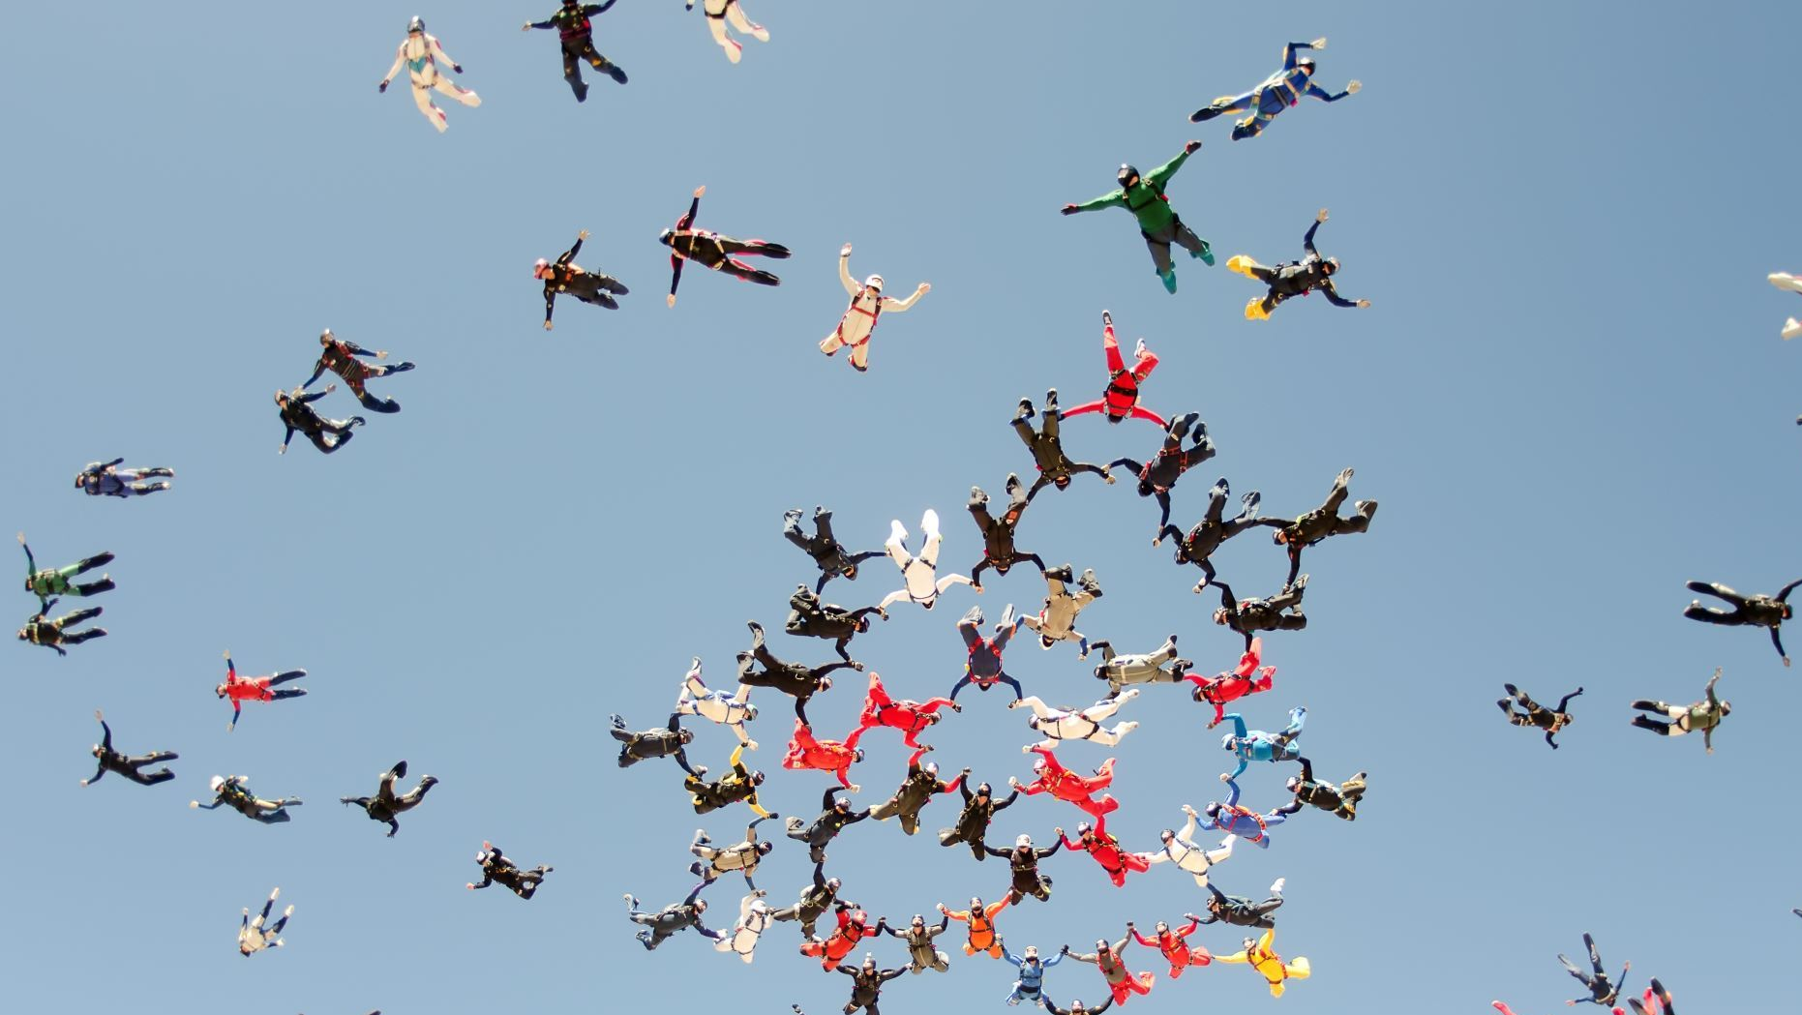
Intersectionality and the complexities of caste and gender-based discrimination
Intersectionality of caste / gender adds complexity to the challenges faced by marginalized individuals
'Discriminatory and cruel, inhuman degrading treatment of over 165 million people in India has been justified on the basis of caste’
(Human Rights Watch)
Women from lower castes face compounded discrimination
More vulnerable to various forms of violence, including domestic abuse and sexual assault
Accusations of witchcraft, predominant in lower castes, are rooted in land disputes, poverty, village politics or as punishment for the rebuffing of sexual advances
Lower caste women more likely to be forced into early marriages, which not only deprive them of education and personal development but also perpetuate cycles of poverty and gender inequality
Dowry violence, disproportionately affects women from lower castes, puts their lives at risk and reinforces harmful gender norms
Devadasis primarily affects girls from lower castes and subjects them to a life of sexual exploitation and social exclusion

Slide 8
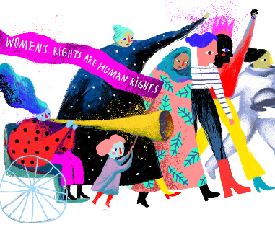
Harmful traditional and cultural practices as violence against women
UN highlighted global incidence of VAW and its negative impact on development and peace
Human rights approach (Universalism) v Cultural Relativism
CR View - The notion of family privacy and the traditional view that non-State actors in the family and the community are not responsible for infringement of women’s human rights under international, regional and national standards
Human rights approach - reinforces the universality and applicability of common standards to determine VAW across cultures and the relevance of both civil and political and socio-economic rights in developing intervention

Slide 9
Legal frameworks and policies addressing caste and gender-based discrimination
Convention on the Elimination of All Forms of Discrimination Against Women Committee Statements
'indicate measures in place to protect women and girls, in particular those belonging to religious or cultural minorities, from indiscriminate attacks, and the reoccurrence thereof, in the context of communal violence in the State party'
'specific examples of such legislation and other measures taken and results achieved to eliminate harmful practices against women and girls,’
‘measures taken to modify gender stereotypes and cultural beliefs that portray women in a subordinate role in society, including in textbooks and the media.’
‘the persistence of patriarchal attitudes and deep-rooted stereotypes entrenched in the social, cultural, economic and political institutions and structures of Indian society and in the media that discriminate against women.’
'persistence of harmful traditional practices,’ with a particular emphasis on the lack of ‘sufficient, sustained and systematic action’ taken, by India, to modify or eliminate these harmful practices.

Slide 10
Grassroots movements and organizations working towards social change
Vital role in challenging harmful practices and advocating for social change
Individuals and communities who have experienced discrimination first-hand and are committed to creating a more equitable society
Provide support, resources, and advocacy for communities affected by caste and gender-based discrimination
Raise awareness about the intersectionality of these issues and develop community-led solutions
Crucial role in empowering individuals, fostering solidarity, and mobilizing communities for collective action
International organizations /NGOs provide funding, expertise, and resources to support initiatives that discrimination
Key for advocating for policy reform, raising awareness on a global scale, and fostering international cooperation to combat these issues

Slide 11
The role of education and awareness in challenging these norms
Play a pivotal role in challenging the norms perpetuated by caste, gender, and harmful practices.
Empowering individuals and promoting critical thinking
Crucial role in raising awareness about the damaging impact of harmful practices and fostering a culture of respect and equality.
BUT needs to be the ‘right’ education
Bring about conformity to the system, or it becomes 'the practice of freedom'
Awareness campaigns essential in challenging harmful norms and practices.
Using various media platforms, community engagement, and grassroots initiatives can raise awareness about the intersectionality of caste, gender, and harmful practices
Campaigns help break the silence surrounding these issues and encourage individuals to come forward, share their experiences, and demand change

Slide 12
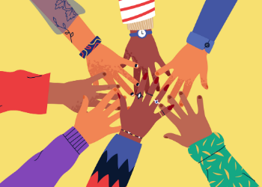
Positionality
Importance of allyship and solidarity in dismantling harmful practices
Allyship involves individuals with privilege using their voices, resources, and influence to support marginalized communities
Requires actively listening, learning, and amplifying the voices of those affected
Involves challenging one's own biases, examining one's privilege, and taking action to address injustice
Solidarity is the act of standing together with marginalized communities and recognizing that their struggles are interconnected
Involves acknowledging that discrimination affects us all
Working collectively to address these issues
Requires individuals and communities to support and uplift each other in the fight
Being an ally is recognising your privilege and developing relationships of trust with underprivileged groups to support the voiceless.
Rather than speaking for these groups, it is crucial to listen to them and help elevate their voices.
Ability to have frank and open discussions

Slide 13
Conclusion: Moving towards an inclusive and equitable society
Intersection of caste, gender, and harmful practices unveils the deep-rooted inequalities and discrimination faced by individuals across the world
By understanding the complexities of these dimensions and their interplay, we can work towards dismantling systemic discrimination and fostering social change
Education, awareness, and collective action are key in challenging harmful norms and practices
Legal frameworks and policies play a crucial role in addressing caste and gender-based discrimination and upholding the rights of individuals
Grassroots movements and organizations are at the forefront of social change, providing support, resources, and advocacy for marginalized communities
Additionally, allyship and solidarity are essential in dismantling harmful practices and promoting collective responsibility
Time to weave a new narrative

Slide 14
Thank you

