Slide 1
Murder in an Attention Economy: Media, Celebrity and the Prosecution of Luka Magnotta

Slide 2
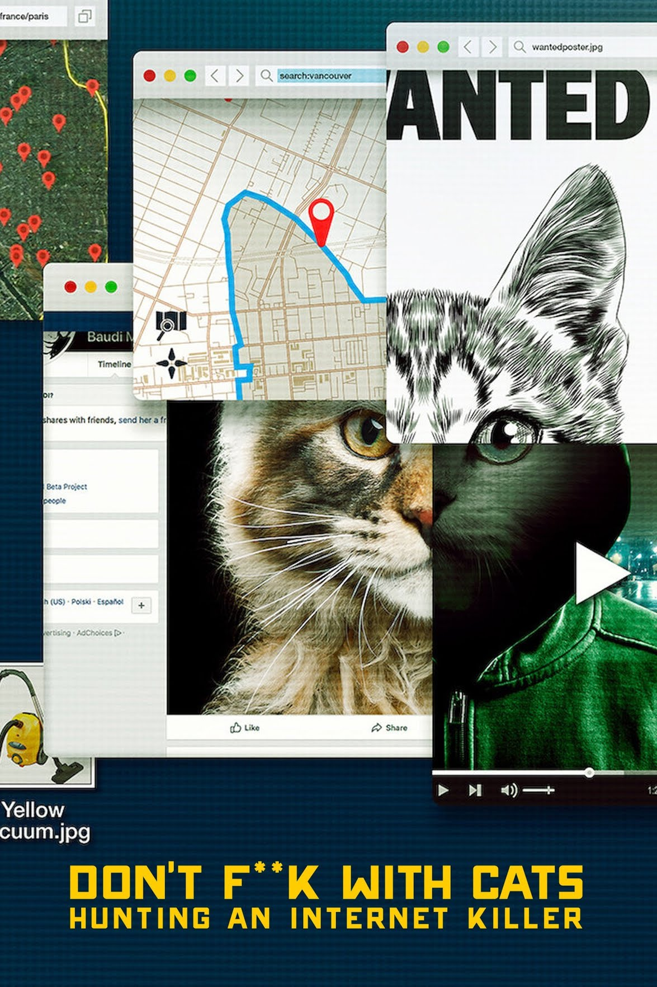
1 Lunatic 1 Icepick
Don’t F**k with Cats: Hunting an Internet Killer (2019) Dir. Mark Lewis.
Notes:
A commonly used list of the main elements is included on the next slide

Slide 3
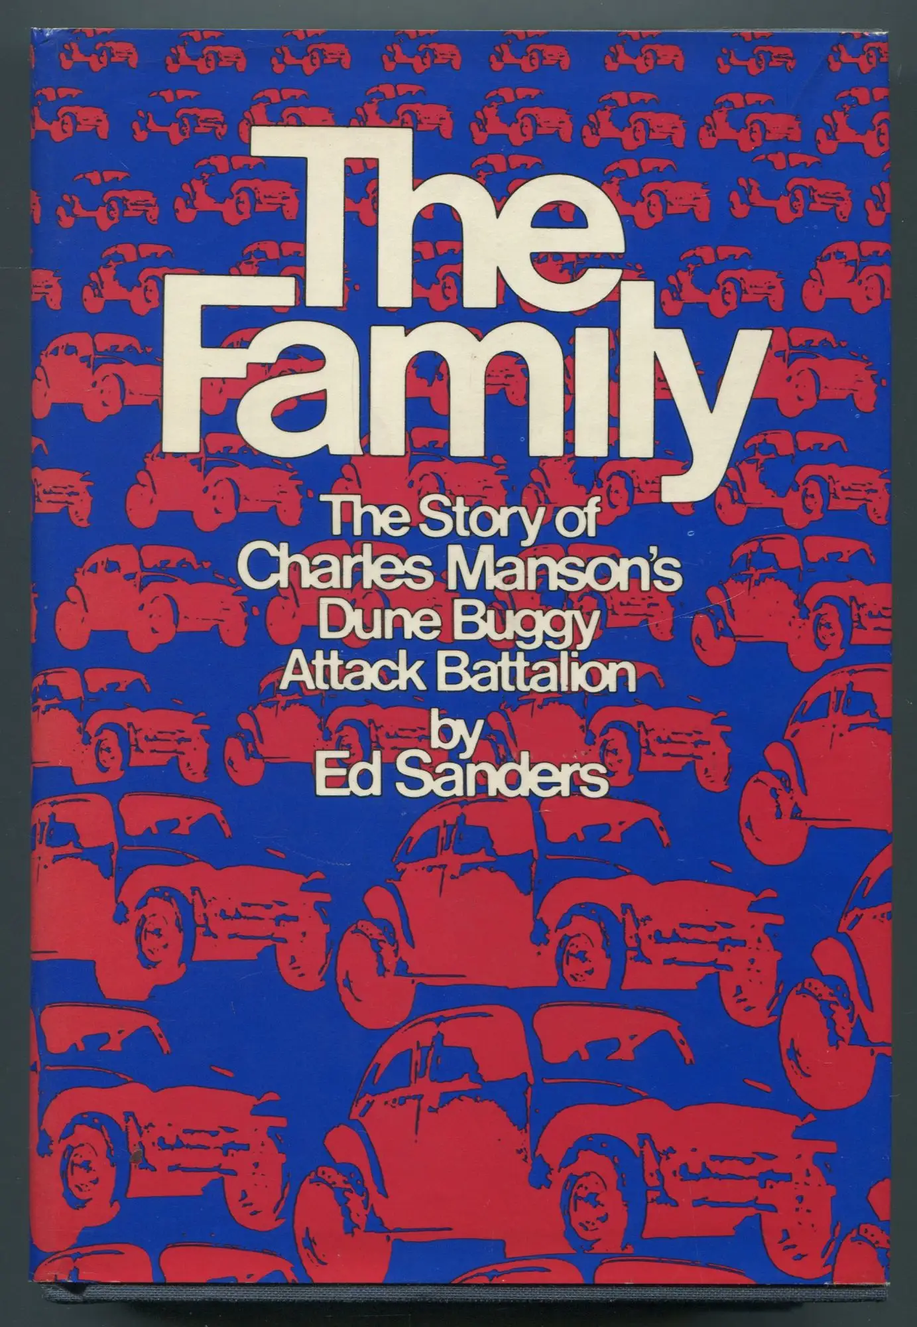
The Origins of the Snuff Movie
The etymological origins of Snuff come from the Victorian phrase ‘to snuff out’, the literal extinguishing of a flame, which, when applied to human life, was used to describe the act of killing (see Jackson 2016, 1–19).
The first reference to snuff movies comes from Ed Sanders’ 1971 book The Family: The Story of Charles Manson’s Dune Buggy Attack Battalion.
‘The Manson Family’ also provided the inspiration for a little seen exploitation film called The Slaughter.
The film sat gathering dust until a savvy distributor capitalized on the rumors that
Sanders, Ed (1971) The Family: The Story of Charles Manson’s Dune Buggy Attack Battalion. New York: Dutton.
Notes:
A commonly used list of the main elements is included on the next slide

Slide 4
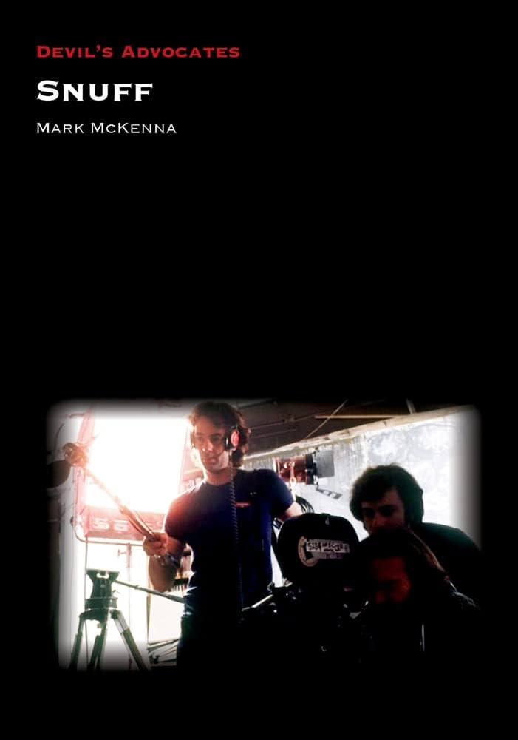
Definitions of the Snuff Movie
FBI Agent, Ken Lanning suggests that to qualify as a legitimate instance of the snuff movie, then the representation would need to be:
A visual depiction of murder (this can be either a series of photographs or a video)
This imagery must have been produced to sexually arouse its intended audience
This imagery must then be commercially distributed for financial gain
McKenna, Mark (2023) Snuff. Liverpool: Liverpool University Press.
Notes:
A commonly used list of the main elements is included on the next slide

Slide 5
Murder in an Attention Economy
Michael H. Goldhaber argued that:
‘The attention economy brings with it its own kind of wealth, its own class divisions - stars vs. fans - and its own forms of property, all of which make it incompatible with the industrial-money-market based economy it bids fair to replace’
(1997: online).
Yeran Kim has argued that reaction videos, such as those discussed:
‘Have a formative effect on the attention economy by means of shifting attention from the … stars … to ordinary people’ (2015: 334),
Goldhaber, M. (1997) ‘The attention economy and the net’, First Monday, 2(4). Available at: http://firstmonday.org/ojs/index.php/fm/article/view/519/440.
Notes:
A commonly used list of the main elements is included on the next slide

Slide 6
Celebrity and the Serial Killer
‘The iconic status of serial killers in contemporary American culture [provides] compelling evidence of the collapse in the difference between fame and notoriety.’
‘Today the famous are often the visible, rather than the talented’ (2015: 297).
Schmid, David (2015) Natural Born Celebrities: Serial Killers in American Culture . Chicago: University of Chicago.
Notes:
A commonly used list of the main elements is included on the next slide

Slide 7
References
Brass, Dick. 1975. ‘Snuff Porn? The Actress is Actually Killed’. New York Post. 3, 15.
Goldhaber, M. (1997) ‘The attention economy and the net’, First Monday, 2(4). Available at: http://firstmonday.org/ojs/index.php/fm/article/view/519/440. Accessed on October 27, 2019.
Jackson, Neil. 2016. Introduction: Shot, Cut and Slaughtered. In Snuff: Real Death and Screen Media, eds. Jackson, Neil, Kimber, Shaun, Walker, Johnny and Watson, Thomas Joseph, 1-19. London: Bloomsbury.
Kim, Yeran (2015) ‘Globalization of the privatized self-image: the reaction video and its attention economy on YouTube’. In: Routledge Handbook of New Media in Asia (eds.) Larissa Hjorth, Olivia Khoo. Routledge: London. pp. 333-342.
McKenna, Mark (2023) Snuff. Liverpool: Liverpool University Press.
Sanders, Ed (1971) The Family: The Story of Charles Manson’s Dune Buggy Attack Battalion. New York: Dutton.
Schmid, David (2015) Natural Born Celebrities: Serial Killers in American Culture . Chicago: University of Chicago.
Don’t F**k with Cats: Hunting an Internet Killer (2019) Dir. Mark Lewis.
Snuff (1976) Dir. Michael Findlay, Simon Nuchtern.

