Slide 1
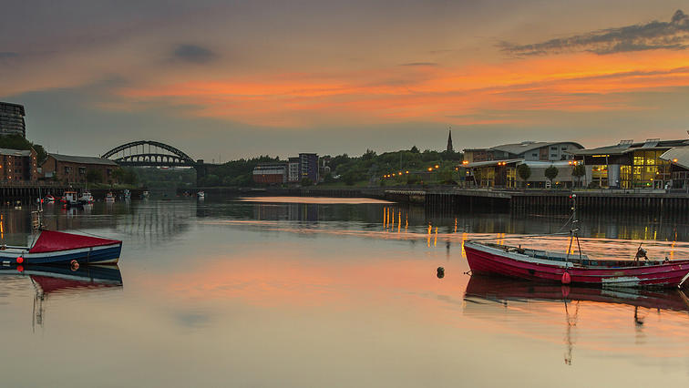
TELLING A DIFFERENT STORY
HOLLYWOOD ON THE WEAR

Slide 2
LEVELLING UP THE SCREEN INDUSTRIES
“
This book seeks to document a critical moment for the screen industries in the United Kingdom by examining the contribution of smaller metropolitan adjacent areas that are often not typically considered in wider discussions of a national film industry. By adopting a case study approach, this book seeks to address this oversight and in doing so, detail the opportunities and obstacles to the growth of three distinct regions: Sunderland, Southampton, and Stoke-on-Trent.
”
Mark McKenna (forthcoming) Levelling Up the Screen Industries: Regenerating a Britain Left Behind. London: Routledge.

Slide 3
LEVELLING UP THE SCREEN INDUSTRIES
“
we will be bringing forward proposals to transform this country with better infrastructure, better education, better technology. If you ask yourselves what is this new govern-ment going to do, what is he going to do with his extraordi-nary majority, I will tell you … we are going to unite andlevel up.(Boris Johnson, speaking outside Downing Street,13 December 2019)
”
Mark McKenna (forthcoming) Levelling Up the Screen Industries: Regenerating a Britain Left Behind. London: Routledge.

Slide 4
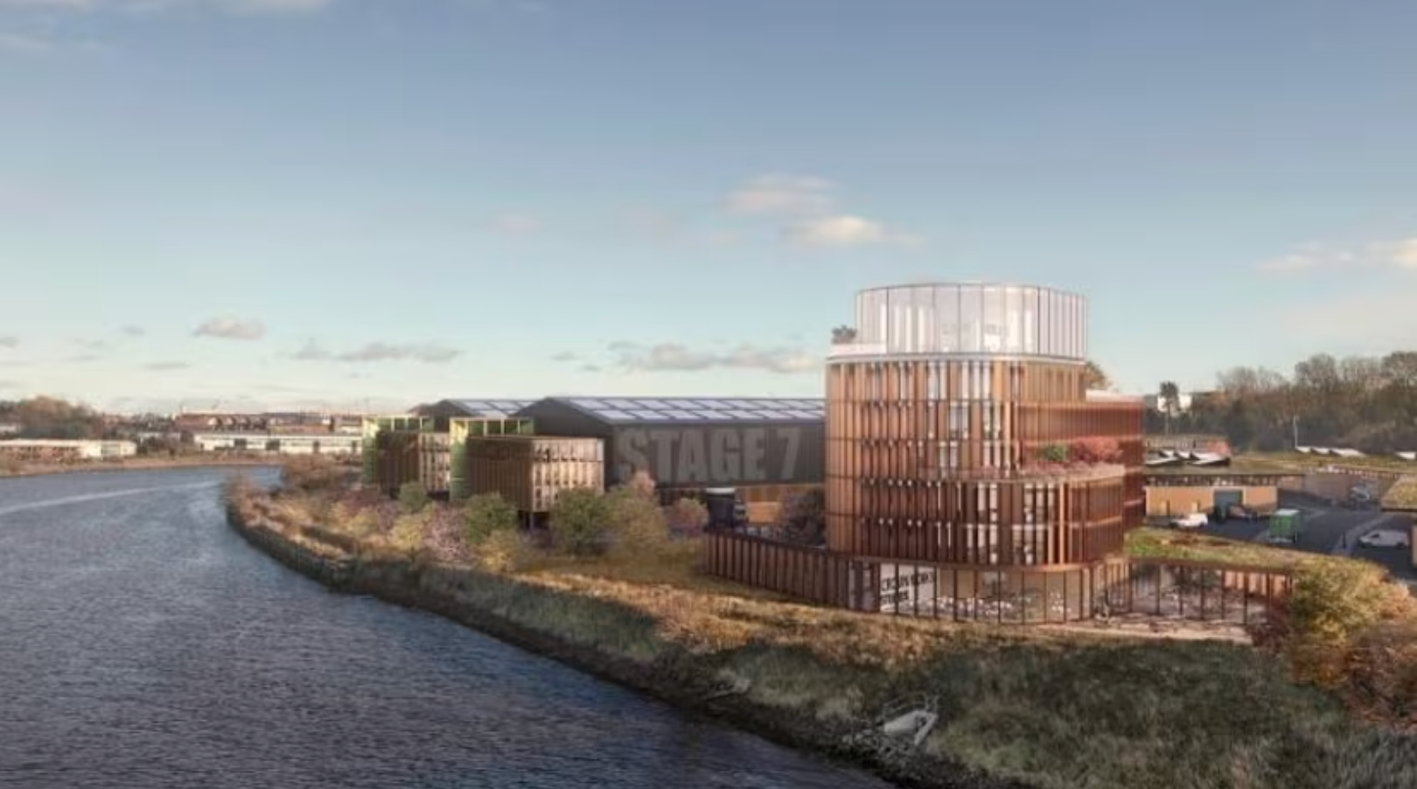
HOLLYWOOD ON THE WEAR
“
The proposed development of a major film and television studio represents a significant new investment in the UK and creative economy. The vision is to create a major studio that meets the requirements of the international film and television industry, enabling Sunderland to establish itself as a prime destination for the UK’s high-end film and TV production.
Located prominently on the banks of the River Wear,
the studio will be of the highest quality design and
will provide an iconic landmark which signals the
cultural status of the city within the UK and abroad.
”
https://www.crownworks.co.uk/the-vision

Slide 5
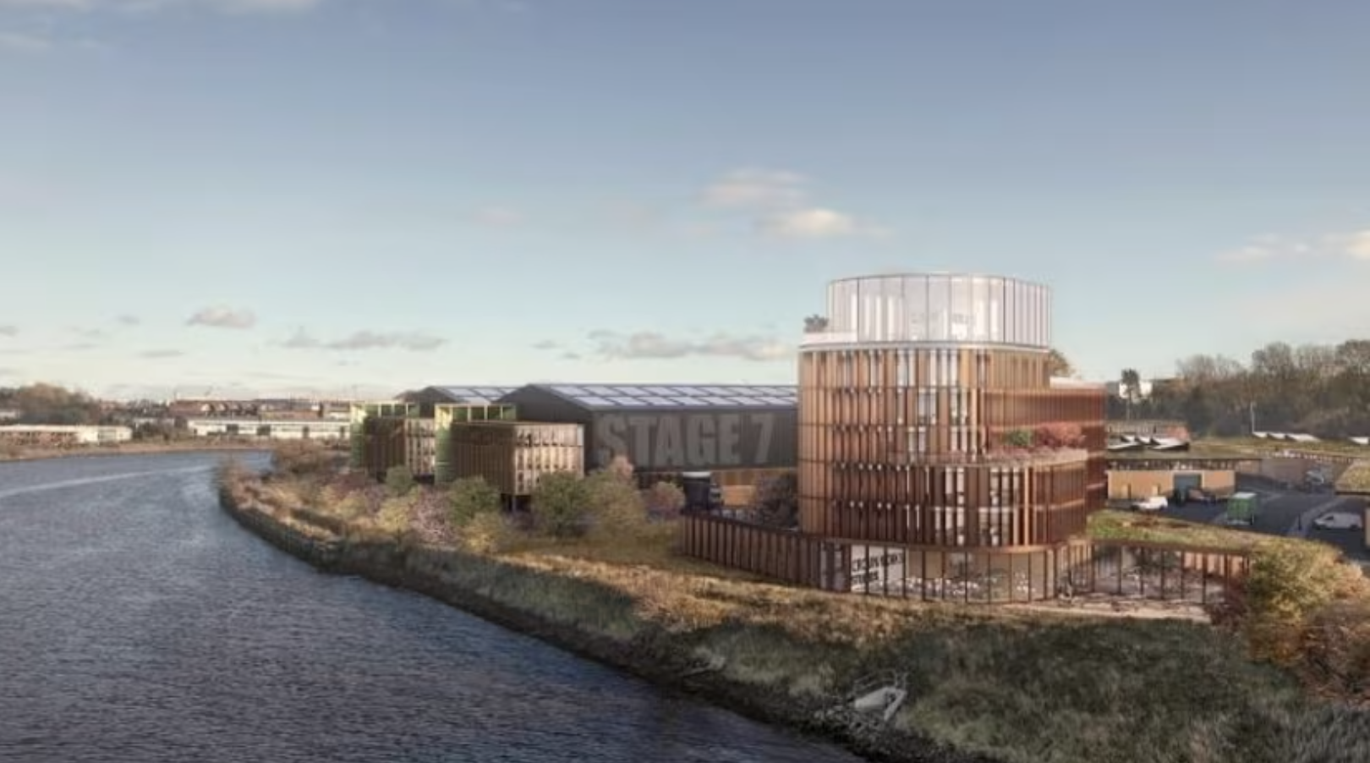
HOLLYWOOD ON THE WEAR
Halfane, Andy (2024) ‘From the era of anxiety to an age of aspiration’

Slide 6
THE MOST AMBITIOUS CITY CENTRE REGENERATION PROJECT IN THE UK
https://www.riversidesunderland.com/

Slide 7
THE ROLE OF EDUCATION IN LEVELLING UP
“
Rather than creating nuanced and interconnected systems for building people up, the closure of courses instead only knocks down pathways out of disadvantage.
”
https://blogs.lse.ac.uk/impactofsocialsciences/2023/08/07/sensationalist-messaging-around-low-value-degrees-ignores-the-reality-of-economic-inequality/

Slide 8
THE VALUE OF MEDIA EDUCATION
“
Media, screen, journalism and communication studies subjects are sometimes dismissed as ‘low-value’ or ‘Mickey Mouse’ subjects. Our report provides very substantial evidence to counter these claims. These subjects are highly popular among young people. They play an essential role in the creative industries which contribute £108bn annually to the economy, and education in these subjects supports a globally leading cultural sector.
”
https://www.theguardian.com/education/article/2024/jun/11/media-studies-popular-dynamic-profound-impact-report

Slide 9
CONDITIONS FOR SUCCESS
Mission 1: Living standards
Mission 2: Research and development
Mission 3: Transport
Mission 4: Digital connectivity
Mission 5: Education
Mission 6: Skills
Mission 7: Health
Mission 8: Well-being
Mission 9: Pride in Place
Mission 10: Housing
Mission 11: Crime
Mission 12: Local leadership
https://www.gov.uk/government/publications/statement-of-levelling-up-missions/statement-of-levelling-up-missions

Slide 10
THANK YOU

