Slide 1
Beyond Novelty: A More Social and Reflective Take on Musical Interfaces and Music Technology
Dr. Mathew Dalgleish
mat.dalgleish@staffs.ac.uk

Slide 2
Overview
Towards human instruments
My background and early work
The N in NIME (the relentless drive for newness)
Slower approaches, with examples
Concluding remarks
Bibliography

Slide 3
Acoustic Instruments
The earliest musical instruments date back ~50,000 years (Atema, 2004).
The traditional (Western) musical instruments still in use today have evolved very slowly (over 100s-1000s of years), but their designs stagnated in the late 18th Century (Magnusson, 2019).
This has given the impression that they are fixed, optimal, or idealised designs (Marshall, 2009).
But fundamentally imbalanced designs - emerged primarily for acoustical (sound projection) rather than human reasons (comfort, ease of use, etc.).

Slide 4
The Acoustic Instrument Paradox
On one side:
As Joel Ryan (1991) notes, “effort is closely related to expression in the playing of traditional instruments.”
For performers, overcoming the challenges imposed by their instruments can support a lifetime of rich engagement and learning.
Many examples of extreme virtuosity.

Slide 5
The Acoustic Instrument Paradox
On the other side:
The demands made by traditional instruments (strength, dexterity, etc.) are significant to the extent that some people are inevitably excluded from participation.
Instrument responses are predictable and repeatable, and perfection is seen as a sign of performance attainment - any errors are placed on the shoulders of the performer.
i.e. Design (and lutherie) issues are often closely entwined with social issues (Kaszynska, 2021).

Slide 6
Acoustic Instrument IO
Performance interface rarely considered in isolation.
Choice of sound generation mechanism and compatible interface largely determines the form of the instrument.
Physical connection between sound gen mechanism and performance interface passes rich haptic vibrations to the performer (Marshall, 2009).
Haptic sensation the primary means of navigation for experienced players and main conduit of performer-instrument intimacy (Marshall, 2009; Rebelo, 2005).

Slide 7
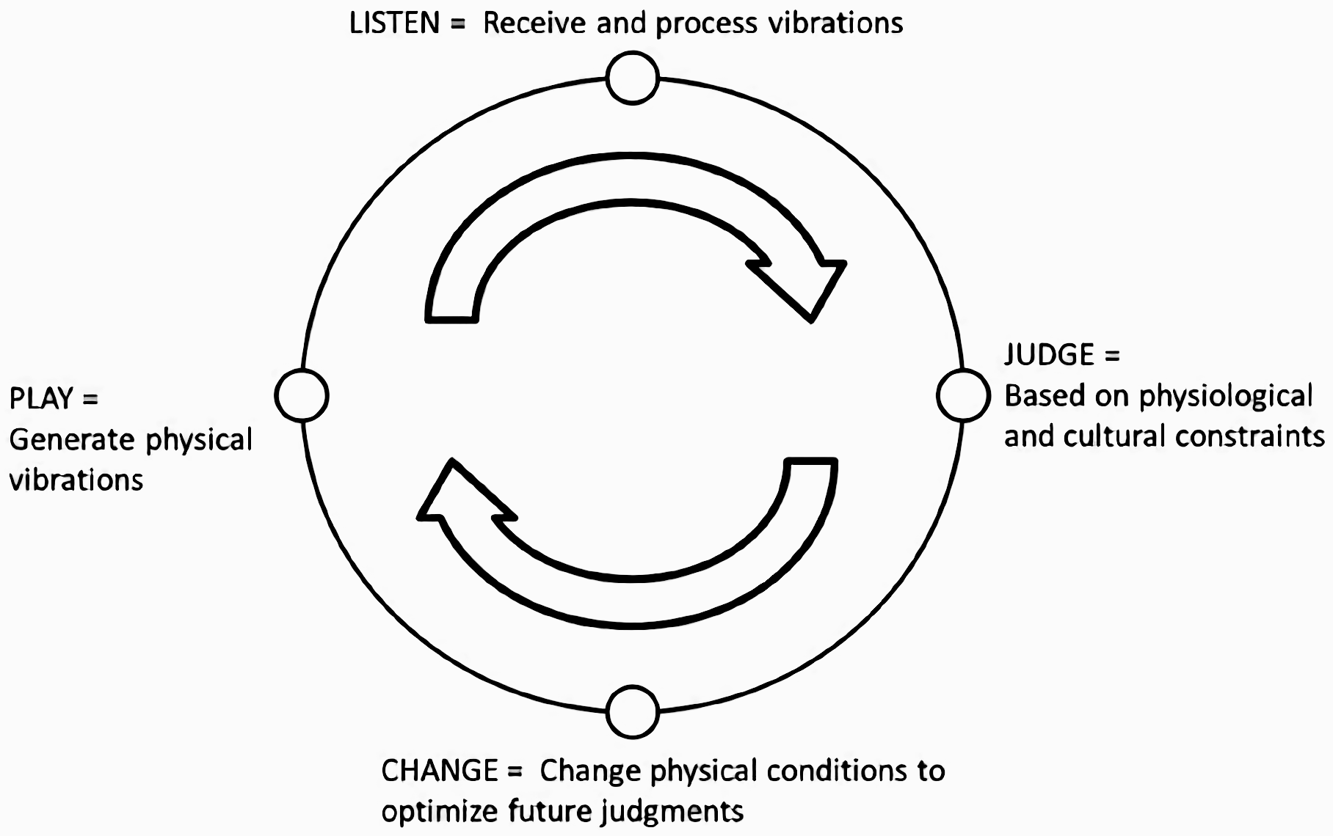
Leman’s (2008) action-reaction cycle:

Slide 8
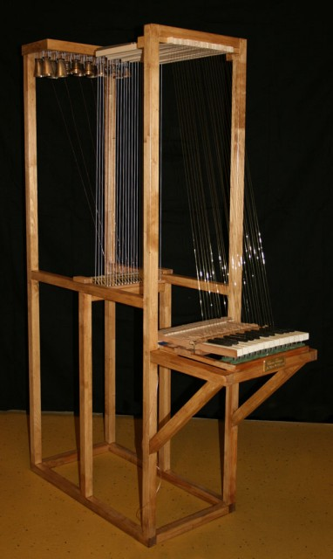
Electrification
Earliest electric instruments like the Golden Dionysis (right) date back to 18th C. (Davies, 2004).
Industrialisation of electricity in 19th Century spurred a spate of new instrument designs (Weidenaar, 1995).
Many electric instruments initially augmented acoustic designs driven by desire to be heard in groups.
Fully electronic instruments (elec. sound gen.) soon followed.

Slide 9
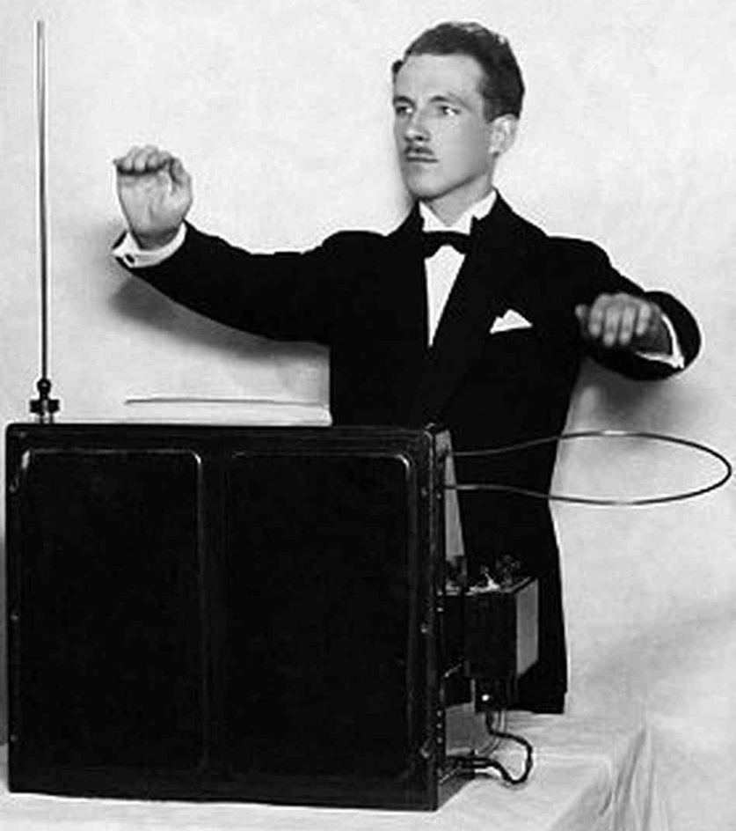
Early Electronic Instruments
Often innovative sound generation.
A few examples of innovative interfaces, e.g. the theremin (right) (Glinsky, 2000), but the familiar organ-type keyboard adopted by most electronic instruments post-1920.
Visual design language minimises the shock of the new.
Essentially still instrument-objects.

Slide 10
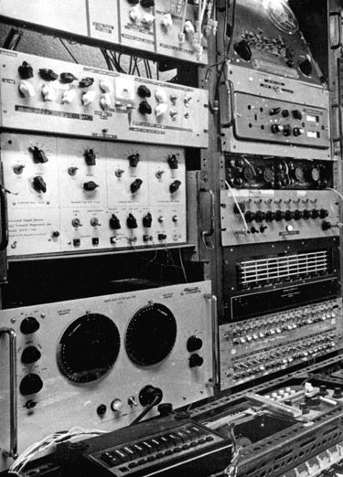
The EMS
The post-WWII electronic music studio separated and promised control over every musical parameter - at the expense of speed, labour, size, and expense (Manning, 2013).
Reactions against the EMS:
The modular synthesizer
Live electronics

Slide 11
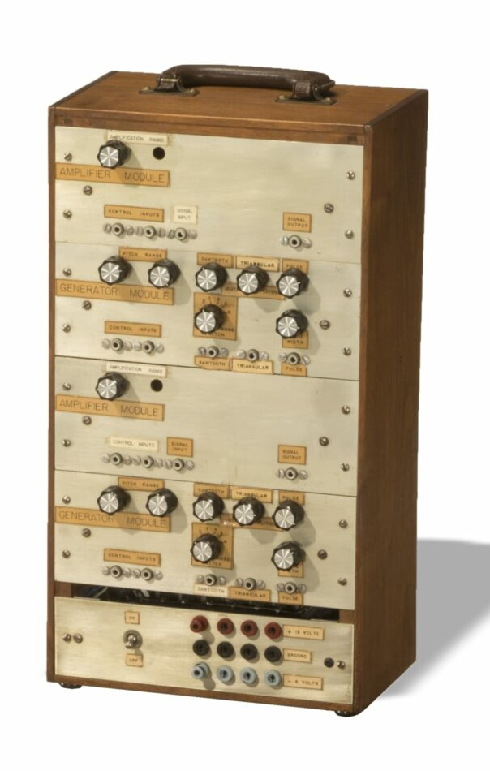
Modular Synths
Early work by Harald Bode (et al.).
Commercial electronic instruments independently developed by Don Buchla and Bob Moog (Dunn, 1992; Manning, 2013).
The Moog modular made no distinction between audio and CV - any output could be connected to and act on any input.

Slide 12
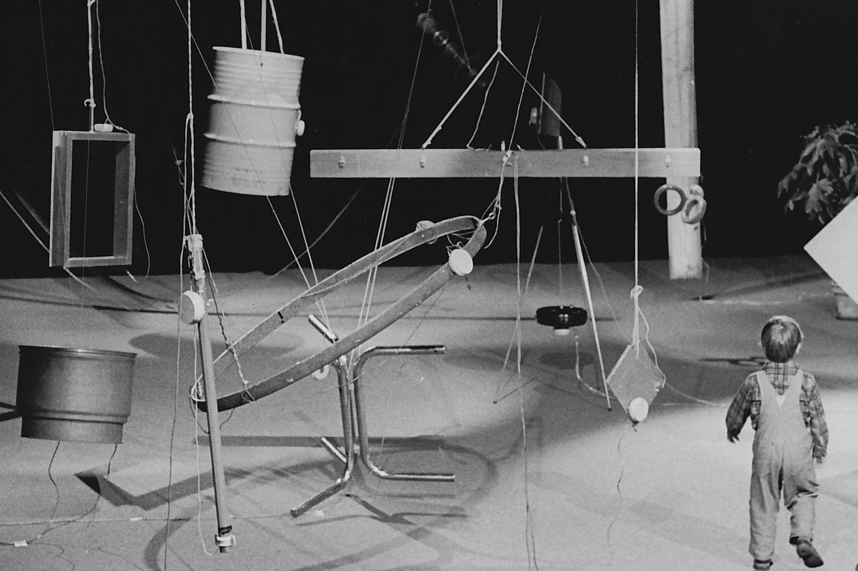
Live Electronics
DIY-led (Nakai, 2021).
Made the separation of the instrument’s elements explicit - any type, size and shape of interface can be (loosely) connected to any means of sound generation.
The interface can be designed around the needs and/or body of the performer(s).
Rainforest IV (1969-72) by David Tudor, an early participatory installation.

Slide 13
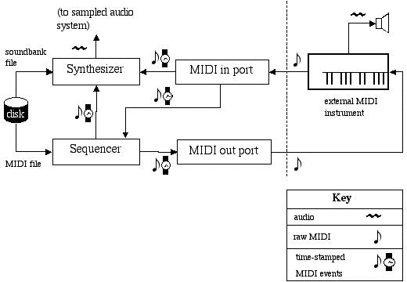
MIDI (1982)
The separated (keyboard) instrument designed into the MIDI protocol v1 (Lanier, 2011)

Slide 14
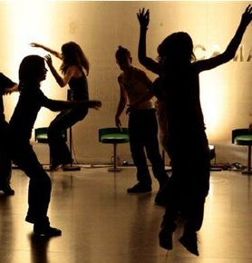
Towards Human Instruments
Human-focussed instruments in the 1980s and 1990s:
Very Nervous System (1983) by David Rokeby
SOUND=SPACE (right) (1984) by Rolf Gelhlhaar.
The Hands (1985) by Michel Waisvisz.
Lady’s Glove (1991) by Laetitia Sonami.

Slide 15
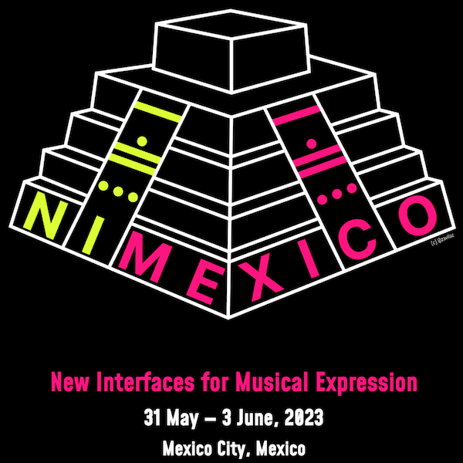
NIME
New Interfaces for Musical Expression (NIME) conference founded in 2001 as a workshop at CHI in Seattle.
Held annually since and field has expanded significantly.
Hundreds of new instruments and interfaces presented over the last twenty-two years.

Slide 16
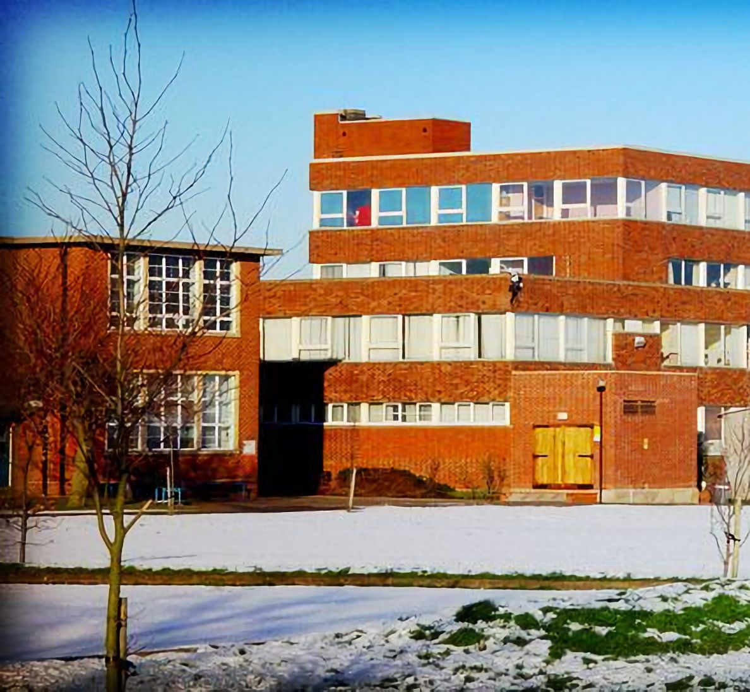
My Background
Born without a left arm below the elbow, and with significant lower limb orthopaedic issues.
Grew up and went to school on the outskirts of Birmingham.
Instruments:
Trumpet from age 6 - lessons from regional music service.
Guitar from age 12 - self-taught.

Slide 17
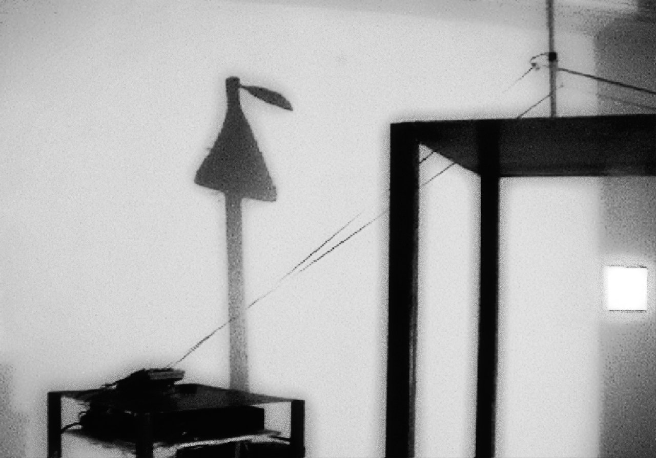
Loop (2004)
Created at Northumbria Univ.
Ambient sound recorded at one end of a tape loop then played back 2 minutes later.
Modified C90 cassette tape and four track recorder - already obsolete.
[…] the obsolete no longer needs to be useful and thus, is free to be reimagined.

Slide 18
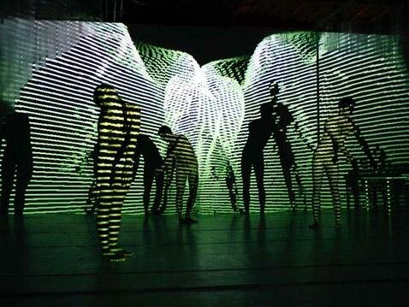
Troika Ranch workshop (2005)
“involves a hybrid of three artistic disciplines, dance/theater/media (the Troika), in cooperative artistic interaction (the Ranch).”
Isadora - independent real-time media manipulation software developed since 1999.
Plus IO hardware!

Slide 19
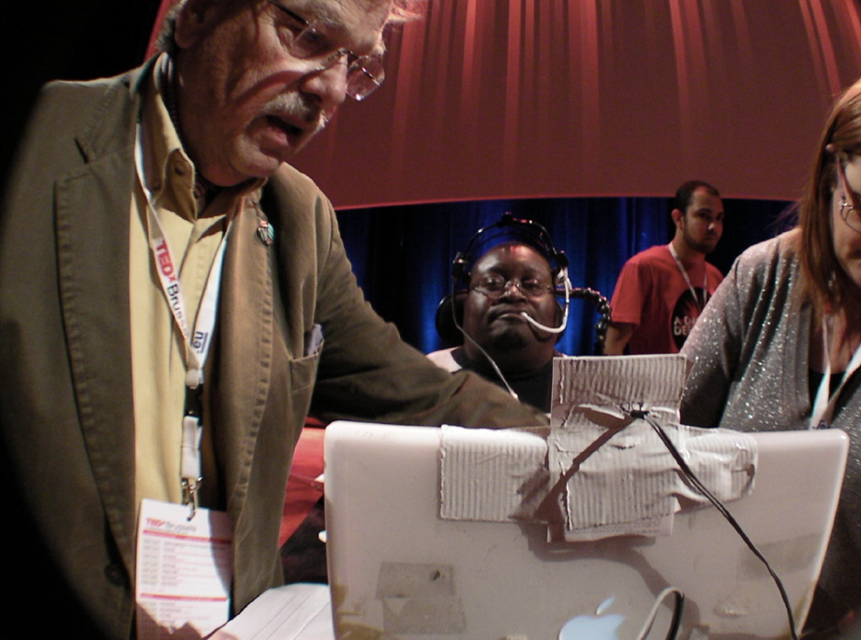
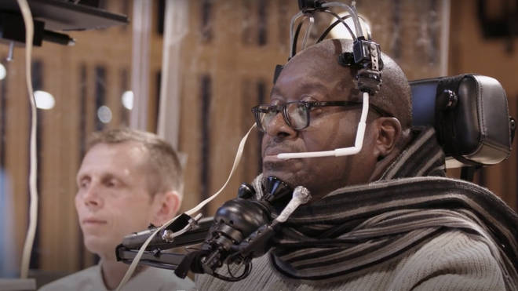
Gehlhaar’s HEAD=SPACE (2005/6)
Head-mounted, breath-activated interface and accompanying software, written in MaxMSP, for trumpeter Clarence Adoo.
Levelling the playing field:
"It makes me feel like a [real] musician again."

Slide 20
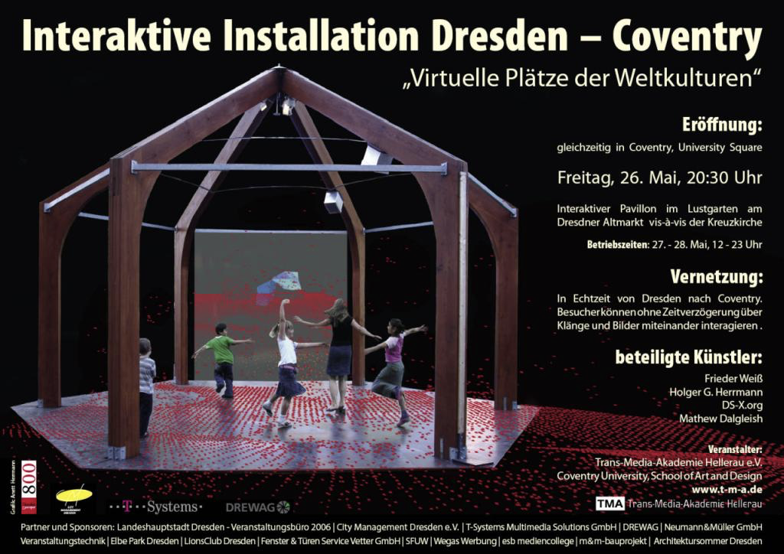
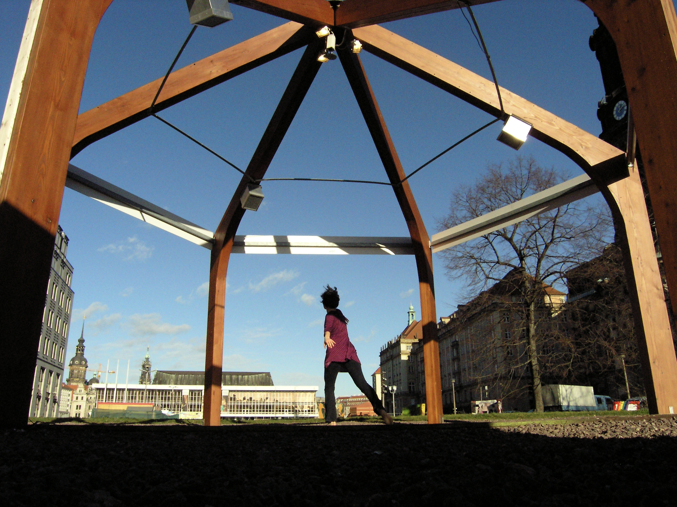
Virtual Squares of World Culture (2006), with TMA Dresden and Frieder Weiss
Different topologies for the same installation.
Instrument as platform.

Slide 21
Physical Sequencer (2009)
By Giuseppe Guerriero, with Tom Mudd Mat Dalgleish, and Yamaha Design.
Simple/simplified, binary interaction:
Seen as essential for accessibility.
Quickly unsatisfying.
Prompted a move away from direct or close control towards influence:
David Tudor-inspired (Dalgleish, 2016).
Embrace of unpredictability.
More focus on listening.
Implications for virtuosity and accessibility.

Slide 22
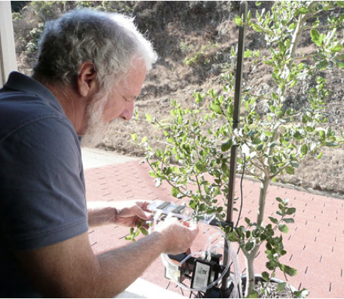
Eden 3 v1-2 (2009-10)
By Reiko Goto and Tim Collins (Collins-Goto studio), with Mat Dalgleish, Trevor Hocking, and Carola Boehm.

Slide 23
Vanishing Point (2011)
The slow interface – slit-scan photography-influenced technique
X
X

Slide 24
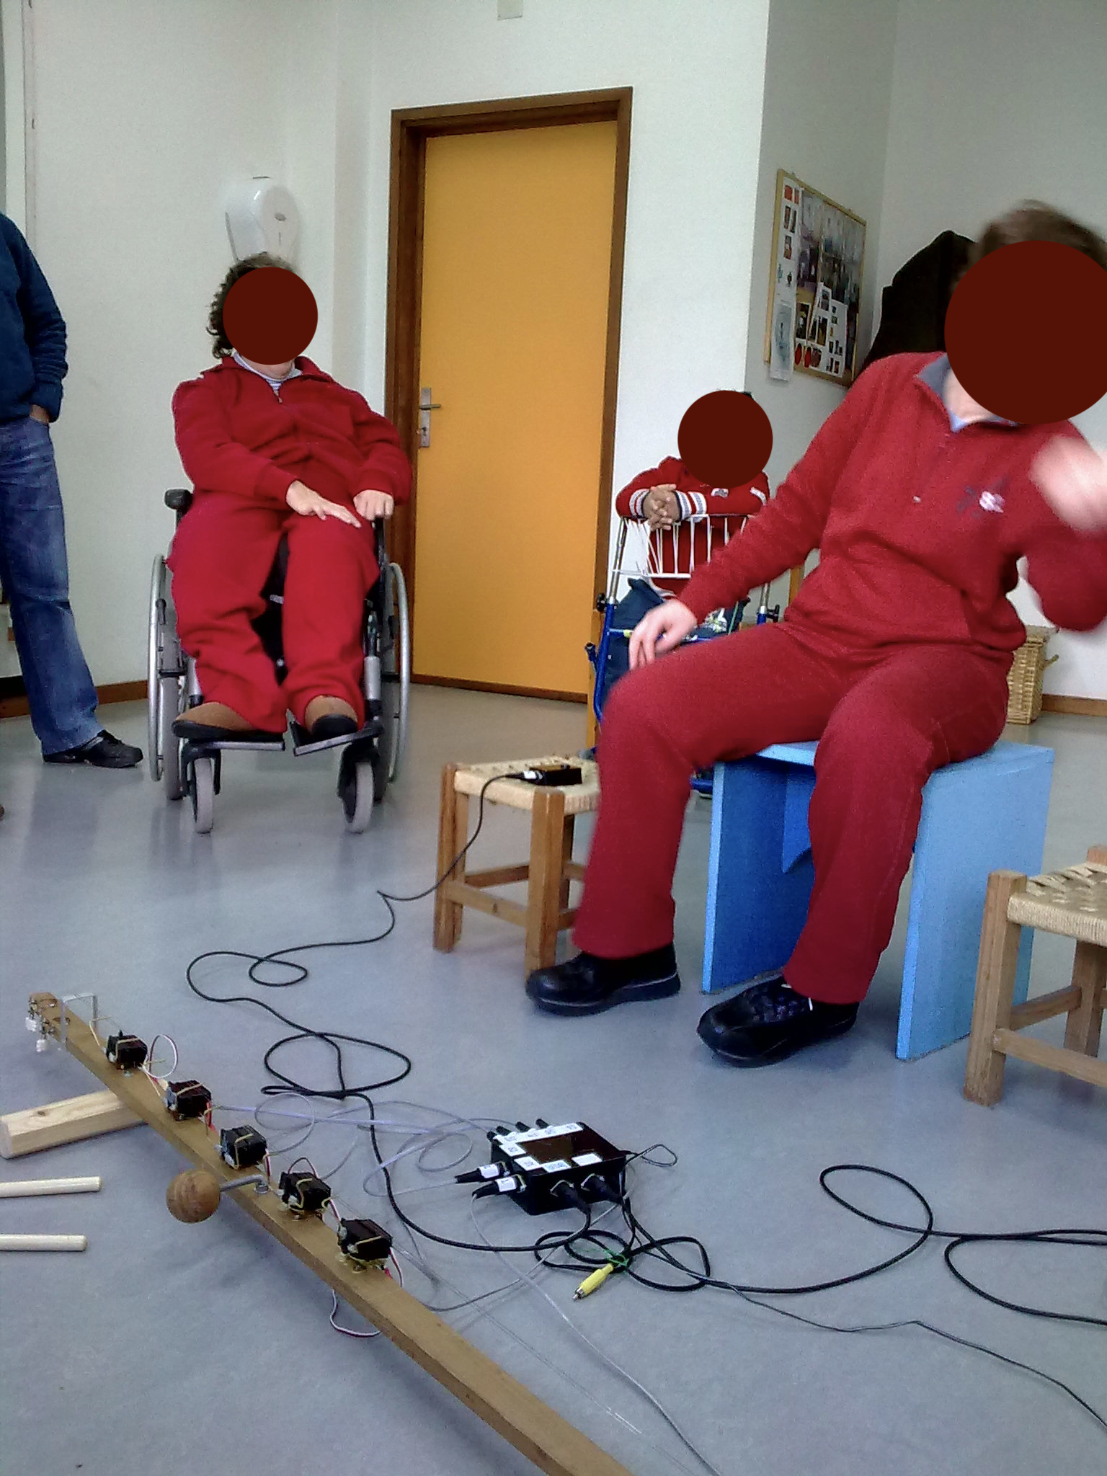
ServoString (2009)
With Rolf Gehlhaar.
US rangefinder-controlled robotic string instruments.
Foldable - fits easily in train and plane hand luggage.
Reusable and repairable.
Open design, easily replicated.

Slide 25
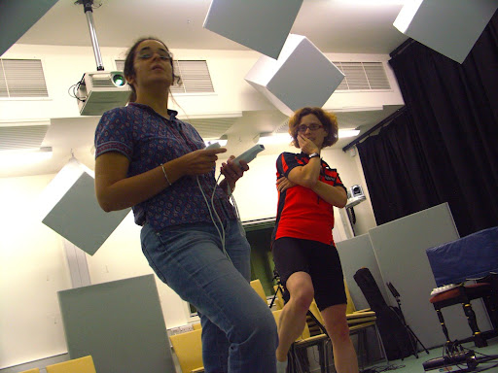
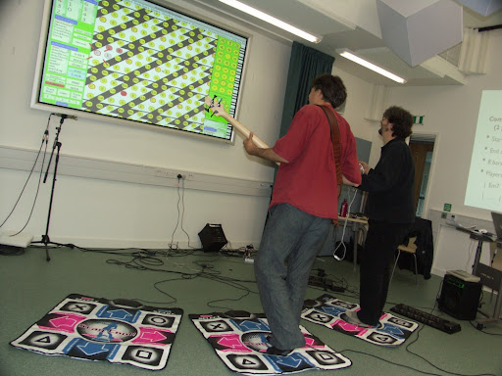
WBHSP (2010-11)
Builds on earlier work by Simon Holland.
Musical harmony considered to be abstract and technical.
Usually taught via abstract, domain-specific concepts, principles, rules, and heuristics.
WBHSP (Holland et al., 2011) focuses on concrete locations, objects, areas and trajectories.

Slide 26
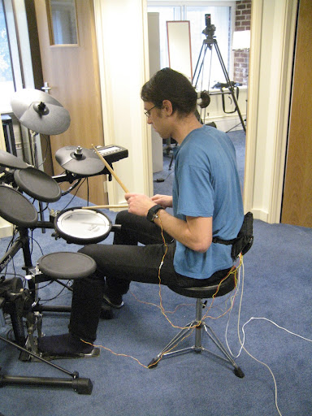
Haptic Drum Kit (2009-10)
HDK (Holland et al., 2010) employs vibrotactile devices, one attached to each limb, that generate pulses to help play rhythmic patterns.
Aim is to foster rhythm skills and multi-limb coordination.
Pilot study compared the efficacy of audio and haptic guidance for learning to play polyphonic drum patterns of varying complexity.

Slide 27
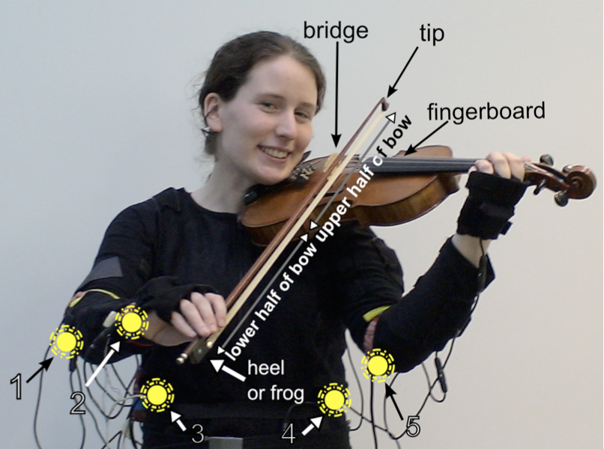
Music Jacket (2011)
Prototype provides vibrotactile feedback to indicate how to correctly hold and bow the violin (van der Linden et al., 2011).
Prototype tested in a pilot study with four beginners.
Observations showed improvements compared to no feedback in 3 of 4 players.

Slide 28
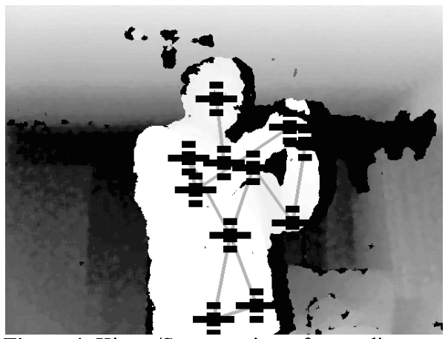
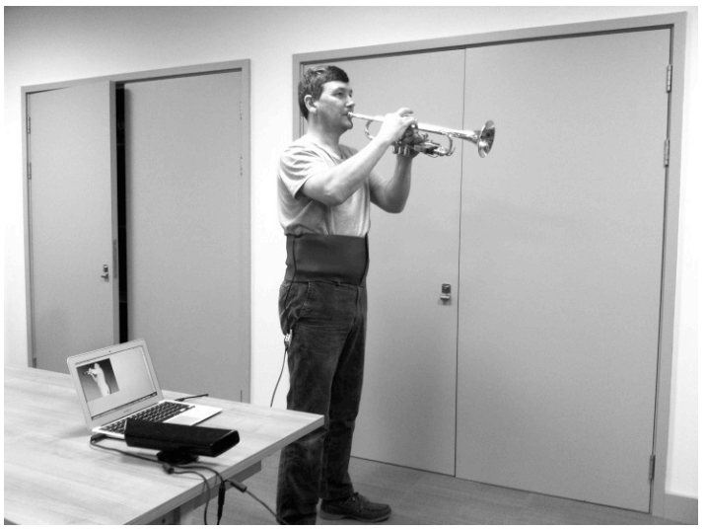
Postrum (2014)
Intended for solo trumpet practice (Dalgleish and Spencer, 2014).
Player posture surveyed by 3-D camera.
Haptic belt nudges the player if posture lapses from the ideal on either of two axes.

Slide 29
NIME
The NIME community has continued to grow worldwide.
Hundreds of new instruments and interfaces have been presented over the last 22 years.
Remember - we can design electronic and digital musical instruments around individual bodies or needs (what I early called human instruments), and this has little or no impact on sound generation.
Why then, are there still relatively few examples of long-term NIME use, particularly by disabled players?

Slide 30
The N in NIME
The N in NIME is for ‘New’
The relentless drive for novelty isn’t always helpful:
[It] “often ends up explicitly promoting cutting-edge technologies (such as maker processes, high performance computing, machine learning) whose wide-scale environmental impact is largely unknown and not yet discussed.” (Morreale et al., 2020)

Slide 31
Co-Design?
There is a broad consensus as to the benefits of participatory design/co-design.
But:
Only a few examples of meaningful involvement of disabled people in new instrument design.

Slide 32
Additionally…
It takes a lot of time to find productive player-instrument fits/matches.
Even more so where there are unknowns.
As relatively untried and untested, new instruments are full of unknowns!
Testing itself takes a lot of time (and resources).
Shortage of expertise (especially in facilitation and evaluation).
Delayed interest in and uncertainties around evaluation (Jorda and Mealla, 2014; Barbosa et al., 2015).

Slide 33
Taking It Slow
Slow Food - Petrini (2003):
Reaction against fast life (seen as harmful and unfair) and the disappearance of local food traditions.
Slow Design - Faud-Luke (2002):
New values for design and a shift towards sustainability.
Slow Tech: Designs for Digital Downtime exhibition curated by Protein and Henrietta Thompson of Wallpaper (2011):
Design and technology intended to counteract busy lifestyles.

Slide 34
Slower: A Provisional Process
Fully considering the suitability of existing solutions (which often have advantages in terms of price, access, sustainability, testedness, expressivity, etc.).
This includes:
The possibility of incidental fit.
The possibility of adaptation.
Testing as much as possible and rethinking if needed.
If existing solutions are insufficient or unsuitable, proceed with the development of new designs.
Importance of the design funnel (iterative processes of sketching, prototyping, etc.).

Slide 35
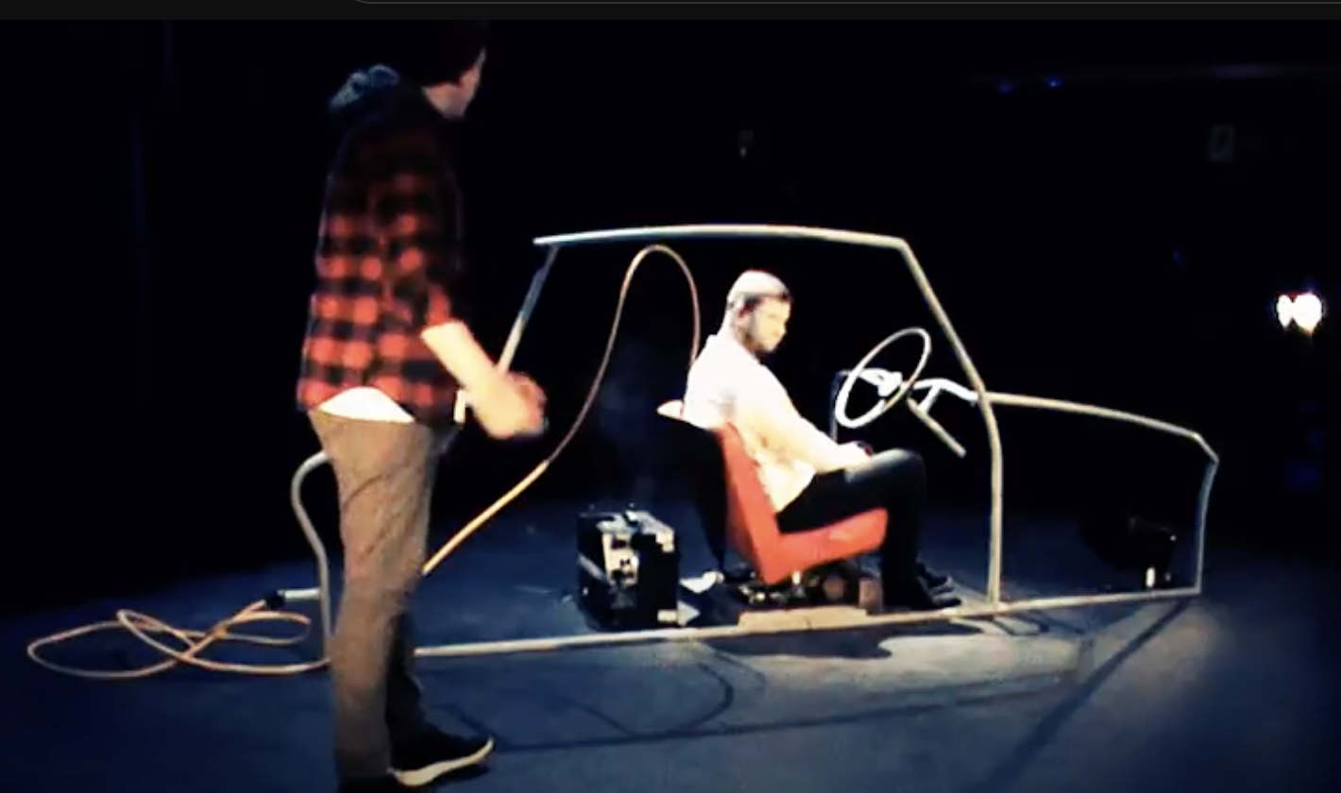
Bert (2017)
Theatre as a slow context (sound as kind of interface).
Audio Description (AD) for theatre widely but not universally adopted - has limitations and can be othering.
Project explored supplementing and replacing AD for theatre with ambiently diffused sound design.
Blind and visually impaired audience from around Midlands (~25 people).
Modest but unexpected social legacy/afterlife.
Notes:
https://www.youtube.com/watch?v=QQNI-cS09m4

Slide 36
Procedural Audio Objects (2019-20)
Part 1:
A lo-fi prop prototype - a 1950s-style Sci-Fi ray gun.
Bela DSP board (small and close to zero latency) embedded, plus integrated small amplifier and speaker.
Importance of throwaway - disposable idea, but reusable technology.

Slide 37
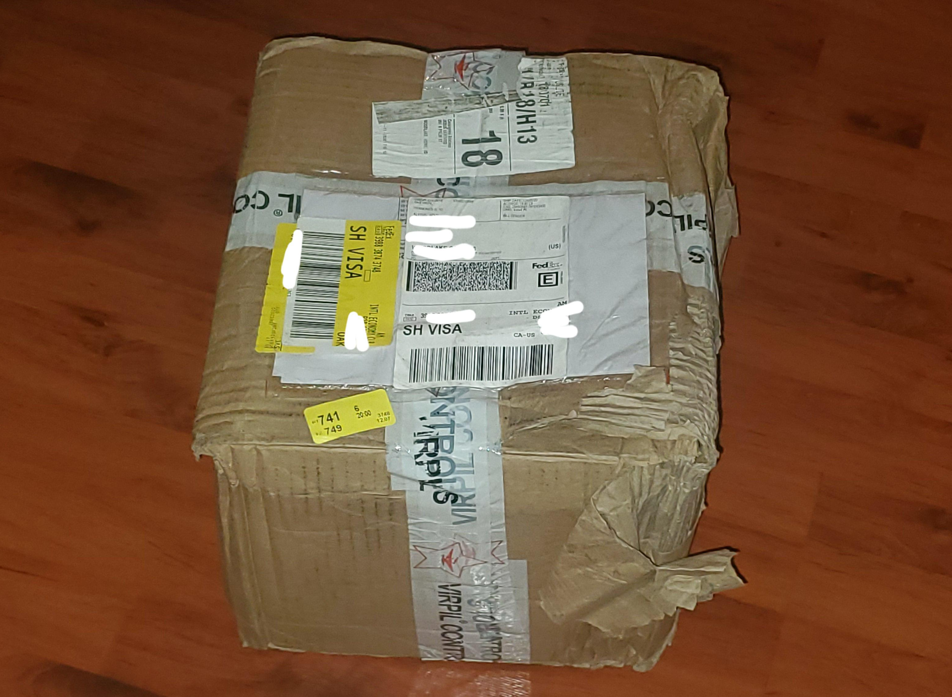
Procedural Audio Objects (2019-20)
Part 2:
A procedurally-generated audio play that’s different each time it runs. Reused same Bela platform as Part 1.
Reimagines Maeterlinck’s The Interior (1895), originally for toy theatre.
Radio-style TUI with the play hidden amongst 10+ simulated radio stations.
Designed to be posted as a standard parcel (pandemic-friendly).
12 users in study. Delivery model encouraged more/longer engagement?

Slide 38
Small Modular Synthesizers as One-Handed Instrument (2022-)
X
X
X

Slide 39
TYG (2024-)
X
X
X

Slide 40
Signs of Change
Some positive examples:
The OHMI Trust
Survey followed by video assessment before WCET begins.
Andrew McPherson’s adapted instruments.
Renewed interest in the circuit bent instruments of Nic Collins and Reed Ghazala.
The third wave of HCI is starting to influence NIME.

Slide 41
Concluding Remarks
Not all design is social, but many design issues and social issues are closely entwined (need to think holistically).
Related contexts can offer new insights.
By slowing down, and moving past the creation of new designs as a default or first action, we can:
Leverage tried and tested designs (or aspects of).
Get the most out of existing solutions (which may have benefits in terms of cost, access, etc.).
Discover new uses - and new users.
Less waste.
Better focus on what the new should really mean.

Slide 42
Bibliography
Atema, J. (2004) Old Bone Flutes. PAN, December 2004.
Barbosa, J., Malloch, J., Wanderley, M. and Huot, S. (2015) What Does Evaluation Mean for the NIME Community? In Proceedings of the international conference on New Interfaces for Musical Expression (NIME 2015). The School of Music and the Center for Computation and Technology (CCT), Louisiana State University, Baton Rouge, Louisiana, USA, pp. 156-161.
Bouwer, A., Holland, S. and Dalgleish, M. (2013) The Haptic Bracelets: Learning Multi-Limb Rhythm Skills from Haptic Stimuli While Reading. In Holland, S., Wilkie, K., Mulholland, P. and Seago, A. (eds.) Music and Human-Computer Interaction. Cultural Computing. Springer. https://doi.org/10.1007/978-1-4471-2990-5_6
Bouwer, A., Holland, S. and Dalgleish, M. (2013) Song Walker Harmony Space: Embodied Interaction Design for Complex Musical skills. In Holland, S., Wilkie, K., Mulholland, P. and Seago, A. (eds.) Music and Human-Computer Interaction. Cultural Computing. Springer.
Dalgleish, M. (2014) Reconsidering Process: Bringing Thoughtfulness to the Design of Digital Musical Instruments for Disabled Users. In Proceedings of INTER-FACE: the 2nd International Conference on Live Interfaces (ICLI 2014), Lisbon, Portugal, 20-23 November 2014, pp. 308-315.
Dalgleish, M. (2016) The Modular Synthesizer Divided: The Keyboard and Its Discontents. eContact! Journal for Electroacoustic Practices, vol. 17.4 (April 2016).

Slide 43
Bibliography
Dalgleish, M. (2016). Wiring the Ear: Instrumentality and Aural Primacy in and After David Tudor’s Unstable Circuits. Leonardo Music Journal, vol. 26 (Dec 2016), pp. 73-74. https://doi.org/10.1162/LMJ_x_00988
Dalgleish, M. (2016). Unconventional Inputs: Old/New Instruments, Design, DIY and Disability. eContact! Journal for Electroacoustic Practices. vol. 18.3 (Dec 2016).
Dalgleish, M. (2017) Loop: A Circular Ferric Memory in Slow Decline. Leonardo Music Journal, vol. 27 (2017), pp. 49-50. https://direct.mit.edu/lmj/article-abstract/doi/10.1162/LMJ_a_01011/69469
Dalgleish, M. and Reading, N. (2019) Seeing With One’s Own Ears: Soundtrack As Interface for Theatre. In I. Soveral and F. Pombo (eds.). SYNCHRESIS: Audio Vision Tales. University of Aveiro Press.
Dalgleish, M. and Spencer, S. (2014) Postrum: Developing Good Posture in Trumpet Players Through Directional Haptic Feedback. In Proceedings of the 9th Conference on International Musicology (CIM14), Staatliches Institut für Musikforschung, Berlin, Germany, 4-6 December, pp. 334-338.

Slide 44
Bibliography
Dalgleish, M. and Whitfield, S. (2021) Sound Objects: Exploring Embedded Computing for Procedural Audio in Theatre. In R. Toulson et al. (eds.) Music and Innovation. Routledge. https://www.taylorfrancis.com/chapters/edit/10.4324/9780429345388-14
Dalgleish, M and Williams, N. (2022) The Eurorack Synthesizer as One-Handed Instrument, in Innovation in Music ‘22, Royal College of Music, Stockholm, Sweden, 17-19 June 2022.
Davies, H. (2004) Creative Explorations of the Glitch in Music. Available at: https://ethw.org/w/images/d/d0/Davies.pdf
Dunn, D. (1992) A History of Electronic Music Pioneers. Eigenwelt der Apparatewelt: Pioneers of Electronic Art. Ars Electronica.
Fuad-Luke, A (2002) 'Slow Design': A paradigm shift in design philosophy?, Development by Design, Bangalore, India, 01-02 December 2002.
Gehlhaar, R. (1991) SOUND = SPACE: an interactive musical environment, Contemporary Music Review, 6(1), pp. 59–72. doi: 10.1080/07494469100640061
Glinsky, A. (2000) Theremin: Ether Music and Espionage. University of Illinois Press.

Slide 45
Bibliography
Goto, R. and Collins, T. (2018) Plein Air: The Ethical Aesthetic Impulse. Available at: https://collinsandgoto.com/wp-content/uploads/2018/10/2011-GOTO-COLLINS-WEAD-Plein-Air-Ethics-and-Art.pdf
Holland, S., Bouwer, A. and Dalgleish, M. (2011) Whole Body Interaction in Abstract Domains. In D. England (ed.) Whole Body Interaction (Human-Computer Interaction Series), Springer Verlag, pp. 19-34.
Holland, S. Bouwer, A., Dalgleish, M. and Hurtig, T. (2010) Feeling the Beat Where It Counts: Fostering Multi-Limb Rhythm Skills with the Haptic Drum Kit. In Proceedings of the 4th International Conference on Tangible, Embedded and Embodied Interaction (TEI’10), Cambridge, Massachusetts, USA, 25-27 January 2010.
Jorda, S. and Mealla, S. (2014) A Methodological Framework for Teaching , Evaluating and Informing NIME Design with a Focus on Expressiveness and Mapping. In Proceedings of the International Conference on New Interfaces for Musical Expression, pp. 233-238.
Kaszynska, P. (2021) The genealogies and archaeologies of social design – the architectures of the common good. Presented at Design as Common Good, online conference, 25-26 March 2021.
Lanier, J. (2010) You are not a gadget. Knopf Doubleday.

Slide 46
Bibliography
Leman, M. (2008) Embodied Music Cognition and Mediation Technology. The MIT Press.
Magnusson, T. (2019) Sonic Writing. Technologies of Material, Symbolic and Signal Inscriptions. London: Bloomsbury.
Manning, P. (2013) Electronic and Computer Music (4th ed.). Oxford University Press.
Marshall, M.T. (2009) Physical interface design for digital musical instruments, PhD thesis, McGill University Canada.
Morreale, F., Bin, S. M. A., McPherson, A. P., Stapleton, P. and Wanderley, M. (2020). A NIME of the times: developing an outward-looking political agenda for this community. In Proceedings of the International Conference on New Interfaces for Musical Expression, pp. 191-197. https://doi.org/10.5281/zenodo.4813294
OHMI Trust (u.d.) About [online]. Available at: https://www.ohmi.org.uk/about.html
Nakai, Y. (2021) Reminded by the Instruments: David Tudor's Music. OUP USA.
NIME (u.d.) The International Conference on New Interfaces for Musical Expression [online]. Available at: https://www.nime.org/
Petrini, C. (2003) Slow Food. Grub Street Publishing.

Slide 47
Bibliography
Rebelo, P. (2006) Haptic sensation and instrumental transgression. Contemporary Music Review 25 (1-2), pp. 27-35.
Ryan, J. (1992) Effort and Expression. In Proceedings of the 1991 International Computer Music Conference, Montreal, Quebec, Canada, October 16-20, 1991, Strange. San Francisco: Computer Music Association, 1992.
Sonami, L. (2023) Lady’s Glove instruments [online]. Available at: https://sonami.net/portfolio/items/ladys-glove/
Torre, G., Andersen, K. and Baldé, F. (2016) The Hands: The Making of a Digital Musical Instrument. Computer Music Journal, 40(2), pp. 22–34. doi:10.1162/COMJ a 00356
van der Linden, J., Rogers, Y., Crissman, T. and Dalgleish, M. (2011) Technology Inspired Design for Pervasive Healthcare. In Workshop on User-Centered Design of Pervasive Healthcare Applications, part of the 6th Pervasive Healthcare conference, Dublin, Ireland, 23 May 2011.
Weidenaar, R. (1995) Magic Music from the Telharmonium. Scarecrow Press.

