Slide 1
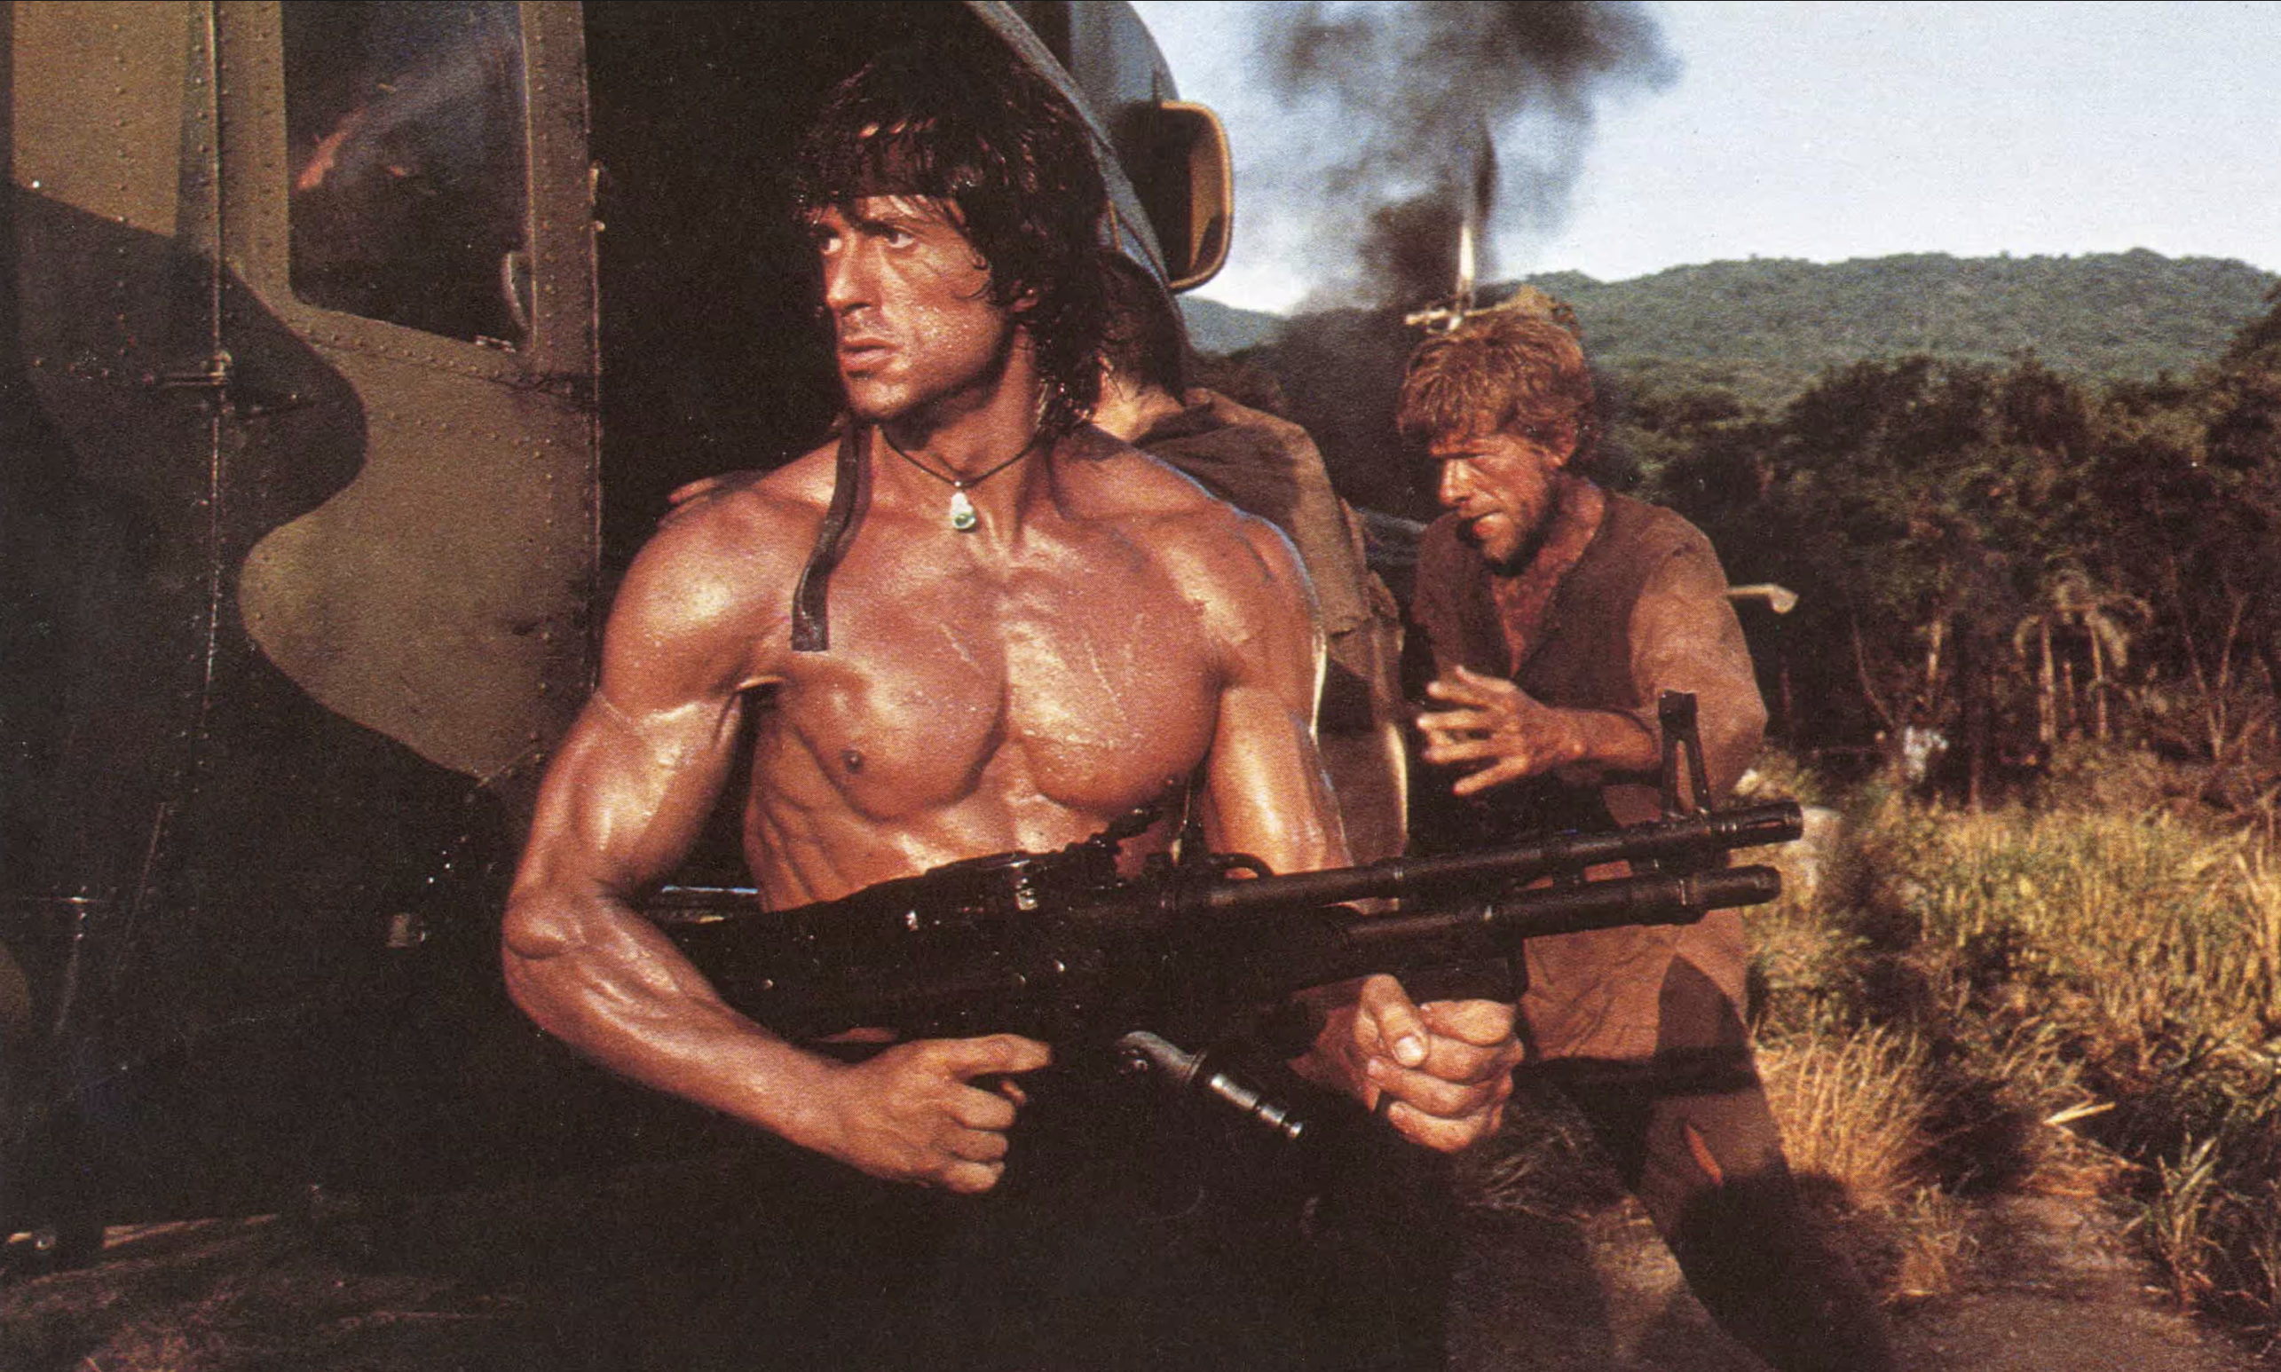
THE POLITICS OF PERFORMING RAMBO
CELEBRITY STUDIES
UNIVERSITY OF AMSTERDAM
1-3 JULY

Slide 2
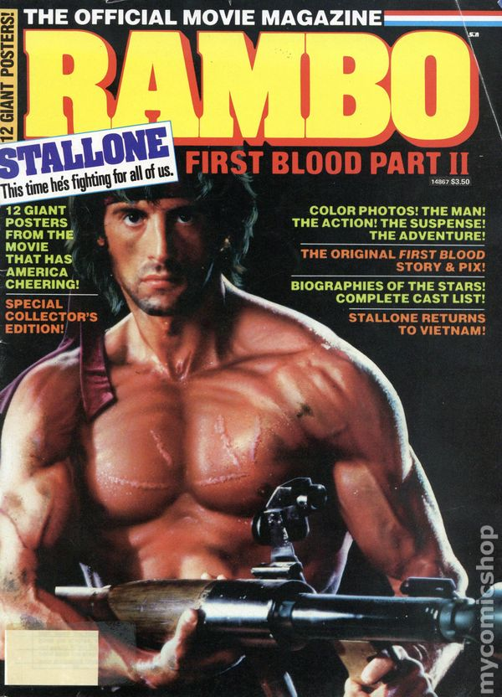
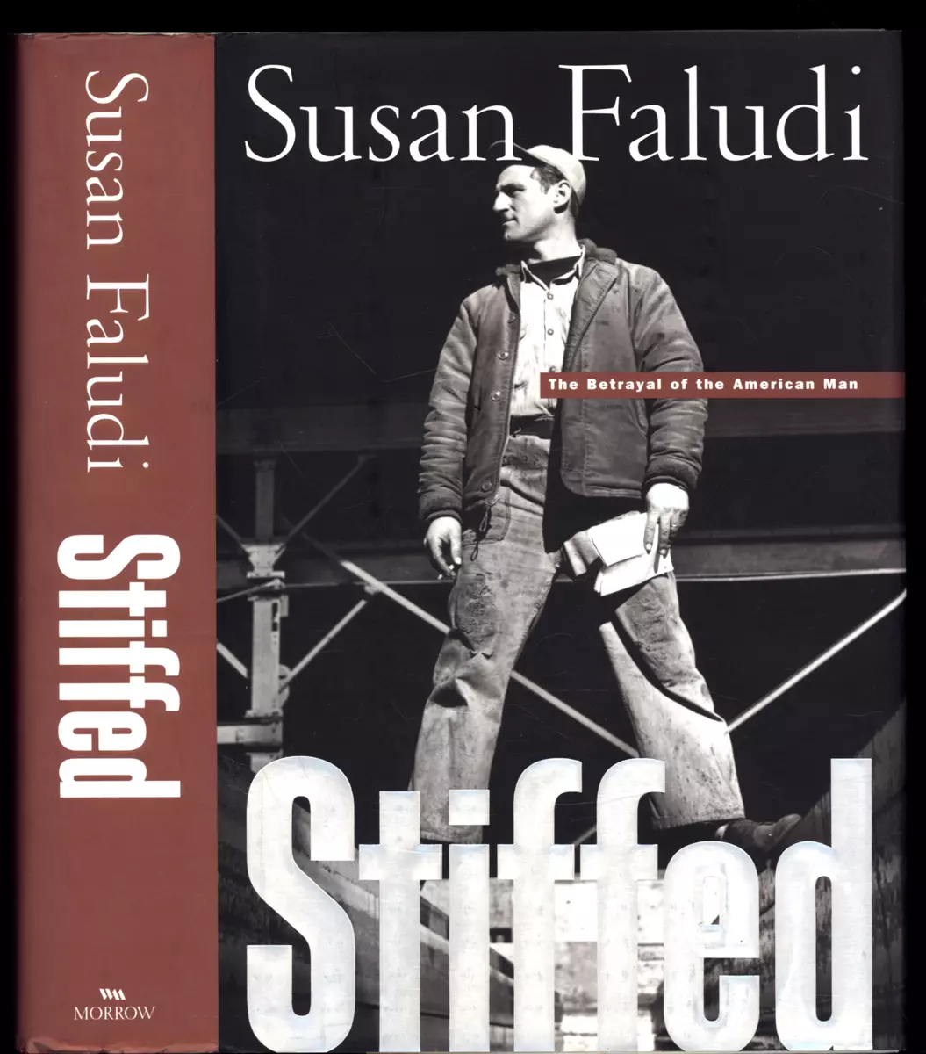
RAMBOMANIA IN CONTEXT
“
This year stores are stocking up with war paraphernalia: a $150 replica of Rambo’s high-tech bow and arrow, Rambo knives and an assortment of toy guns, including a semiautomatic job that squirts a stream of water 10 ft. Youngsters will soon be able to pop Rambo vitamins, and New Yorkers can send a Rambogram, in which a Stallone look-alike will deliver a birthday message or carry out a tough assignment like asking the boss for a raise. The U.S. Army has started hanging Rambo posters outside its recruitment offices, hoping to lure enlistees. Rambo fever is even spreading overseas.
”
Zoglin, Richard (1985) ‘An Outbreak of Rambomania’, Time Magazine,

Slide 3
COMPLICATING STALLONE’S RAMBO
“
Conventional perceptions and clichés about the Rambo series are drawn almost entirely from the second of the […] films, which scored by far the highest returns at the box office
Faludi, Susan (2000) Stiffed: The Betrayal of the American Man, New York: William Morrow & Co.
A son who grew up and out of his father’s control.
Complicated, troubled, indeed haunted, too often misunderstood. [Suggesting that] If you’ve heard about him but haven’t met him before, he’s about to surprise you
”
Morrell, David (2000) First Blood, New York: Grand Central Publishing.

Slide 4
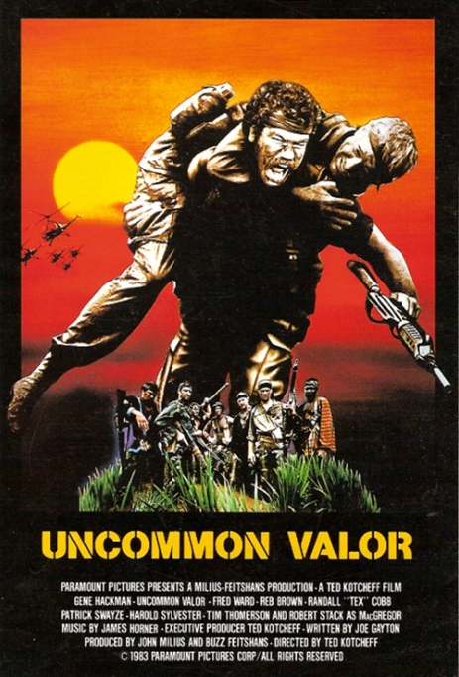
RAMBO AS PART OF THE COMIC BOOK “COMING HOME” NARRATIVES
“
Rambo II attempts no stronger assertion of the MIA issue or takes no more radical stance on their political handling of the Vietnam War itself than did either Uncommon Valor or Missing in Action, yet because of the visibility of its star and its incredible box-office popularity it became a catchword of eighties social history whenever an Vietnam War issue was raised. However, of all of these films, Rambo II is the one that has been most widely recognized as an intentional comic book characterization (96).
As their comic book designation implies, the majority of these films approach the complex problem of “coming home” from an exploitative and simplistic fantasy perspective
”
Palmer, William J. (1993) Films of the Eighties: A Social History, Carbondale, Illinois: Southern Illinois University Press .

Slide 5
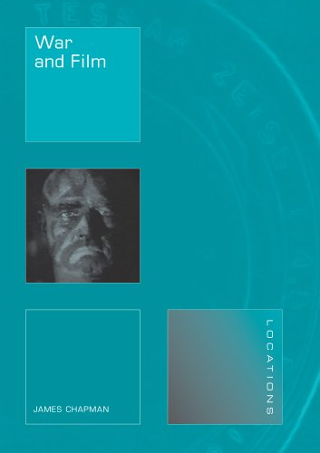
THE PLEASURES OF GENRE
“
Unless we assume that all audiences were right-wing revisionists, the pleasures of Rambo are mainly to be derived from factors other than its politics.
The success of Rambo is due mainly to the pleasures of the action-adventure movie … it belongs to a lineage of action-adventure films that also includes the likes of The Last of the Mohicans, Gunga Din, The Vikings and The Professionals.
Rambo himself is nothing if not a late twentieth-century version of the frontier scout ‘Hawkeye’ in James Fenimore Cooper’s Leatherstocking tales. Like Hawkeye, an Englishman who
has gone native, Rambo is a ‘noble savage’.
”
James Chapman (2008) War and Film,

Slide 6
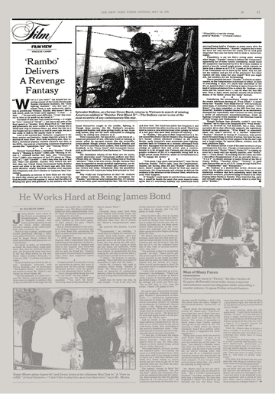
EXPLOITING THE MOMENT
“
Unless we assume that all audiences were right-wing revisionists, the pleasures of Rambo are mainly to be derived from factors other than its politics.
The success of Rambo is due mainly to the pleasures of the action-adventure movie … it belongs to a lineage of action-adventure films that also includes the likes of The Last of the Mohicans, Gunga Din, The Vikings and The Professionals.
Rambo himself is nothing if not a late twentieth-century version of the frontier scout ‘Hawkeye’ in James Fenimore Cooper’s Leatherstocking tales. Like Hawkeye, an Englishman who
has gone native, Rambo is a ‘noble savage’.
”
James Chapman (2008) War and Film,

Slide 7
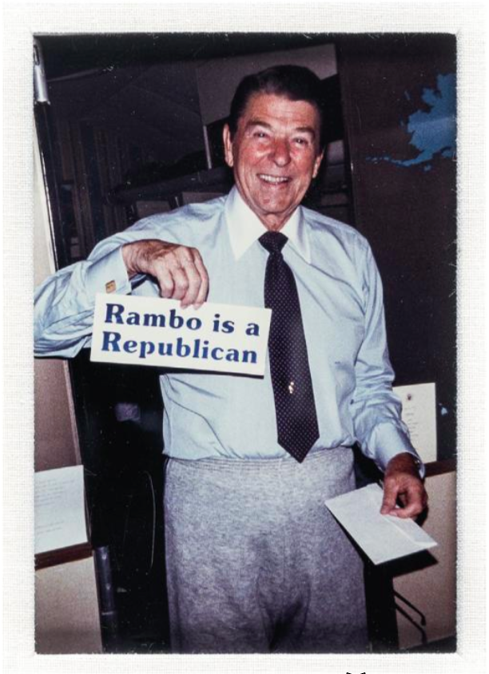
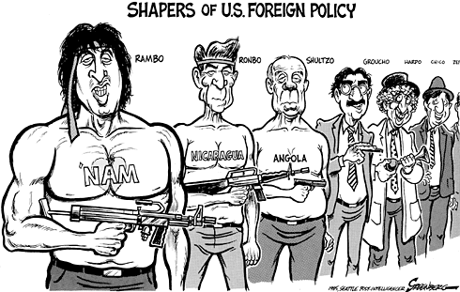
COMIC BOOK POLITICS
“
As their comic book designation implies, the majority of these films approach the complex problem of “coming home” from an exploitative and simplistic fantasy perspective” and in doing so, largely ignore “the physical, psychological, racial, and social problems of Vietnam veterans trying to cope with life in a society that for a decade had denied their existence”
”
Palmer, William J. (1993) Films of the Eighties: A Social History, Carbondale, Illinois: Southern Illinois University Press .

Slide 8
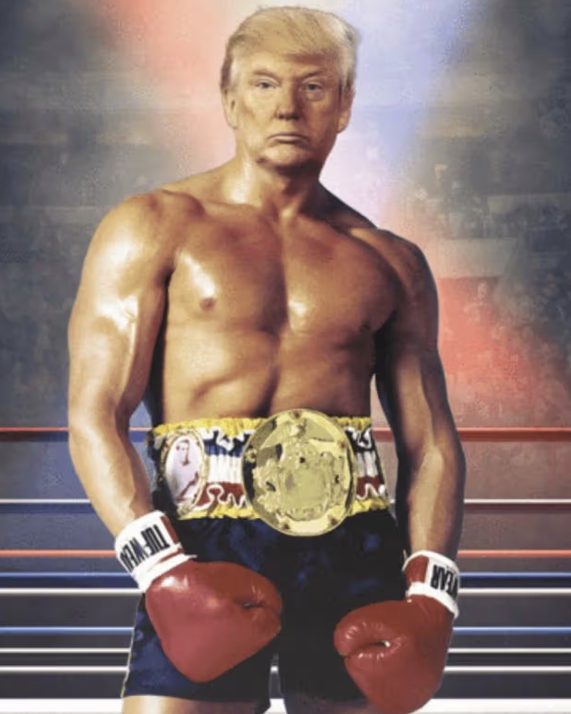
TEMPERING THOSE ASSOCIATIONS?
“
I love Trump. He’s a great Dickensian character. You know what I mean? There are certain people like Arnold, Babe Ruth, that are bigger than life.
But I don’t know how that translates —he let out a laugh—to running the world.
”
Setoodeh, Ramin (2016)’Sylvester Stallone on Donald Trump, Republicans and Running for Office’, Variety.

Slide 9
CAN EXPLOITATION BE TOO EXPLOITATIVE?
“
A MAGA fever dream.
At a time when children from Latin America are being ripped away from their parents at the southern border, when the president is planning to spend billions more on a boondoggle of a border wall, when racism against racial minorities is peaking. In other words, when we live in Trump's America, it is impossible to view this film as anything other than a rationalization of the very bigotries that are hurting millions of people in our real world.
”
Matthew (2016) MAGA fever dream of "Rambo: Last Blood, Salon.

Slide 10
THANK YOU

Slide 11
CAN EXPLOITATION BE TOO EXPLOITATIVE?
“
A MAGA fever dream.
At a time when children from Latin America are being ripped away from their parents at the southern border, when the president is planning to spend billions more on a boondoggle of a border wall, when racism against racial minorities is peaking. In other words, when we live in Trump's America, it is impossible to view this film as anything other than a rationalization of the very bigotries that are hurting millions of people in our real world.
”
Matthew (2016) MAGA fever dream of "Rambo: Last Blood, Salon.
Notes:
The resonance and success of this success of this image inspired a wave of scholarship that continued for over a decade. That really begins with Valerie Walkerdine important essay in 1986, and that quickly leads to a series of book-length studies that are interested in the ideological implications of the masculine images that came to dominate the screen in the 1980s. These are really important studies, Steve Cohan and Ina Rae Hark’s collection Screening the Male: Exploring Masculinities in the Hollywood Cinema in 1992, Yvonne Tasker’s Spectacular Bodies: Gender, Genre and the Action Cinema the following year and Susan Jeffords Hard Bodies: Hollywood Masculinity in the Reagan Era the year after that. Books that sit at the intersection between film studies and gender studies and that have since become essential reading for anyone interested in the politics of representation, in what these images mean? In what they signify? And what is at stake in the acceptance and circulation of these images, for men, as well as for women?
Yvvone Tasker argued, that, alongside Arnold Schwarzenegger, Sylvester Stallone was the leading exponent of what she called ‘muscular cinema’ (1993), part of a longer tradition of masculine representation that she explores in Spectacular Bodies.
While Susan Jeffords argued that the period was marked by images of ‘hard-bodied masculinity’ (1994), that communicated ‘strength, labor, determination, loyalty, and courage,’ …’ the indefatigable, muscular, and invincible masculine body’ (Jeffords 1994, 24-25), and that stars like Stallone functioned as a ‘collective symbol’

Slide 12
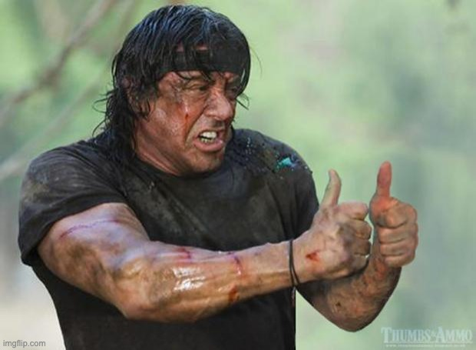
THANK YOU

