Slide 1

ARBOR
National Task Force
12th March 2013
Dr Sacha Oberweis CEng MCIBSE
Notes:
1

Slide 2

Presentation overview
General overview of ARBOR
Benchmark report
What do we actually do…
  So far…
  … and in the coming months
Further sources of information

Slide 3
The idea behind ARBOR
EU 202020 targets aimed at preventing a 2°C temperature rise
  Reduction in GHG emissions by 20% of 1990 levels
  Reduction of energy consumption by 20% through increased energy efficiency
  Increase global share of RES to 20% within the EU
Biomass currently accounts for about half of all renewables in EU (4% of TPES)
The scenarios published by the European Commission show that the annual amount of biomass heat and electricity will account to a total of 1,650 terawatt hours (TWh) in 2020 (increase of 69%)
Much expertise in Biomass is available....
....but is neither co-ordinated nor matched with commercial exploitation

Slide 4
ARBOR – The basics
Accelerating Renewable Energies through valorisation of Biogenic Organic Raw Material
INTERREG IVB NWE project with a budget of 7 361 959 € launched in 2011
3 Work Packages
  Stimulating sustainable production, collection and preparation of biomass for energy
  Conversion and utilisation of biomass to energy
  Sustainability assessment and strategy development
Dissemination of knowledge
  Investments: SRC plantations, Centre of Excellence, closed loop biomass cycle, biogas
  Pilots: biodiversity, phytoremediation, cover crops, added value
  Seminars, task forces, workshops, etc.

Slide 5

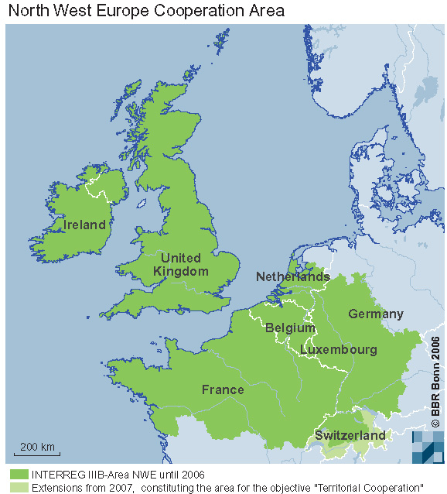












Partnership

Slide 6
The Benchmark Report

Slide 7
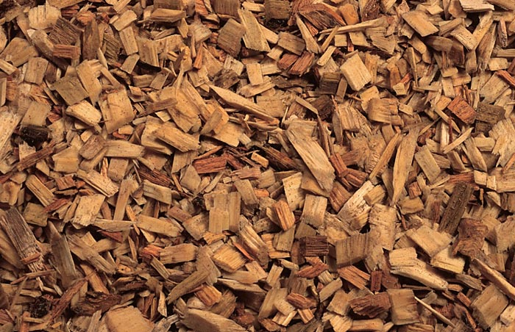
What do we do?
Short rotation coppice
Biomass on contaminated land
Treatment of wetlands
Valorisation of digestate
Fuel quality assessment
Conversion technologies

Slide 8
What is SRC?
Fast-growing trees
Biomass is harvested periodically (max 8 years)
Drying and combustion of wood chips
Production of bio-energy without impacting the food chain
Goals for ARBOR:
  Valorisation of unused industrial areas
  Support biodiversity in agricultural areas
  Synergies of trees – animal production
Valorising unused industrial land: 5 pilots total 4 ha
Supporting biodiversity in agricultural area: 2 pilots total 2.5 ha
Agroforestry: 1 pilot total 1 ha

Slide 9
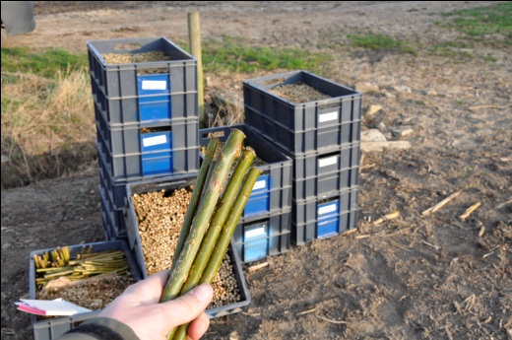
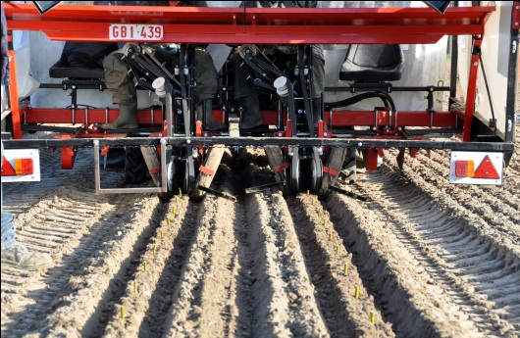
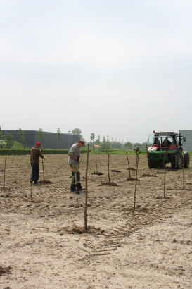
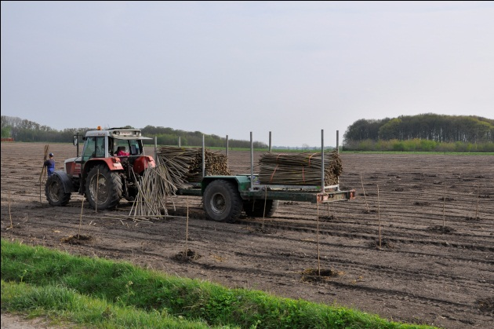
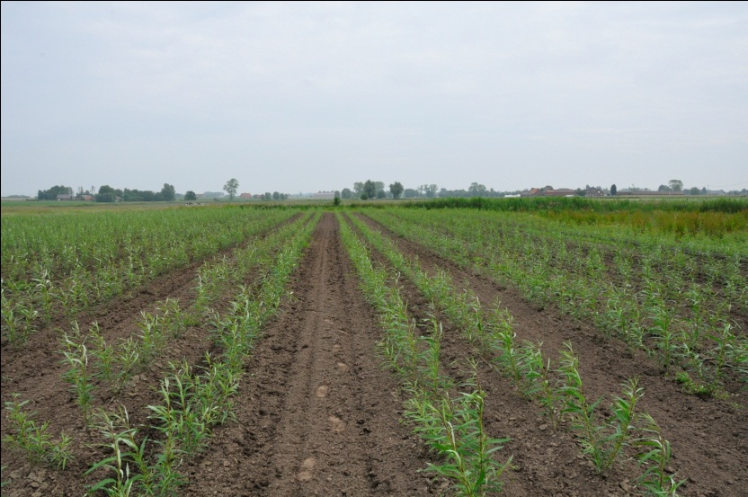
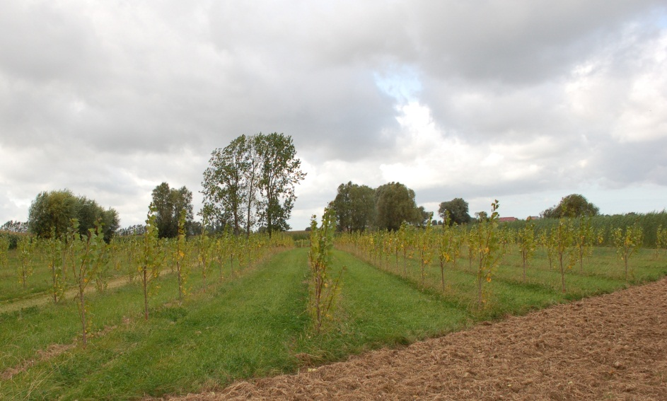
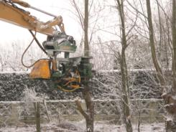
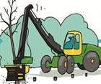
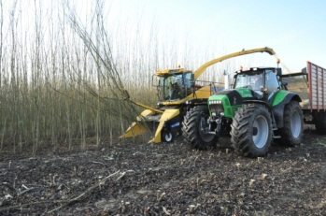
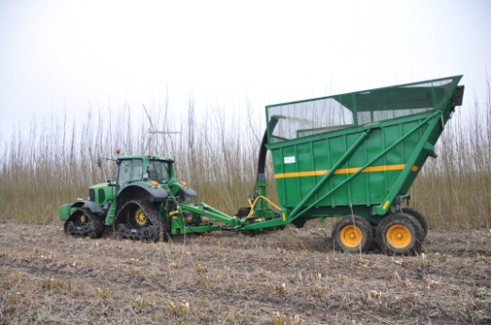
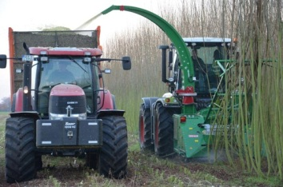
Planting in 2012
March – April
6 ha willow (3 year cycle)
2nd half of May
1,5 ha poplar (5 year cycle)

Slide 10
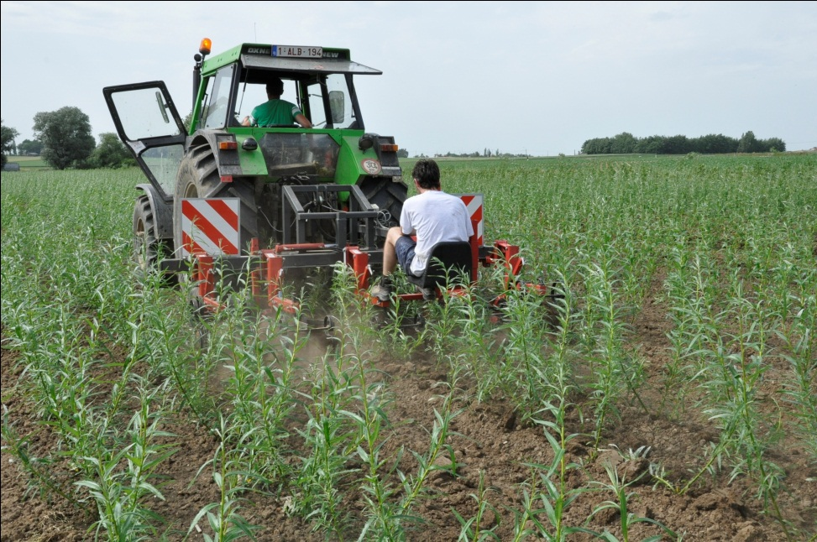
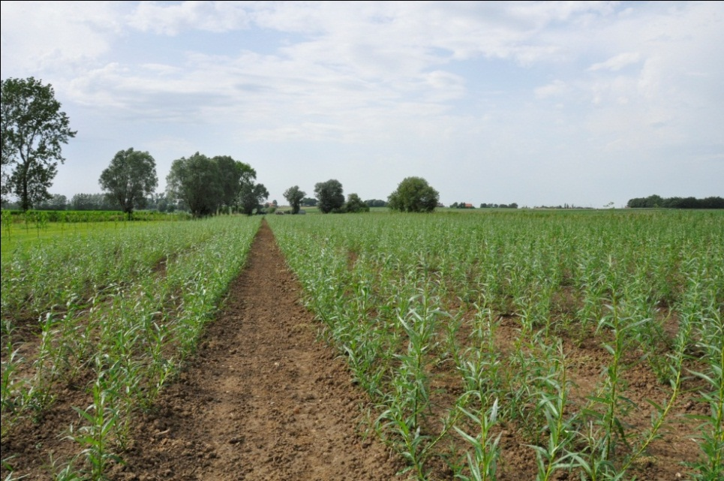
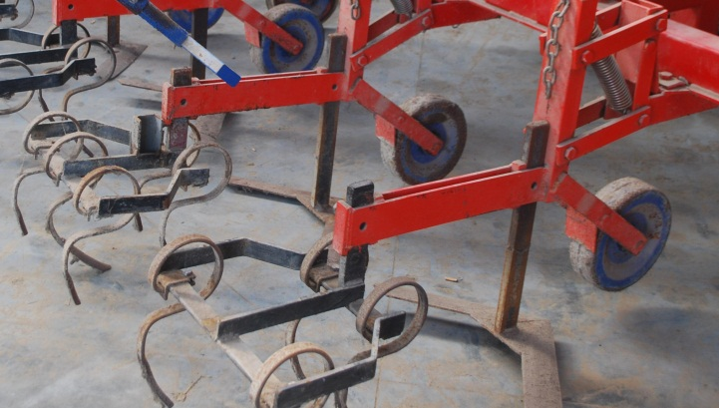
Weed control
Initially herbicide just after planting
in combination with mechanical weed control (3x)

Slide 11
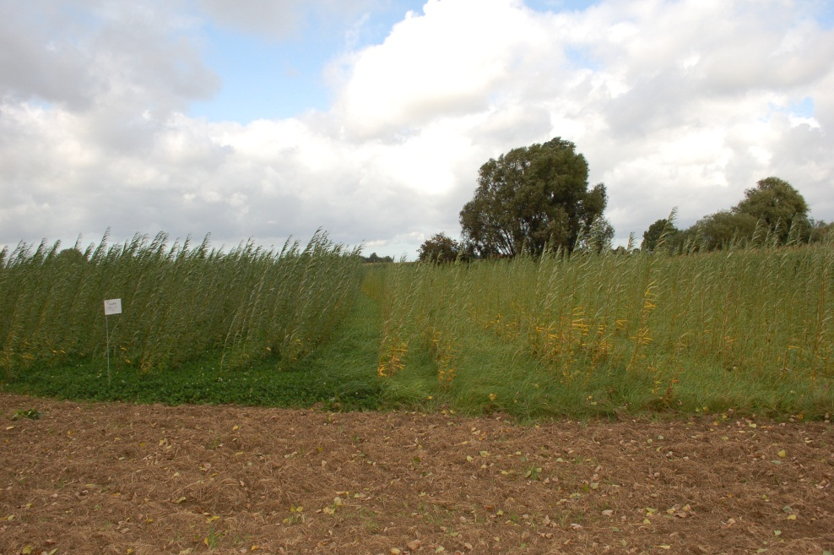
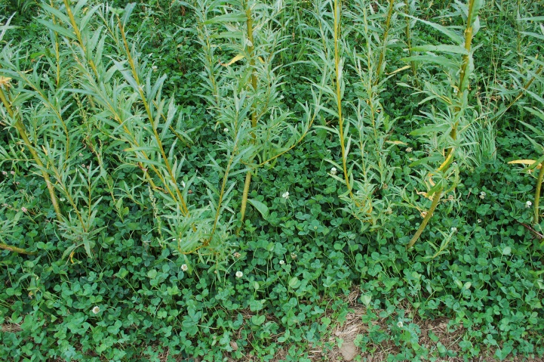
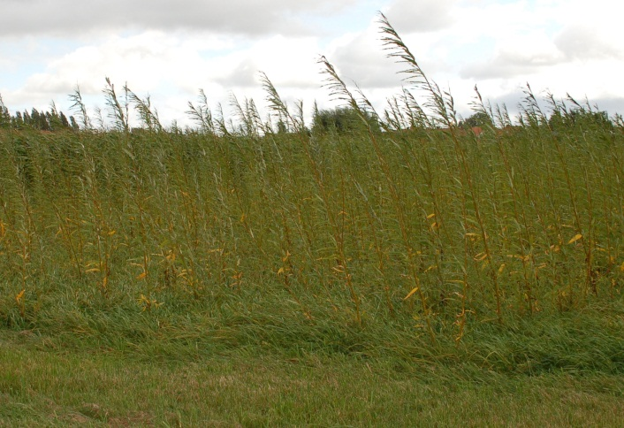
Experimental weed control
by sowing cover crops a few weeks after planting
white clover
rye-grass

Slide 12
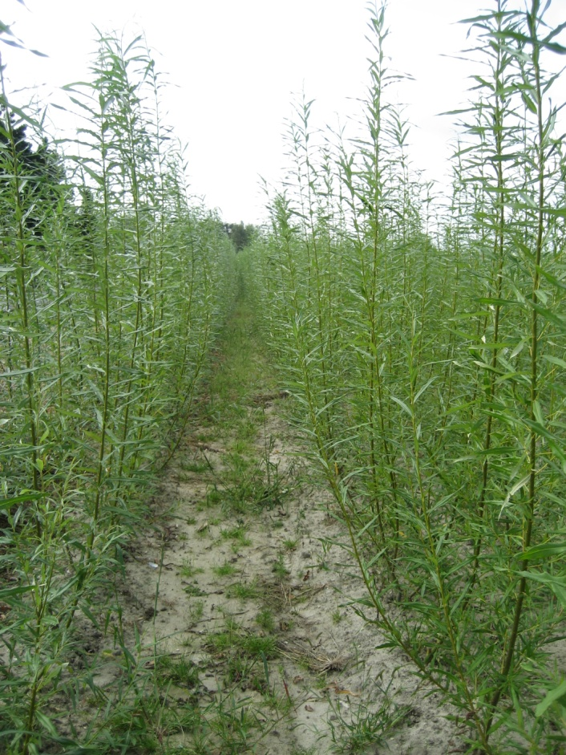
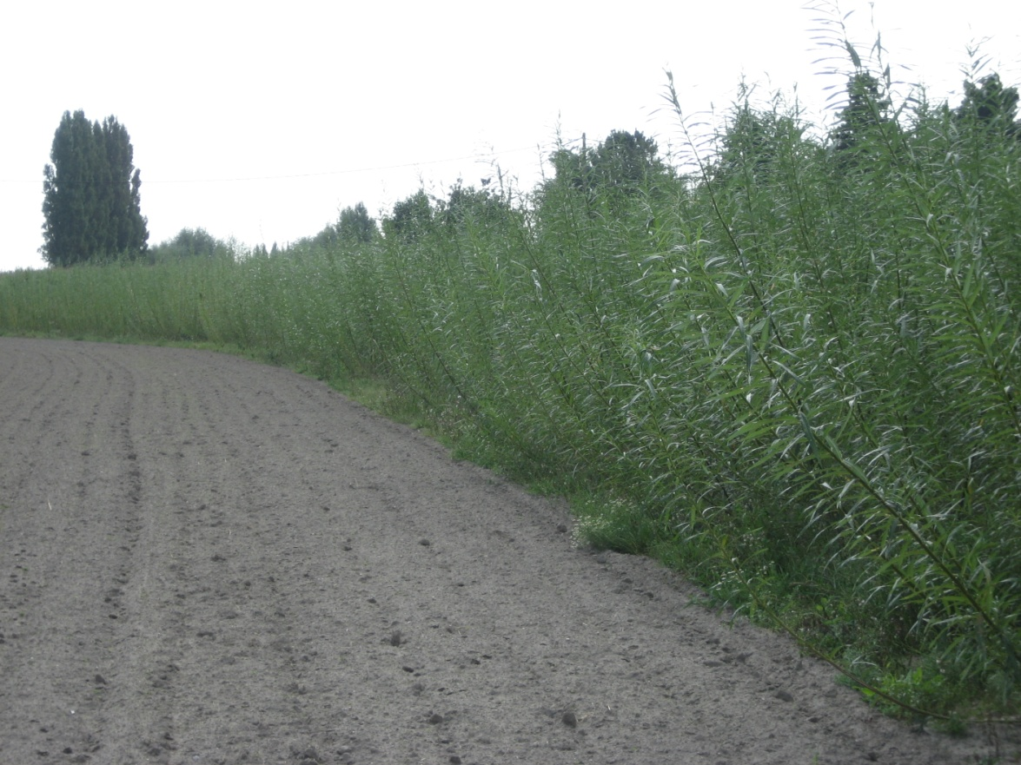
Meulebeke
5 months after planting

Slide 13
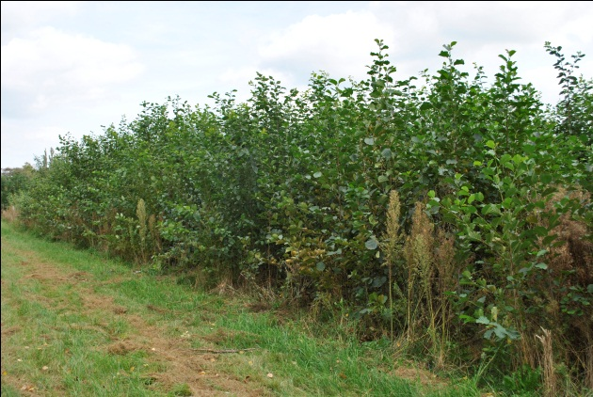
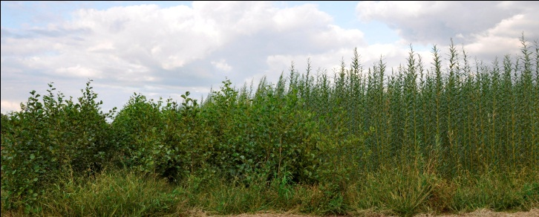
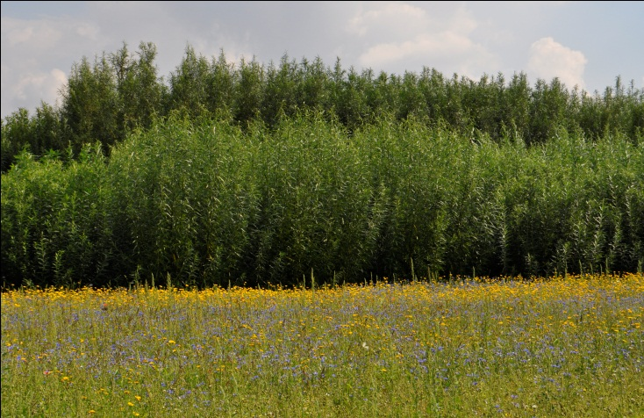
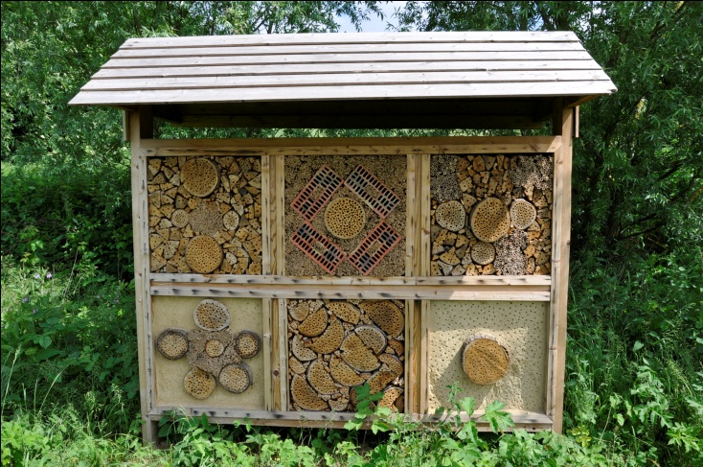
Biodiversity measures
Structural variation:
  By introduction of indigenous species
  Phased harvesting
  Small surfaces and preferably oblong
  Conservation of nearby small landscape elements
Headlands: pollen and nectar margins for pollinators and other beneficials or butterflies.
Grassy margins inside for overwintering natural predators of willow beetle.
Installation of insect hotels and nest boxes.

Slide 14
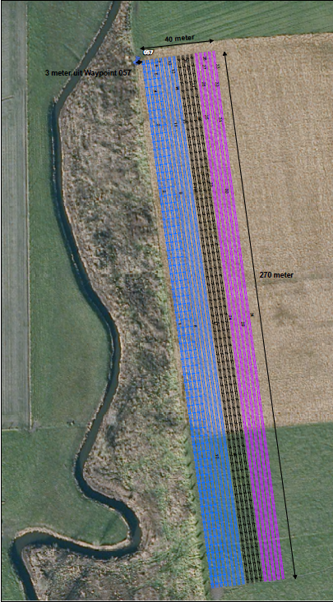
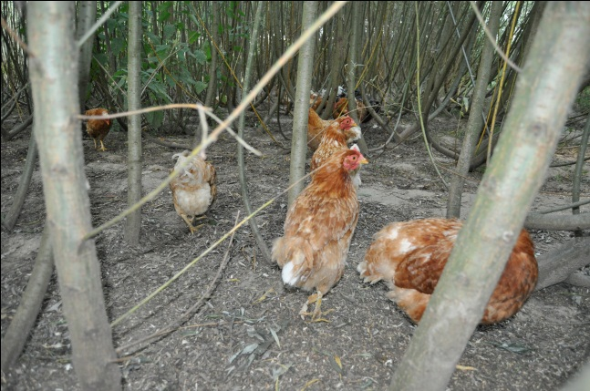
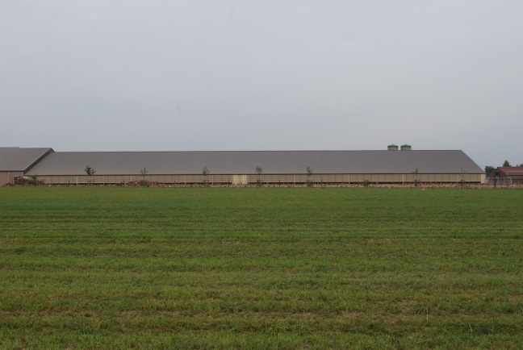
Combined use – 1ha in Poeke
Chicken and (wood) chips
  Extra income for farmers and more efficient land-use
  Animal well being end ecological production
  Draining
  Buffer for odour
  Landscape integration
Tora, Olof, Tordis and Klara

Slide 15
Outcomes and further work
Good case scenarios
Increased biodiversity and measured impact
Study of valorisation pathways
  Wood pellets
  Gasification
Economical feasibility
Fuel quality tests (Staffordshire University)
Bottlenecks and their solution(s)

Slide 16
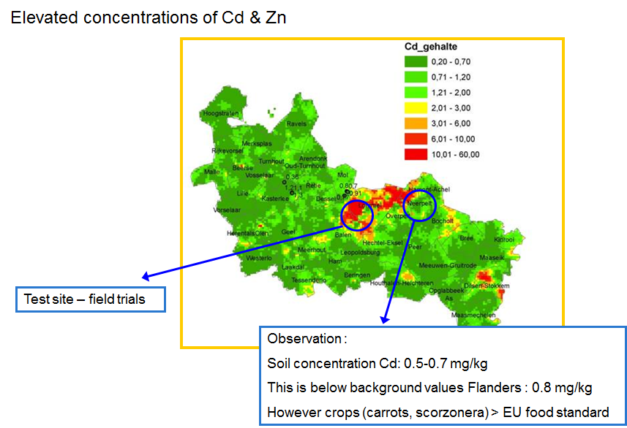
Case study BCL – De Kempen (Campine Region)

Slide 17
Soil characterization

Slide 18
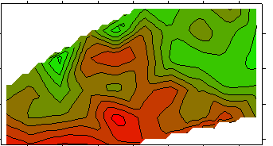
Soil characterization for Cd_{tot}
Total Cd concentration (mg/kg)

Slide 19
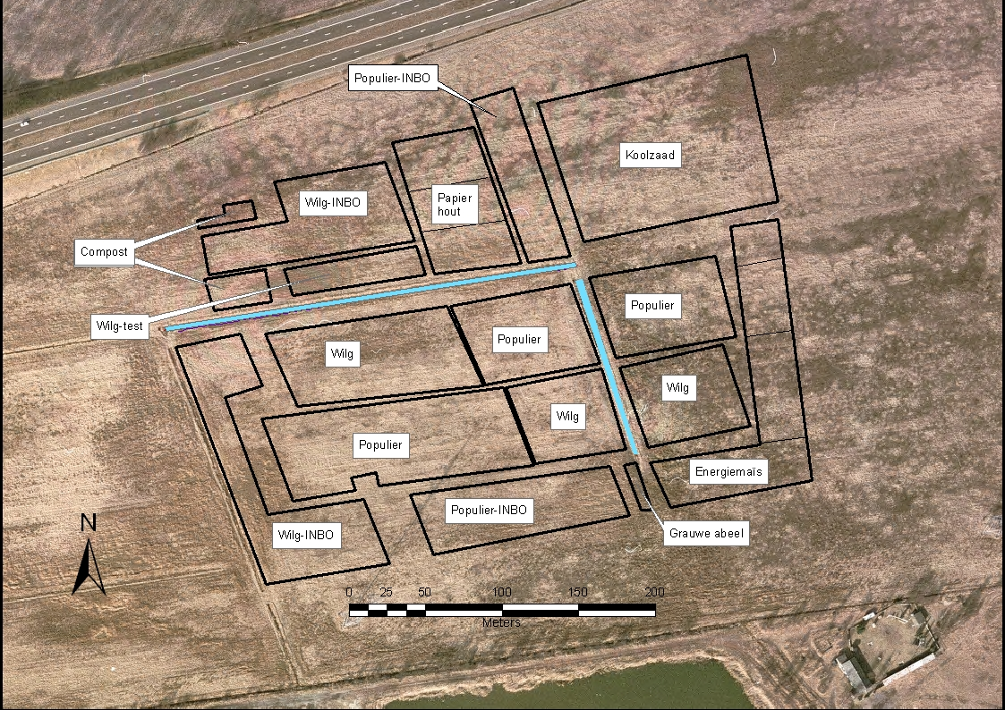
Notes:
Enkel Populier 1 cm per jaar groei, schoon recht zonder zijtakken → papier
Wilg heeft meer struikvorming, veel meer biomassa

Slide 20
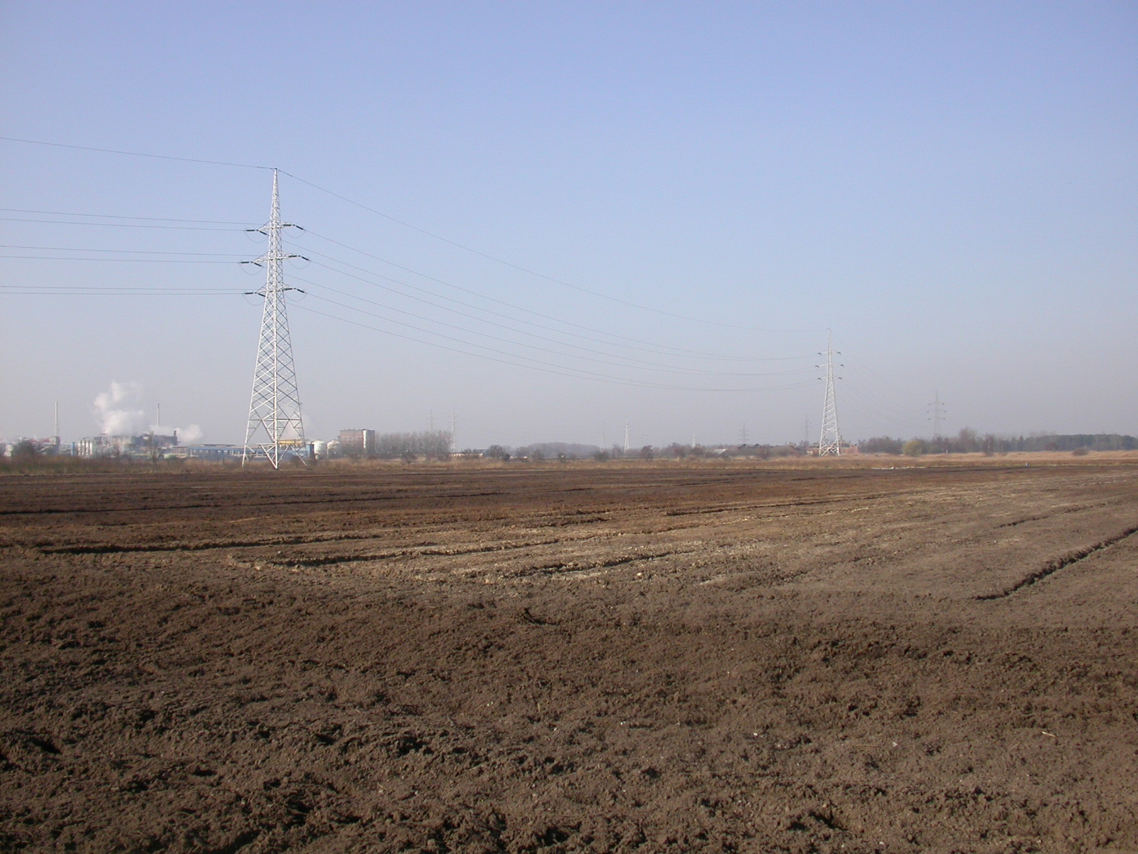

Slide 21
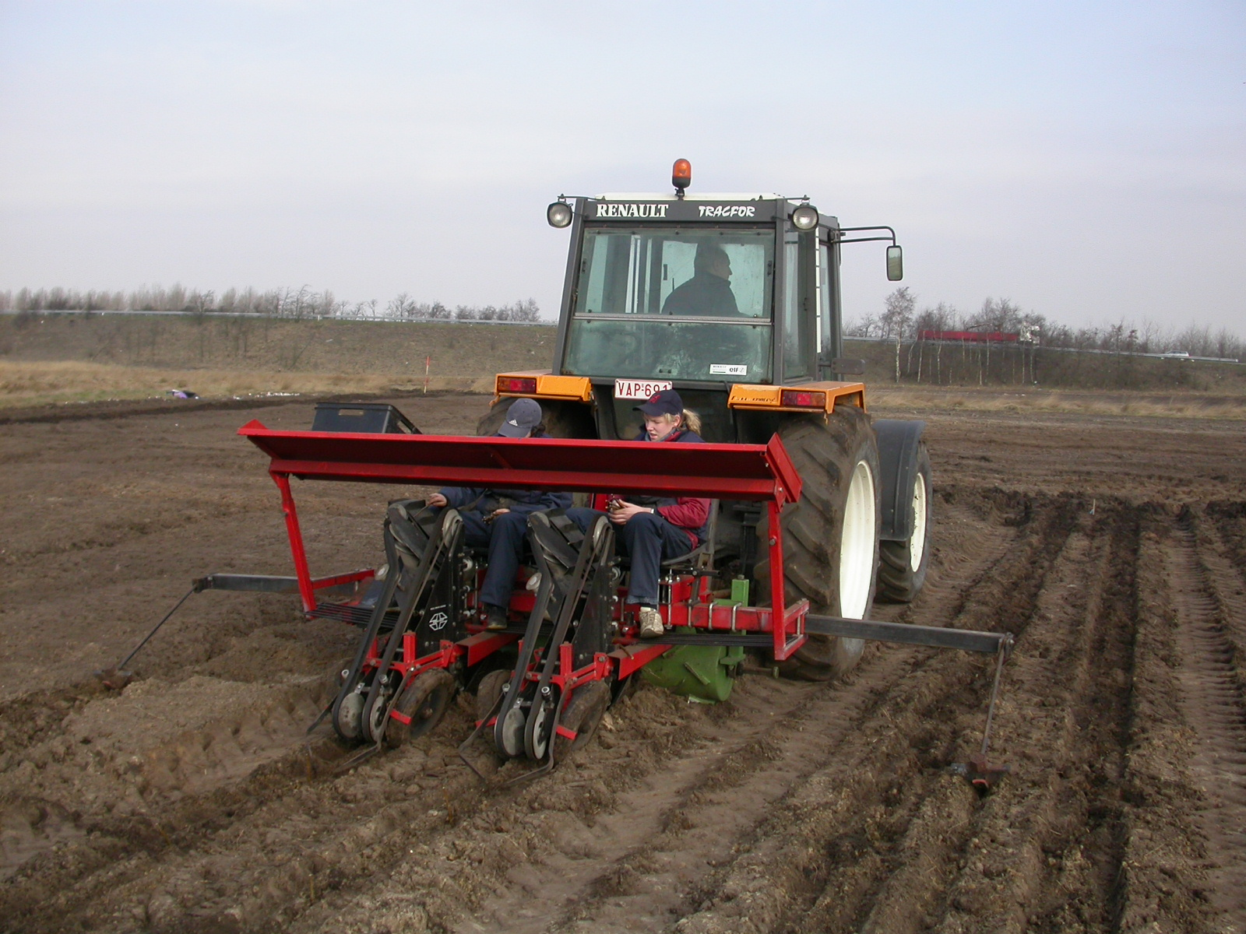

Slide 22
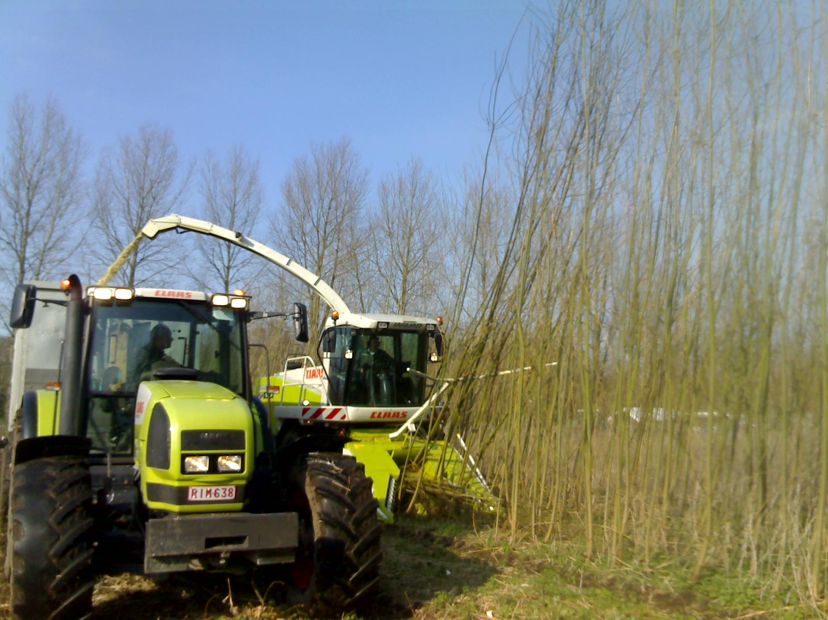

Slide 23
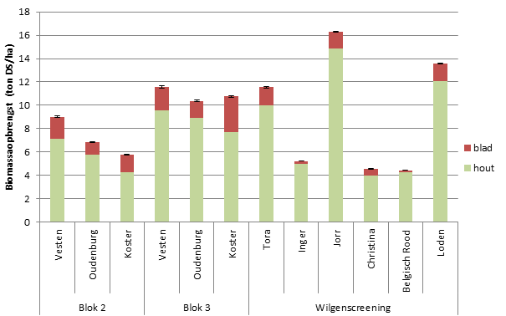
Yield of poplar & willow
(t DM / ha, 2nd year of 2nd rotation)
Notes:
23

Slide 24
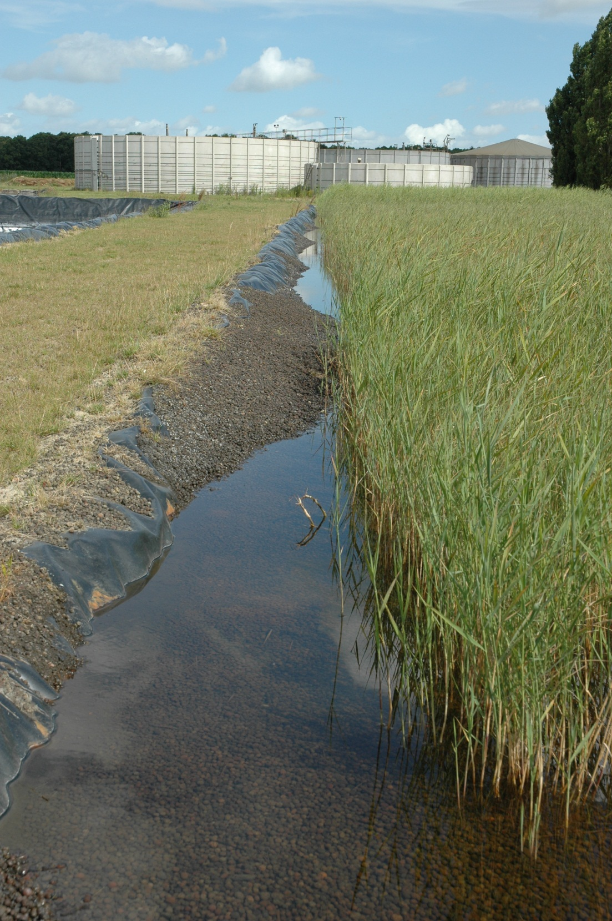
Treatment of wetland
Lots and lots of it…
Added bonus for landowners
Biodiversity
Water quality?

Slide 25
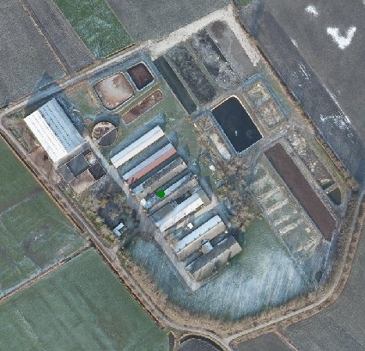
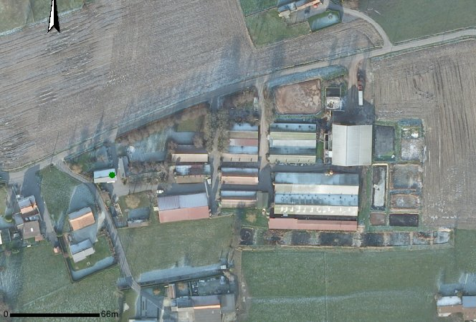
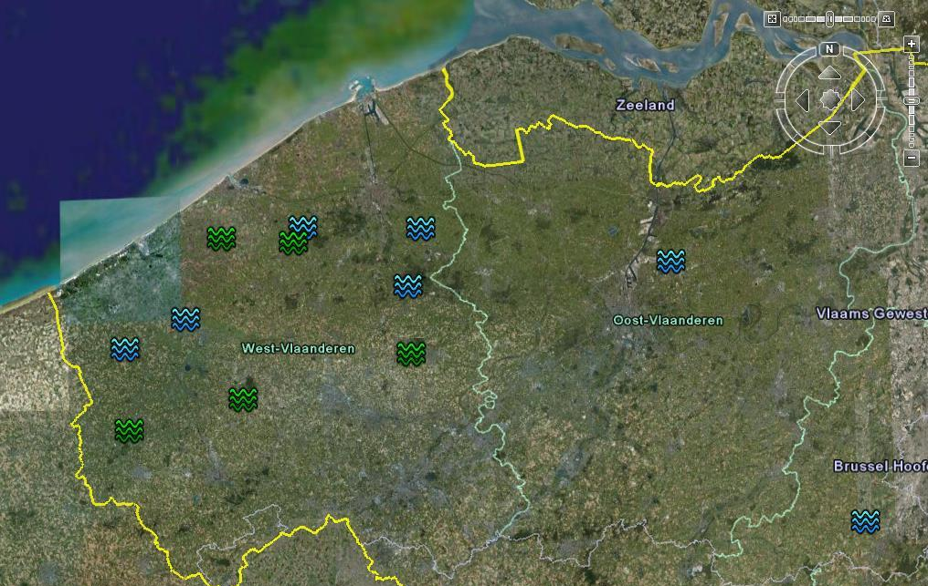
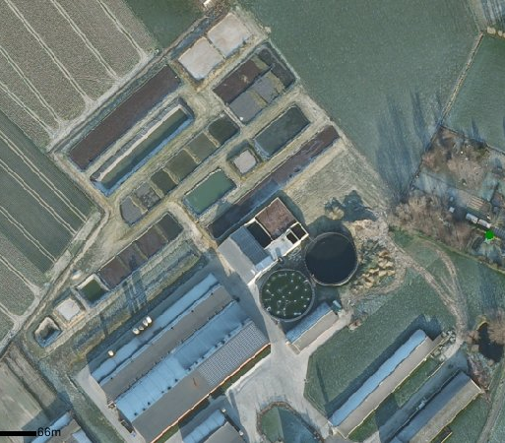
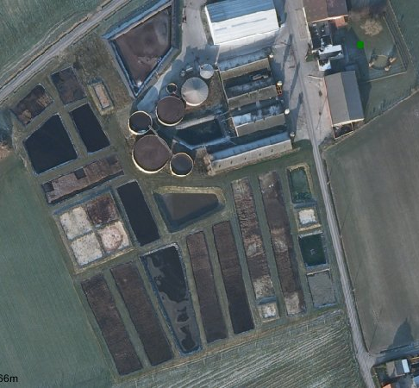
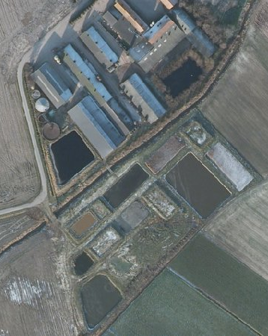
ICH – 0,5 ha
Wetland area
GI – 3 ha
Prim. & Sec. Manure treatment
Pig farm
PI – 1 ha
WVL– 3 ha
LA – 0,5 ha

Slide 26
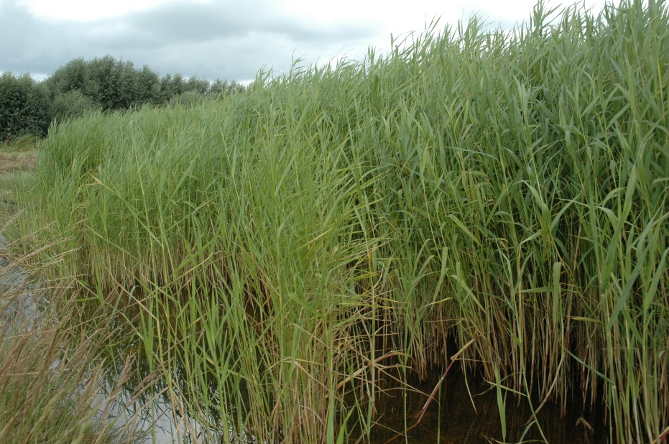
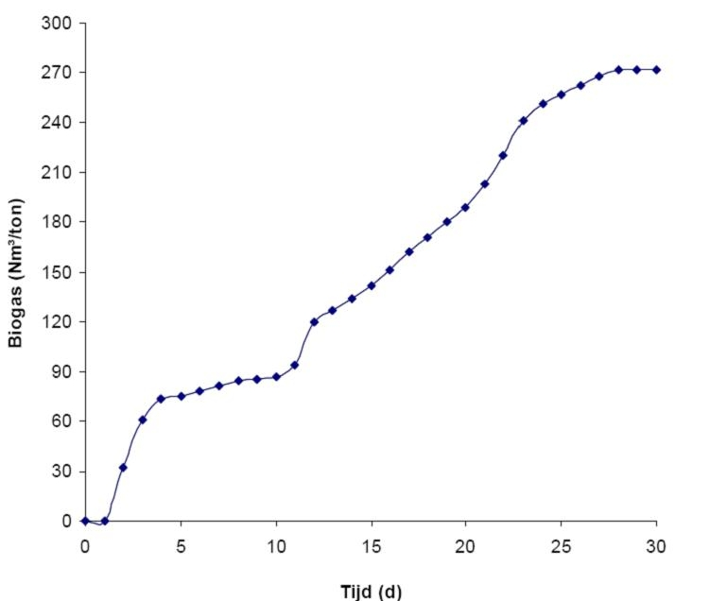
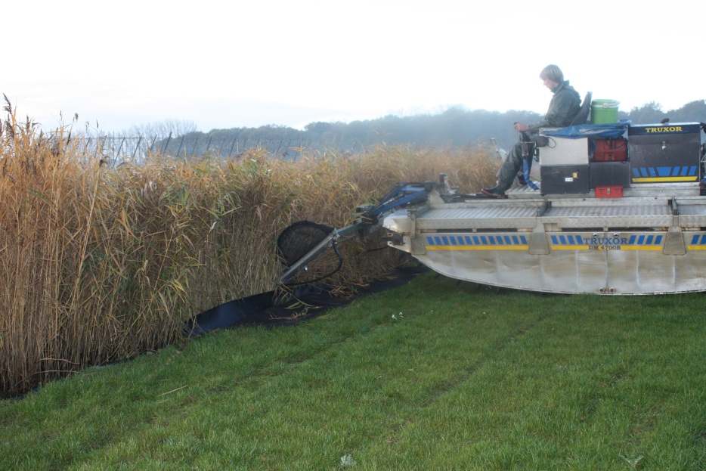
Biogas yield (Nm3/t)

Slide 27
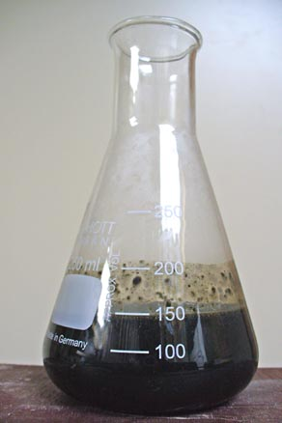
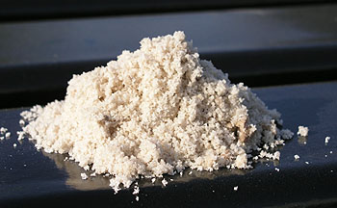
Why recover nutrients?
Awareness of phosphorus depletion
Awareness of increasing artificial fertiliser use
  Energy consuming
  Economical burden for farmer
Question: how can digestate be valorised as a valuable source of nutrients?
OR: how can digestate be turned into a ‘green’ substitute for artificial fertilisers?
Extract nutrients!

Slide 28
First conclusions market study: fertiliser industry
Inorganic P/K - fertilisers
  No odorous compounds
  Max. 10% water
  High in P2O5 and/or K2O
  Low in heavy metals
  Struvite seems most promising but this is to be consolidated in further meetings
Inorganic N – fertilisers
  Check potential ammonium sulphate from acid air washers
Organic fertilisers
  Traceability of input streams
  Competitive price
  Guaranteed volumes
  Potential for Struvite? SF digestate (legislative aspects)?

Slide 29
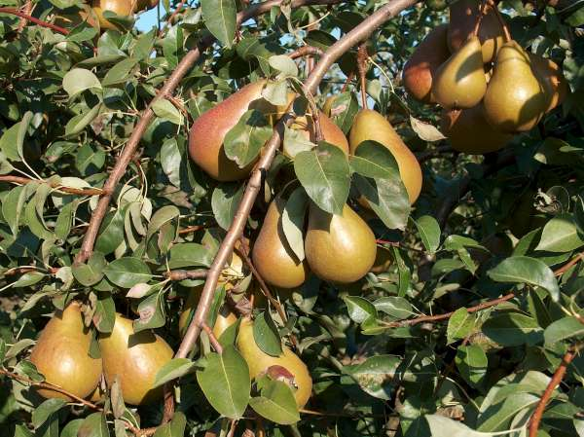
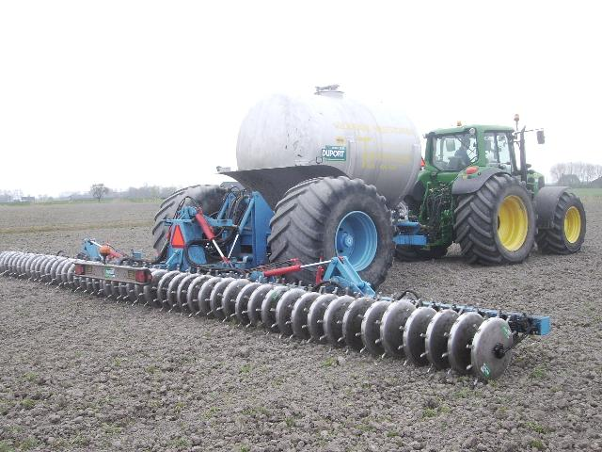
First conclusions market study: agricultural use
Field trials for apples and pears with:
  Digestate
  Struvite (Mg)
Agricultural use of reject water from acid air washer?
  Ammonium sulphate - solution which contains 3-7% N
  pH varies between 3-7
  S-content (1 kg N = 1.3 kg S)
  Results from field trials!
Agricultural use of NK-concentrates
  Arable land: 76-90%
  Grassland: 67-81%
  Results from field trials!
To (partially) replace artificial fertiliser
Restricts use!
Dutch research

Slide 30
Biomass at Staffordshire University
Fuel quality assessments
  Moisture
  Ash
  Calorific Value
Biomass gasification
  Tar removal
  Different raw materials
  Suitability for power generation
Biomass boiler for cooling and heating

Slide 31
Fuel tests – Flemish Manure Association
(www.vcm-mestverwerking.be)

Slide 32
Fuel tests – Research Centre Luxembourg (www.crte.lu)

Slide 33
Fuel tests – Institute for Future Energy Systems (www.izes.de)

Slide 34
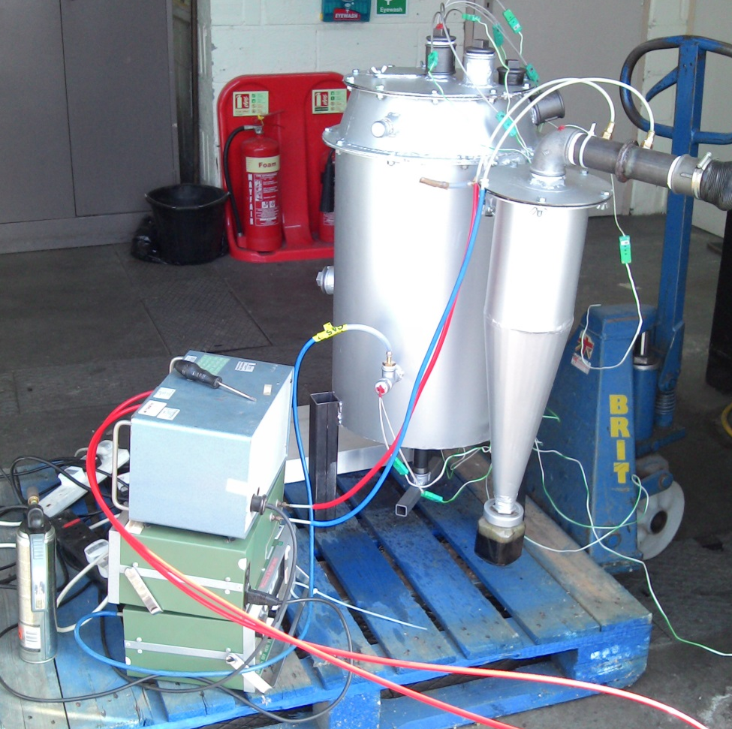

Biomass gasification

Slide 35

… and it works
Temperatures up to 1100 deg C
Gas mixture
  18% CO
  10% H2
Tar removal
  Quantify filter efficiency
  Various filter media
Flammable gas mixture within 10 minutes
No fan – draft induced with compressed air

Slide 36
Biomass boiler

Slide 37
For further information
Thank you for listening
w: www.arbornwe.eu
e: s.oberweis@staffs.ac.uk
t: +44 (0)1785 353565

