Slide 1
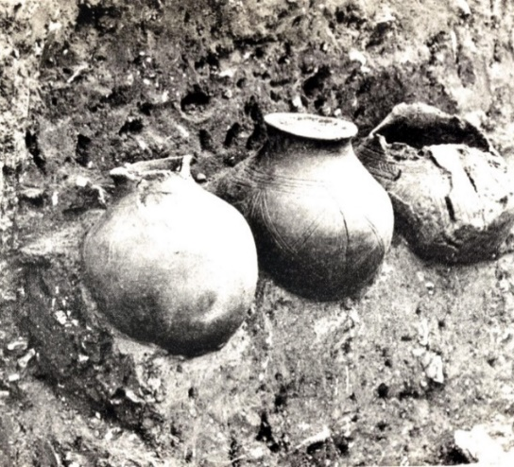
The study of cremation in the past: what is it good for?
Dr Kirsty Squires, Staffordshire University, UK
(Kirsty.Squires@staffs.ac.uk)

Slide 2
Lecture outline
By the end of the lecture you should understand:
What information can be extracted from cremated remains;
How they can inform our understanding of the past;
Why the study of cremation in the past is important in archaeology;
A more in-depth understanding of Anglo-Saxon funerary rites.

Slide 3
Warning!
This presentation contains images of human remains

Slide 4
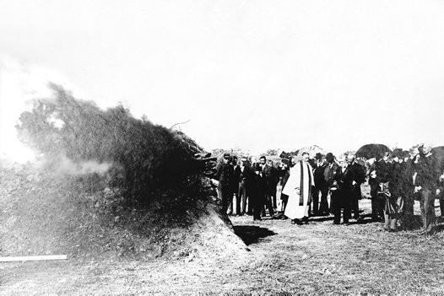
What is cremation?
“The act and process of burning a body as part of a funerary rite; a ritualised event”
(Thompson, 2015)
The earliest recorded use of cremation as a funerary rite dates to around 24,000 BCE from Australia and became a majority rite from around 8,000 BCE
Cremation was practiced by societies around the world in the prehistoric and historic past
Cremation became a minority rite in Europe following the adoption of Christianity (c. 313 AD) until the late 19th century AD – there are exceptions…
19th century cremation at Springvale Necropolis, Victoria (Australia)
Notes:
Iron Age, Romans, Greeks, Anglo-Saxons, Vikings, Japan, India, Native Americans, and aborigines etc.

Slide 5
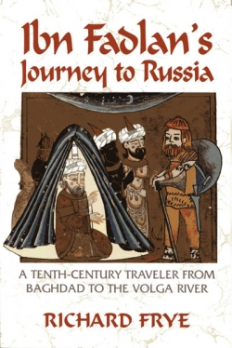
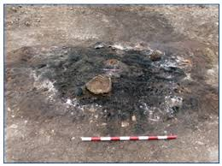
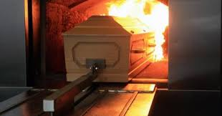
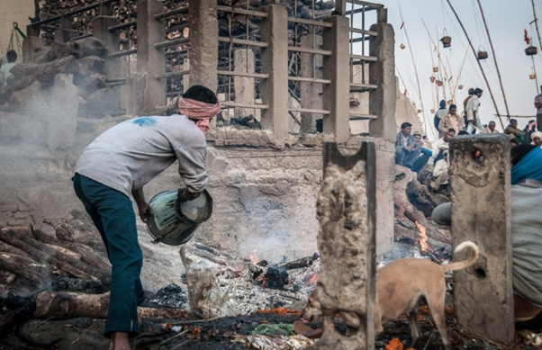
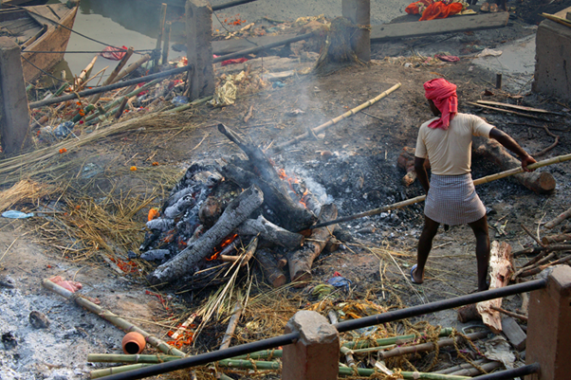
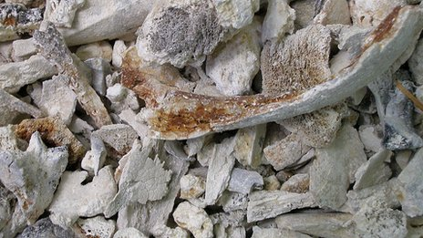
How do archaeologists interpret cremation in the past?
Cremation in “Western” society
Ethnographic studies
Literary sources
Archaeological and osteological remains
Notes:
Remains of the Funeral Pyre from the Central Celtic Burial (#10) at Karakochovata Tumulus (Bratya Daskalovi), south-central Bulgaria.

Slide 6
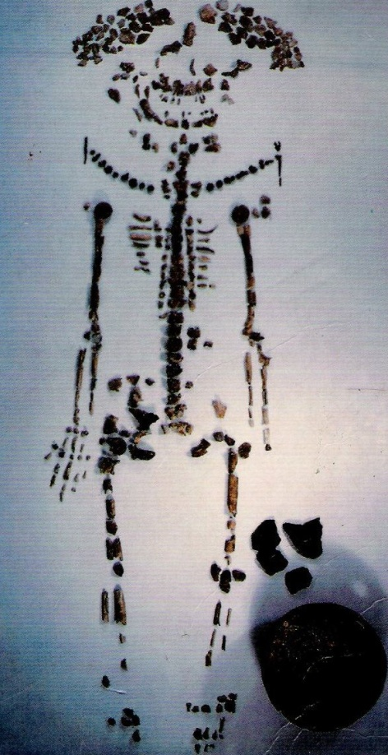
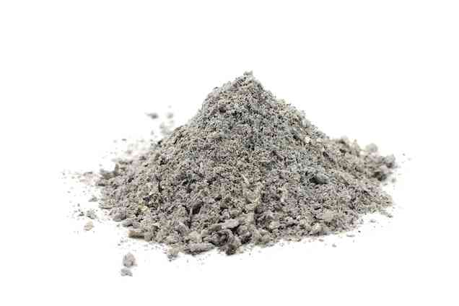
Extracting information from cremated remains
Common misconception that cremation results in unidentifiable, small fragments of bone and ash
Fragments of bone can be quite large and provide a plethora of information about the deceased and cremation process

Slide 7
What information can be extracted from cremated bone?
Biological information | The cremation process
Minimum number of individuals (MNI) | Temperature
Age | Duration
Sex (not gender) | Oxidising conditions
Pathological conditions | Whether the body was fleshed/ unfleshed at the time of cremation by looking at shrinkage, warping, and fracture patterns
Trauma | Position of the body on the pyre
Stature? | Intentional manipulation of remains resulting in extensive fragmentation
Notes:
MNI – duplicate elements, don’t look at size as this is inaccurate (return to this point shortly).

Slide 8
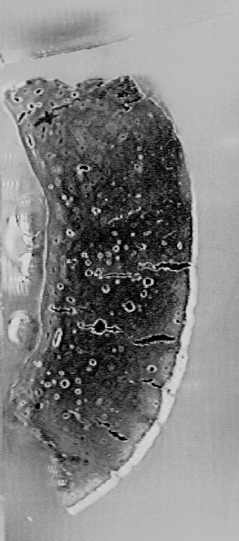
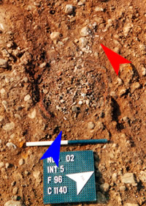
Issues associated with the analysis of cremated bone
Shrinkage (i.e. metrics are unreliable)
Loss of diagnostic elements during the cremation and collection process, burial environment, etc.
Fragmentation of diagnostic remains
How can we overcome these issues?
Notes:
Technical methods

Slide 9
Case Study: Early Anglo-Saxon England

Slide 10
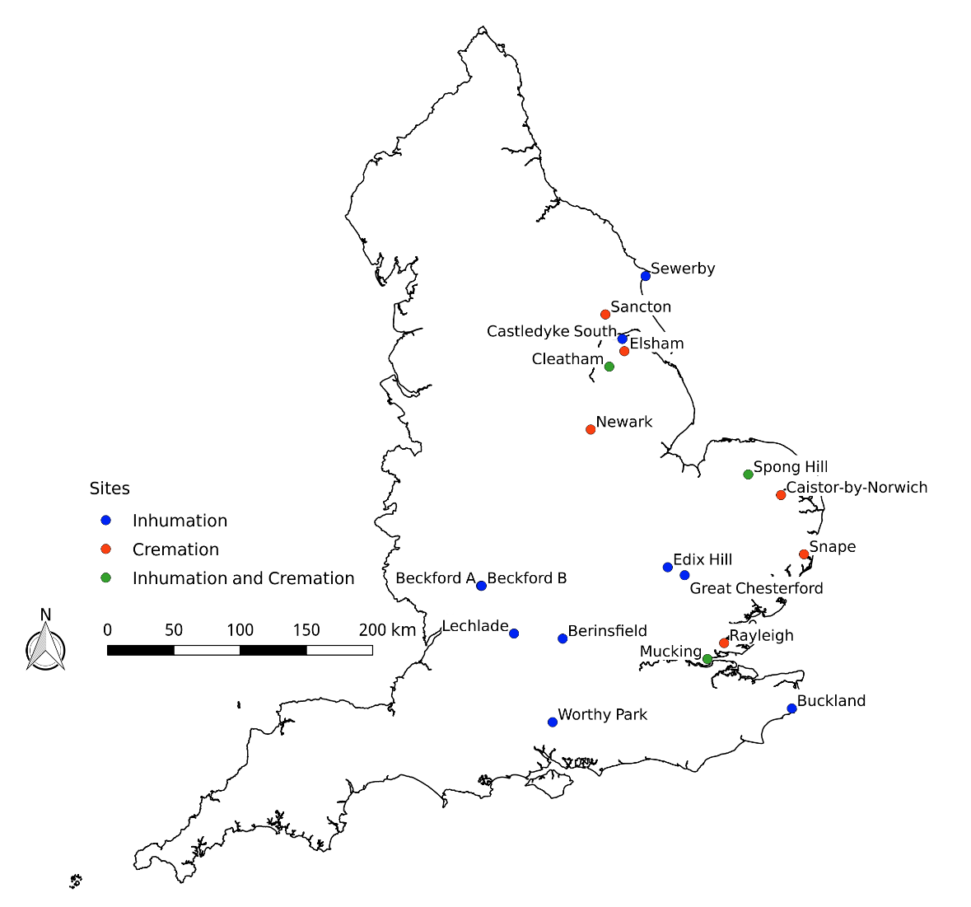
Cremation in early Anglo-Saxon England
Cremation and inhumation practised throughout the early Anglo-Saxon period – popularity of cremation waned in the mid-6th century AD
Inhumation practiced over a wider geographical area than cremation
Weapons, jewellery, domestic-related objects, pottery vessels, and animal offerings are associated with early Anglo-Saxon mortuary rites
Notes:
Cremation practiced from early 5th to late 6th century – later in some areas (early 7th century)

Slide 11
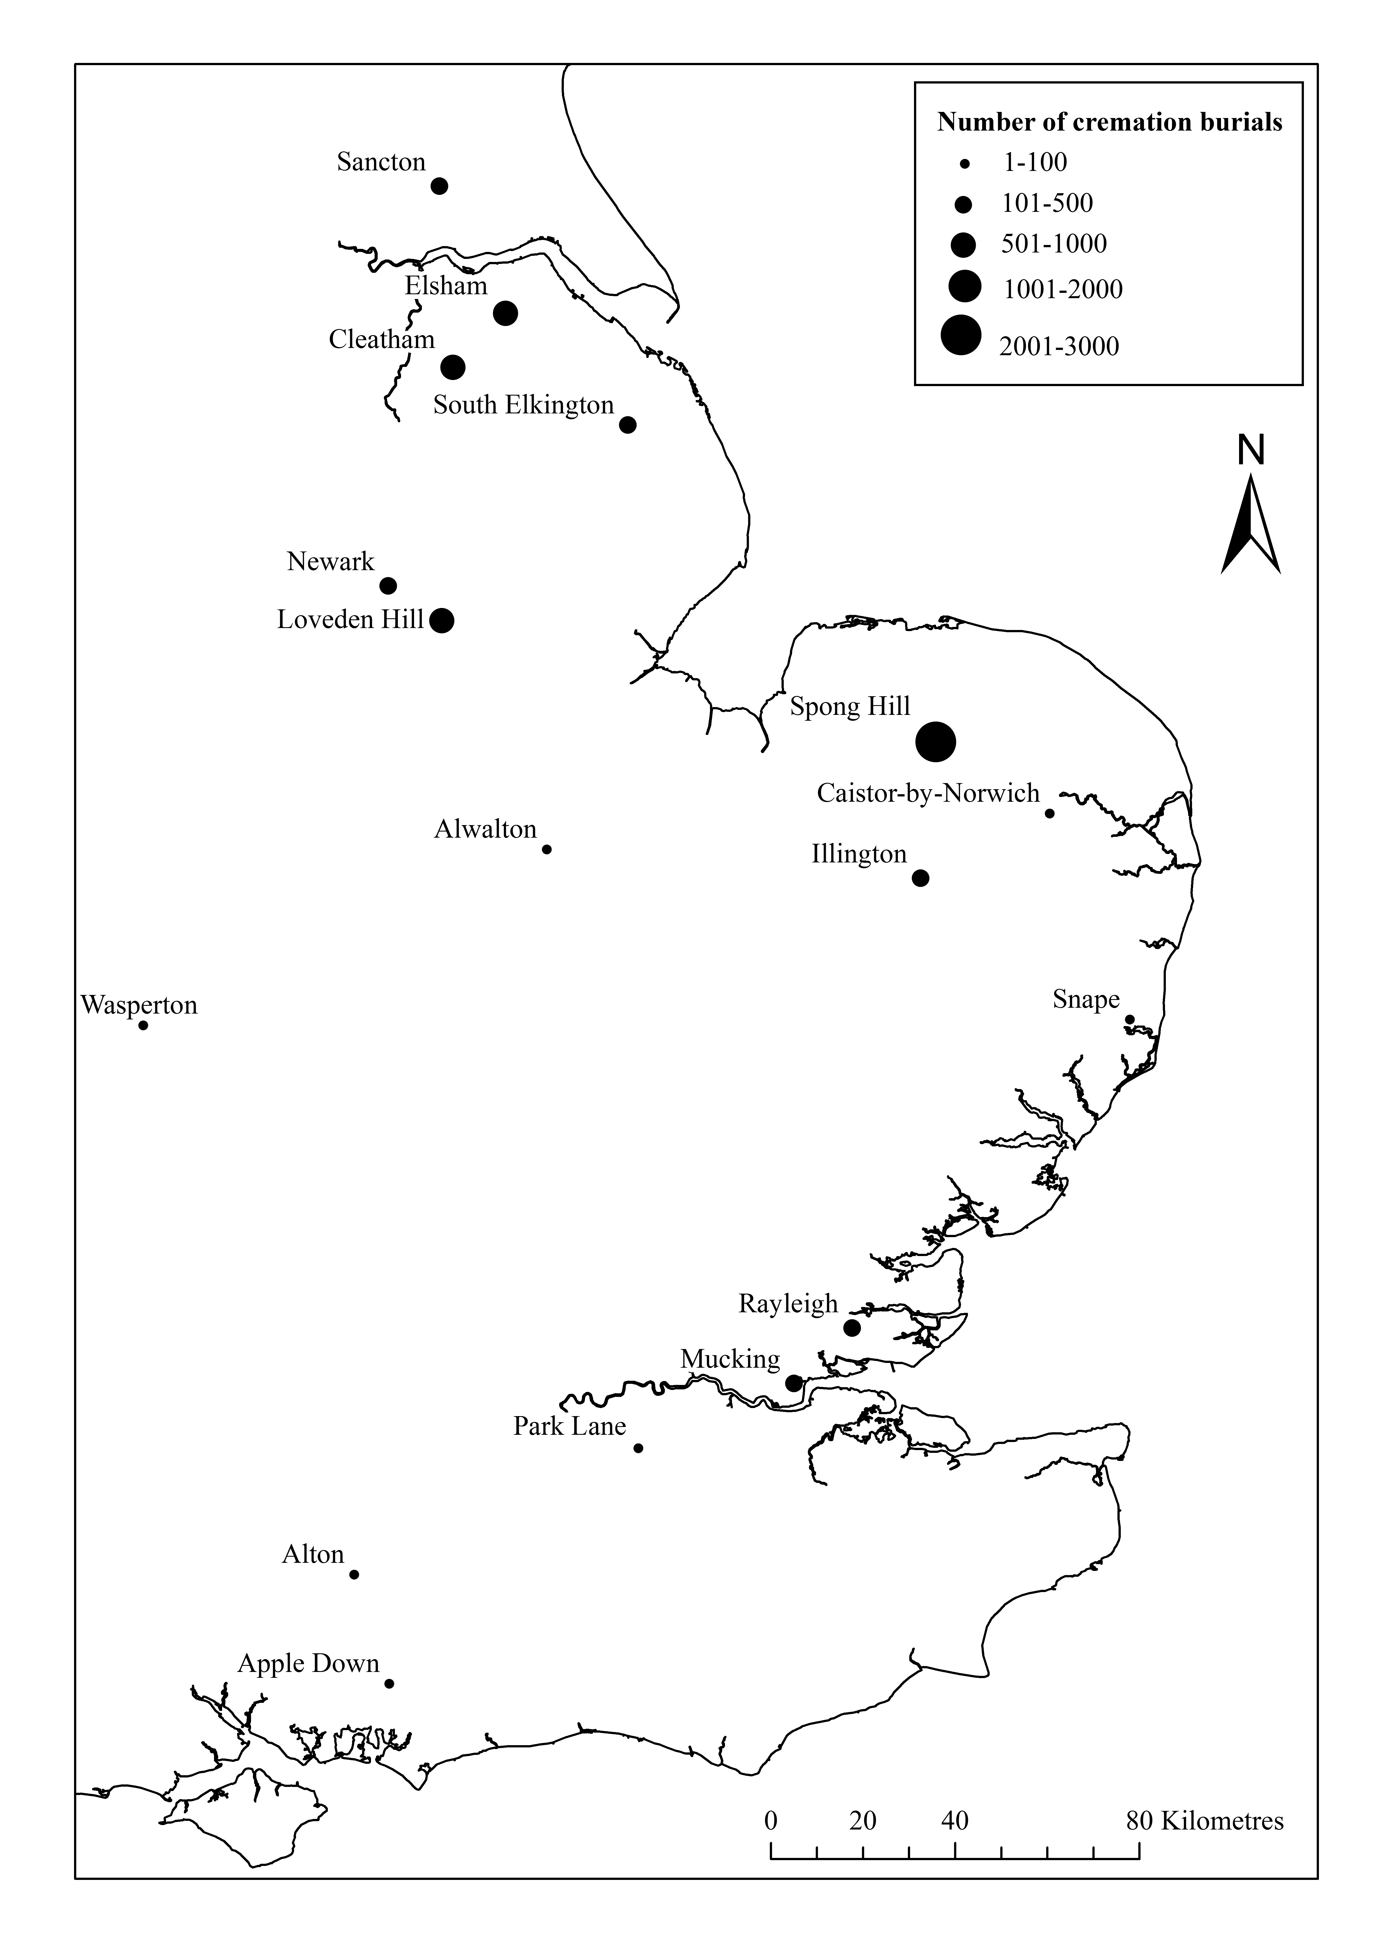
Demography of early Anglo-Saxon cremation cemeteries
Caution needed when interpreting small sets of data – why?
Notes:
Basic biological profiles – aim to show how this information can be used to further our understanding of the social identity of individuals that were afforded this funerary rite.
MNI – cremation cemeteries much larger than inhumation sites and appear to have served a number of settlements. Spong Hill is the largest (n=2284), followed by Cleatham (n = 1009), Elsham (n = 564), Mucking (n = 403), and Sancton (n = 364).
Under-representation of juveniles – this is seen in inhumation cemeteries and across much of the archaeological record. Some AS archaeologists suggested that the dearth of inhumed juveniles was due to them being afforded the cremation rite but an analysis of the demographic data proved otherwise – disposal was the same amongst both funerary practicing groups.
More females than males – some exceptions but this could be attributed to highly fragmented remains and small data sets. More females due to shrinkage? Unlikely as we see a similar pattern in inhumations cemeteries.
May not be representative of the whole population

Slide 12
What is a biocultural analysis?
An investigation into the relationships between human biology and culture.

Slide 13
How do archaeologists carry out biocultural analyses?
Comparison between the demographic attributes of population and associated material culture, the spatial layout of sites, and investment mortuary rites.

Slide 14
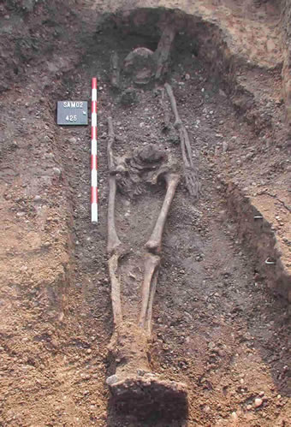
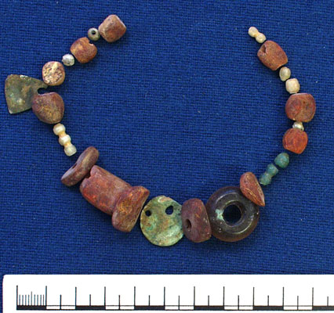
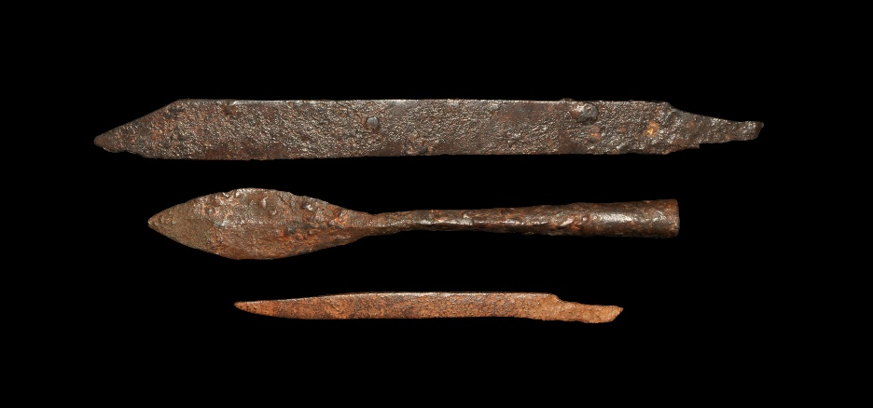
Early Anglo-Saxon funerary rites: inhumation
Inhumation burials were frequently examined by archaeologists to establish the identity of early Anglo-Saxon populations
Wide range of funerary provisions offered to the dead
Notes:
Objects most frequently identified in cremation burials

Slide 15
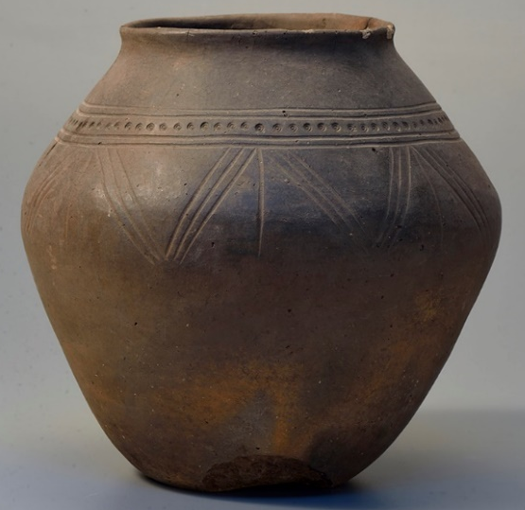
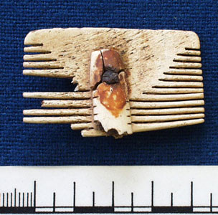
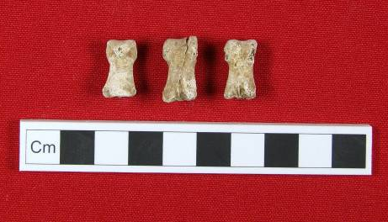
Early Anglo-Saxon funerary rites: cremation
Osteological and artefactual evidence from cremation cemeteries was often overlooked in the past
Recent research has highlighted that significant amounts of information pertaining to early Anglo-Saxon identity can be obtained from cremated remains
Pyre- and grave-good offered to the dead – what is the difference?
A pottery cinerary urn from Lackford (Suffolk)
Bone comb fragment (Abingdon, Oxfordshire)
Cremated bear phalanges (Cleatham, Lincolnshire)
Notes:
Objects most frequently identified in cremation burials

Slide 16
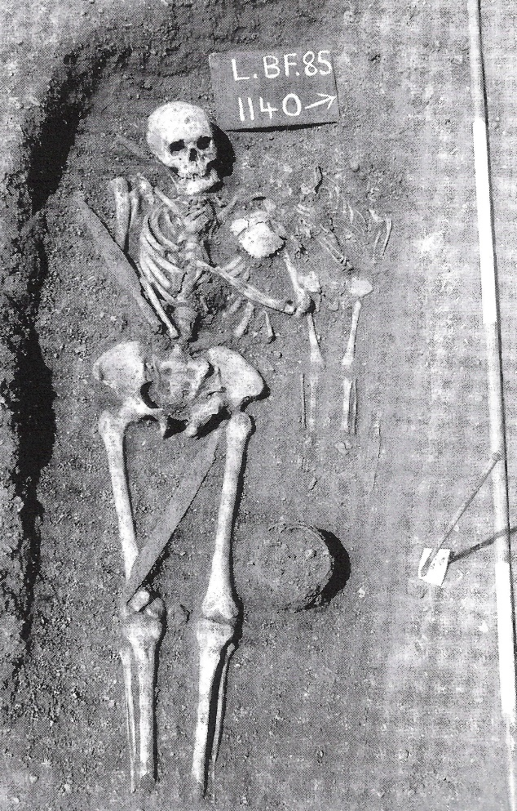
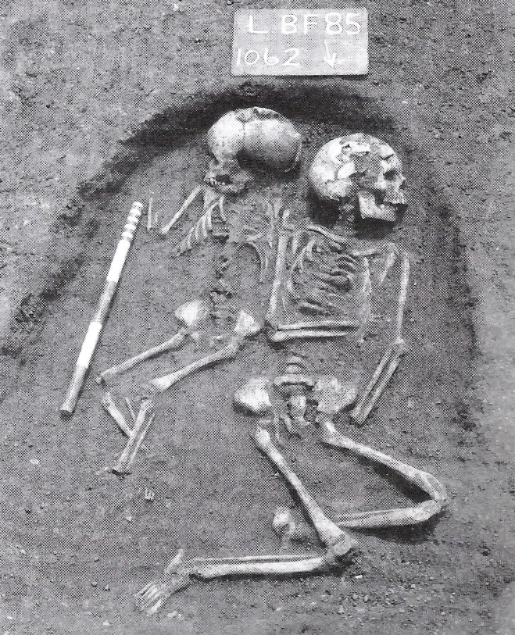
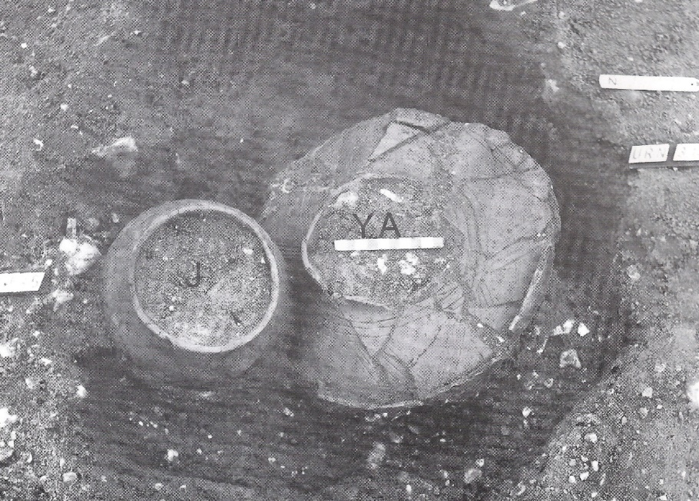
Multiple burials: A social responsibility?
This rite was carried out by both inhuming and cremating groups
An infant or child buried with an adult is the most common type of multiple burial
Many possible explanations for the inclusion of children in this funerary rite – extension of care and protection into the afterlife?
Child and young adult cremation burial (Spong Hill, Norfolk)
Double child burial (Lechlade, Gloucestershire)
Double burial (Lechlade, Gloucestershire)
Notes:
The average number of multiple burials from both inhumation and cremation cemeteries never exceeds more than 10% of the burial population.
Lechlade: 11-12 year old and a 4-5 year old
Lechlade: 30-35 year old and a 2.5-3.5 year old
Stoodley’s (2002) study showed that the average number of multiple burials per (inhumation) site was 5.4% of the burial population.
Edmund’s Late Saxon Law code (ad 939–49)

Slide 17
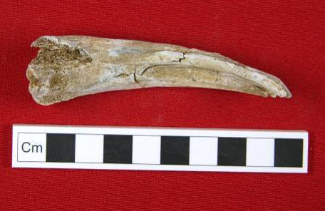
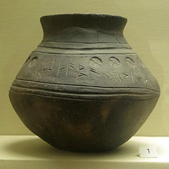
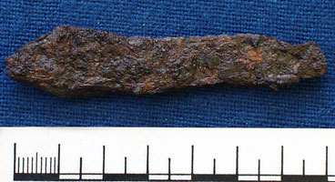
Age specific funerary assemblages
Grave assemblages are gender neutral or more closely resemble objects afforded to adult females
Range and number of pyre and grave goods is more limited in juvenile burials
Infants and children buried in shorter urns – analogous to knife length in inhumation burials
Younger individuals less likely to be afforded animal offerings
Cremated animal bone (Cleatham, Lincolnshire)
Height of cinerary urns vs. age
(Cleatham, Lincolnshire)
Pottery cinerary urn (Loveden Hill, Lincolnshire)
A knife found in a child’s inhumation burial from Abingdon (Oxfordshire)
Notes:
Through a comparison of demographic attributes of a cemetery population and associated artefacts we can build a picture of the identities of individuals living amongst cremation practicing groups.

Slide 18
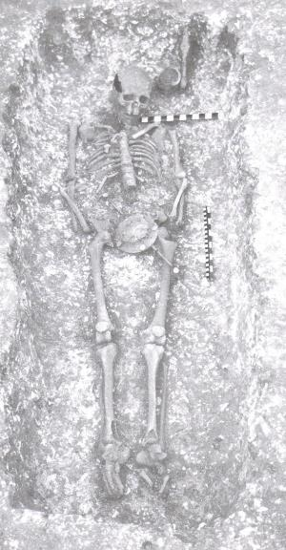
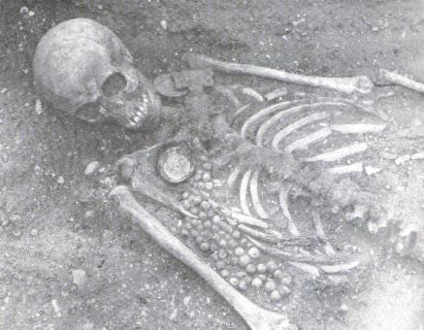
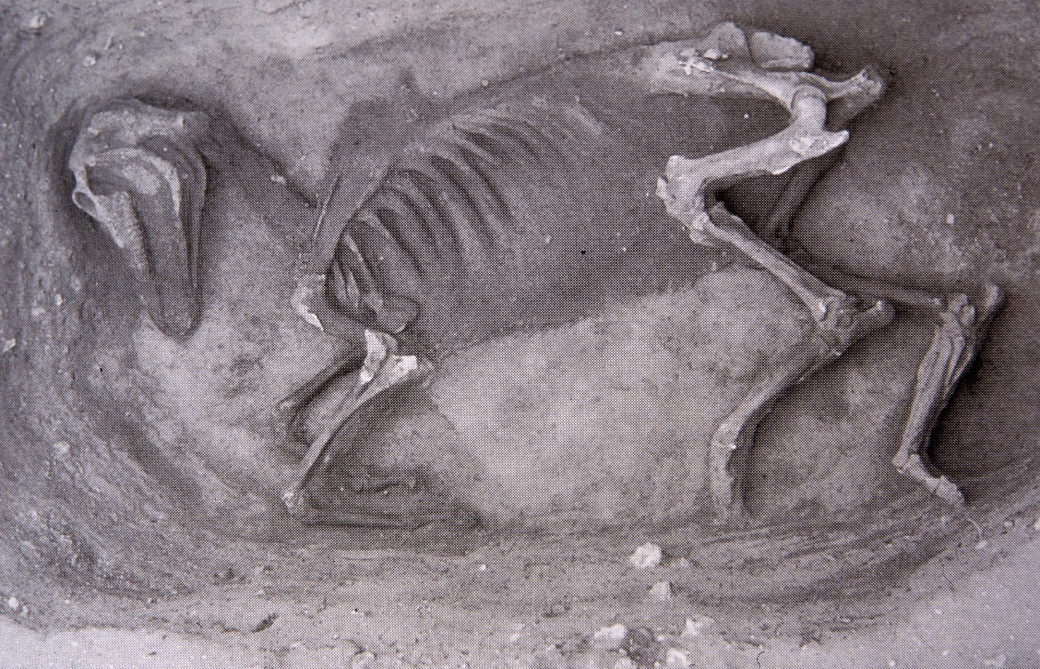
Gender oriented grave provisions: inhumation
Distinctive male and female grave assemblages
Horses more commonly found with males of higher social standing
Spearhead
Square-headed brooch
Bucket
Seax
Saucer brooches
Shield
Beads
Horse burial, Sutton Hoo
Grave 49, Worthy Park, Hampshire
Grave 102, Berinsfield, Oxfordshire

Slide 19
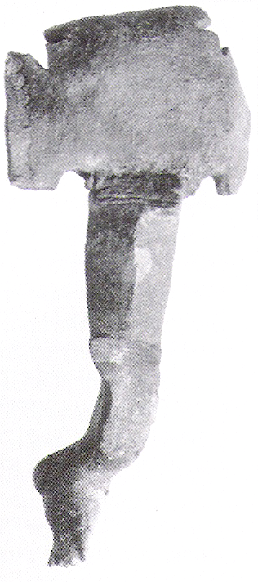
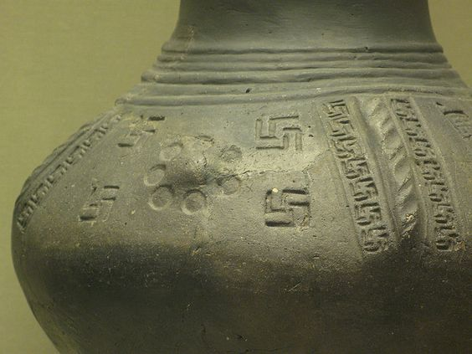
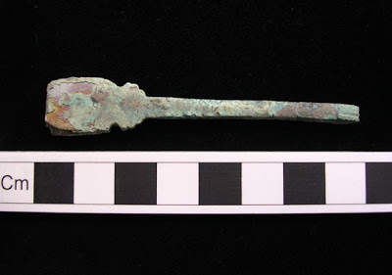
Gender oriented grave provisions: cremation
Dichotomous grave assemblages largely absent – female identity displayed clearer than that of their male counterparts
Males and females were equally likely to be afforded animal offerings
Associations between sex and cinerary urn dimensions are infrequent and weak
Heat-damaged small-long brooch from Spong Hill (Norfolk)
Copper-alloy tweezers from Spong Hill (Norfolk)
Pottery cinerary urn from Cleatham (Lincolnshire)
Notes:
Toilet sets – males

Slide 20
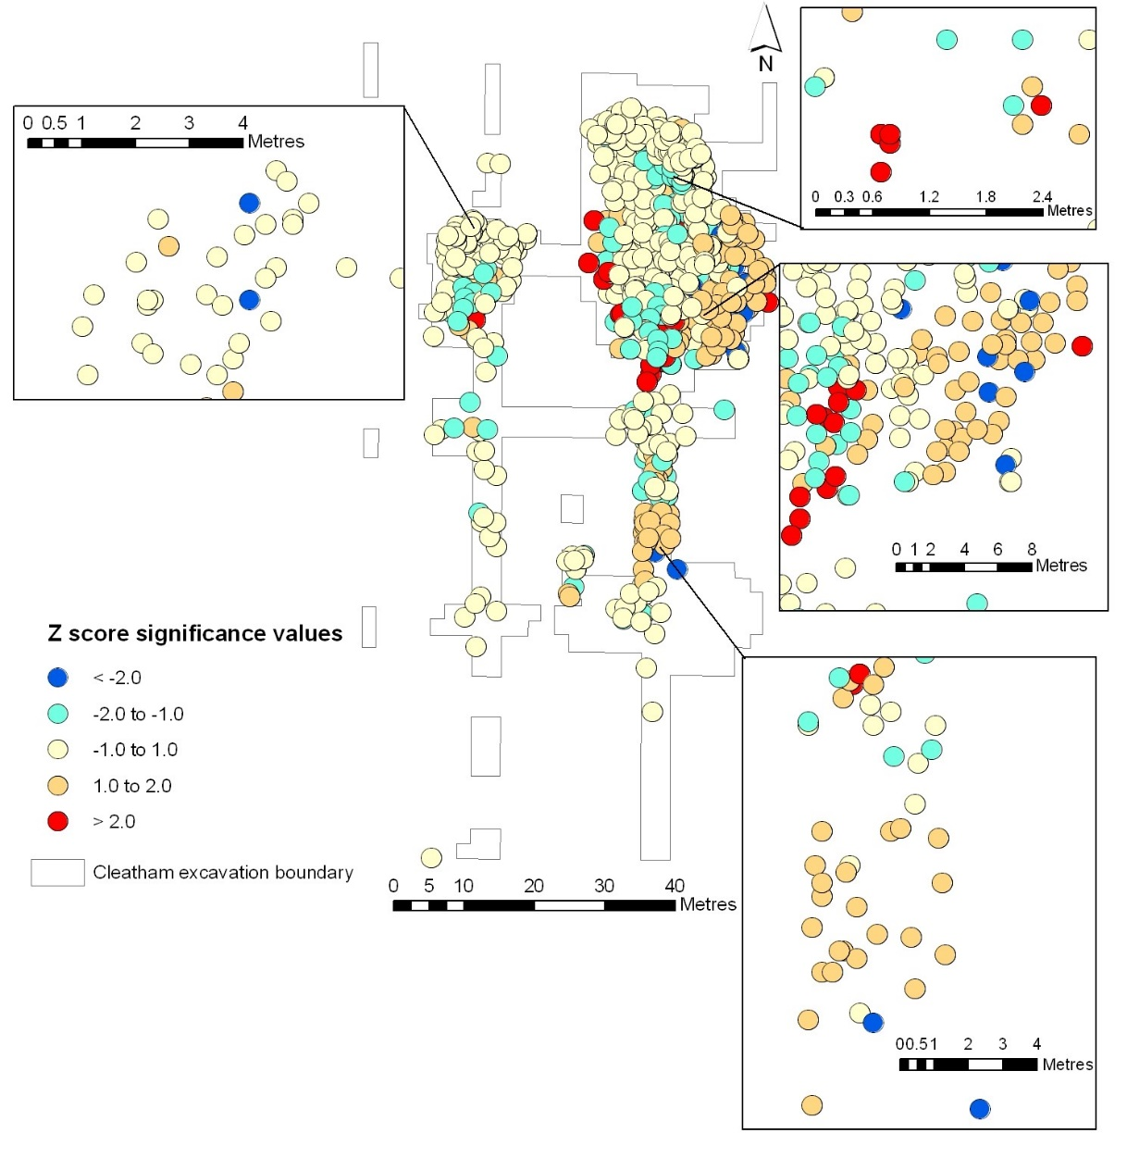
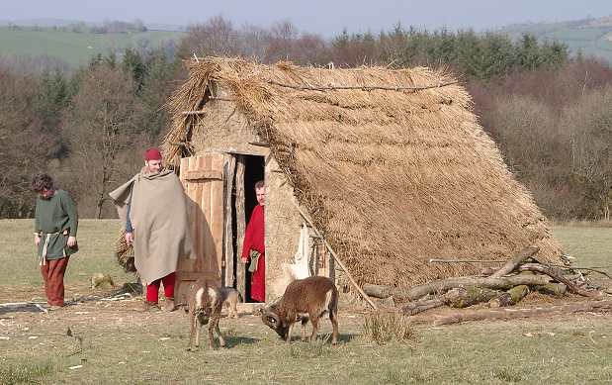
Spatial distribution of burials: age
Clusters of infant and child burials at Cleatham (Lincolnshire)
Under-representation of children at cemetery sites – buried elsewhere?
Lack of segregation and multi-focal nature of early Anglo-Saxon cemeteries suggest the dead were buried in household plots
Notes:
ArcGIS
Spatial cluster analysis of subadult and adult burials, when adolescents are classified as adults at Cleatham. The top left hand box shows a weakened association between the previously positively associated adult burial cluster (see Illus. 21). Similarly, the top right hand box shows a reduction in the size of the positive statistically significant subadult cluster of interments, which has reduced in size from twelve associated deposits (see Illus. 21) to five affiliated burials. A statistically significant group of eleven subadult interments and numerous negatively associated adult burials has emerged to the west of the weakened north-eastern cluster of adult burials.
These are illustrated in the central box on the right hand side. The bottom right hand box further highlights that the inclusion of adolescents in the adult grouping has weakened a previously positively significant adult burial cluster (see Illus. 21).

Slide 21
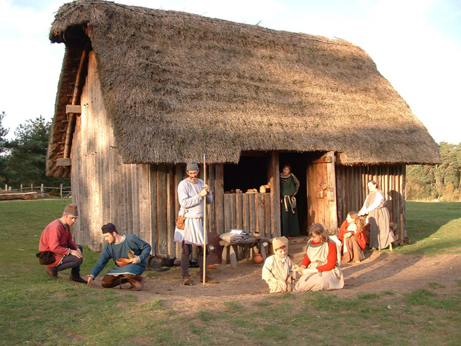
Spatial distribution of burials: sex
Muted gender display in the cremation rite may be attributed to greater integration of households on a community level and the lack of internal social divisions within household units
Cluster of female burials at Cleatham (Lincolnshire)

Slide 22
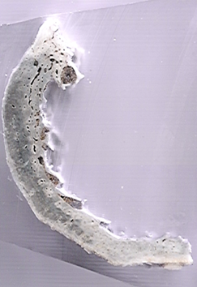
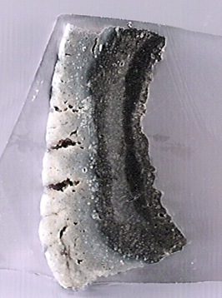
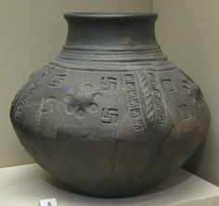
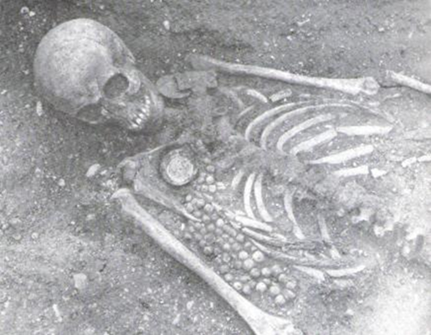
Differential investment of funerals
Greater preparation and investment in the cremation rite
Variable investment (fuel, labour, time, and grave provisions) placed in the funeral based on social identity
Thin section of a humerus (burial FN414, Elsham, Lincolnshire)
Thin section of a humerus (burial FN273b, Elsham, Lincolnshire)
Highly decorated cinerary urn (Spong Hill, Norfolk)
Furnished inhumation burial (Berinsfield, Oxfordshire)

Slide 23
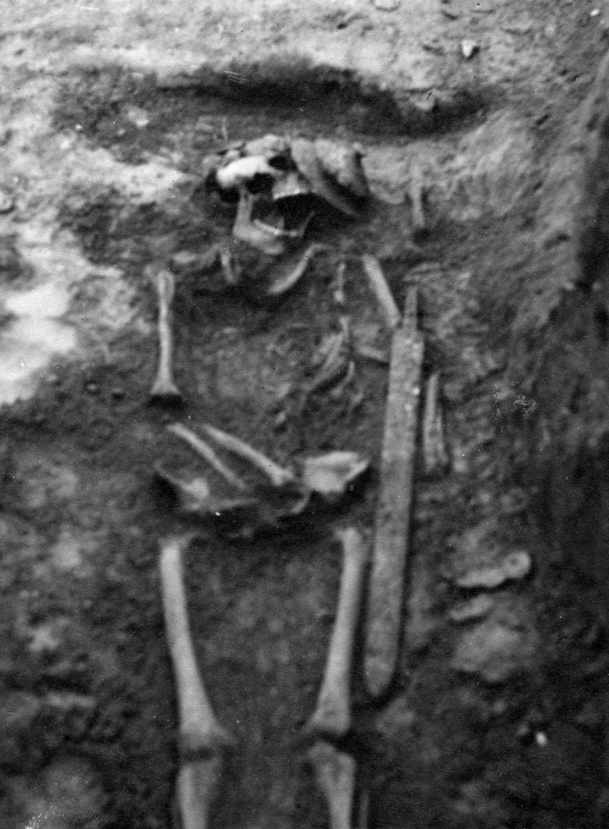
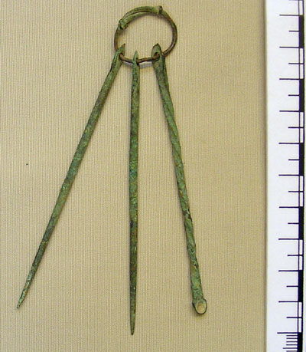
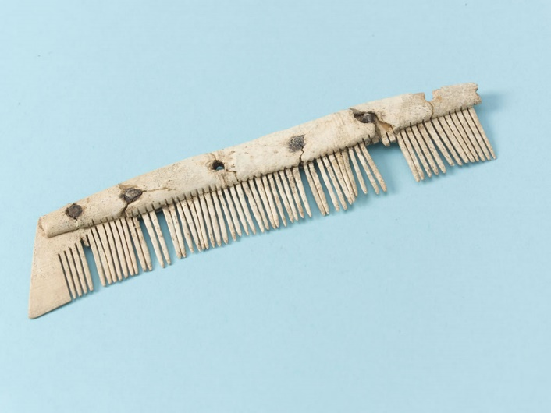
Why do we see differences between cremation and inhumation practicing communities?
Households, and society as a whole, become more stratified – construction of distinctive gender-oriented identities
Burial tableau may have also been influenced by ideological changes in the late 5th – early 6th century AD
Notes:
Inhumation image: the Anglo-Saxon burial site close to Morden Road, Mitcham (London) was initially excavated between 1888 and the 1920’s and 230 burials were unearthed. The grave goods discovered date from 450 to 600.

Slide 24
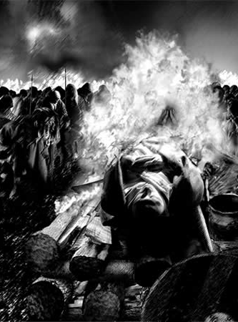
Why is the study of cremation in the past important in archaeology?
A more rounded understanding of past populations
Identification of unique funerary rites
Similarities/ differences in the representation of social identity between groups on a local and national level

Slide 25
Summary
What information can be extracted from cremated remains?
A plethora of biological information and details concerning the cremation process can be obtained from burned bone though there are issues
How can cremated remains inform our understanding of the past?
Demographic details can be used alongside material cultural and the spatial distribution of burials to gain an insight into social identity
Why is the study of cremation in the past important in archaeology?
A more rounded understanding of past societies, pinpoints unique funerary traditions, and how social groups on a local and national level differ in terms of their social identity and disposal of the dead, as exhibited in early Anglo-Saxon England

Slide 26
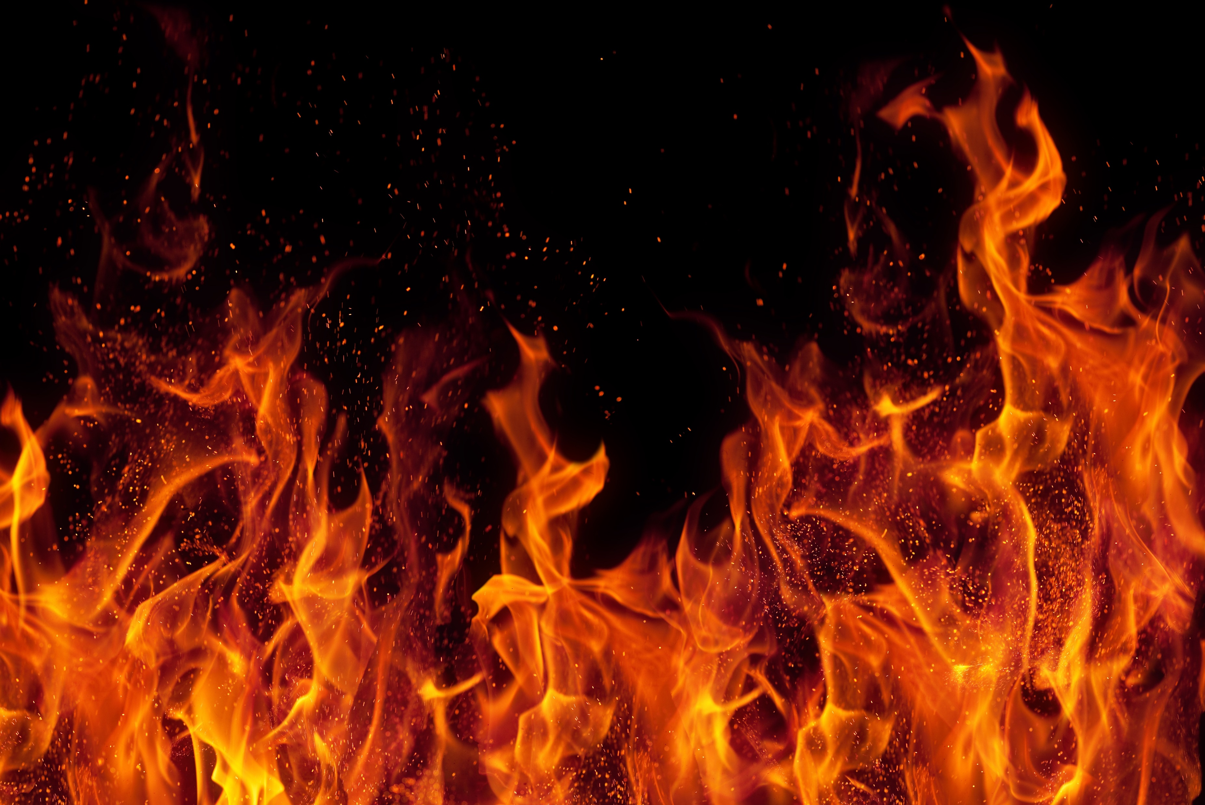
Any questions?

