Slide 1
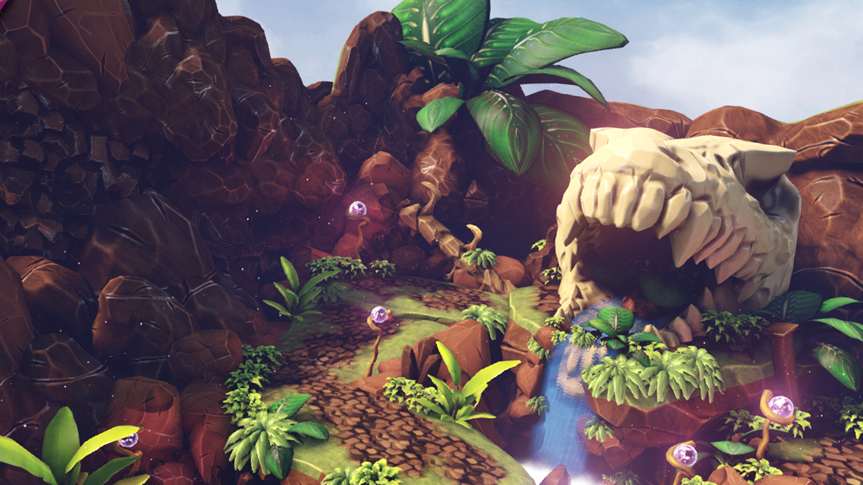
EXTRA CURRICULAR GAME DEV
@ STAFFORDSHIRE UNIVERSITY
AT STAFFORDSHIRE UNIVERSITY

Slide 2
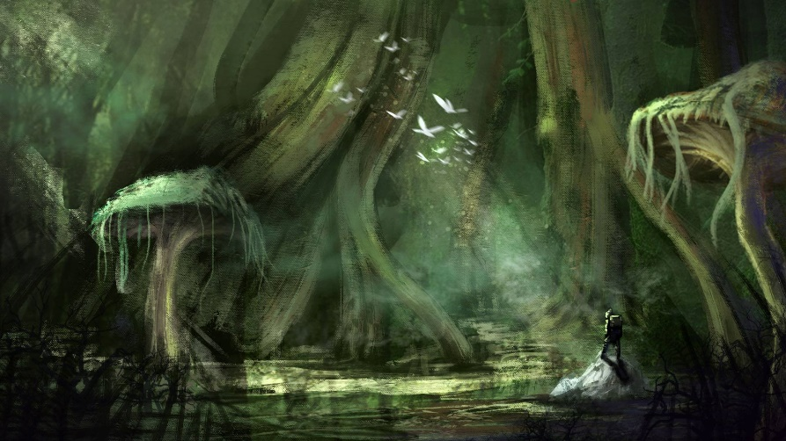
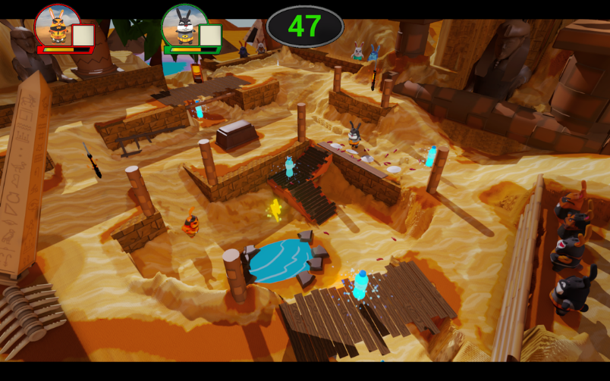
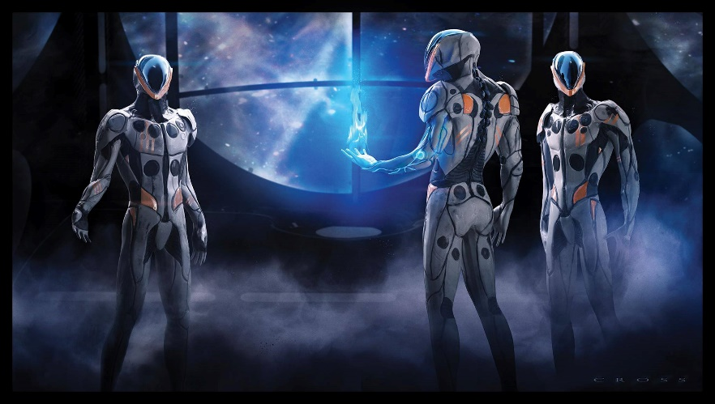
What Students do
Every level of our degrees there is a chance to make games…
Our 2nd and 3rd year students work together.
Foundation
1st
2nd
3rd
Masters
2D Games Engines
Introduction to Games Design
Junior Collaborative Games Design
Senior Collaborative Games Design
Mobile Development

Slide 3
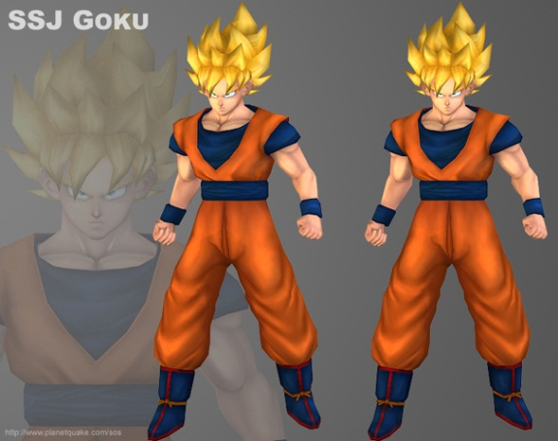
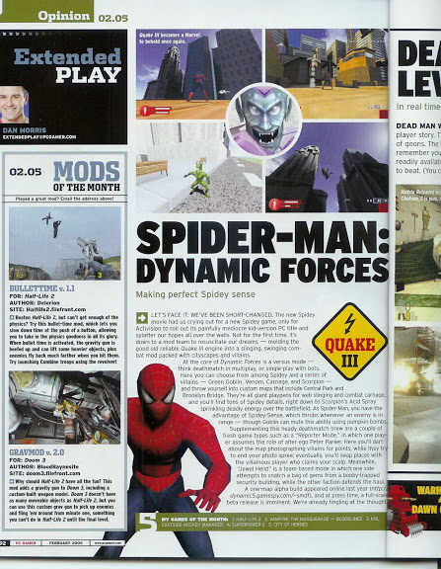
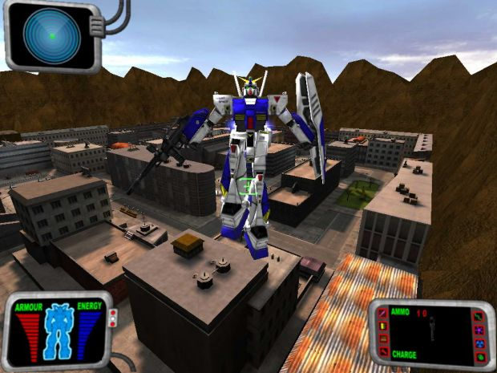
Why is extra curricular important?
I got into Games Dev Modding Duke 3D and Quake series..
I built levels for mods that gathered some press through PC Gamer, Polycount and Planetquake.
Some of my Modding peers now run their own studios.
Industry likes to see your own graft, degrees are getting more recognised all the time but external projects show drive.

Slide 4
Why is extra curricular important?
Mods and indie projects are another string to your bow.
Networking early helps build your reach.
Joining communities like MODDB gives users access to job boards.
Practise makes perfect, sometimes traditional assessment can be slow for iteration and doesn’t align easily with industry practise.

Slide 5
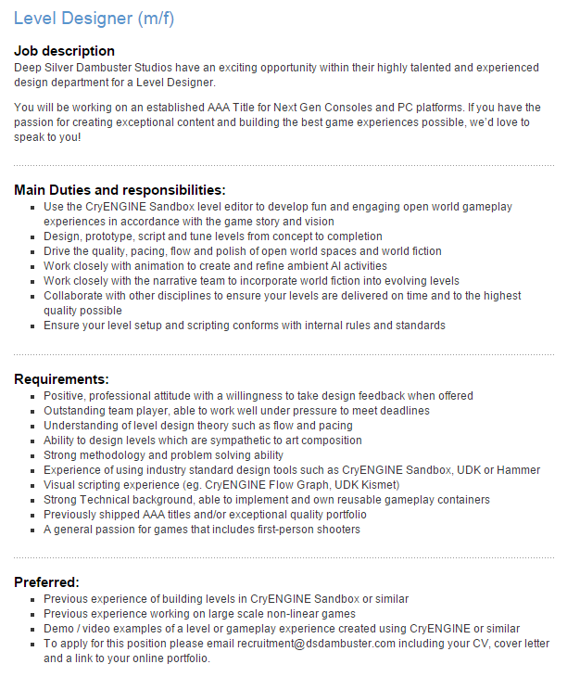
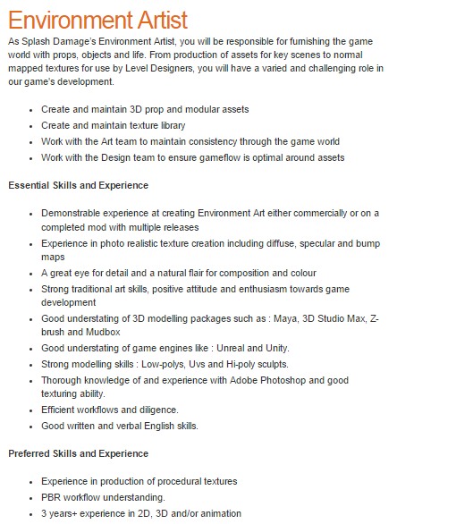
Jobs & Practice
The graduate nightmare… Where do I get experience?
Previous shipped AAA titles and/or exceptional quality portfolio
3 years+ experience

Slide 6
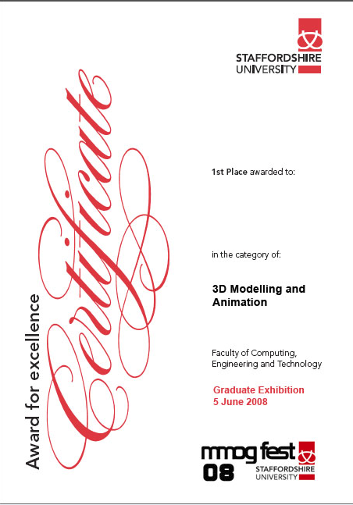
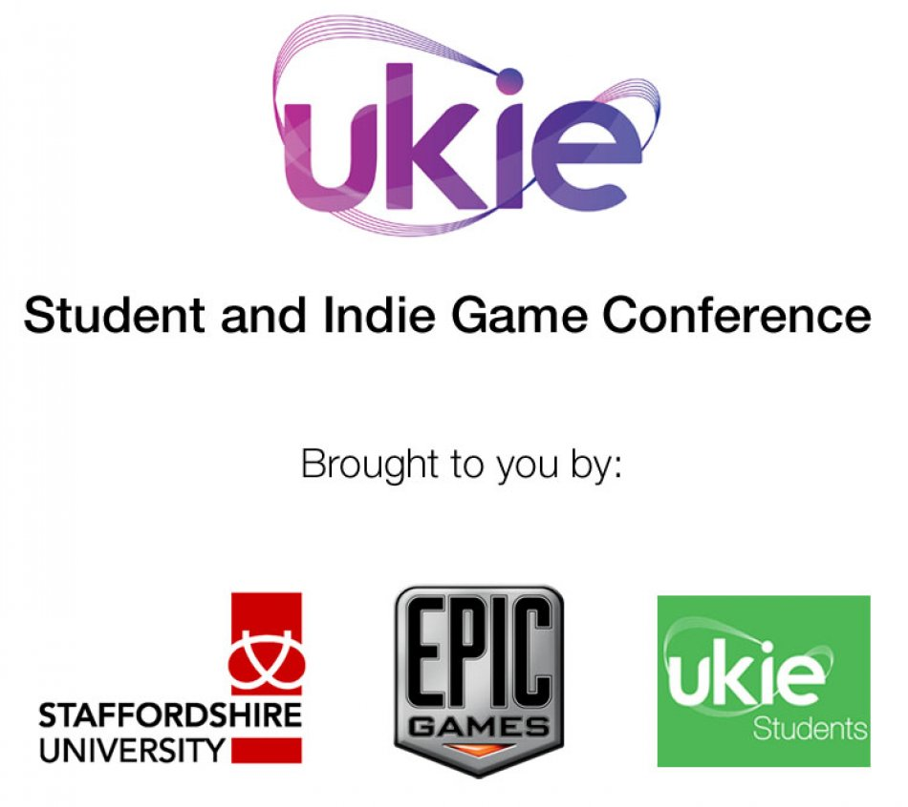
Competitions
Competitions
Game Jams
Conferences

Slide 7
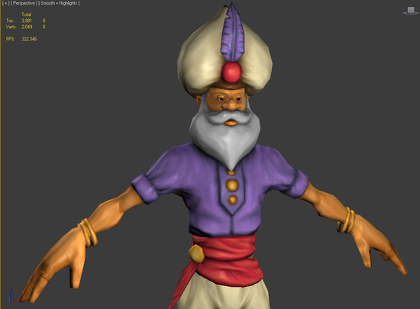
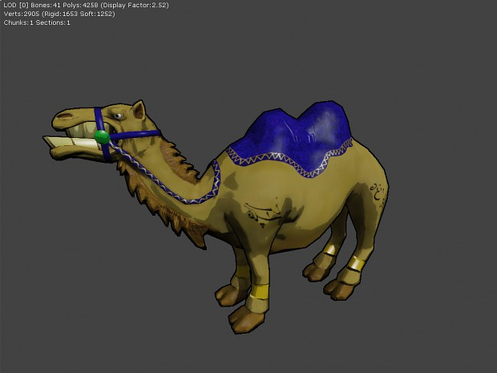
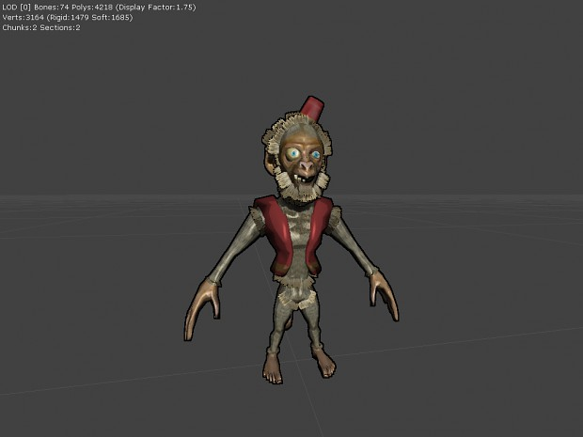
In 2010 we ran our first Unreal Boot Camp.
The idea was to try and replicate a studio setting for a week on campus after all other assessments had finished.
Attendance is completely voluntary.

Slide 8
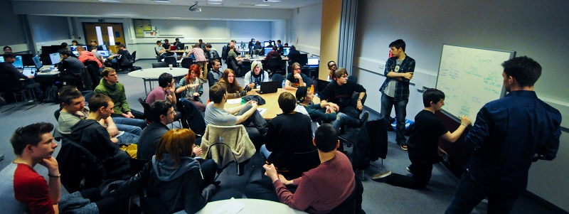
How Boot Camp works
Students sign up for free.
Studio runs 9-5 everyday.
Lecturers get their hands dirty.

Slide 9
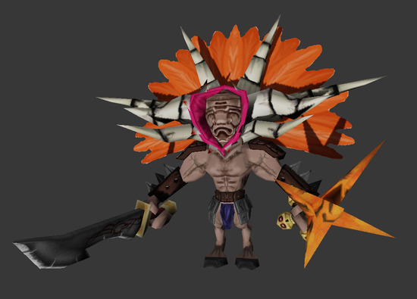
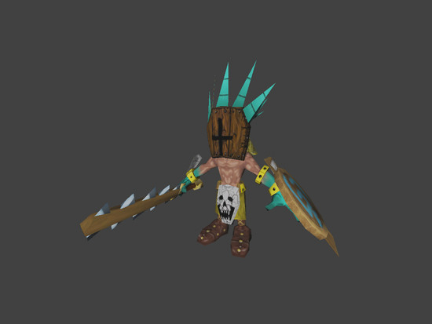
Who runs Boot Camp
I do…
Prior to arrival the team plans a game brief / scope.
I create a prototype build with the most time heavy mechanics. This can take 100 hours or so to do but with the new UE4 frameworks it’s loads faster…
We create daily orders / tasks that students have/try to achieve.
The students then improve the framework and we try to create a game!

Slide 10
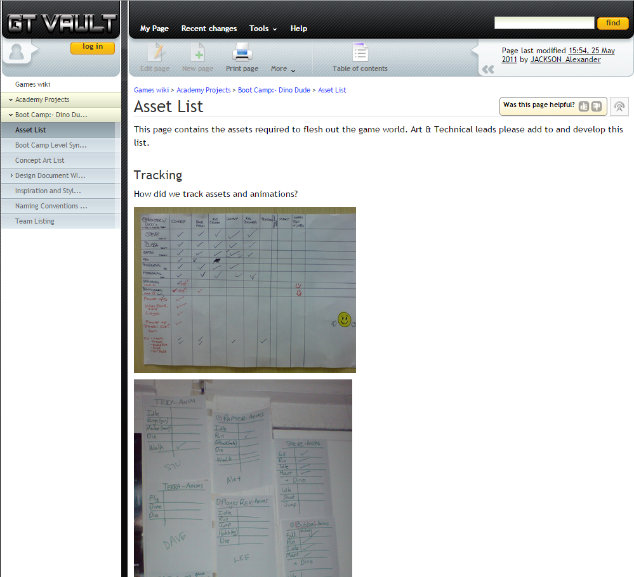
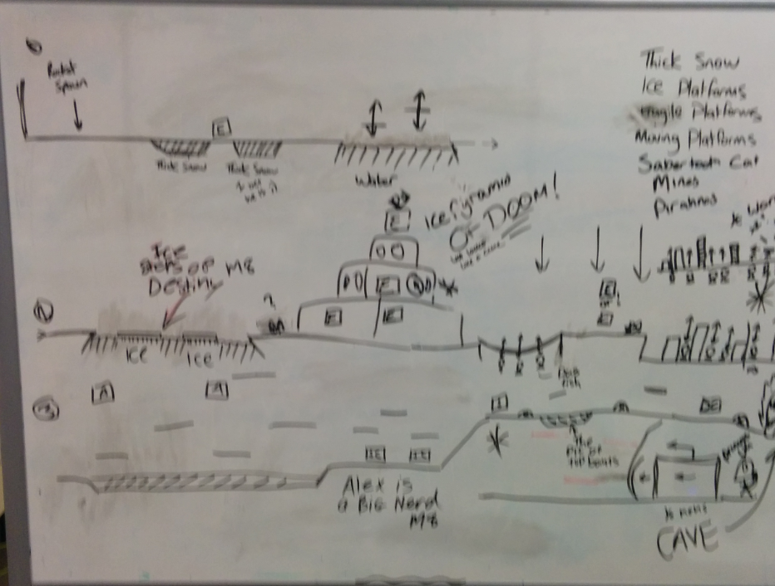
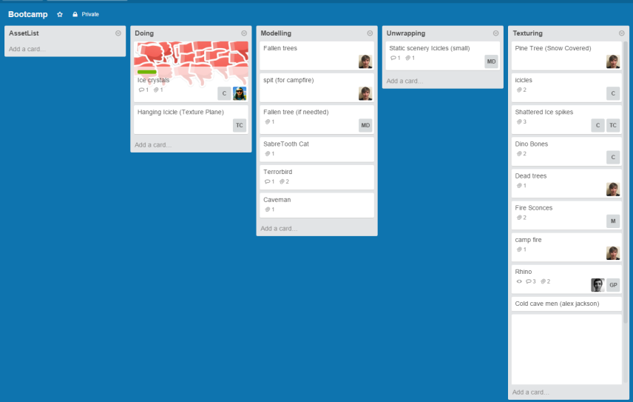
Boot Camp Challenges
Boot camp uses a variety of planning tools Wikis, Trello and data management systems to bring together all the people.
We start with white board level layouts and Google doc design document before sharing everything digitally.

Slide 11
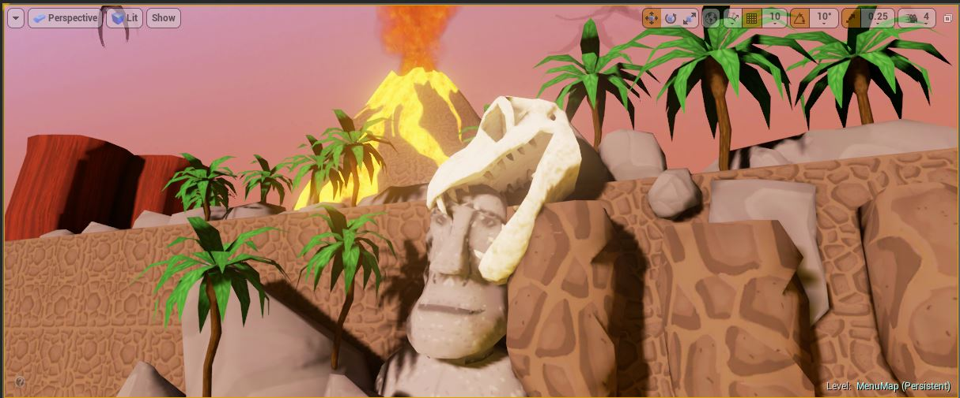
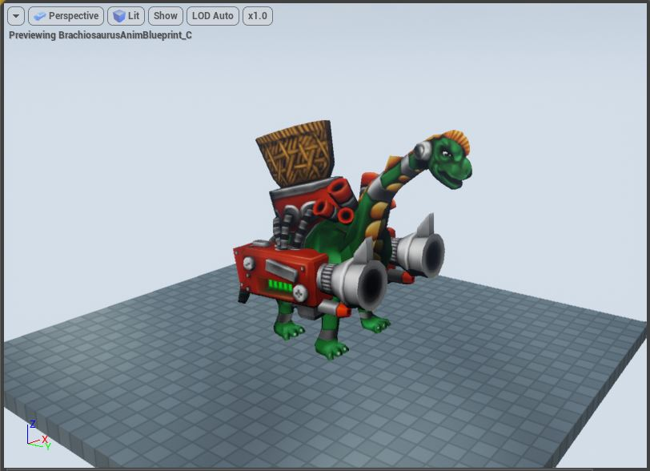
Boot Camp Successes
Each year we’ve made a game.
Our best success so far was the release of Dino Dude onto the AppStore which racked up 50k downloads.

Slide 12
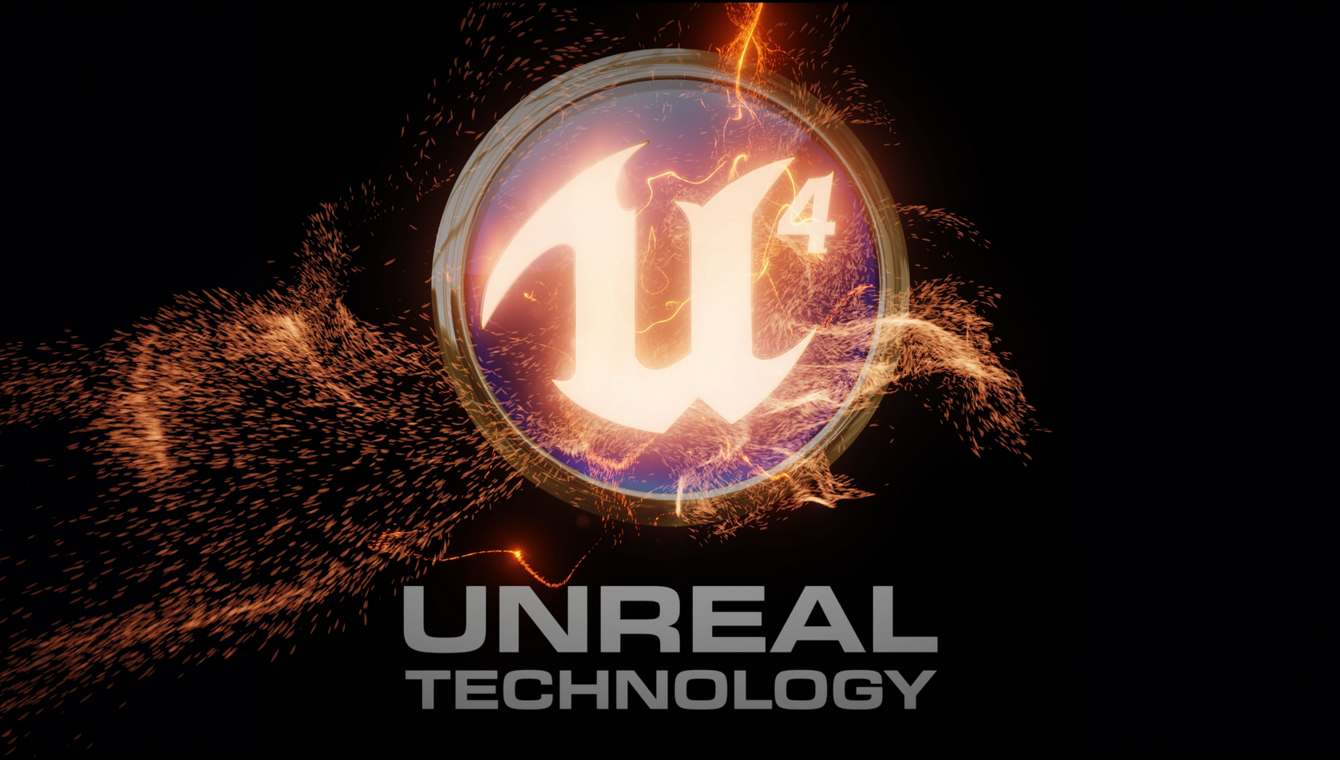

Slide 13
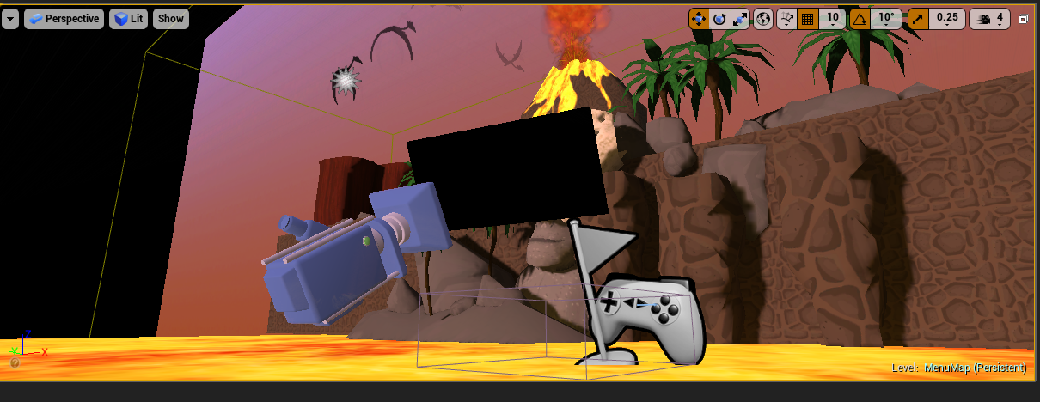
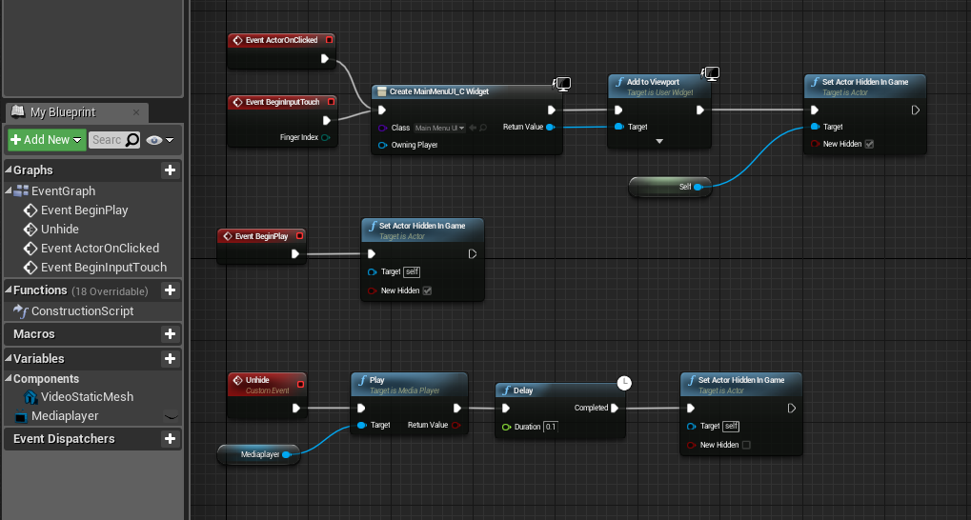
How we used UE4…
Unreal’s media player is very cool. We were able to import MP4 / WMV credit lists and apply them to mesh planes.
The mesh plane was setup so it could be hidden, clicked on etc… We found this method was really great on PC but hurt performance on lower end mobile platforms.

Slide 14
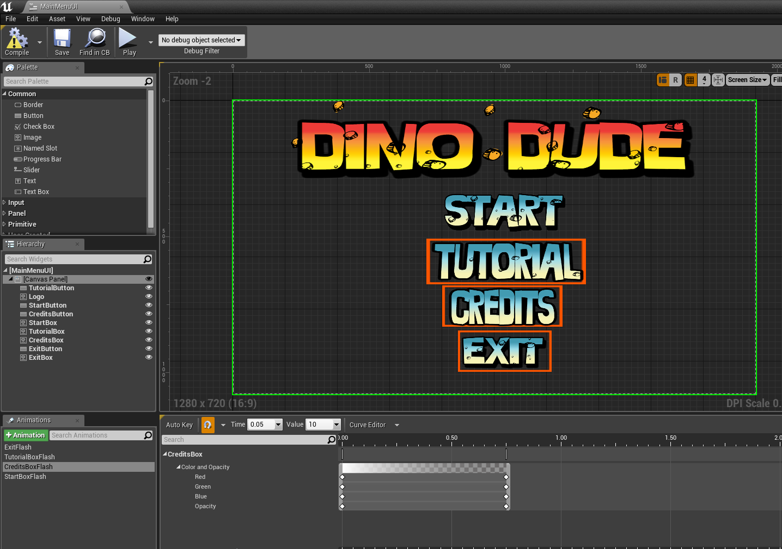
How we used UE4…
Almost all of our UI was done with UMG.
We built the system so that it could be controlled on multiple platforms.
For mouse / touch control we used the default OnClicked behaviour.
For joypad we built a series of flashing boxes to indicate what button was active and toggled them on and of through movement.

Slide 15
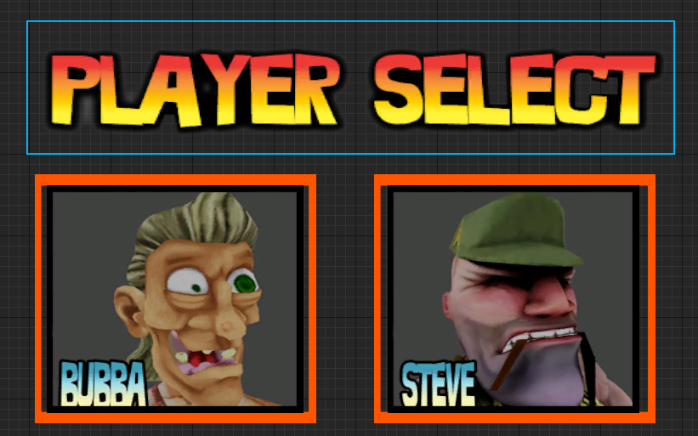
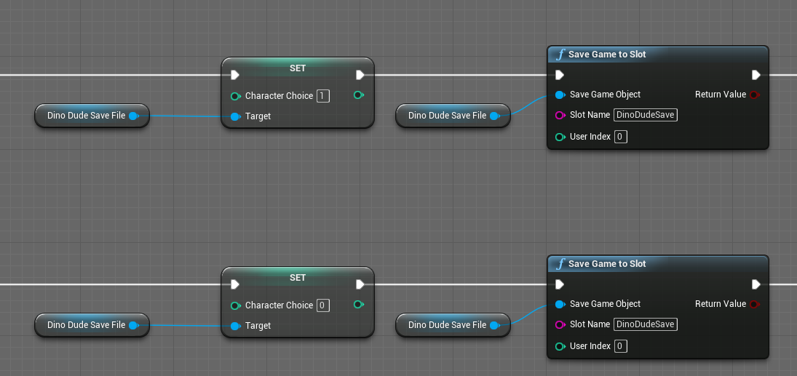
How we used UE4…
The character select screen was built using the Save System demonstrated by Epic in their Tappy Chicken example.
It works by setting an integer.
The Character pawn then chooses a Mesh & Anim Blueprint based off this integer on Event Begin Play.

Slide 16
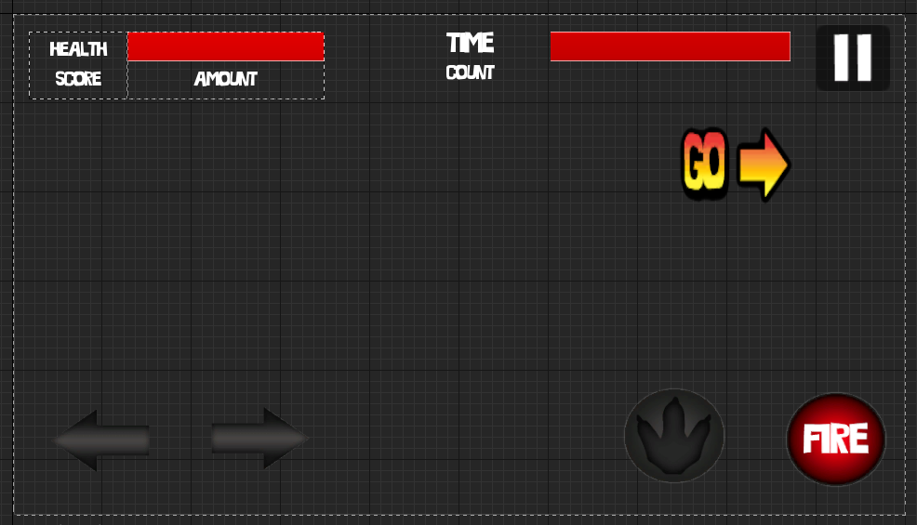
How we used UE4…
To cope with multiple platforms we developed the HUD so that it could be toggled and adapted.
One of our problems was that a user could hold the right arrow on a touch screen and it only fire once.
To cope with continuous input we found that you have to disable “IsFocusable”.
UMG is awesome because of it’s anchor points, they allowed us the keep or UI in similar positions even with screen resolution changes.

Slide 17
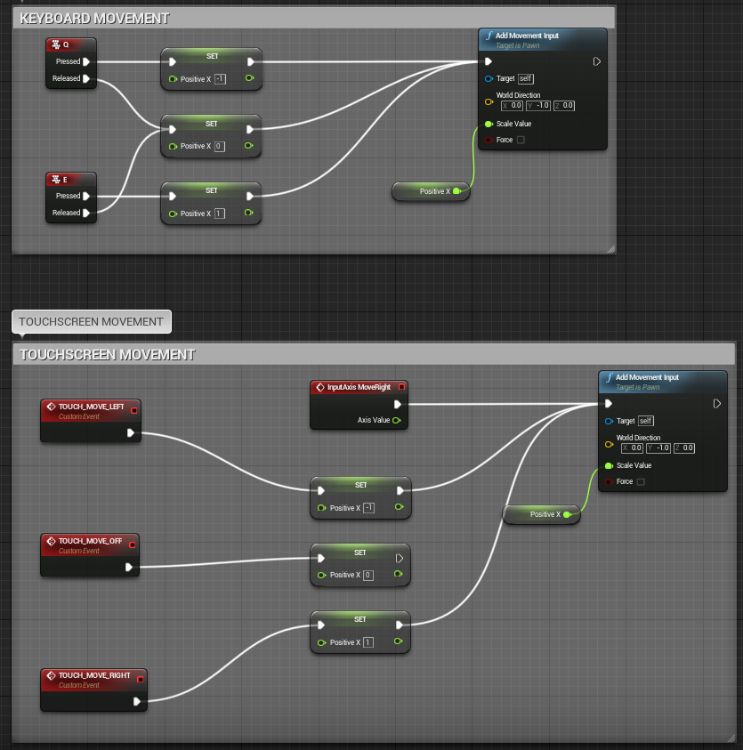
How we used UE4…
The characters in Dino Dude move like classic Gun and Run platforms.
With that in mind we wanted a movement system so that the Character was moving at full speed / idle.
To do this we had 3 integer states to resemble left, right and stationary.

Slide 18
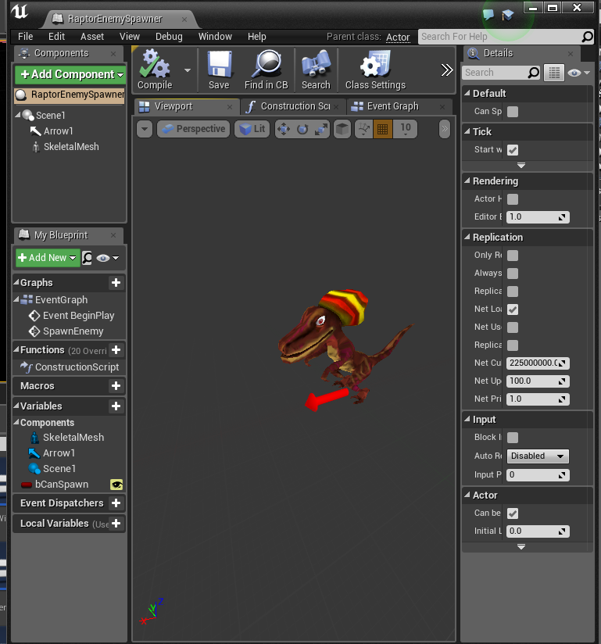
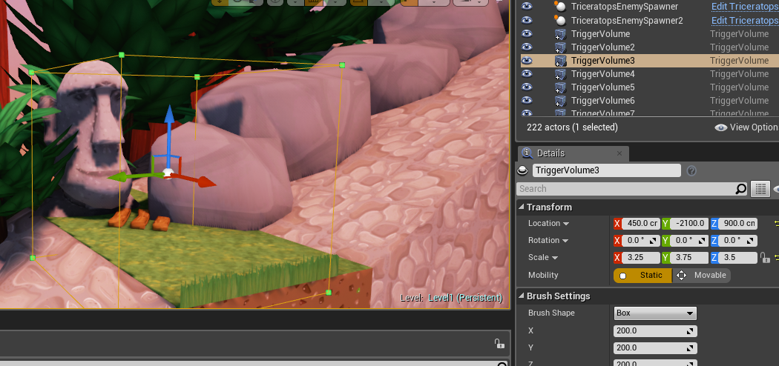
How we used UE4…
Gun and Run games are made awesome by having lots of enemies to blast.
We created a bunch of modular spawn Blueprints which were controlled by Trigger Volumes.
When we first tried this system is was great but it required the level designer to create Overlap / Collison events in the Level Blueprint.

Slide 19
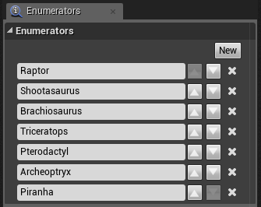
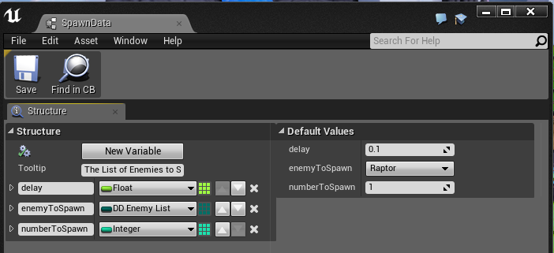
How we used UE4…
To help designers we investigated ways of creating Spawn Data…
To do this we created a custom Enumerator to act as a list and a Structure to hold the data.
In the Enemy Spawner we are able to create arrays of the data an access it using Select Nodes.
By changing the pin type of the select node you can alter different properties using Enumerator list.

Slide 20
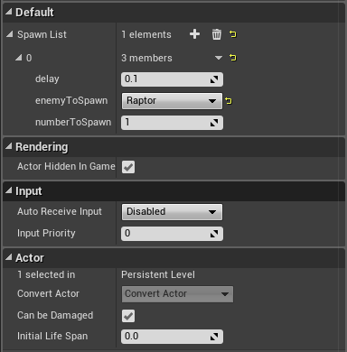
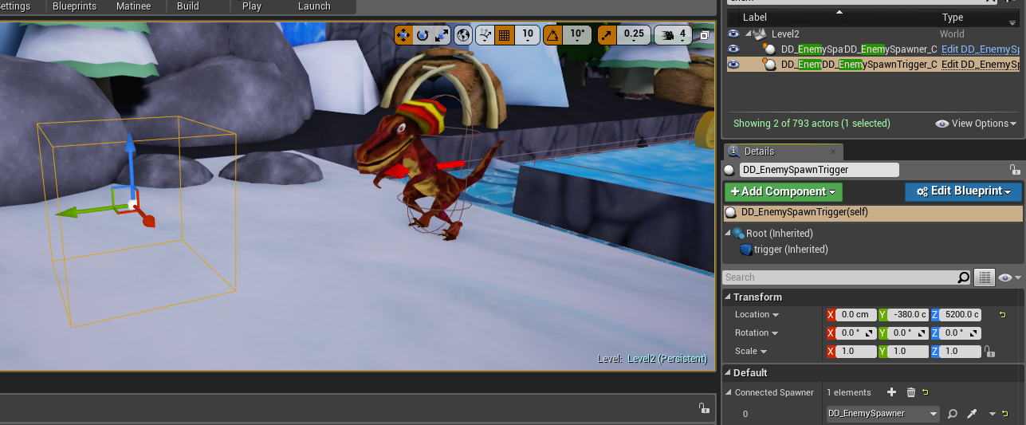
How we used UE4…
To improve our spawn system students made the Trigger Volume into a Blueprint and connected it with level based spawners.
We were able to create a Blueprint that could spawn any enemy class. This allowed designers to drag and drop which was awesome.

Slide 21
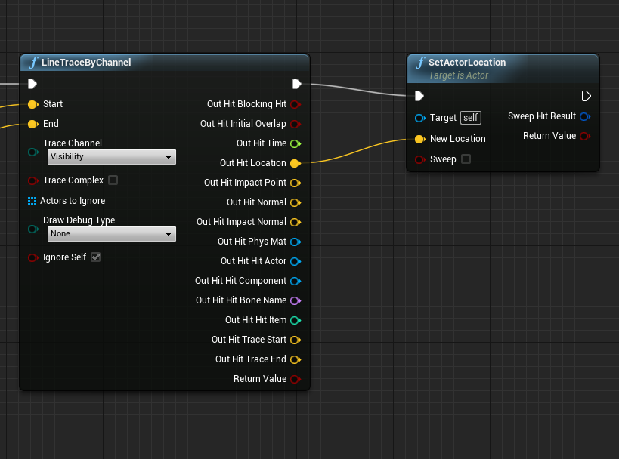
How we used UE4…
We wanted object snapping so that level designers could literally drag a pickup and it be locked to the floor beneath it.
To get do this we used construction scripts and tracing.
To calculate the traces we needed a start and end value…

Slide 22
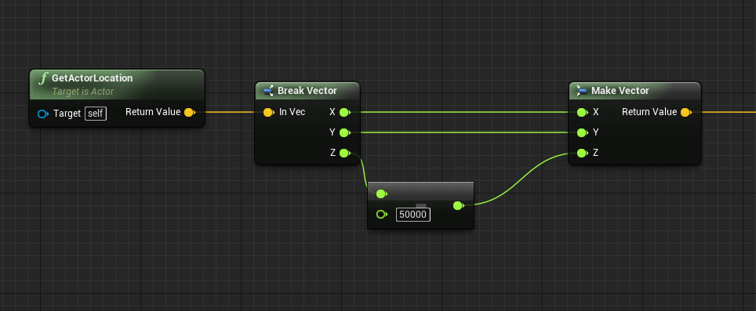
How we used UE4…
The Start Ray was calculated by grabbing the actor location and adding the height of the collision capsule to the Z value.
The End Ray was calculated by taking away from the Z position. Think of it as shooting a ray down to the middle of the earth ☺.
To follow the floor and not snap to it try increasing the Z offset for the Start Ray.

Slide 23
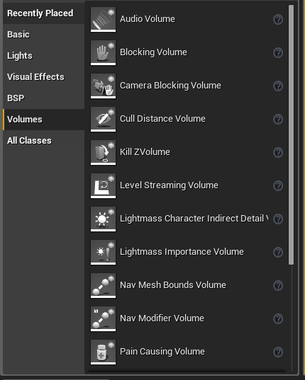
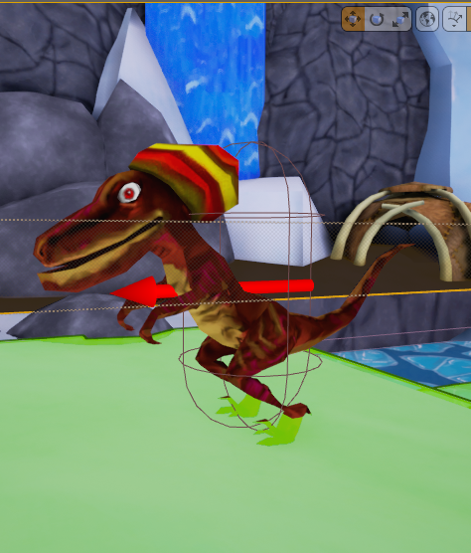
How we used UE4…
If you’ve come from a UDK background I can’t say how important it is to use Nav Mesh Bounds when you start prototyping AI.
The MoveTo commands in the AIControllers will not work properly without it.
By Pressing P after building a level, you can visualise the Nav Mesh through green blocks in your scene.

Slide 24
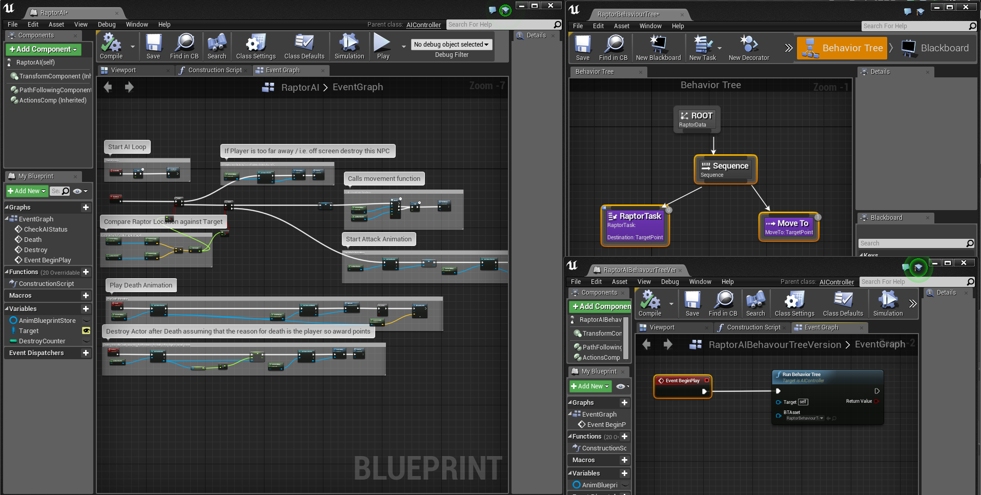
How we used UE4…
The AI was approached in 2 ways; a) using AI Controller movement and b) The new Behaviour Tree system.
For the scope of the quick project we found the AI Controller simpler to setup as it required less Unreal Assets to edit.

Slide 25
How we used UE4…
Blueprint was awesome for our puzzles and traps. Using Blueprint Timelines we were able to build falling and moving platforms.
These systems were also drag and drop and allowed us block out the level fast with simple mesh changes for different traps.

Slide 26
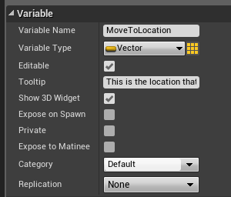
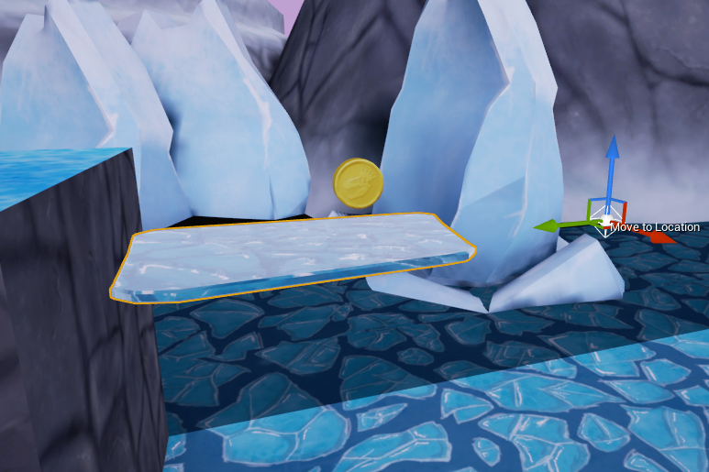
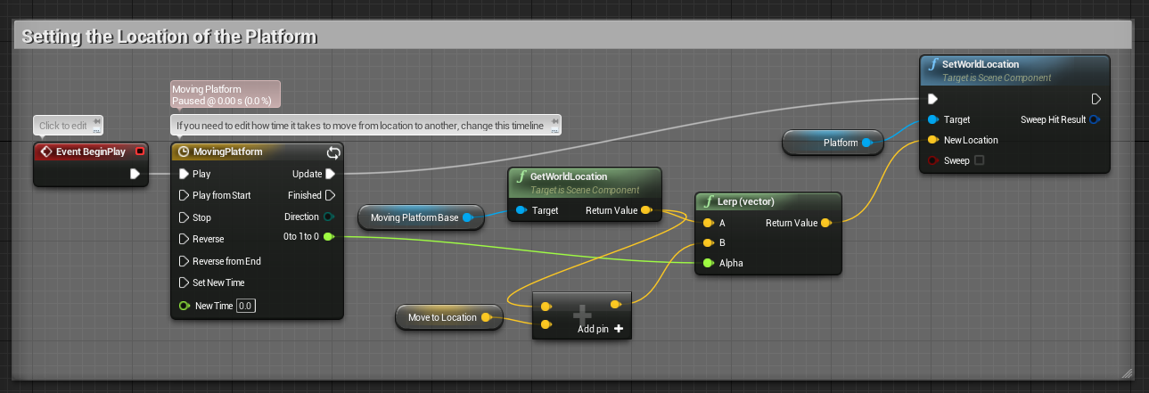
How we used UE4…
We used another method of Timeline manipulation to help designers. Show 3D Widget allows you to place a location for objects to move to in the editor.
This way designers can accurately judge movements rather than just blindly manipulating an objects position.

Slide 27
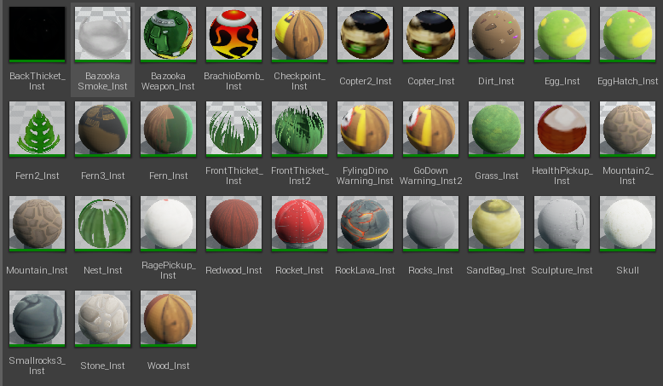
How we used UE4…
Boot Camp model assets are limited to diffuse/albedo textures (Time).
We found great use in master materials, we created lots of different types to help us control animated materials, foliage, emissive and sky domes.
By being careful we were able to still achieve 30FPS on a TEGRA 3 Ouya.

Slide 28
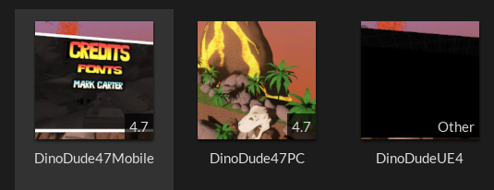
Epic Forums Framework
This year we released our Dino Dude framework for free to the Community, complete with commented Blueprints and Assets.
We were also able to port Dino Dude to Android, PC and OUYA using a forked build.
https://forums.unrealengine.com/showthread.php?70554-Dino-Dude-Staffordshire-University-Learning-Release
https://www.unrealengine.com/blog/ouya-and-unreal-engine

Slide 29
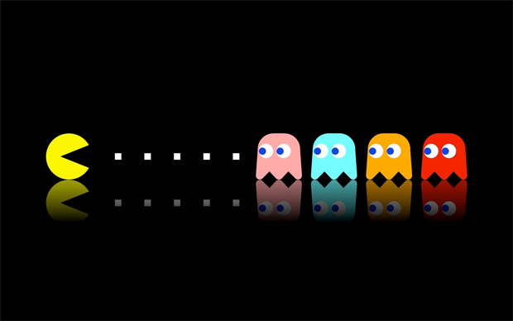
Future Challenges
Scope; we have a week, in many ways Boot Camp is like a games jam but we are allowed sleep…
Platforms; UE4 is really flexible we are racking up a lot of Android Experience.
Releasing projects; getting a Boot Camp project into a useable state is no easy task. The Unreal Marketplace is our next goal!

Slide 30
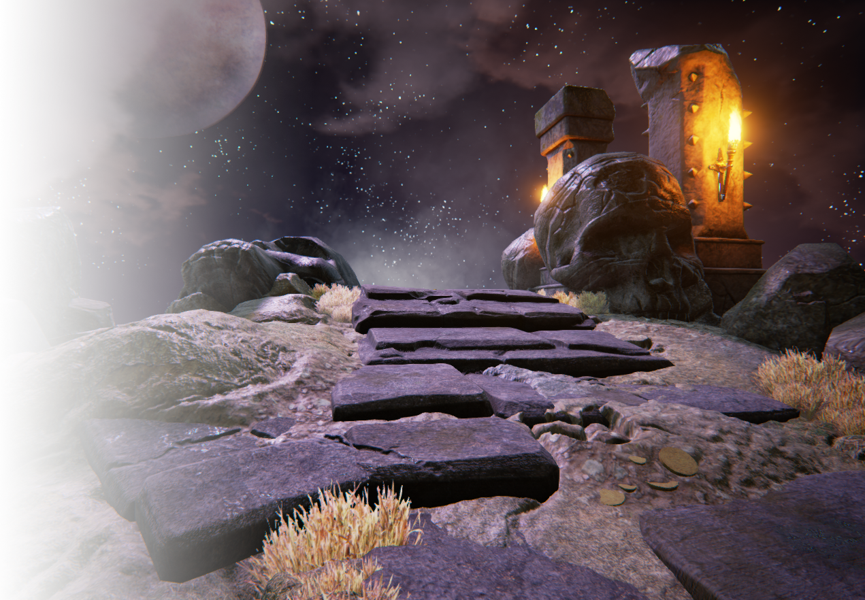
Contact
G.S.Penninck@staffs.ac.uk
@GregPenninck
@staffsgamestech
www.artstation.com/artist/gregpenninck

