Slide 1
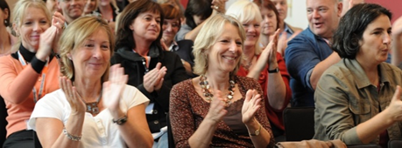
Where is the White Space?
Steve Hall and Jori Leskelä
Learning Teacher Network Conference, Tallinn 2016
Notes:
Original notes:-
There is a lot of white space on these first two slides quite deliberately. It reflects the concept of the relatively recent use and impact of white space on web pages.
Reflection and evaluation:
SH – It was great having this on display as the workshop group came in and sat at the tables. The room layout design was perfect with tables set out for groups in a chevron style and 5 or 6 people to a table, facilitating collaborative work in 2s, 3s or whole table, as well as individual. No-one had their back to the screen. There was an additional table at the back of the room for an additional group, if needed. People were welcomed into the room as they arrived but quietly and subtlely. Participants could sit where they liked on the main group of tables. Later arrivals were invited to join a particular table to manage a balance of numbers and group sizes per table.
Individual copies of the poem ‘The things we steal from children’ were used to indicate places where people might sit and offering a choice of action as participants took up places. Some participants started to look at the poem although most engaged in quiet talk with one another at a table but time (WhiteSpace) was given for them to engage in either activity or to just sit quietly. We had originally planned to have music playing quietly in the background but we didn’t have time to set this up because the room had been used immediately before our session and had run over their time. The layout for the previous session was not what we needed for our session so we had to move tables and chairs quickly without appearing to be rushed or harassed by the time participants started to come in!
The photo of a previous LTN conference was a nice touch at the start.
It would have been good to have asked participants to sign in with their e-mail addresses so that we could follow-up with them – for example it would have been good to ask participants to comment on our own reflections and to add their own.
JL – Steve’s description is thoroughgoing. We needed the whole 30 min to prepare the classroom. Most of this job was done by Steve because I concentrated first on one single technical issue: How to use moveable video camera during our session. I found out that the settings in the classroom computer where such that there would very likely become problems in swapping video camera view and PowerPoint presentation view. So we gave up the idea and did not use video camera at all. (Actually the camera was meant for session that we skipped anyway because of time limits.) I set music playing via iPad but not in the beginning but later when participants had got first impression of the White Space concept. Some of the participants gave spontaneous feedback from the music. They said it was relaxing and I got the impression that playing music was a good idea. Next time, when ever that might be, we could pay more attention to that and plan how to synchronise back round music and the phase of our work shop.
I was very eager to start immediately at 15.30 sharp but Steve was stubborn (but relaxed) and gave participants time to chat and relax. That was a good idea. I saw some participants glancing at us and wondering why we haven’t started. But I got the impression that they trusted that everything that happened was on purpose. That was my the impression of the whole session also. We did some minor mistakes during the session but they happened to be such as if we planned them to be part of the performance.
GENERALLY SPEAKING: It is amazing how little I would (we should) do differently if we had change to conduct the same work shop with the same participants again. I am quite critical to my self and this feeling is very rare.

Slide 2
Introductions
Steve Hall
Giving facts
Learning practitioner
Imagination
4+12+18+7 years
Collaboration
Water
Innovation and creativity
Jori Leskelä
Teacher educator
7+18 +7 years
Sharing ideas, experiences and opinions
Sports
Notes:
Original notes:-
The important approach to model to the group is that of showing limited detail and providing some information but allowing time and space for questions.
We have common message that we would like to share with you. Where, what, why ->Where is the white space … in learning, in my life, in my teaching ...
Explain how we met as professionals at Staffordshire University, shared the concept with one another and then continued to explore our ideas and our questions in May in Tampere
Reflection and evaluation:-
SH – We deliberately kept details about ourselves to a minimum leaving white space on this slide. We also wanted to use a representation of where our thinking was at the time we put the slides together but without referring to it. The purpose of this approach was to provoke curiosity so that if participants wanted to, they could ask questions to gain additional information. We had to disciple ourselves and not provide too much information to leave spec for participants’ own thinking.
JL – The way we introduced our selves was quite uncommon. We took a risk. In quite many cases participants need to feel the presenters are sophisticated academic professionals. We didn’t concentrate to prove that but concentrated to say some words about our careers and about our selves as persons. In this case it was successful. It was aligned with White Space concept and in that way part of our introduction to the concept. Steve also described how the White Space concept “was born” and how it was “fostered” when we met at Staffordshire. The introduction was short but effective, still relaxed.
I still wonder how fast the participants were “on the mood” and understood the White Space concept. The reason may be this: everything was aligned. For example we didn’t say a word about the figure on the right side of this slide. But maybe it gave them some answers to the question WHAT the White Space concept is.

Slide 3
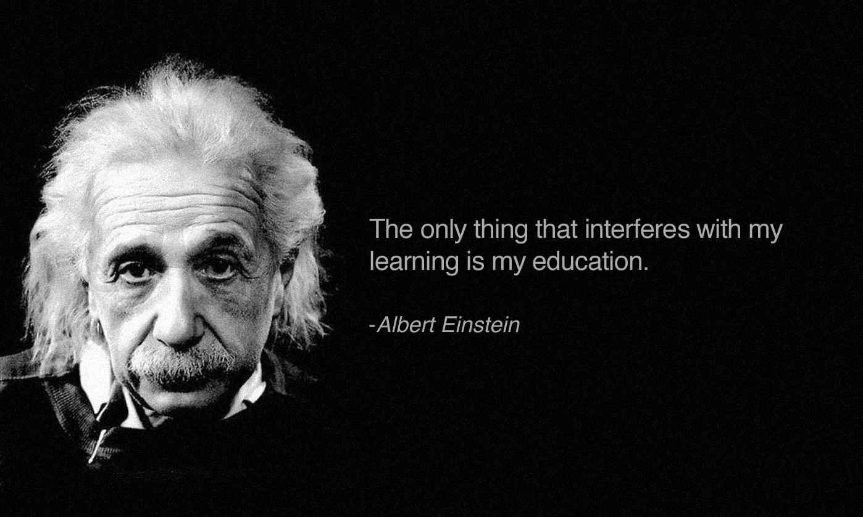
What is White Space as a concept?
The word ‘space’ suggests many concepts – in the world of learning and personal development, the term ‘space’ could mean ‘room for growth’
In the world of education, White Space
as a concept is about leaving…
‘room for thinking’,
‘room for creativity’,
‘room for learning’.
Notes:
Original notes:-
This is the limit of information we wish to share with you initially – our desire is to provoke thinking, discussion and dialogue about the potential of a ‘less is more’ approach to teaching and accountability-driven education.
Provide some time for the concept to be processed… use this time for us to both, separately explain how we have come to consider the importance of WhiteSpace and the philosophy that in teaching and learning, ‘less is more’
Reflection and evaluation:-
SH – We spoke very little while this slide was shown. It provoked a number of comments and questions from participants that enabled a conversation that explored some of the issues and challenges that come with finding ‘whitespace’ for thinking, creativity and learning.
JL – This slide needs no modification. Simple and powerful.

Slide 4
Personal reflection:
On a blue post-it briefly write an occasion you* felt especially restricted, limited, uncomfortable, controlled by others...
On a yellow post-it briefly write an occasion you felt particularly liberated, empowered, imaginative, creative...
When ready, put your post-its on the A3 sheet on your table
Activity 1:
*or, if you wish: … your students felt …
Notes:
Originsl notes:-
Any occasion consisting of learning, personal growth / development or just curiosity to know something new
Reflection and evaluation:-
SH – Jori had identified early on during the planning of our workshop that it was important that we encouraged participants to explore their own feelings when considering both scenario types. This activity brought about a lot of table discussions and the activity was probably the most significant of the whole workshop. There was a danger that we introduced the next activity too soon during the discussions that were taking place and on reflection that could have created a problem. However, the act of placing the next activity face down on the tables and ‘instructing’ participants to not turn them over and look at them, created a ‘closed’ and ‘restricted’ feeling to that activity even before we started it – fortunately that was exactly the feeling we wanted to create for that task, so that we could then introduce a more ‘open’ and ‘freer’ activity after for comparison purposes to illustrate the impact of WhiteSpace on learning activities.
JL – Quick glance on the written post-its shows that the described stories are relevant. Many of them do not concentrate just on simple learning situation but on wider perspective, example on a project or on working culture. That means the participants have understood the wider concept of White Space (Where is the White Space in your life, work, ….). The method we used – using FEELINGS to capture the idea of White Space – worked well. In case the work shop would have been just a launch in a process including also further planning sessions for teachers, we still didn’t have to change anything. Just later on to concentrate on how teachers can plan circumstances and processes to highlight White Space in LEARNING. The extra slides give guidance for that.

Slide 5
Group sharing activity:
Learning situations
Any occasion consisting of learning, personal growth / development or just curiosity to know something new:
… where I have felt especially restricted, limited, uncomfortable, controlled by others...
… where I have felt particularly liberated, empowered, imaginative, creative...
Notes:
Original notes:-
Copy this sheet in A3 to go on tables (one on each table of 6). Have a glance to other members notes
Reflection and evaluation:-
It was useful to have this slide on show during the activity because it acted as a reminder to participants that this was about feelings rather than about content and context. As the activity was important for a planned final activity during the session, it deliberately provided scaffolding for the blue and yellow post-it activity so that we could offer participants a practical response to ‘Where is the WhiteSpace?’ before they left the session.

Slide 6
Activity 2:
Individually, fill in the gaps:
To __ or not __ be, ____ is the ________
Notes:
Original notes:-
Minimum information, ”just do it” (there is either a lot of space or space is very restricted)
The sentence is closed but the task remains quite open
The thinking behind activities 2 & 3 is that it is a naturally creative process to make changes to what has been published previously to add originality – an example of this could be cover versions of songs that change the way in which the song sounds. One idea we discussed was to have music playing before the session which are all cover versions of previously recorded songs.
Reflection and evaluation:-
SH – The activity went better than expected. The biggest issue was that we gave out this A4 sheet but placed it face down on tables telling participants not to look until we said they could. This added to the tension and raised their emotions even though it was unintentional. As a result, many of the participants were already conscious of their feelings when they started the activity which helped us to make the point about WhiteSpace – by telling them not to look we had restricted the WhiteSpace even before they started the activity!
JL – This aciivity (2) and the next (3) as a package was very good. During these activities we discussed on many levels: how the participants felt, how these activities represent examples of White Space (being present or not). The activities worked perfectly as we planned: The participants really FELT the psychological White Space being present (freedom to create, think and express ideas) or not being present (the discomfort not to exactly now what was expected to do, which easily causes the fear of perhaps doing wrong things and so be embarrassed or the result being publicly judged to be wrong etc. All those feeling prevent learning and being creative)
One absolutely most important finding for me was this: If you do these kind of activities not individually but in pairs it gives you mental White Space!!!!!! The reasons may be many. (Steve, you could research this in your PhD thesis. This really interests me). The reasons might be example these:
When you have chance to discuss how your pair understands the assignment, it may open your mind from your own restrictions (restrictions affecting fair). That is step one towards creativity.
When you have chance to discuss how your pair understands the assignment, it may release your mind to see thing more openly (you are more creative). This is step two towards creativity.
When you hear what kind of suggestions brings into your pair’s mind it will inspire your mind to be even less restricted to new ideas. This is step three towards creativity.
When you and your pair finally are not sure what to do, 1) it is much more comfortable to know that you are not the only one to “feel stupid” (fear and embarrassment decreases) 2) in case you decide to “just to do as you as a pair understand how to do it” it gives you comfortability when it is time to present what you did (even if you feel you may see other presentation to be totally different)

Slide 7
Activity 2:
Original version:
To be or not to be, that is the question
(from Hamlet by William Shakespeare)
Notes:
Original notes:-
Minimum information, ”just do it” (there is either a lot of space or space is very restricted)
The sentence is closed but the task remains quite open
The thinking behind activities 2 & 3 is that it is a naturally creative process to make changes to what has been published previously to add originality – an example of this could be cover versions of songs that change the way in which the song sounds. One idea we discussed was to have music playing before the session which are all cover versions of previously recorded songs.
Reflection and evaluation:-
We deliberated for some time about whether we should provide this slide as it suggests a ‘correct answer’ rather than an ‘alternative answer’ as being the only acceptable response.
It was very interesting that some participants, who had clearly gained an understanding of our initial suggestion of what was ‘WhiteSpace’ decided to use the spaces to create their own versions of the poem and were not drawn into the closed activity suggesting that they were already comfortable with the concept of WhiteSpace and were driven more by the opportunity to create a ‘different’ answer rather than the ‘correct’ or ‘expected’ answer. Other participants were clearly stressed by the activity and this became obvious when we asked how participants felt when asked to complete the task. Some responded that they felt under (self-inflicted) pressure to remember the right answer, to be ‘correct’ even though the instructions did not explicitly say that was what was required. Others said that it was doubly stressful because it was not in their first language (an interesting dimension that was raised again but in a different way in the next activity). One person was further stressed when asked to explain to the whole group exactly how this felt which is again another issue for further thought regarding WhiteSpace when being invited to ‘open up’ about feelings or to respond to a direct question.
However, as a step towards participants responding to the idea of WhiteSpace, it was a very important stage in the process and in the workshop.

Slide 8
Activity 3:
In pairs, complete the following:
I must go down to the sea again
To the lonely sea and the sky
……………………………………………….
……………………………………………….
Notes:
Original notes:-
Discussion during or later or do we have time for it?
Reflection and evaluation:-
We decided to use a second poem to create a similar activity to the previous ‘open yet closed’ activity but this time with more WhiteSpace.
We created WhiteSpace through (i) a reminder to participants that there were actually no instructions other than to complete the poem; (ii) secondly it was a paired activity and using pairs itself creates WhiteSpace;: and (iii) no gaps to complete but two lines to complete the poem.
The response of the group was very encouraging and clearly, many of them had bought into the idea that our ‘less is more’ approach to very limited instructions provided the participants with WhiteSpace – they had more room to be creative and innovative if they wished. One overheard comment was, ‘We can do what we like. We could translate the first two lines into our own language and then write our own second two lines.’
The outcomes were predictably their own creations and not even one of them was an attempt to match the last two lines to the original which we showed participants with the next slide.

Slide 9
Activity 3:
Original version
I must go down to the sea again.
To the lonely sea and the sky
And all I ask is a tall ship
And a star to steer her by
(from Sea Fever by John Masefield)
Notes:
Originsl notes:-
The answer if this is a closed task without the opportunity to use WhiteSpace to be imaginative or creative
Reflection and evaluation:-
None of the participants came up with this as a solution.

Slide 10
Activity 3:
In pairs, complete the following:
I must go down to the sea again
To the lonely sea and the sky
……………………………………………….
……………………………………………….
Notes:
Original notes:-
Discussion during or later or do we have time for it?
Reflection and evaluation:-
This slide was just for purposes of revisiting the challenge.

Slide 11
Activity 3:
Imaginative option
I must go down to the sea again
To the lonely sea and the sky
I left my shoes and socks down there
I wonder if they’re dry
(an alternative version by Spike Milligan)
Notes:
Original notes:-
One possible answer amongst thousands of potential answers if we see the space as an opportunity to be creative and imaginative
Reflection and evaluation:-
The purpose of including this as one solution to the challenge was to illustrate that the activity offers an opportunity to be innovative. It is an illustrative example that also makes you smile because of the humour and shows what one person thought would make a good alternative solution.

Slide 12
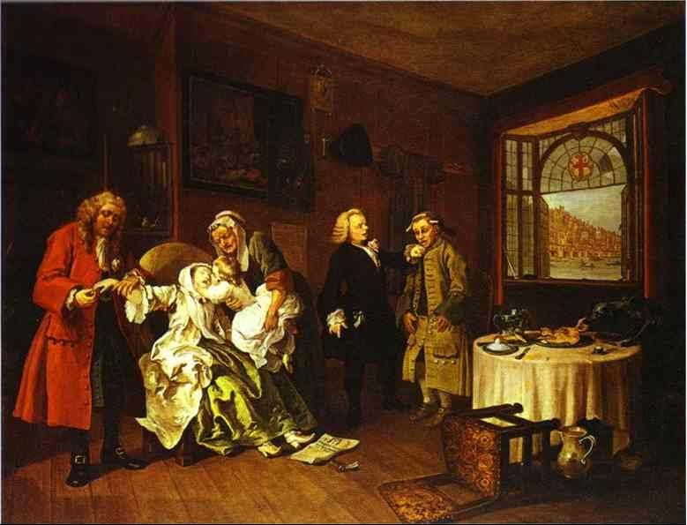
Activity 4:
Small task for groups of three “A story through painting”
Notes:
Original notes:-
Make sure we have tables with 4, 5 or 6people sitting at each – there should be no tables with less than 4 or more than 6
Reflection and evaluation:-
We skipped this activity. It was a good decision for two reasons: 1) There was too little time left to run the whole package. We had to skip something. 2) The participants had already gotten very good impression what we mean by the White Space concept. We really did not need this activity at all. And this activity is the most time consuming. Skipping this gave us a lot of space to end the session in a “White Space way”.

Slide 13
Does having White Space make your brain work actively and did you feel you were productive?
Notes:
Original notes:-
The context of this activity could have been …
Collaborative story telling, the paintings of Hogarth, social history in 17th century, …
Did White Space give added value concerning - being creative (creating a story)? - being collaborative … and could they be important parts of students’ learning?
Reflection and evaluation:-
We didn’t use this slide as the discussion had already moved beyond it. The answer was obviously ‘Yes’ and, on reflection, a better question might have been ‘In what ways do you think WhiteSpace may have offered opportunities for your brain to work actively and for you to be productive?’

Slide 14
Activity 5:
In pairs
Choose one of your blue post-its (one of your own) from the A3 sheet on your table
Using the sheet provided write down ideas for introducing White Space into the situation
Notes:
Original notes:-
Remember to collect or photograph all the sheets. If there is time left, share few of these ideas with the whole group.
Reflection and evaluation:-
JL –We skipped this activity also. If there was more time I would like to put it on this activity (before Hogarth activity).
SH – I agree with Jori’s comment and would move straight on to this activity after the second poem activity. The group were ready to engage with this kind of activity, even after an hour of being in the workshop in the last session of a Friday afternoon after a very long first day of the conference. We deliberately to stick to what we had said at the beginning and to finish at 4.30pm. On reflection, as it was the first time we had run the workshop we made the right decision but there is clearly an interest in the concept and I would like for Jori and I to consider how to follow-up with the dialogue (possibly with those members of the group who are interested.

Slide 15
Paired collaborative activity:
Learning situations with White Space
As a pair choose one of your blue post-its (one of your own) from the A3 sheet on your table
How could you use White Space to help the learner to become more liberated, empowered, imaginative, creative...
…… ….. ……. ……
(Above there is an example of a learner being especially restricted, limited, uncomfortable, controlled by others…)
Notes:
Original notes:-
Copy this sheet in A4 to go on tables (one for each pair). Pairs need time to discuss before choosing. Personally in the pair: choose one occasion of your own and explain it to your pair and vice versa and as a pair choose one to further process
Reflection and evaluation:-
This is probably our only regret, that we did not have time to go on to this activity. It would have been difficult to include it within the one hour but had the workshop included a break for coffee, it would have been good to come back to do this activity after coffee so that we could continue with the drawing of conclusions discussion.

Slide 16
Conclusion… so far!
Notes:
Reflection and evaluation:-
Again we could have made more of this activity if we had had more time. However we used the following slide as a means of drawing an initial conclusion and then went on to show the supplementary slides which together acted as a plenary and worked well.

Slide 17
What if?
no White Space:
with White Space:
Giving facts
Giving facts
Imagination
Imagination
Collaboration
Collaboration
Innovation and creativity
Innovation and creativity
Sharing ideas, experiences and opinions
Sharing ideas, experiences and opinions
Notes:
Original notes:-
We have common message that we would like to share with you. What if …. White Space is used to increase imagination, collaboration, innovation, creativity and sharing ideas experiences and opinions?
Reflection and evaluation:-
It was useful to go back to an earlier image which we had deliberately not commented on at the time (although we were prepared to if anyone had asked a question – in other words we had left WhiteSpace for questions to our stimulus in case participants started asking questions right from the start).

Slide 18
Where is the White Space?
So, finally ...
Steve Hall and Jori Leskelä
Notes:
Original notes:-
Where is the White Space … in your learning, in your life, in your teaching, in your students’ learning etc.
Reflection and evaluation:-
We used the additional slides to explore the question once again.

Slide 19
Where is the White Space?
- additional slides which may be of interest ….
Contact details:
Steve Hall s.j.hall@staffs.ac.uk
Jori Leskelä jori.leskela@tamk.fi

Slide 20
Where can White Space exist in teaching and learning?
Pauses in speaking to provide time for processing information and reflecting on its meaning?
Blank pages for doodles
Places to go to think and reflect
Unplanned time for follow-up and follow-through
Open doors, open minds
Coaching conversations
Notes:
Reflection and evaluation:-
We did very good job by giving participants a quick glance of “the next steps” because it provided a link between the questions we were posing to participants and to the practice with which they were able to identify. It may help us to consider future workshops if we share some of these thoughts with participants before we ask them to complete the final Activity 5, on slides 14 and 15.

Slide 21
How could you use White Space to make learning more effective?
recognise the need for imagination
delay stating learning objectives – leave it as white space until midway through the learning activity
only plan (initially) for 50% of teaching time
stop talking
not too much (not too much confusion, not too long away from your comfortable zone), not too little
right moment for it
Notes:
Reflection and evaluation:-
We spoke very little when we showed these slides right at the end of the workshop session other than to say they were some of our initial ideas but that they did not offer a definitive list. We felt that the slides could speak for themselves but that after the other activities which had gone so well, they ‘provoked’ some further thinking and discussion (which continued for quite a long time after we formally ended the session).

Slide 22
Why is White Space important and what is its meaning?
Where is the white space
- for teachers and students to test out what students have learned
- for students to engage and find their motivation (space for their own objectives, space to test their competences by facing real life problems)
- for teachers develop themselves, to benchmark other schools, to share ideas with colleagues "developing soul-mates" in their schools, in other schools even in other countries, to try new things and even fail, learn from failure and try again
- for teacher groups, for leaders on various levels
- in student's mind for new understanding, for changing attitude, for considering different kind of opinions (peers' opinions, ...)
- for self reflection
- to ask silly questions?
Where is the white space during lectures
- time for students to think (mulling?)
- test their ideas and understanding through discussion and debate?
Where is the white space to relax?
Where is the space for teachers' authority and autonomy (power) and trust so that they can concentrate on developing, implementing and inquiring themselves the results, the pros and cons, and to continue developing? Usually this process takes years.
Notes:
Original notes:-
This is the most contradictory slide because there is so little white space, but it does reflect our early conversations.
This slide also reflects our ’inverted’ approach to the presentation/workshop which is to provide less information at the beginning and to only introduce further information if it is needed.
Reflection and evaluation:-
We were surprised when we both realised that we had turned around the normal way of a presentation when a lot of information is given early on. It was interesting that our planning of the workshop used a lot of WhiteSpace at the start to model the concept and to provide ‘space’ for participants to experience what happens when there is little WhiteSpace compared to when there is more, and then to gradually introduce more information to ‘feed’ participants own ideas and imagination.
It was quite amusing to have talked about presentations that eliminate WhiteSpace by filling every slide with text – then we showed our final slide which, in comparison to the rest of the workshop presentation, was full of text! Again in an inverted way, it made the point very effectively.

