Slide 1
The Challenges of Dementia Care and the (Un)Making of Meaning: analysis of an online forum on carer spirituality
Hans Stifoss-Hanssen
Peter Kevern

Slide 2
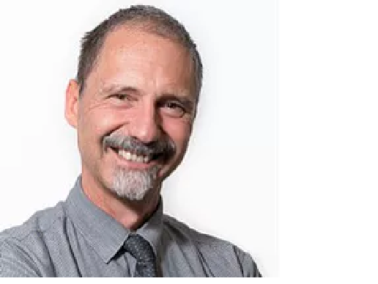
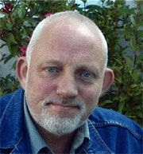
Where we were in December 2017:
A number of psychometric studies suggest that S/R coping affects caregiver stress, burden and wellbeing but . . .
. . . only a few interview studies explore how this happens in practice

Slide 3
A starting-point:
Talking Point
For those of you who are spiritual, I'm just wondering if any of you have thoughts which lend a spiritual perspective to going through dementia. Are there any spiritual lessons to be gained through the journey of either the care giver or the victim? Or do you have any spiritual perspectives related to any aspect of dementia which helps give you strength, or to make sense of the whole cruel dementia experience?
Notes:
https://forum.alzheimers.org.uk/threads/spiritual-aspects-of-dementia.54434/

Slide 4
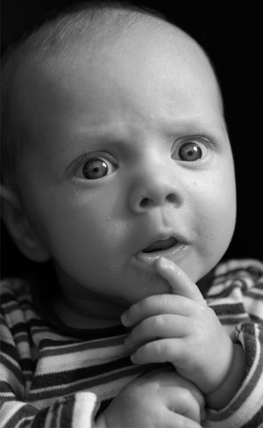
Some Responses . . .
64 entries from 25 participants, 62/64 posts by 23 people over a single week
Variation:
“It’s all rubbish”
“An angel spoke to me”
“I’m confused and discouraged”
“A challenge to grow”

Slide 5
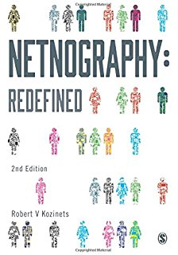
. . . a methodological problem . . .
Forum posts as transient-permanent
Posters choose when to post, and in what thread
Ethics: although technically a document in the public domain, how clear was this to participants?

Slide 6
PAPER 1: ANALYSIS OF CONTENT
Thematic analysis (IPA) across the whole archive to identify primary and superordinate themes
Unpacking of hermeneutics by deep reading of individuals’ contribution

Slide 7
Six responses:
Special revelation
Atheism
Soulmaking
Source of strength
Blessing for PWD
Caring as life’s purpose

Slide 8
Figure 1: model of the relationship between themes (numbers refer to themes from Table 2; letters to contributors)
<1> Dialectical conflict between r/s and experience
8. Dementia as destiny or telos (B,R,V)
1. Dissonance/injustice (A,U)
7. Blessing for PWD (A,G,M)
<3> potential positive relationship between r/s and experience
2. Failure to make spiritual meaning (A,U)
<2> reject dialectical premise
5. Potential for spiritual growth (A,E,G,R
6. S/R source of carer strength (A,G,R,U)
4. Experience proves the absence of spiritual meaning (D,F,I,J,K,P,Q)
3. Special revelation overrides experience (B)

Slide 9
KEY POINT
In a post-secular society, the stories people tell about meaning may recycle familiar theological content
Understanding the narrative options may yield insight into how they may provide direction and hope.

Slide 10
PAPER 2: ANALYSIS OF STRUCTURE
We had identified a distinct form of ‘narrative reasoning’ with a standardised structure:
A ‘position statement’ and/or
An affirmation of a previous poster or content.
A testimony or narrative (29/62 posts)
A reflection on the narrative which provides a conclusion
Is the narrative format giving shape, direction and so meaning to the experience of carers?

Slide 11
Research Tools
Arthur Franck (1995) The Wounded Storyteller. Health narratives of Restitution, Chaos and Quest lead to . . .
. . .Ruard Ganzevoort (1995) Religious Coping Reconsidered. Maps structure and components of R/S coping narratives

Slide 12
Ganzevoort’s psycho-narrative theory of S/R coping: “The author tells a story to an audience for a purpose”
Whenever a new event appears, be it situational or developmental, the author will try to interpret it and give it a place in one of the (central) stories of his or her personal narrative. If the person can do so, a coherence of meaning can be seen. This process is called primary or event appraisal in coping theories . . . When finding a suitable interpretation seems impossible (i.e., to connect it to one of the available story lines), an existential crisis will occur. The secondary or resource appraisal is part of this process too, as the perceived resources are part of the story

Slide 13
Can Ganzevoort’s criteria provide a basis for analysis?

Slide 14
KEY POINT
In a post-secular society, the stories people tell about meaning may re-use familiar theological rhetoric.
Understanding how that rhetoric operates may provide insights into how ‘quest narratives’ may be constructed

Slide 15
Dimension | Narrative criteria | Content: PADRAIG
Authorship | Taking responsibility | The more I learn of conventional society the more I'm grateful to have been left to make my way alone in this funny old world. For all intent and purpose I should have been a good Catholic, but I have nothing to do with it. (21)
 | Narrative competence | On reflection I can't begin to describe the tremendous benefits I've derived from such a background. There is so much to appreciate in the time we are allotted in this world. In my case there was little time to waste in achieving the many goals I set my self and was able to retire by age 54. (21)
 | Search for self | Best of all I thank God for providing the strength of mind and body to care for my wife on my own at home for her final five years. For me it was a privilege, an honour, humbling experience and the most rewarding time of my life. (21)
Story | Basic trust | I was to meet a young teenage girl in a dance hall that was to change my life forever. I had found a place that felt like what I imagined was a real home. (30)
 | Inclusion of fragmentation | …. so many victims find it impossible to let the past go. What's done cannot be undone, but lessons can be learned. …. Many allow the experience to continue to ruin their lives with hate and bitterness. No matter what bad experience we may have had there is always a positive aspect to it. When our 15 year old daughter was killed by a dangerous driver, one might ask, what could have been positive outcome there? (35)
 | Transcendent actor | "You were sent to me, you made me whole” (50)
 | Metaphorical speech | Best of all that young factory girl took me on in marriage even though all I had to offer was a dream. The dream was of a home in the countryside where children would be free to express themselves in mind and body.(30) When I first entered the free world…. (30)

Slide 16
Audience | Responsiveness | Big Effort, Like you I believe that we don't use the full capacity of our brain. One of the advantages I derived from the nuns beating the devil out of me for using my left hand (they knew no different) it forced me to use the side of the brain I would not have used naturally (50) Exchanges with Big Effort and Isabilla
 | Transcendent address - search for intimacy | What I do know is she was my salvation and still inspires me by her example. She was such a gentle, quiet and selfless person. (50)
 | Transcendent address – search for the sacred | It may appear from my posts that I have lost faith, but in fact it may surprise some to learn that I pray every day. (50)
Purpose | Ordering the experience – search for meaning | Once I was released into a strange new world I chose to forget my stolen childhood and moved from that God forsaken land called Ireland. Not until I was in my seventies and caring for my wife was I to discover the reason I was in those Institutions. (21)
 | Seeking acceptance – search for intimacy | The first time I was invited to her home; a two up two down with a family of her two brothers and two sisters I experienced a richness of love and security that no money can buy. Years later I understood when she had AD why she wished to 'go home.' (30)
 | Seeking acceptance – search for the sacred | Best of all I thank God for providing the strength of mind and body to care for my wife on my own at home for her final five years. For me it was a privilege, an honour, humbling experience and the most rewarding time of my life. (21)
 | Hope | Towards the end of our Alzheimer's journey I well remember saying to my wife as she lay in bed: "You were sent to me, you made me whole, it is now OK to let go, I'll be fine." What prompted me to utter those words I'll never know. (50)

Slide 17
Can stories merge?
The authors communicate, relate the different elements of the stories to each other?

Slide 18
Padraig finds resonance with Isabilla and Big Effort, internarrativity?
Isabilla: Padraig to hear you speak like this is truly humbling. You could just as easily have turned bitter and taken a very different view point. You appear to have made a success of you life and your early life was no hindrance to it. Others may have chosen to follow a different path and end up in a poor poor me victim mentality to the extent they live their lives still enslaved to the institution that abused them.
Padraig responds: Isabilla, You are correct when you say that so many victims find it impossible to let the past go. What's done cannot be undone, but lessons can be learned. Sadly I receive too many Emails of late with reference to the suffering of victims of the Magdalen Laundries. Many allow the experience to continue to ruin their lives with hate and bitterness. No matter what bad experience we may have had there is always a positive aspect to it.
Big Effort Hello Padraig, I am Irish, luckily I grew up post this carry on, and it doesn't bear thinking about. Your life and accomplishments have been the ultimate triumph over adversity. Religion has a whole lot to answer for..... but your story highlights what the human spirit is capable of rising above…….
Big Effort Like Padraig and Isabella, I grew up in Ireland (Eire). The tentacles of religion (NOT spirituality) crushed any budding spirituality right out of me. It has taken the Alzheimers Journey to make me wonder if there is a purpose or sense in all this suffering and sadness and loss…….

Slide 19
What does this mean? Ganzevoort: Religious identity, context and coping
A merged metastory of shared religious transformation, a change from religion to spirituality?
A story of religious emancipation (emancipation from religion), and spiritual empowerment at the same time. Out of one kind of spirituality (religion), into another.
Out of Ireland, into the “free world”, UK ☺.
A transformation towards a religiosity that is a resource for meaning in life, for strength and endurance, and has a link (contact, meditation, prayer). Theologically, this reveals a particular God image (knowing what/who), and a particular way of getting to know God (knowing how).
Ontology and epistemology? God is more compassionate and caring, and I am getting to know God through my experience of caring.

Slide 20
SOME INTERIM CONCLUSIONS
‘Non-religious’ carers still may need and actively seek an account of the meaning of their experience
Ambiguous character of S/R – can support or undermine resilience
The active struggle for meaning may prove stressful and require support
Strategies to resolve the dialectic adopt some standard ‘arguments’ familiar in theodicy
The search for meaning adopts familiar rhetorical forms
Different accounts ‘work’ for different people

