Slide 1
Balancing Heritage and ProgresS:
REIMAGINING THE POTTERIES AS A CENTRE FOR DIGITAL FILM PRODUCTION
s.k.thomas@liverpool.ac.uk

Slide 2
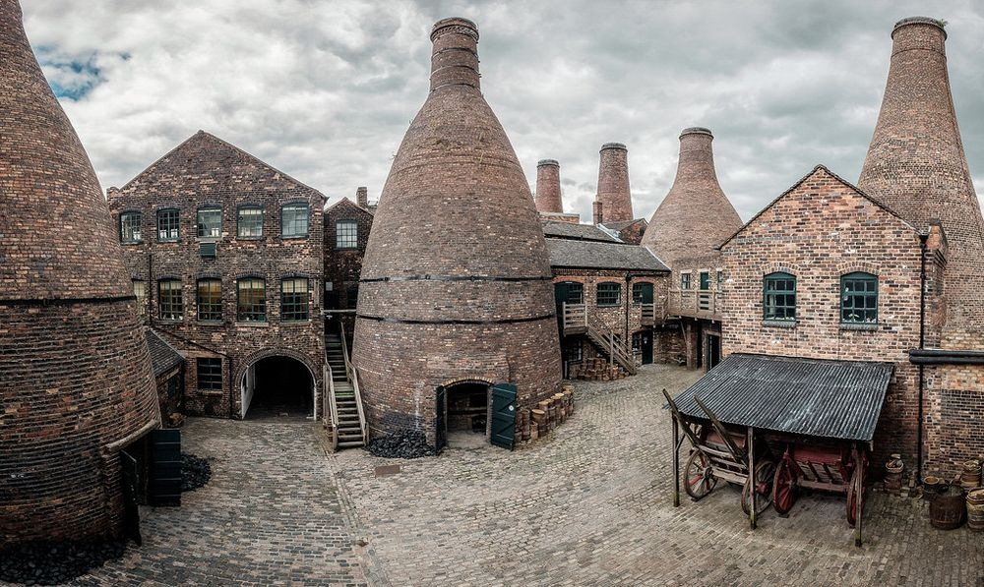
“
LEVELLING UP THE SCREEN INDUSTRIES
This book seeks to document a critical moment for the screen industries in the United Kingdom by examining the contribution of smaller metropolitan adjacent areas that are often not typically considered in wider discussions of a national film industry. By adopting a case study approach, this book seeks to address this oversight and in doing so, detail the opportunities and obstacles to the growth of three distinct regions: Sunderland, Southampton, and Stoke-on-Trent.
”
Mark McKenna
Levelling Up the Screen Industries:
Regenerating a Britain Left Behind.
London: Routledge.

Slide 3
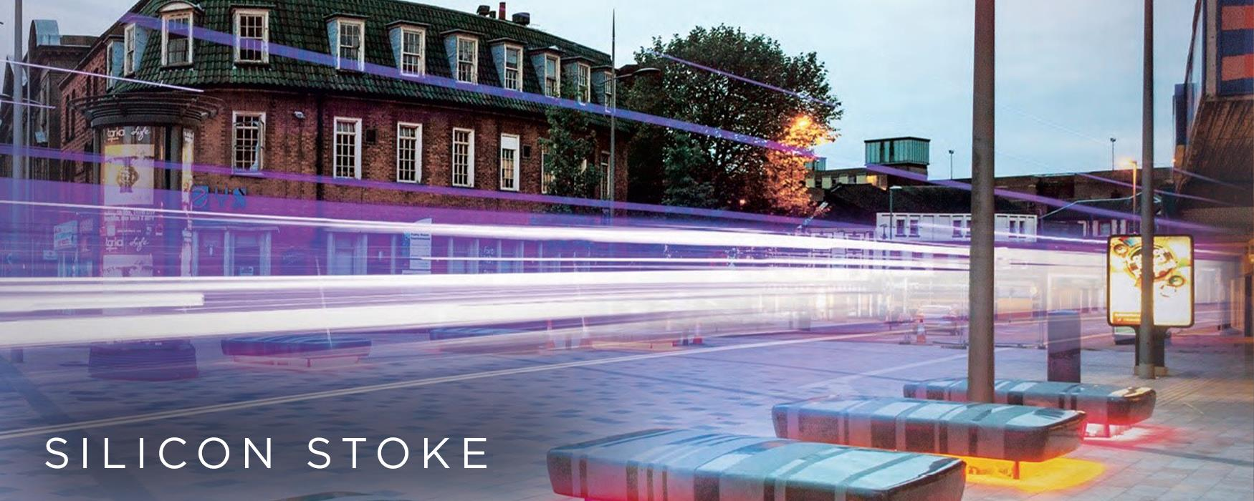
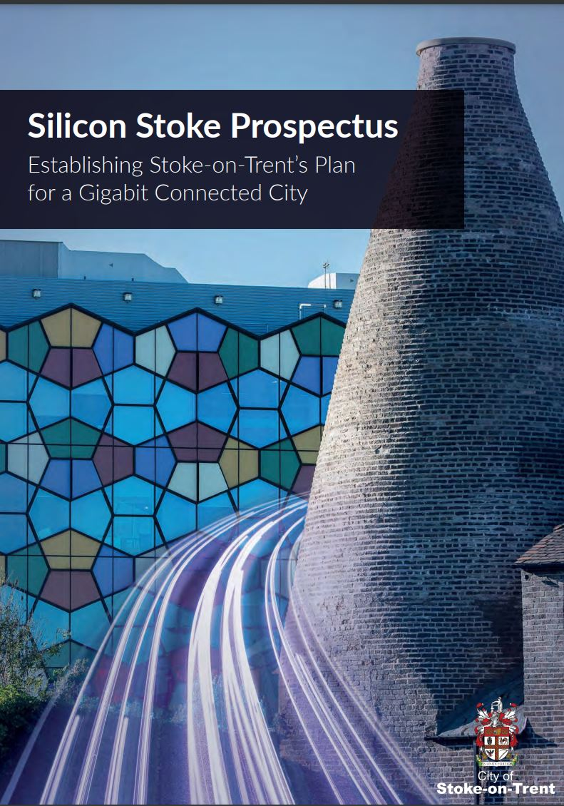
“
CITY COUNCIL - SILICON STOKE
Building first-class digital infrastructure is crucial for levelling up the country and I'm thrilled our £8.5 million investment for a vast fibre broadband network underneath this great city will act as the springboard for 'Silicon Stoke’.
The funding, alongside the bold vision of the city's council leaders, will transform the city into a hotbed of digital innovation - creating jobs, boosting businesses and improving lives.
”
Matt Warman
The Minister for Digital Infrastructure and Broadband

Slide 4
“
REIMAGINING STOKE AS A DIGITAL HUB
Stoke-on-Trent is joining a growing network of Smart Cities across the globe. In the same way that ceramics gave Stoke-on-Trent global brand recognition alongside the likes of Vallauris, Arita and
Delft, now we have the opportunity to join a new network of smaller cities such as Aalborg, Eindhoven and Hobart in forging a new path in digitally enabled, sustainable growth..
”
Councillor Abi Brown Leader
Stoke-on-Trent City Council

Slide 5
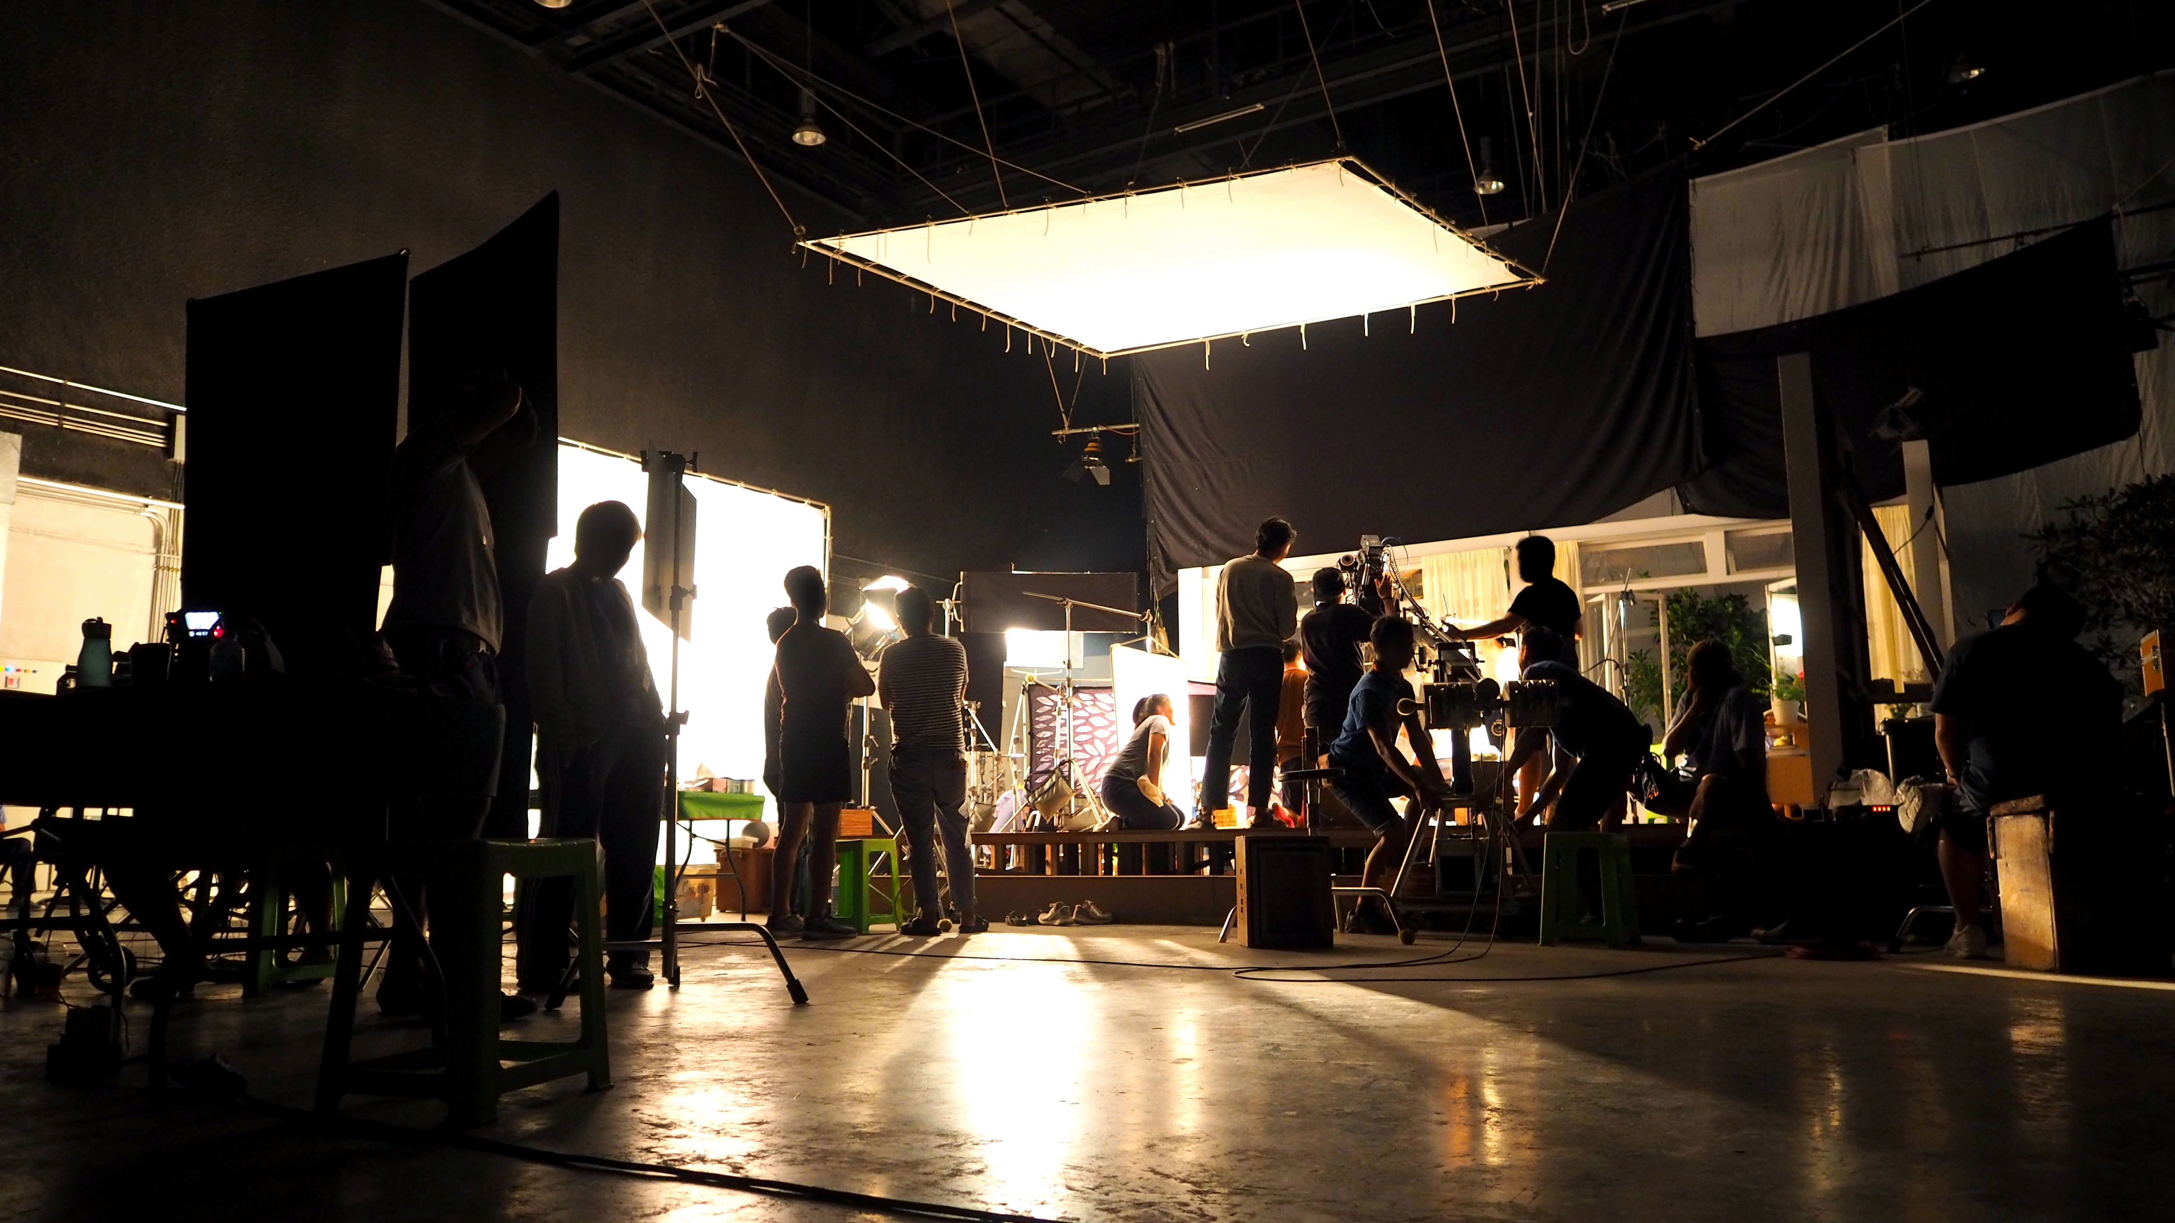
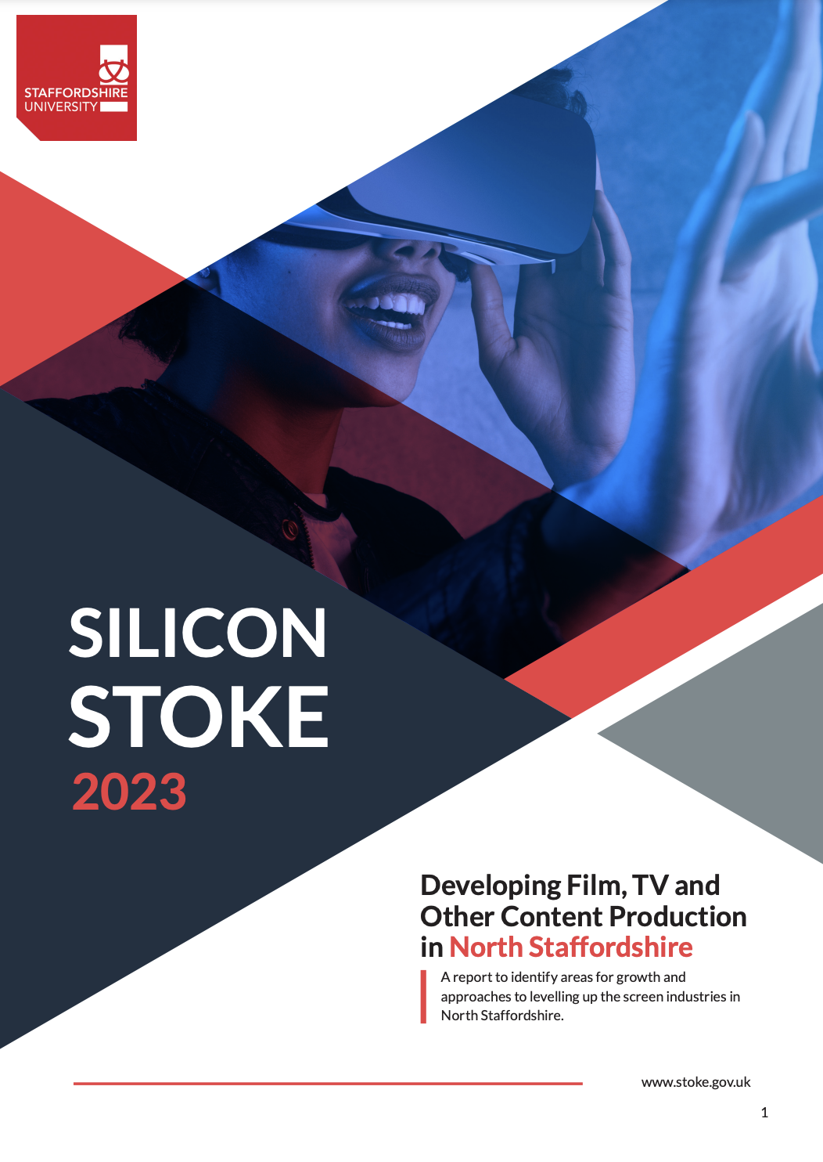
Growing the screen industries BUILD AN AUDIENCE INVEST IN TALENT INVEST IN THE FUTURE
RECOMENDATIONS

Slide 6
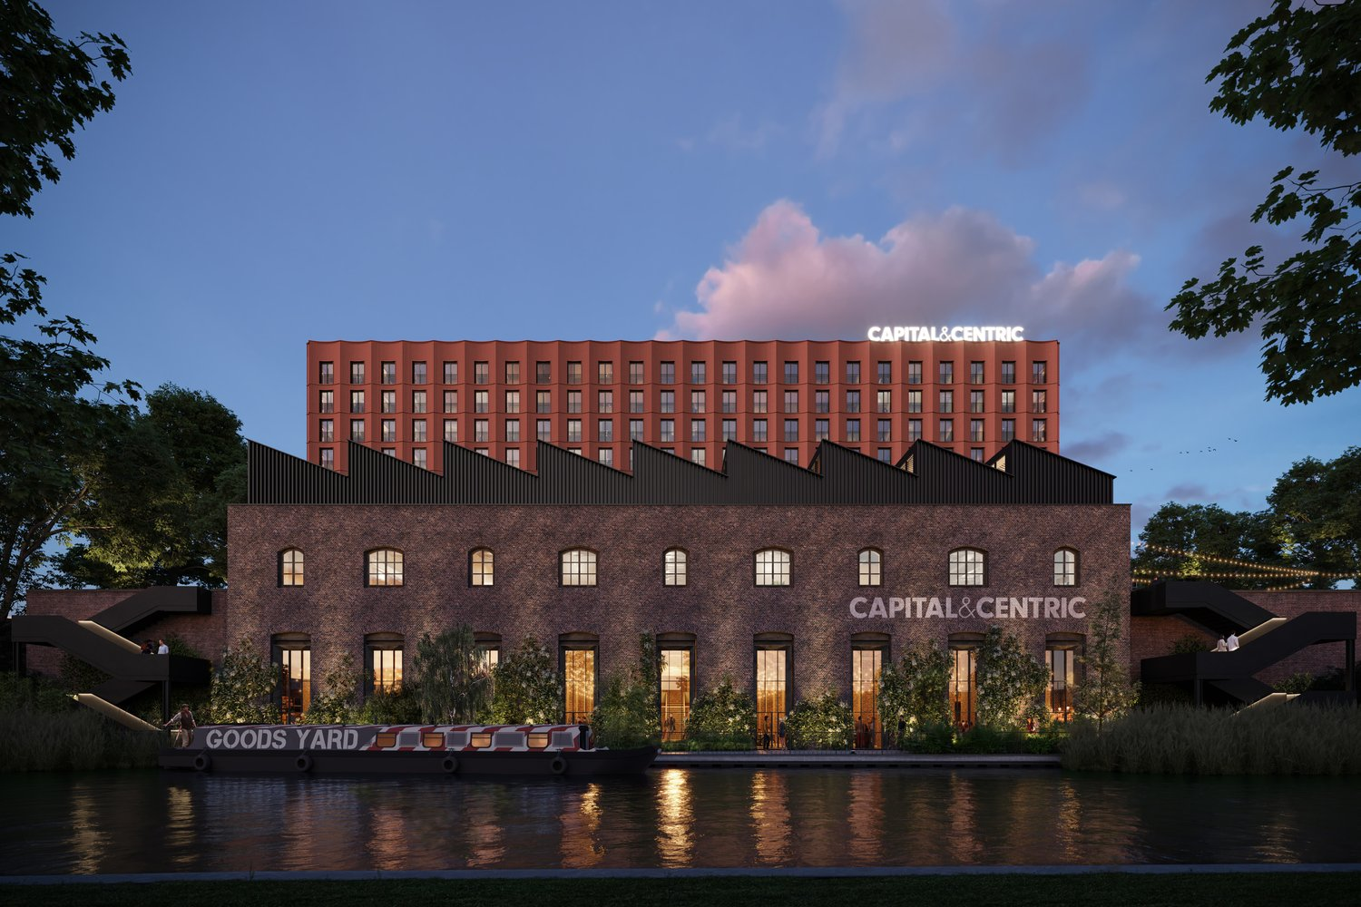
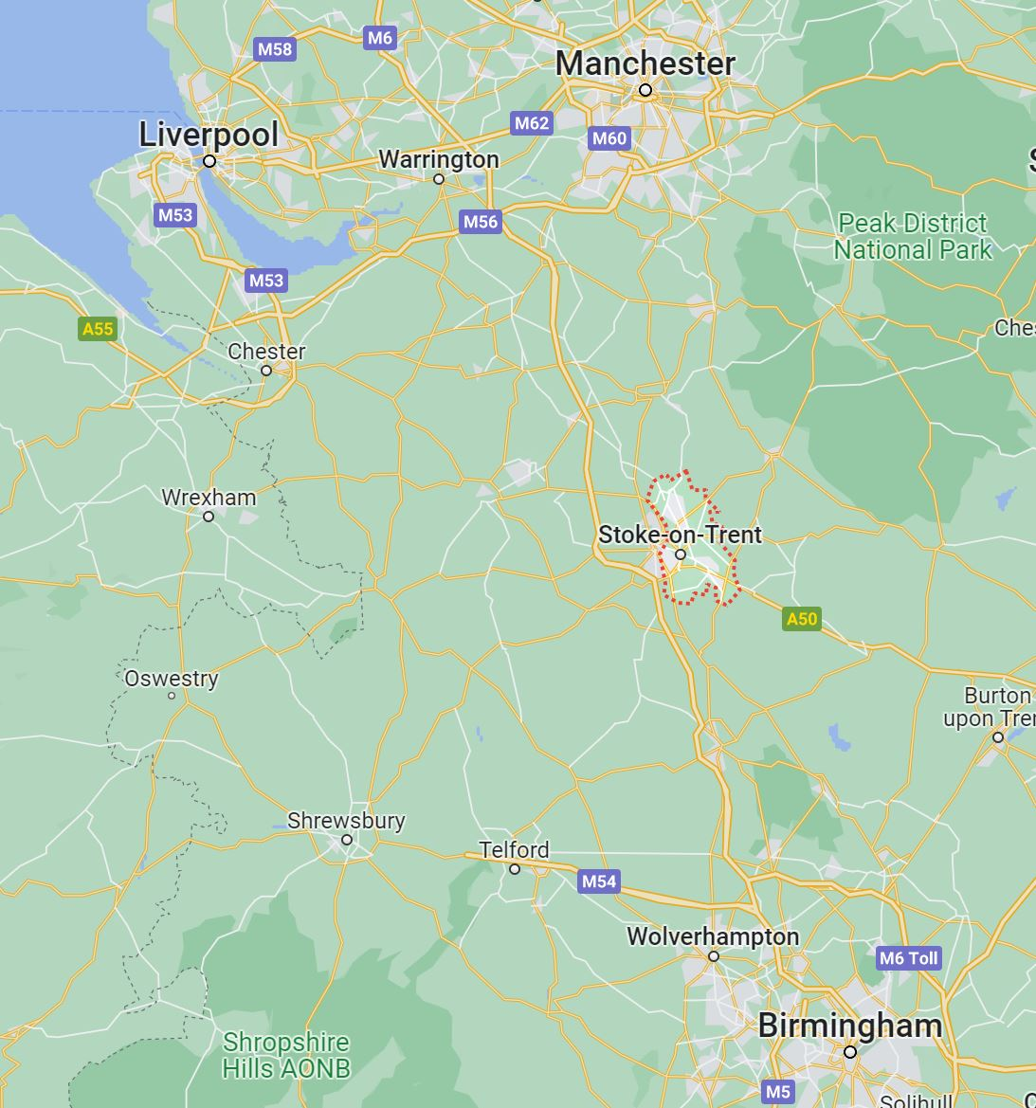
“
CHALLENGES
The digital infrastructure offered by the 5G rollout presents an opportunity to reconceptualise the region’s links, and conceive of the region as connected by ‘the north-west passage’ – a ‘creative corridor’ productively linking us to Manchester, Birmingham and Liverpool, then, rather than concede that we can’t compete, we look at how we can collaborate and in doing so, move away from the idea that the region is trapped in the Bermuda Triangle.
”
Mark McKenna
Levelling Up the Screen Industries:
Regenerating a Britain Left Behind.
London: Routledge.

Slide 7
RECOMENDATIONS
The Staffordshire Film Office is being launched and operated by We Are Staffordshire – the county’s place marketing organisation – which is made up of the county and all eight district and borough councils, as well as representatives from over 200 businesses including a private sector-led Place Board. The organisation this week marked the end of its three-year pilot and start of a new chapter, having raised £90,000 in funds from the private sector and district and borough council partners to continue its work.

Slide 8
THANK YOU
ANY QUESTIONS?
s.k.thomas@liverpool.ac.uk

