Slide 1
Integrating Physical Fitness into Esports: A Comprehensive Training Plan for Esports Athletes

Slide 2
Study purpose
Purpose of the study: the study is very much in the design stage however the purpose is to assess the impacts of a physical training program which is tailored towards esports athletes and to evaluate if it improve both their performance and overall well being.
Rationale while cognitive skills like reaction time, decision making and strategic thinking are crucial in esports, physical fitness is often overlooked. However, recent research including work by Lies and Watson has shown that physical health can significantly impact cognitive performance, stress management, and even in-game success. This study seeks to fill that gap by developing a physical regimen that complements cognitive training.

Slide 3
Study focus
Unique physical challenges in esports: Esports athletes face unique physical strains, including poor posture, repetitive strain injuries (rsi), and sedentary lifestyle risks (e.g., cardiovascular problems). These issues, if left unaddressed, can hinder long-term career success and overall health.
Mental health concerns: high levels of stress, anxiety and burnout are prevalent in competitive gaming, which can impact performance and longevity in esports. Long lasting impacts of poor mental health has been documented leading to further stress on retirement.

Slide 4
Theoretical framework
Cognitive-Physical Interaction Theory: The research is grounded in the concept that physical fitness supports cognitive abilities. Improved cardiovascular health, strength, and posture can lead to better cognitive function, faster reaction times, increased focus, and reduced mental fatigue (Hartson 2003).
Holistic Training in Traditional Sports: Traditional sports integrate both mental and physical conditioning to optimize performance. This study proposes adopting a similar holistic approach for esports athletes (Etkin 2024).

Slide 5
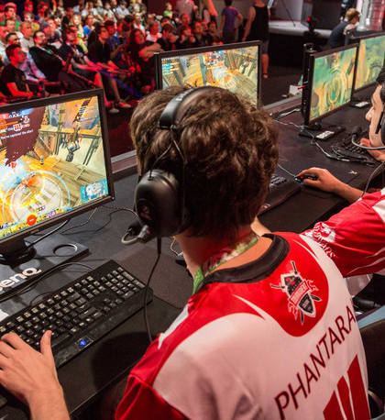
Research Methodology:
Mixed-Methods Approach: The study uses both quantitative and qualitative data to ensure a comprehensive evaluation of the training program.
Quantitative Data: Collected through physical fitness tests, cognitive performance assessments, and psychological well-being surveys pre- and post-intervention.
Qualitative Data: Feedback from participants on their experiences, perceived improvements, and mental health changes.
Participants: Esports athletes who voluntarily engage in the program. The study aims to have a diverse group in terms of age, skill level, and type of esports they play.

Slide 6
The physical training program
Program Duration: 12 weeks, progressively intensifying to match participants' growing physical capabilities.
Training components:
Cardiovascular Fitness: Exercises to improve heart health, stamina, and endurance, which can translate to sustained focus during long gaming sessions.
Strength Training: Targeted exercises to build muscle strength, especially in the back, shoulders, and core to improve posture and prevent injuries.
Flexibility & Mobility: Stretching routines designed to enhance flexibility, reduce stiffness from prolonged sitting, and promote faster recovery.
Posture & Ergonomics: Special focus on exercises that correct posture, alleviate strain from extended screen time, and ensure proper ergonomics during gaming.

Slide 7
Assessment & Data Collection
Physical Fitness Tests: Includes measures of endurance, strength, flexibility, and posture.
Cognitive Performance Evaluations: Pre- and post-tests measuring reaction time, decision-making speed, focus, and in-game performance (e.g., K/D ratios, APM—Actions Per Minute).
Psychological Well-being Surveys: Aimed at assessing stress, anxiety levels, and overall mental health before and after the intervention.

Slide 8
Expected Outcomes
Physical Health Improvements: Anticipated enhancements in cardiovascular fitness, strength, and posture that reduce the risk of esports-related injuries.
Cognitive Performance Gains: Improved reaction times, better focus, and more strategic decision-making under pressure.
Mental Health Benefits: Lower stress levels, enhanced mood, and better emotional regulation, leading to greater mental resilience during competition.
In-Game Success: Measurable improvements in in-game performance metrics such as win/loss ratios, reaction speeds, and teamwork cohesion.

Slide 9
Broader Implications
The study will provide a model for integrating physical training into routine esports coaching. It highlights the importance of treating esports athletes as holistic competitors, whose physical health is just as vital as their mental and gaming skills.
Future studies could build on this model, exploring specific physical training regimens tailored to different esports genres or expanding the sample size.

Slide 10
References
Hartson, R., 2003. Cognitive, physical, sensory, and functional affordances in interaction design. Behaviour & information technology, 22(5), pp.315-338.
Pedraza-Ramirez, I., Ramaker, B., Mathorne, O.W., Watson, M. and Laborde, S., 2024. Behind the Curtains of Elite Esports: A Case Study From a Holistic Ecological Approach to Talent Development. Case Studies in Sport and Exercise Psychology, 8(S1), pp.S-18.
Watson, M., Jenny, S.E. and Johnson, T., 2024. Esports Coaching. In Routledge Handbook of Esports (pp. 203-213). Routledge.
Watson, M., Smith, D., Fenton, J., Pedraza-Ramirez, I., Laborde, S. and Cronin, C., 2022. Introducing esports coaching to sport coaching (not as sport coaching). Sports Coaching Review, pp.1-20.

