Slide 1
Blending brains and Brawn
Integrating physical activity into esports curriculum
Cameron Vanloo
Staffordshire university

Slide 2
The rational of physical training within esports curriculum.
https://youtu.be/fISgKl8dB3M
Exercise in the 1960’s in the US
https://twitter.com/i/status/1790300946280456515
Spike ball G2 pre game against Top esports

Slide 3
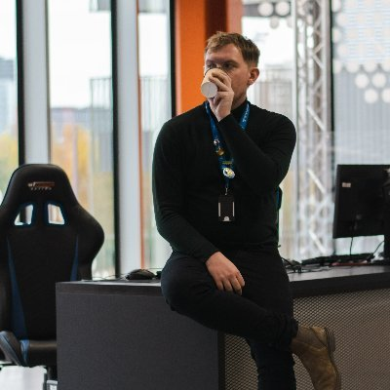
Introduction
Cameron Vanloo Lecturer at Staffordshire university for the past three years
8 Years in the esports industry
Current research
Integrating physical activity into esports curriculum (Early stages)
Addressing inclusivity challenges for disabled gamers (Publishing September)
PHD The impact of physical exercise and training on amateur competitive gamers (Ongoing)

Slide 4
Overview
The study focused on three main areas
Psychological and sociological benefits of exercise
Case study of Gsport and sports day.
Exercise within the curriculum

Slide 5
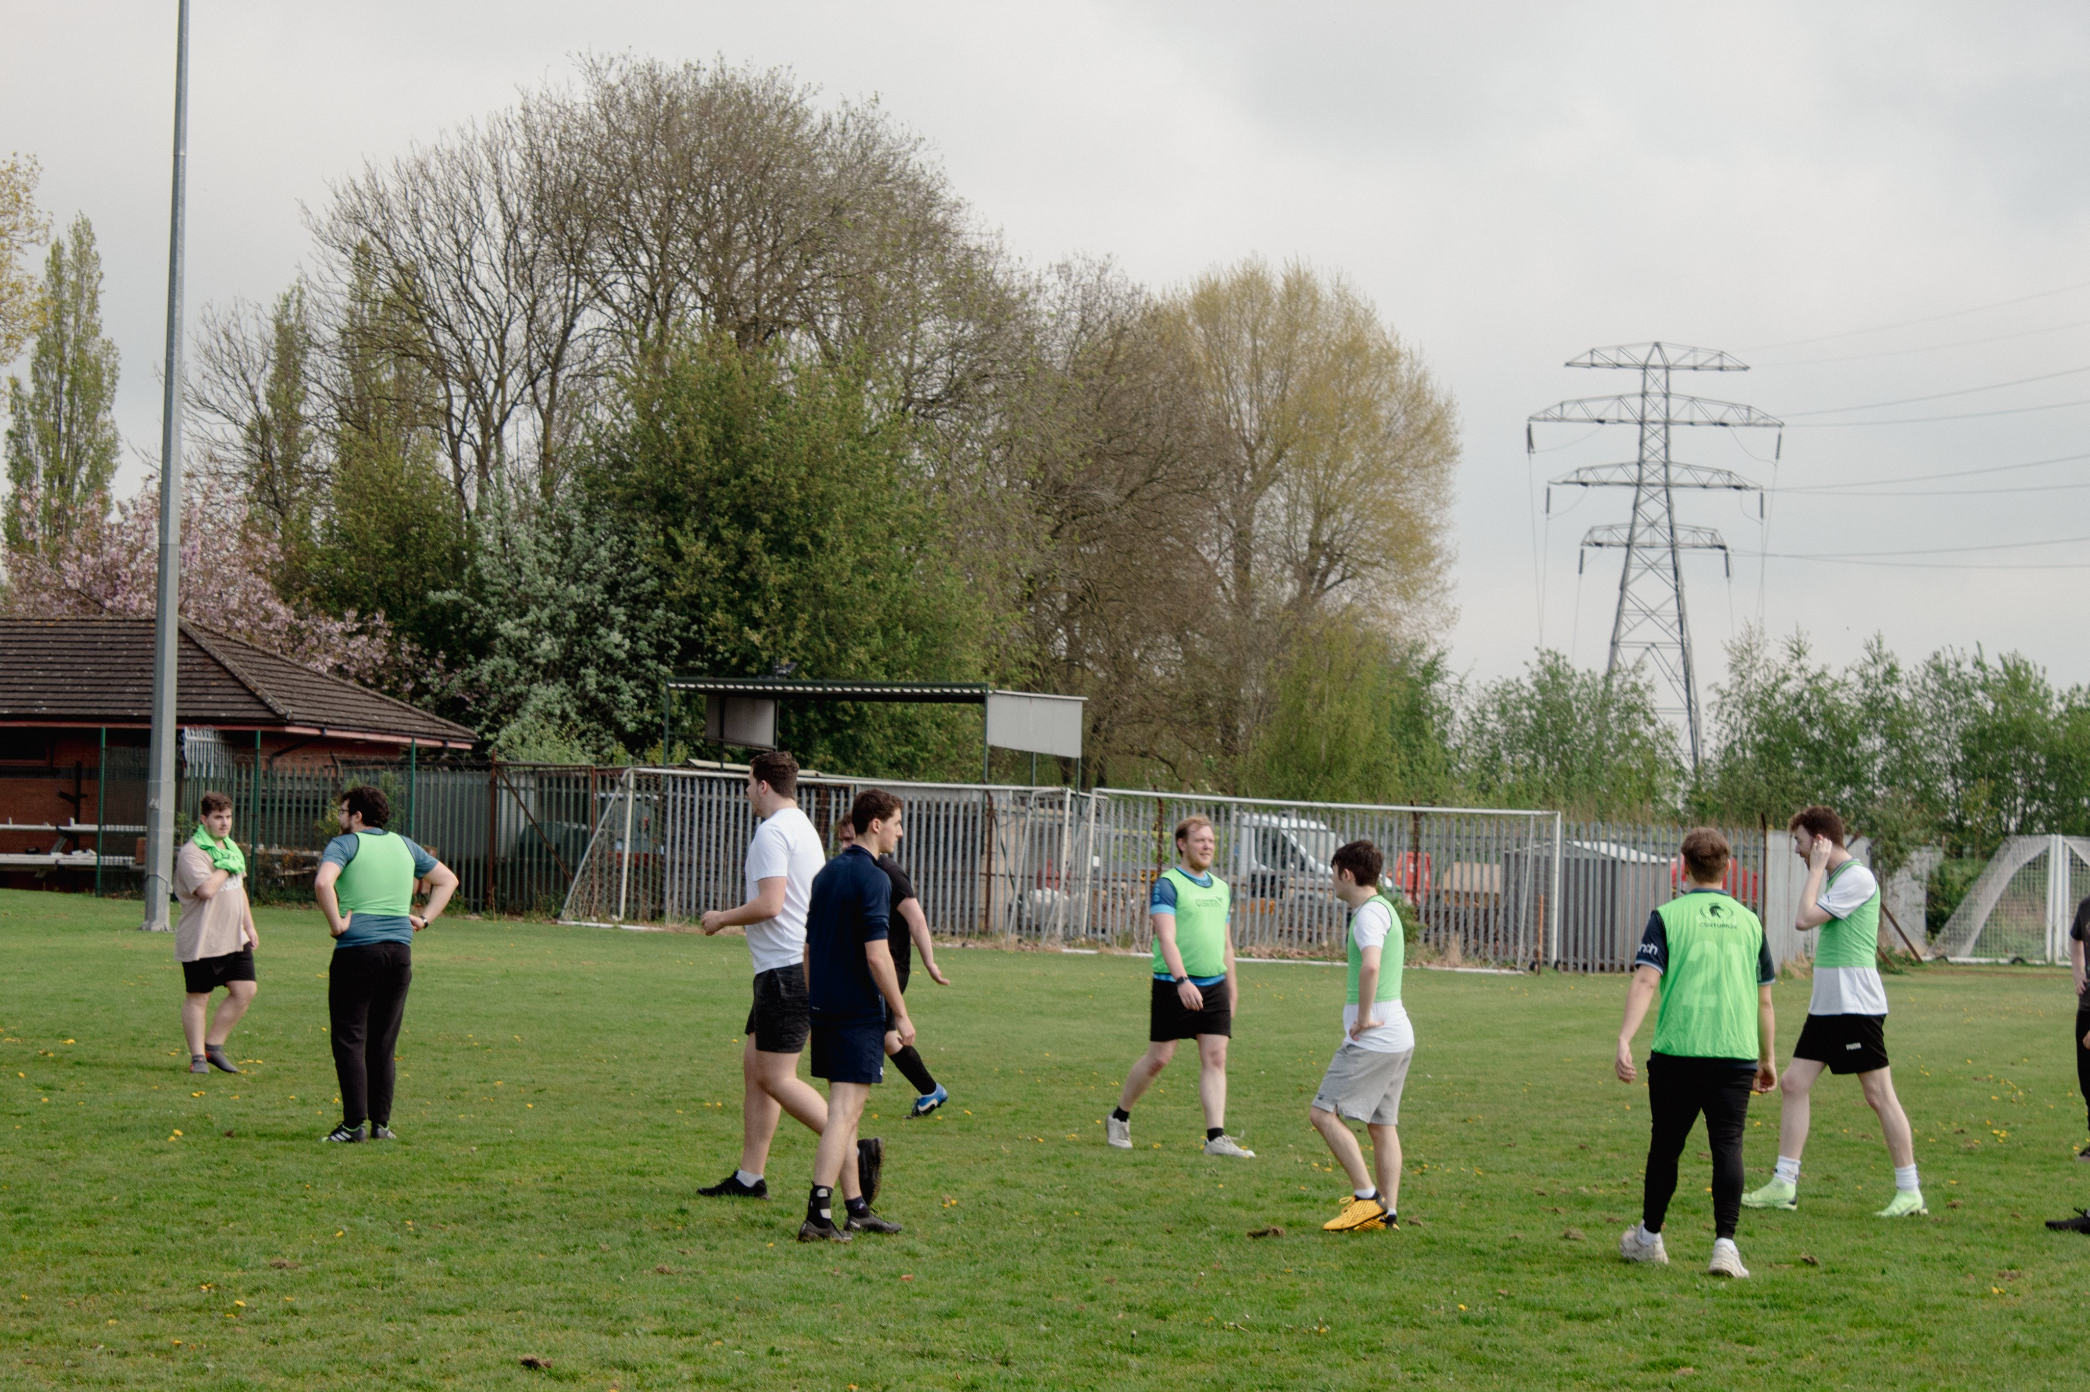
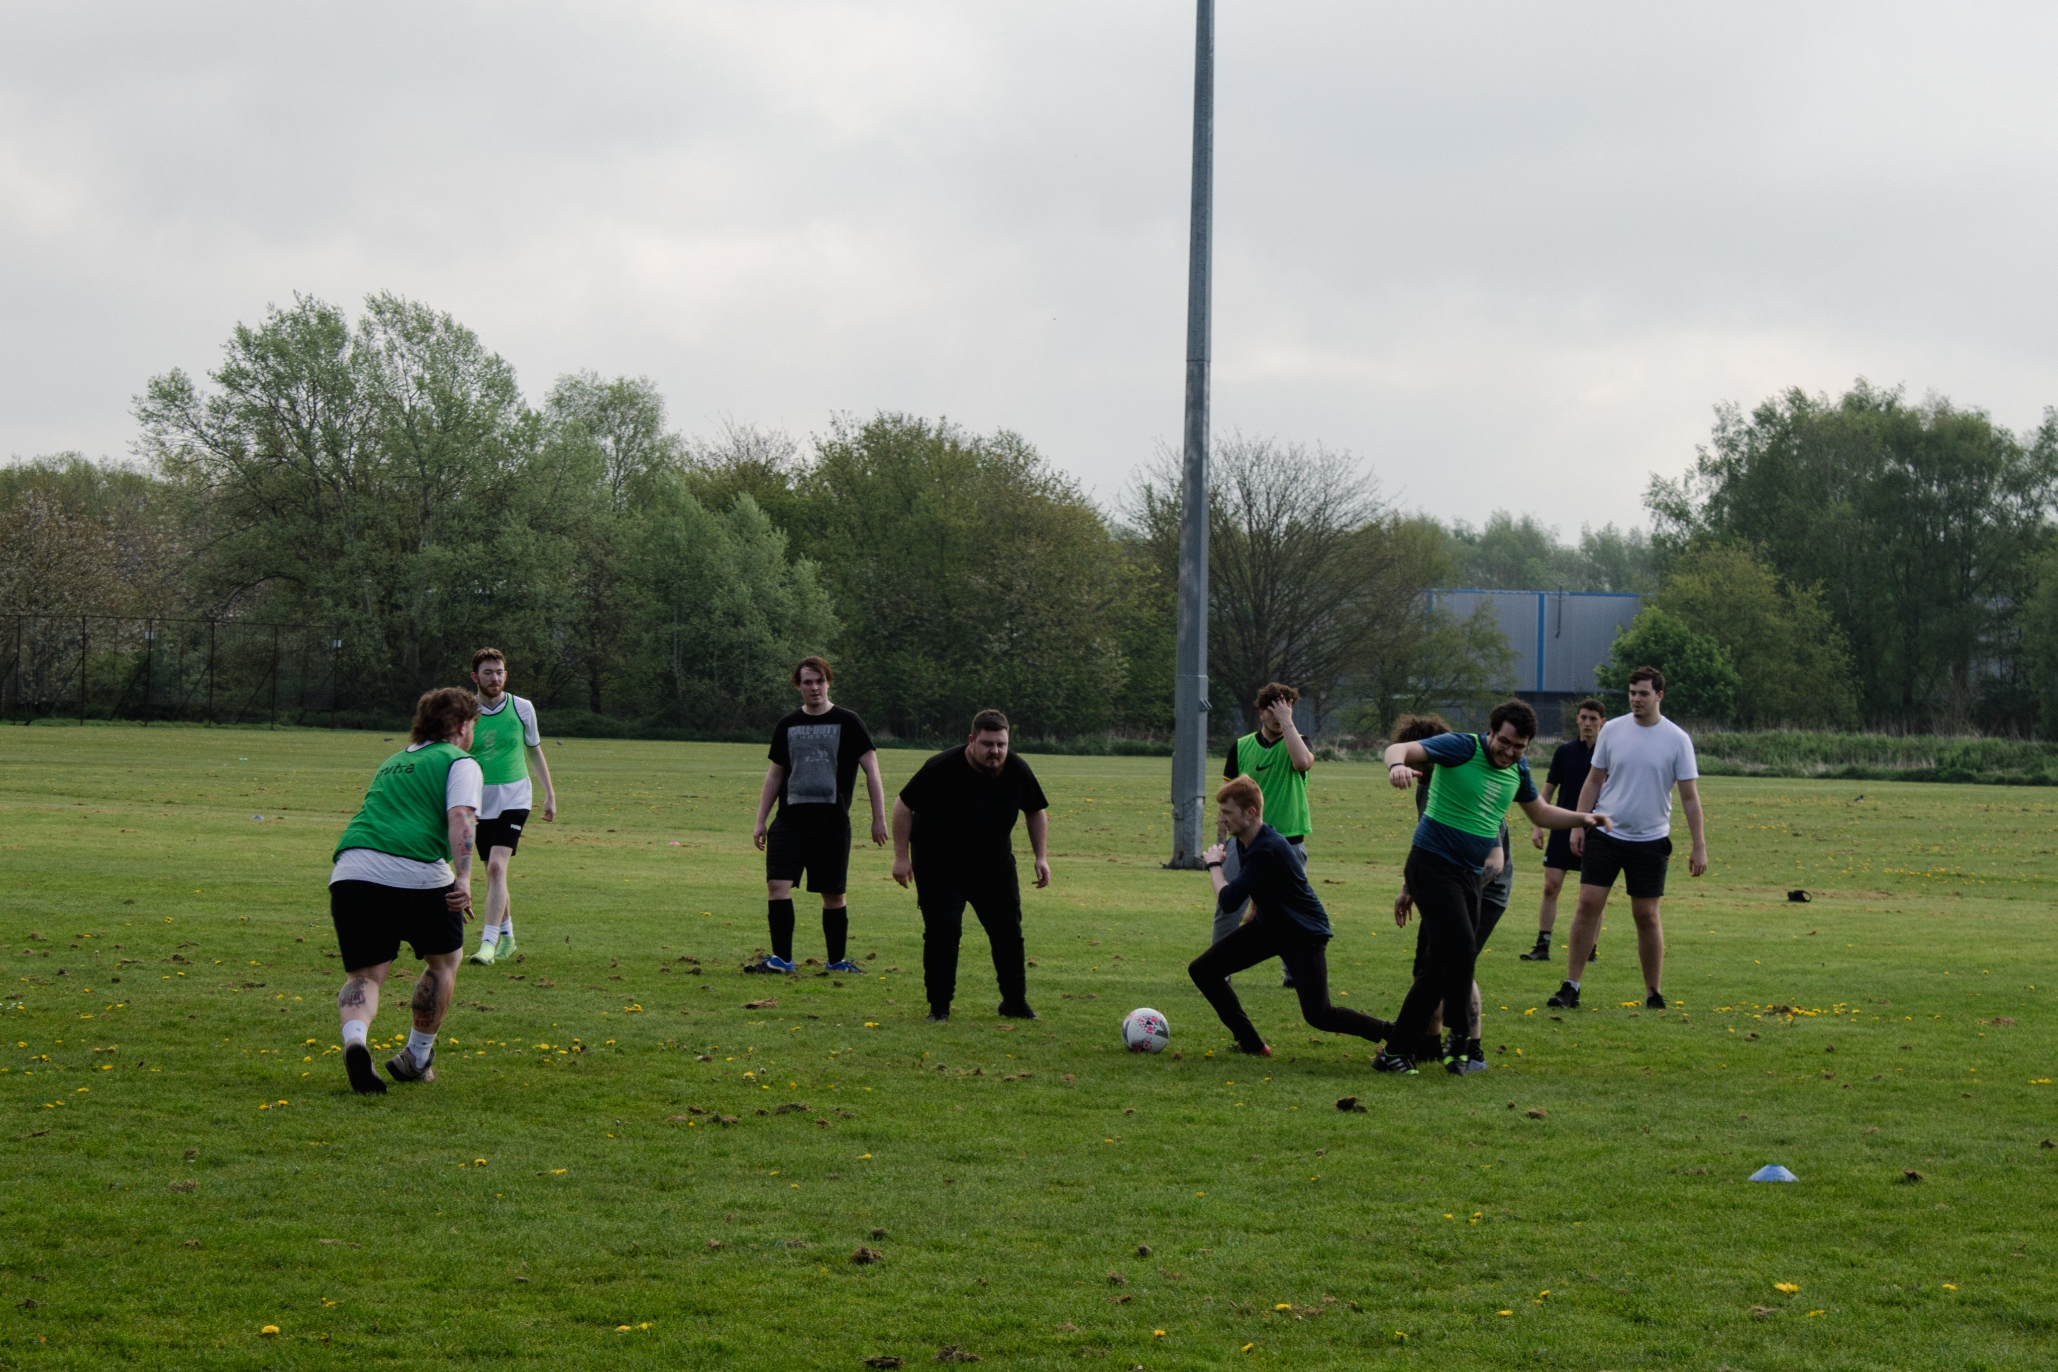
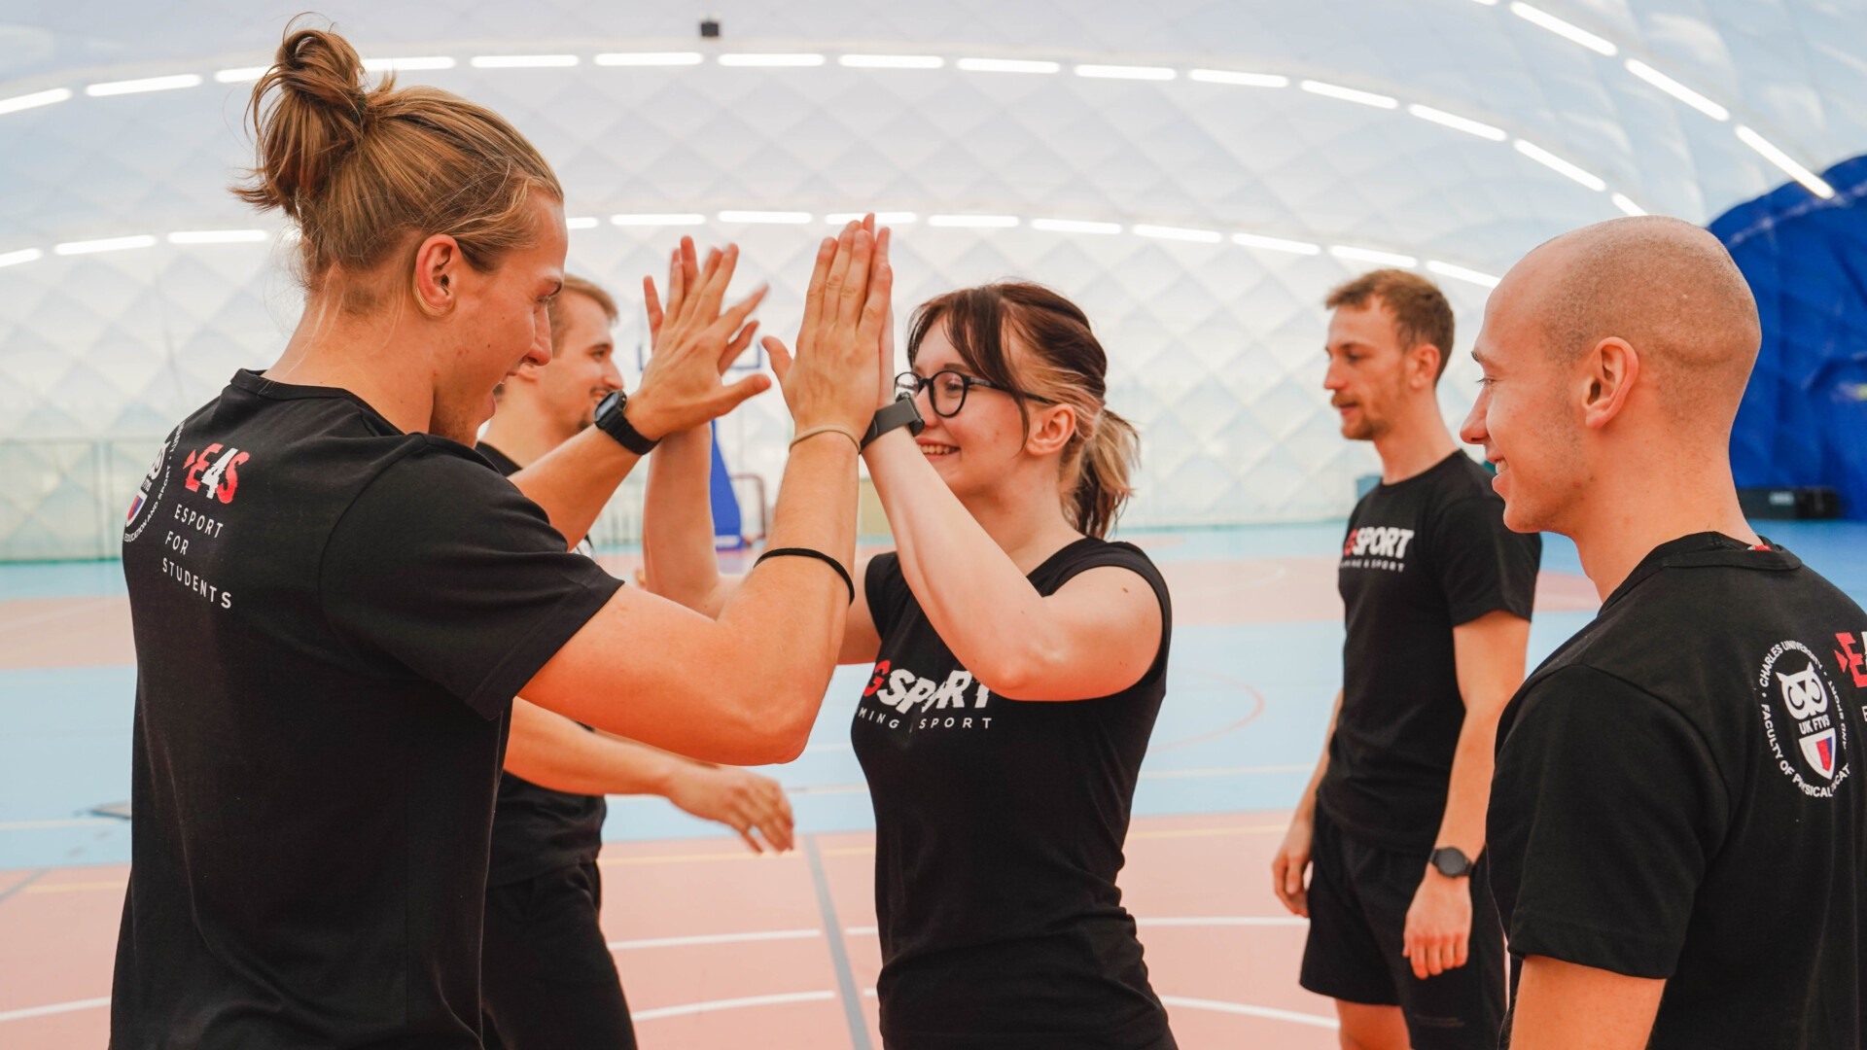
Psychological and sociological benefits of exercise
Psychological benefits | Sociological benefits
Improved Mood Reduced Stress Enhanced Cognitive Function Increased Self Esteem Better Sleep Alleviation Of Depression And Anxiety | Social Interaction Community Engagement Reduced Social Isolation Promotion Of Teamwork And Cooperation Shared Goals and Achievements
Notes:
Improved Mood: Exercise stimulates the production of endorphins, neurotransmitters that promote feelings of happiness and euphoria, leading to a better mood.
Reduced Stress: Physical activity helps reduce levels of cortisol, the body's stress hormone, leading to decreased feelings of stress and anxiety.
Enhanced Cognitive Function: Regular exercise has been linked to improved cognitive function, including better memory, focus, and decision-making skills.
Increased Self-esteem: Achieving fitness goals and experiencing improvements in physical appearance can boost self-esteem and self-confidence.
Better Sleep: Exercise can help regulate sleep patterns and improve sleep quality, leading to feeling more rested and rejuvenated.
Alleviation of Depression and Anxiety: Regular exercise has been shown to be as effective as medication in alleviating symptoms of depression and anxiety.

Slide 6
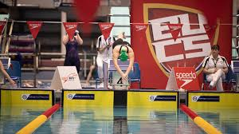
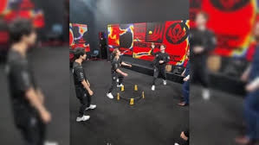
Case study of Gsport and sports day.
The adoption of physical exercise has been a growing trend in Esports as a whole as time has gone on the overall health and wellbeing of athletes and the larger gaming community has become more important and that has become noticeable within our students, and there pastimes. Esports no longer is solely focused towards arguably social outcasts as such People are engaging in sports outside the curriculum last year was the first year we saw more students engage with sports while studying than not.
He Idea of putting in sport into esports curriculum happened to come from the idea of Gsport first set up three years ago by Charles University Czech Republic. Which combined esports and sports competitions.
This showcase tournament spreads now across 8 countries in Europe and end with a in person sport and esports festival.
The other case study used was a local play sports day we ran in early May which was our most sign up event as a course with 75 sign ups 36% of the course cohort. This was done to support development and release stress around assignment deadlines. Which was supported with a range of success.

Slide 7
Exercise within the curriculum
Coaching based modules have been adopted within esports curriculum already although many of these are focused on the in game mechanics themselves. Although a fundamental thing to focus on in the development of coaches physical training also has some additional waiting and requirement.
Adopting physical training into learning provides skills which we see as vital to overall performance and outcomes for educational success.
Module for physical education within Higher education is something which lacks due to timetables as such further training and time within set modules. To be a adopted provision for all students within esports curriculum to be logged as modular accreditation.

Slide 8
Impacts and future outcomes
Cross-Disciplinary Collaboration
Curriculum Expansion
Practical Application
Holistic Approach

Slide 9
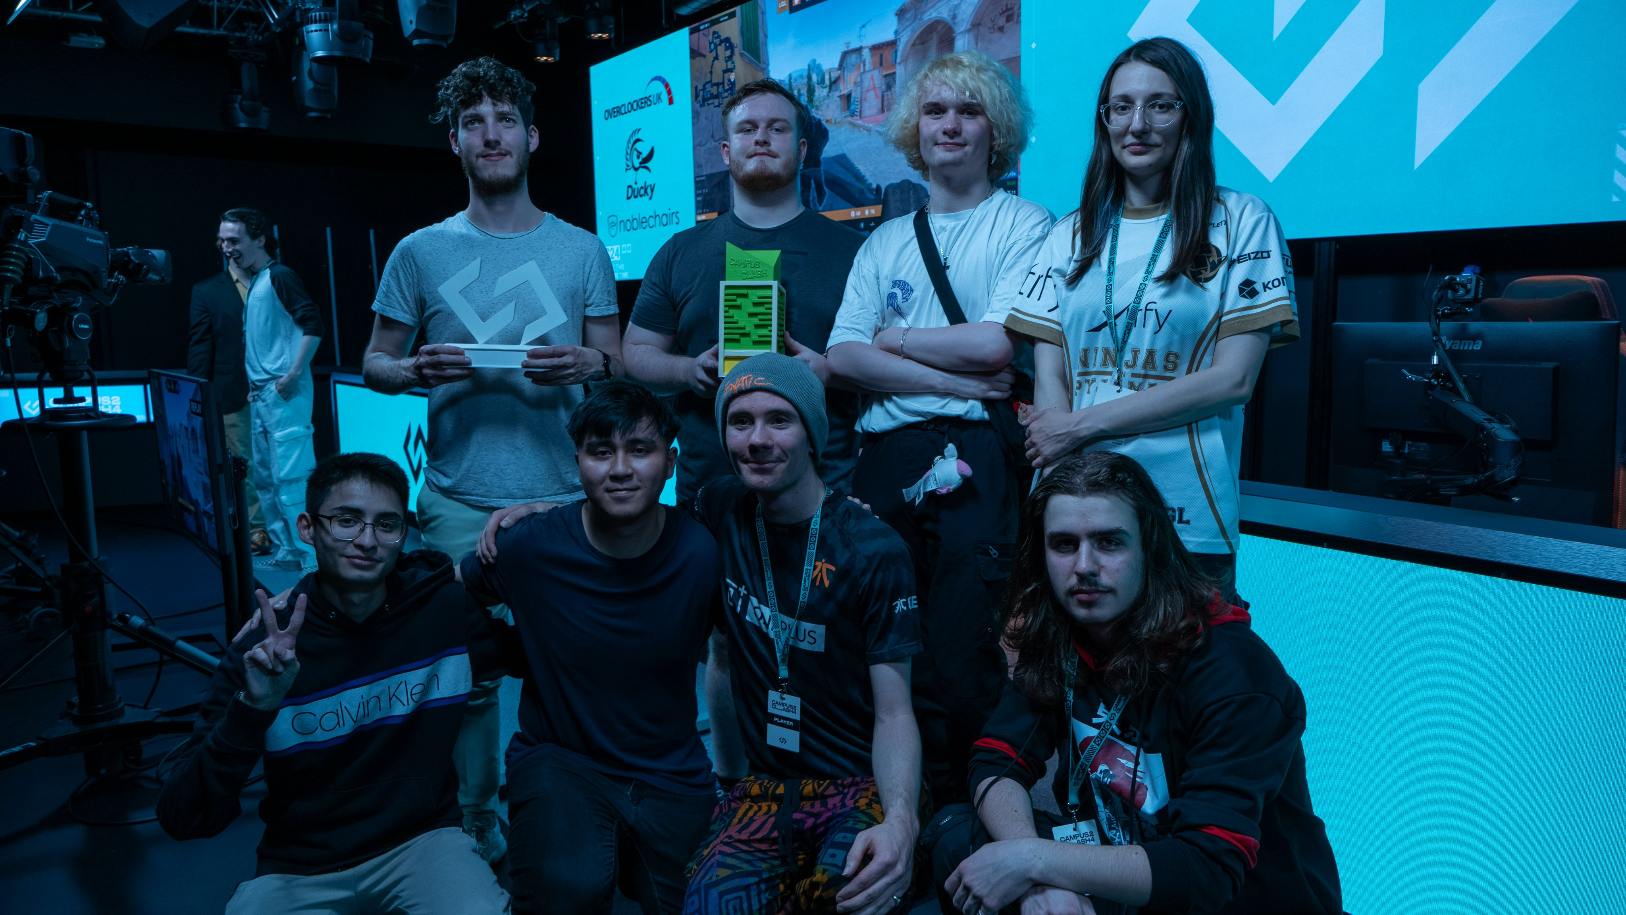
Thank you
Cameron Vanloo
X- @vanloo_Cameron
Email: Cameron.vanloo@staffs.ac.uk
LinkedIn Cameron Vanloo

Slide 10
References
Adams, K.L., Billings, A.C., Bowman, N., Coble, J., Cranmer, G.A., Devia-Allen, G., Rodgers, E.B.D., Einstein, C., Farquhar, L.K., George IV, J. and Grabowski, M., 2019. Understanding esports: An introduction to the global phenomenon. Rowman & Littlefield.
Adnan, M. and Anwar, K., 2020. Online Learning amid the COVID-19 Pandemic: Students' Perspectives. Online Submission, 2(1), pp.45-51.
Åkesdotter, C., Kenttä, G., Eloranta, S. and Franck, J., 2020. The prevalence of mental health problems in elite athletes. Journal of science and medicine in sport, 23(4), p
González, C.S.G., del Río, N.G. and Adelantado, V.N., 2018. Exploring the benefits of using gamification and video games for physical exercise: a review of state of art. IJIMAI, 5(2), pp.46-52.
González-Bueso, V.; Santamaría, J.J.; Fernández, D.; Merino, L.; Montero, E.; Ribas, J. Association between Internet Gaming Disorder or Pathological Video-Game Use and Comorbid Psychopathology: A Comprehensive Review. Int. J. Environ. Res. Public Health 2018, 15, 668
Granic, I.; Lobel, A.; Engels, R.C.M.E. The benefits of playing video games. Am. Psychol. 2014, 69, 66–78
p.329-335.

