Slide 1
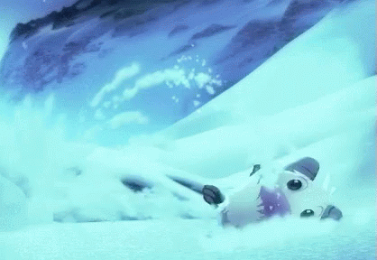

The good the bad and the ugly of seasonal esports
A riot games special

Slide 2
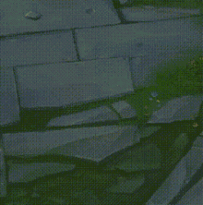
The three questions to ask yourself
Are publishers pushing to much for seasonal success
Are consumers expectations becoming more and more unrealistic
Is the idea of consumer expectations and burnout within publisher culture.

Slide 3
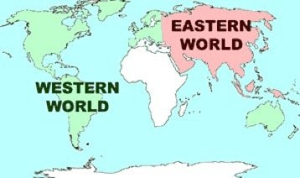
Defining the west and its relation to the world
Stuart Hall provided a critical account of the ‘West’ in a 1992 piece of writing:
‘The underlying premise of this chapter is that "the West" is ahistorical, not a geographical, construct. By "western" we mean the type of society (...): a society that is developed, industrialized, urbanized, capitalist, secular, and modern. Such societies arose at a particular historical period - roughly, during the sixteenth century, after the Middle Ages and the break-up of feudalism. They were the result of a specific set of historical processes - economic, political, social, and cultural. Nowadays, any society which shares these characteristics, wherever it exists on a geographical map, can be said to belong to "the West." The meaning of this term is therefore virtually identical to that of the word "modern.“’ (Hall, 1992)

Slide 4
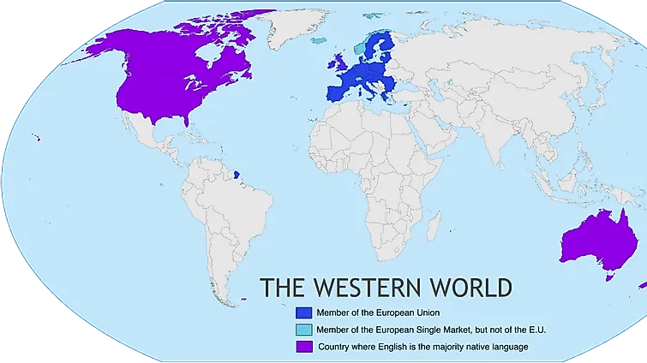
The western society situation

Slide 5
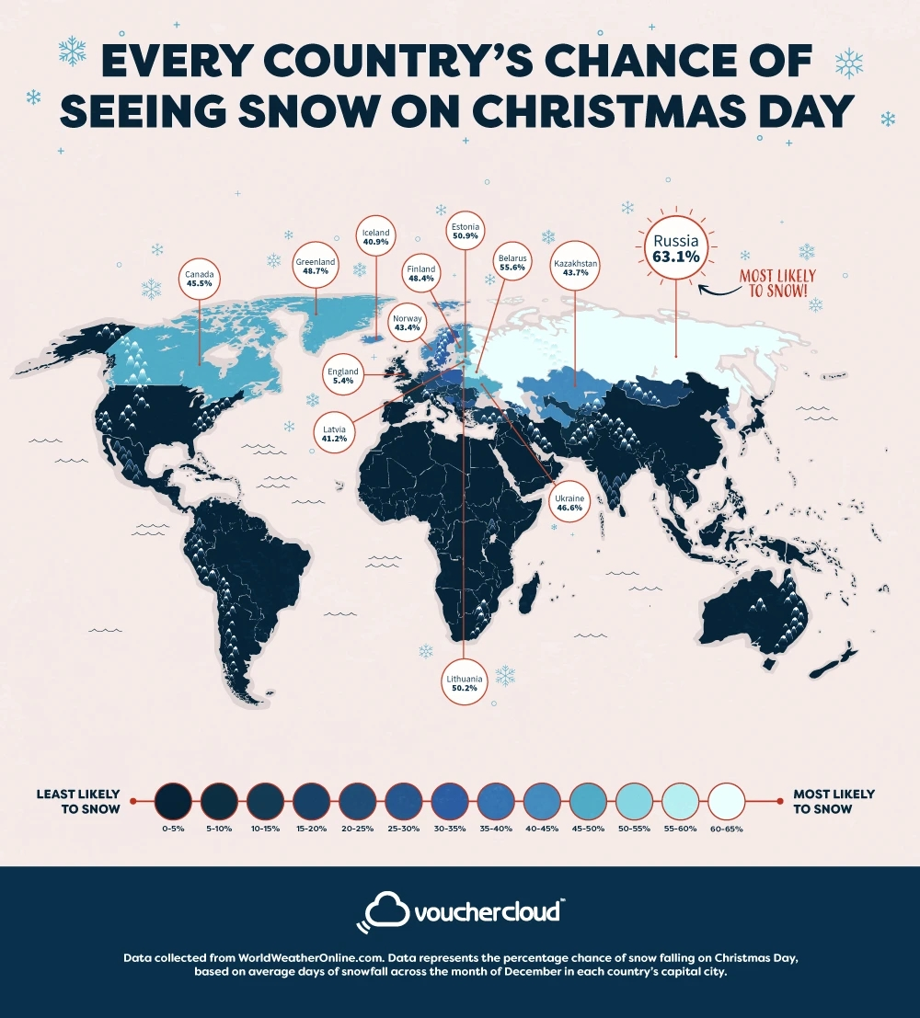

Slide 6
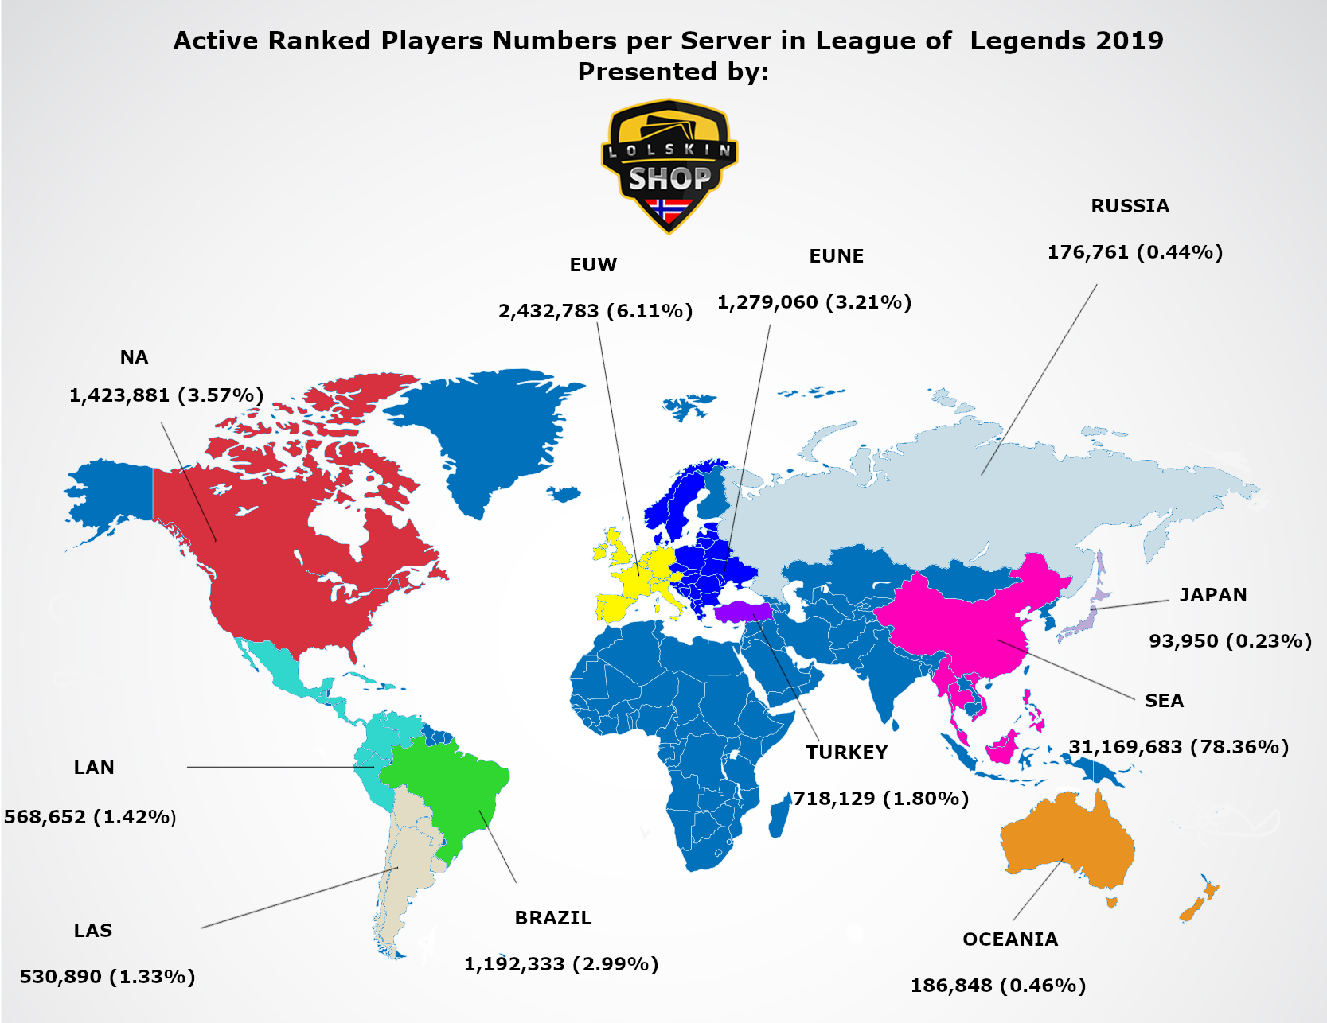

Slide 7
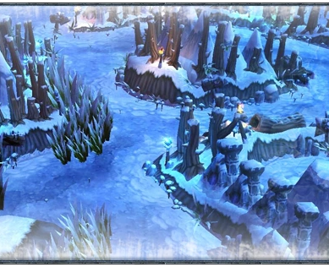
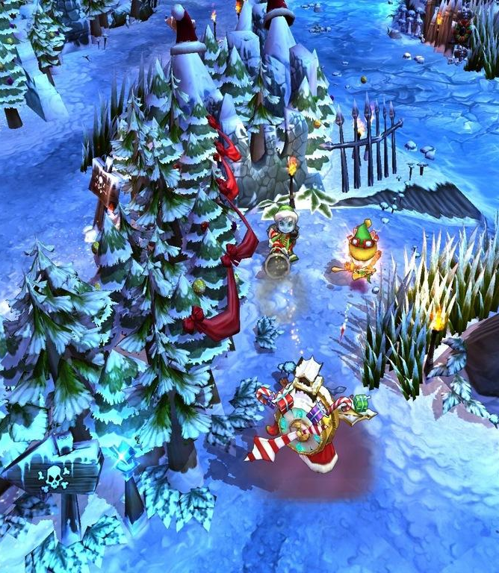
Snowdown showdown
This was one of the first events launched for league of legends after the launch of the game in 2009 Snowdown showdown was a game mode created for celebrating the holiday season and was one of the first major events after release.
The map had a direct visual update as well as realising 5 winter skins for the following champions, zilean, Nunu , Teemo, Tristana, Nidalee.

Slide 8
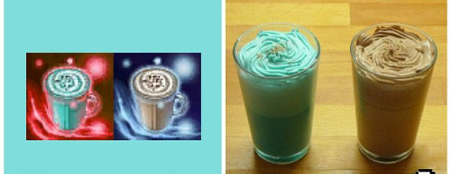
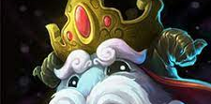
What riot offered
75% of rune pages using riots non page earnt currency
Unique runes
  Mark of the crippling candy cane 2.2% critical damage
  Mark of the Yuletide Tannenbaum +0.62% critical chance
  Glyph of the special stocking -0.58% cooldowns
  Seal of the elusive snowflake +0.67%
  Glyph of the gracious gift +0.12 ability power [er level (+2.16 at champion level 18)
  Deal of the stout snowman +.72 health per level (+12.96 at champion level 18)
Changing pot icons to Egg nogg
The map was also designed for Christmas with visual changes to the map and turning the iconic rift into a winter nights battlefield.
Remember this was 2 months after the launch of the game

Slide 9

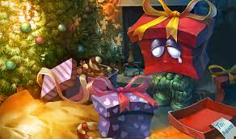
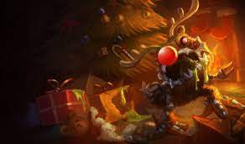
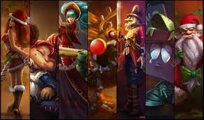
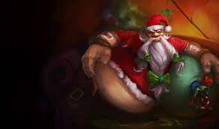
2010
New winter animated log in screen with winter updated music's for logging in.
Egg nog returned for potions
Runes returned again with 75% off
The winter map also returned this this year.
skins introduced in this year were:
  Re gifted Amumu
  Santa Gragas
  Reindeer Kog’Maw
  Candy Cane Miss Fortune
  Ragdoll Poppy
  Nutcracko Shaco
  Silent Night Sona

Slide 10
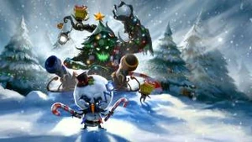
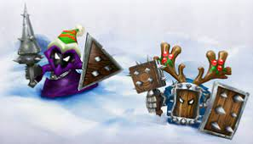
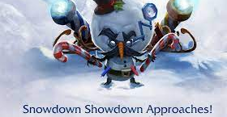
2011
The winter log in screen came back with a new art for the new skins accompanied by a new winter song.
The biggest in game change was minions getting a festival look added to them.
Riot released 4 winter skins this year the lowest number for the seasons yet however the skins had a increased quality about them:
  Toy solider Gangplank
  Snowmerdinger
  Mistletoe LeBlanc
  Festive Maokai

Slide 11
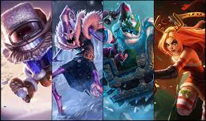
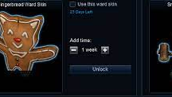
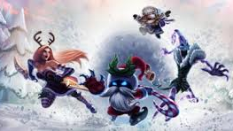
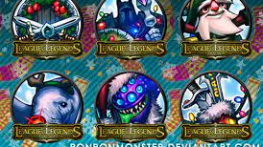
2012
New log in screen once again with same music as previous year.
Egg nogg on potions were removed and this was the first time since launch this feature got removed.
Gifted skins were launch in this year due to snowdown and was create in 2012 and originally and was a limited time event originally within the game.
Players were offered free, wards for logging and were collected when a player logged into the game.
Exclusive earnt winter summon icons
Four new skins added:
  Dark candy fiddlesticks
  Slay belle Katerina
  Bad Santa Veigar
  Snow Day Ziggs

Slide 12
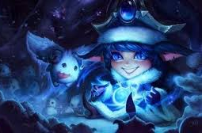
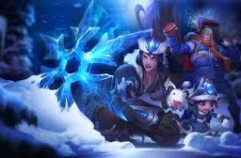
2013
New log in screen for the year although music was once again the same as 2011.
Only three skins were added however they were with partial affects and the price increased from 975RP to 1350RP:
  Winter wonderland LULU
  Snow Day Singed
  Snowstorm Sivir
No winter summoners rift this year but this was in part due to releasing Aram the howling abyss
New icons once again were given out
Mystery gifts were introduced to the game for winter this year
Ward skins returned however this time were at the price of 640 RP
1v1 and 2v2 aram showdown was introduced as a one time thing which is now commonly used within community in relation to rule sets for competitive 1v1

Slide 13
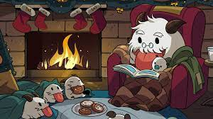

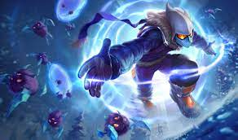
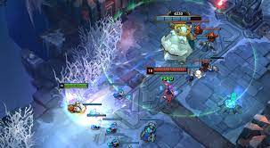
2014 the year of the poro
New log in screen this time with new holiday day themed music replace the 2011 Christmas music.
Three new skins came into the game all 640RP and where Poro themed
Icons were again released this time costing 250RP first time the holiday
There were three free icons introduced alongside a new limited time game mode which was called the legend of the poro king
A winter themed Hud was also introduced for ARAM.
All winter holiday skins were removed from legacy and people were able to buy the previous skins each year three new skins were released these were:
  Snow Day Malzahar
  Winter Wonder Orianaa
  Poro Rider Sejuani

Slide 14
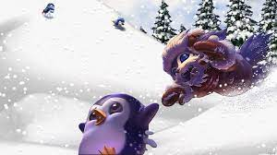
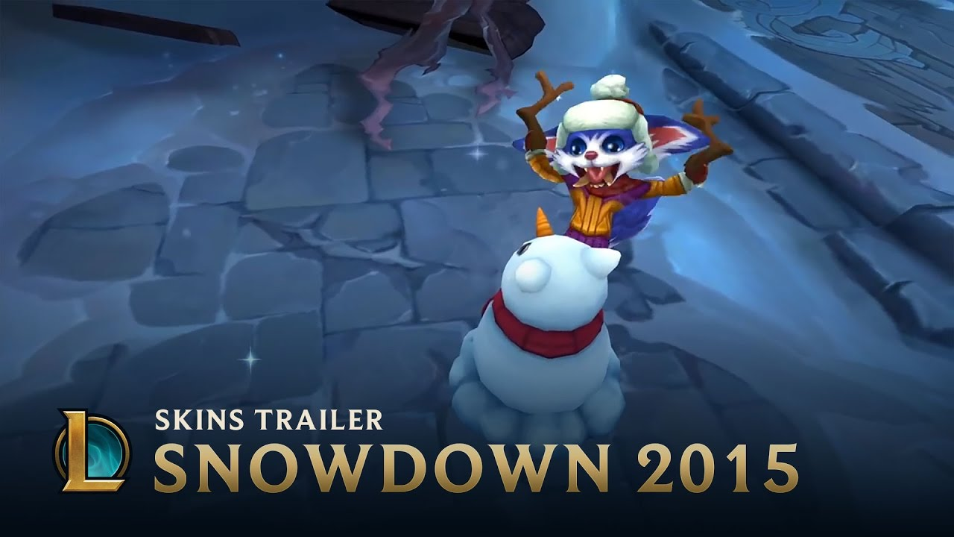
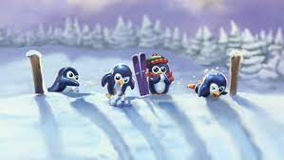
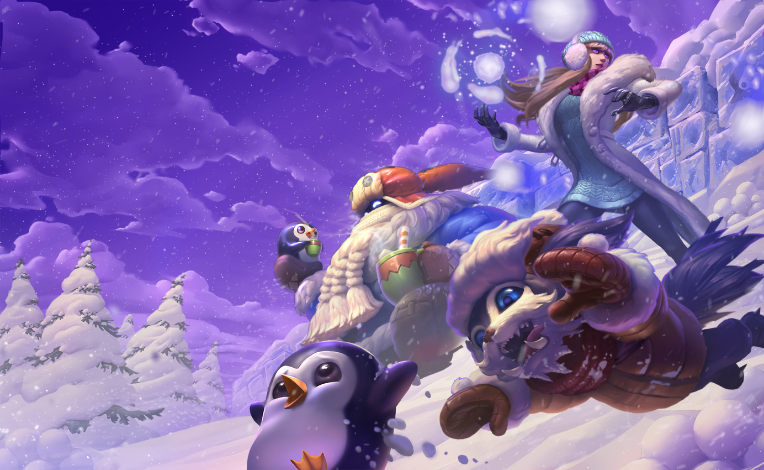
2015 THE YEAR OF THE PINGU
New log in screen this time with new holiday day themed music.
For the third year in a row they released 3 skins all 1350rp:
  Snow Day Bard
  Snow Day Gnar
  Snow Day Syndra
Three wards were released like previous years all 640rp theme penguins
Riot returned with free summoner icons 4 this year
Three 250rp icons were also entered the game
And the poro king game mode returned for a second year in a row.
Minion skins in game also came back to all game modes
They also introduced if you brought a legendary skin priced at 1820RP during the event you were given a free skin at random
They also released my shop for the first time which now has been common factors of targeted skin marketing for many publishers.

Slide 15
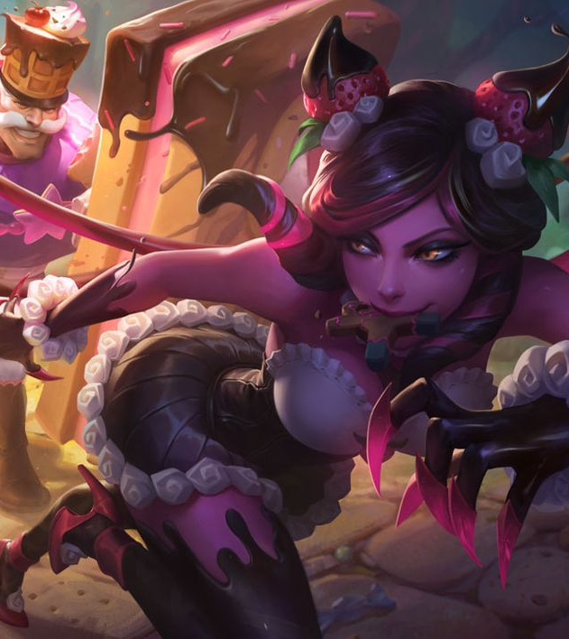
2016 and 2017
New log in screen this one was interactive the first fully inactive log in screen by riot.
3 new skins were released:
  Santa braum
  Snow day Graves
  Winter Wonder Karma
Poro kind game mode returned
New icons which had additional poro skins attached for a limited time only.
Emote came into the game and were unlockable from playing the game mode.
Holiday merch was realised as well as Christmas lot.
Winter summer rift made a return for 2016 first time this was seen as the peak holiday season!
2017 followed the theme and had small updates different skins and merchandise lines however all main themes stayed the same.
The main different was a return of popular game mode Urf but with a snow based theme.

Slide 16
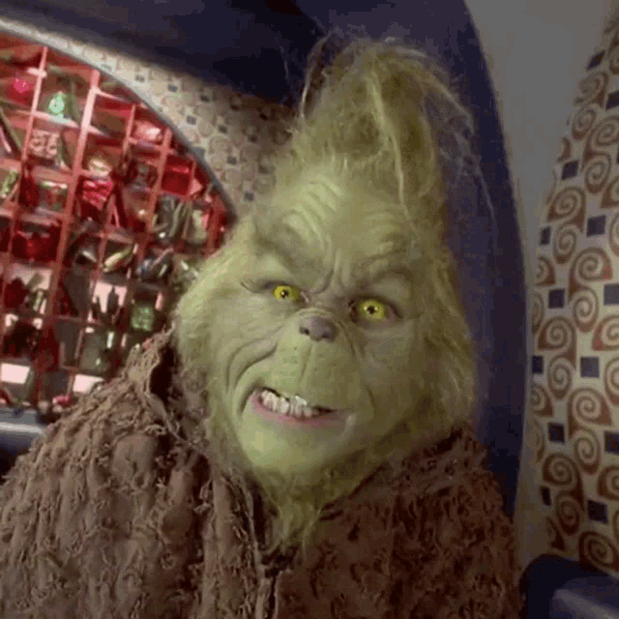
2018
The last snow down in game event was launched
Chroma were introduced
A battle pass was linked in relation to the fact that battle passes were brought in as the next new revenue stream outside skins purchases and loot boxes.
The battle pass gained some heat however after the time players got their head around it they were happy with the value earnt from it.

Slide 17
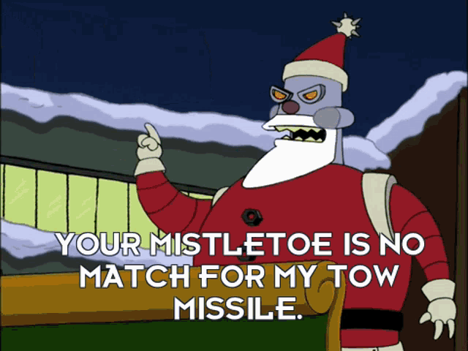
2019 to 2022
Some Christmas line skins have been released however riot has decided to move away from the theme no additional content has been directly made for the game for the holiday season. With riot claiming to be focused on larger map updates. And setting for new seasons which riot how now placed in line with the start of the Calander year since 2023.
As such we need to consider that it not just about riot hating Christmas.

Slide 18
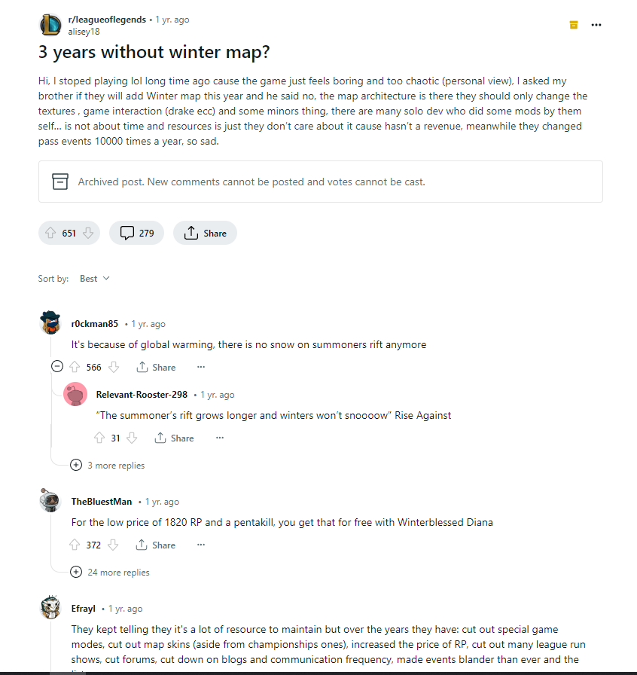
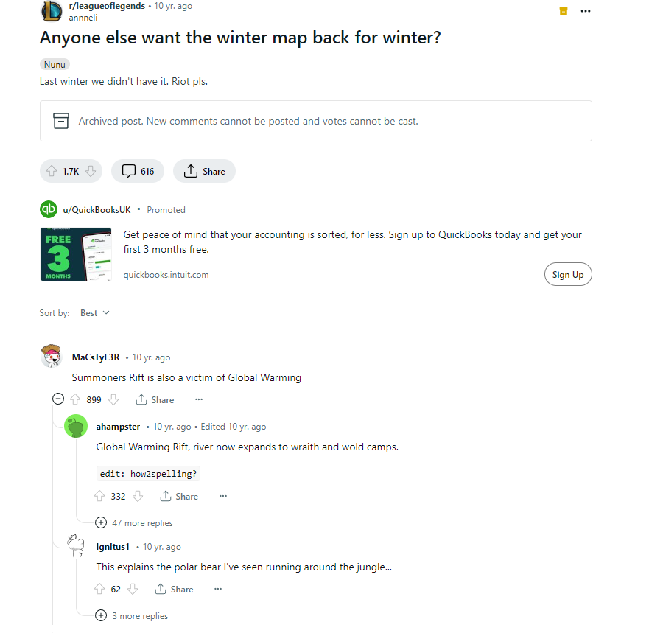
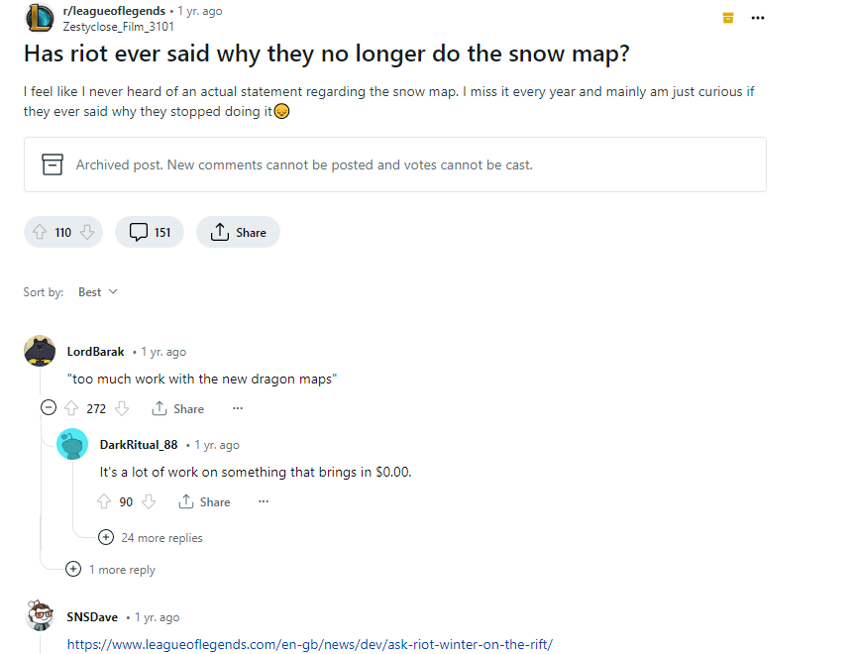
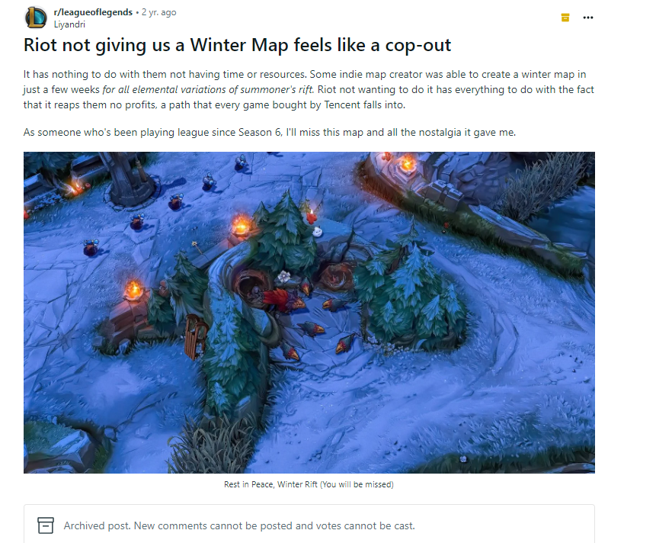
Community viewpoint

Slide 19

Round up
It not realistic that a game like league of legends continue to put focus on a holiday which the vast majority of its player base doesn’t celebrate.
There is only a reasonable amount of time players will invest in Christmas skins with many of these skins not being used outside of the winter months.
In game modes focused about winter again isn’t applicable to many of the audience.

Slide 20
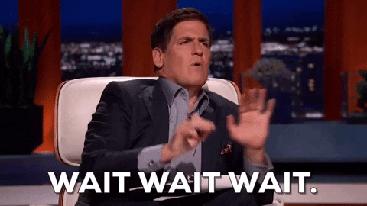
But hang on!!!!

Slide 21
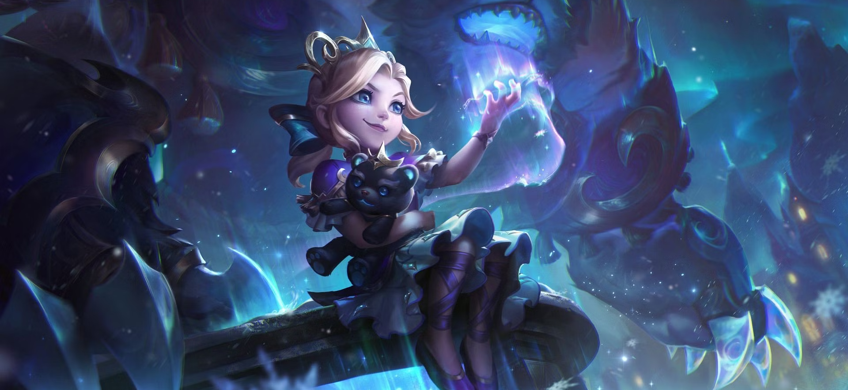
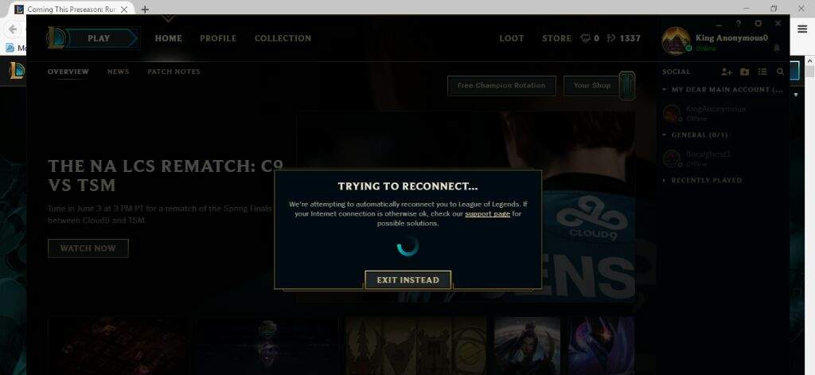
Riot ruined my plans
This year although not completely festive riot have returned with winter skins and spent some time ending their season with arena mode and in true riot style breaking their client.

Slide 22
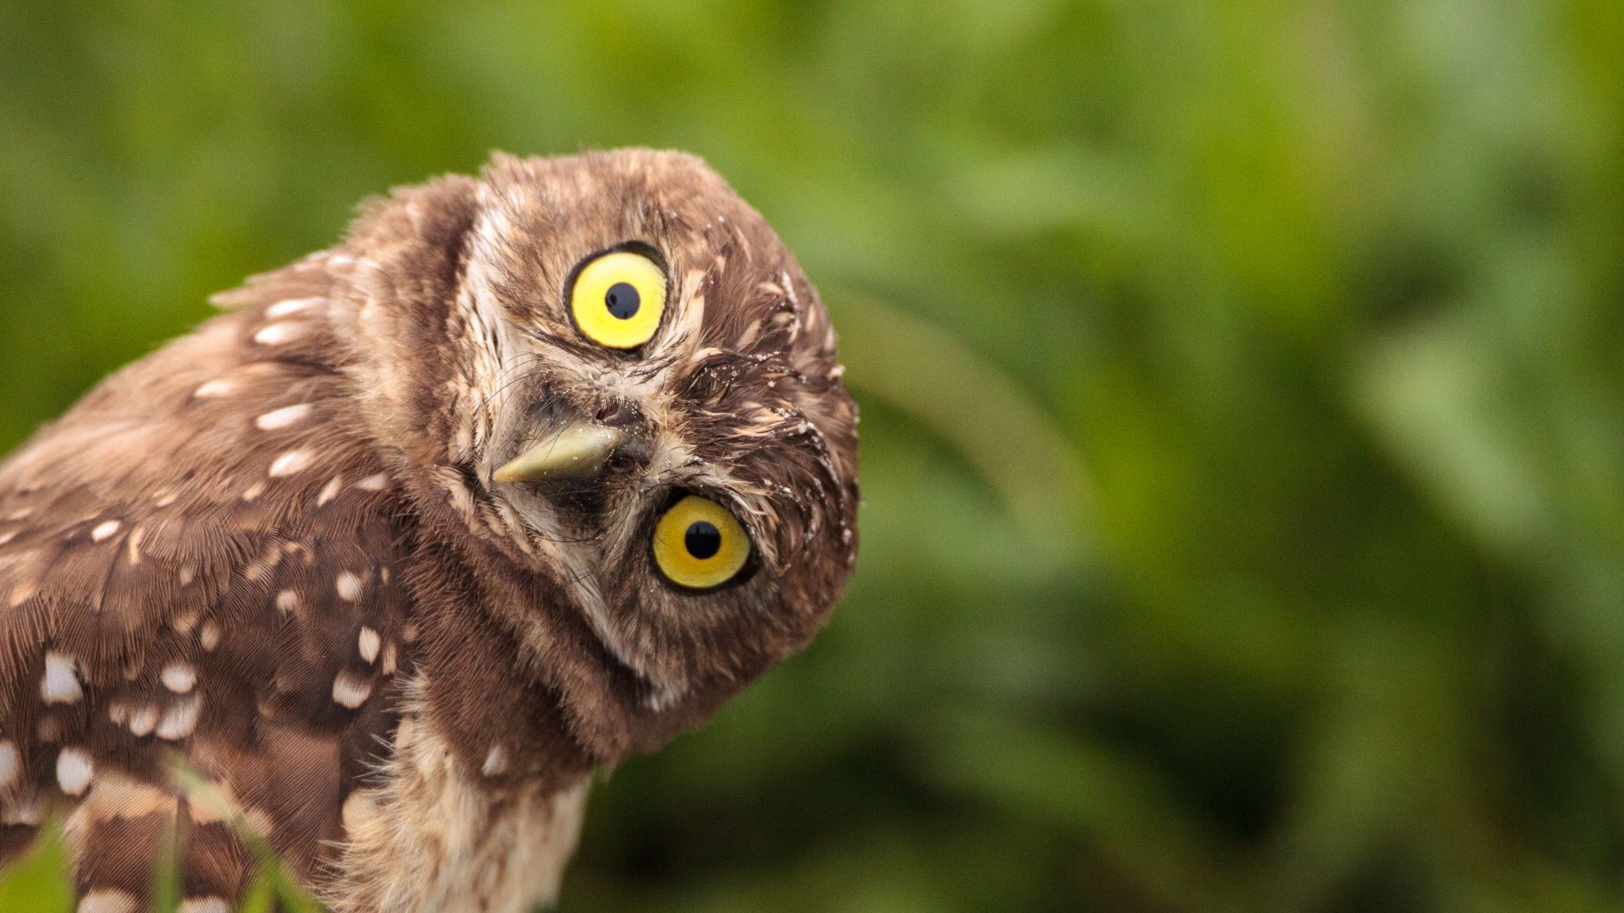
Any questions?

Slide 23
References
Bajtarević, E., 2023. Rewarding Labor and Valuable Investments inside of Video Games (Master's thesis).
Bujňáková, E., 2023. Consumer Behavior of League of Legends Players.
Jarrett, J., 2021. Gaming the gift: The affective economy of League of Legends ‘fair’free-to-play model. Journal of Consumer Culture, 21(1), pp.102-119.
Jokela, F., 2018. Character Design and Customization in MOBA Games.
Lucht, F., 2019. The Success of the Freemium Business Model. How Riot Games flourishes with a free to play game. Manager, (29), pp.114-124.
Ratan, R.A., Taylor, N., Hogan, J., Kennedy, T. and Williams, D., 2015. Stand by your man: An examination of gender disparity in League of Legends. Games and culture, 10(5), pp.438-462.

