Slide 1
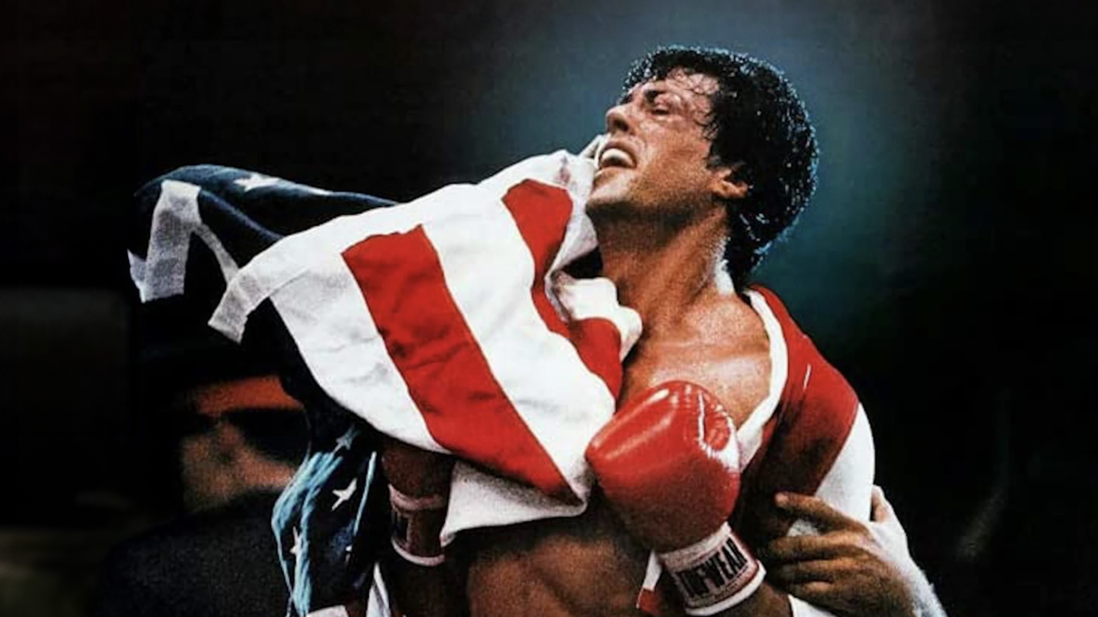
EVEN ROCKY HAD A MONTAGE
AESTHETICS AND IDEOLOGY IN 1980S ACTION CINEMA

Slide 2
Understanding Star Brand Narratives in the Post Studio Era
“
Stars are both a phenomenon of production and a phenomenon of consumption
(Dyer, 1979)
They are both labour and the thing labour produces
(Dyer, 1986)
”
Richard Dyer (1979) Stars, London: British Film Institute.
Richard Dyer (1986) Heavenly Bodies, London: British Film Institute

Slide 3
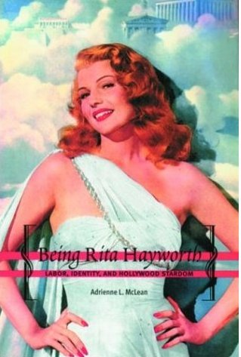
RITA HAYWORTH: AMERICAN LOVE GODESS
“
Rita Hayworth, a movie star and princess of American glamour, symbolizes a phenomenon of profound sociological significance.
Rita Hayworth, [is] a movie star and princess of American glamour, symbolises a phenomenon of profound sociological significance.”
Men fell in love with Gilda, but they woke up with me.
”
McLean, Adrienne L (2004) Being Rita Hayworth: Labor, Identity, and Hollywood Stardom, New Jersey: ‎ Rutgers University Press
Winthrop Sargeant (1947) ‘The Cult of the Love Goddess in America’, Life Magazine, November 10th, p.80.

Slide 4
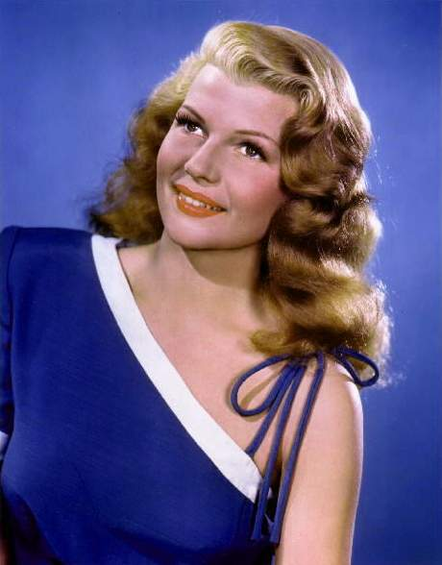
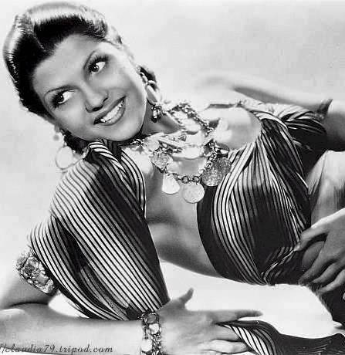
CONSTRUCTING THE ‘AMERICAN LOVE GODDESS’
Margarita Carmen Cansino, circa 1935
Rita Hayworth, circa 1945

Slide 5
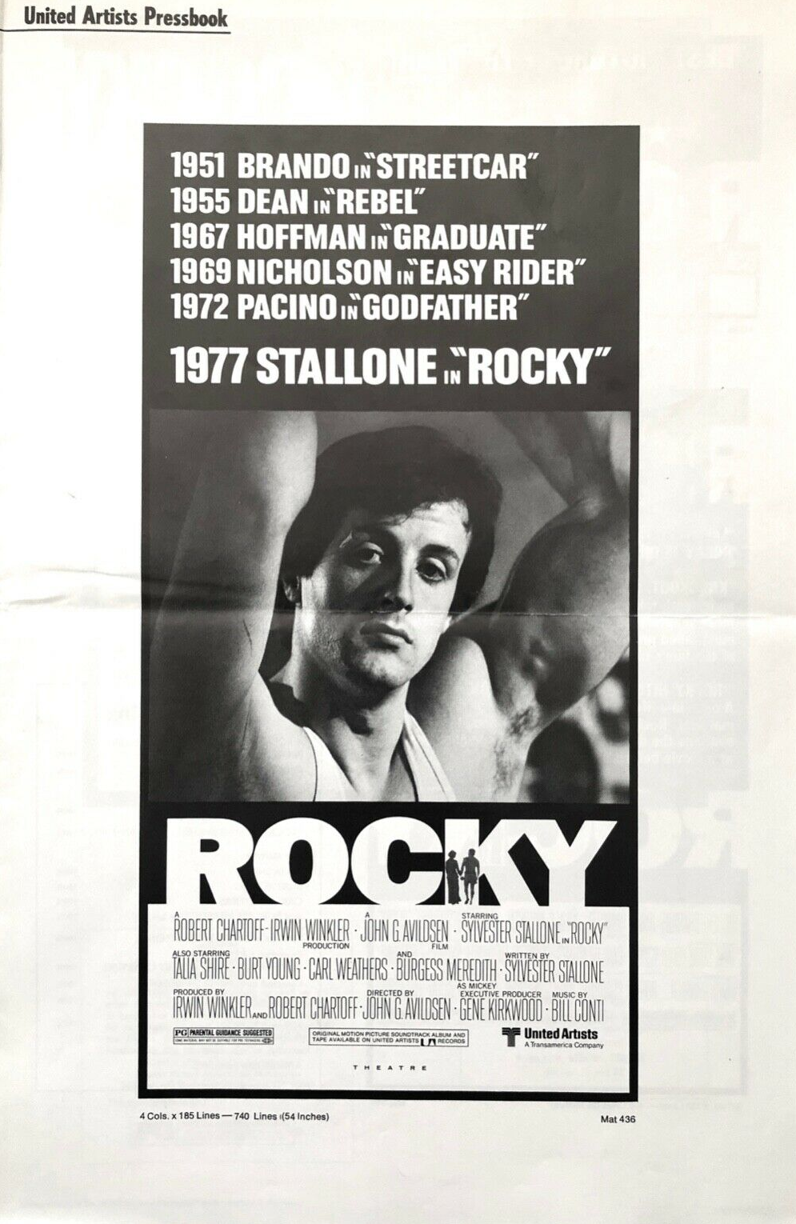
EVERY HERO NEEDS AN ORIGIN STORY
“
Stallone was a chronic runaway and troublemaker who forced his parents to place him in a foster home where he could be professionally counselled.
Robert Chartoff/Irwin Winkler Production company were immediately impressed and offered to buy Stallone’s screenplay. But what Stallone wanted most was a chance to play Rocky. Despite a bank balance of $100, a pregnant wife and a landlord “who wanted to see him on the curb”. He promised he would work for nothing if he could have the part.
”
(1976) ‘Stallone’s Drive to Put ‘Rocky’ On Screen Reads Like Hollywood Movie Script!’. Rocky Pressbook. United Artists: California.

Slide 6
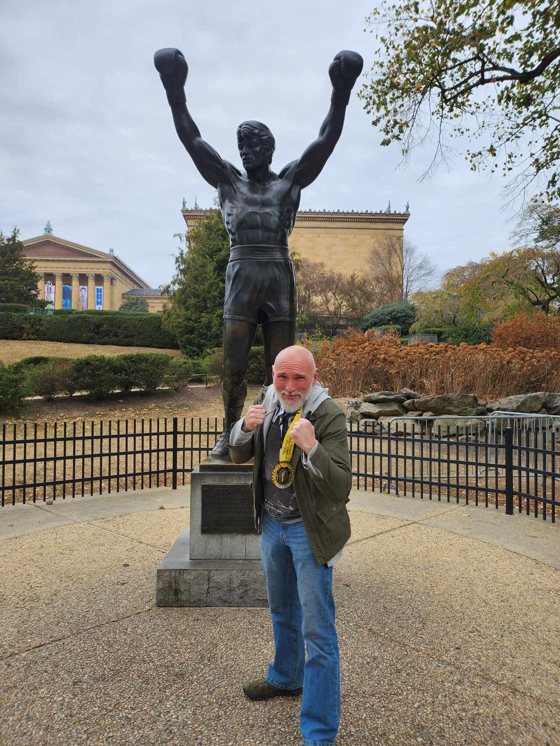
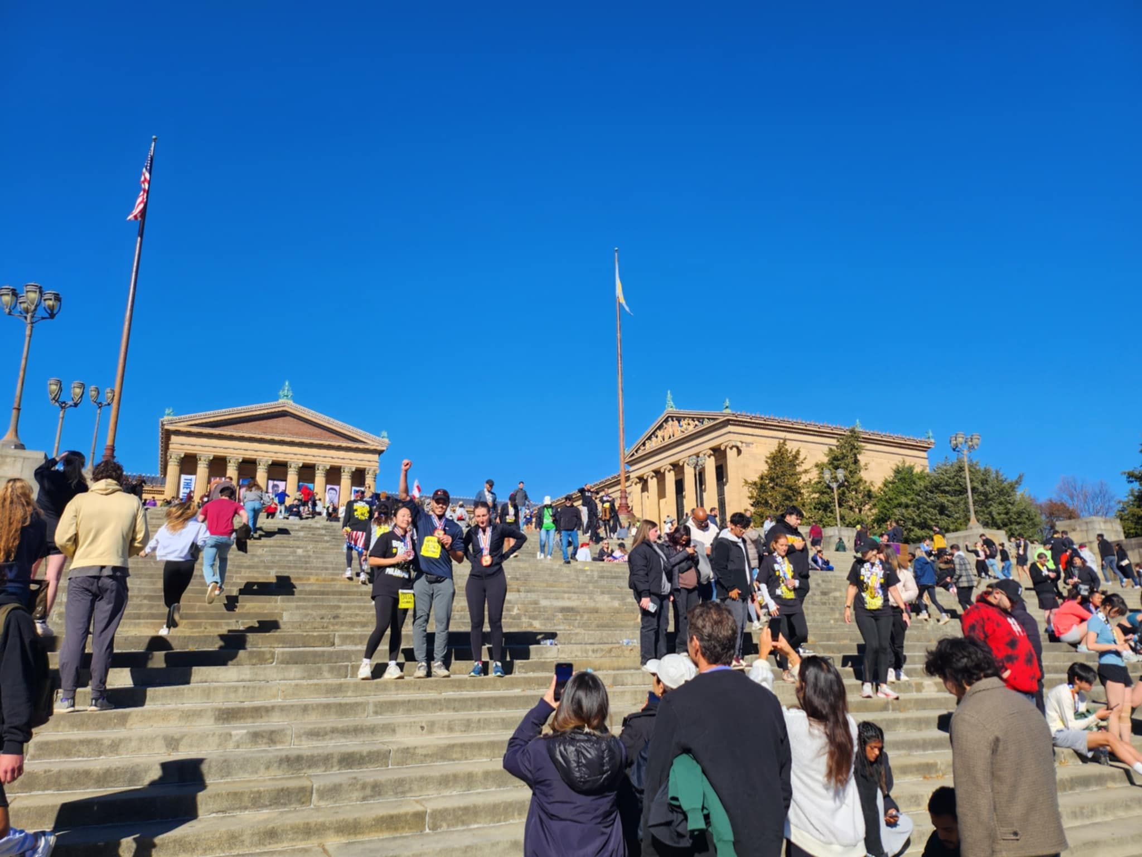
ACCENTS, EMBELISHMENTS
AND ATTRACTIONS
“
We came up with a tremendous publicity campaign, it was about how this unknown guy named Sylvester Stallone walked into our office with a script and the company was prepared to buy the script, but Stallone said, ‘I’m not going to sell it to you unless I star in the film.’ And we (supposedly) said, ‘No way.’ And he said, ‘Well, you can’t have the script.’ And we said, ‘We will give you $18,000.’ And that was the figure we used. And a deal was made and Stallone could star in this film which he wrote. And he got all of $18,000. Now is this true? It was horseshit! But it worked. It promoted the whole underdog concept and kept on going.
”
Gabe Sumner, Head of Marketing, United Artists.

Slide 7
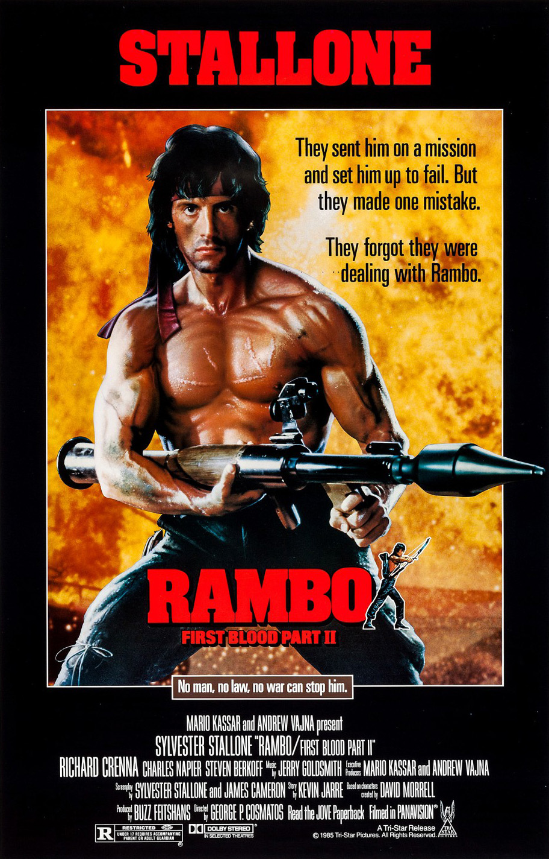
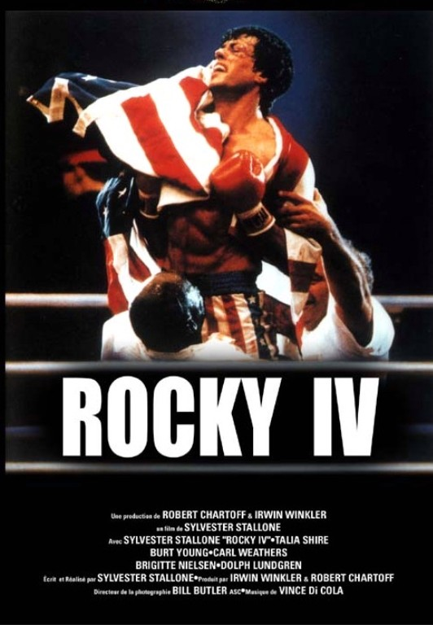
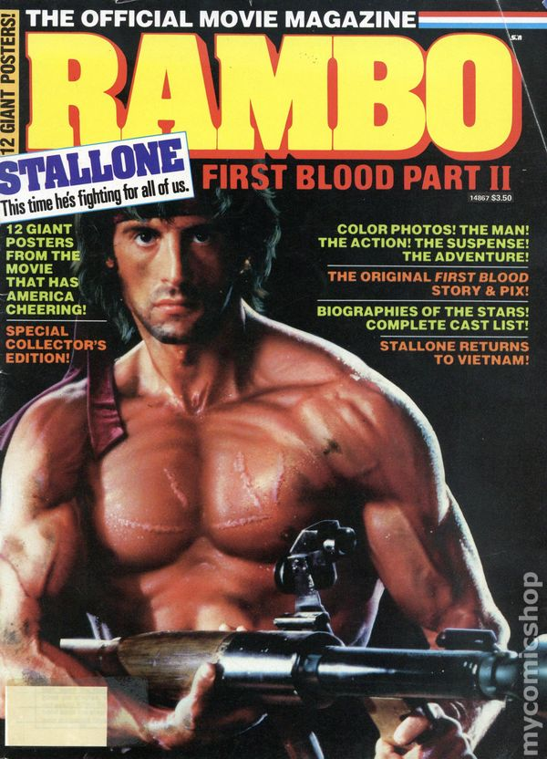
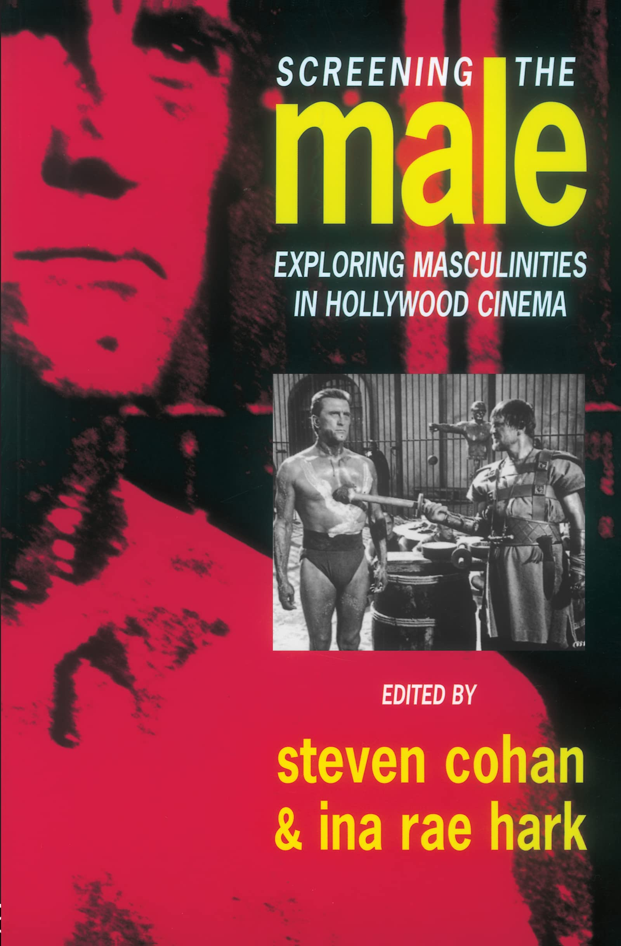
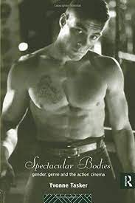
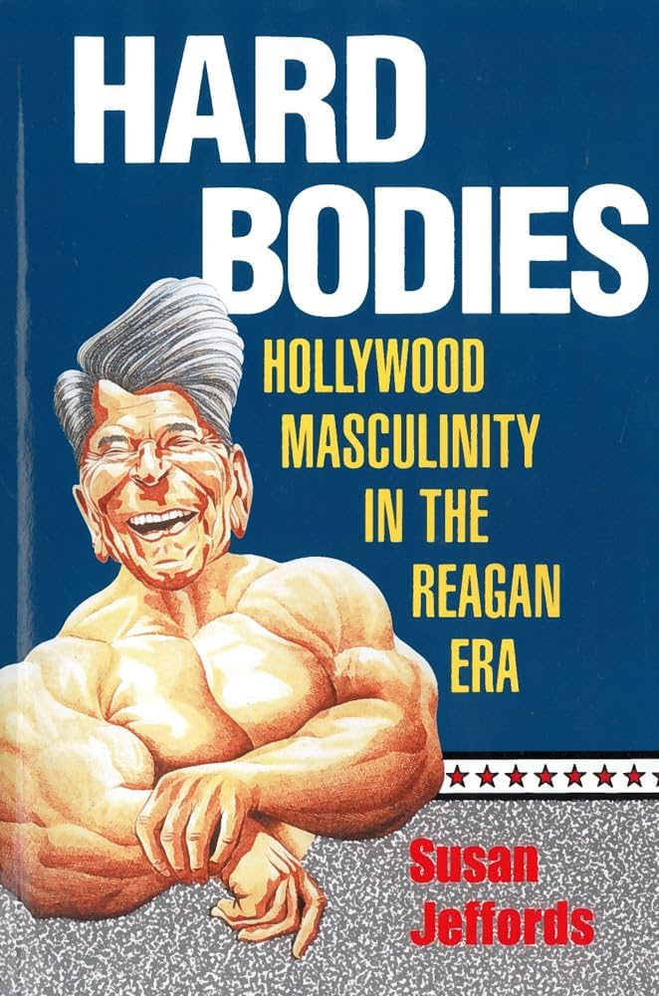
HARD BODIED POLITICS
“
[The] articulations of bodies constituted the imaginary of the Reagan agenda and the site of its materialisation
(Jeffords, 1994, 24)
The hypermasculinity and hard body of Sylvester Stallone came to represent a national mastery over foreign and domestic enemies.
(Frank P. Tomasulo, 1995)
”
Susan Jeffords (1994) Hard Bodies: Hollywood Masculinity in the Reagan Era.

Slide 8
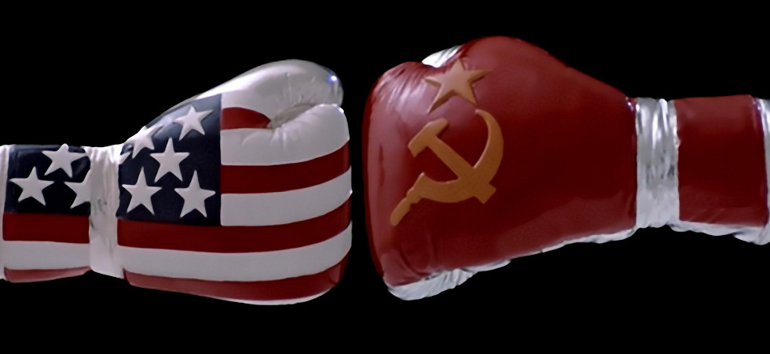
WRESTLING WITH GENRE
“
unless we assume that all audiences were right-wing revisionists, the pleasures of Rambo are mainly to be derived from factors other than its politics … for all its contemporary political resonance, Rambo is nothing more or less than a traditional adventure film.
”
James Chapman (2008) War and Film

Slide 9
EVEN ROCKY HAD A MONTAGE

Slide 10
CONFLICTING IDEOLOGIES
Reaganite cinema: what a feeling!
“
Rocky IV is the culmination of Stallone's play with montage’ (2014).
(Paul Ramaeker, 2014)
The look and the sound of Flashdance signifies an integration of marketing and industrial synergy, and the text becomes merely an advertisement for other products and a ‘component’ in a larger capitalist-entertainment-business system of “commercial intertextuality” and “high-concept”
(Gary Needham, 2016)
”
Gary Needham (2016) Reaganite cinema: what a feeling!

Slide 11
ROCKY IV

