Slide 1
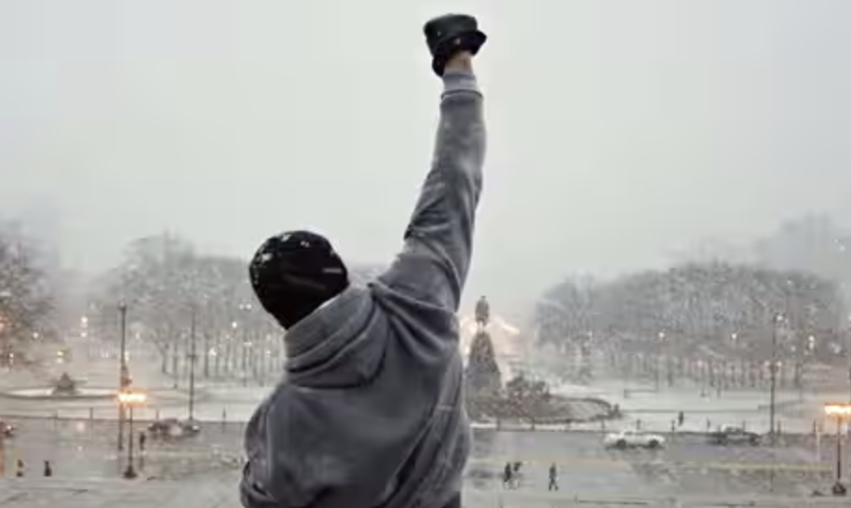
BA/LEVERHULME SMALL RESEARCH GRANTS SRG 2023-24
UNDERSTANDING STAR BRAND NARRATIVES IN THE POST STUDIO ERA

Slide 2
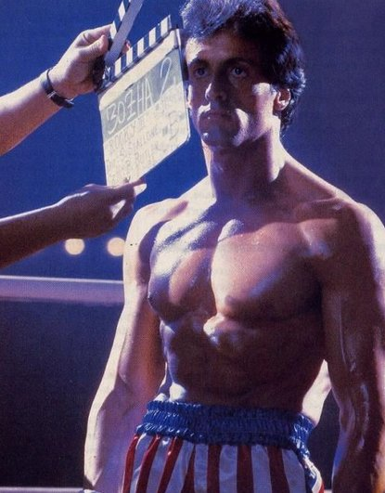
STALLONE: IDENTITY, LABOUR AND PERFORMANCE
The Action Hero: Surveying Stallone Studies
The Underdog: The Role of Adversity in Stallone’s Brand Narrative
The Actor: Monologues and Silences in the Performance of Sylvester Stallone
The Movie Star: Cultural Distinction and Historic Attitudes to Franchised Entertainment
The Difficult Auteur: Writer, Director and Producer
The Republican: The Politics of Performing Rambo
The Thinker: Renegotiating the Image
The Geriaction Star: The Economic Value of Redundancy
The Media Celebrity: Labour, Legacy and Meaning
McKenna, Mark (Forthcoming) Stallone: Identity, Labour and Performance, Edinburgh: Edinburgh University Press.

Slide 3
UNDERSTANDING STAR BRAND NARRATIVES IN THE POST STUDIO ERA
ABSTRACT
The proposed research will interrogate the role of historical brand narratives constructed around film stars, considering the effect that those narratives have on the popular perception of particular stars, and the agency of the star in that process.
Using Sylvester Stallone as a case study, the project will challenge the widespread belief that film stars achieved autonomy with the decline of the Hollywood studio system from the 1960s onwards, through an exploration of the fabricated narrative of disadvantage and determination that was imposed on Stallone by United Artists in the promotion of Rocky in 1976. This narrative rewrote Stallone’s life of relative privilege, recasting him as a working-class hero, and has since become the cornerstone of his biography.
Through a combination of ethnographic and archival research, this project will consider the continued value of narratives like this in the contemporary marketplace.

Slide 4
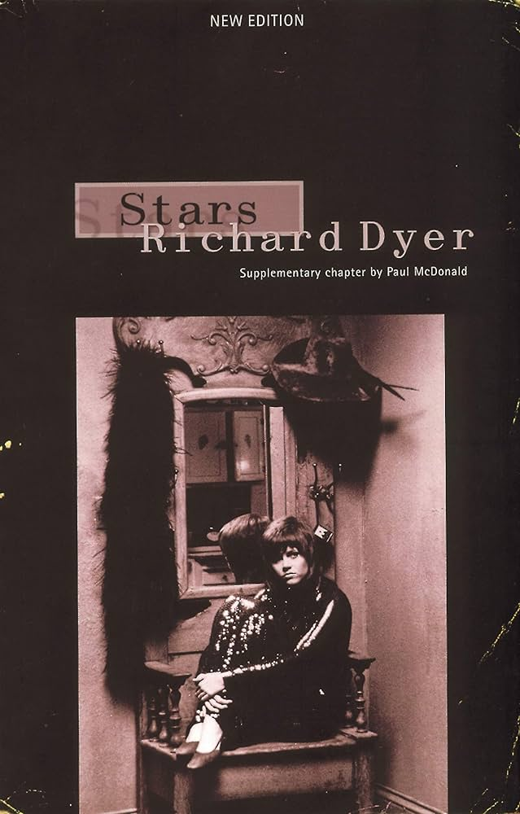
FEASIBILITY OF THE METHODOLOGY
The project's primary aim is to investigate the nature of film stardom in the post - studio era and to challenge the prevailing notion that stars achieved creative autonomy with the decline of the studio system. While it’s secondary aim is to map the value of star brand narratives for audiences and how audiences the make connections between time, body, and space (Rocky, Stallone, and Philadelphia) based on those narratives and insert themselves into them.
To do that the project seeks to answer a series of questions based upon Richard Dyer’s thesis, that the stardom is both a phenomenon of production and a phenomenon of consumption.

Slide 5
FEASIBILITY OF THE METHODOLOGY
STARS AS A PHENOMENON OF PRODUCTION
RQ1. [Organisations & Institutions]
What role did United Artists play in developing the biography and did this contradict any earlier biographical details, and if so, how was this negotiated and resolved ?
RQ2. [Products & Discourse]
How did the narrative develop and grow over time and are there any moments when the narrative takes on a greater significance or resonance, if so, why?
RQ3. [Marketing and Branding]
How and when did these ideas consolidate into a brand and how has that defined Stallone’s subsequent persona?

Slide 6
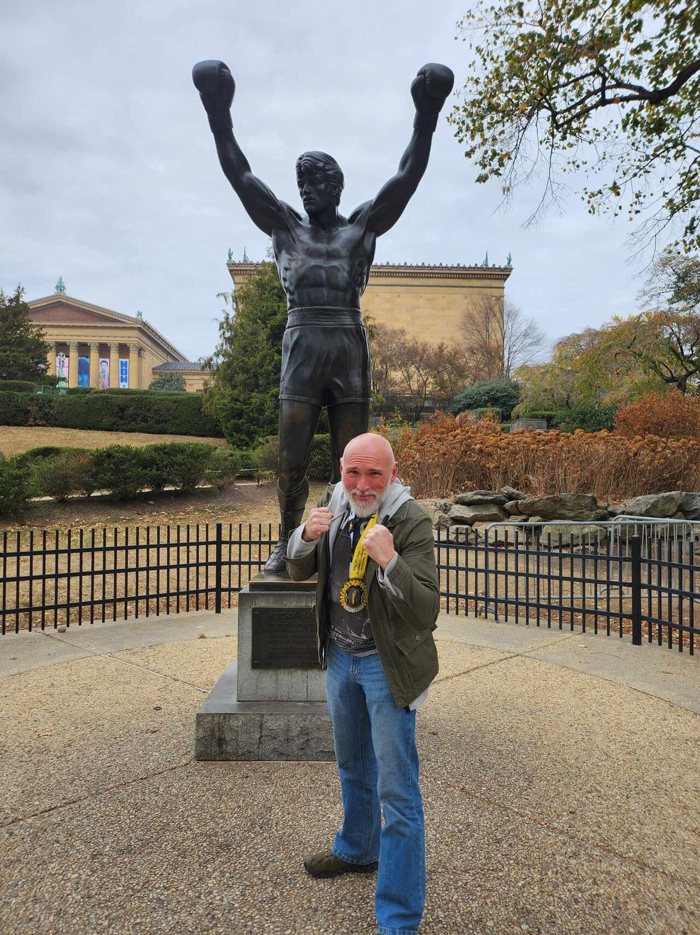
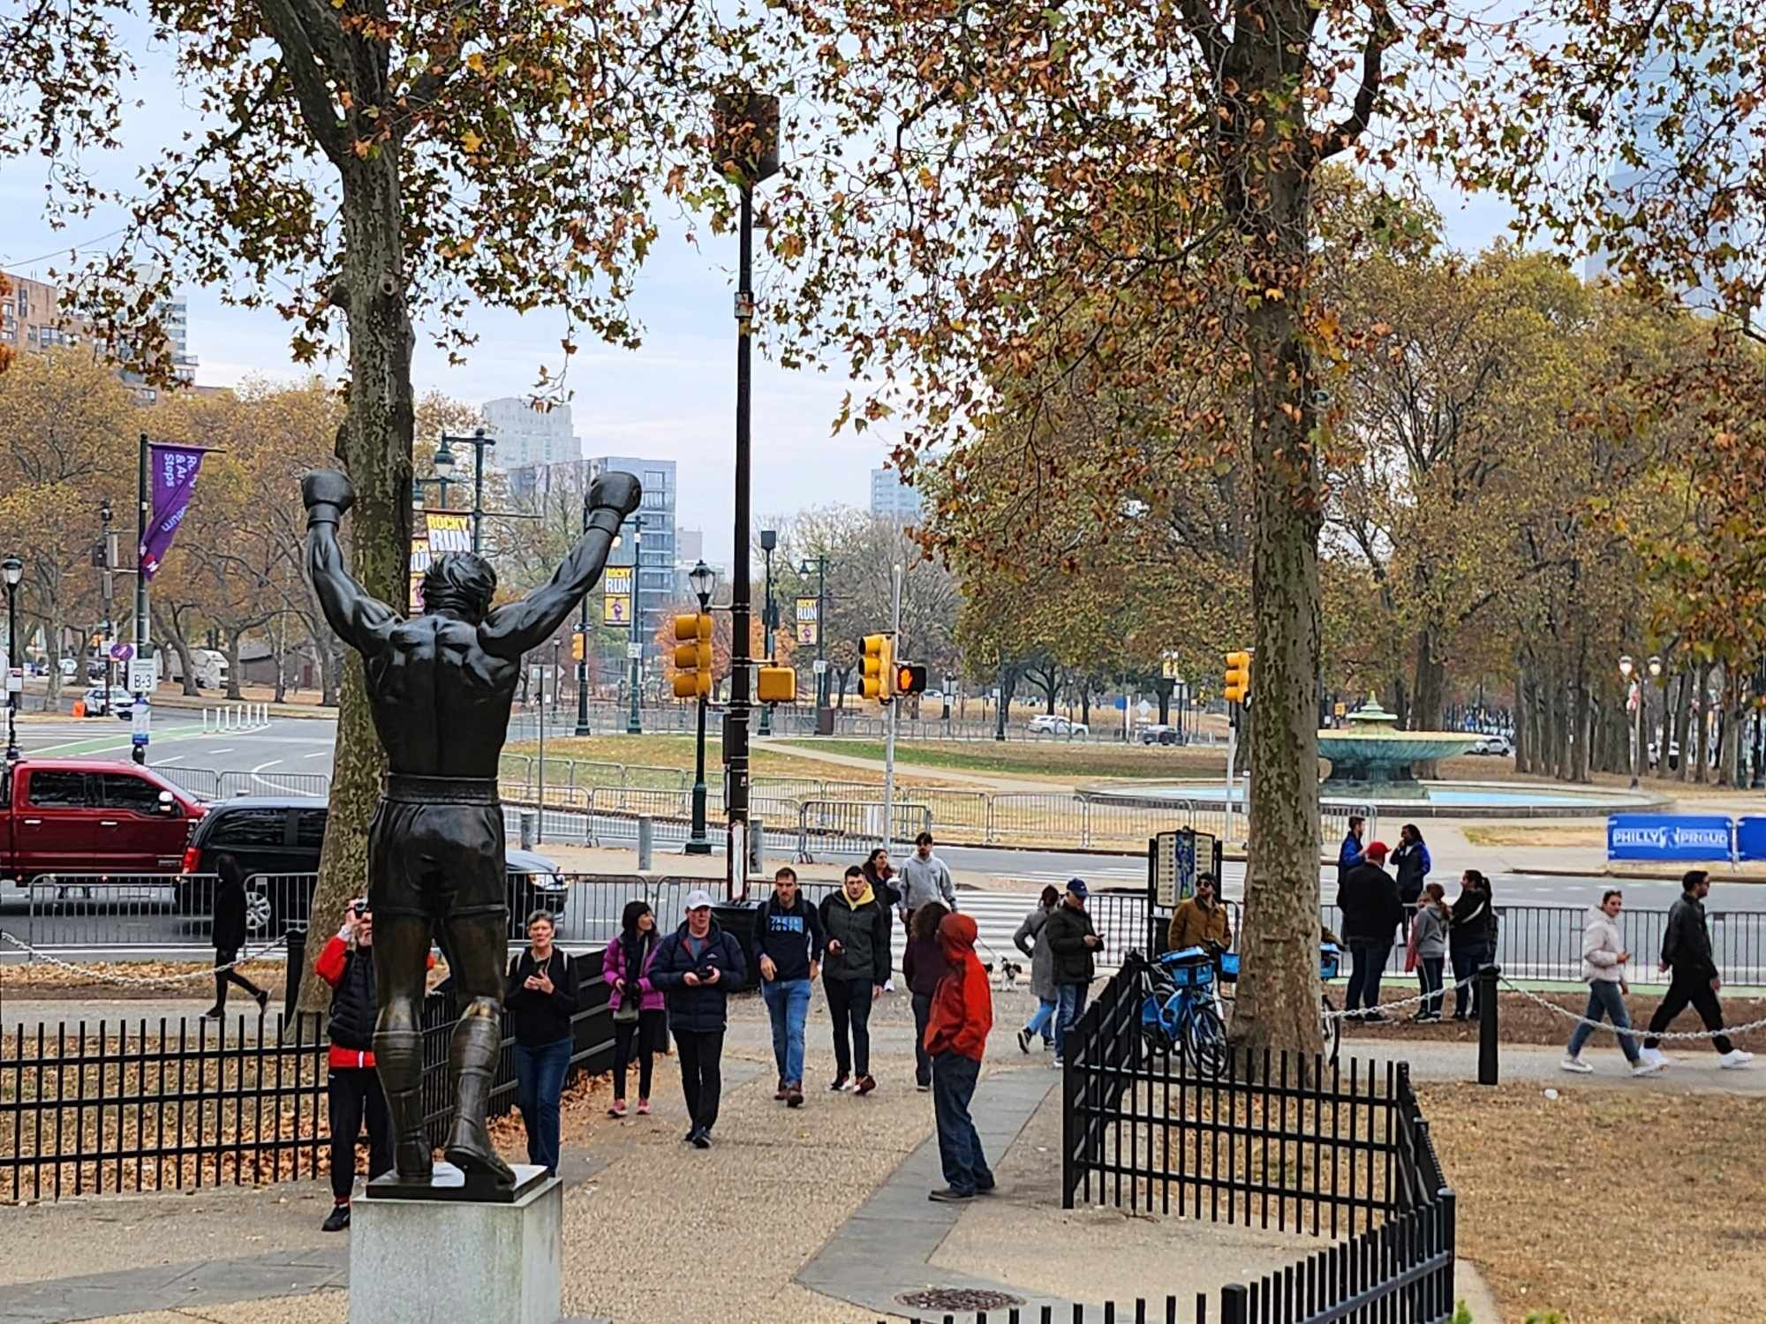
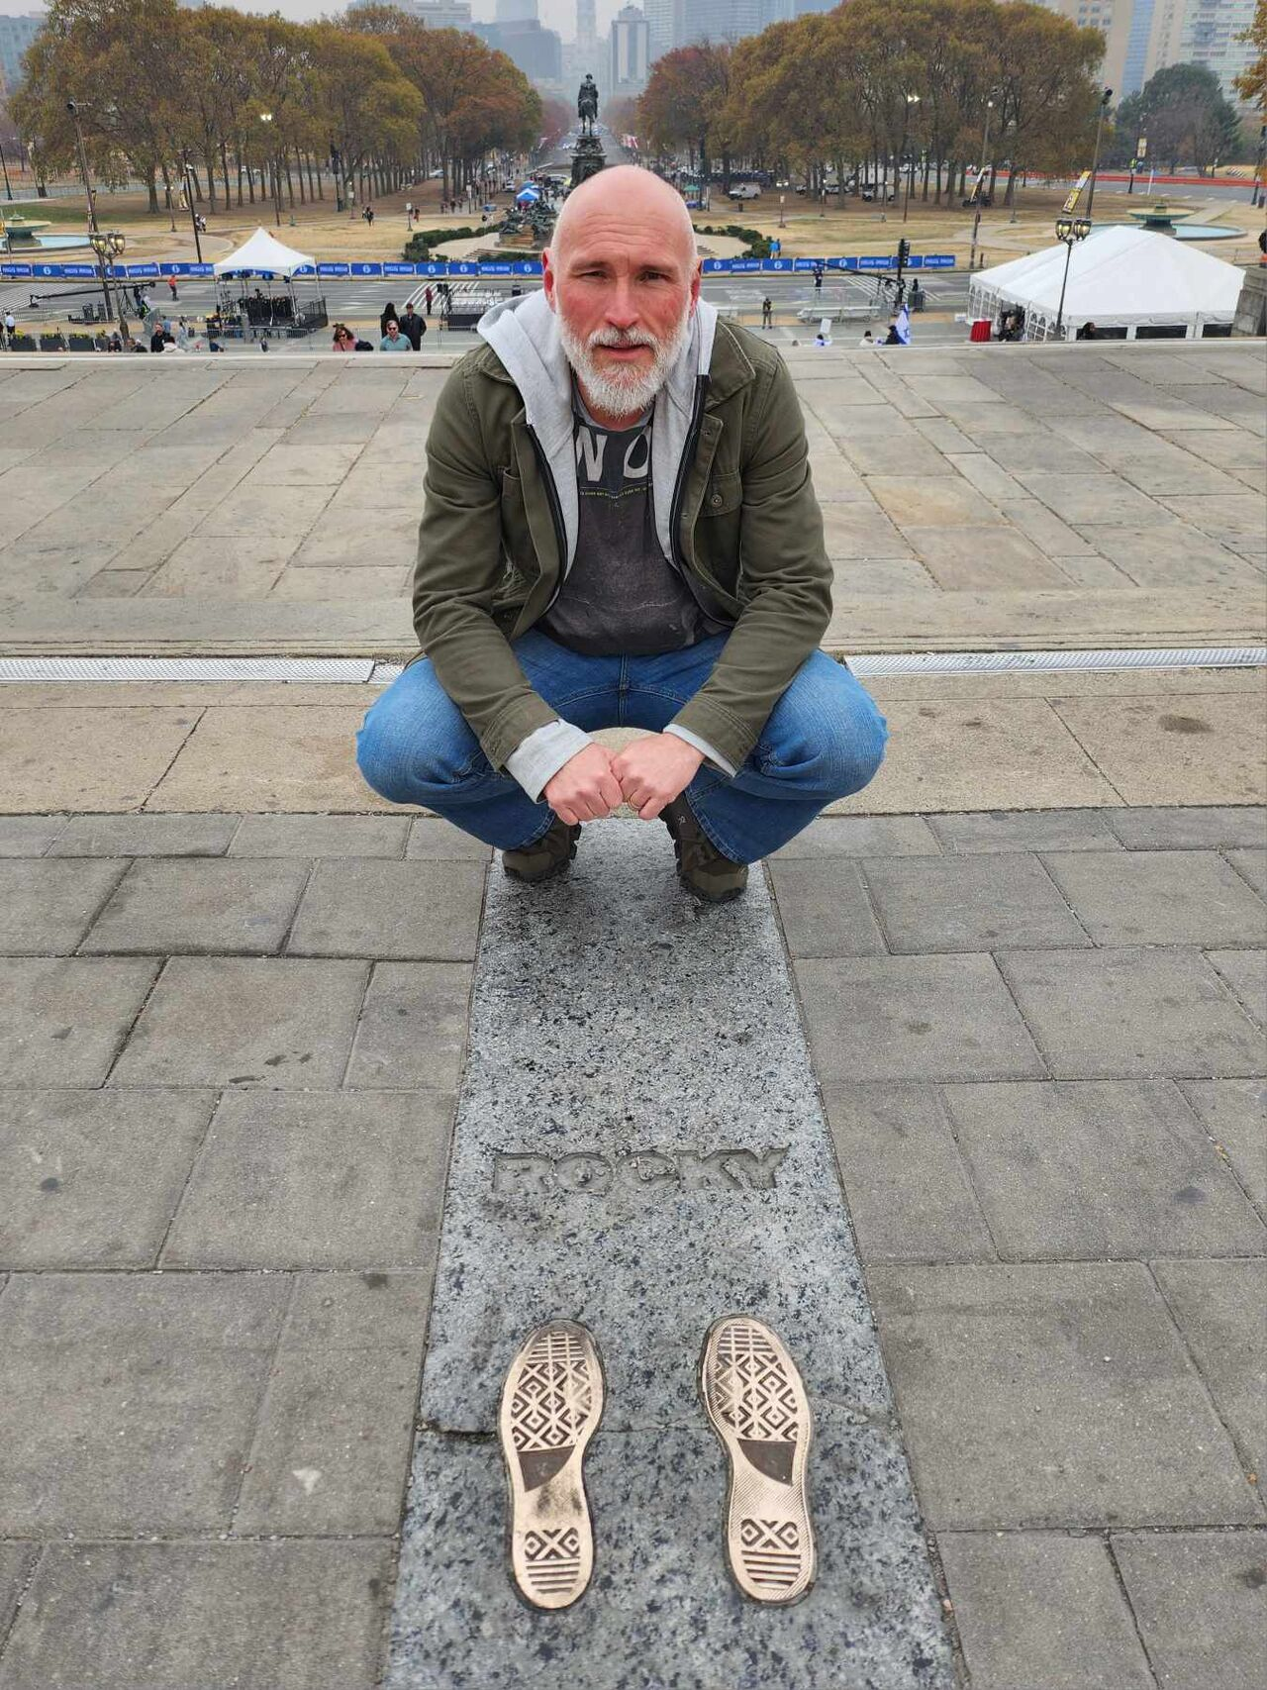
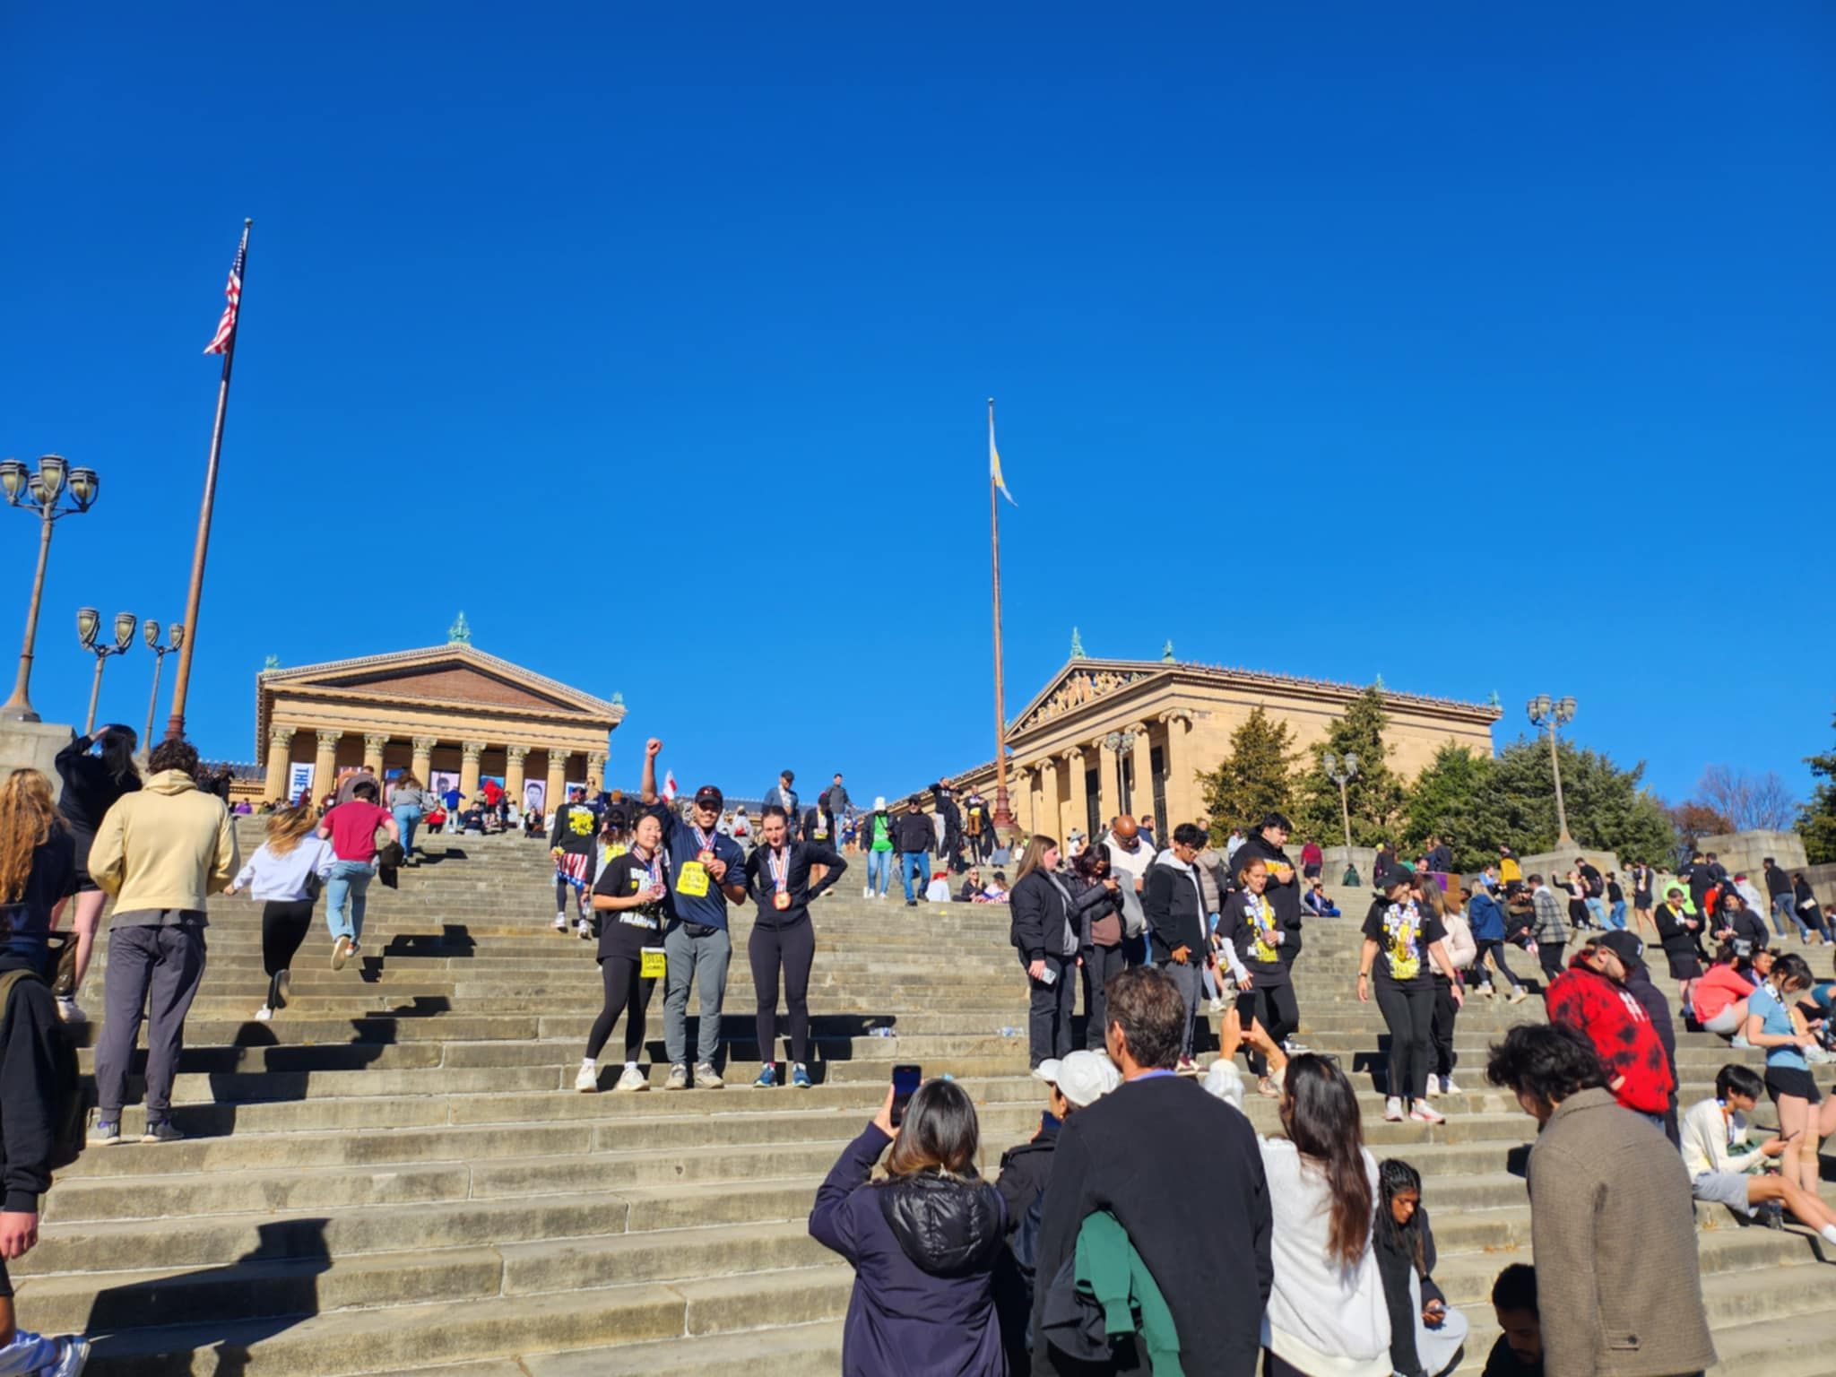
FEASIBILITY OF THE METHODOLOGY
STARS AS A PHENOMENON OF CONSUMPTION
RQ4. [History & Memory]
What are audiences responding to when they make the pilgrimage to the Philadelphia Museum of Art and how much is about the character Rocky Balboa and how much is about the actor Sylvester Stallone?
RQ5. [Commerce & Economics]
The shop that now sits at the foot of the museum is the result of a sustained effort by Stallone to capitalise on the legacy and association of Rocky. How do the shop and the city contribute to his brand narrative and reinforce the popular perception of Stallone as a motivational figure?
RQ6. [Authenticity and Integrity]
How much awareness is there among the fan community that the origin story of Stallone is a construction developed by the studios and has that affected the coherence of the star image ?

Slide 7
OVERVIEW OF THE OUTPUTS
ANTICIPATED
A presentation of the preliminary findings at the Media Industries conference, held every two years at Kings College London
A journal article of those findings to be published in the journal Celebrity Studies
A presentation summarising the overall findings of the project at the Celebrity Studies conference, held annually (location to be confirmed).
Scholarly monograph, Stallone: Identity, Labour and Performance (80,000 words) to be published by Edinburgh University Press (as part of the International Film Stars series).
ACTUAL OUTPUTS TO DATE
A presentation summarising the preliminary findings of the project at the Celebrity Studies conference in Amsterdam, 2024.
A journal article of those findings published in the Velvet Light Trap journal.
STILL ON TRACK TO DELIVER
A presentation summarising the overall findings of the project at the Media Industries conference in London 2026.
A journal article of those findings published in the Velvet Light Trap Scholarly monograph, Stallone: Industry and Performance (80,000 words) to be published by Edinburgh University Press (as part of the International Film Stars series).

Slide 8
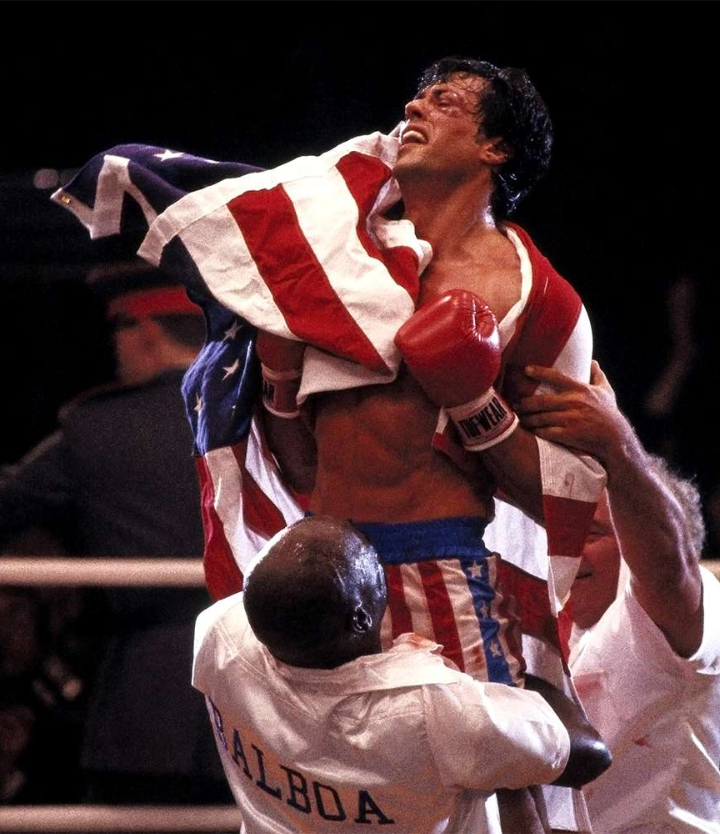
QUALITY AND INTEREST OF THE RESEARCH PROPOSAL
It has clear aims and objectives
It has a clear methodology linked to those aims
It employs an innovative methodology that tests established ideas
It offers value for money
Will deliver a significant body of work for minimal outlay

Slide 9
MANY THANKS
ANY QUESTIONS?

