Slide 1
LEVELLING UP THE SCREEN INDUSTRIES
FILM AND TELEVISION PRODUCTION
AS REGENERATIVE STRATEGY
IN PLACES LEFT BEHIND

Slide 2
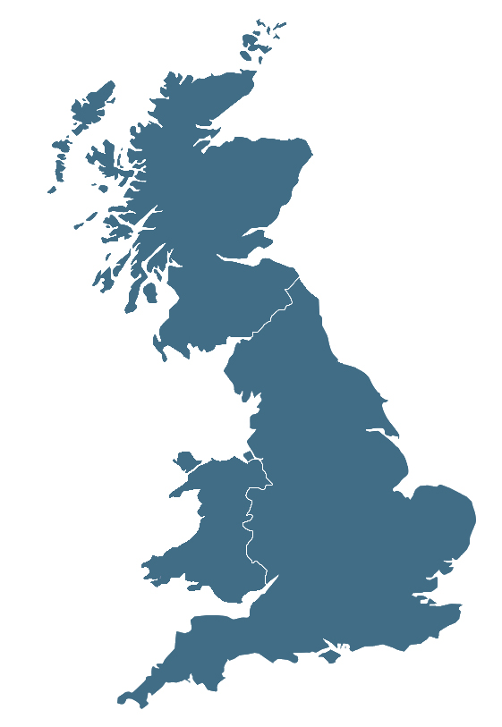
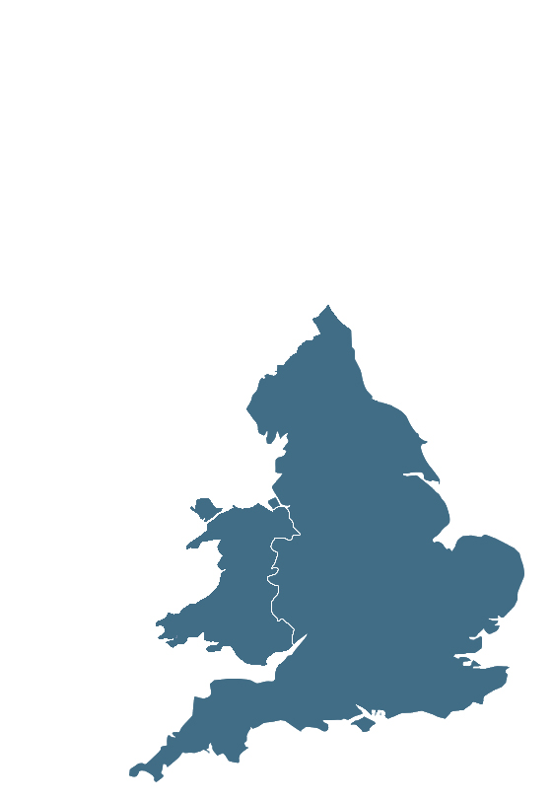
MAPPING THE PROJECT
“
There is a significant body of work that considers the role of the regions and regionality in the British film and television industry, is perhaps seen most visibly in Lez Cooke's A Sense of Place: Regional British Television Drama, 1956-82 (2012), an important study of regional British television drama from its beginnings on the BBC and ITV in the 1950s to the arrival of Channel Four in 1982. The recent devolution of Channel 4, and then the BBC, combined with the investment and growth of areas like MediaCityUK, Salford, Birmingham, and Liverpool as sites of production, has rekindled interest in the role of the regions in the future of Britain’s film and television economy. However, aside from a few notable exceptions, this work has consistently foregrounded the contribution of larger metropolitan areas, leaving the contribution of smaller city regions underexplored. Of course, without the critical mass and infrastructure of larger city regions, smaller economic areas face a significant disadvantage in fulfilling their potential as locations for producing film and TV content, but that does not mean that attempts are not being made to capitalise on the economic and cultural benefits that a thriving film industry would bring.
”

Slide 3
MAPPING THE PROJECT
“
There is a significant body of work that considers the role of the regions and regionality in the British film and television industry, is perhaps seen most visibly in Lez Cooke's A Sense of Place: Regional British Television Drama, 1956-82 (2012), an important study of regional British television drama from its beginnings on the BBC and ITV in the 1950s to the arrival of Channel Four in 1982. The recent devolution of Channel 4, and then the BBC, combined with the investment and growth of areas like MediaCityUK, Salford, Birmingham, and Liverpool as sites of production, has rekindled interest in the role of the regions in the future of Britain’s film and television economy. However, aside from a few notable exceptions, this work has consistently foregrounded the contribution of larger metropolitan areas, leaving the contribution of smaller city regions underexplored. Of course, without the critical mass and infrastructure of larger city regions, smaller economic areas face a significant disadvantage in fulfilling their potential as locations for producing film and TV content, but that does not mean that attempts are not being made to capitalise on the economic and cultural benefits that a thriving film industry would bring.
”

Slide 4
MAPPING THE PROJECT
1
Sunderland
A post-industrial city still bound to ideas of shipbuilding, coal-mining and glass-making – industries that were decimated more than forty years ago but continue to inform the regional identity.
2. Stoke-on-Trent
A region famed for its association with the ceramics industry but struggling to reinvent itself as a digital centre while not turning its back on its heritage and global association with ‘The Potteries’,
2
3. Southampton
An area more commonly known for its shipping and maritime industries, but home to a complex creative ecosystem populated by an array of cultural development agencies, many of which emerged following the region’s failed City of Culture bid;
3

Slide 5
incremental ecosystems
“
Incremental ecosystems are characterised by the entrepreneurial energies of local creative personnel, rather than from major capital investment
”
Spicer, A. (2023). Bristol’s Film and Television Industries: An Incremental Ecosystem. In: Virani, T.E. (eds) Global Creative Ecosystems. Dynamics of Virtual Work. Palgrave Macmillan, Cham. https://doi.org/10.1007/978-3-031-33961-5_7

Slide 6
THE LEFT BEHIND
“
Of all the popular imaginaries constructed to describe the nature and condition of later-day social exclusion, few have risen to prominence so swiftly, or come to dominate debate so comprehensively, as “the left behind
(Morrison, James 2022, 1).
Areas blighted a ‘structural cocktail of disadvantage including low paid jobs, welfare erosion, indebtedness, destitution, and food insecurity.
(Etherington, David, Jones, Martin, Telford, Luke
”
Morrison, J.(2022) The Left Behind: Reimagining Britain’s Socially Excluded. Pluto Press: London.

Slide 7
LEVELLING UP THE LEFT BEHIND
“
We will be bringing forward proposals to transform this country with better infrastructure, better education, better technology. If you ask yourselves what is this new government going to do, what is he going to do with his extraordinary majority, I will tell you … we are going to unite and level up.
”
Boris Johnson, speaking outside Downing Street,13 December 2019

Slide 8
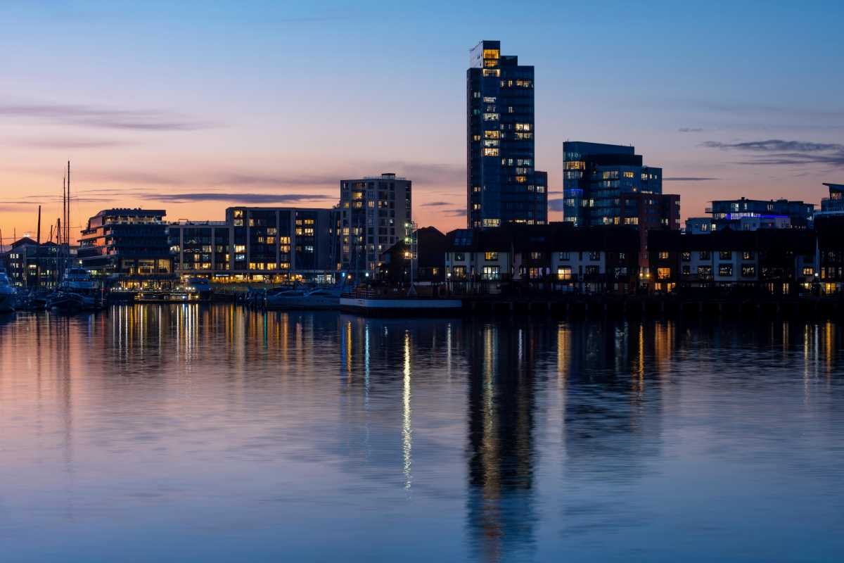
CASE STUDY THREE: SOUTHAMPTON AND THE SOLENT
“
The basic organisational structure for planning and management in the Solent is highly fragmented. Many types of statutory and non-statutory authorities and agencies have a role to play, each with its own powers, objectives and priorities, and area of jurisdiction
(2001, 159).
”
Inder, A. (2001) ‘Partnership in planning and management of the Solent, in Dixon-Gough,

Slide 9
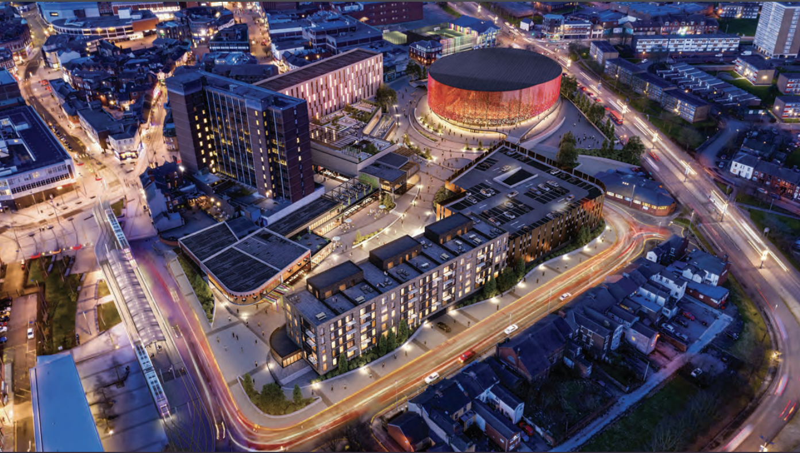
CASE STUDY TWO: STOKE ON TRENT AND STAFFORDSHIRE
“
Silicon Stoke’ prospectus, set out the ambitions for the digital transformation of Stoke using £8.53m of government funding. Reimagined as a smart city, the Council had already established much of the infrastructure on which this city would be built: a 113km full-fibre network right across the city providing the opportunity for 5G connectivity, the introduction of a gaming hub, a full-fibre academy at Stoke-on-Trent College, as well as a new Digital Academy.
”
Silicon Stoke

Slide 10
CASE STUDY ONE: SUNDERLAND – CROWN WORKS STUDIO
Crown Works Studios in Sunderland is a significant film and TV production facility with a total investment of £450 million. This funding comprises £120 million from the UK government, allocated over ten years, and £330 million from private sources.
The private investment is provided by FulwellCain Studios, a joint venture between global entertainment company Fulwell 73 and investment firm Cain International.
The government funding is part of a devolution deal aimed at transforming the North East into a major hub for film and high-end TV production. This investment is expected to create over 8,000 jobs and generate £336 million annually for the regional economy.
Construction of the studios is planned in three phases between 2024 and 2027, with the first six sound stages anticipated to be operational by 2026
Sunderland.gov.uk

Slide 11
FINAL THOUGHTS
“
The stories that we tell about a place matter, and that if the stories we tell look backwards and down, they will ultimately be self-defeating, that they can trap a place and a people in a downward spiral, trapped by their own history, and trapped by their own geography.
Conversely, if the stories we tell about a place look forwards and up, then that aspiration and can become an economic driver that can become self-actualising – that those stories and that optimism can help to reshape a place and reinvigorate a people
”

Slide 12
LEVELLING UP THE SCREEN INDUSTRIES
THANK
YOU
FILM AND TELEVISION PRODUCTION
AS REGENERATIVE STRATEGY
IN PLACES LEFT BEHIND

