Slide 1

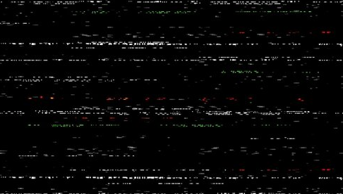
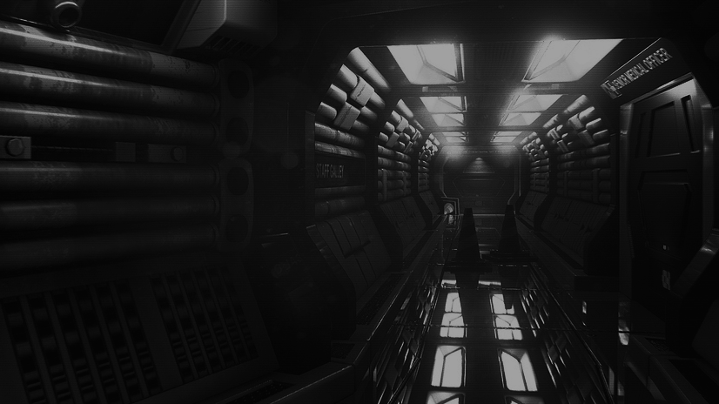
//TENSION IN TTRPGS: TOO TERRIFYING TO TRY?
//BEN RIMMER
//ESTHER MACCALLUM-STEWART

Slide 2
//TENSION IN TTRPGS: TOO TERRIFYING TO TRY?
//HORROR: PIONEERS
//BEN RIMMER
//ESTHER MACCALLUM-STEWART
//KRZYWINSKA 2002
//PERRON 2008
//PHOENIX 2019

Slide 3
//TENSION IN TTRPGS: TOO TERRIFYING TO TRY?
//BEN RIMMER
//ESTHER MACCALLUM-STEWART
//HORROR: PIONEERS
//KRZYWINSKA 2002
//Liapis and Denisova (2023) found that there is a gap in research aimed at Table Top Role Playing.
//PERRON 2008
//PHOENIX 2019

Slide 4
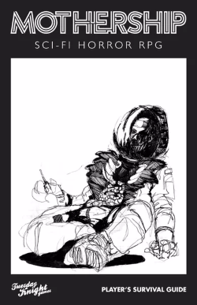
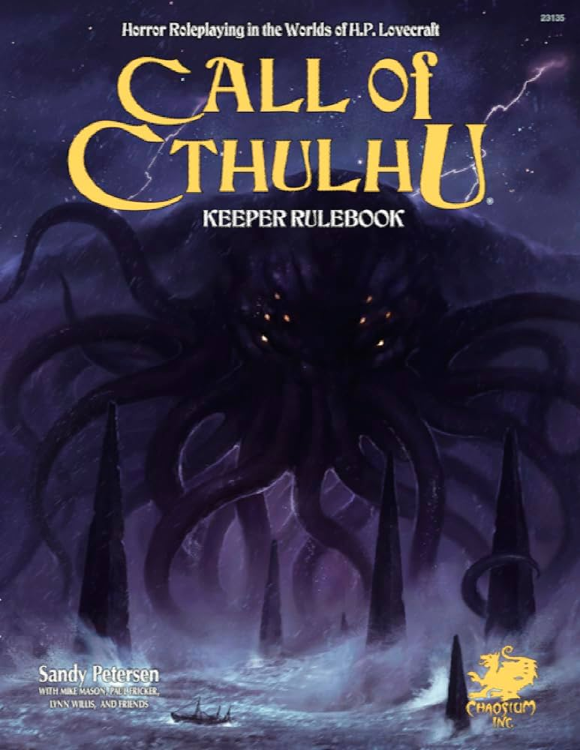
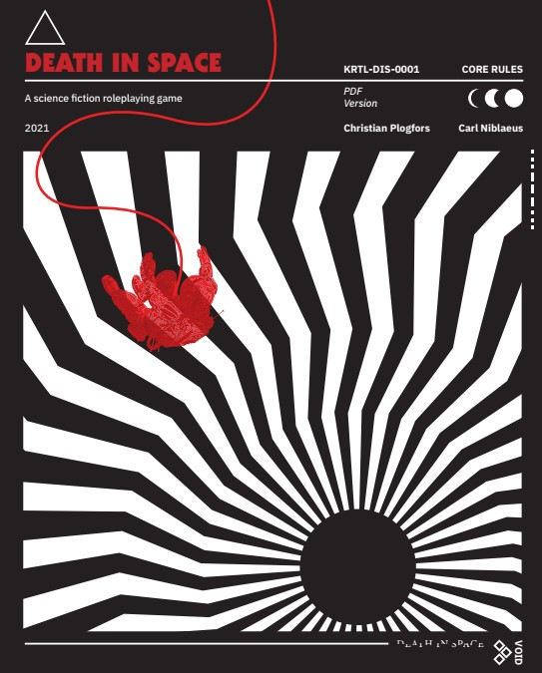
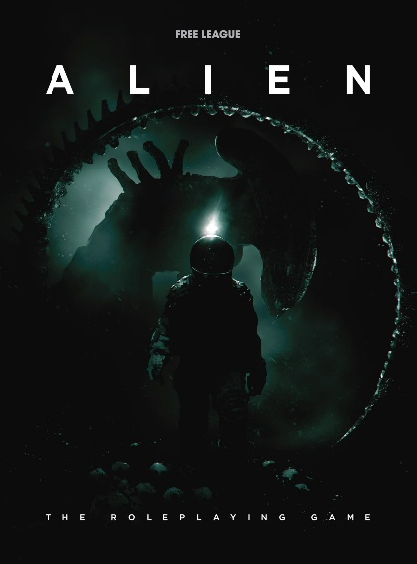
//CURIOSITY KILLED THE JONSEY
//HORROR: PIONEERS
//Horror TTRPG couldn’t be any more popular in the current climate
//KRZYWINSKA 2002
Liapis and Denisova (2023) found that there is a gap in research aimed at Table Top Role Playing.
//PERRON 2008
//PHOENIX 2019
//ALIEN RPG
//MOTHERSHIP
//CALL OF CTHULHU
//DEATH IN SPACE

Slide 5
//HORROR: PIONEERS
//CURIOSITY KILLED THE JONSEY
//Horror TTRPG couldn’t be any more popular in the current climate
Liapis and Denisova (2023) found that there is a gap in research aimed at Table Top Role Playing.
//ALIEN RPG
//MOTHERSHIP
//CALL OF CTHULHU
//DEATH IN SPACE

Slide 6
//HORROR: PIONEERS
//WHAT MAKES THEM TICK?
//KRZYWINSKA 2002
Video games historically steal from different horror medium to manifest horror
They do this because its effective however video games and films have one major difference.
//ALIEN RPG
//MOTHERSHIP
//CALL OF CTHULHU
//DEATH IN SPACE
//PHOENIX 2019
Video Games are interactive.

Slide 7
//WHAT MAKES THEM TICK?
//TTRPG IS DIFFERENT
Unlike video games. TTRPG is even further detached from reality where the game is nearly completely make believe and players sit within the Magic Circle (Huizinga 1938) – if you want to subscribe to this or theory or not – you still have to play pretend.
Video games historically steal from different horror medium to manifest horror
They do this because its effective however video games and films have one major difference.
Video Games are interactive.

Slide 8
//WHAT MAKES THEM TICK?
//TTRPG IS DIFFERENT
//INTO THE FRAY TO MAKE PLAY WITH FEAR
Freudian or Jungian archetypes of sex as monsters as seen in Resident Evil countless times, notably in 7 where the mother becomes an insectoid monster with an overgrowth between her legs.
Unlike video games. TTRPG is even further detached from reality where the game is nearly completely make believe and players sit within the Magic Circle (Huizinga 1938) – if you want to subscribe to this or theory or not – you still have to play pretend.
When you play pretend – how do you create fear?
Video games historically steal from different horror medium to manifest horror
Horror video games often rely on overused tropes.
They do this because its effective however video games and films have one major difference.
Silent Hill 2 works to invoke the uncanny with the character Maria, who has both large yet thin eyes, off pale skin and mouth which is too wide.
Freudian or Jungian archetypes of sex as monsters as seen in Resident Evil countless times, notably in 7 where the mother becomes an insectoid monster with an overgrowth between her legs.
//DEATH IN SPACE
Video Games are interactive.
Even jump scares are prevalent throughout cheap and indie horror titles.

Slide 9
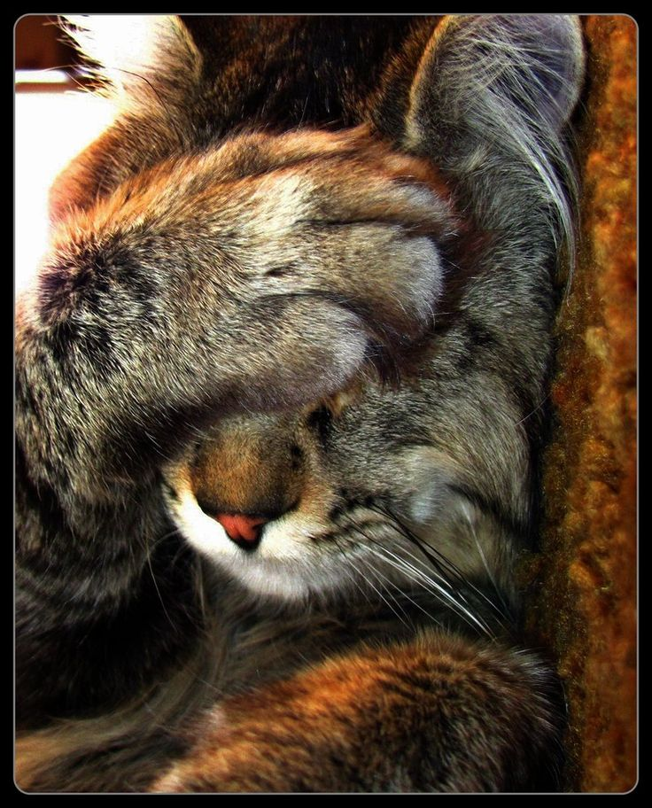
//INTO THE FRAY TO MAKE PLAY WITH FEAR
//WHAT MAKES THEM TICK?
When you play pretend – how do you create fear?
Its easy, just create a violent sex monster that you know is coming to eat you in Dungeons and Dragons and you’ve made a horror game!
Horror video games often rely on overused tropes.
Freudian or Jungian archetypes of sex as monsters as seen in Resident Evil countless times, notably in 7 where the mother becomes an insectoid monster with an overgrowth between her legs.
Video games historically steal from different horror medium to manifest horror
They do this because its effective however video games and films have one major difference.
Silent Hill 2 works to invoke the uncanny with the character Maria, who has both large yet thin eyes, off pale skin and mouth which is too wide.
//DEATH IN SPACE
Video Games are interactive.
Krywinska (2002) and Costikyan (2005) argued that informing the player of incoming threats creates uncertainty and adds layers of fear within games.

Slide 10
//INTO THE FRAY TO MAKE PLAY WITH FEAR
//WHAT MAKES THEM TICK?
When you play pretend – how do you create fear?
Its easy, just create a violent sex monster that you know is coming to eat you in Dungeons and Dragons and you’ve made a horror game!
Horror video games often rely on overused tropes.
Freudian or Jungian archetypes of sex as monsters as seen in Resident Evil countless times, notably in 7 where the mother becomes an insectoid monster with an overgrowth between her legs.
Video games historically steal from different horror medium to manifest horror
They do this because its effective however video games and films have one major difference.
Silent Hill 2 works to invoke the uncanny with the character Maria, who has both large yet thin eyes, off pale skin and mouth which is too wide.
//DEATH IN SPACE
Video Games are interactive.
Krywinska (2002) and Costikyan (2005) argued that informing the player of incoming threats creates uncertainty and adds layers of fear within games.
A horror game is more than scary looking monsters. Its all about creating emotions. Which Perron explored in 2009.

Slide 11
When you play pretend – how do you create fear?
Its easy, just create a violent sex monster that you know is coming to eat you in Dungeons and Dragons and you’ve made a horror game!
//INTO THE FRAY TO MAKE PLAY WITH FEAR
//WHAT MAKES THEM TICK?
A horror game is more than scary looking monsters. Its all about creating emotions. Which Perron explored in 2009.
Horror video games often rely on overused tropes.
Freudian or Jungian archetypes of sex as monsters as seen in Resident Evil countless times, notably in 7 where the mother becomes an insectoid monster with an overgrowth between her legs.
Video games historically steal from different horror medium to manifest horror
They do this because its effective however video games and films have one major difference.
Silent Hill 2 works to invoke the uncanny with the character Maria, who has both large yet thin eyes, off pale skin and mouth which is too wide.
//DEATH IN SPACE
Video Games are interactive.
Krywinska (2002) and Costikyan (2005) argued that informing the player of incoming threats creates uncertainty and adds layers of fear within games.
Games are a rich source from which to elicit emotional reactions from the player. When engaging in play, the player has something to lose.

Slide 12

A horror game is more than scary looking monsters. Its all about creating emotions. Which Perron explored in 2009.
//INTO THE FRAY TO MAKE PLAY WITH FEAR
//WHAT MAKES THEM TICK?
Games are a rich source from which to elicit emotional reactions from the player. When engaging in play, the player has something to lose.
Horror video games often rely on overused tropes.
To reinforce this. Sidhu and Carter (2021) completed as study that showed 17/20 Dungeons and Dragons players found that their character deaths where the most memorable experience.
Freudian or Jungian archetypes of sex as monsters as seen in Resident Evil countless times, notably in 7 where the mother becomes an insectoid monster with an overgrowth between her legs.
Video games historically steal from different horror medium to manifest horror
They do this because its effective however video games and films have one major difference.
Silent Hill 2 works to invoke the uncanny with the character Maria, who has both large yet thin eyes, off pale skin and mouth which is too wide.
//DEATH IN SPACE
Video Games are interactive.
Even jump scares are prevalent throughout cheap and indie horror titles.

Slide 13
//INTO THE FRAY TO MAKE PLAY WITH FEAR
//WHAT MAKES THEM TICK?
//LETS RECAP
Games are a rich source from which to elicit emotional reactions from the player. When engaging in play, the player has something to lose.
Horror video games often rely on overused tropes.
To reinforce this. Sidhu and Carter (2021) completed as study that showed 17/20 Dungeons and Dragons players found that their character deaths where the most memorable experience.
Freudian or Jungian archetypes of sex as monsters as seen in Resident Evil countless times, notably in 7 where the mother becomes an insectoid monster with an overgrowth between her legs.
Video games historically steal from different horror medium to manifest horror
They do this because its effective however video games and films have one major difference.
Silent Hill 2 works to invoke the uncanny with the character Maria, who has both large yet thin eyes, off pale skin and mouth which is too wide.
//DEATH IN SPACE
Video Games are interactive.
Even jump scares are prevalent throughout cheap and indie horror titles.
Games steal – TTRPG isn’t immune to this
Players feel emotions when they believe they have something to lose – says Perron.
Death is memorable. – says 17/20 D&D Players
Freudian and Jungian psychology plays a foundational inspiration for monsters – as seen in Resident Evil
Knowledge is…. Fear?

Slide 14
Games are a rich source from which to elicit emotional reactions from the player. When engaging in play, the player has something to lose.
To reinforce this. Sidhu and Carter (2021) completed as study that showed 17/20 Dungeons and Dragons players found that their character deaths where the most memorable experience.
//INTO THE FRAY TO MAKE PLAY WITH FEAR
//WHAT MAKES THEM TICK?
//LETS RECAP
//HORROR TTRPG LANDSCAPE
Horror video games often rely on overused tropes.
Games steal – TTRPG isn’t immune to this
Freudian or Jungian archetypes of sex as monsters as seen in Resident Evil countless times, notably in 7 where the mother becomes an insectoid monster with an overgrowth between her legs.
Video games historically steal from different horror medium to manifest horror
Players feel emotions when they believe they have something to lose – says Perron.
They do this because its effective however video games and films have one major difference.
Death is memorable. – says 17/20 D&D Players
Silent Hill 2 works to invoke the uncanny with the character Maria, who has both large yet thin eyes, off pale skin and mouth which is too wide.
//DEATH IN SPACE
Freudian and Jungian psychology plays a foundational inspiration for monsters – as seen in Resident Evil
Video Games are interactive.
Even jump scares are prevalent throughout cheap and indie horror titles.
Knowledge is…. Fear?

Slide 15
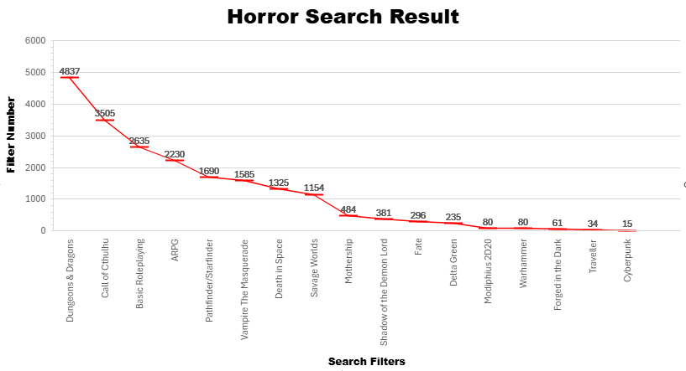
Games steal – TTRPG isn’t immune to this
Players feel emotions when they believe they have something to lose – says Perron.
Death is memorable. – says 17/20 D&D Players
Freudian and Jungian psychology plays a foundational inspiration for monsters – as seen in Resident Evil
Knowledge is…. Fear?
//INTO THE FRAY TO MAKE PLAY WITH FEAR
//WHAT MAKES THEM TICK?
//HORROR TTRPG LANDSCAPE
//LETS RECAP
Horror video games often rely on overused tropes.
Freudian or Jungian archetypes of sex as monsters as seen in Resident Evil countless times, notably in 7 where the mother becomes an insectoid monster with an overgrowth between her legs.
Video games historically steal from different horror medium to manifest horror
They do this because its effective however video games and films have one major difference.
Silent Hill 2 works to invoke the uncanny with the character Maria, who has both large yet thin eyes, off pale skin and mouth which is too wide.
//DEATH IN SPACE
Video Games are interactive.
Even jump scares are prevalent throughout cheap and indie horror titles.

Slide 16
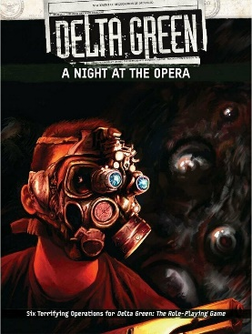
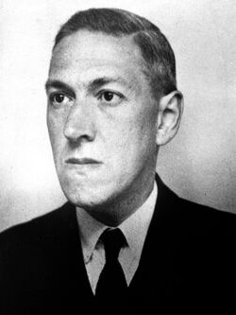
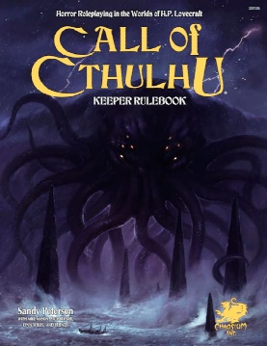
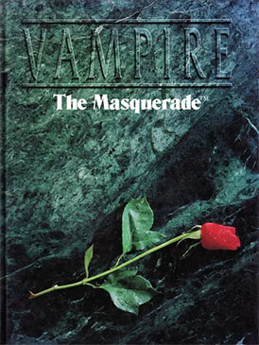
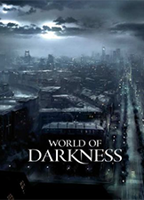

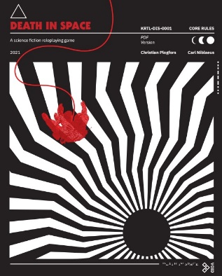
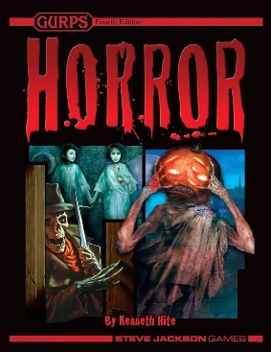
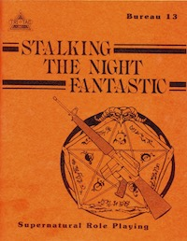
Games steal – TTRPG isn’t immune to this
Players feel emotions when they believe they have something to lose – says Perron.
Death is memorable. – says 17/20 D&D Players
Freudian and Jungian psychology plays a foundational inspiration for monsters – as seen in Resident Evil
Knowledge is…. Fear?
//INTO THE FRAY TO MAKE PLAY WITH FEAR
//WHAT MAKES THEM TICK?
//HORROR TTRPG LANDSCAPE
//LETS RECAP
Horror video games often rely on overused tropes.
Freudian or Jungian archetypes of sex as monsters as seen in Resident Evil countless times, notably in 7 where the mother becomes an insectoid monster with an overgrowth between her legs.
Video games historically steal from different horror medium to manifest horror
They do this because its effective however video games and films have one major difference.
Silent Hill 2 works to invoke the uncanny with the character Maria, who has both large yet thin eyes, off pale skin and mouth which is too wide.
//DEATH IN SPACE
Video Games are interactive.
Even jump scares are prevalent throughout cheap and indie horror titles.

Slide 17
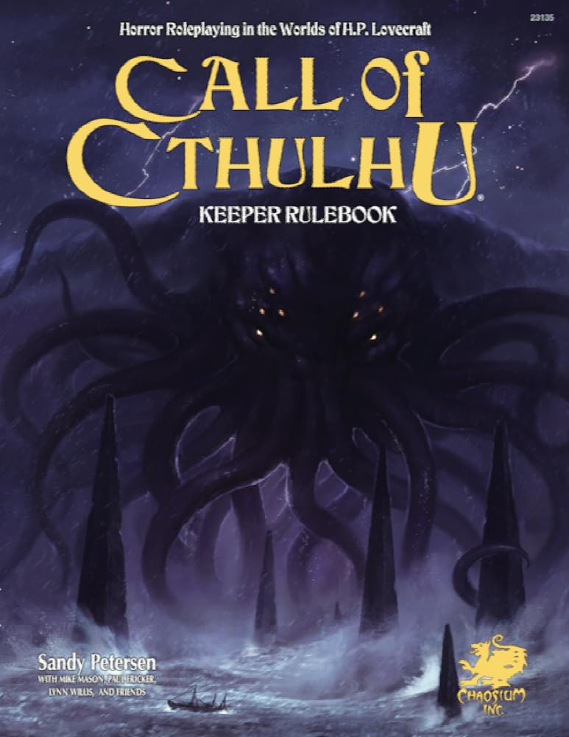
Games steal – TTRPG isn’t immune to this
Players feel emotions when they believe they have something to lose – says Perron.
Death is memorable. – says 17/20 D&D Players
Freudian and Jungian psychology plays a foundational inspiration for monsters – as seen in Resident Evil
Knowledge is…. Fear?
//INTO THE FRAY TO MAKE PLAY WITH FEAR
//WHAT MAKES THEM TICK?
//HORROR TTRPG LANDSCAPE
//LETS RECAP
Freudian or Jungian archetypes of sex as monsters as seen in Resident Evil countless times, notably in 7 where the mother becomes an insectoid monster with an overgrowth between her legs.
Video games historically steal from different horror medium to manifest horror
They do this because its effective however video games and films have one major difference.
Silent Hill 2 works to invoke the uncanny with the character Maria, who has both large yet thin eyes, off pale skin and mouth which is too wide.
//DEATH IN SPACE
Video Games are interactive.
Even jump scares are prevalent throughout cheap and indie horror titles.
What do these all share and why have I highlighted.

Slide 18
Games steal – TTRPG isn’t immune to this
Players feel emotions when they believe they have something to lose – says Perron.
Death is memorable. – says 17/20 D&D Players
Freudian and Jungian psychology plays a foundational inspiration for monsters – as seen in Resident Evil
Knowledge is…. Fear?
//INTO THE FRAY TO MAKE PLAY WITH FEAR
//WHAT MAKES THEM TICK?
//HORROR TTRPG LANDSCAPE
//LETS RECAP
They all share a common theme in design.
Freudian or Jungian archetypes of sex as monsters as seen in Resident Evil countless times, notably in 7 where the mother becomes an insectoid monster with an overgrowth between her legs.
Mechanical Mental Health System
Video games historically steal from different horror medium to manifest horror
Mechanically weak and expendable characters
The Unknown
They do this because its effective however video games and films have one major difference.
Silent Hill 2 works to invoke the uncanny with the character Maria, who has both large yet thin eyes, off pale skin and mouth which is too wide.
Overwhelming or Insurmountable Odds
//DEATH IN SPACE
Video Games are interactive.
Rules Lite or Rapid Play
Even jump scares are prevalent throughout cheap and indie horror titles.
Body Horror and the Grotesque
What do these all share and why have I highlighted.

Slide 19
//HORROR TTRPG LANDSCAPE
Aspect | Game
Mental Health Statistic | Call of Cthulhu (Sanity) Achtung! Cthulhu (Stress) Alien the Roleplaying Game (Stress) Mothership: Sci-Fi Roleplaying Game (Stress)
‘Weak’ Characters | Alien the Roleplaying Game Call of Cthulhu Vampire the Masquerade / World of Darkness
The Unknowable / Confusion | Call of Cthulhu Paranoia
Possibility of death or Insanity | Alien the Roleplaying Game Call of Cthulhu Death in Space Delta Green Mothership: Sci-Fi Roleplaying Game
Overwhelming or Insurmountable odds | Call of Cthulhu Vampire the Masquerade / World of Darkness
Rapid Playstyle | Alien the Roleplaying Game Mothership: Sci-Fi Roleplaying Game Death in Space
Body Horror and the Grotesque | Mothership: Sci-Fi Roleplaying Game, Death in Space Alien the Roleplaying Game
Transmedia Connotations | Bureau 13: Stalking the Night Fantastic GURPS Horror
They all share a common theme in design.
Mechanical Mental Health System
Mechanically weak and expendable characters
The Unknown
Overwhelming or Insurmountable Odds
Rules Lite or Rapid Play
Body Horror and the Grotesque

Slide 20
//HORROR EMOTIONS
Horror is difficult to create without the right tools and atmosphere can be lost in a moment with a joke or vibrating phone.
Horror is at its best when atmosphere and tone take charge – at this point the game system almost becomes redundant with a skilled game master.
However D&D and other none Horror Systems lacks the mechanical systems to fully exploit the players emotions. It’s a hard sell to tell your level 8 warrior badass they should be afraid of CR4 Monster.

Slide 21
//HORROR EMOTIONS
Stress systems, critical injuries and high lethality game systems tell the player how they should feel and as such players will adjust their play style and expectations of the game. (hopefully) and allow themselves to ‘feel’ the horror.
The goal is to immerse the player as much as possible while not taking away too much agency.

Slide 22
//BLEED THEORY
Bleed Theory (Bowman 2015) was researched in the context of LARP however provides insights into how players connect emotionally to their characters and tapping into these methods can help render more immersion.

Slide 23
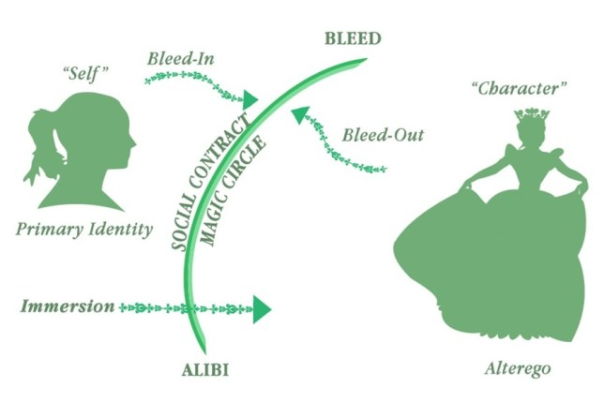
//BLEED THEORY
https://nordiclarp.org/2015/03/02/bleed-the-spillover-between-player-and-character/

Slide 24
//BLEED THEORY
The goal of the GM in this instance is to aim to provide moments of horror and not aim to create one long fearful experience as it just wont be possible with external factors at play.
Proving the players with something to lose (their character, loved one, attachment, plot hook, narrative device) will allow these events of bleed to occur but never guarantees them.
Not everyone scares or cares the same.

