Slide 1


Mentoring: Beyond Talent
Sam Winnall & Dr Paul Mansell

Slide 2
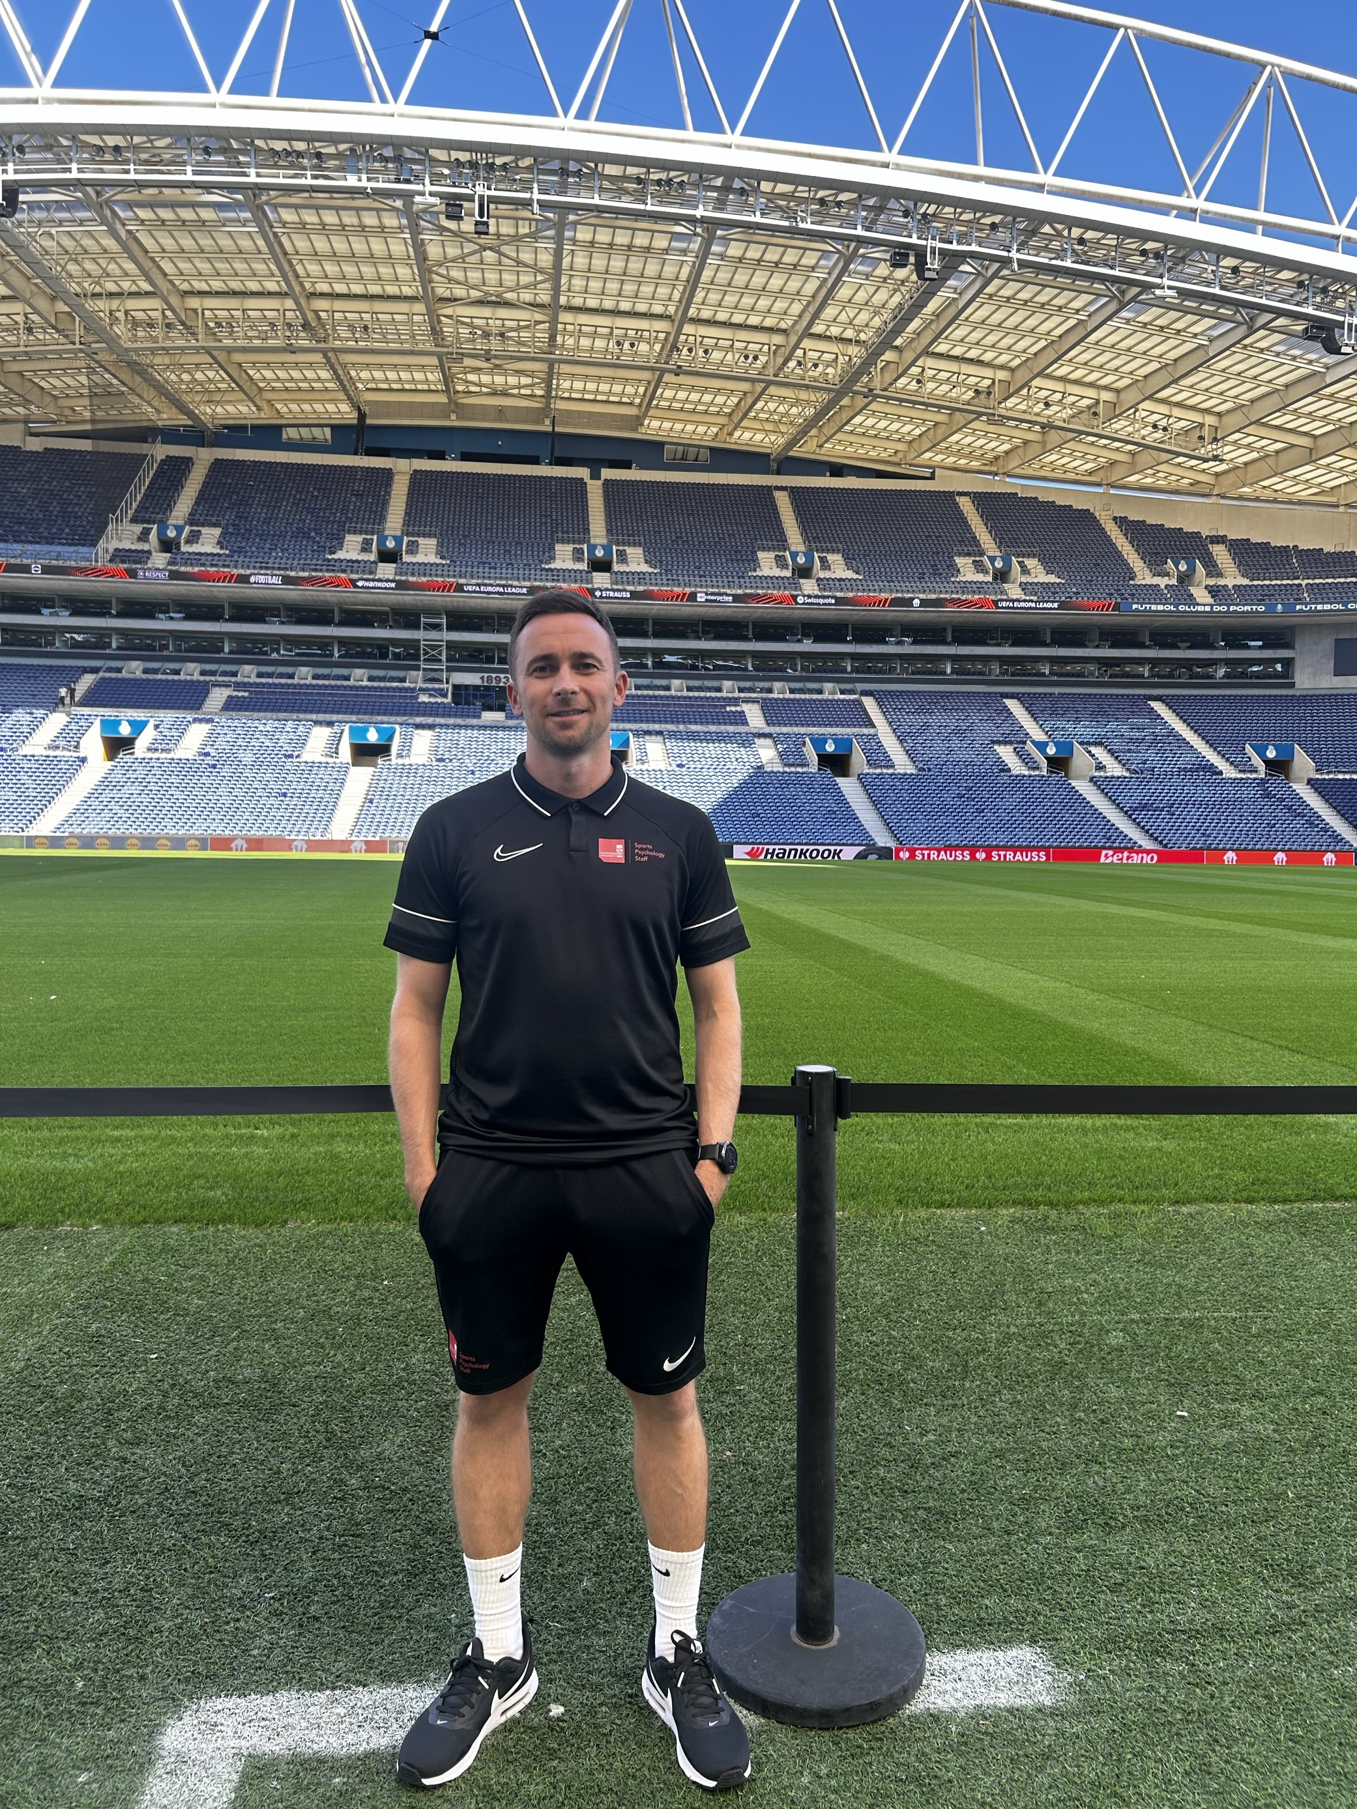
A brief introduction
Dr Paul Mansell
Lecturer in Sport and Exercise Psychology
Host of ‘Performing Under Pressure’ podcast
MSc at Staffs
PhD at University of Birmingham

Slide 3
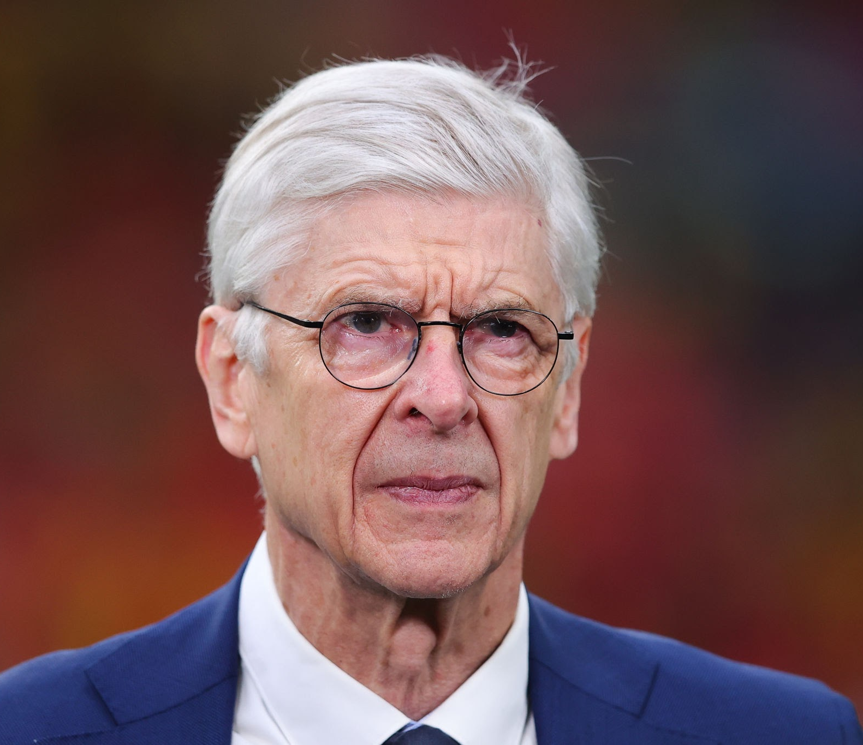
Mentoring: beyond talent
It’s also the final mental hurdle, and that’s where we see the final part, I think, of the development of a player. It is a combination of motivation, stamina and being able to survive disappointment and analysing my own game. That’s where I slowly become an adult. Do I analyse well what’s happening to me? Can I resist disappointments? Can I bounce back from disappointments? I would say on top of this, to all these questions “we” as the football world don’t help players in this phase well enough.
- Arsene Wenger on the transition to senior football and the need for clubs to provide more support on developing the necessary resilience which has been highlighted as a key trend in our consultations
Arsene Wenger
FIFA's Chief of Global Football Development

Slide 4
Mentoring: beyond talent
Our why
Wanted to harness lived experience with sport psychology theory and practice
Where
Premier League Category 1 Academy
How
Collaborative design, reflective practice measures
Interviews with 12 players, 3 staff, mentor focus group

Slide 5
1. Know your mentor, raise awareness of the transition
3. Social support
4. Wellbeing
2. Dealing with uncertainty
5. Performing under pressure
Denotes 1-to-1 session
6. Testing performance under pressure

Slide 6
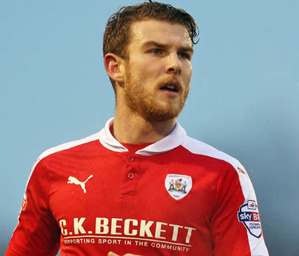
A brief introduction
Sam Winnall
Former professional footballer with over 300 appearances and 100 goals
Trained counsellor
Mentor at Wolverhampton Wanderers
MSc Sport and Exercise Psychology
Keynote speaker

Slide 7
Mentoring: beyond talent
General Positives:
Dealing with stress
Readiness for transition
Togetherness
Proactive coping
Specific Positives:
Trust
Lived experience
Independence
Safe Space

Slide 8
Mentoring: beyond talent
“It helped speaking to my mentor when I wasn’t getting minutes at the start of the season because he had experienced that too. He told me to stay positive and to train well which helped me because I went home and didn’t stress so much. If I hadn’t have had that conversation, I’d have gone home and been more stressed and moody” (Player 10)
“The 1-2-1’s – you know you can bring up whatever you want and its not going to get shared with anyone. Maybe in the academy, if you speak to one member of staff, it then gets passed around, but with my mentor, I could speak about anything” (Player 7)
“There is nobody in the club I feel I could talk to where it would be completely secure, but having my mentor allowed me to fully open up. This is because he is not a club employee” (Player 5)

Slide 9
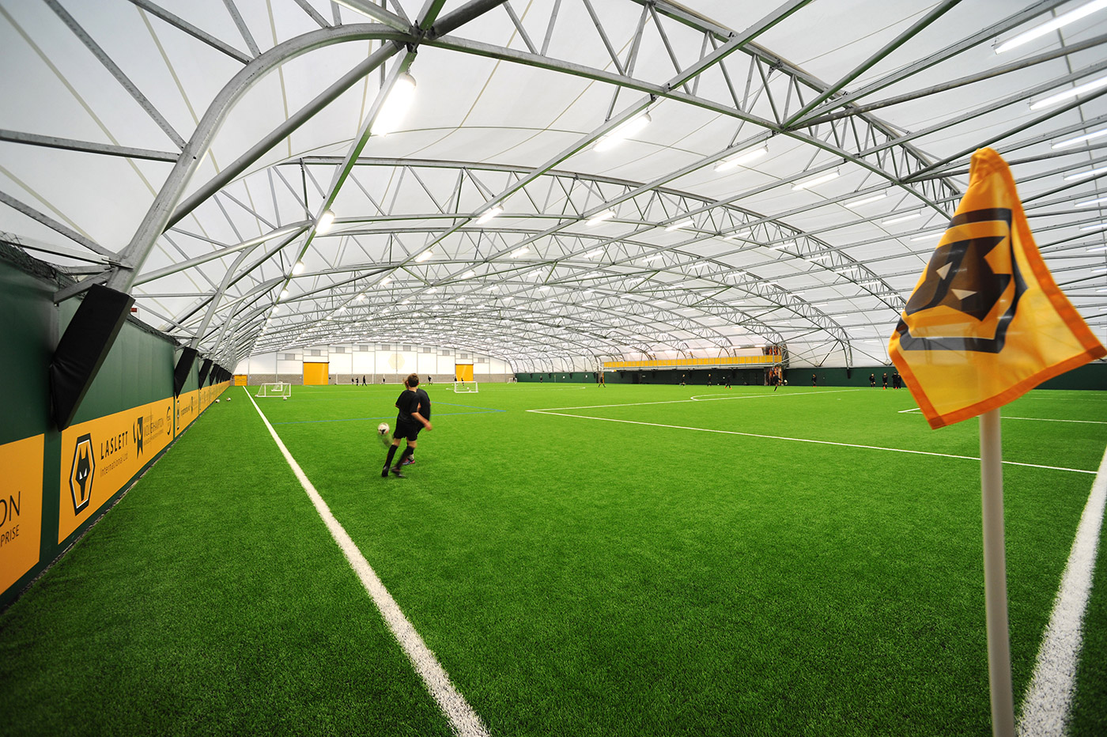
Mentoring: beyond talent
Club Benefits
Enhanced wellbeing
Staff CPD (e.g., learning from mentor experiences)
Having a ‘research arm’ of an academy, being a pioneer (SM3)

Slide 10
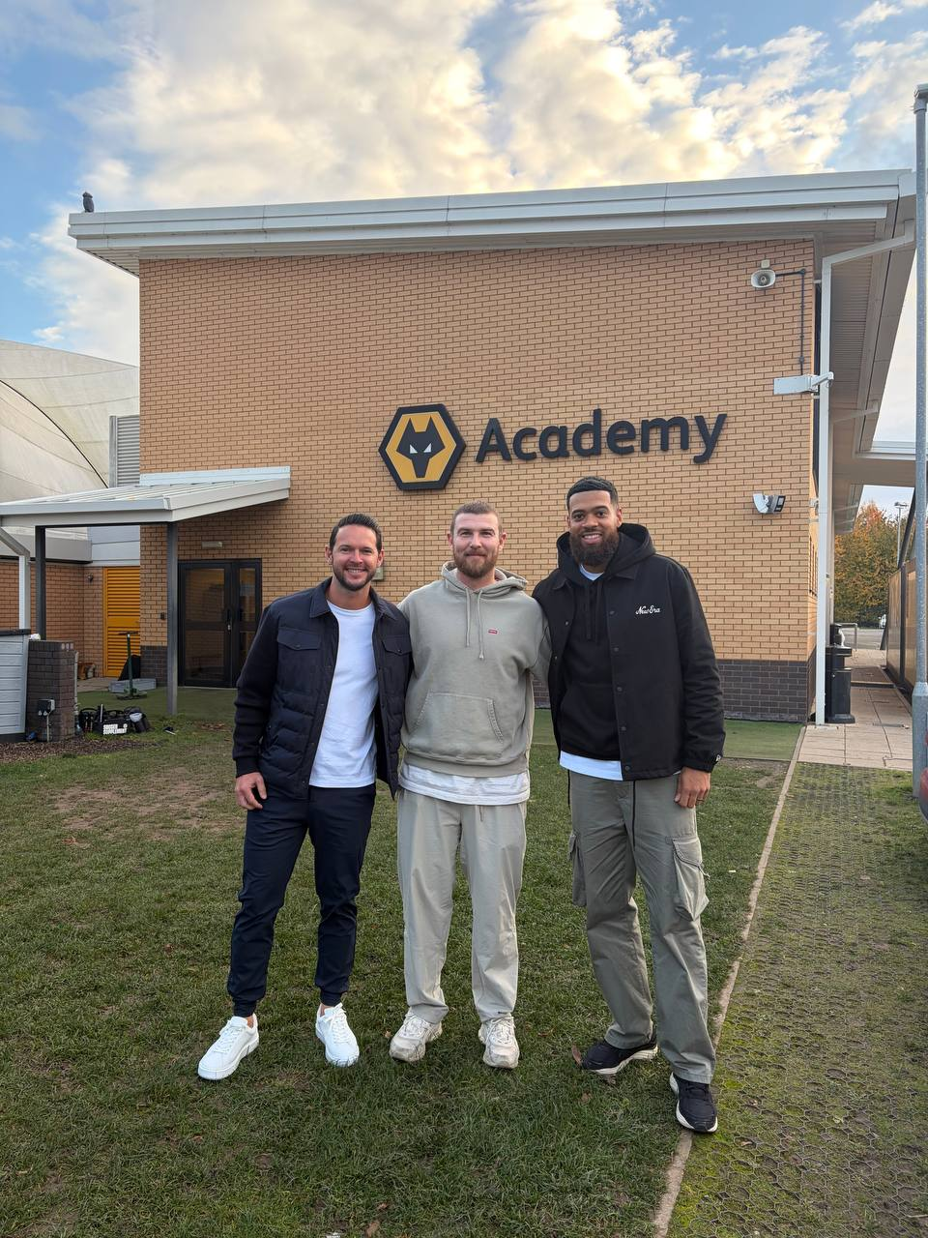
Mentoring: beyond talent
Ex-player (Mentor) Benefits
Vocational
Creation of role
developing skills
Bridging the end of career transition
Purpose
Camaraderie of mentor “team”

Slide 11
Mentoring: beyond talent
Reflections
Logistics (Missed sessions)
Parent involvement

Slide 12
Mentoring: beyond talent
Summary
Evidence for M:BT as an approach to support academy-senior transition
An additional method of support – not a replacement for existing provision
Specific benefits included: trust, independence, lived experience, safe space

