Slide 1
The Playfulness of Drag:
Crossplay in The Philippines and its Role in Reclaiming the Artistry of Drag
Rika Paderes
University of Staffordshire
PhD Researcher
1

Slide 2
Crossplay as a keystone for the Philippine culture of drag to reclaim artistry over a reputation of being a cheap and easy form of comedy.
2
Notes:
First of all for the uninitiated, crossplay is a portmanteau of cosplay and cross-dressing, to mean when someone is cosplaying as someone who has a gender that is not their own. And what we are looking at is crossplay as a keystone for phillipino drag culture to recover its lost artistry from being typecasted as an easy form of comedy, where roleplay creates new context for crossdressing. There is some context I need to prime you with first.

Slide 3
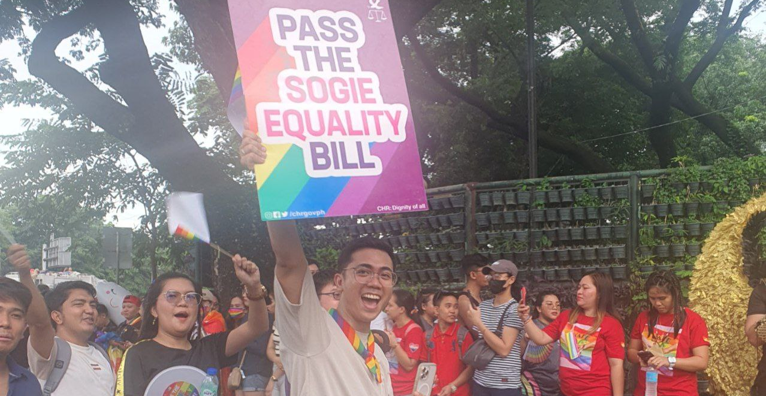
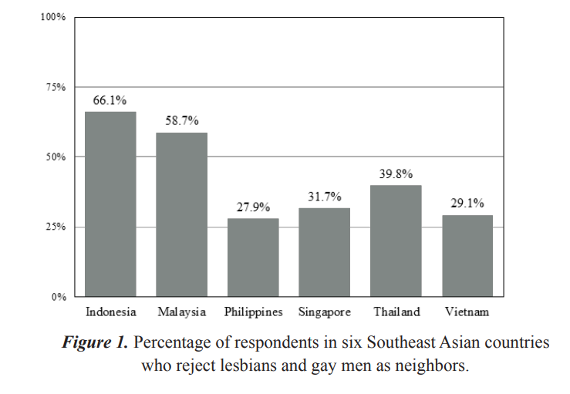
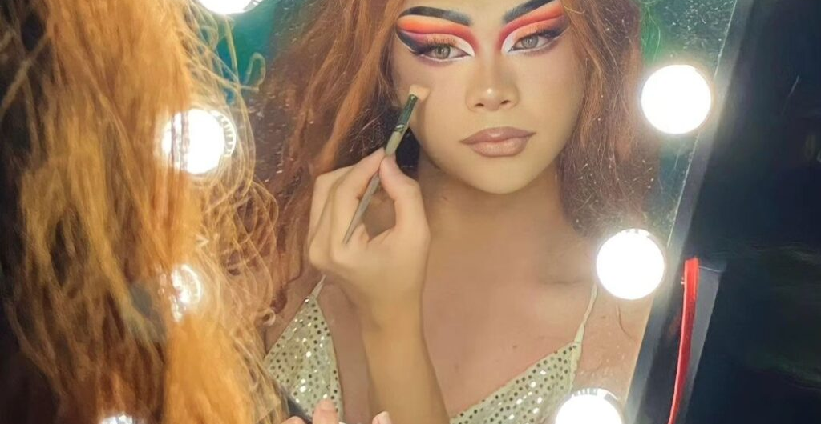
The Philippines and Drag
Rappler (2023). Pride March in Quezon Memorial Circle.
CDN (2024). Ponce does her own makeup.
Manalastas, E.J. et al. (2017). ‘Homonegativity in Southeast Asia: Attitudes toward Lesbians and gay men in Indonesia, Malaysia, the Philippines, Singapore, Thailand, and Vietnam’, Asia-Pacific Social Science Review, 17(1), pp. 25–33. doi:10.59588/2350-8329.1120.
3
Notes:
Now, the Philippines has a complex relationship with queerness and gender. 80% of the country is roman catholic

Slide 4
Manalastas, E.J. et al. (2017). ‘Homonegativity in Southeast Asia: Attitudes toward Lesbians and gay men in Indonesia, Malaysia, the Philippines, Singapore, Thailand, and Vietnam’, Asia-Pacific Social Science Review, 17(1), pp. 25–33. doi:10.59588/2350-8329.1120.
4
Notes:
but apparently Philippines is the least rejective country in Southeast Asia of having queer neighbours, the most rejective being Indonesia at 66% of respondents having homonegative sentiment towards gay neighbours, but Philippines with a much lower 28%. When one would think that the two ideologies would clash, Philippinos apparently take loving thy neighbour more seriously than others.

Slide 5
*SOGIE: Sexual orientation, gender identity, and expression
Rappler (2023). Pride March in Quezon Memorial Circle.
5
Notes:
To say that the Philippines is “progressive”, however, is not quite right either. Perhaps in relation to other southeast Asian countries, but I think a more accurate term would be tolerant, rather than progressive.
To exemplify the complication further, There is still no law that protects diverse gender identities from discrimination. Bills that would protect their identities are tactically stalled. (Amnesty Philippines, 2023). Yet, one-hundred-and-ten-thousand members of the queer community and supporters showed up at Quezon City’s Pride Festival in 2023 to constitute the largest LGBTQ+ gathering in all of Southeast Asia (De Guzman, 2023).

Slide 6
CDN (2024). Ponce does her own makeup.
6
Notes:
The Philippines is a country of contradiction in this regard. It makes a country that is tolerant, rather than accepting. And it leaves the culture of Filipino drag artistry in a unique position. Drag culture in the Philippines, though quite enjoyed in the mainstream, is argued for its place in artistry due to its roots in grotesque comedic parody.

Slide 7
“Drag queens are often belittled because other people think of them as men in dresses, but there’s more to that […] It’s an art form.”
The GUIDON. (2017) Everyday Queens.
7
Notes:
It leaves participants feeling like a joke that has its performers feeling belittled and Not taken seriously as an artform.

Slide 8
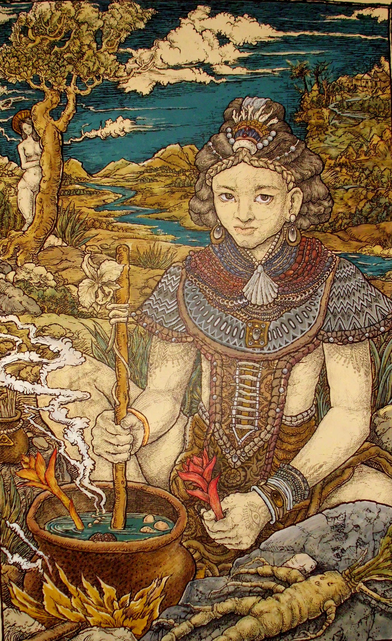
Pre-colonial Gender
Babaylan
Babaylans are “ritual specialists”, spiritual leaders and healers. Typically of the female sex, due to the close regard of spiritualism to femininity.
Asog (Visaya) / Bayog (Tagalog)
Babaylan that were born male, but choose to take on feminine traits
gromyko. (2013). Alchemy of a Babaylan. [Digital].
8
Notes:
This complicated relationship with queerness, I believe, comes from Filipinos engaging in gender fluidity long before colonising Spaniards came in the 1500s. Babaylan, who were our precolonial spiritual leaders and cultural custodians, were mostly of the female sex, since femininity is understood to be a large part of babaylan practice. However, the role was also available to men who served the role of Babaylan by choosing to take on feminine identities and mannerisms - these would be referred to as Asog or Bayog.
As you can assume, the roman catholic Spaniards were not happy about this. Subsequently, Babaylans were hunted down, tortured, or in the case of the Asog, forced to cut their long feminine hair, and so saw the introduction of binary gender roles, and the degradation of women’s status in Philippines.

Slide 9
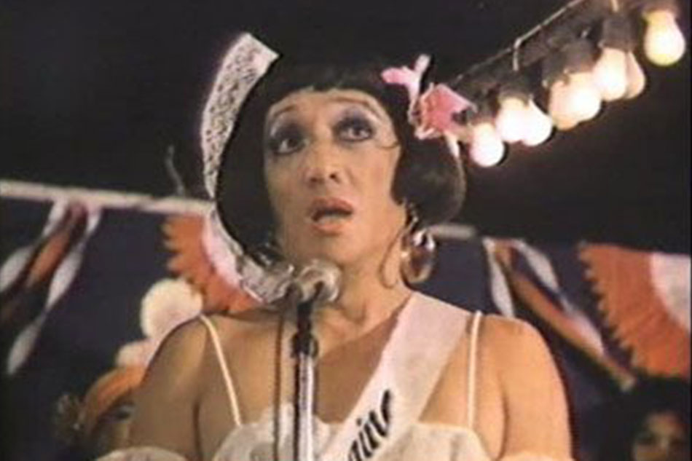
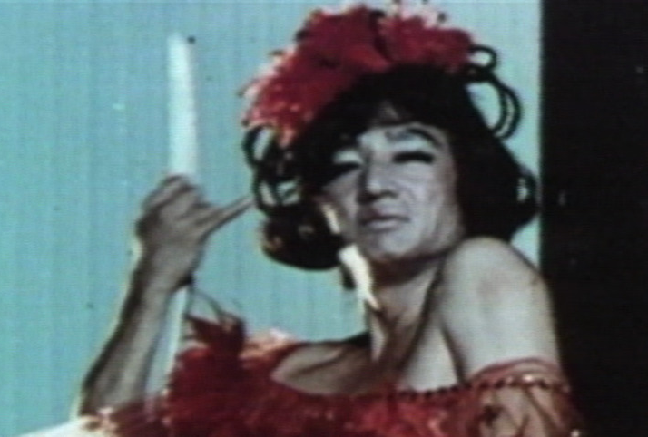
Drag as Comedy
Ang Nanay Kong Tatay (1978).
Facifica Falayfay (1969).
9
Notes:
Where comedy complicates things even more is the root of comedy and drag being used as a form of subtle resistance in the face of Japanese occupation of 1942 through early vaudeville, or to Filipinos, Bodabil.
Dolphy, the Filipino King of Comedy, saw success in his roles as crossdressing men in his iconic comedies.
On one hand his success of gender parody allowed queer identities to be exposed to the masses of the Philippines through mainstream media. The comedy it was laced with added a palatability to the topics – though perhaps the palatability of its comedic dressing is what condemned drag to be perceived as a cheap form of comedy entertainment.

Slide 10
Crossplay as Roleplay
Shared foundations
Actor and Spectator roles
About taking on a character in performative transformation, taking on different identities and mannerisms and different physical appearances
(Participants can sometimes act as both performance and audience members)
Embodiment
Participants transform their appearances and mannerisms to inhabit and embody a character
Occurrences of character bleed
Feelings and thoughts between cosplayer and character influence each other
Playful space
Set in special, context-based settings that let people explore freely
Hoover, et al. (2018). ‘Performance Studies and Role-Playing Games’
10
Notes:
Now there are are some points here that I’ve developed further after the submission process. Starting with with refining and consolidating where crossplay comes in, and why I believe crossplay can be seen as a roleplay activity.

Slide 11
Crossplay as Roleplay
Crossplayers are performing identities that are different from their own.
Crossplay is not necessarily about parodying gender, or grotesque caricatures. Rather, in cosplay there is stronger focus on interpreting and representing a beloved character (Loke, 2016).
Similar to roleplay as a function, crossplay gives room for a participant to “feel and identify with avatar made real through cosplay” (Lamerichs, 2017).
There is an experienced safety or “magic circle” to crossplaying where normal rules are suspended.
It allows for the exploration of taboo or difficult subjects to be explored.
Crossplayers can assert creative agency over gender play without the stigma of cheap comedic branding.
11
Notes:
So…
At its most basic form, crossplayers are performing identities that are different from their own.
They immerse themselves in interpreting and embodying their chosen character.
(3) Also, its inherent place in fan culture makes it so there is stronger focus on the interpretation of the character itself, rather than caricature and parody.
(4) For some who engage in crossplay, which we will look at next, there are accounts of experiences with the magic circle in some regard,
(5) where participants feel like they can explore taboo or difficult subjects with crossplay as a vehicle.
(6) This all, I assume, is beginning to sound very familiar to us, and here, the intersection between crossplay and roleplay makes it so the gender bending play is about asserting creative agency despite gender boundary, rather than to purposefully parody it.

Slide 12
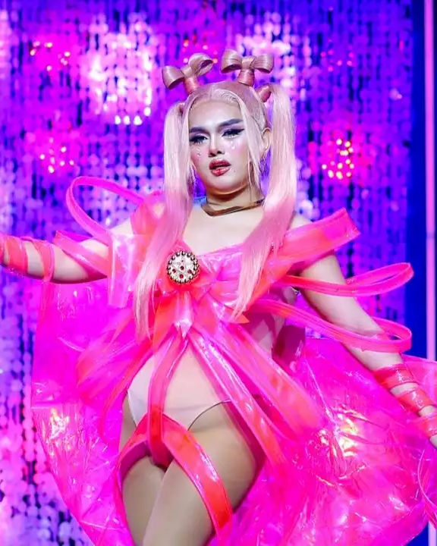
Artistry in Action
“My comeback look is actually a full circle moment for me, because it represents the first time I ever did drag. My first time in drag (no surprise here) was actually cosplay when I was 12. I dressed up as Freya from Chobits at a school event, and I never felt more beautiful. Fun fact, I actually won Best Dressed and Most Creative that day, and that moment really changed my life, paving the way for the J-Quinn you see today.
Which is why my drag has a lot of callbacks to that very moment. It’s always been for the young queer kids, much like myself, who first lived their female fantasies through cosplay.”
J Quinn, 2024.
12
Notes:
In the case of cosplay, the artistry and creativity of its participation becomes undeniable. Cosplay encompasses so many aspects of artistry, where the performer takes such care to export a fictional character into a physical form through careful roleplay rituals. They come to being through the creative interpretation of the character, the planning and logistics, the crafting of the cosplay itself, and of course the performance and execution of the roleplay (Lamerichs 2017).
Interestingly, drag and cosplay come hand-in-hand for some Filipino drag performers. For Filipino drag queen J Quinn, third season contestant of Drag Race Philippines (2024), it was a meaningful gateway into drag.

Slide 13
Artistry in Action
“My comeback look is actually a full circle moment for me, because it represents the first time I ever did drag. My first time in drag (no surprise here) was actually cosplay when I was 12. I dressed up as Freya from Chobits at a school event, and I never felt more beautiful. Fun fact, I actually won Best Dressed and Most Creative that day, and that moment really changed my life, paving the way for the J-Quinn you see today.
Which is why my drag has a lot of callbacks to that very moment. It’s always been for the young queer kids, much like myself, who first lived their female fantasies through cosplay.”
J Quinn, 2024.
13
Notes:
crossplay was a way for them to access their “female fantasy” and was gladly even celebrated for it at their school event. We go back to seeing parallels between crossplay and roleplay, where crossplay seems to have a magic circle quality. We see here the allowance that cosplay spaces provide, that layer of protection from the artistry of cosplay. It was perhaps the act of being allowed to call the moment of crossdressing, ‘cosplay’, that gave J Quinn the security from tabooness.

Slide 14
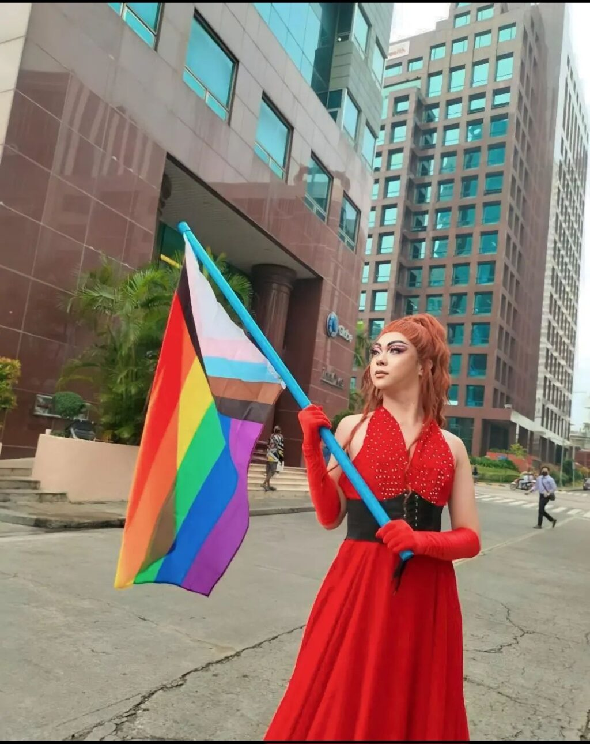
Artistry in Action
“I always tell [my family] that I have a show or whatever, but they didn’t know that it was drag, I mostly do promotions through my Instagram, so they can’t see it. But I posted [about the watch party] on my Facebook, and they were supportive by sharing my drag photos to their wall and stories. Then, they decided to go. […]
In cosplay, you embody the character you want to be. But in drag, you are creating your own persona, your own character to show to people.”
Vi Ponce, 2024.
14
Notes:
For drag queen Vi Ponce, who integrates cosplay into her drag, cosplay first served as a cover story from her family, eventually going on to perform in front of them. She says, in her own way, how cosplay and drag has intersected for her to be a form of showing off “your own character”, an echo of J Quinn using their crossplay as a safe way of expressing themselves

Slide 15
Implications
Changes to the seriousness of which drag performances are taken outside of queer spaces
Increasing popularity of crossplay increase exposure and therefore normalisation
Empowerment for marginalised identities to explore themselves
15
Notes:
As far as implications go in seeing drag as a roleplay art, it starts with the changes to how the Philippines sees cross gendered roleplaying. Less as only men wearing dresses, performing comedic acts, and more as performance art. While the Philippines is also seeing large success in anime conventions, and subsequently, crossplay, the increase in exposure may very well lead to normalisation of gender-boundary-breaking play. And perhaps, through reframing crosplay as a roleplay performance, we give legitimisation to embodied exploration through crossplaying, where marginalised identities can play with their identity in a safe environment.

Slide 16
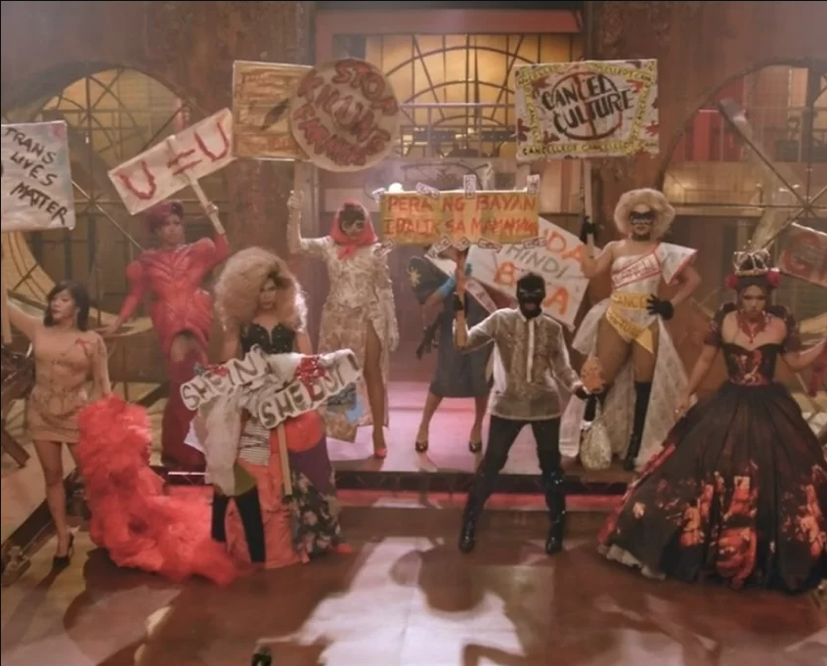
16
Notes:
For crossplayers, it’s about expressing appreciation for their favourite character. Or sometimes it is about getting to explore a taboo part of themselves within the comfort of performance art’s magic circle. Maybe, it is about being a vehicle for creating and channelling a persona.
This intersection, where roleplay function meets crossdressing, creates an explosion of creative and artistic meaning. Crossplay embodies a space where participants know they are pretending, but can act, feel, and express as if it were real in the momentary safe circle of performance. Crossdressing, through this intersection, is elevated from parody, to a performance of role-playing.

Slide 17
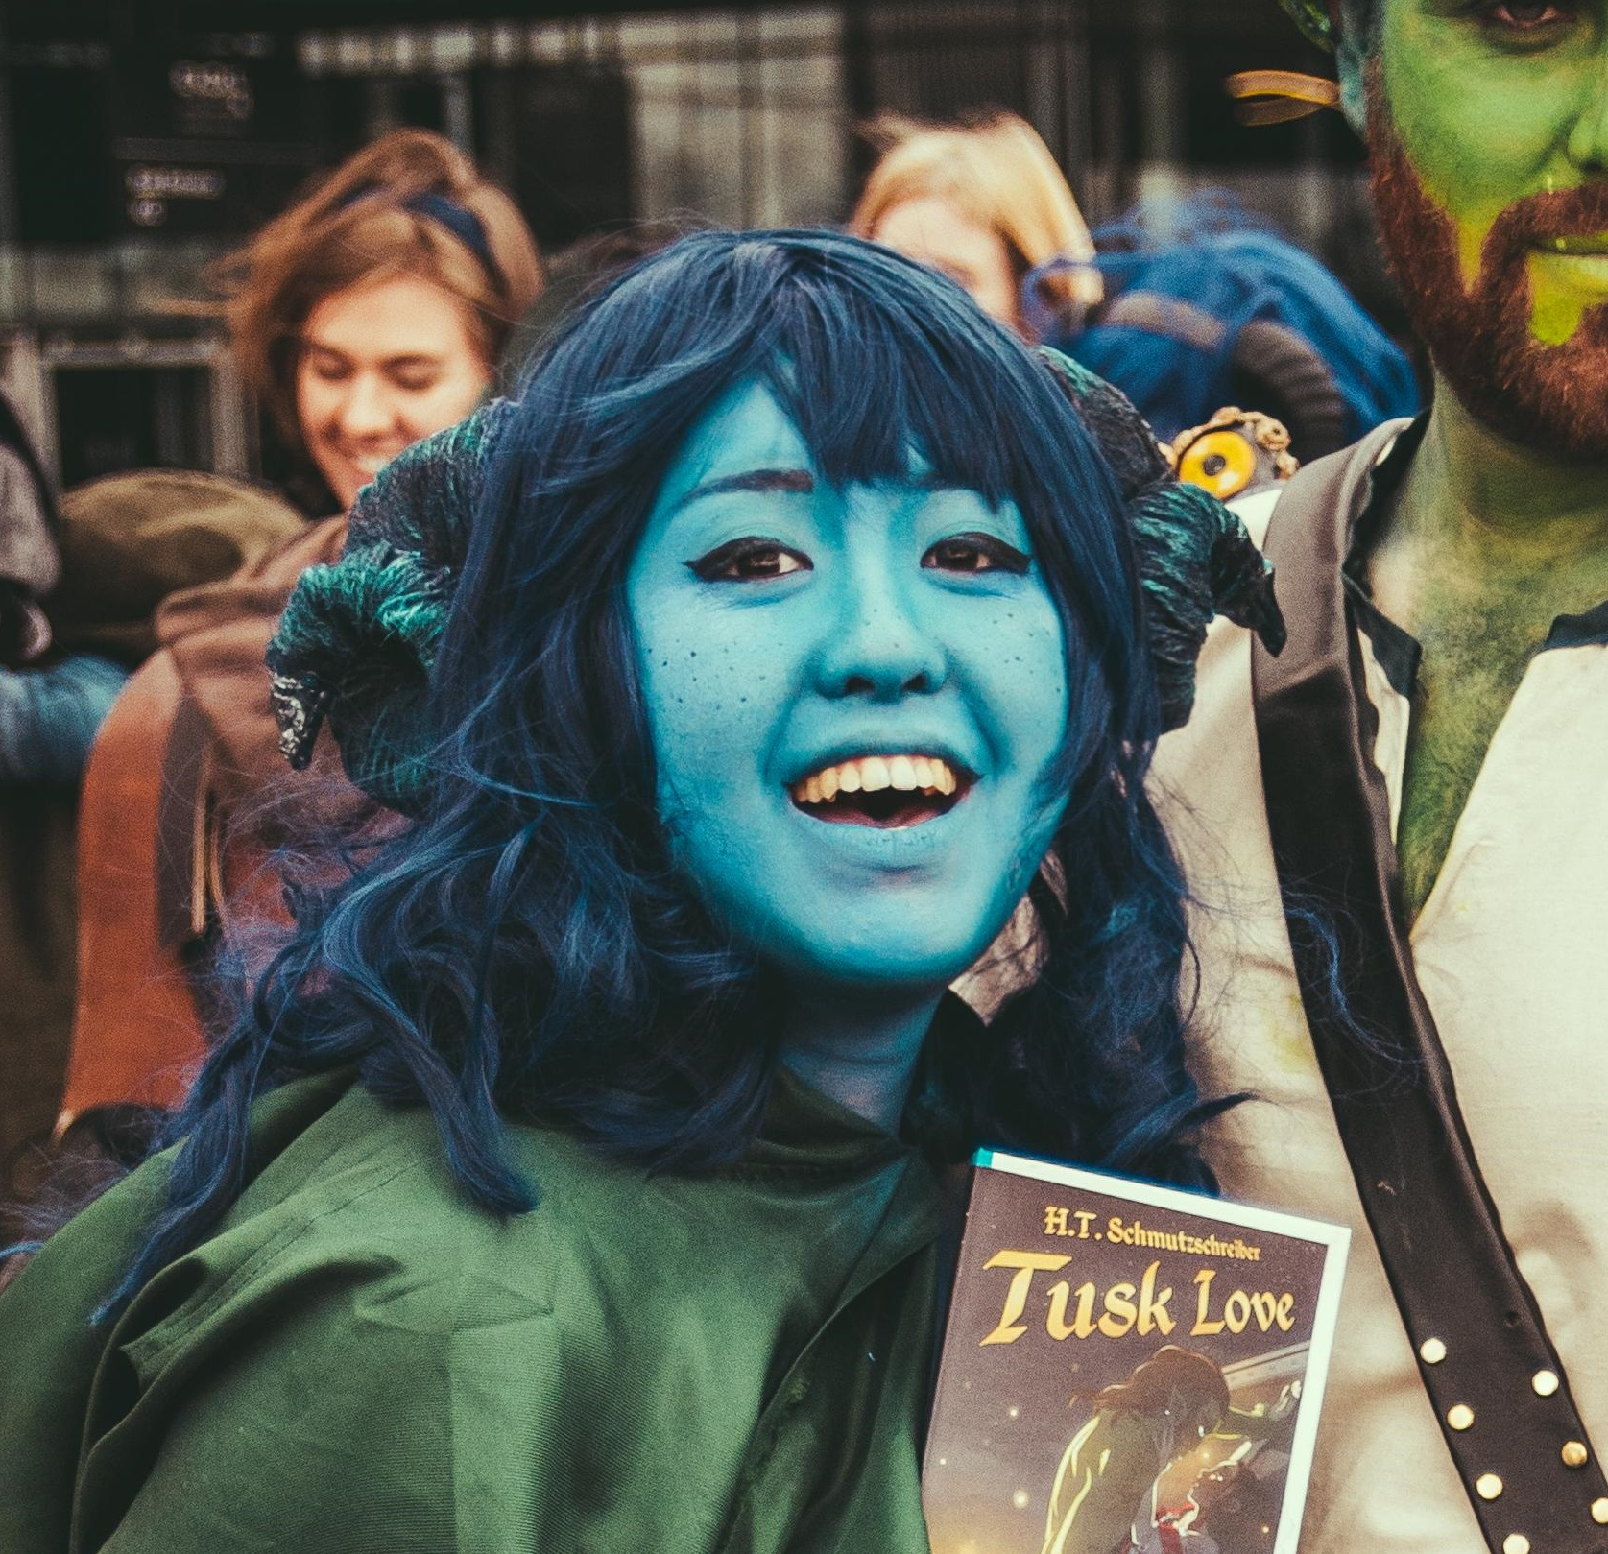


Thank you!

Slide 18
Hidden Slides
Defining Terms
On Babaylan and colonisation
Crossplay as a taboo act
The Guidon, Everyday Queens
Extra content on crossplay

Slide 19
Crossplay as Roleplay
Are “restored” or “twice behaved”. They’re repeated actions, are practiced, and prepared for.
Intended to affect observers, where there are roles of “performer” and “observer”. (Sometimes it is the same person)
Involves behaviours that are “exaggerated, emphasised, formalised, or patterned”.
Has a special quality where one can pretend and observe multiple meanings and emotionally react as if it’s real
Are “made special” in the sense that they ideally stand out from everyday life.
Hoover, et al. (2018). ‘Performance Studies and Role-Playing Games’
11
Notes:
Theare are some points I’ve developed further after the submission process, so bare with me. Let’s look at where crossplay comes in. Well, it can be recontextualised with roleplay studies, starting with why I believe crossplay can be seen as a roleplay activity. The

Slide 20
Defining terms
Drag:
Performance art that exaggerates or challenges typical gender expression, usually through parodying femininity in a hyperbolic way.
Cosplay:
“Fans [constructing] and [wearing] costumes that allow them to re-enact existing fictional characters from popular culture” (Lamerichs, 2017)
Crossplay:
“Similar to cosplay, with the exception of participants [dressing] up as characters that are of their opposite gender” (Loke, 2016)
Notes:
Before we get into it, let me define some key terms.
Drag is about performing gender in some sort of performance – often through exaggerating and parodying it.
Cosplay is a A portmanteau of “costume” and “play”. character performance where participants of the activity dress as a character from a piece of media, and it usually means acting out that character’s mannerisms during photoshoots or interactions with other cosplayers, and other such fan-based activities.
Crossplay is where these two intersect – it’s another portmanteau of “crossdressing” and “cosplay”. These are cosplayers who cosplay as characters that are a different gender from themselves.
Naturally, what’s happening here is roleplay, where we see the crossplayers treat their characters and genders as roles that they assume. Where for many roleplayers it’s about an active and imaginative processes of exploring different ways to express yourself, drag performers and cosplayers alike creatively interpret different roles with just as much investment.

Slide 21
“At a time when Europe was witnessing hundreds of thousands of women—especially those from lower classes—being tortured, hanged, and burned on charges of witchcraft and sorcery, the Spanish colonizers likewise renamed the Native women ritual specialists they encountered according to images with which they were already familiar: as hechicera (witch, sorceress, old hag), diablesa (she-devil), sacerdotisa del infierno (priestess of hell), and bruja (witch, old hag).”
Babaylan Sing Back
Nono, 2021
gromyko. (2013). Alchemy of a Babaylan. [Digital].

Slide 22
“Non-participants might even detest the act of cross-dressing by Crossplayers as well as their embodiment of feminine or masculine features, which are against the traditional gender male-masculine and female-feminine binary.”
To be or not to be the queerest of them all: Investigating the Freedom of Gender Performativity within the Queer Space of Cosplay/Cross play
Elween Loke, 2016

Slide 23
Everyday Queens, The Guidon
“Drag queens are often belittled because other people think of them as men in dresses, but there’s more to that,” says interdisciplinary studies senior Kippie Paurom, who is also a member of Dollhouse. “It’s an art form.”
Certainly, this view is gaining traction in the West, aided by shows like RuPaul’s Drag Race. But the prevalent attitude towards drag in the Philippines seems to have not changed much over the years.
“Drag here in the Philippines is seen as cheap, loud, and not a respectable job,” says information design sophomore and Dollhouse member Noah Escarda. “It’s divided mostly into two categories: beauty and comedy.” Escarda describes how the Filipino media miscommunicates the art of drag, perpetuating incorrect notions and pedalling the image of a crass drag queen telling jokes.
Dollhouse Sex Gen (Secretary General) Josie Go, an interdisciplinary studies senior, remarks that “these kinds of portrayals of drag make it difficult for the Philippine audience to view drag in a light that is separate from simply a comedy show.”
Cadenas, S. and Arcenas, K. (2017) Everyday queens, The GUIDON. Available at: https://theguidon.com/2017/10/everyday-queens/ (Accessed: 02 April 2025).
Notes:
The Guidon is the official student publication of the Ateneo de Manila university, founded in 1929
Cadenas, S. and Arcenas, K. (2017) Everyday queens, The GUIDON. Available at: https://theguidon.com/2017/10/everyday-queens/ (Accessed: 02 April 2025).

Slide 24
Roleplay, cosplay, crossplay
“Through re-enactment, cosplay can provide players with the joys of make believe through the creation of outfits and the freedom to perform in them.” (Lamerichs, 2017)
“Fandoms are characterized by their creativity, [and] online and offline sociality […] The creativity of fans can be read as a type of appropriation that borrows and repurposes existing cultural materials to produce something new.” (Lamerichs, 2017).
“The main reason cosplayers participate in M2F crossplaying is largely apolitical and purely related to an expression of their fan devotion” (Leng, 2013)
“The appeal of M2F crossplay for many cosplayers is also directly linked to the notion of dressing up as a process that combines a sense of fan identity and playfulness with the wearing of an outfit.” (Leng, 2013)
“The decision to Crossplay is mostly based on Crossplayers’ attraction to the characters as well as their wish to fulfil their aspiration by earning respect from the audience. Comparatively, sex of the characters is found to be less significant.” (Loke, 2016).
Notes:
These quotes here establish some really unique qualities of crossplay

