Slide 1
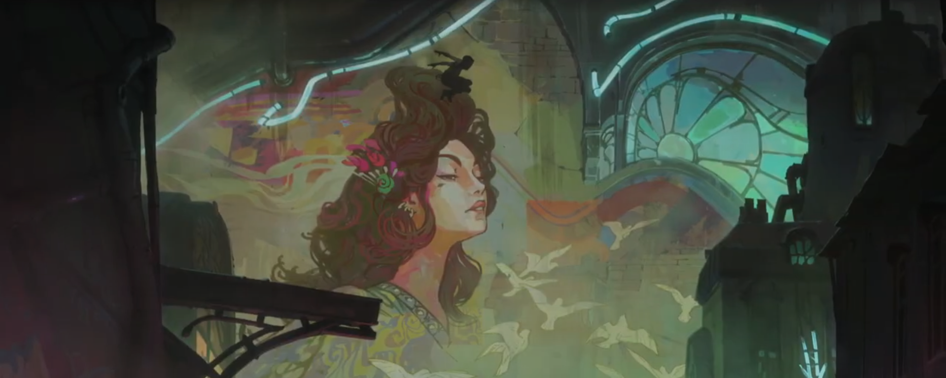
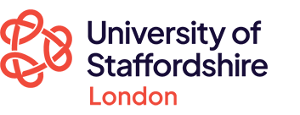
Styling Hextech and Shimmer:
The Function of Art Nouveau and Art Deco in Arcane
Rika Paderes, PhD Researcher
Chris Harding, Lecturer
Notes:
Hi, good afternoon, welcome to our presentation for our paper – Styling Hextech and Shimmer: The Function of Art Nouveau and Art Deco in Arcane. We’ve a lot to get through, so let’s get straight to it.

Slide 2
Key Points
Arcane uses art history as ideological narrative
Visuals code class, power, conflict, and resistance
Counterculture aesthetics visually disrupt the binary
There is a clear visual divide that informs the viewers of the surface level conflict. Art Nouveau is used to visually code Zaun, whereas Art Deco is used to visually code Piltover.
By choosing the art movements they did, Riot Games/Fortiche visually coded the ideologies of the cities with rich symbols and contexts
Design has been used to create visual alliances, conflicts, but also a literal visual disruption of the design and narrative status quo through counterculture
Notes:
Point 1: Our presentation is going to explore how Arcane uses historical Art Movements – specifically Art Nouveau and Art Deco – not just for artistic flair, but also to encode their settings in deep ideological meaning. Zaun visually aligns with art nouveau, reflecting the organic, and the chaotic. Piltover adopts the sleek visuals of Art deco, reflecting control and wealth
Point 2: These visual oppositions frame the show’s social conflict, and it’s done in a really compelling way through the semiotics of these art movements
However, that’s where my knowledge ends, and chris’ begins:
Point 3:

Slide 3
Defining Key Terms
Semiotics
Compositional Interpretation
Visual Ideology
Art Nouveau
Art Deco
Punk
The study of signs and meaning (signifier/signified). The signifier is the visible objective, and the signified is the idea that it represents.
A method developed by Gillian Rose (2016) to analyse an image for its objective contents.
How Arcane uses of visual style to naturalise social and political structures.
A style of art defined by flowing lines, and the beauty in natural, organic form.
A style of art defined by symmetrical geometry, industrial technique, and metalwork.
A cultural response to social unease, repression, and disillusionment of the current political climate.
Notes:
There are some key terms that we need to keep in mind. Semiotics is the study of signs and meanings, or signifiers/the signified. The signifier is what we see, and the signified is what it represents.
Compositional interpretation is a method of analysing an image for its objective contents.
Visual ideology in this paper is how Arcane uses visual style to naturalise social and political structures.
Art Nouveau is a style of art defined by flowing lines, and the beauty in natural forms.
Art Deco is art defined by symmetrical geometry, industrial technique, and metalwork.
Punk is the cultural response to social unease, repression, and disillusionment of the current political climate.

Slide 4
Method
Understanding what is seen and what is meant
Semiotic analysis of visual sign
Compositional Interpretation
Notes:
The methods we’ll adopt are semiotic readings and compositional interpretation, both taken from Gillian Rose’s methodological frameworks. Compositional interpretation is to look at a piece of work objectively for its visuals, and we will use this method to analyse the image for its objective contents. After that, we will look at the semiotic reading of it – or how the objective contents create symbols and meanings.

Slide 5
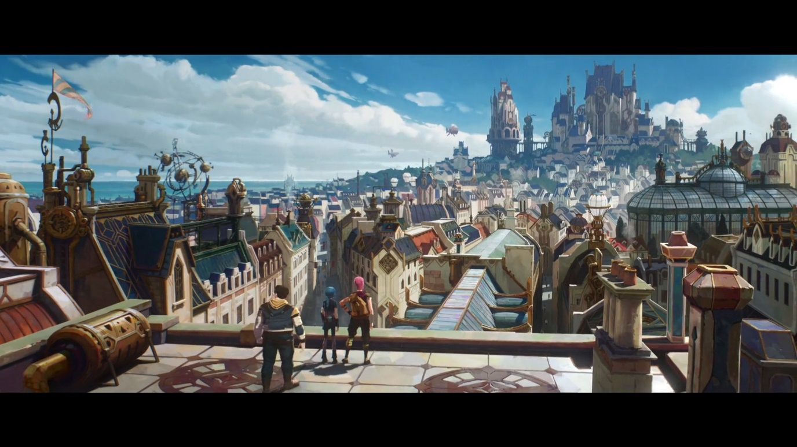
Visual Design & aRCANE:
Zaun and Piltover as visual opposites
“Imagine a place where it’s hard to tell what is magic and what is technology. [...] Here are two cities intertwined in a double helix of creation and annihilation, inextricably at odds but also interdependent and not all that different from each other. Above is the resplendent, inventive Piltover, looking ever skyward in its dedication to science and progress. Below is the scrappy, rebellious Zaun, finding inspiration and community in its outsider status.” (Vincentelli, 2024)
Notes:
Contrasts are the name of Arcane’s visuals, following the story of two sisters and two sister cities. One that is literally built atop the other.
To put things simply, the one above, Piltover, is defined by its wealth-driven “science and progress”. It’s politics are controlled by scholars, the elite, and investors.
The one below, Zaun, is “scrappy and rebellious”. It’s controlled by whoever is the strongest at the time. Or whichever crime lords have the means to enact control. class conflict at the heart of its narrative
The pilot episode shows 4 kids of zaun literally climbing upwards from their “undercity”. The scene reveals buildings gilded in geometric designs of metallic flare; inventive, angular, and very decorative
The art book, the art and making of arcane, outlines how much importance the visual design was to the production and storytelling – so it’s just as important that we look at it closely
Visual coding is embedded in the very foundations of its storytelling, so let’s look briefly at where Deco and Nouveau align with the cities visually

Slide 6
Visual Design & aRCANE:
Zaun and Piltover as visual opposites
“Imagine a place where it’s hard to tell what is magic and what is technology. [...] Here are two cities intertwined in a double helix of creation and annihilation, inextricably at odds but also interdependent and not all that different from each other. Above is the resplendent, inventive Piltover, looking ever skyward in its dedication to science and progress. Below is the scrappy, rebellious Zaun, finding inspiration and community in its outsider status.” (Vincentelli, 2024)
Notes:
Contrasts are the name of Arcane’s visuals, following the story of two sisters and two sister cities. One that is built atop the other.
To put things simply, the one above, Piltover, is defined by its wealth-driven “science and progress”. It’s politics are controlled by scholars, the elite, and investors.
The one below, Zaun, is “scrappy and rebellious”. It’s controlled by whoever is the strongest at the time. Or whichever crime lords have the means to enact control. class conflict at the heart of its narrative
The pilot episode shows 4 kids of zaun literally climbing upwards from their “undercity”. The scene reveals buildings gilded in geometric designs of metallic flare; inventive, angular, and very decorative
The art book, the art and making of arcane, outlines how much importance the visual design was to the production and storytelling – so it’s just as important that we look at it closely
Visual coding is embedded in the very foundations of its storytelling, so let’s look briefly at where Deco and Nouveau align with the cities visually

Slide 7
Visual Design & aRCANE:
Zaun and Piltover as visual opposites
“Imagine a place where it’s hard to tell what is magic and what is technology. [...] Here are two cities intertwined in a double helix of creation and annihilation, inextricably at odds but also interdependent and not all that different from each other. Above is the resplendent, inventive Piltover, looking ever skyward in its dedication to science and progress. Below is the scrappy, rebellious Zaun, finding inspiration and community in its outsider status.” (Vincentelli, 2024)
Notes:
Contrasts are the name of Arcane’s visuals, following the story of two sisters and two sister cities. One that is built atop the other.
To put things simply, the one above, Piltover, is defined by its wealth-driven “science and progress”. It’s politics are controlled by scholars, the elite, and investors.
The one below, Zaun, is “scrappy and rebellious”. It’s controlled by whoever is the strongest at the time. Or whichever crime lords have the means to enact control. class conflict at the heart of its narrative
The pilot episode shows 4 kids of zaun literally climbing upwards from their “undercity”. The scene reveals buildings gilded in geometric designs of metallic flare; inventive, angular, and very decorative
The art book, the art and making of arcane, outlines how much importance the visual design was to the production and storytelling – so it’s just as important that we look at it closely
Visual coding is embedded in the very foundations of its storytelling, so let’s look briefly at where Deco and Nouveau align with the cities visually

Slide 8
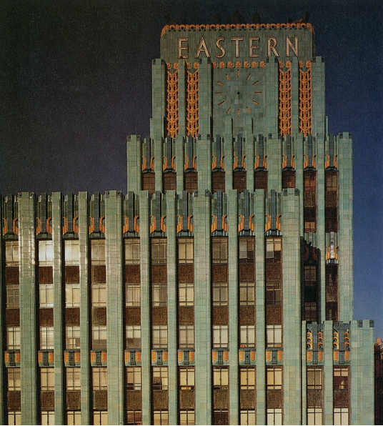
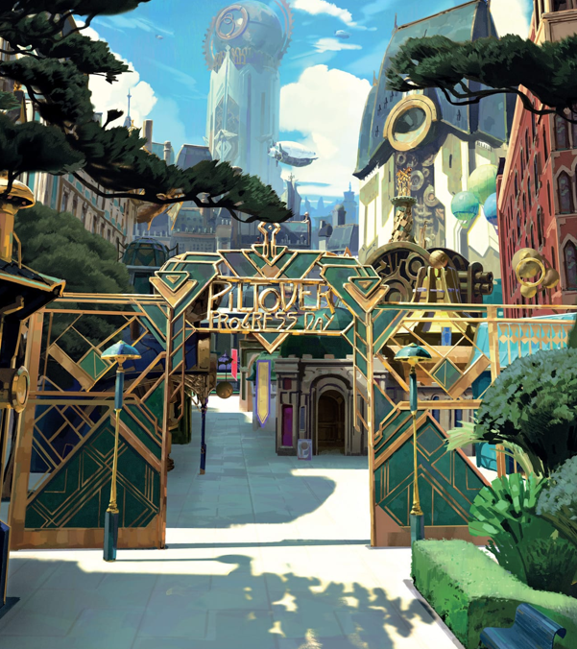
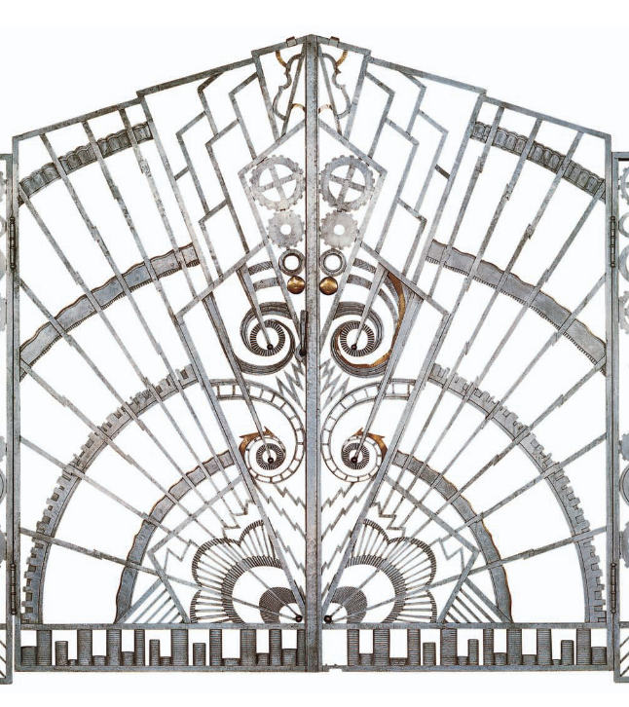
Piltover & Art DECO
“inspired by atomic and crystal structures [which] reveled in the display of opulence”
Piltover’s aesthetic:
Structured, idealised, modern
Notes:
Art Deco is about industrialisation, luxury, and futurism. Piltover’s architecture uses symmetry, gold, crystal, and clean geometry. Historically, Art Deco was associated with elite modernity and even colonialism—its elegance often masked systemic power., and was “inspired by atomic and crystal structures” In Arcane, Piltover uses this style to present itself as rational and enlightened, but it's also a visual system of exclusion.

Slide 9
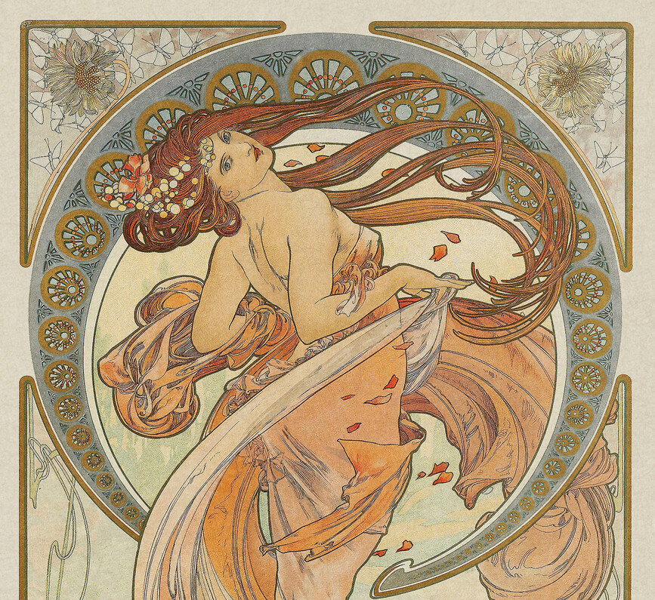
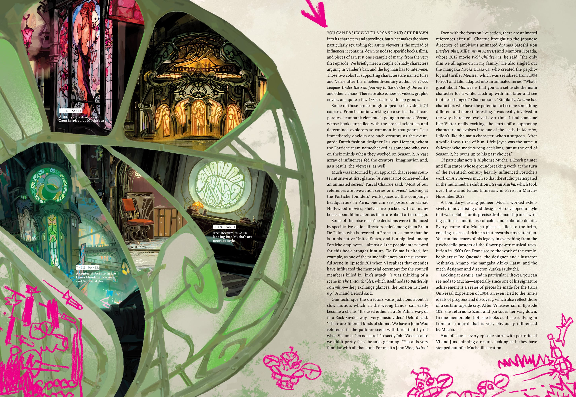
Zaun & Art Nouveau
“sinuous, naturalistic style famous for its asymmetry and whiplash lines.”
Zaun’s aesthetic: expressive, fluid, handcrafted
Notes:
In contrast, the movement of Art Nouveau is defined by its “sinuous, naturalistic style famous for its asymmetry and whiplash lines.” The organic forms drew upon nature, femininity, and the irrational; qualities that are easily suppressed under the movements of industrial capitalism. In a sense of its social signifiers, Art Nouveau was as much a revolutionary visual style as it was a signifier of resistance to a machine age – the refusal to be linear. In Arcane, it codes Zaun as a place of resistance—visually aligning the city with marginality, improvisation, and vulnerability.

Slide 10
“As it slowly established itself, just before and just after the First World War, Art Deco signalled a change in sensibility. It succeeded Art Nouveau, and the difference was striking. If Art Nouveau drew its images from flowers and trees, Deco borrowed the style of machines. If Art Nouveau's forms were rounded, Deco's were geometric.”
(Fulford, 2003).
Notes:
If the in-built content wasn’t enough, Art Deco and Art Nouveau are critically identified to be opposites. “If Art Nouveau drew its images from flowers and trees, Deco borrowed the style of machines. If Art Nouveau's forms were rounded, Deco's were geometric.”

Slide 11
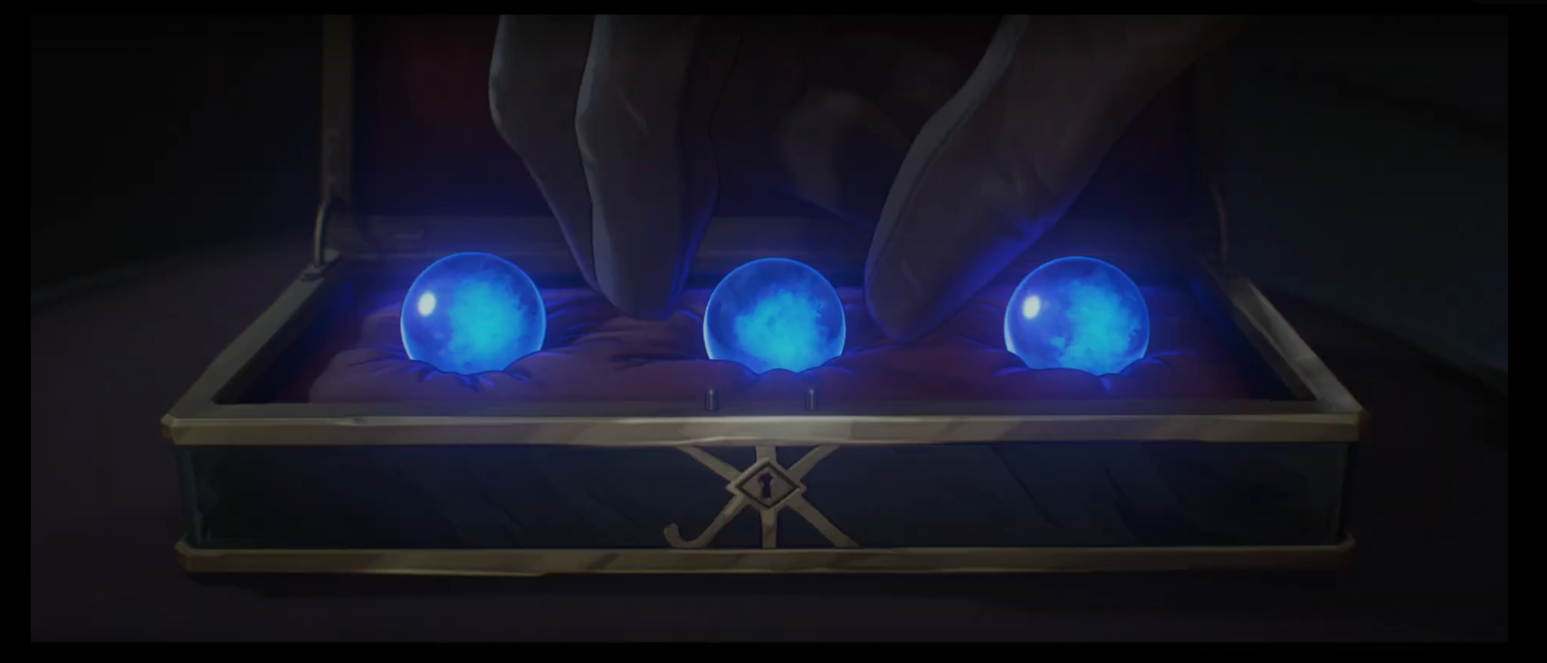
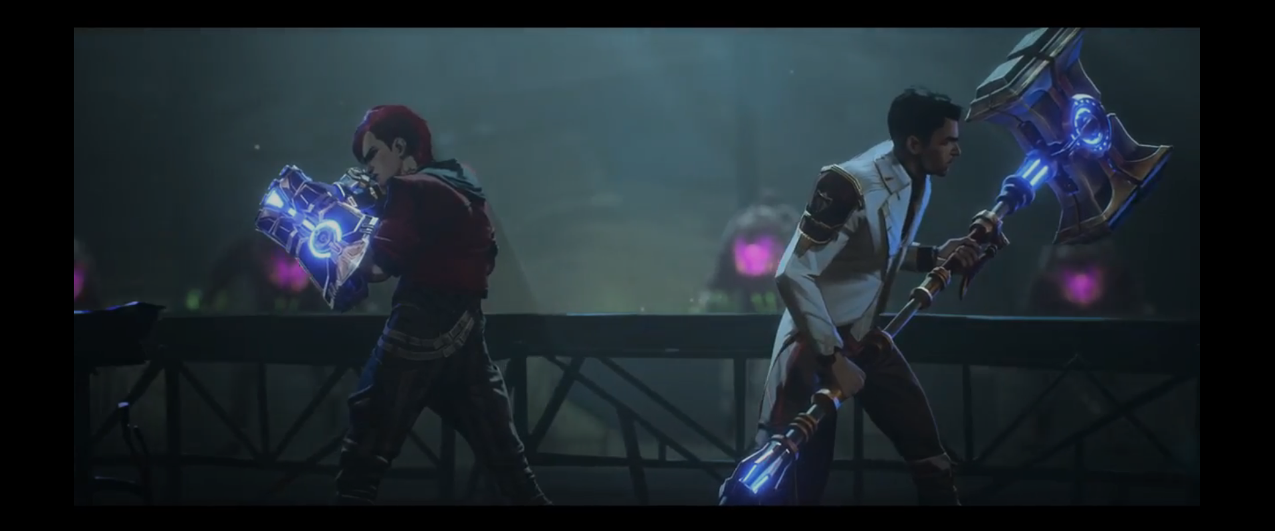
Hextech
Refined through reason – developed through a system of investors and educational institutions
“A way of democratizing magic to those who didn’t have those abilities naturally.” (Sather, 2016)
“I want Hextech to be a tool for us to build a new world.”
Brought an age of prosperity – but further deepened the fissures of inequality
A utopian aspiration for social progress
Often dressed in geometric gilding and overengineered aesthetics
Accessible through the institutional elite
Science out of excess
Notes:
Let’s outline what Hextech is, that’s pretty important to Piltover’s visual coding. It’s a refined crystal that gives individuals access to magical powers. Hextech is Piltover’s miracle; contained, refined, and controlled. Its visual design mirrors Piltover’s ideology: power should be elegant, symmetrical, and controlled by the institution. Born of the ability to invest in science like it’s art, it also means that it’s a power that is accessible only by the institutional elite, and it’s refined through a system of investors and educational institutions. It powers machinery that is decorated with clean geometric engineering in a show of an excess of wealth that echoes Art Deco conventions.

Slide 12
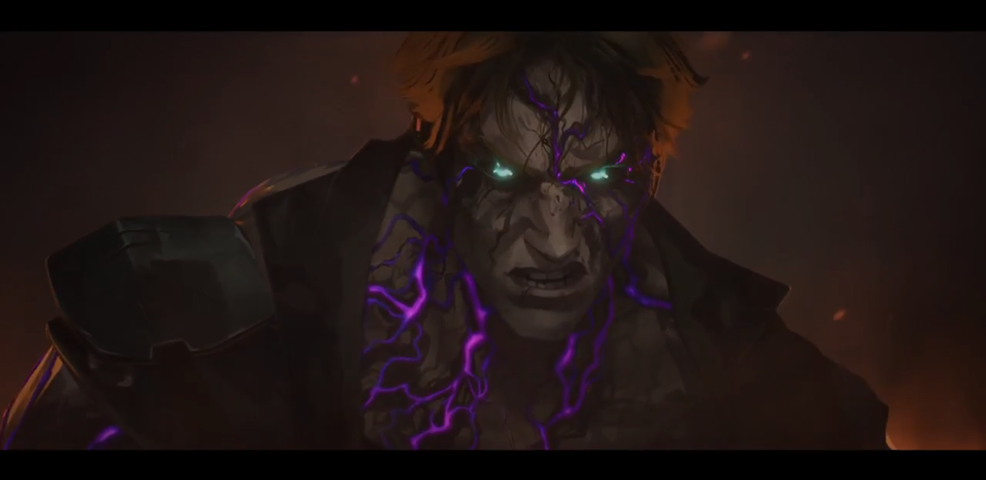
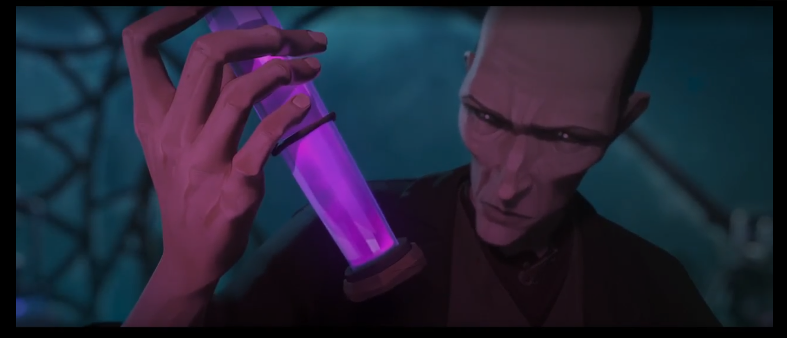
Shimmer
Refined through lack of regulation; developed through the unchecked means of an individual
It changes the biology of whoever imbibes it – rather than enhances technology
Accessible without the need for elite barriers - at the price of addiction and monstrous mutation
Created out of constraint rather than excess, of “making magic out of nothing”. (Vincentelli, 2024)
Luminescent purple glow that is unnatural and evokes imagery of toxicity
Controlled by a self-appointed individual leader, or a group of crime lords
Notes:
As with everything in Arcane, Shimmer is Hextech’s foil. Rather than giving indirect access to magic by powering tools, shimmer is ingested or injected much like a drug, directly effecting the body to give someone monstrous power. Created out of the need to survive, it’s controlled by whoever is the most powerful at the time, or a group of crimelords. Shimmer visually corrupts the body, but also enhances it. It glows from within—organic and volatile. Its design of winding veins echoes Art Nouveau’s curves, but here they’re invasive, marking both power and pain. Shimmer is Zaun’s visual response to systemic neglect.

Slide 13
 | Hextech | Shimmer
Signifiers | Blue crystals, metallic gilding, geometric angles, symmetric design | Purple fluid, bodily mutation, flowing liquid, winding veins
Signified | Rational progress, elite control, utopian identity | Raw physical power, rebellion, survival through necessity
Expressive content | Hextech appears and feels bright, reverent, and hopeful | Shimmer scenes appear murky, chaotic, and violent
Notes:
If we look at it semiotically, they have wildly contrasting signifiers – but ones that really interestingly tell us that Art Deco and Art Nouveau are coded even in the city’s technological representatives. Hextech signifies to us blue light, geometric angles, and symmetric design. It signifies to us that Piltover’s technology is ideologically rational, and controlled by those who have capital. Shimmer, on the other hand, is a purple fluid, manifesting as winding veins and organic mutation. It signifies rebellion, and raw survival born from necessity.

Slide 14
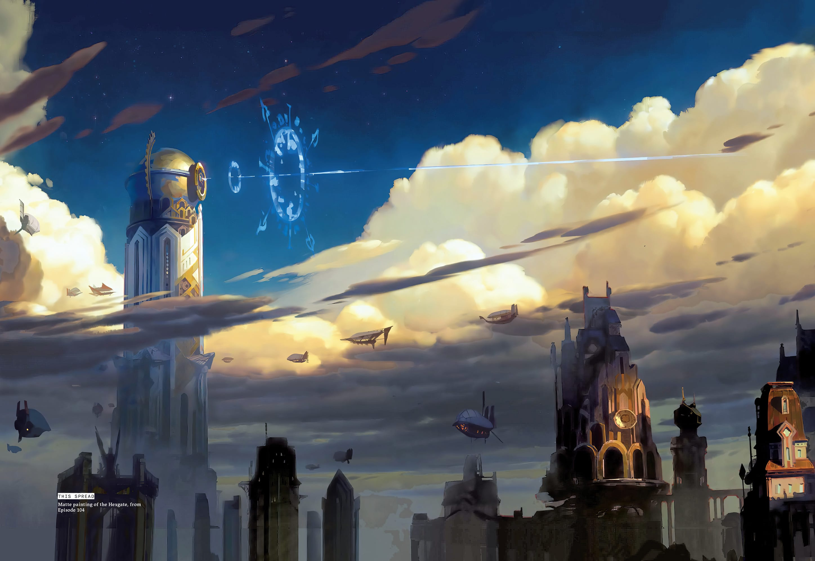
The Art Techno
“There is so much wealth in Piltover that they must have some money to invest in science, as if it was art.” (Vincentelli, 2024).
- Piltover is constructed by vertical design, brass filigree, and symmetrical architecture
- Creates an ordered and controlled visual language that calls on Art Deco; which Is historically entwined with industrialism and colonial tone
- “If Art Nouveau drew its images from flowers and trees, Deco borrowed the style of machines.” (Fulford, 2003).
Notes:
Let’s look closer at Piltover’s sociological alignment for where it falls into place of Art Deco’s signifiers. The art book tell us that “there is so much wealth in piltover that they invest in science like it’s art”.
And as we looked at previously, the verticality, the symmetry, and metallic decorations shows us a celebration of industrialism and wealth; a style borrowed from the art of machinery

Slide 15
Compositional Interpretation: Piltover
Notes:
This is the image we’ll be breaking down using compositional interpretation
Content
The image is of a cityscape, with ornate Europen-inspired buildings. The rooftops include chimneys, observatory domes, and a detailed orrery, and metal-plated geometric ornaments. In the background, there is a massive academic complex atop a hill, the composition framing it as a focal point. Small airships appear to dot the sky, indicating advanced technology. The figures in the foreground appear to be observing the city, with rugged clothes that contrast the city’s polished appearance.
Colour
The sky takes up a large amount of the composition in white/light grey clouds and light blue skies. The buildings are a lightly coloured with creams, and rooves of cool blues that are accented with metals that appear to be brass or gold. The characters are dressed in darker tones.
Spatial organisation
In the foreground are three characters, alongside architectural detailing and pipes. The midground shows richly packed rooftops and streets. The clouds move in a focal line towards the academic complex, which, at the background, is on a gradual rise that gives the city a tiered, hierarchical layout.
Light
The sunlight is bright and apparent due to the strong shadows cast on the ground from the foreground figures. There is natural daylight, which emphasises the vastness of the city.
Expressive content
The open sky, colours, and spatial framing give the mood of optimism, awe, and exploration. The upwards gaze towards the central institution suggests ambition and admiration. The characters appear to be pausing to take in the city; literally looking up to the academic complex.

Slide 16
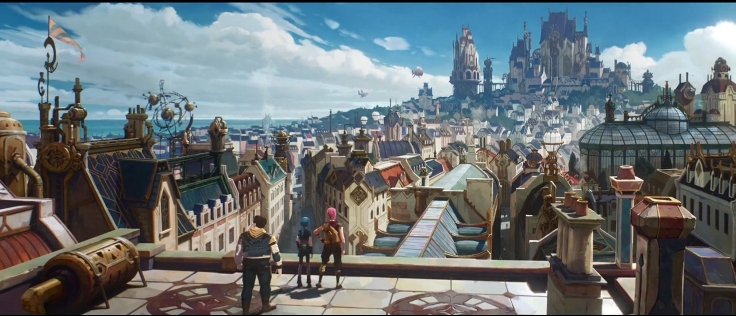
Compositional Interpretation: Piltover
Content | The image is of a cityscape, with ornate European-inspired buildings. The rooftops include chimneys, observatory domes, and a detailed orrery, and metal-plated geometric ornaments. In the background, there is a massive academic complex atop a hill, the composition framing it as a focal point. Small airships appear to dot the sky, indicating advanced technology. The figures in the foreground appear to be observing the city, with rugged clothes that contrast the city’s polished appearance.
Colour | The sky takes up a large amount of the composition in white/light grey clouds and light blue skies. The buildings are a lightly coloured with creams, and rooves of cool blues that are accented with metals that appear to be brass or gold. The characters are dressed in darker tones.
Spatial Organisation | In the foreground are three characters, alongside architectural detailing and pipes. The midground shows richly packed rooftops and streets. The clouds move in a focal line towards the academic complex, which, at the background, is on a gradual rise that gives the city a tiered, hierarchical layout.
Light | The sunlight is bright and apparent due to the strong shadows cast on the ground from the foreground figures. There is natural daylight, which emphasises the vastness of the city.
Expressive content | The open sky, colours, and spatial framing give the mood of optimism, awe, and exploration. The upwards gaze towards the central institution suggests ambition and admiration. The characters appear to be pausing to take in the city; literally looking up to the academic complex.
Notes:
Here’s an example of how we broke down each image we are about to see here using compositional interpretation in quite a bit of detail, but to spare you the long text, we’re going to give you a summary of each interpretation
Content
The image is of a cityscape, with ornate Europen-inspired buildings. The rooftops include chimneys, observatory domes, and a detailed orrery, and metal-plated geometric ornaments. In the background, there is a massive academic complex atop a hill, the composition framing it as a focal point. Small airships appear to dot the sky, indicating advanced technology. The figures in the foreground appear to be observing the city, with rugged clothes that contrast the city’s polished appearance.
Colour
The sky takes up a large amount of the composition in white/light grey clouds and light blue skies. The buildings are a lightly coloured with creams, and rooves of cool blues that are accented with metals that appear to be brass or gold. The characters are dressed in darker tones.
Spatial organisation
In the foreground are three characters, alongside architectural detailing and pipes. The midground shows richly packed rooftops and streets. The clouds move in a focal line towards the academic complex, which, at the background, is on a gradual rise that gives the city a tiered, hierarchical layout.
Light
The sunlight is bright and apparent due to the strong shadows cast on the ground from the foreground figures. There is natural daylight, which emphasises the vastness of the city.
Expressive content
The open sky, colours, and spatial framing give the mood of optimism, awe, and exploration. The upwards gaze towards the central institution suggests ambition and admiration. The characters appear to be pausing to take in the city; literally looking up to the academic complex.

Slide 17
Compositional Interpretation: Piltover
Notes:
Here, we can see how Piltover is visually idealised. The academic complex is framed as the focal point, elevated both physically and ideologically. Light and colour reinforce clarity and openness, while the upward composition constructs a hierarchy—placing the institution above the street level. The characters in the foreground are rugged and darker-toned, further highlighting their contrast with Piltover’s polished order.

Slide 18
Compositional Interpretation: Hextech
Notes:
This shot centres Hextech as a symbol of engineered power. The glowing cores and golden filigree express prestige and precision, aligning with Piltover’s ideology of rational, ornamental control. The weapons are massive and symmetrical, signalling balance and strength. But they also separate the wielder from the violence—these aren’t bodily mutations like Shimmer, but prosthetic extensions. It’s a very different philosophy of power: one of order, reach, and technological control.
Content
Two characters stand back-to-back, each wielding large, glowing weapons made of metals, and decorated with shiny brass-like filigree. One wears a red hooded outfit, while the other wears a sleek white coat with similar geometric gold filigree. The weapons are glowing neon blue, as if powered by modern technology. The weapons also seem highly engineered with panels, dials, and fretwork, showing the detail that has been put into engineering the weapons. Both weapons appear elegant due to the golden décor, but are massive in scale.
Colour
Both weapons are dominated by electric blue, contrasting the toxic purple of Shimmer, and signalling the Hextech energy. The weapons have golden and metallic trims, reflecting prestige, wealth, and Piltover’s capacity for ornamentalism.
Spatial organisation
The weapons are perfectly symmetrical in design, even framed symmetrically in the framing of the shot. The size relative to the characters are significant; they dominate each side of the frame and demand the viewer’s attention. The sheer scale signifies a focus on Hextech being a prosthetic extension of the body – once more contrasting Shimmer, in being biological change of the body.
Light
The lighting primarily comes from the weapons’ Hextech cores, making them focal points of the composition. The weapons emit a concentrated glow, with specific placements in the ornamentation that make the glowing appear controlled and engineered.
Expressive content
The weapons, by nature, are both bludgeoning weapons (gauntlet and hammer), signifying brutality and violent combat. However, it also means that on a metaphysical level, the characters never physically touch their combatants – their weapons are the vehicle for their violence, an extension of their bodies, providing the wielders power expanding their reach and brutality of control, rather than a method to biologically change their method of control.

Slide 19
The signified
- Uses the visual contextual signifiers of Art Deco through its mechanised decadence
- Neon blue lights evoke the imagery of modern technology
- Shown to power tools that expands the user’s ability to enact brutality
- Exposes Piltover’s paradoxical ideology: the weapons represent technological progress, but they are also instruments of violence cloaked in idealism
- Users may gain power not through loss of bodily autonomy, but the extension of it at the expense of capital rather than body
Notes:
Looking at those analyses semiotically, we can see how Art Deco gives rich cultural context to Piltover’s mechanised decadence. The technology is dressed to be read as modern, and represent technological progress. But it’s also violence cloaked in idealism. Its users gain power not through loss of bodily autonomy, but the expense of capital.

Slide 20
The Neo Nouveau
- In The Art and Making of Arcane, Zaun is described as a “hodgepodge of styles – Art Nouveau, Gothic, a little industrial”, and “making magic out of nothing” (Vincentelli, 2024).
Whiplash curves, asymmetrical design, hand-crafted and improvised
For Zaun, its flowing forms and hand-forged aesthetics do not just look different from Piltover; it also serves to ‘other’ Zaun from Piltover.
Signifies a city that functions outside of Piltover’s rationalist, Art Deco hierarchy
Notes:
On the other hand, Zaun’s aesthetic is a clear ode to Art Nouveau. It’s handcrafted, emotional, and full of visual movement. spaces like Silco’s office fuse floral curves with mechanical scrap. This hybridisation resists Piltover’s ordered Art Deco symmetry with Whiplash curves, asymmetrical design, hand-crafted and improvised set dressing. It signifies a city that operates outside from Piltover’s art deco hierarchy

Slide 21
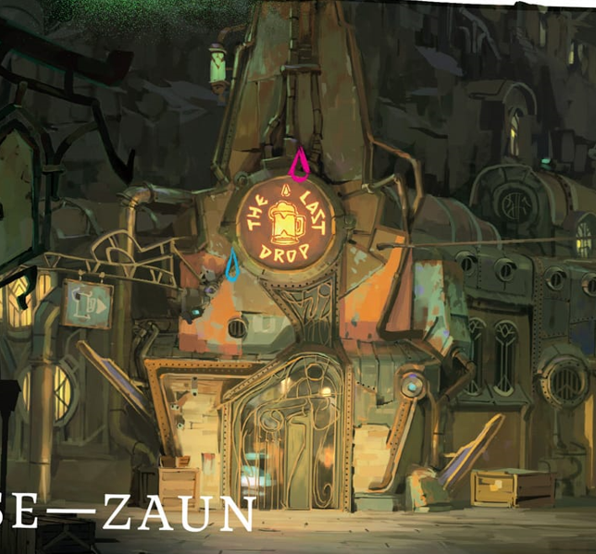
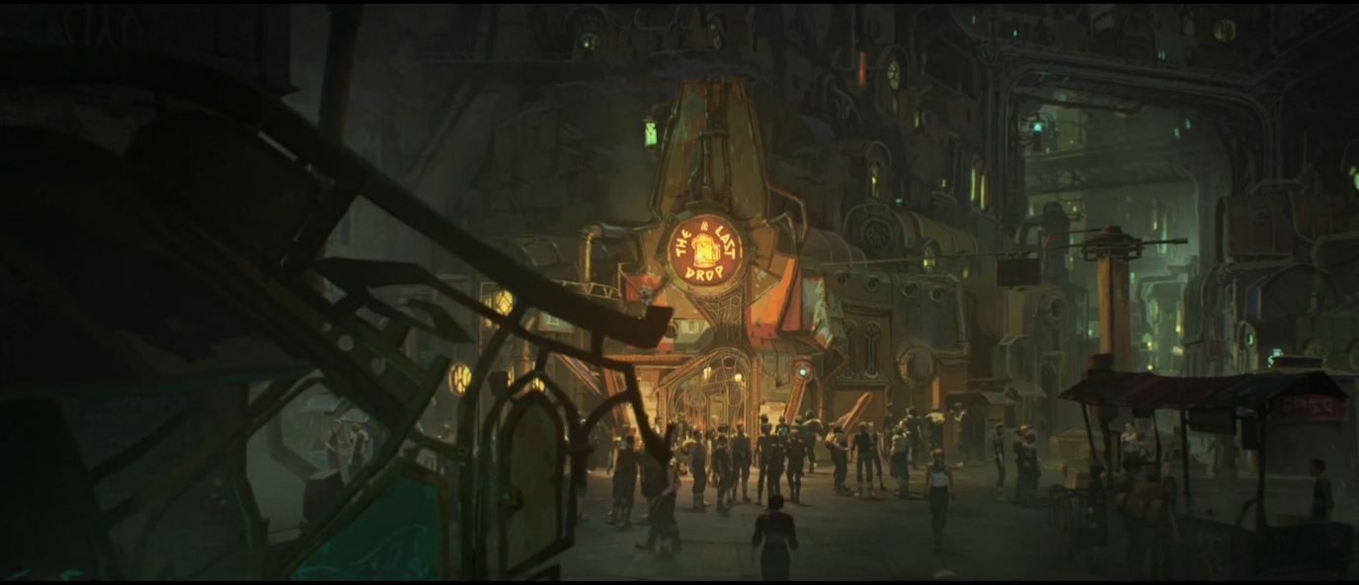
Zaun: Compositional Interpretation
Notes:
Here we see Zaun as lived reality: crowded, patched together, polluted; but also alive. The Last Drop becomes a central space of gathering and perhaps resistance. Its Art Nouveau curves, visible even in the doorway, inject a kind of visual softness into the industrial chaos. The scene mixes tension with warmth: a place of struggle, but also of belonging. The use of light and layering creates an atmosphere of enclosure, survival, and subcultural identity.
Content: A bustling urban environment in an underground environment. The central focus is a building called “The Last Drop”. A large group of people gather at the building. There are vendor stalls. The architecture is layered, dense, and heavily mechanical. The buildings are comprised of mis-matched materials, pipes, and metal plates. The piping and metalwork is sinuous and contrastingly organic in visuals. A closer look at the building’s door shows clear inspiration from Art Nouveau designs (Figure 11) with curves, spirals, and organic asymmetry.
Colour: Earthy, desaturated tones take up most of the composition, conveying an industrial atmosphere. Warm tones are used for the central building. Small areas of neon green give a sense of artificial lighting. The subdued, muddy palette gives a sense of decay, age, and pollution.
Spatial organisation: Strong depth is established through the layering of buildings, enhanced by the used of diminishing and diffused lighting. The figures are densely packed at the entrance of “The Last Drop”. The tightly packed, disordered windows sections the setting to appear claustrophobic and enclosed.
Light: The primary light source comes from the warm tones of “The Last Drop”, with secondary lighting coming from ambient glows from windows.
Expressive content: There is a mix of gritty realism, but community. The gathering crowd suggests tension or excitement, with the industrial visual and colours of decay evoke a sense of social struggle. The name “The Last Drop” perhaps implies desperation, or finality; perhaps even refuge, which is reinforced by its warm lighting and gathering crowd.

Slide 22
Compositional Interpretation: Shimmer
Notes:
This image encapsulates the semiotic chaos of shimmer. The glow is internal, corrupted, and uncontrollable. Visually, it drawsn on organic, sinuous forms that echo Art Nouveau, but here it’s twisted into something clearly violent. The composition centres mutation and emotional intensity, marking clear contest with Hextech’s symmetrical, impersonal mode of enacting power. What this signifies to us is that shimmer users don’t extend control, they surrender to it, which reflects Zaun’s relationship with power born from desperation.
Content:
A man who is visibly mutated. His expression is angered and pained, with unnatural glowing teal eyes, and purple winding veins that spread across his body, appearing almost sinuous. The veins are suggested to be chemically corrupted by the glowing purple. The man’s clothes are made of armour and fabric, suggesting a combatative character. The background is dark, with warm embers, which is signifying destruction and intense fire.
Colour: Dark browns and blacks dominate the image, but the intense saturation contest brings focus to the purple hues. It creates focal points that demand the viewer’s focus. The neon purples and blues are unnatural, and suggest biological corruption.
Spatial organisation: The character is centred and occupies most of the frame. He appears to be leaning forward slightly which makes him appear confrontational. The eyes are at the centre of the frame, demanding focus.
Light: The intense unnatural lighting is suggested to be coming from the character in frame, indicated by the glow of his eyes and veins. The ambient lighting is low, which pushes the attention to the figure.
Expressive content: The gritted teeth and brow suggest rage, and an overwhelming force. The composition in cohesion suggests infection, unnatural mutation, and a power that is difficult to control.

Slide 23
The Signified
- The purposeful contrast between Hextech and Shimmer is stark; in colour, manifestation, and method of enacting control
- Shimmer expresses organically through sinuous lines of veins across the body
- Operates as a symbol of Zaun’s ingenuity under oppression
- Contextually and aesthetically matches Art Nouveau in its rejection of mechanisation
- A medium by which inhabitants may finally attain power and attention – at the cost of bodily autonomy
- Art Nouveau is turned into visual discourse
- Zaun becomes a site of resistance and marginality through visual movement, chaos, and fluidity.
Notes:
The signifiers are a stark contrast – and so is the signified. Shimmer expresses organically, aesthetically and contextually matching Art Nouveau’s rejection of mechanisation. Inhabitants gain power at the cost of bodily autonomy – clearly morphing the technologies into a veiled discussion on how power is enacted by the bourgeoise and proletariat. What this does is turn Art Nouveau and Art Deco into visual discourse, that turns Zaun into a site of resistance and marginality through visual movement, chaos, and fluidity.

Slide 24
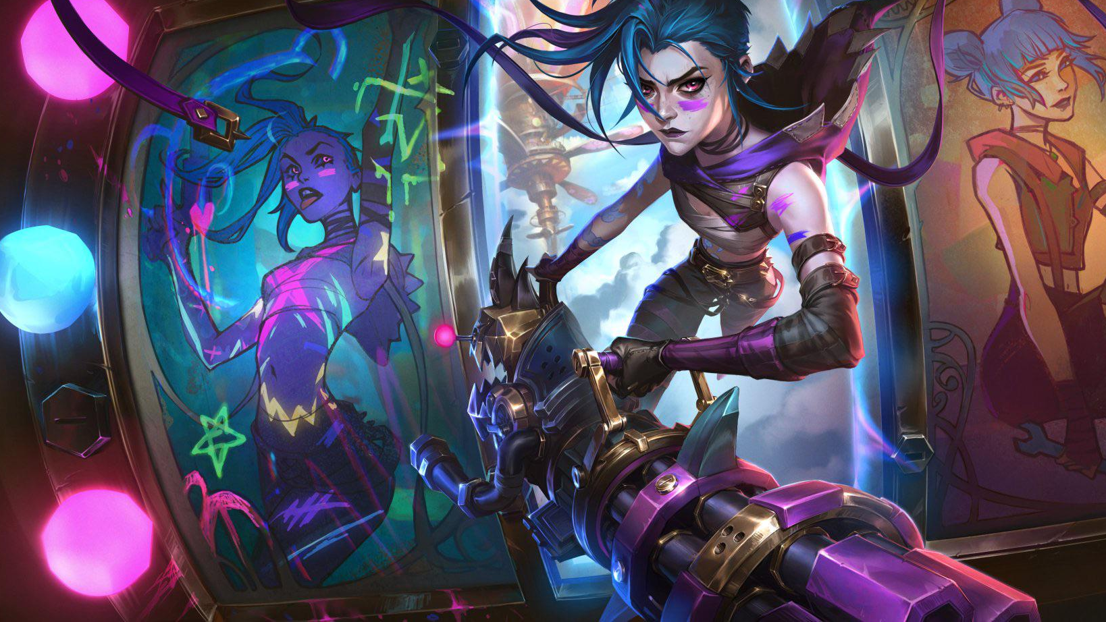
“WHAT’S WRONG WITH MY PANTS?”
-Jinx, 02x04, Arcane
Notes:
Let’s talk about what happens when we disrupt this visual order.

Slide 25
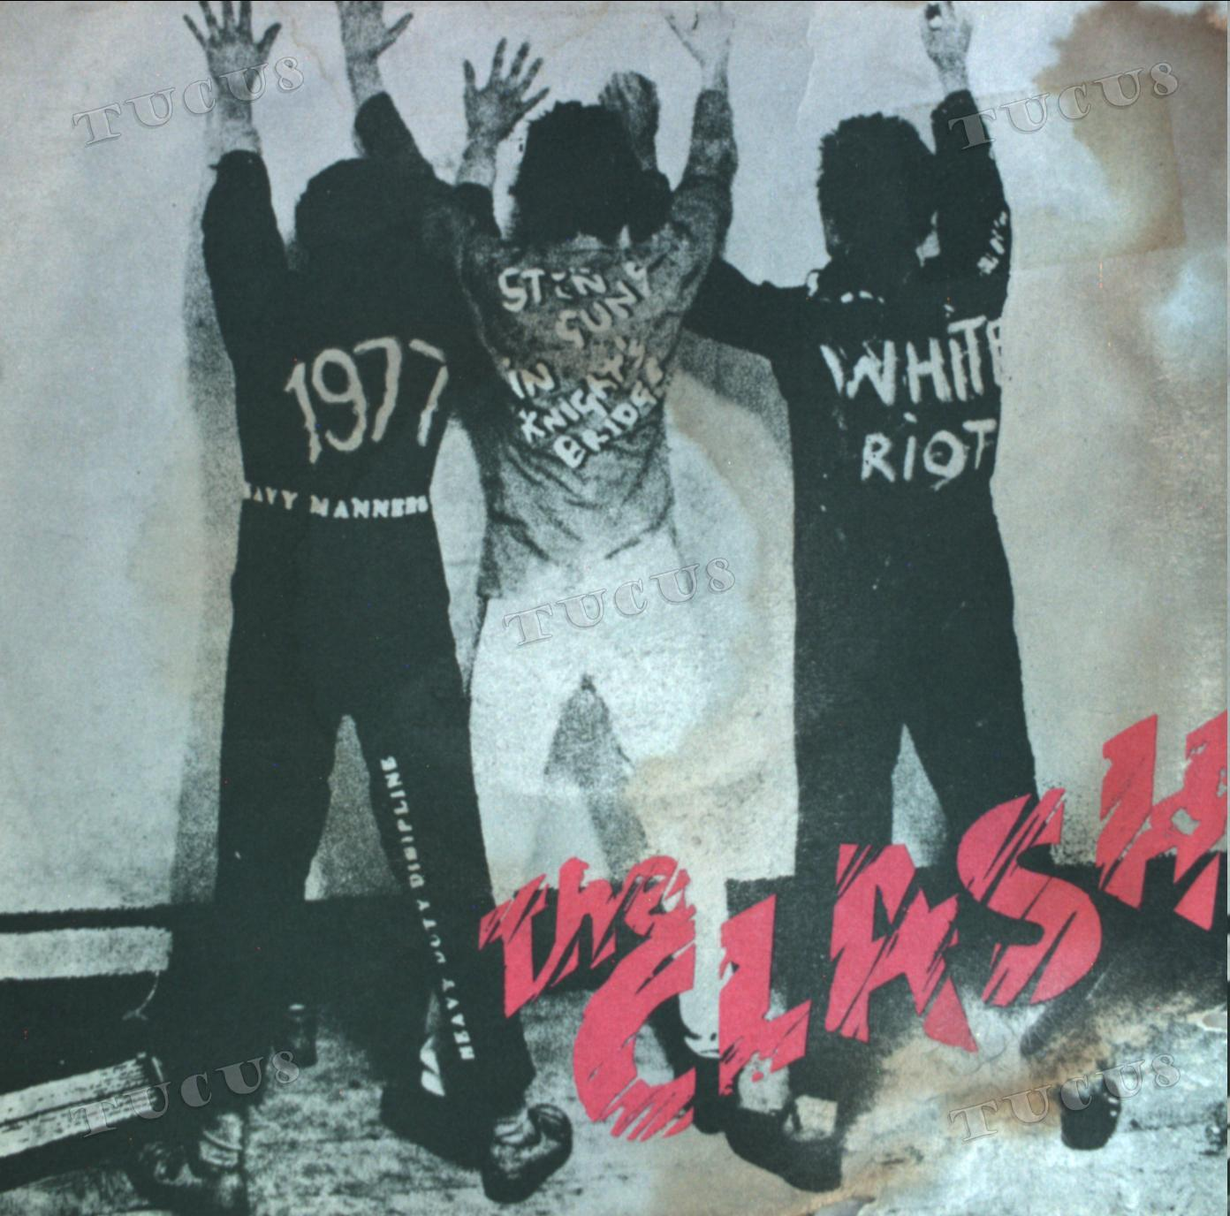
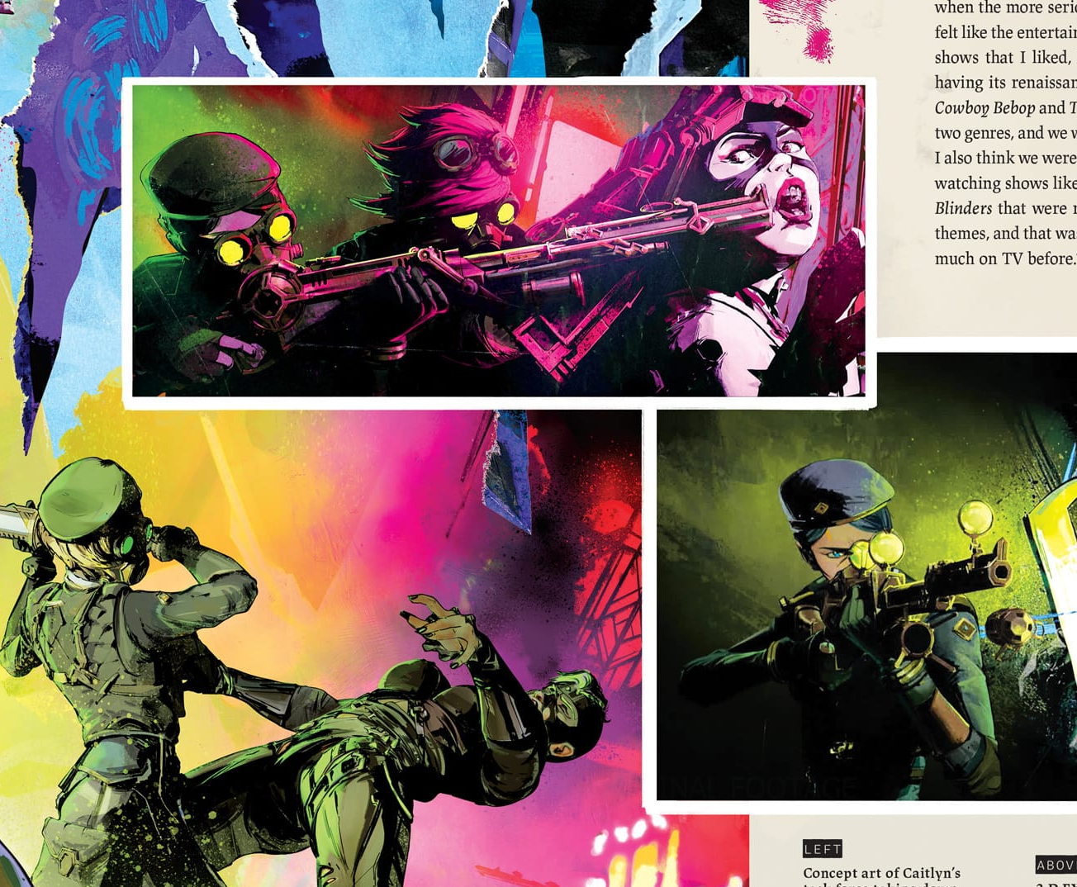
How does punk "fit in" to Arcane?
Punk in its myriad forms, is at its core about rebelling against the status quo and dismantling "the machine".
From Vander and Silco's younger exploits, to the Firelights and Jinxers – these factions are Punk at heart.
Ideologically there are rifts (as with punk historically) and these grievances are expressed through music, aggression, non-conformity, and aesthetics.
Notes:
Punk feeling like a massive contrast, visually distinct, and a kick in the face, like it doesn't fit is exactly the point it is trying to make.
Zaun and The Lanes are culturally and economically repressed by the surface, living under the bootheel of the Enforcers and Piltover.
Punk DOESN'T fit in – that's the non-conformist anti-establishment angle that diametrically opposes the current ideology and socially accepted "norm"
Jinx, The Firelights, Shimmer users, all pull in the same direction, but their visual designs mirror the distinct qualities each group values.

Slide 26
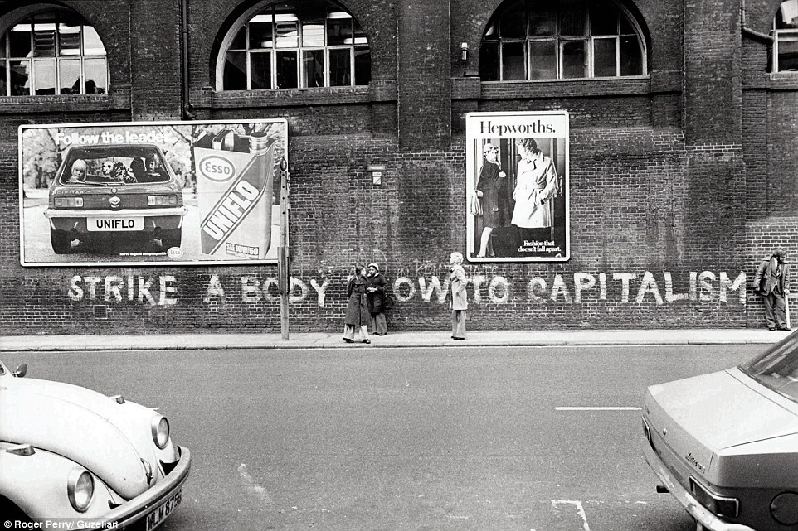
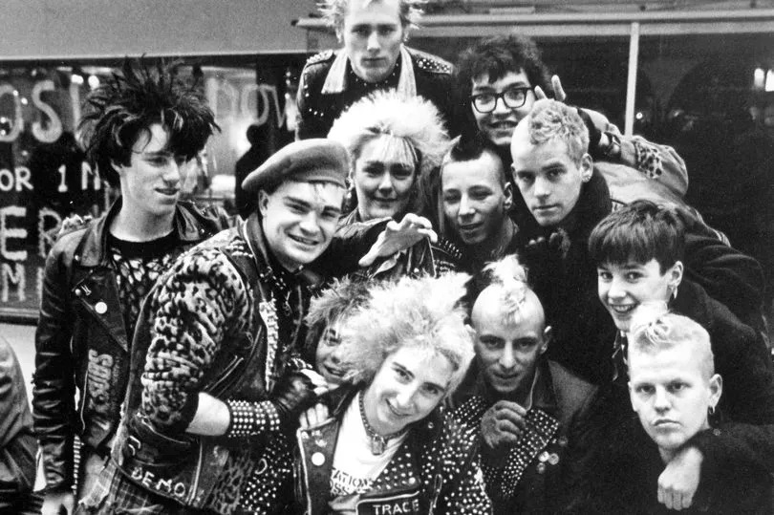
Overview of Punk
Punk, as a subculture, arose as a reaction to the social conditions and political and economic unrest in 1970's Britain.
Punk has a 'DIY' ethos, rejecting conventional approaches to music, artwork, and fashion.
Punk is unabashedly against classism, racism, sexism, anti-war, and pro-queer and marginalised groups.
Often depicted as "yobbish", violent, and chaotic, the aggression and rawness of its ideals are core to the antagonist stance against the establishment.
Notes:
Provocation, confrontation against the cultural repression, and self-expression area all key markers for the subculture.

Slide 27
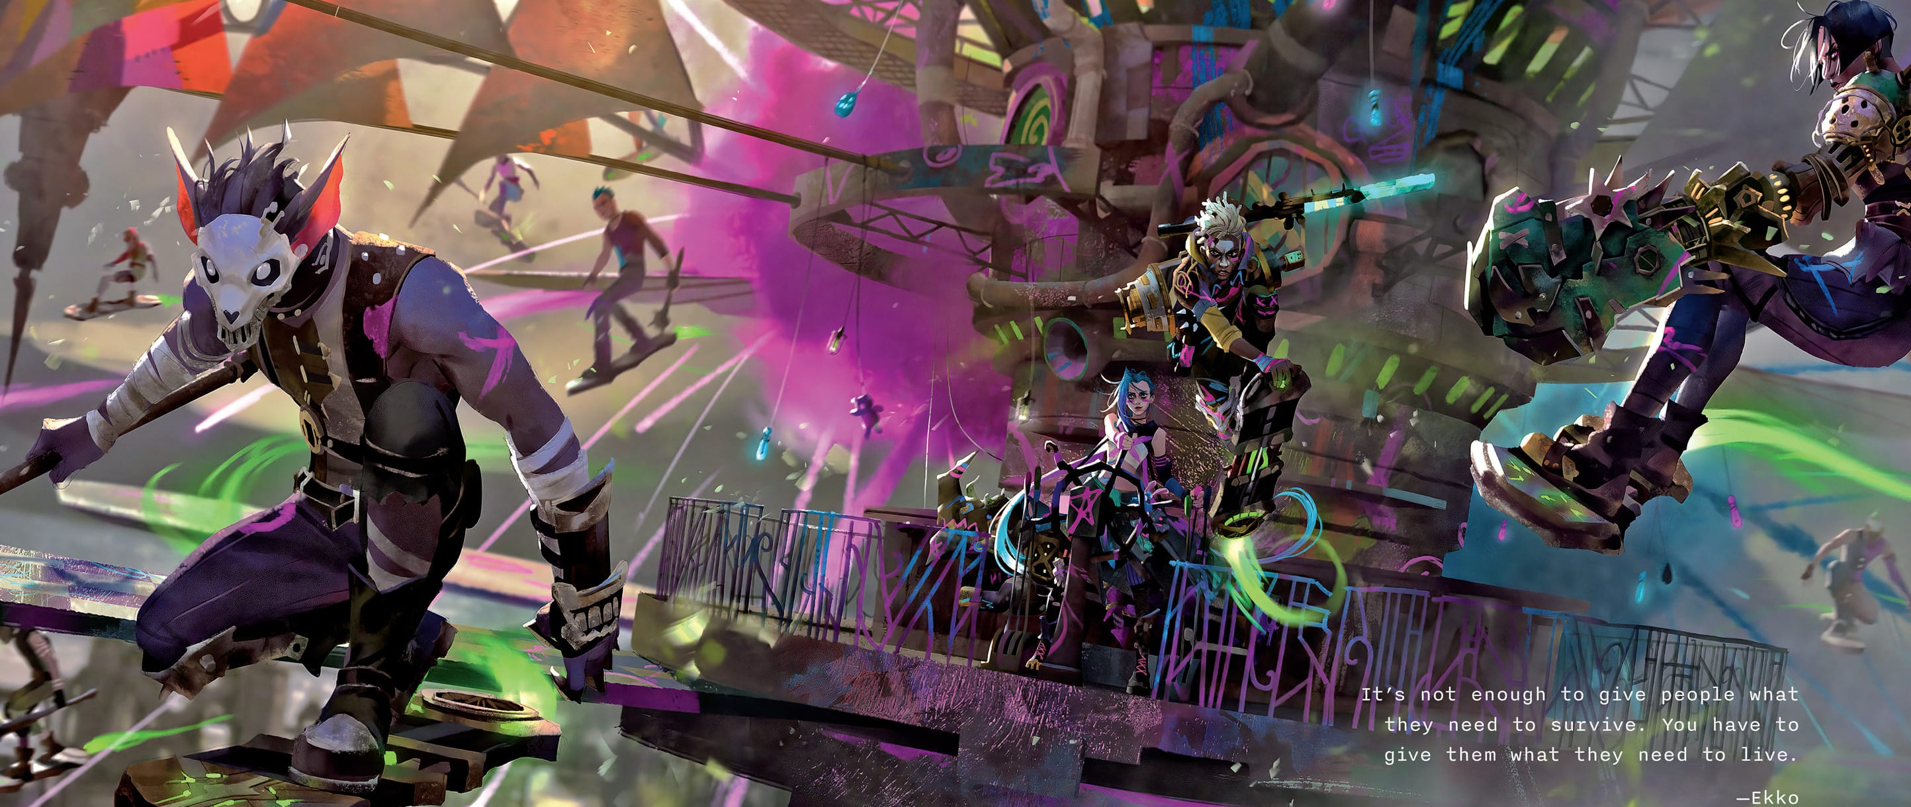
“Violence has also sometimes appeared in the punk subculture but has been opposed by some subsets of the subculture, such as the pacifist strain anarcho-punk" - Roger Sabin

Slide 28
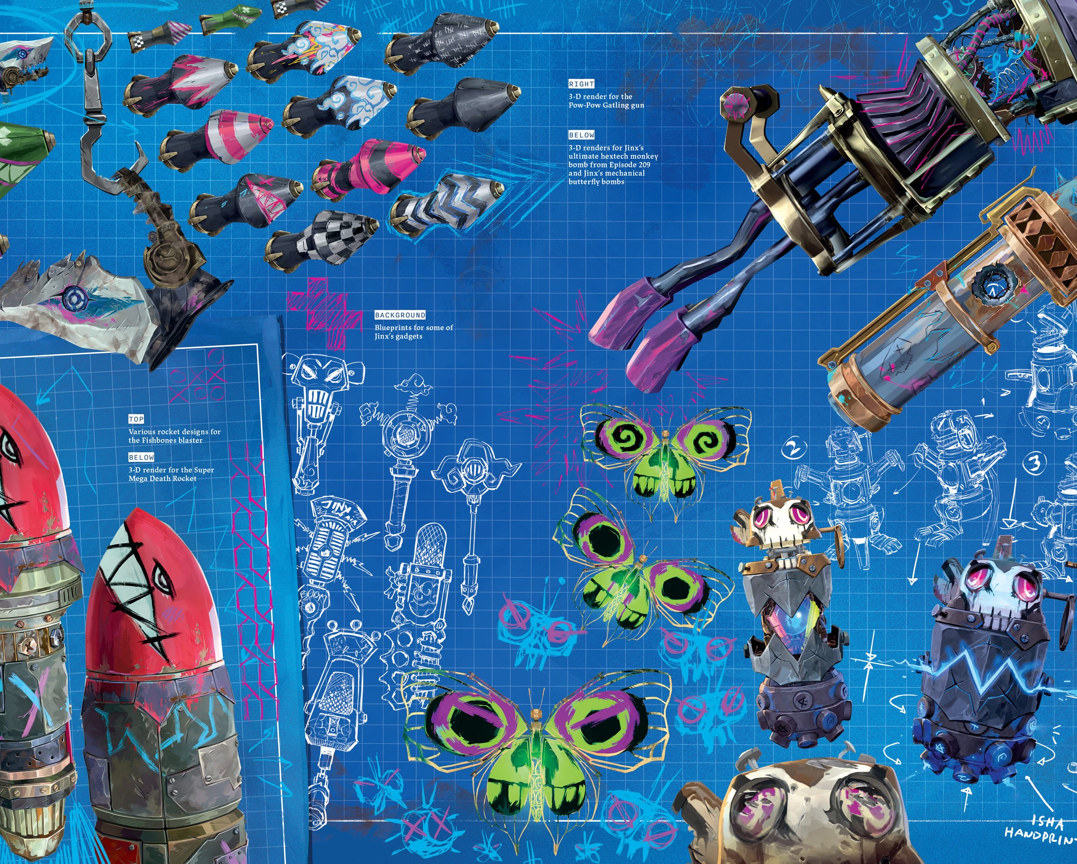
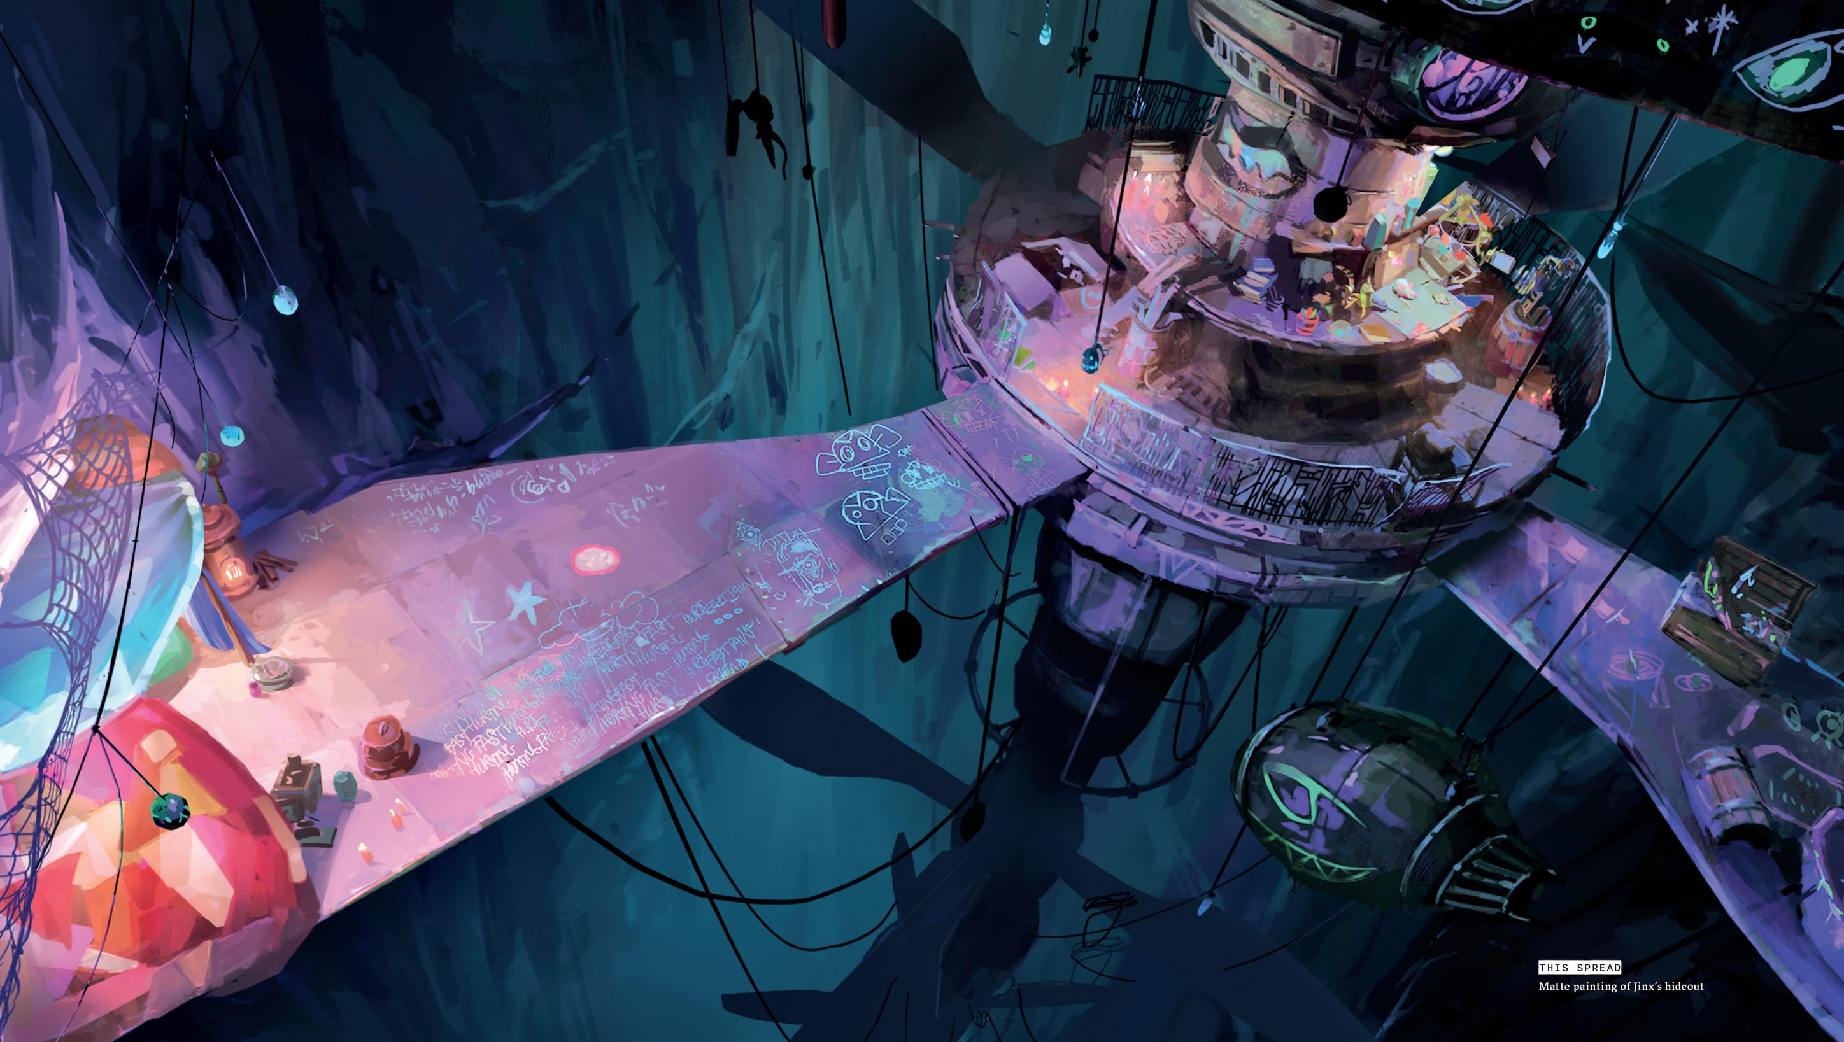
Visual Code of Conflict
Jinx and the "Jinxers" (in addition to other sub-factions in Zaun), break the visual code previously established.
Where Nouveau and Deco were the prevailing visual design and culture, Jinx and her accomplice's break this, become distinct oppositional.
Punk has no direction or clear-cut rules, much like the Jinxers. They may conform to a group style that is specific to them but remain individuals.
Notes:
Punk and cyber aesthetics are intertwined with Art Nouveau and Art Deco in a stylistic choice that reinforces an anachronistic positioning of the ideological and cultural zeitgeist explored in the series.

Slide 29
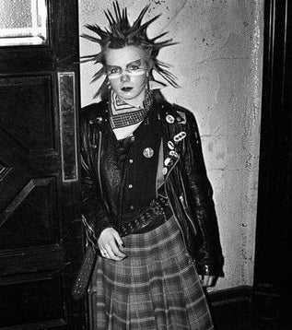
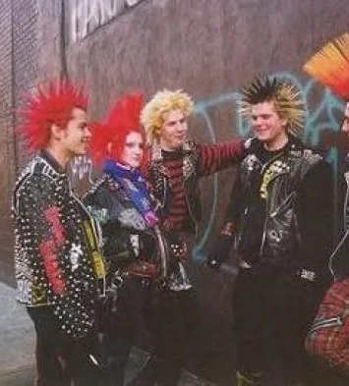
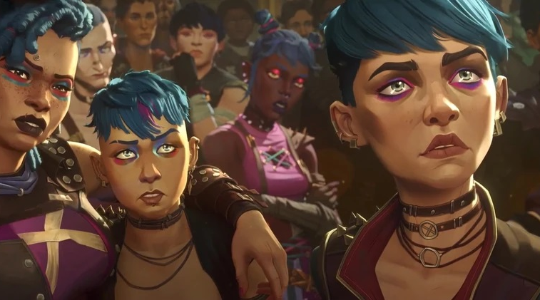
Punk Aesthetic
Punk aesthetic in broad strokes relates to the 'DIY' attitude. It's accessible, cheap, and all about self-expression.
In mainstream media we think of the Anarchy 'A', mohawks, and facial piercings, those are surface level observations.
Punk encompasses expression of culture, race, gender, and sexuality, often blurring social norms.
Notes:
Gender-bending fashion, low-cut and promiscuous clothing, dyed hair, and messy tattoos and makeup – signifiers of punk and rebellion against the status quo.

Slide 30
Conclusion
The use of art movements shape the themes of class struggle, method of power, and rebellion
Through visual design, Piltover becomes a symbol of beauty and science born of excess.
Zaun is a symbol of marginality and its differences with Piltover, and its science born of survival
The implementation of the historical movements are not just aesthetic choices; they are coded systems of meaning that act as semiotic tools, encoding each city’s political identity.
The Art Deco inspired visuals reflect and ideology of progress that is as exclusionary as it is aspirational.
The organic forms of Zaun construct it as a visual and ideological juxtaposition to Piltover. If Piltover embodies control, Zaun embodies resistance.
The visual code is purposefully disrupted by a third movement in counterculture
The visuals metaphysically disrupt the design philosophy of the show, literally going against the status quo that serves as a semiotic disruption
Visuals are more than set dressing – they can act as narrative scaffolding
Art Nouveau, Art Deco, and counterculture aesthetics turn into storytelling mechanisms. Viewers are invited not only to revel in artistic richness, but to read and decode with the power in each visual.
Notes:
We’ve discussed how Arcane uses art history not just as aesthetic choices, but as coded systems that build on the story’s narrative. Piltover’s Art Deco visuals reveal an ideology of progress that is as exclusionary as it is aspirational. Zaun’s visuals reveal an ideology of science born of survival, of resistance and marginalisation. Then punk kicks down the door revealing a metaphysical use of counterculture, where it visually disrupts this status quo. And ultimately, transforms art into discourse that asks viewers to both enjoy the beauty, and also decode the power in each visual.

Slide 31


Questions?
Rika Paderes
rikapaderes@staffs.ac.uk
linkedin.com/in/rikapaderes/
Christopher Harding
Christopher.harding@staffs.ac.uk
linkedin.com/in/c-harding/

Slide 32
References
Fulford, R. 2003, Art Deco's glamour: Series: Art Deco Design: [National Edition], Don Mills, Ont.
McDermott, C. (2007) Design: The key concepts. London, UK: Taylor & Francis.
Vincentelli, E. (2024) The Art & Making of Arcane. Insight Editions.
Rose, G. (2016) Visual Methodologies: An Introduction to Researching with Visual Materials. 4th ed. SAGE Publications.
Sather, A. (2016) The visual language of Hextech, nexus.leagueoflegends. Available at: https://nexus.leagueoflegends.com/en-us/2016/12/the-visual-language-of-hextech/ (Accessed: 09 July 2025).
Ashby, C. (2022) Art Nouveau. 1st ed. London: Bloomsbury Visual Arts.
Greenhalgh, P. (2000) ‘Art Nouveau: Politics and Style’, History Today, (April), pp. 4-5.
Charles, V and Carl, K. (2012). Art Deco. Parkstone International.
Edward Denison (2019) ‘Art Deco and the Other’, in The Routledge Companion to Art Deco. 1st ed. Routledge, pp. 293–314.

