Slide 1
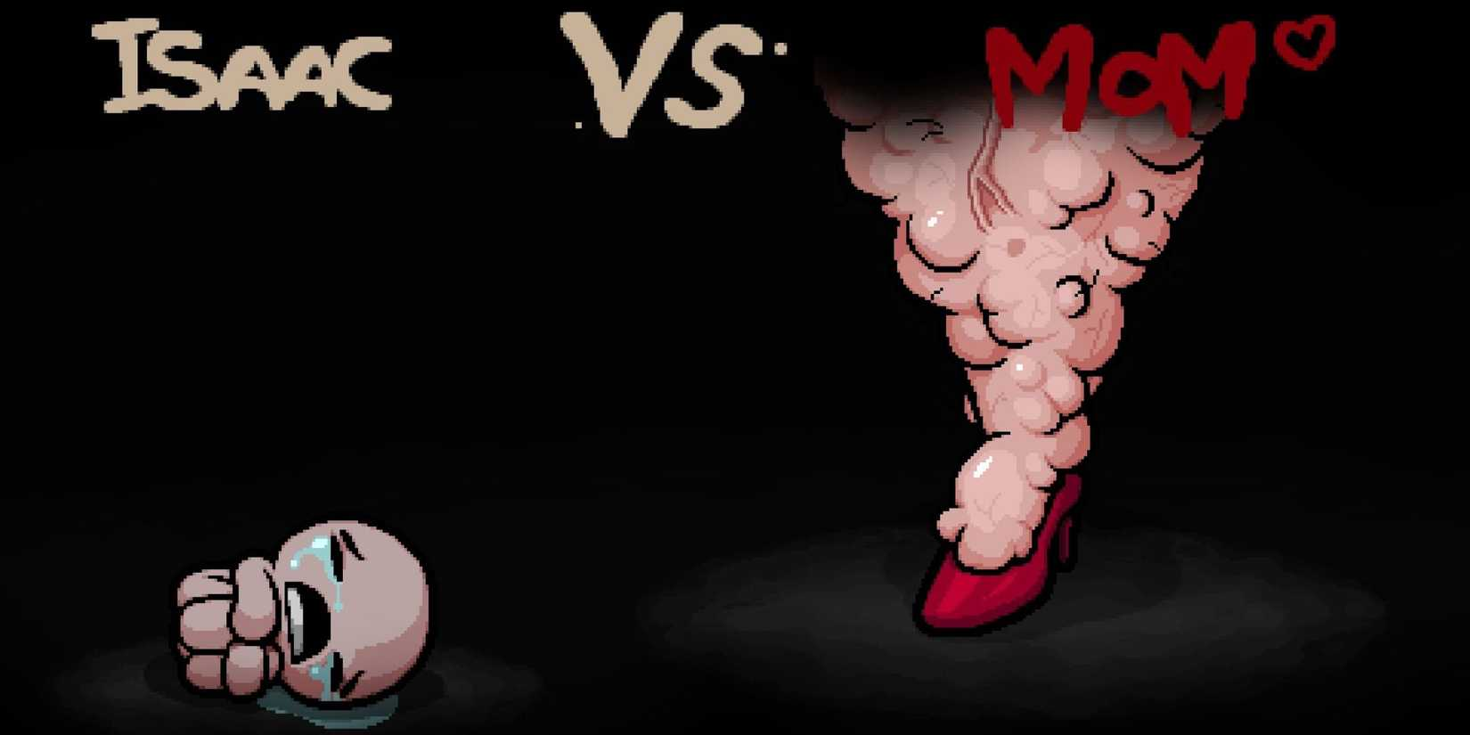



The Maternal Grotesque:
Motherhood in Horror Games Cinematics & Design
University of Staffordshire
London Campus
Rika Paderes
Demi Gilhooley
Chris Harding

Slide 2
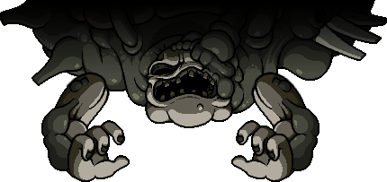
Key Points
Biological signifiers – The Grotesque Matriarch re-codes imagery of maternal safety
Parasitic behaviours – Insectoid motifs shifts the concept of birth from a human miracle to a physogastric horror
Loss of agency – The archetype puts the grotesque matriarch at a profound loss of spatial and physical autonomy
Notes:
The key points that we found, and will touch on in more detail pivot around biological signifiers, parasitic behaviours, and a loss of agency.
With biological signifiers, it’s the idea that imagery usually used for safety is stripped of its sacred status, and re-writes the image of the maternal sanctuary. Then we have the parasitic behaviours; insectoid motifs that represent forced fecundity, and turns birth into a physogastric (fi-so-gastric) horror. And a profound loss of agency – feeding on the idea that the act of giving birth consumes you, and makes you lose your bodily autonomy.
Physogastrism – a characteristic of certain bugs , commonly involving queens having enlarged abdomens to hold large ovaries, for lifelong fecundity

Slide 3



Theoretical frameworks
Semiotics
Haptic Abjection
Monstrous Feminine
Notes:
There are three theoretical frameworks by which we look at the Grotesque Matriarch, starting with, of course, Monstrous Feminine, which is the challenging of the traditional view of women as passive victims in horror, looking instead at how media makes terrifying monsters out of patriarchal fears of the female body and maternal power. We also use Haptic Abjection, where the idea is that visuals are so viscerally rendered that your eyes translate it to an involuntary physical reaction. And of course, semiotics, which allows us to look at signs and symbols, helping us look at camera angles, textures, and sounds.

Slide 4
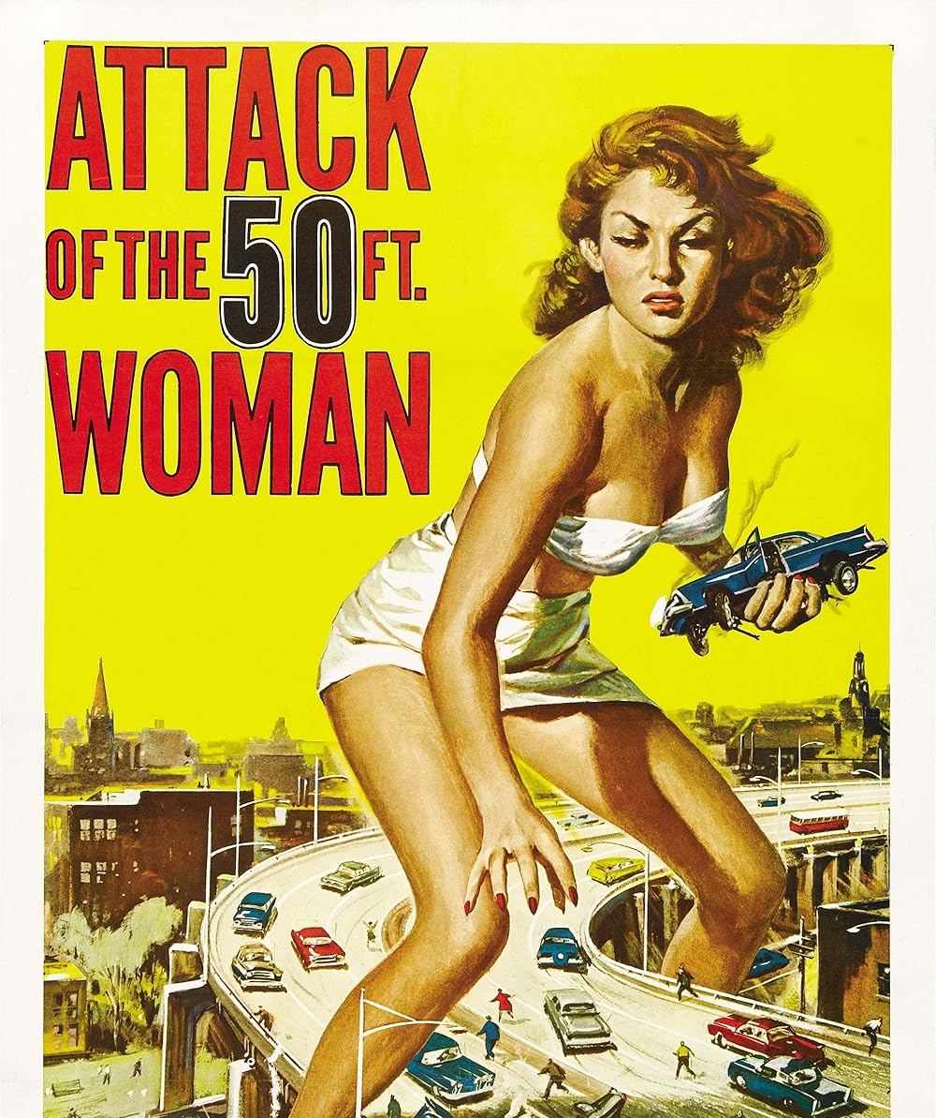
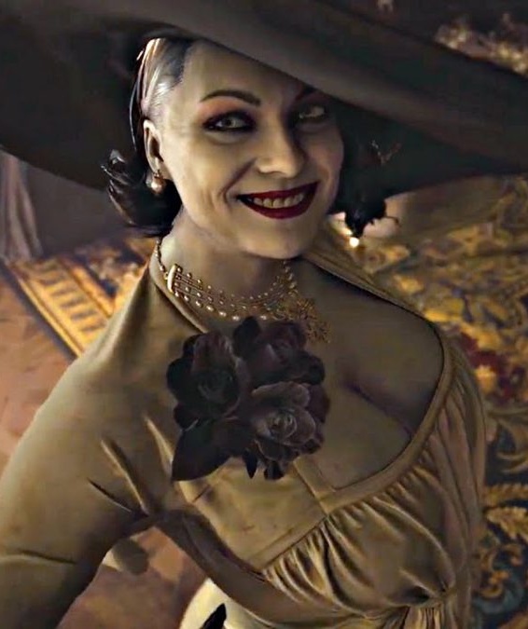
Monstrous feminine
"While the monster changes its shape through history, attiring itself in the prevalent fears of the day, the categories it symbolizes as society’s Other, according to Wood, include: women; the working class; other cultures; ethnic minorities; alternative political ideologies (for example, the threat of communism in 1950s stories about alien invaders); alternative sexualities (monsters are often identiﬁed with homosexuality or bisexuality, especially in vampire ﬁlms); and children (ﬁlms like The Exorcist [1973] or The Omen [1976] ﬁgure the child-as-monster).“
(Wells, 2000).
Wells, P. (2000) The horror genre: from Belasco to Buffy. London: Wallflower Press.
Notes:
Drawing of Barbara Creed's work on the Monstrous Feminine, we look at the maternal body and how video game cinematics paint it in this really interesting typecast.
There's this phenomenon of repeating visual queues of a grotesque version of a matriarch. The term we take from our research – The Grotesque Matriarch, references a figure that is designed to deconstruct the idea of a mother as a safe haven or a sanctuary.
Monsters in horror historically changes throughout history to match the prevalent fears of that current age. It’s a reflection of society’s repressed “other” – in this case, women, and the alternative meaning to maternal power. The idea of the monstrous feminine gives these archetypes the framework for their subversion of maternal sanctuary, and therefore, the really unique threat of the Grotesque Matriarch that is ultimately about the subversion of how power manifests.
Wells, P. (2000) The horror genre: from Belasco to Buffy. London: Wallflower Press.

Slide 5
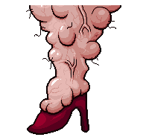

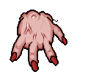


Haptic Abjection
"When the eyes see or the lips touch that skin on the surface of milk—harmless, thin as a sheet of cigarette paper, pitiful as a nail paring—I experience a gagging sensation and, still farther down, spasms in the stomach, the belly; and all the organs shrivel up the body, provoke tears and bile, increase heartbeat... [The abject] is something rejected from which one does not part, from which one does not protect oneself as from an object. Imaginary uncanniness and real threat, it beckons to us and ends up engulfing us.“
(Kristeva, 1982).
Kristeva, J. (1982) Powers of horror: an essay on abjection. New York: Columbia University Press.
Notes:
We’re going to be looking at how physical body is a large part of the imagery at hand – Julia Kristeva here regards the feeling of the abject. She describes a realisation of how gross something is, the feeling of drinking milk, and feeling sick for it. It’s an immediate, somatic response – she gags, spasms, feels tears, bile, and her heart. For the context of the Grotesque Matriarch, we found that the design and cinematics often make use of the haptic gaze – it’s this idea that the textures and animations are rendered with such visceral fidelity that we have a physical – or somatic – reaction to it. Though we actually only use The Binding of Isaac here for some powerpoint decoration and a different game for a case study, we can see examples of how differently “mom” and [animation] Isaac are rendered to really different fidelitites – so you can almost reach out and feel Mom’s legs with your eyes.
The raw visual data on the screen becomes so heavy, warm, and fatty, and the player isn’t allowed to look at her from a safe distance. Visual signifiers turn into physical sensation, and thus, haptic gaze through abjection.
Kristeva, J. (1982) Powers of horror: an essay on abjection. Translated by L.S. Roudiez. New York: Columbia University Press.

Slide 6
Semiotics
“Everything is present in film: hence the obviousness of film, and hence also its opacity. The clarification of present by absent units occurs much less than in verbal language. The relationships in praesentia are so rich that they render the strict organization of in-absentia relationships superfluous and difficult. A film is difficult to explain because it is easy to understand. The image impresses itself on us, blocking everything that is not itself.”
(Metz, 1974).
Praesentia | Absentia
The present – what is present in front of you | The absent – hidden signs
“THE WOMB” flashes on the screen as the sprite of Isaac stands in the middle of the room. The walls are red, fleshy, and bulbous. The music is slow, with minor keys in slow frequency. The player has come far enough that Isaac’s animations, sprite, and attacks are distorted and viscerally gross. | Traditionally we see the womb as sterile and safe; instead we are faced with a zone full of grossly designed enemies, bugs, and dirty fluids. By withholding the traditional signs of safety, the game jarrs the player into facing the abjection of “MOM”.
Metz, C. (1974) Film language: a semiotics of the cinema. Chicago: University of Chicago Press.
Notes:
Semiotics – simply put – the study of signs and symbols – we actually thought of avoiding semiotics as a framework for this. We covered semiotics last year – we couldn’t possibly come to the same conference, with the same framework, could we? But we found that the recurring symbols were really hard to ignore, so we scrapped using Althusserian Marxism as a lens, and went back to semiotics. The symbols are practically inseparable – everywhere we look, there are symbols birthing, death, and rebirthing. Visual signifiers of pregnancy, of the violent representation of the female biology. In a traditional sense, maternal signs of birth, body, and warmth are signifiers of sanctuary. But gothic and horror contexts re-code these symbols to be signifiers of abjection, of biological dread, and a distinct loss of bodily control.
We look to Christian Metz’s thoughts on the language of visual shots. So when we look at a case study later, we are looking at the cinematography of the shot, and not only the design of the character. [next slide animation]
Metz, C. (1974) Film language: a semiotics of the cinema. Chicago: University of Chicago Press.

Slide 7
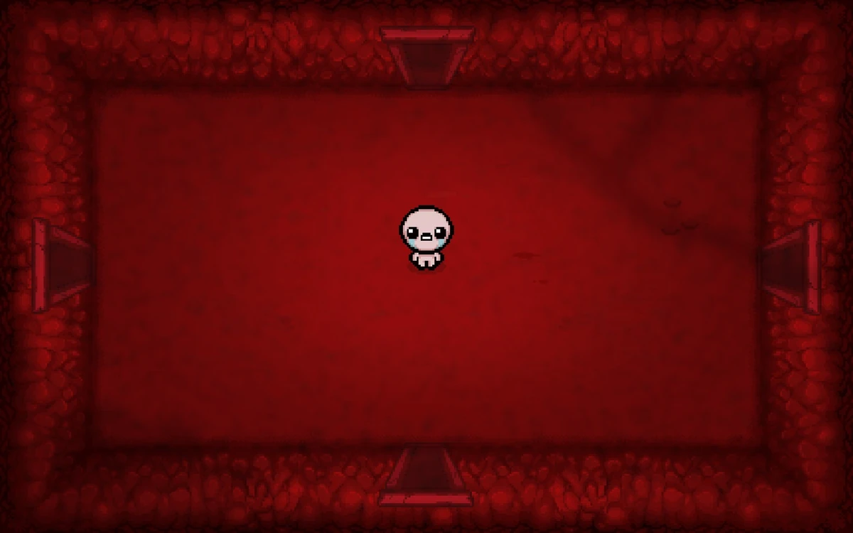

Praesentia | Absentia
The present – what is present in front of you | The absent – hidden signs
“THE WOMB” flashes on the screen as the sprite of Isaac stands in the middle of the room. The walls are red, fleshy, and bulbous. The music is slow, with minor keys in slow frequency. The player has come far enough that Isaac’s animations, sprite, and attacks are distorted and viscerally gross. | Traditionally we see the womb as sterile and safe; instead we are faced with a zone full of grossly designed enemies, bugs, and dirty fluids. By withholding the traditional signs of safety, the game jarrs the player into facing the abjection of “MOM”.
Notes:
When we look at “The Womb” level in TBOI through this framework as an example, the Womb as a red, pulsing environment cannot alone shock the player unless the player’s mind is simultaneously referencing the concept for what a womb is supposed to be – safe, warm, a sanctuary. By withholding the symbols of safety, the game forces the visuals to function as violent abjection.
What is present is the red, fleshy, and bulbous walls. By now, usually, Isaac’s sprite looks more like this [animation] as the player picks up several powerups. What we do not see, but implicitly know, is that there is something wrong with this area. It is full of gross enemies, bugs, and seeping fluids. The player is jarred into facing the abjection of Mom.
Metz, C. (1974) Film language: a semiotics of the cinema. Translated by M. Taylor. Chicago: University of Chicago Press

Slide 8
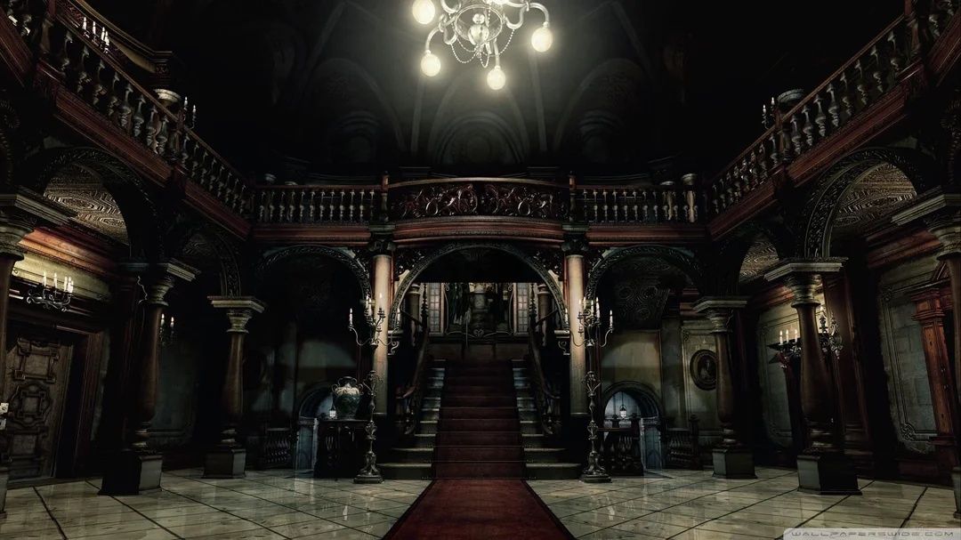

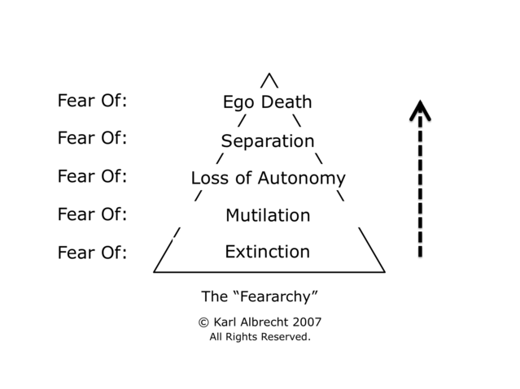
On the topic of Fear
When looking into how horror is portrayed, from themes and topics, to the key visual elements that inspire terror, we can easily gain inspiration from our culture, history, and lived experiences.
However, the essence of fear, the gnawing and uncomfortable feeling we have when confronted with it is rooted in psychological factors. Karl Albrecht, an existentialist, devised a pyramid that covers the 5 core fears that all others can be classed under. He called this diagram, “The Feararchy”.
Before delving into the grotesque and monstrous pits ahead, first we must understand some key terms and the contexts they give.
Notes:
Albrecht, K. (2007), Practical Intelligence: the Art and Science of Common Sense
Dr Irvin Yalom has similar ideas, also basing it off some broader terminology, calling them The Existential Givens as Death, Freedom, Isolation, and Meaninglessness – fundamental concerns that shape the human experience. They cover similar ground, although Albrecht details more physical fears with some clearer examples and definitions.
Yalom, I. (1980), Existential Psychotherapy.

Slide 9
The Feararchy
Extinction
The fear of annihilation and ceasing to exist – an idea more complex than just death, but of no longer being. L’appel du vide, call of the void, or as Sartre would call it, “the vertigo of possibility” – a momentary existential event testing your will to survive or succumb to the urge to jump and plummet. Some of the fears covered by extinction include the dark, flying, fear of heights, and fatal diseases – mortal threats.
Mutilation or bodily invasion
The fear of losing our bodily structure, having our bodies invaded and abused, or losing function of parts of ourself. Generally this fear relates to feeling unsafe, of insects, surgical procedures, and pregnancy.
Notes:
Sartre, J.P. (1943), Being and Nothingness.
Sartre explores the concepts of being and nothingness by contrasting human consciousness (or no-thingness) with the existence of objects and an expression of existentialism. His works build of the foundations built by his predecessors, for example The Concept of Anxiety (1844), written by Soren Kierkegaard who explains the depths and weight of anxiety that emergence when individuals are forced to confront the boundlessness of being – the awareness off the “possibility of possibility”, further describing anxiety as the “dizziness of freedom”.
Kierkegaard, S. (1844), The Concept of Anxiety.

Slide 10
The Feararchy
Loss of Autonomy
The fear of being immobilised, restricted, smothered, or controlled. These fears unlike some others can be related to psychological entrapment or paralysis, as well as more physical or social fears such as no social or economic mobility, strangulation, or coercion.
Ego Death
Characterised as humiliation, shame, and worthlessness. Humans need to feel like they belong, are capable of being loved, and have value in some regard. Our sense of self is often fragile and easy to throw into shambles. Public speaking, bullying, or even having a birthday forgotten by someone close to you can have deep knock-on effects to one’s ego and self worth

Slide 11
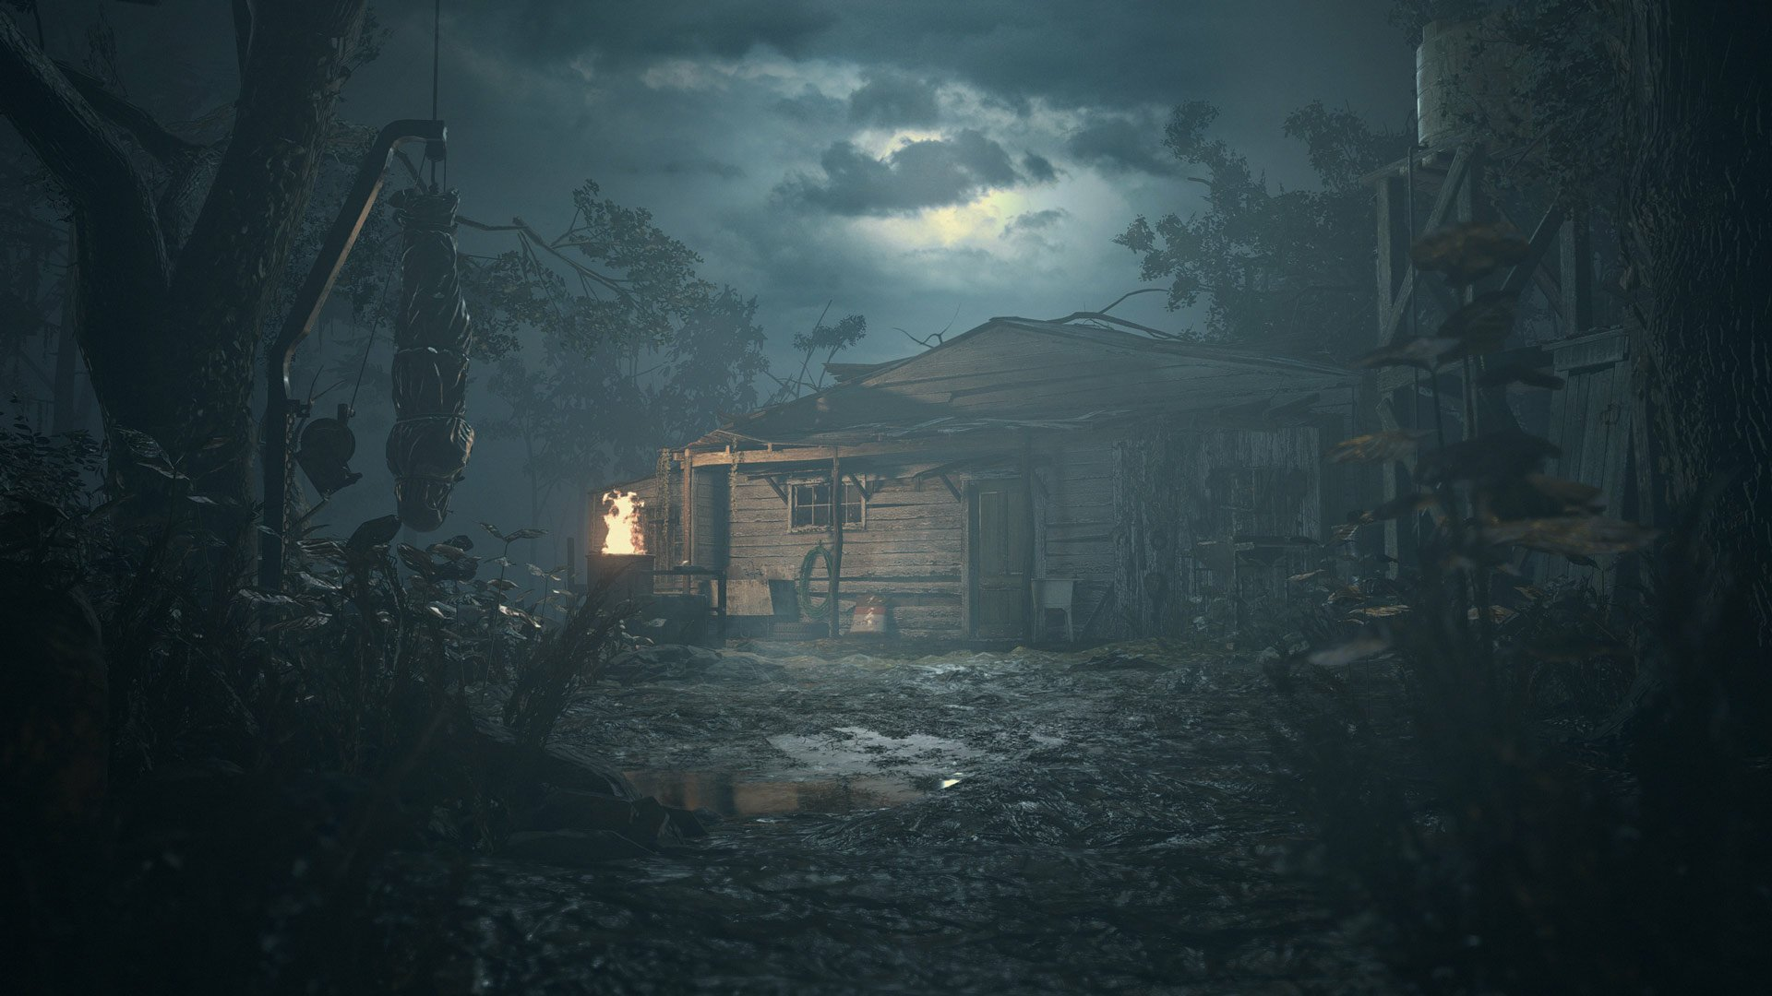
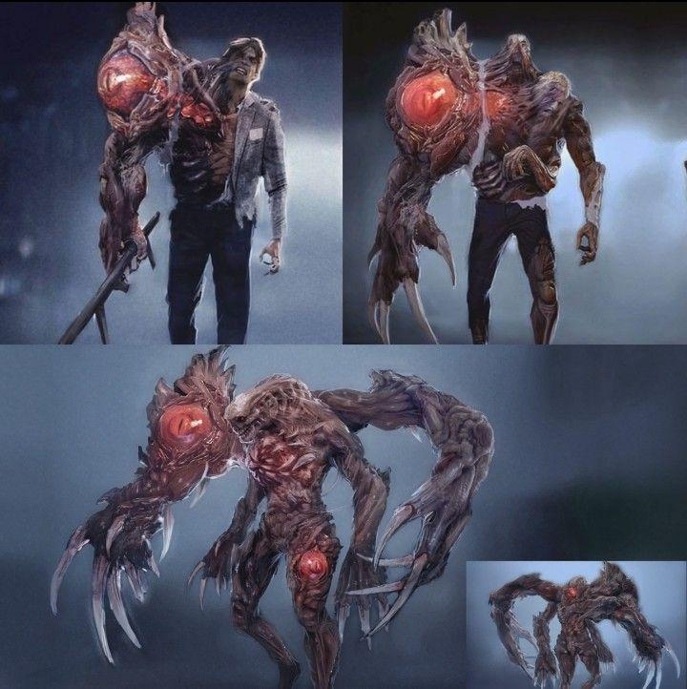
Fearful Fathers and Morbid mothers
Paternal fears are often portrayed through the lens of ego death and extinction, with some elements of separation thrown in for context to further develop those fears and insecurities.
Male and father figures in horror games, or as “evil” figures are often abusive out of fear of being seen as worthless or forgotten, that to be more others must be less, regardless of any familial ties.
Whenever we see changes to physical attributes, they are the male form made perfect, or weaponised to be more efficient at delivering terror and intimidation.

Slide 12
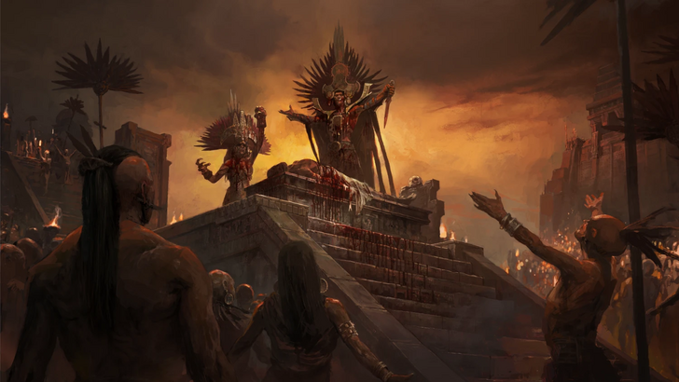
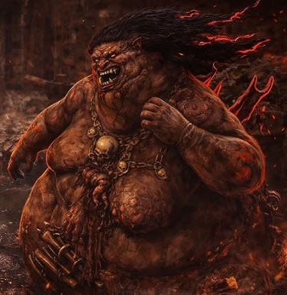
Fearful Fathers and Morbid Mothers
Matriarchal depictions of both their visual and psychological components focus more on loss of autonomy, mutilation, and a strong element of separation. This contrasts against powerful, intimidating, and brutish imagery of patriarchal figures.
They are depicted in a similar light as sirens - evil but seductive, a transfigured and a twisted form of womanhood, directed at the sexualisation or abjection of natural processes such as birth, breastfeeding and menstruation.
This is taken to the extremes, objectified, or morphed into an insectoid “queen” with rarely more than a singular purpose.

Slide 13
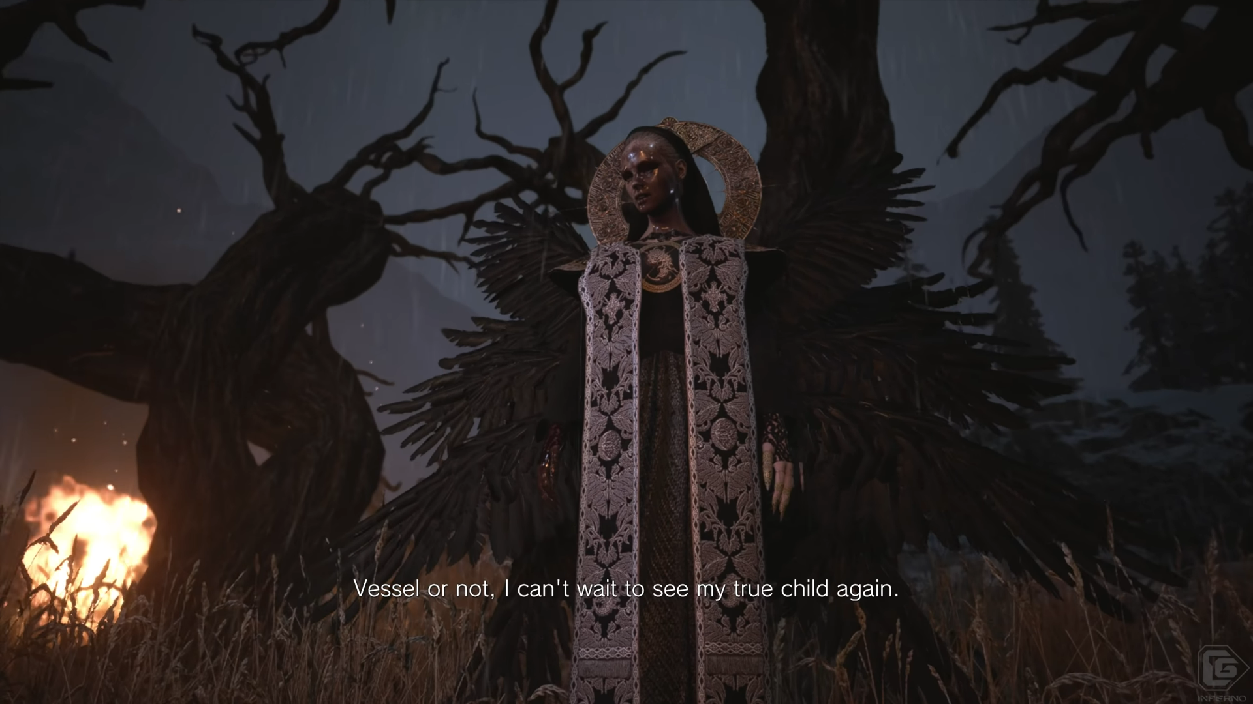
The Maternal GROTESQUE
Notes:
RE8 “Mother Miranda”
https://www.youtube.com/watch?v=S00AAVYgmDA

Slide 14
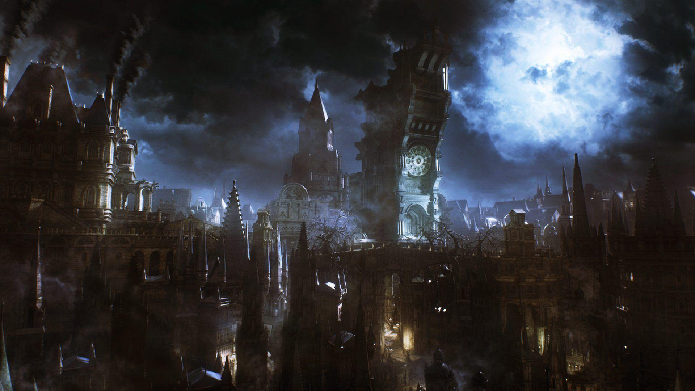
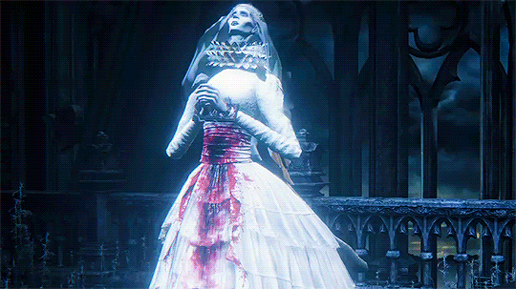
Bloodborne – Pthumerian Queen
The Pthumerian Queen from Bloodborne is seen only as semi-monstrous, and is more akin to a vessel than a person. She has been “gifted” a womb that can bear an eldritch god’s newborn as a celestial surrogate in the real world.
She is only portrayed staring at a blood moon, denoting the next cycle of the nightmare, and gently weeping while in restraints, hearing her child crying for its mother after being pulled from her. She is shown as sympathetic character, a victim of the much greater threats that treat her and humanity as novelties to be used.
The animations used are very limited in this instance, showcasing her lack of importance beside childbearing. She does however have another variant in the chalice Dungeons that is a boss, where she uses multiple blood-based attacks projected from the uterus area. As a note, the dungeon version is still pregnant but wears the same attire.

Slide 15
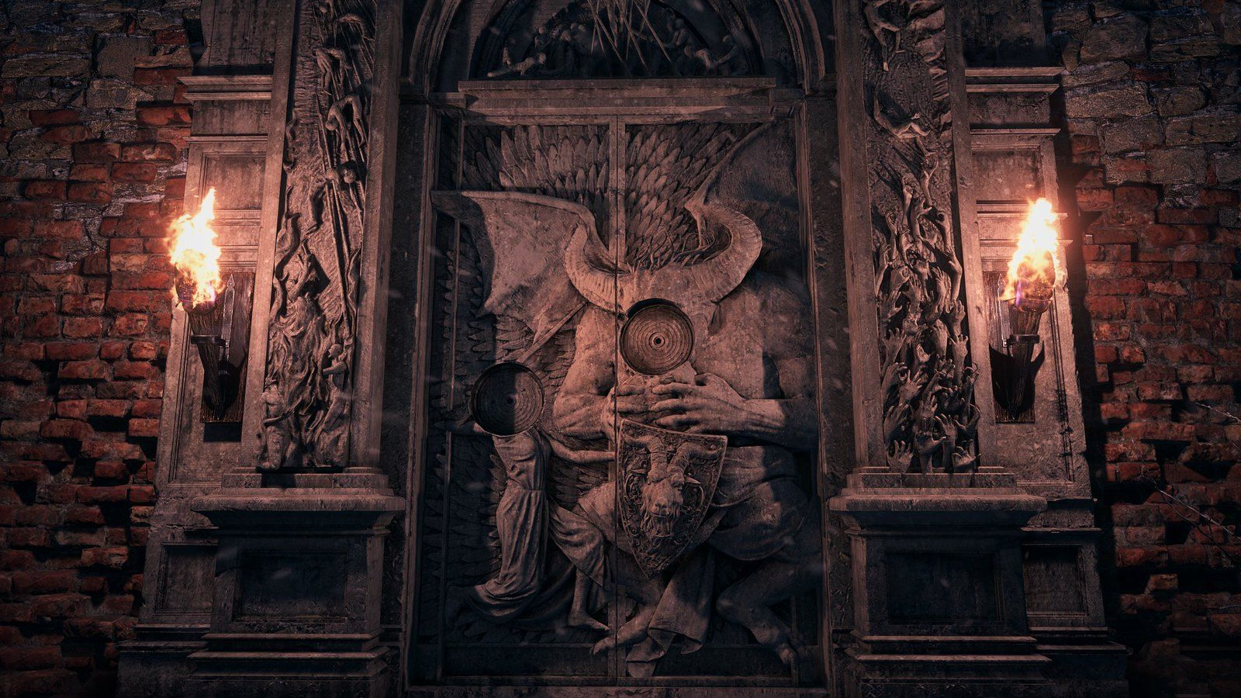
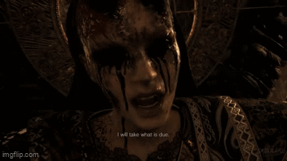
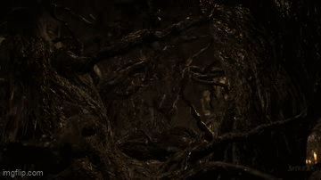
Resident Evil: Village – Mother Miranda
Mother Miranda has two distinct forms: a generally quiet, reserved motherly nun figure, and a more twisted, mutated angelic form - a perversion on the religious aspects, surrogate mother to the games’ antagonists. She is monstrous both visually and through her acts, forcefully subjugating and manipulating others and abducting Rose.
She goes against the angelic and loving persona that she used to put on as soon as the veil is removed and her true self revealed. Her body language changes from smaller movements, an air of femininity and innocence, to erratic and “sharp” movements with lots of weight and vicious intent behind them.

Slide 16
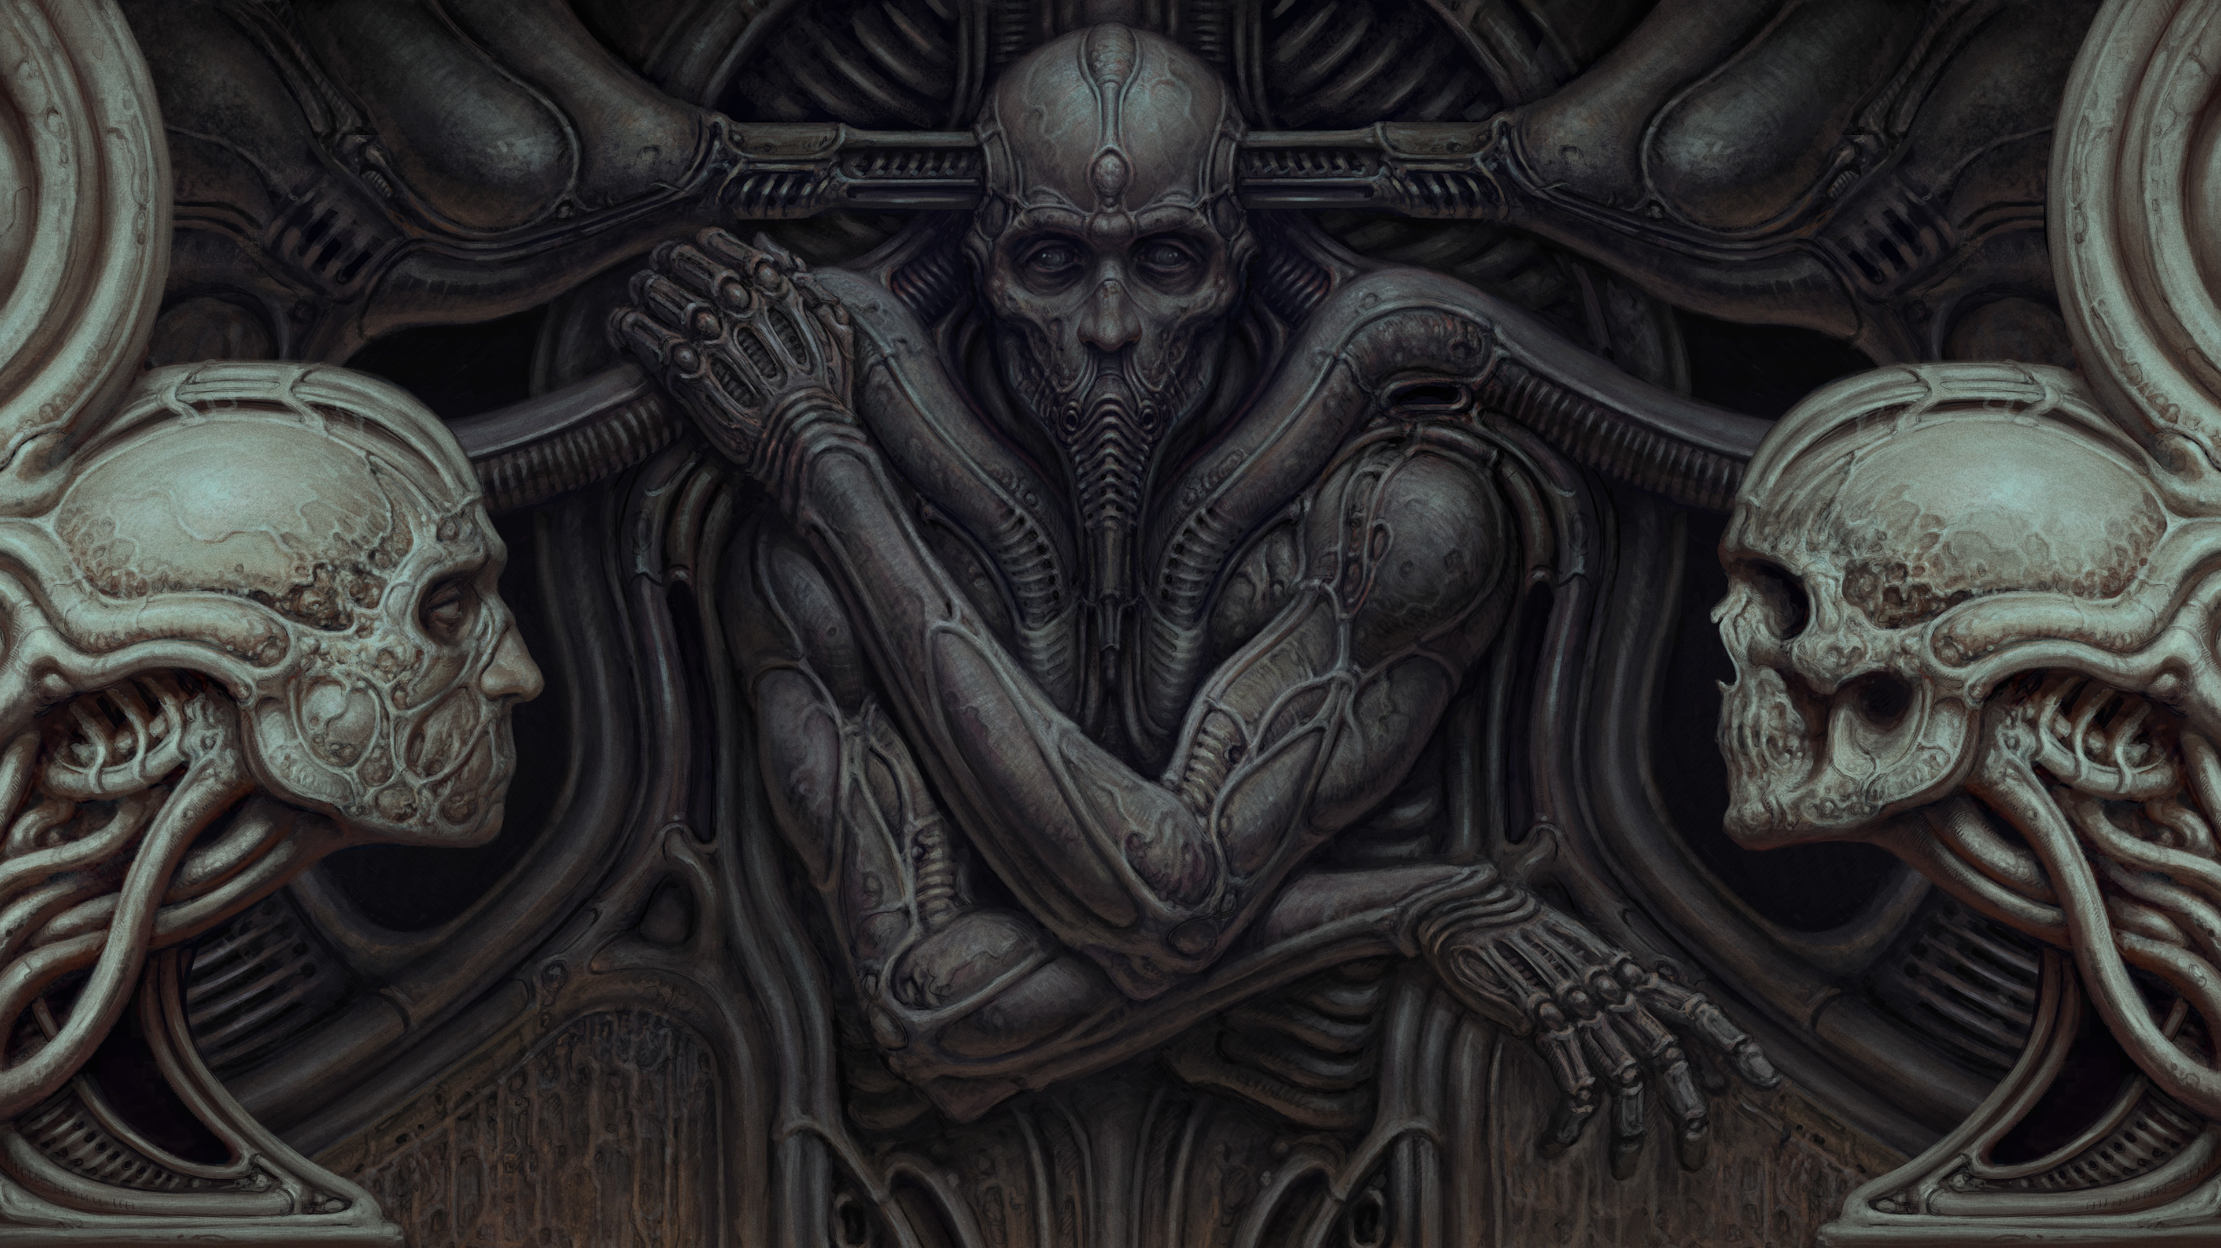
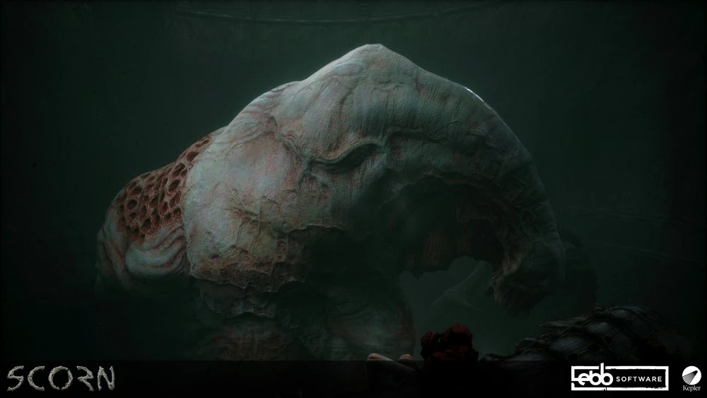
Scorn – Crater Queen
In Scorn, the aesthetic of biomechanics is heavily inspired by H.R Geiger’s work, notably the exploration of sex and reproduction through deific inspired edifices. Phallic feeding tubes, gruesome depictions of birthing, and vagina dentata, are a common sight throughout the world in Scorn. A gigantic “broodmare” called the Crater Mother, hooked up to biomechanical engineering and part of a never-ending cycle of birth. The exploration of the grotesque femininity prioritises functionality and worship over compassion and emotion.
The Crater Queen cannot speak and does not react to the torturous acts the player must inflict to progress. She groans in pain, slowly craning her head towards the player, mournfully looking at us with pitiful and questioning eyes. Shivers and undulations periodically occur, exemplifying the torment and agony suffered daily.

Slide 17
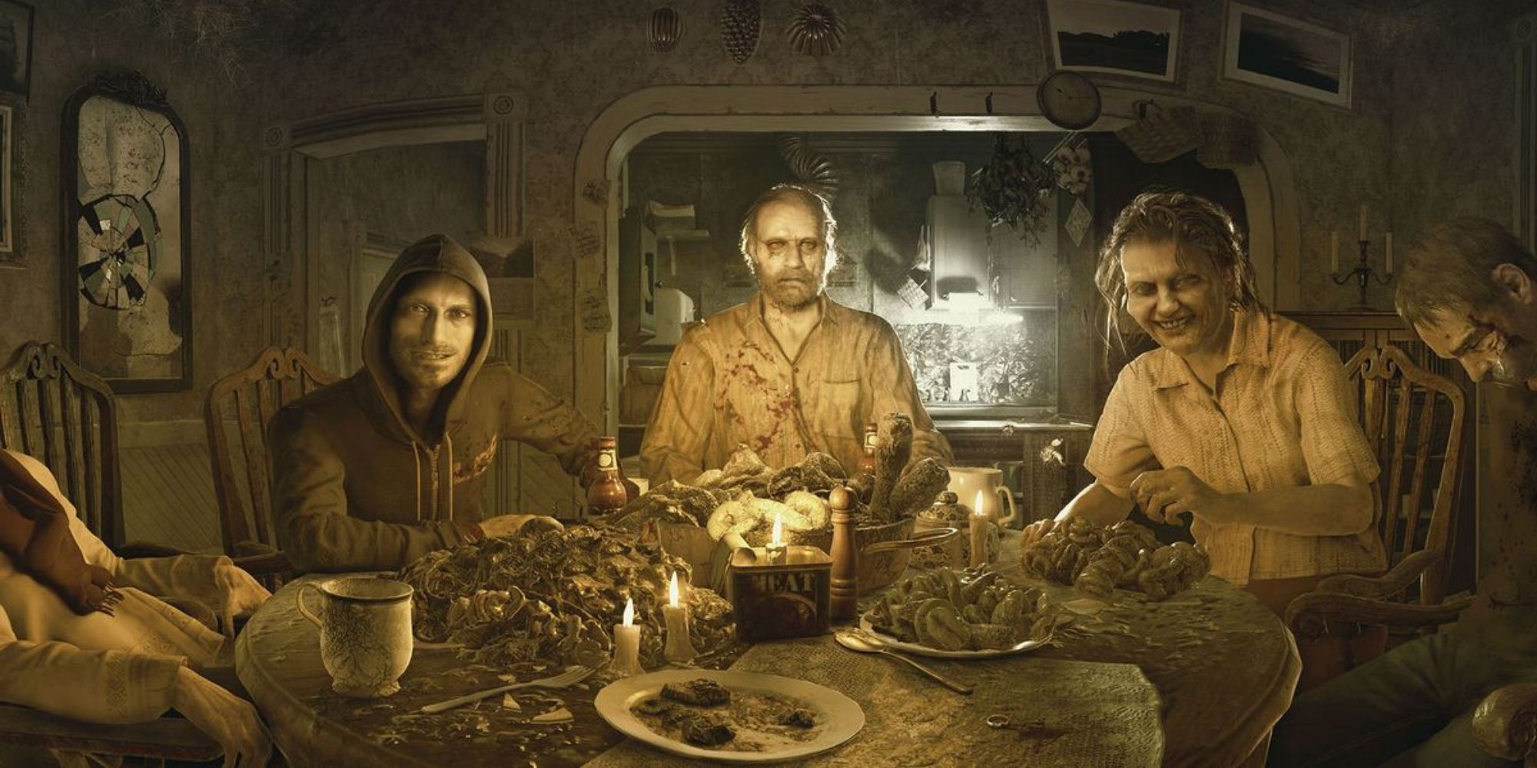
The Monstrous Patriarch

Slide 18
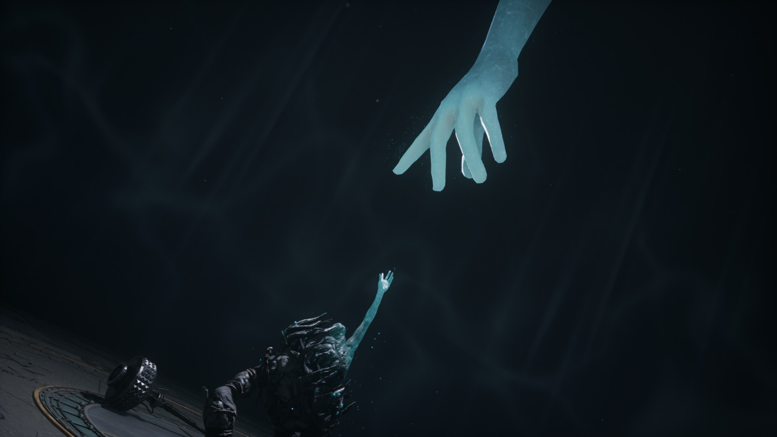
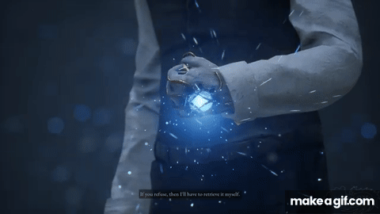
Lies of P - Geppetto
Geppetto in Lies of P, is a neglectful father whose son tragically dies at a young age. He takes his son’s corpse and twists it into a puppet, all the while creating a facsimile puppet of his son, which whom he controls and manipulates to “grow his heart”, an unwitting and unwilling host for the corpse puppet’s new heart.
Geppetto is emotionally and psychologically a monster, his phrasing and use of language is manipulative. His two final acts as a father he puppeteers his son to fight his “son”, and a regretful sacrifice after realising the error of his ways. He is portrayed is a genius engineer with deep empathy for his workers, but this is all a façade as he works on is magnum opus “P”.

Slide 19
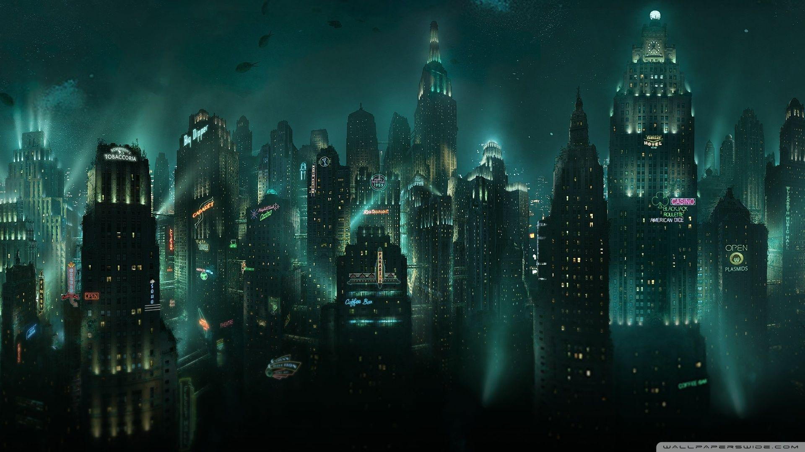
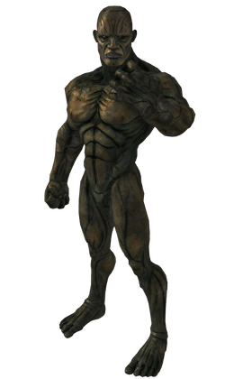
Bioshock – Frank Fontaine
Frank Fontaine is shown as one of “the good guys” for a time, but is later revealed to be an antagonist, a criminal who uses poor houses and orphanages as sources for labour and his experiments. He produces the idea of Big Sisters and Little Sisters in Bioshock after discovering “Adam”.
Any victories and successes are his alone, regardless of who put the real work in. That feeds into his ego and will to have power over others. When people use Adam for a prolonged period, they mutate and become splicers or are Big Daddies - wholly reliant on it to live. However, when he transforms in the final act, his form (ironically) becomes that of Atlas, a chiselled muscular male figure, his idea of perfection.
Frank’s language and swagger, the way he smooth talks, sidles around, and ruminates before the big reveal is a huge contrast to the ogre-like bounding behemoth we see in the final act. His most monstrous is just his own bloated perception of himself outwardly expressed.

Slide 20
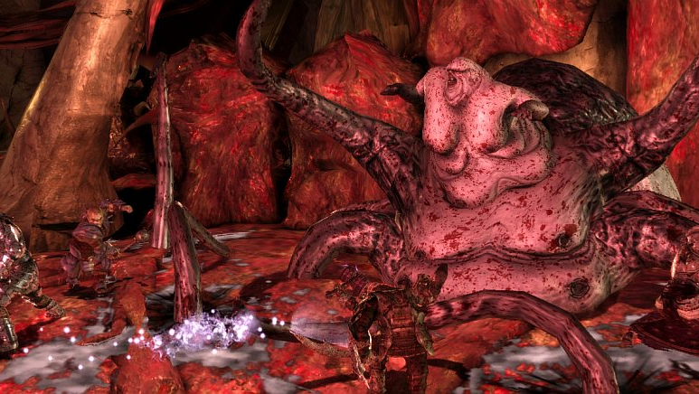
Case study: The Broodmother
Dragon Age Origins (2009)

Slide 21

The Broodmother
Warning – The next few slides contain references to loss of bodily autonomy, mutilation, cannibalism and extreme body horror.

Slide 22
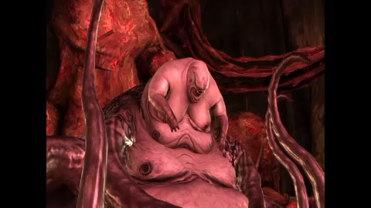
Notes:
A codex within Dragon Age: Origins states:
“When exposed to the darkspawn taint, men are driven mad and eventually die. Women, however, undergo great pain and gross mutations that cause most of them to perish. Those that survive, however, become the grotesque broodmothers. These giant, twisted behemoths birth many darkspawn at a time; a single broodmother can create thousands of darkspawn over the course of her lifetime.” BioWare. (2009). Dragon Age: Origins [Video game]. Electronic Arts.

Slide 23
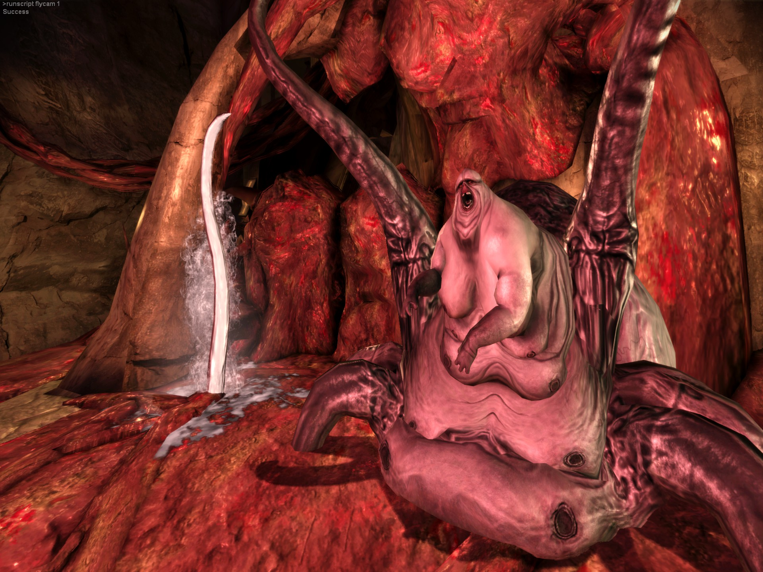
An Examination of the BroodMother
“When exposed to the darkspawn taint, men are driven mad and eventually die. Women, however, undergo great pain and gross mutations that cause most of them to perish. Those that survive, however, become the grotesque broodmothers. These giant, twisted behemoths birth many darkspawn at a time; a single broodmother can create thousands of darkspawn over the course of her lifetime.” BioWare. (2009). Dragon Age: Origins [Video game]. Electronic Arts.
Notes:
In the Dragon Age universe, a Broodmother is created when a woman is fed the blood of darkspawn. In this way, allowing women to be captured by the darkspawn is represented as a grave threat in the Dragon Age universe.

Slide 24
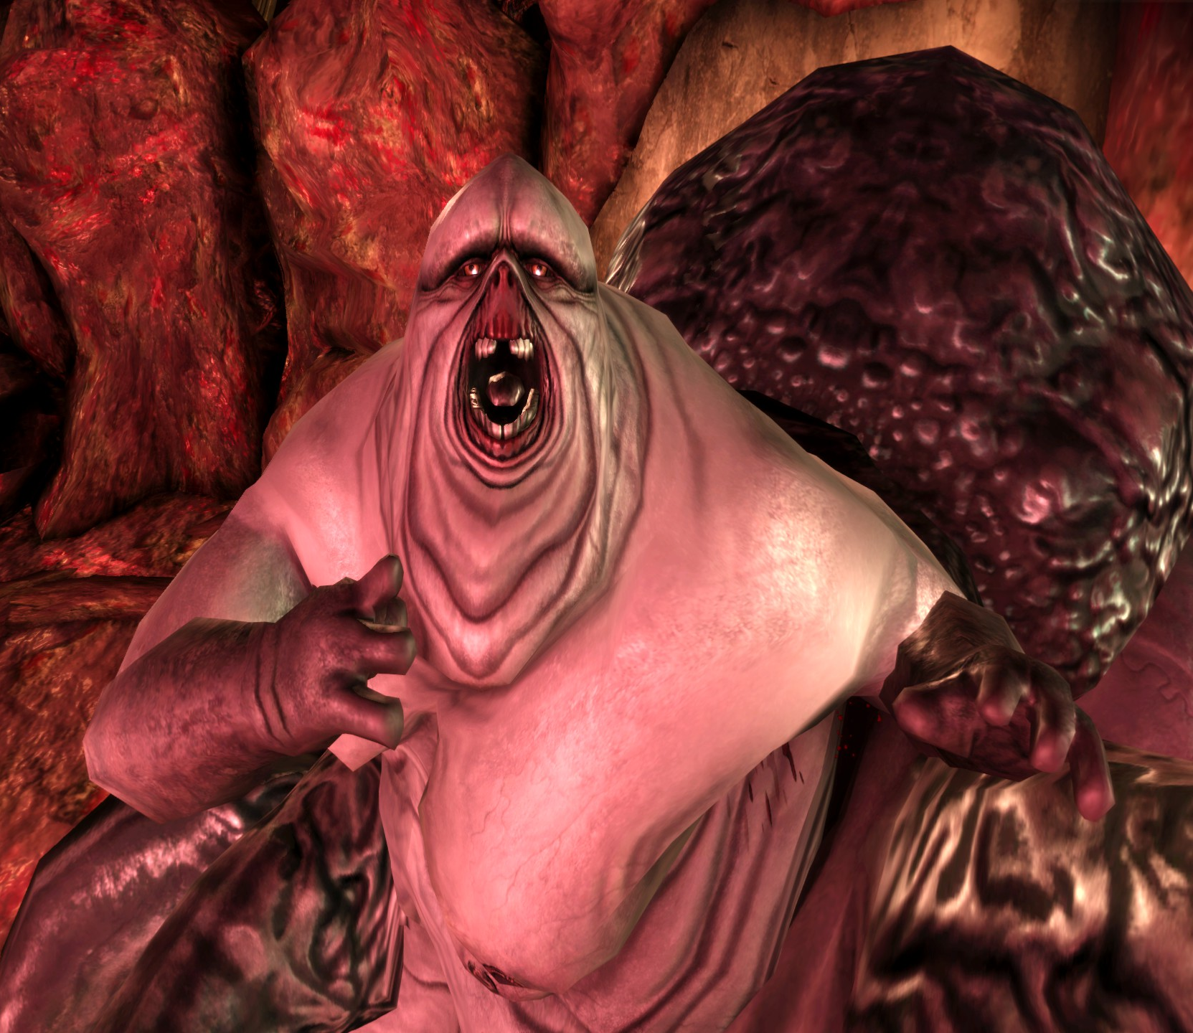
The Broodmother
Subject Analysis
Oily skin, Enlarged breasts, Swollen Body, blood-engorged limbs
Sexual Maturity / Puberty / Pregnancy, Blood engorgement is a representation of menstruation, another indication of sexual maturity in women
Notes:
"Menarche marks the point at which a girl becomes a woman; when childhood innocence may be swapped for the mantle of monstrosity associated with abject fecundity. The physical changes of puberty—breasts, pubic hair, curving hips and thighs, sweat, oily skin, and most significantly, menstrual blood— stand as signifiers of feminine excess, of the body as out of control (Ussher 2006: 19)." - The broodmother’s design takes this idea to the extreme (Stang, S, (2019) - a swollen, overweight, oil and fluid-covered creature, surrounded by blood and mucus and placenta-like cables and surfaces, with multiple bulbous breasts and a huge, swollen tick-like opisthosoma, beneath a thick scutum.

Slide 25
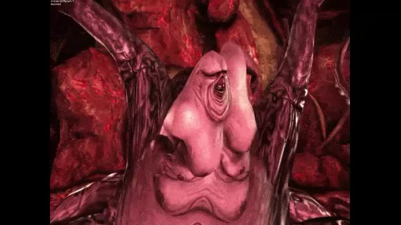
The Broodmother
"Menarche marks the point at which a girl becomes a woman; when childhood innocence may be swapped for the mantle of monstrosity associated with abject fecundity. The physical changes of puberty—breasts, pubic hair, curving hips and thighs, sweat, oily skin, and most significantly, menstrual blood— stand as signifiers of feminine excess, of the body as out of control (Ussher (2006)”
(Stang, S, (2019) The Broodmother’s design takes this idea to the extreme - a swollen, overweight, oil and fluid-covered creature, surrounded by blood and mucus and placenta-like cables and surfaces, with multiple bulbous breasts and a huge, swollen tick-like opisthosoma, beneath a thick scutum.
Subject Analysis
Expressive content | The Broodmother exhibits hyper-exaggerations of changes one would see in a sexually mature or pregnant woman
Notes:
"Menarche marks the point at which a girl becomes a woman; when childhood innocence may be swapped for the mantle of monstrosity associated with abject fecundity. The physical changes of puberty—breasts, pubic hair, curving hips and thighs, sweat, oily skin, and most significantly, menstrual blood— stand as signifiers of feminine excess, of the body as out of control (Ussher 2006: 19)." - The broodmother’s design takes this idea to the extreme (Stang, S, (2019) - a swollen, overweight, oil and fluid-covered creature, surrounded by blood and mucus and placenta-like cables and surfaces, with multiple bulbous breasts and a huge, swollen tick-like opisthosoma, beneath a thick scutum.

Slide 26
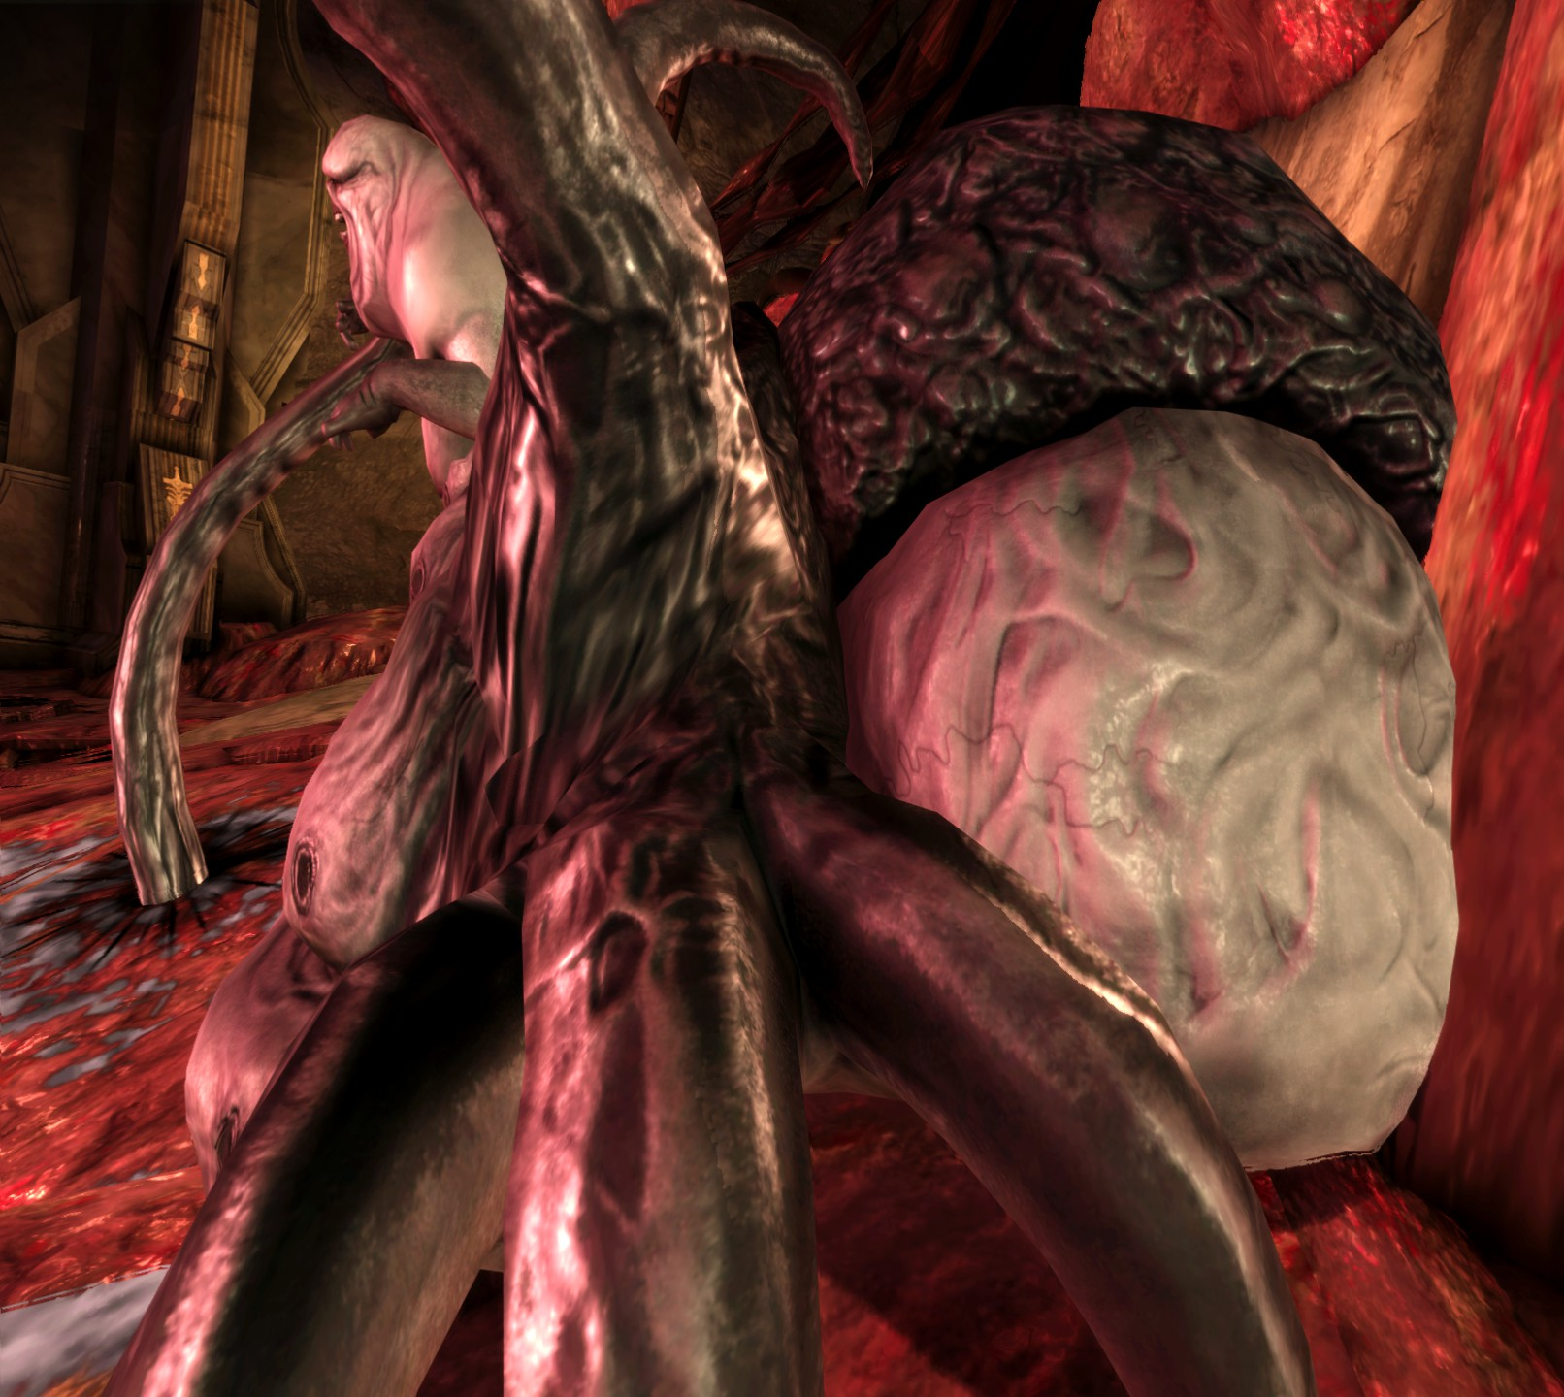
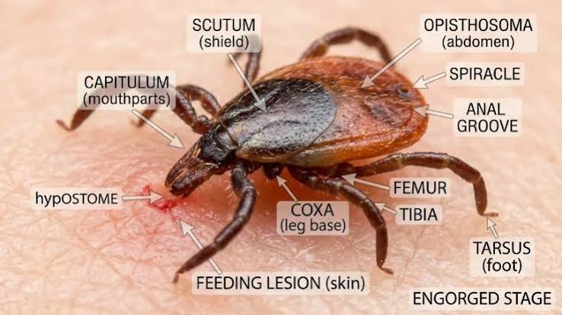
Scutum Swollen Opisthosoma
Often seen in insects, to protect their bodies Physogastrism, in insects, or being gorged with blood in ticks.
Anderson, M. (2026)
Notes:
Women becoming insect or parasite-like is a frequent trope in the monsterification of the women in media. Wilcox, L. (2017) states “Woman as becoming-insect is a fearful spectre in many works of science fiction that is often portrayed negatively as a warning against tampering with uncontrollable forces of nature represented by the threat of reproduction uncontrolled by masculine sovereign power.”

Slide 27
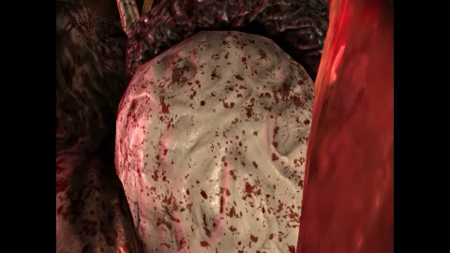
The Broodmother
Subject Analysis
Women becoming insect or parasite-like is a frequent trope in the monsterification of women in games and cinema.
Wilcox, L. (2017) states “Woman as becoming-insect is a fearful spectre in many works of science fiction that is often portrayed negatively as a warning against tampering with uncontrollable forces of nature represented by the threat of reproduction uncontrolled by masculine sovereign power.”
Expressive content | The broodmother is insect or tick-like.
Notes:
Women becoming insect or parasite-like is a frequent trope in the monsterification of the women in media. Wilcox, L. (2017) states “Woman as becoming-insect is a fearful spectre in many works of science fiction that is often portrayed negatively as a warning against tampering with uncontrollable forces of nature represented by the threat of reproduction uncontrolled by masculine sovereign power.”

Slide 28
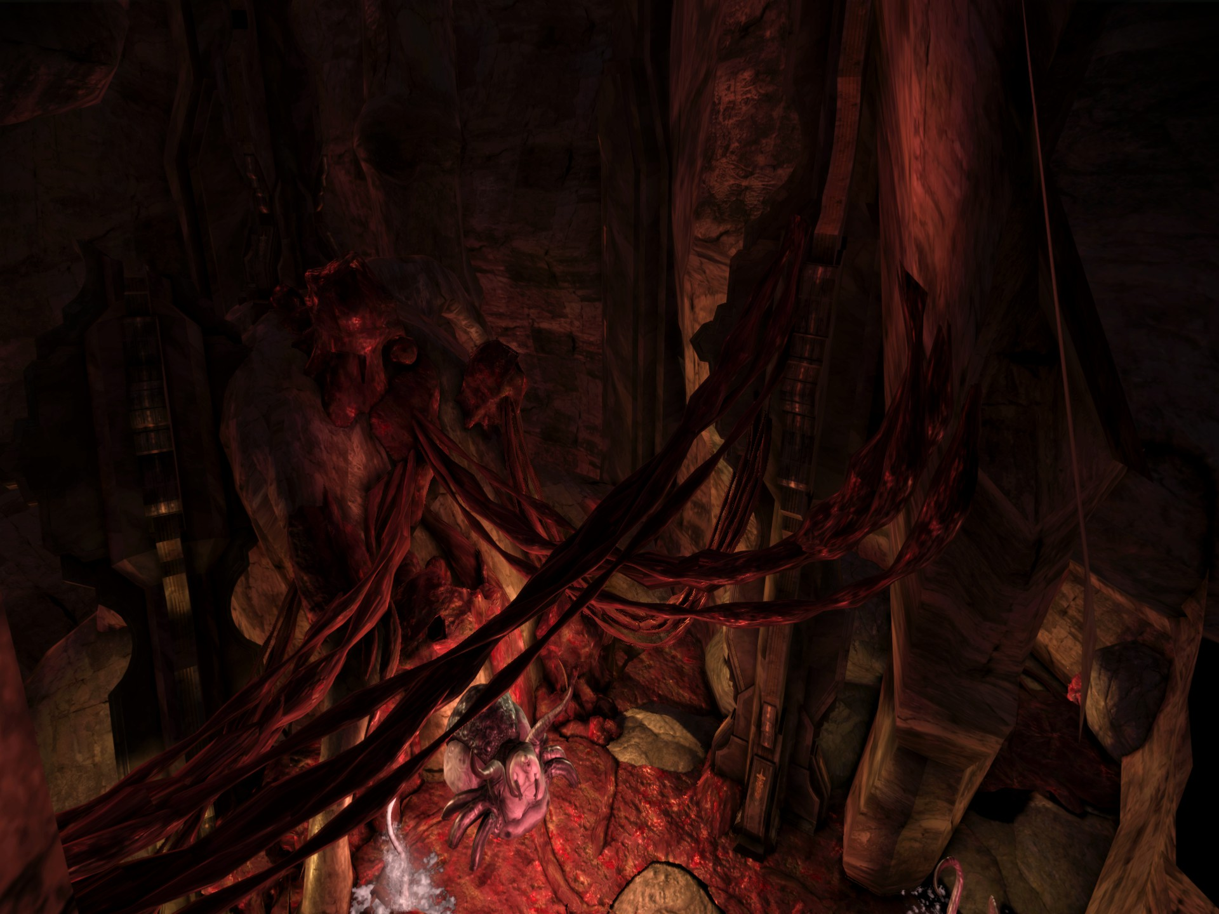
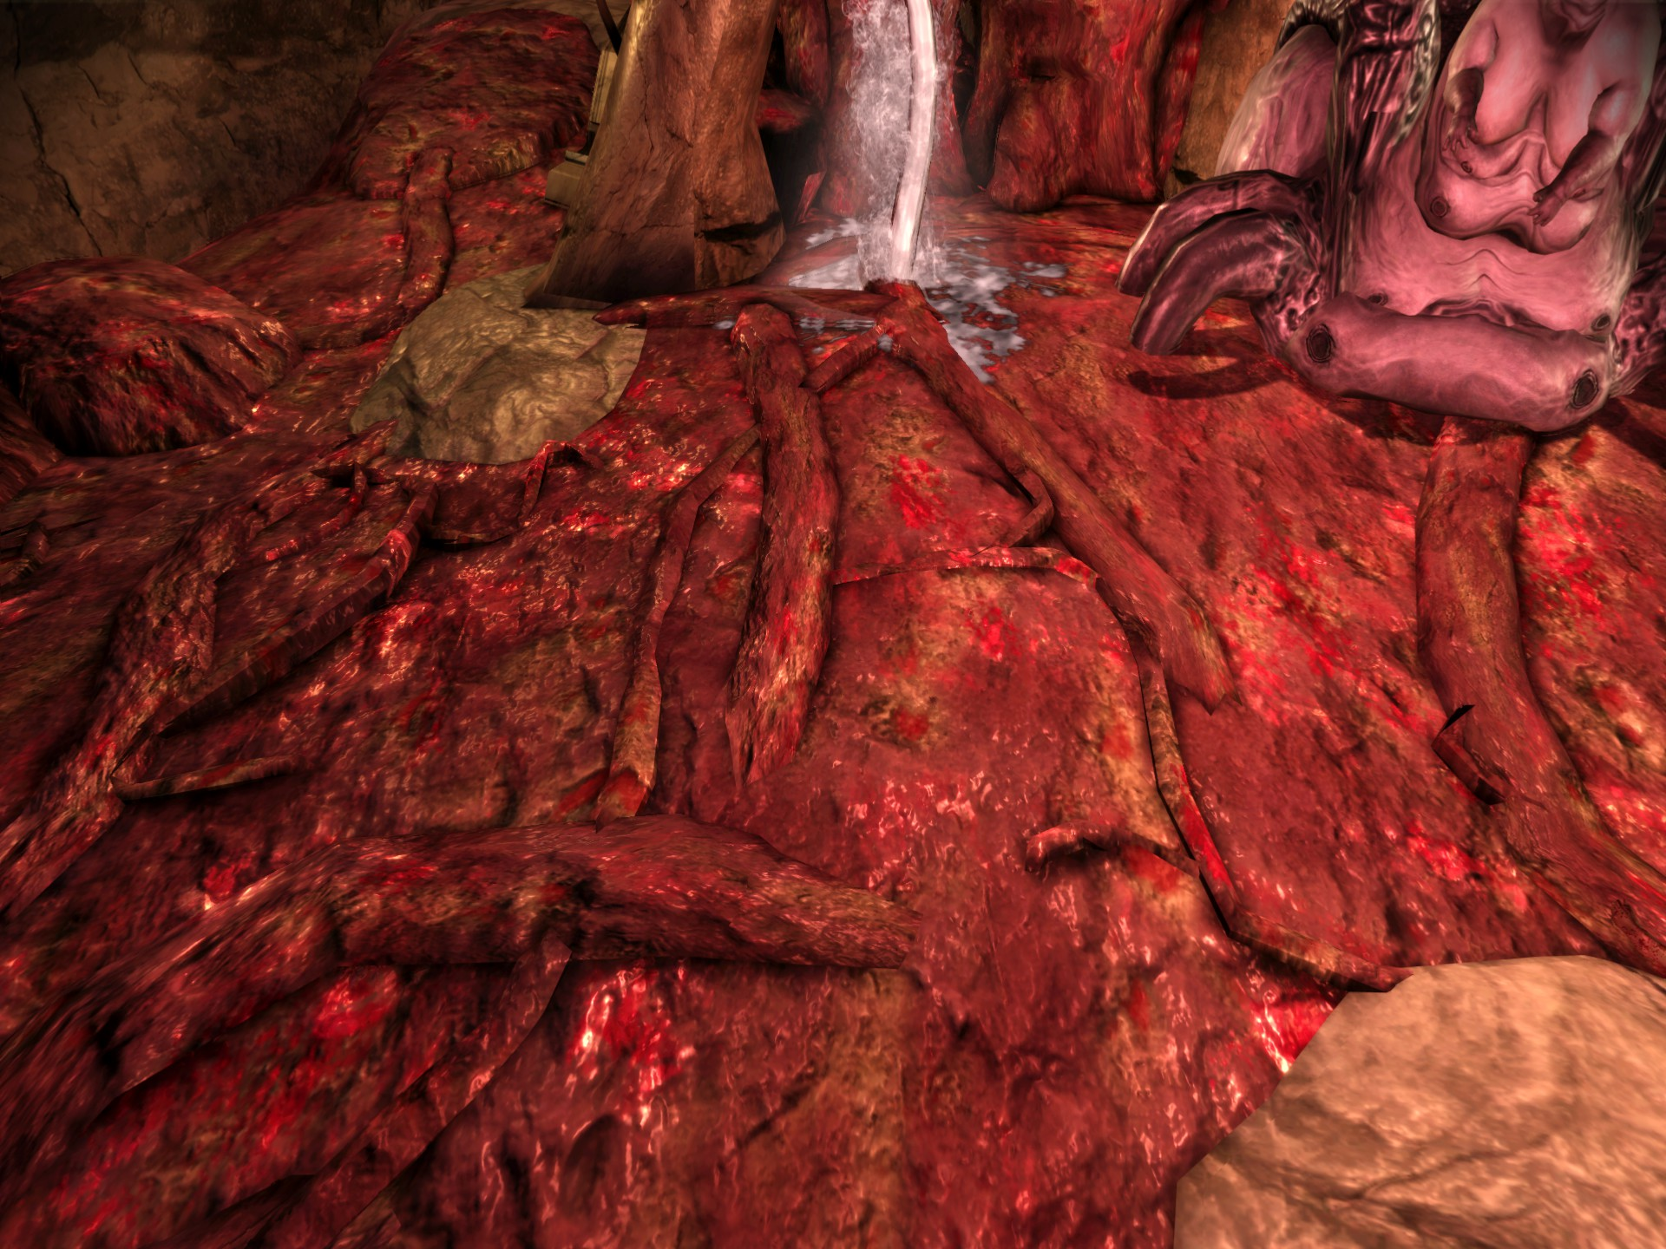
The Broodmother
Environmental Analysis
Signifiers | Dark, wet chamber, Placenta-like tendrils, Blood and fluid covered ground
Signified | A womb like environment, A flesh-based “Nest”
“In many films the monster commits her or his dreadful acts in a location which resembles the womb. These intra-uterine settings consist of dark, narrow, winding passages leading to a central room, cellar or other symbolic place of birth.” (Creed, B (1993)
Notes:
“In many films the monster commits her or his dreadful acts in a location which resembles the womb. These intra-uterine settings consist of dark, narrow, winding passages leading to a central room, cellar or other symbolic place of birth.” (Creed, B (1993)) – And such is the Brood Mother’s lair representing an external womb, or nest, to which she is literally and visibly rooted to, unable to move or leave.
Looking at the Broodmother’s “nest”, we see more of these tropes brought into play.
“Horror films that depict monstrous births play on the inside/outside distinction in order to point to the inherently monstrous nature of the womb as well as the impossibility of ever completely banishing the abject from the human domain.
The womb represents the utmost in abjection for it contains a new life form which will pass from inside to outside bringing with it traces of its contamination – blood, afterbirth, faeces.” (Creed, B, (1993))

Slide 29
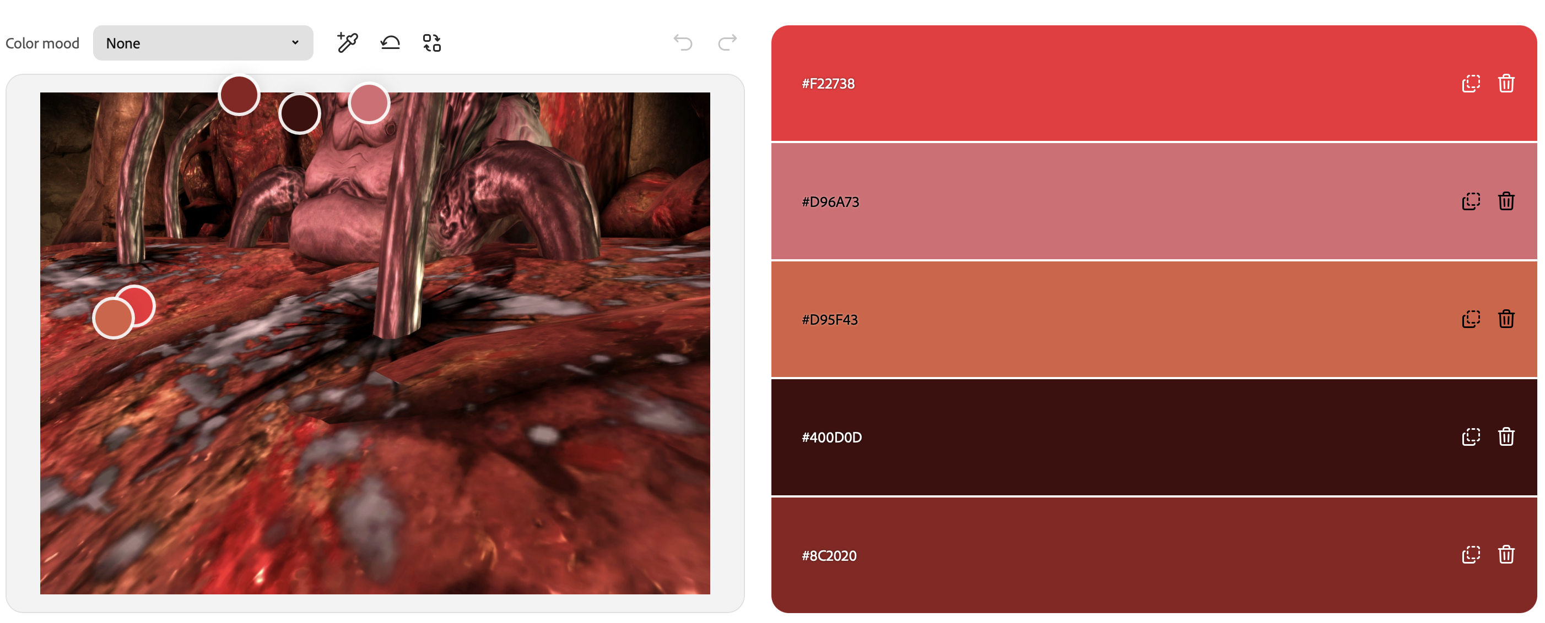
The Broodmother
Environmental Analysis
The walls are uterine, like the akin to the inside womb – the environment covered with afterbirth, fluids, and blood. The colour scheme is full of blood reds and flesh pinks and purples, dark browns, and in fluids both murky white and mucus-greens.

Slide 30
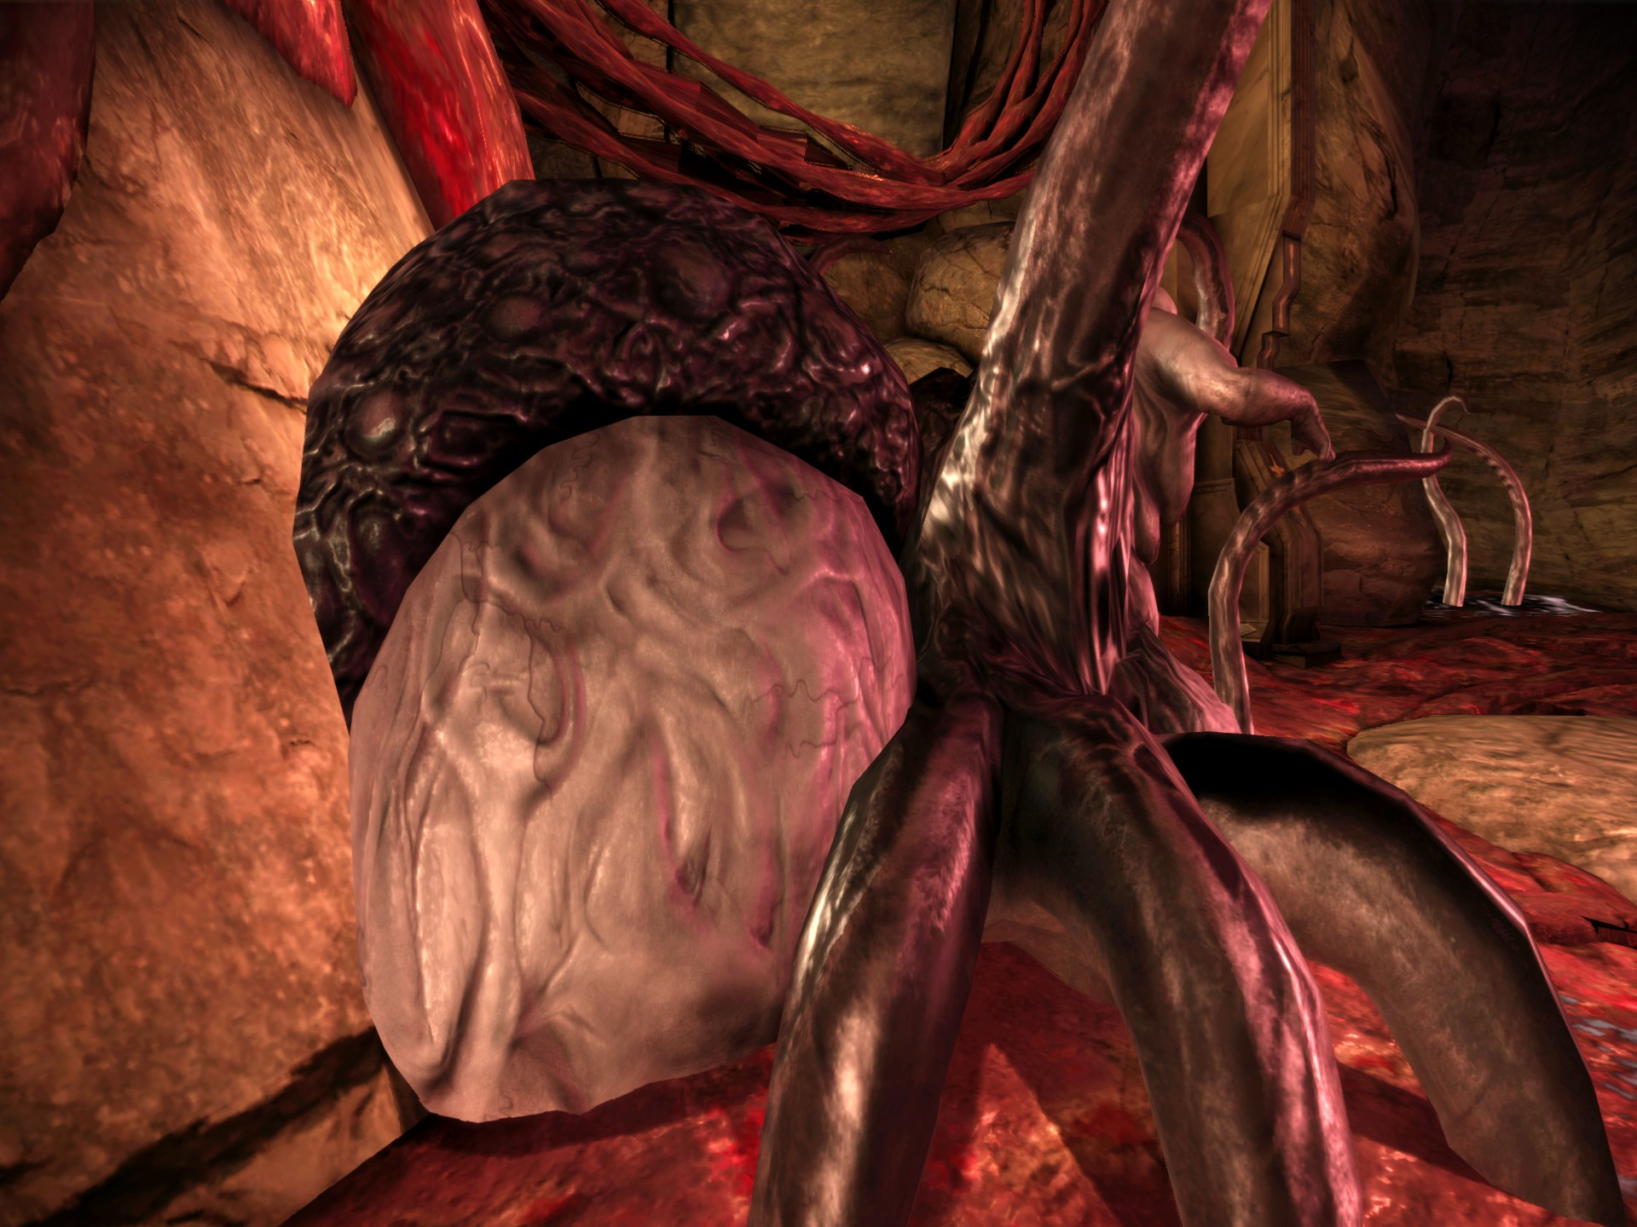
Looking at the Broodmother’s “nest”, we see more of these tropes brought into play.
“Horror films that depict monstrous births play on the inside/outside distinction in order to point to the inherently monstrous nature of the womb as well as the impossibility of ever completely banishing the abject from the human domain.
The womb represents the utmost in abjection for it contains a new life form which will pass from inside to outside bringing with it traces of its contamination – blood, afterbirth, faeces.” (Creed, B, (1993))
Expressive content | The broodmother is a part of her womb-like nest. She is literally connected to it.

Slide 31
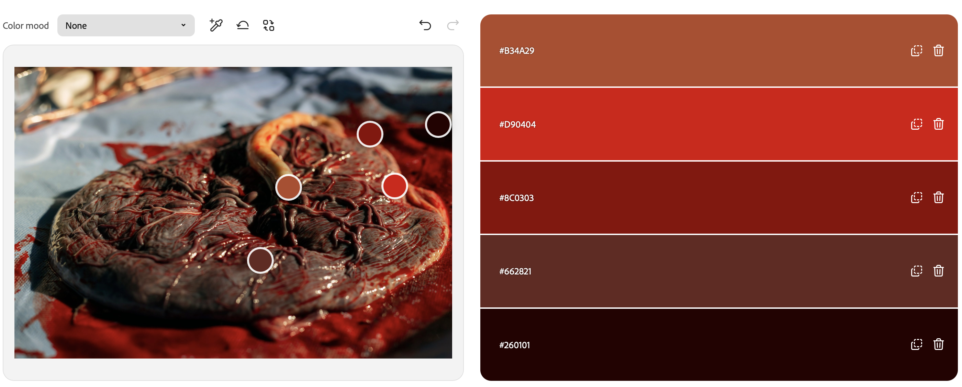
The Broodmother
Environmental Analysis
The colour palette of the environment and the Broodmother is exceptionally similar to that of an actual placenta and afterbirth.
In this case the womb has been literally externalized – and thus these “traces of contamination” are brought out into the external world.

Slide 32
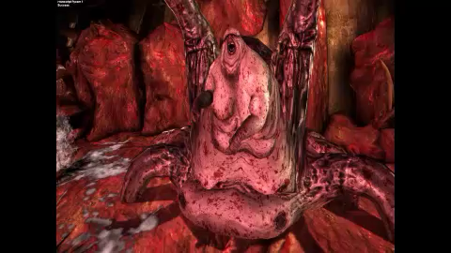
The Broodmother
Dehumanisation and Lost Agency
In addition to her exaggerated form and womb-like nest, a lot has been done to dehumanise the brood mother.
Rooted in this gigantic fleshy womb, she has lost her ability to speak, and her arms are swollen, small, and childlike, clearly showing her loss of bodily autonomy, and potentially a loss of sapience. She lashes out, swinging her arms and tentacles, aggressive and animalistic in her behaviour.
“The womb is horrifying per se and within patriarchal discourses it has been used to represent woman’s body as marked, impure and a part of the natural/animal world.” (Creed, B, (1993)).
Notes:
Note to mention that these small hands are only used, in the introductory cutscene, to touch her breasts and wipe her mouth – serving both to sexualize the broodmother further (by having her touch her breasts) and dehumanizing her further (by having her wipe at her mouth with the back of her hand, as though drooling and beastial.

Slide 33
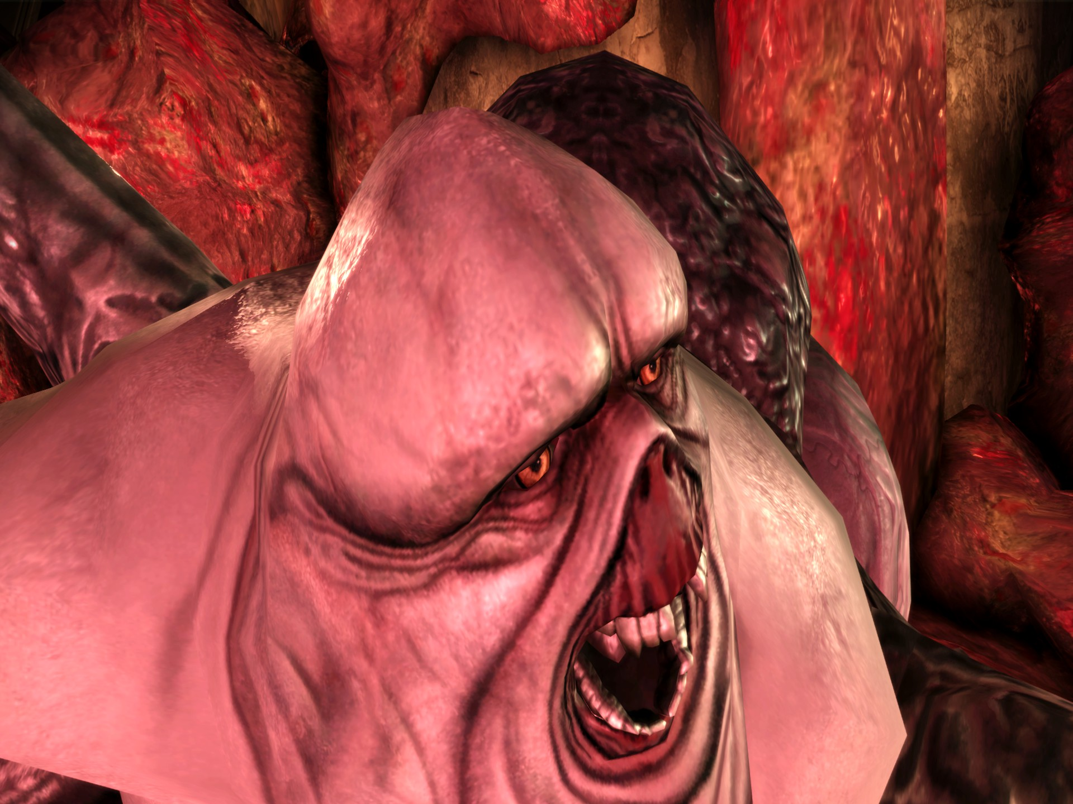
The Broodmother
Dehumanisation and Lost Agency
Not only has her face been mostly removed and distorted, but her entire head has been re-shaped in the form of penile glans.
This could be interpreted as a nod to the concept of the phallic mother, another common theme in horror cinema involving monsterous women (Laplanche and Pontalis, (1985, 311))
The phallic mother “is thought either to possess an external penis or to have a penis hidden inside her body” (Creed, B, 1993), and thus like the Broodmother, does not require a man to reproduce. This further emphasizes the idea that woman who does not need man to reproduce are inherently in some way monstrous.

Slide 34
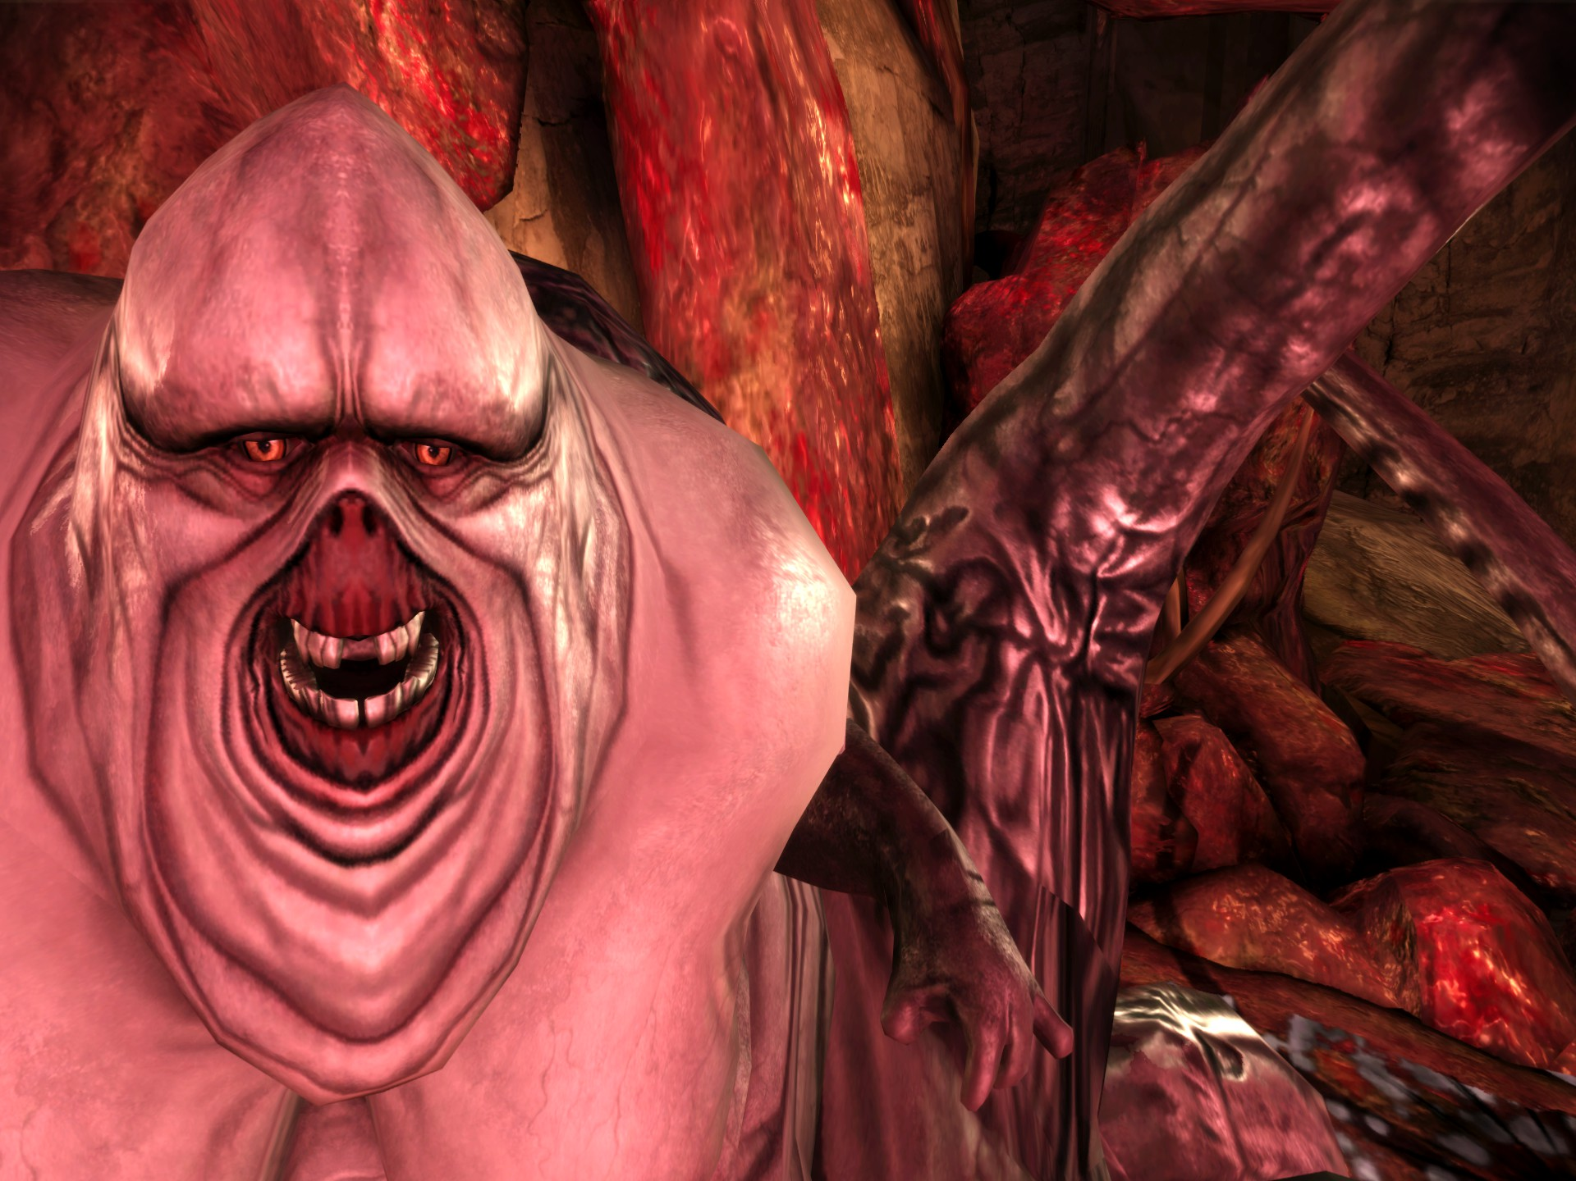
The Broodmother
Conclusions
The Broodmother is the ultimate example of the grotesque maternal. Stripped of her humanity, hyper-sexualized with exaggerated proportions related to her fertility, literally encased within a giant womb with the soul purpose of birthing monsters.
From this point in the game, you have no choice but to kill the brood mother, even knowing that she is a victim (Stang, S, (2019)). At this stage in the game, she is regarded as nothing but a threat that births darkspawn.

Slide 35
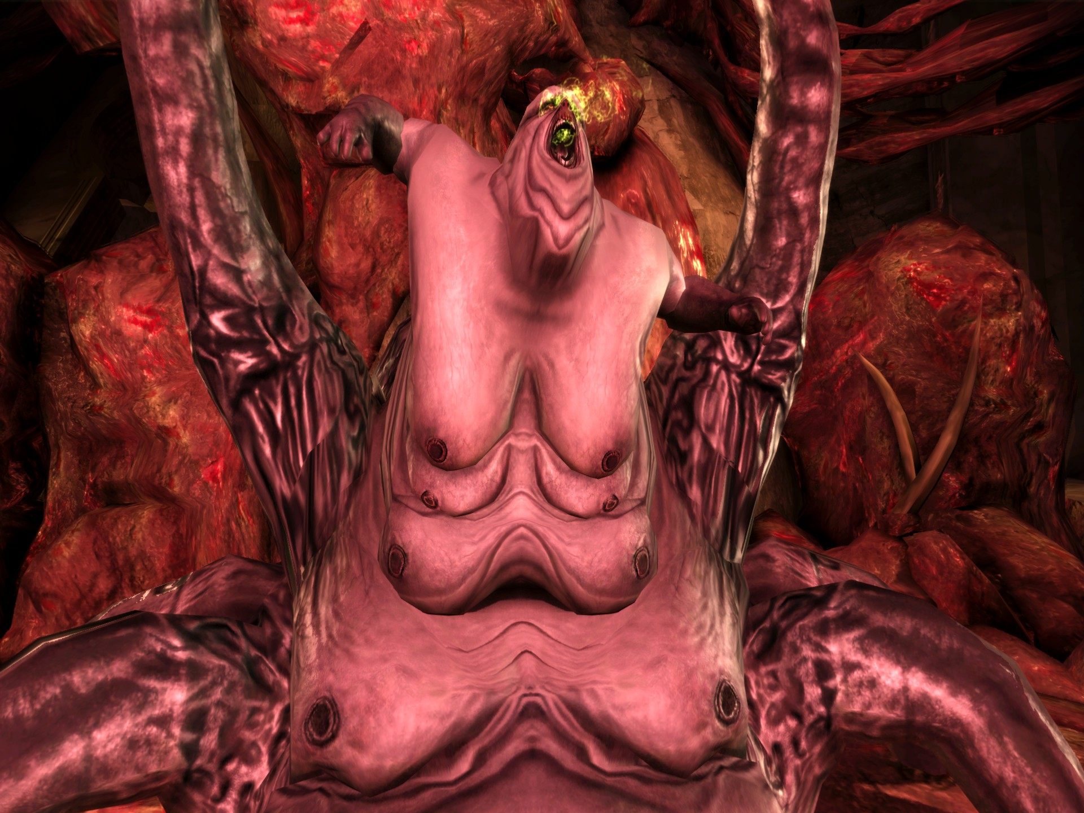
An Examination of the BroodMother
“The most fearful of creatures is, of course, a monstrous mother who parthenogenetically spawns monstrous offspring. Naturally, those offspring are loyal only to her and pose a threat to the protagonist/player-character, who serves as the representative of the normative, patriarchal symbolic order.” (Steng, S, (2019)
“It is woman’s fertilizable body which aligns her with nature and threatens the integrity of the patriarchal symbolic order.” (Creed, B, (1993)). The broodmothers are regarded as that threat – their ability to birth “monsters” regarded as a threat to the entire world.
“We know that darkspawn come from broodmothers. Perhaps at the very heart of our world sits a queen—the first mother. Instead of focusing on her children, we should target broodmothers and ensure that future reinforcements will never be born..” BioWare. (2014). Dragon Age: Inquisition [Video game]. Electronic Arts.
Notes:
In the Dragon Age universe, a Broodmother is created when a woman is fed the blood of darkspawn. In this way, allowing women to be captured by the darkspawn is represented as a grave threat in the Dragon Age universe.

Slide 36



The Grotesque Matriarch
The Grotesque Matriarch is an interactive horror archetype that systematically weaponises the anatomy of reproduction – sometimes dabbling even in the non-human anatomy. It commonly pertains to grotesque imagery of the womb, the placenta, and parasitic lifeforms, inducing a state of profound haptic abjection.
The Grotesque Matriarch relies on bloody designs, haptic animations and textures, and semiotics designed to strip away the cultural expectation of maternal sanctuary. The player is commonly forced into a confrontation with themes of forced birth, biological contamination, and the visceral open anatomy of the female body.
The Grotesque Matriarch is a symbol of dehumanisation, and loss of bodily agency.
Notes:
The Grotesque Matriarch is an interactive horror archetype that systematically weaponises the anatomy of reproduction – sometimes dabbling even in the non-human anatomy. It commonly pertains to grotesque imagery of the womb, the placenta, and parasitic lifeforms, inducing a state of profound haptic abjection.
The Grotesque Matriarch is a strong semiotic system that relies on visceral design, haptic animations and textures, and semiotics designed to strip away the cultural expectation of maternal sanctuary. The player is commonly forced into a confrontation with themes of forced birth, biological contamination, and the visceral open anatomy of the female body.
The Grotesque Matriarch is the ultimate symbol of dehumanisation, and loss of bodily agency.
Old definition: The Grotesque Matriarch is an interactive horror archetype that deconstructs the traditional cultural signifier of maternal sanctuary, transforming the image of the nurturing mother into a site of biological horror, bodily abjection, and an archaic exploration into a loss of bodily autonomy.
The Grotesque Matriarch is not a simple narrative trope, nor monster; she is a haptic experience designed – through purposeful framing and visual design – to directly assault the player's comfort and expectations.
Rewrite 1: the grotesque matriarch is a horror archetype built to destroy the idea of a mother as a safe haven. Instead, the Grotesque Matriarch transforms the maternal body into a site of biological horror and lost autonomy. Far from a simple narrative trope, this figure is a haptic experience designed to violently disrupt the player’s comfort.

Slide 37
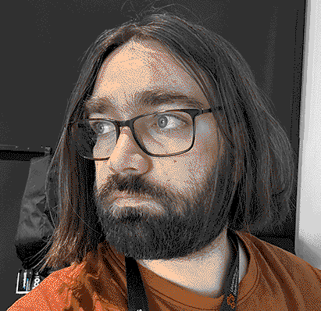
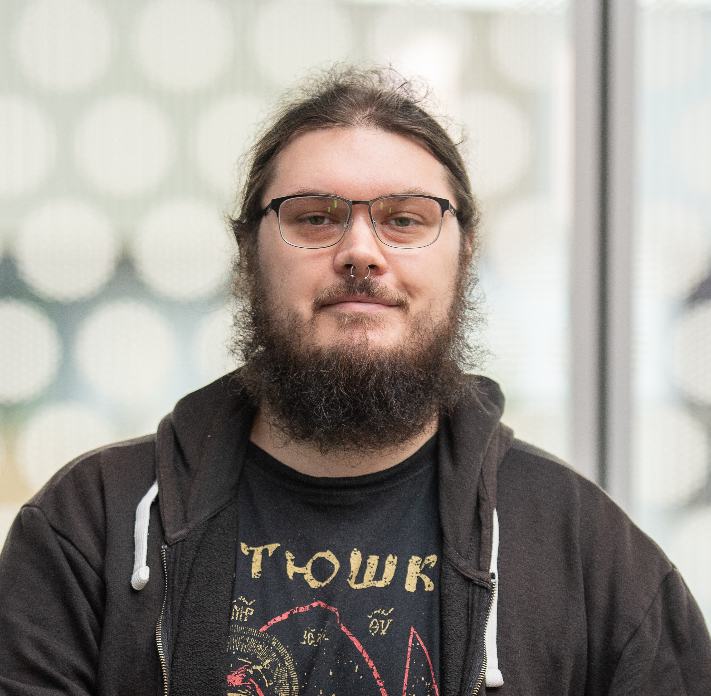

Demi's Socials
Demitrius.Gilhooley@staffs.ac.uk
linkedin.com/in/demitrig/
SpinningMadness.com
Chris's Socials
Christopher.harding@staffs.ac.uk
Linkedin.com/in/c-harding/
https://christopher-harding.journoportfolio.com/
Rika Paderes
Rikapaderes@staffs.ac.uk
linkedin.com/in/rikapaderes/
artstation.com/fethawit

